Slide 1
Beam Plug Installation Status in EHN1
Cheng-Ju Lin
15-March-2018
ProtoDUNE-SP ITI Meeting

Slide 2
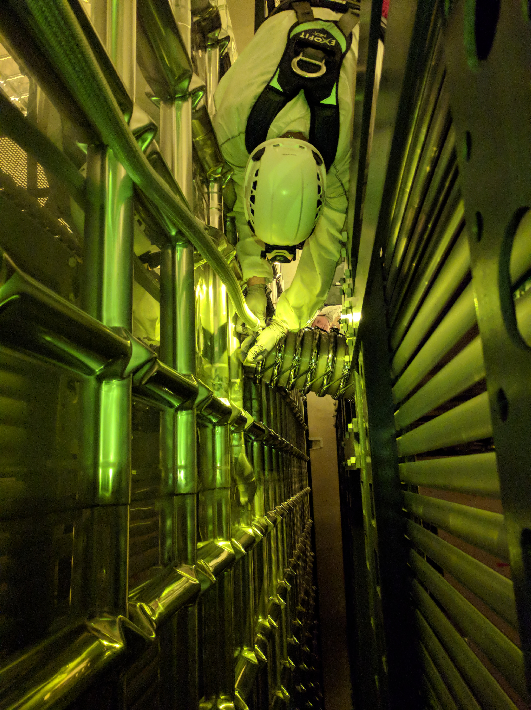
Beam Plug Cable Tray
Beam plug cable tray installed on top of runway beam and bridge beam C
For strain relief and routing the ~5m long stainless steel nitrogen hose from the feedthrough flange to the beam plug
Had to disconnect the hose from the beam plug to remove a twist in the hose
Thanks to Cole and Jerry for their help

Slide 3
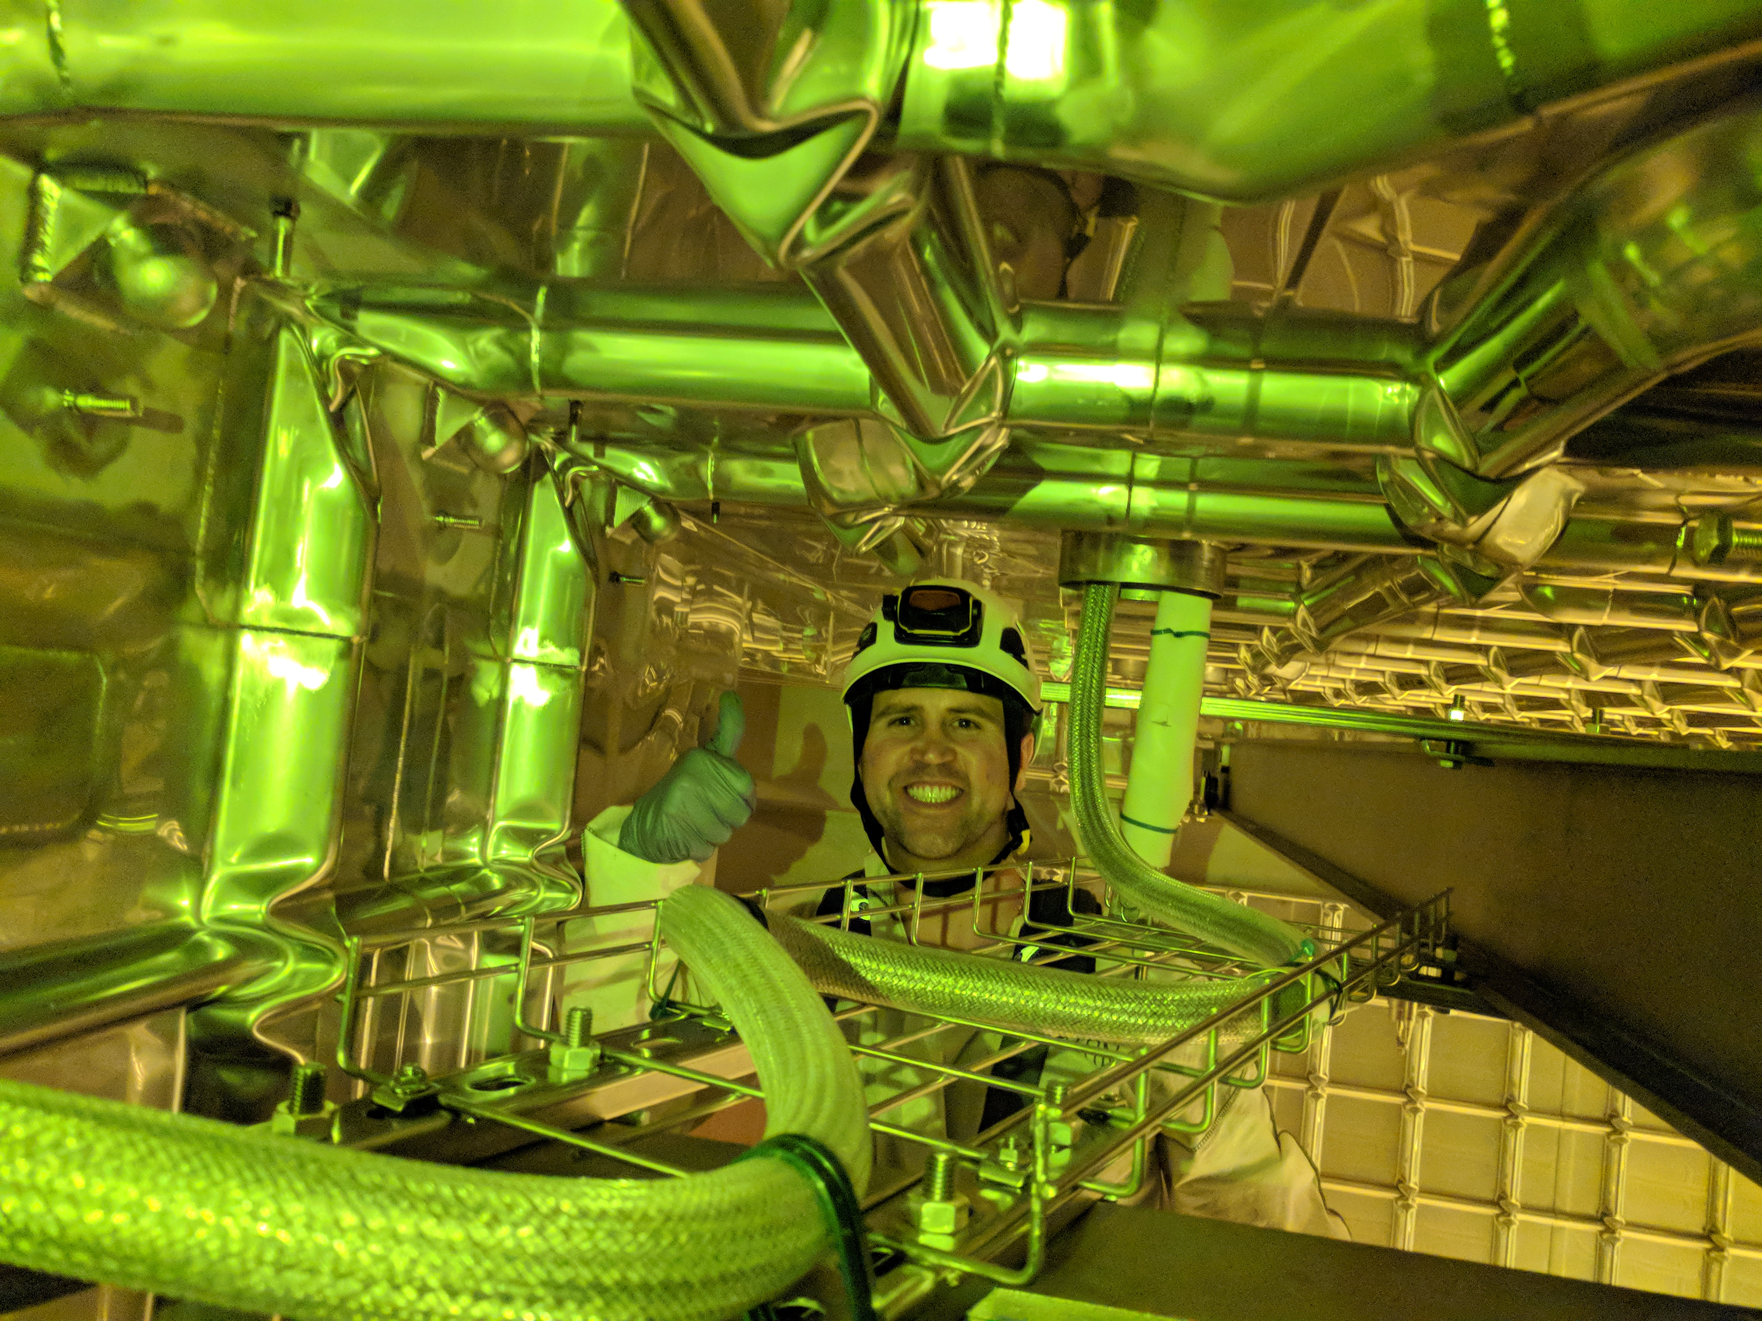
To feedthrough flange
Runway Beam
To beam plug
CPA Bridge Beam

Slide 4
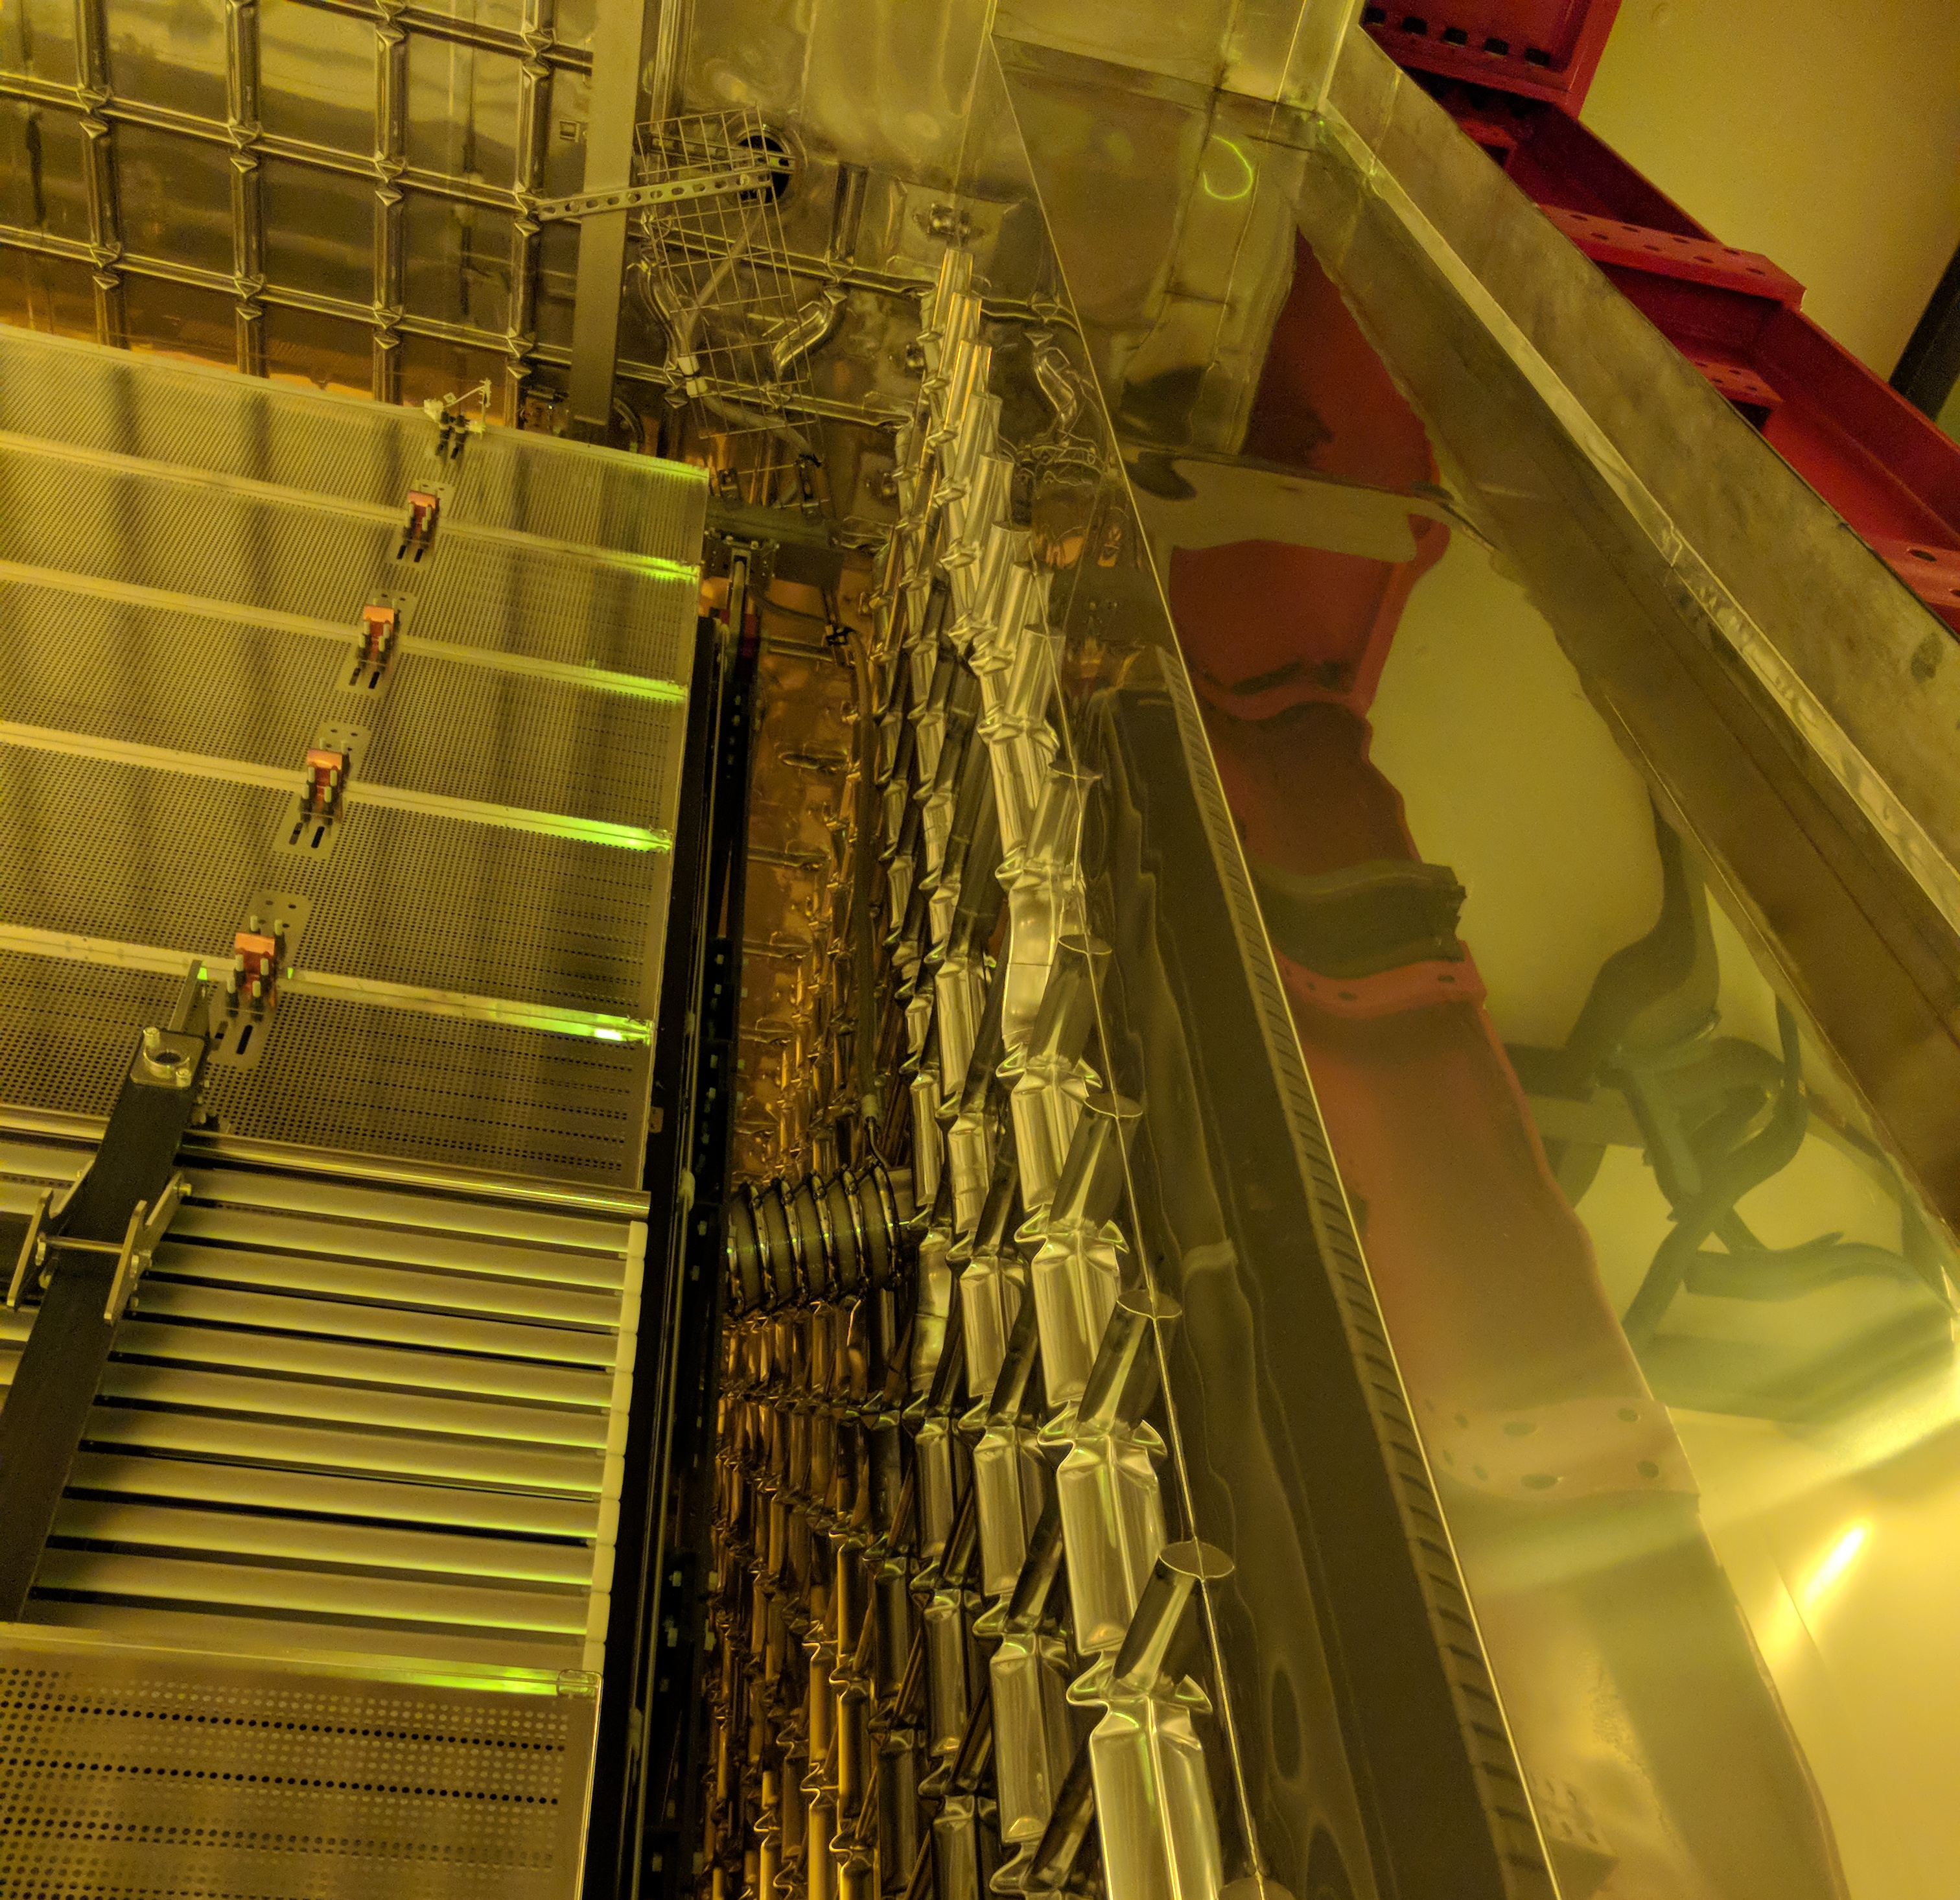

Slide 5
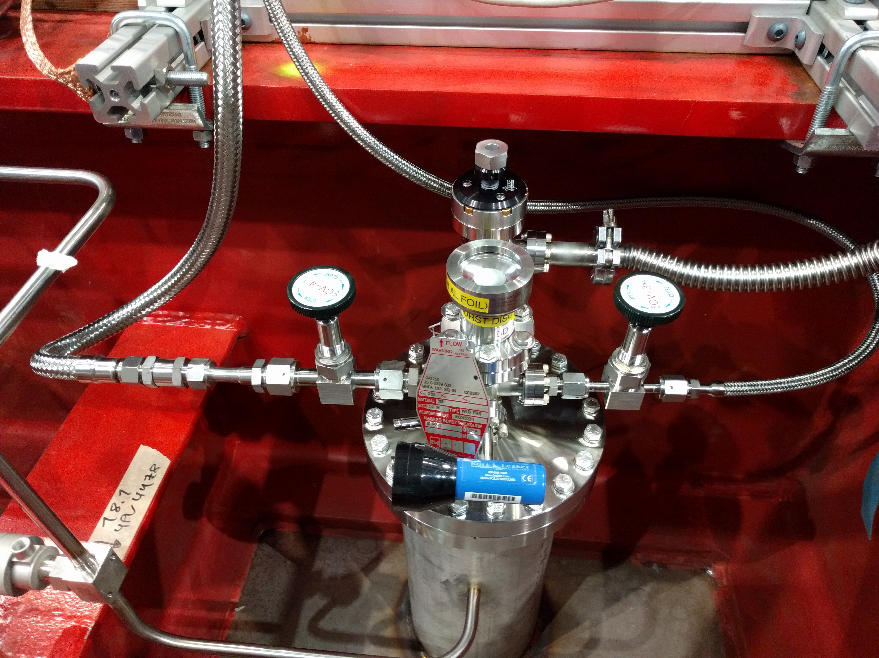
Hose connections between the flange and the gas control panel were made today
N2 Gas From Beam Plug
Back To Control Panel
N2 Gas From Control Panel
To Beam Plug
Beam plug gas system installation is completed !!!!

Slide 6
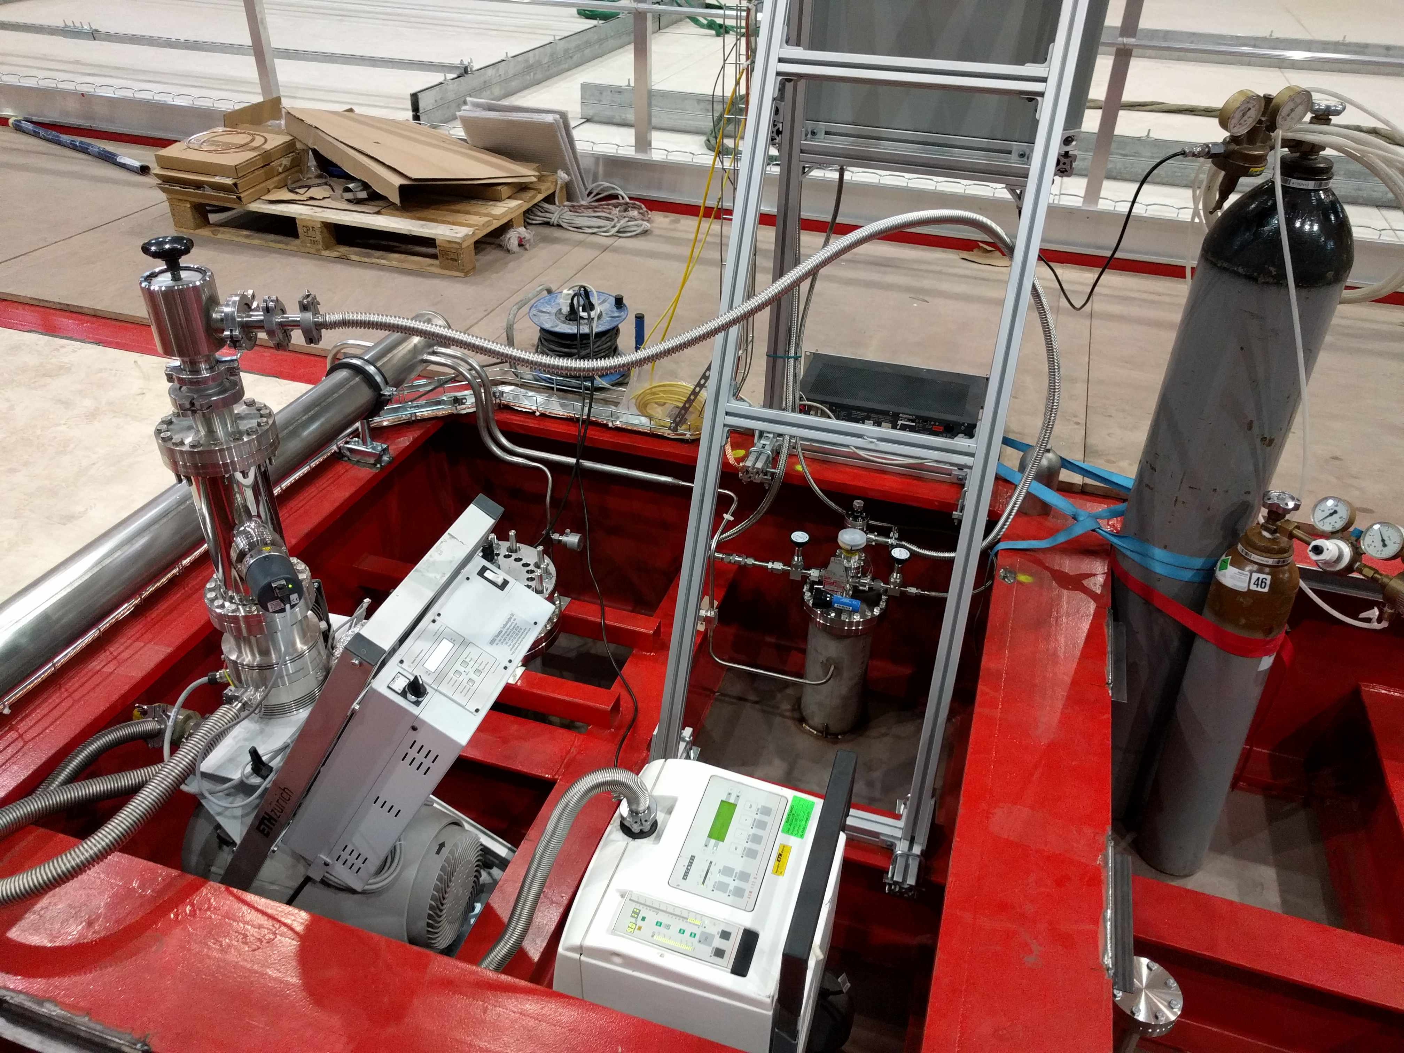
Final Leak Check of the Beam Plug System Completed !!!
Leak Check
Spayed He inside the cryostat along the beam plug and gas hose
Sprayed He on top of the cryostat around the feedthrough flange and sensor
Vacuum at turbo pump ~5x10⁻⁷ mbar
Leak rate < 8 x10⁻¹⁰ mbar L/s

Slide 7
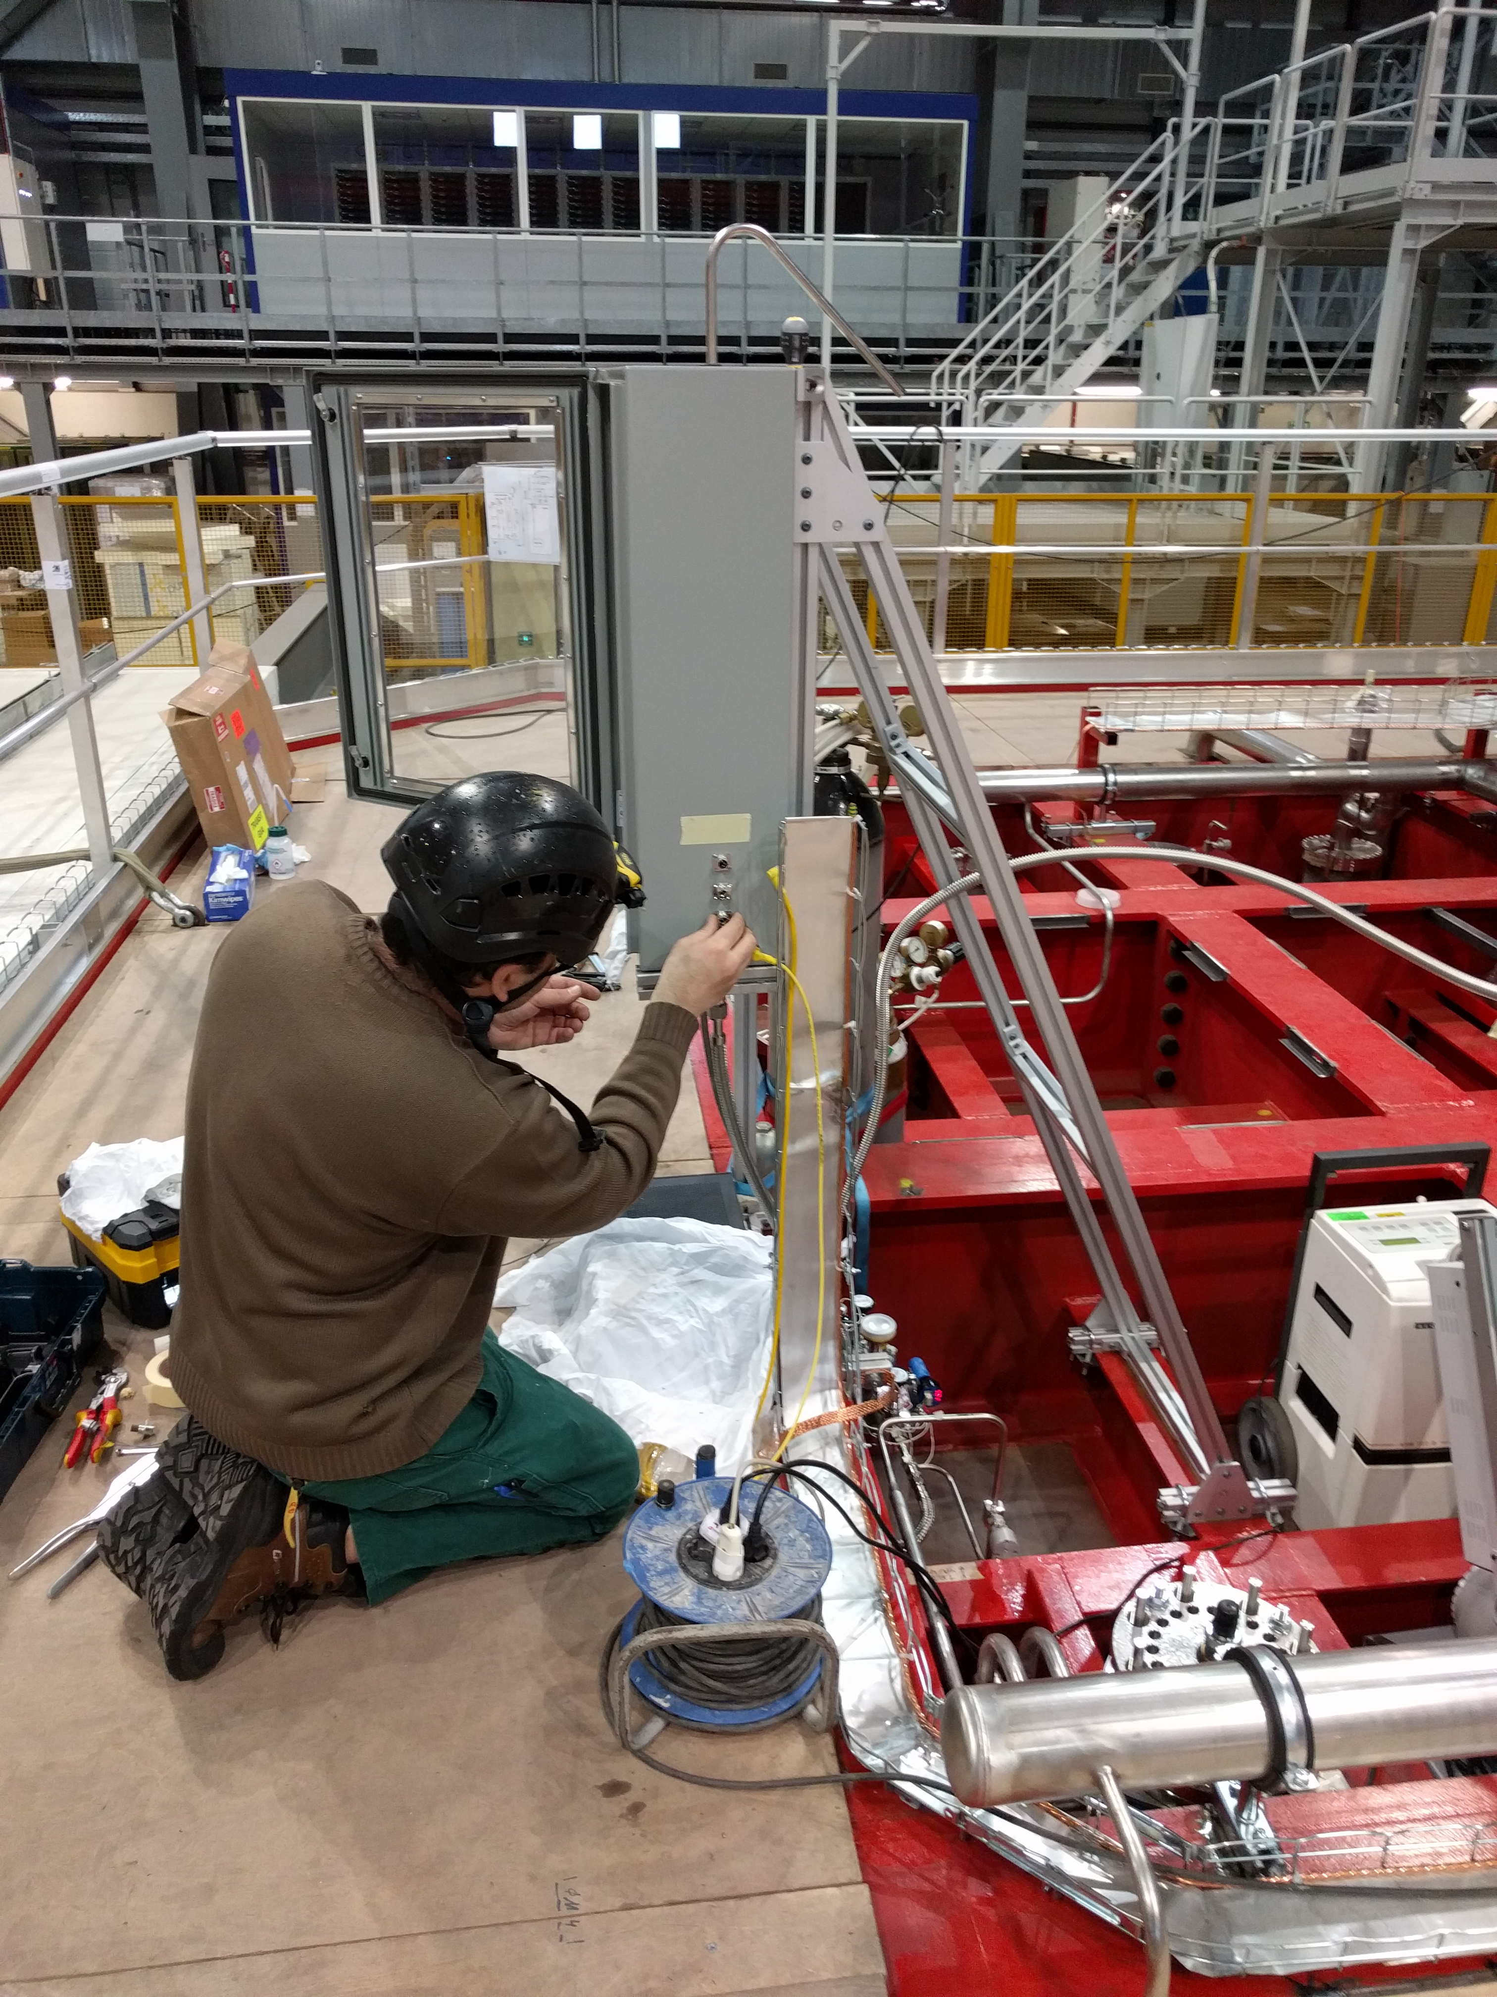
Electrical Connectivity Test
Validated electrical connections using Keithley meter
Profile # 1 to beam plug ground: ~58GOhm
Profile #5 to beam plug ground : ~55GOhm
SHV center conductor (beam plug current monitor) to ground: 0.998MOhm
All consistent with expected values
Remaining Installation Task
Integrating 5 beam plug sensors (two RTD, two pressure and one current monitoring) with DCS
Likely to start cabling tomorrow

