Slide 1
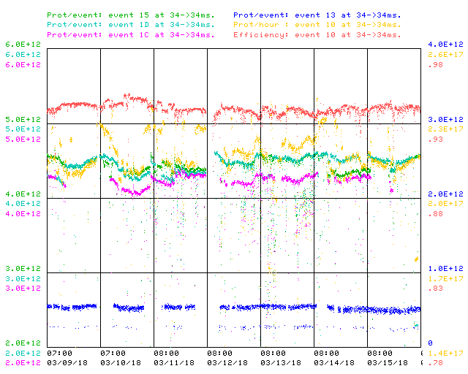
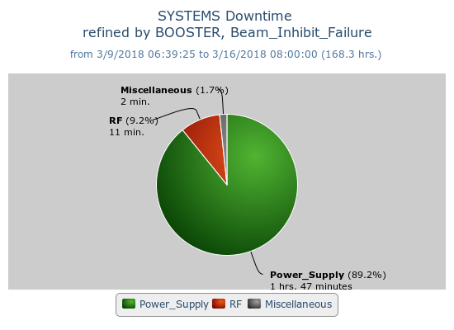
Booster Operations 3/9/18 – 3/16/18
F
T
F
F
Sa
Su
M
F
F
F
W
F
Sa
W
F
F
F
F
F
F
F
Sa
Su
Su
M
Tu
F
F
F
M
M
Su
M
Th
F
M
W
W
W
Th
Sa
W
F
F
Sa
Tu
F
Sa
F
F
Sa
Su
M
F
M
F
Sa
Su
M
Sa
Su
M
Tu
Th
Su
Su
Sa
Su
F
Sa
M
F
Sa
F
W
Su
W
F
M
W
Th
F
Sa
M
F
Sa
Su
W
Th
F
F
Su
W
F
Sa
Su
M
Tu
Sa
M
Su
M
M
W
Th
F
M
F
Su
M
W
Sa
Su
u
F
Sa
Th
Sa
M
W
F
Sa
Su
W
F
Su
M
Capture/Transition Issues
Access to replace BRF16 Cavity
BRF8 Cable Fault
DOGL3 Flow Switch
MKS06 Cable Termi
Collimator Studies
Downtime: ~ 2hrs.
Misc RF station trip. (11min.)
VL2 corrector amp replaced. (40min.)
DOGL3 water flow switch problem. (67min.)
Chopper on trigger box replaced. (5 min.)
Access, BRF21 installed
Access period
This week:
~3.36E19 delivered this week.
Linac Laser Notcher working well.
Currently $15 ~4.6E12 94% $1D ~4.6 E12 94% (5hz), $1C 4.2E12 94%, $13 5E11 91%. Beam to Muon Campus and SY provided as requested.
Conducted beam studies(coupling and beta function) with J-PARC collaboration.
Preparing for scheduled Tuesday shutdown next week.
Next week:
Shutdown work scheduled for Tuesday, vacuum leak checks, RF PA replacements, RF phase matching, other smaller jobs.
Tuesday evening shift beam studies.(2-3hrs.)
Wednesday beam studies to start by 0800. (~8hrs.)

