Slide 1
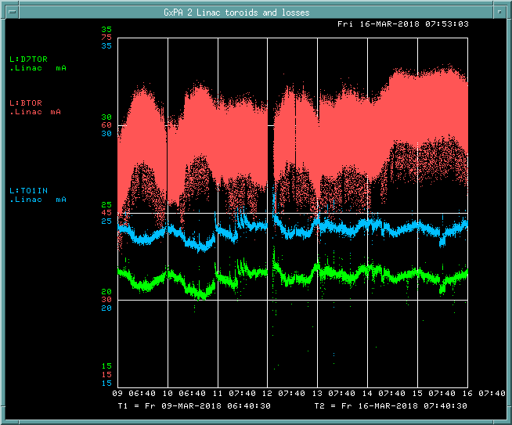
Preacc/LINAC Weekly Performance (Mar. 09 – Mar. 16, 2018)
BTOR: 57.9mA
TO1IN: 22.8 mA
D7TOR: 20.3 mA
LINAC efficiency:
89.0%

Slide 2
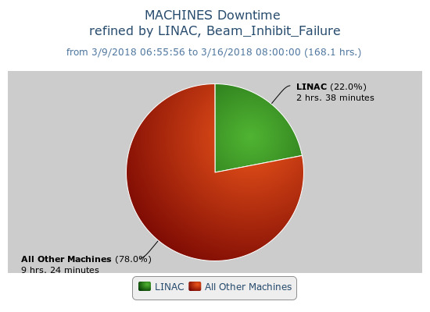
Beam inhibit downtime (2hr 38min)
Shutdown (last Monday)
Switched to old modulator from Marx on LRF5
Replaced 12 Marx cells in LRF2
Plans (next Tuesday)
Chipmunk replacement
120V breaker panel
High voltage connection box installation on LRF1

