Slide 1
Status of SSR1 cavities and cryomodule
Donato Passarelli on behalf of SSR1 team
PIP-II PMG meeting
21 March 2018

Slide 2
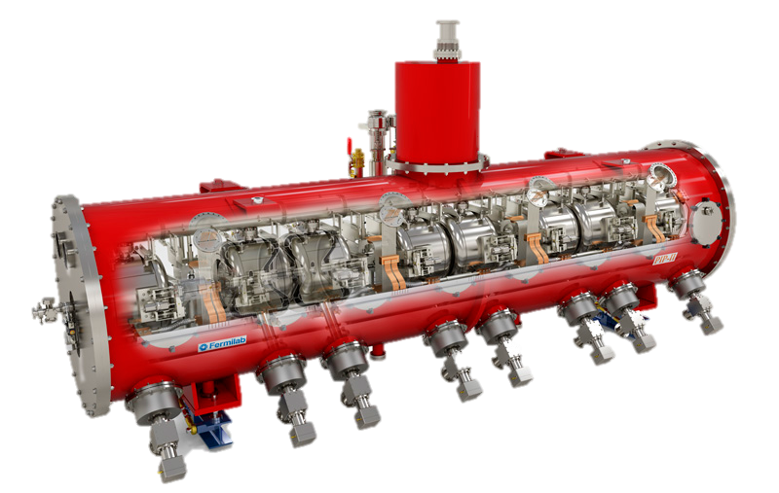

SSR1 CM-1
SSR1 CM-1
  PIP2IT
  PIP II tunnel
 | SSR1
# CMs for PIPII | 2
Cavities per CM | 8
Solenoids per CM | 4
CM configuration c: cavities; s: solenoids | 4x (csc)
CM length (m) | 5.2
SSR1 cryomodule
PIP2IT
SSR CMs capable of operating in both pulsed and CW modes with a beam current of 2 mA avg.

Slide 3
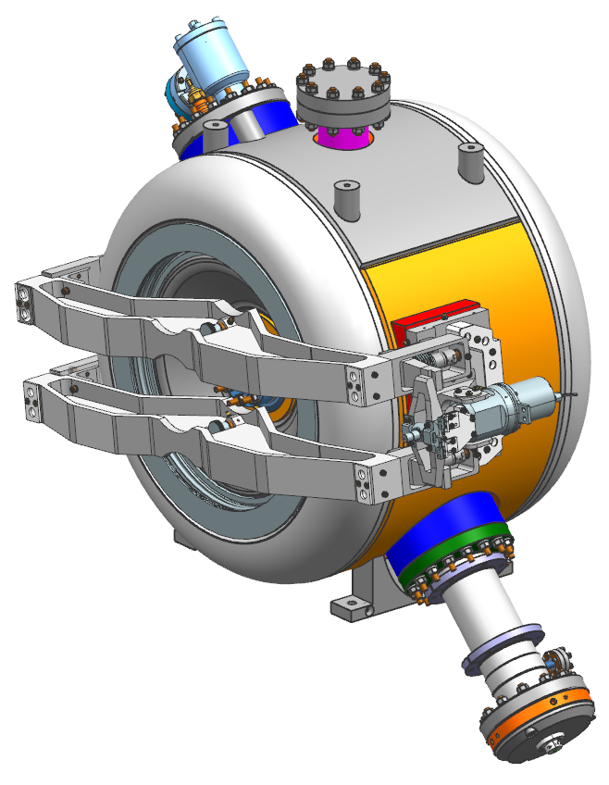
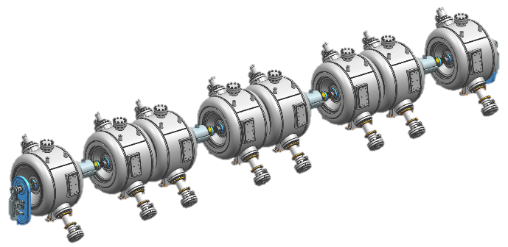
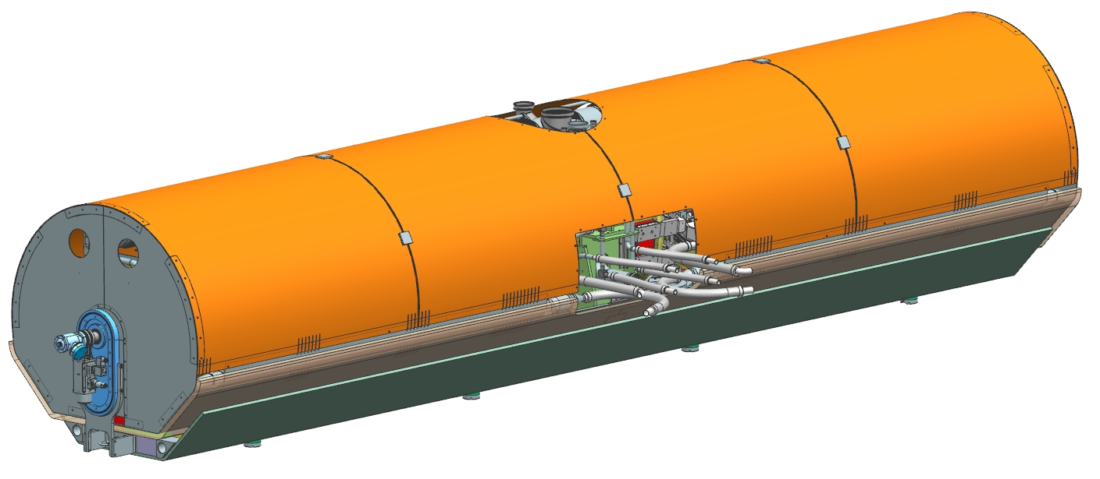
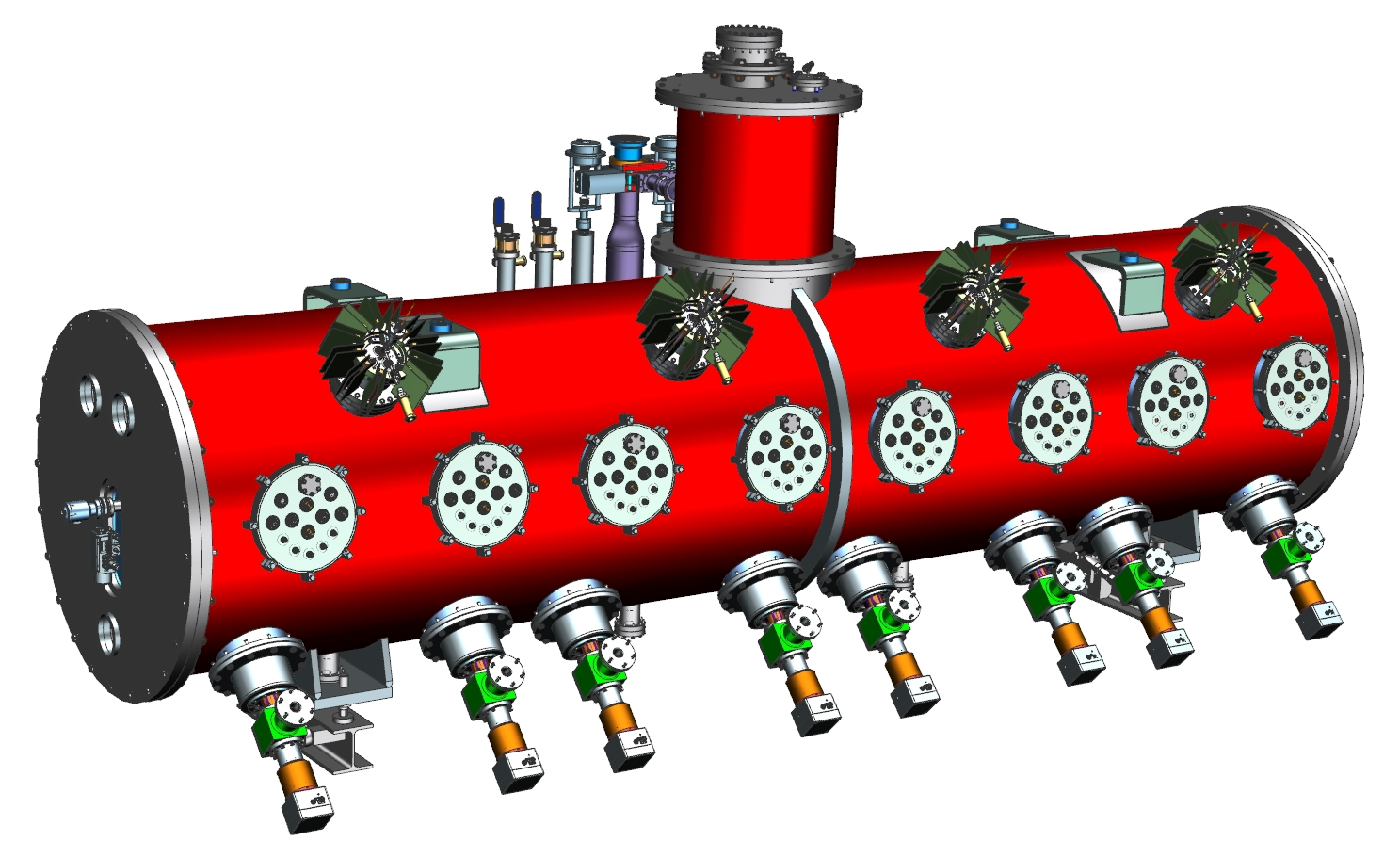
Next milestones and technical challenges
SSR1 CM-1
Qualification of 8 jacketed cavities
  Cavities and cold-end coupler performance
  Tuner and Resonance control studies
  Enable Lab 2 cleanroom and SRF tech team
Cavities string assembly
  Validation of cleanroom procedures
  SRF team for low-beta cavities
Coldmass assembly
  Design completed, ready for procurement
  Validate assembly strategy, tooling and facility
Final cryomodule integration and testing
  Cryomodule performance (RF, thermal, etc.)
  Verification of external interfaces (ICD)
  Validation of SRF cryomodule layout for PIP-II

Slide 4
SRF cryomodules layout for PIP
The cryomodule layout is the same for SSR1, SSR2, LB650, HB650 cryomodules
Vacuum vessel
2-Phase He pipe
Thermal shield
35-50K
Dressed cavity
5 K Line
Support post
Coupler
Strong-back
Assembling and testing SSR1 CM-1, we will validate many features and sub-assemblies common to all SRF cryomodules for PIP-II (except the HWR)

Slide 5
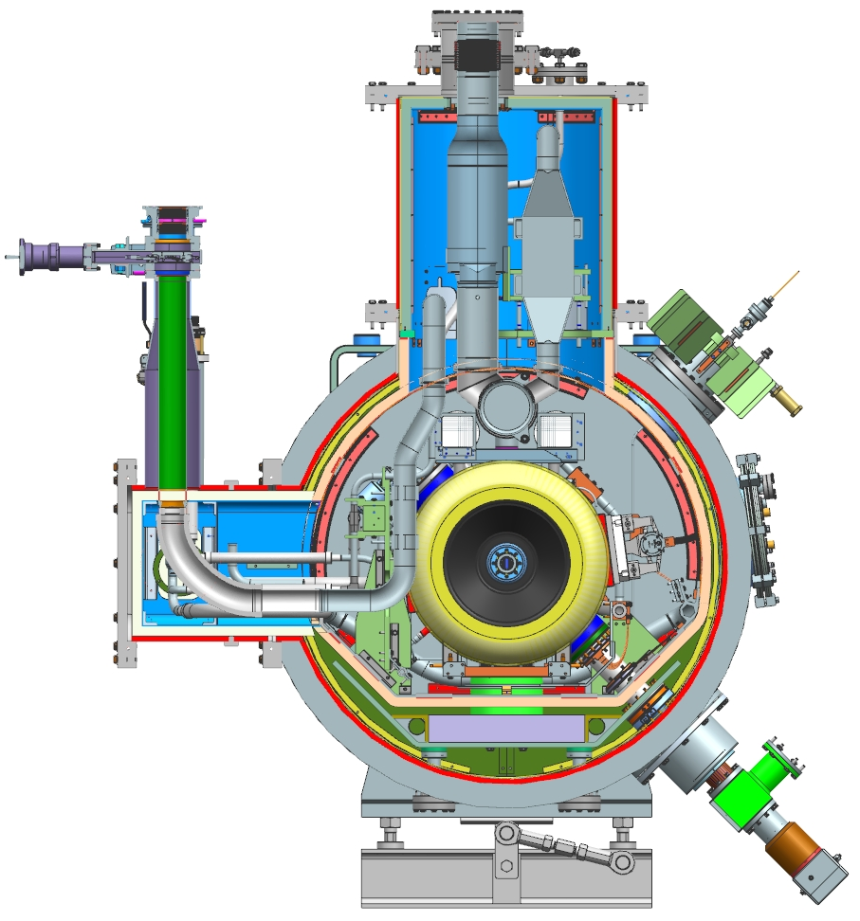
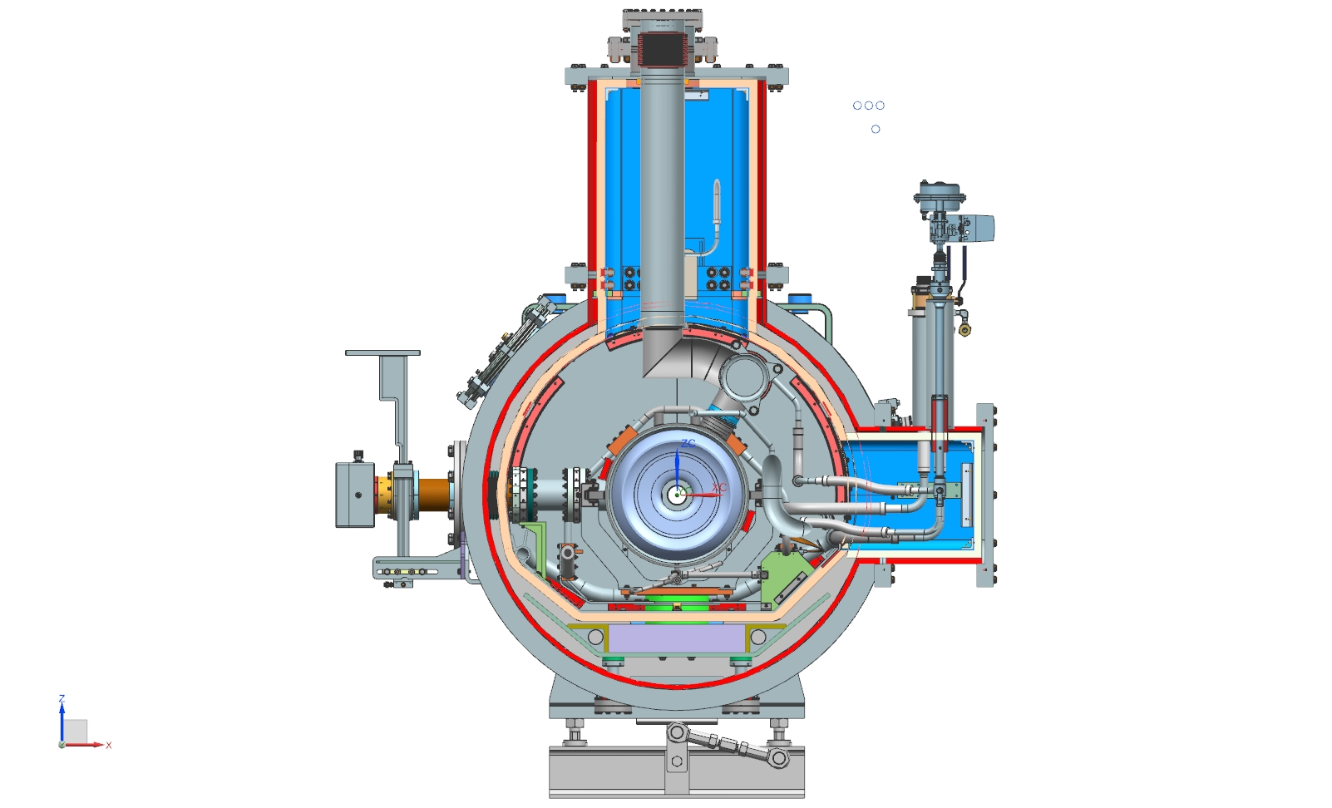
SRF cryomodules layout for PIP
SSR1 CM cross section
HB650 CM cross section

Slide 6
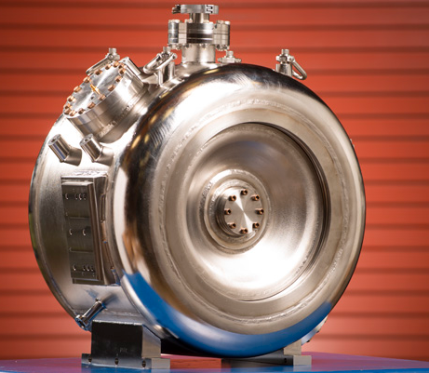
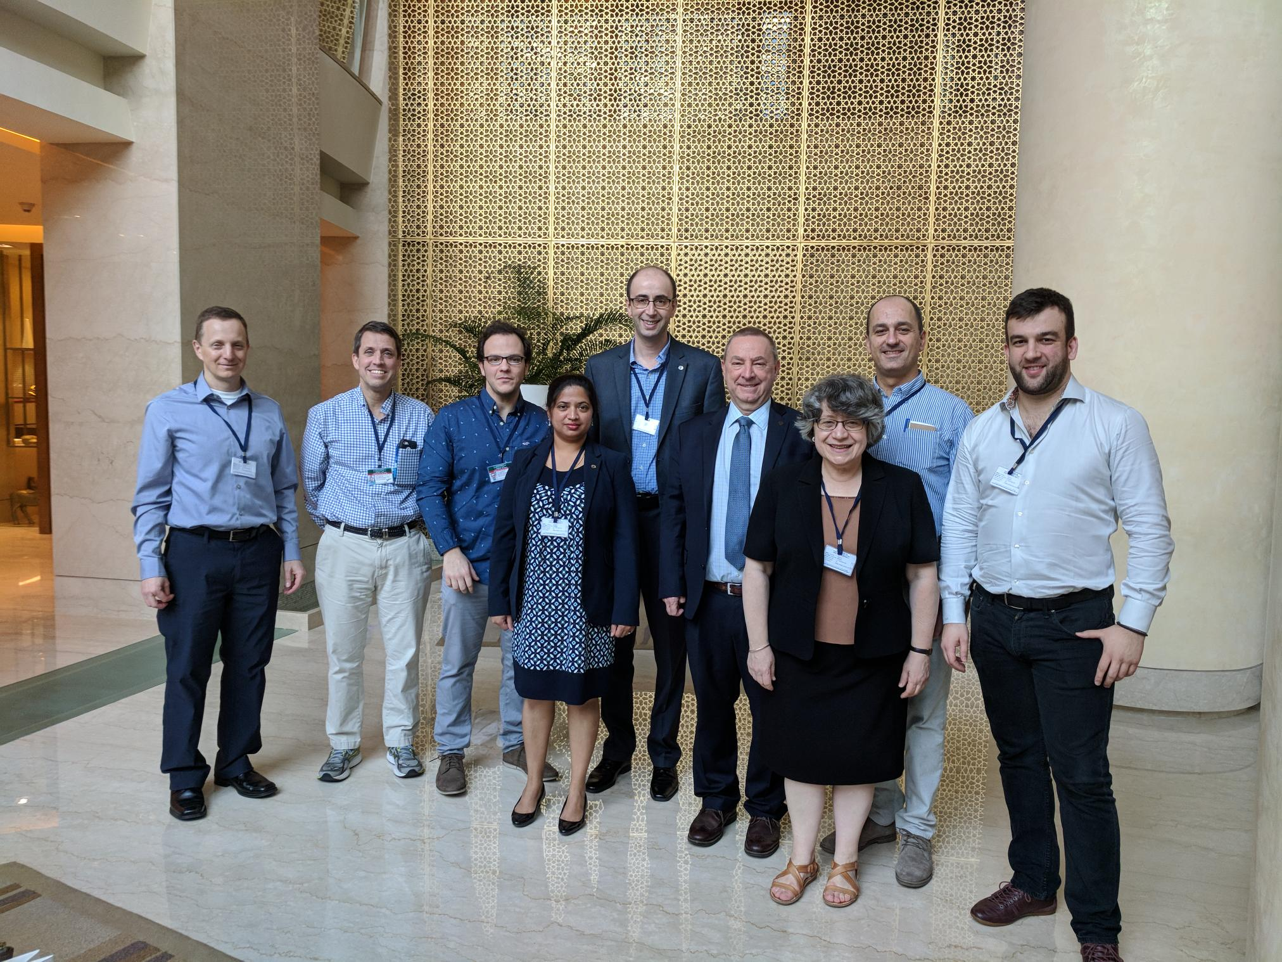
SSR1 jacketed cavities
  10 FNAL cavities were successfully jacketed with stainless steel vessels
  2 IIFC cavities are under jacketing process at BARC
    Our visit in February was very fruitful to support them on cavities fabrication and SSR2 cavity design.

Slide 7
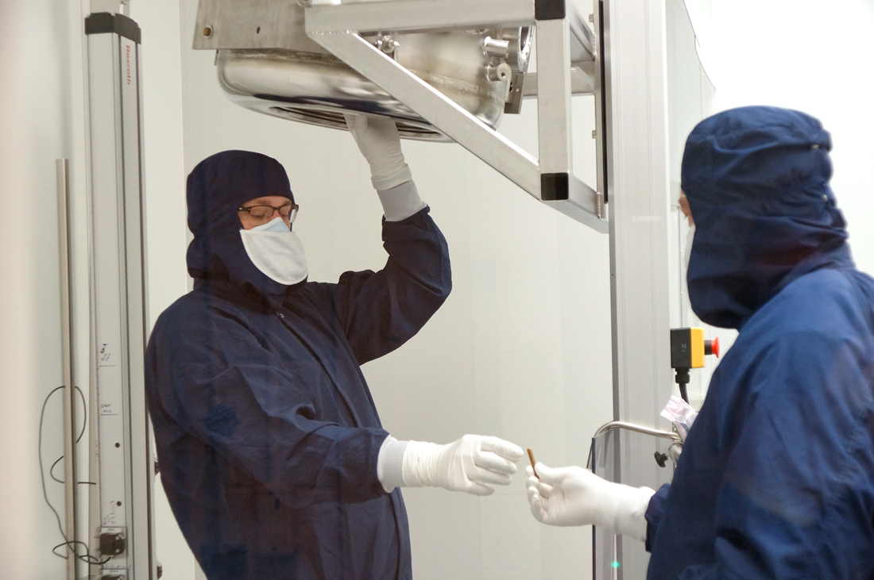
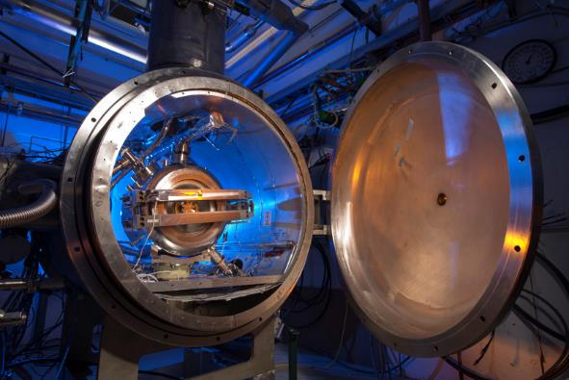
Qualification of jacketed cavities
Ongoing activities
Processing and preparation at ANL
120C baking at MP9
Coupler installation at MP9 (Lab 2 in future)
Testing with LPC/HPC at STC
Qualification plan
S107: LPC qualif. → Coupl. Install./Baking → HPC testing
S110: LPC qualif. → Coupl. Install./ Baking → HPC testing
S111: LPC qualif. → Coupl. Install. Baking → HPC testing
S112: LPC qualif. → Coupl. Install. Baking → HPC testing
S113: BCP+HPR → LPC qualif. → Coupl. Install./Baking → HPC testing
S114: BCP+HPR → LPC qualif. → Coupl. Install./Baking → HPC testing
S109: BCP+HPR → LPC qualif. → Coupl. Install./Baking → HPC testing
S106: BCP+HPR → LPC qualif. → Coupl. Install./Baking → HPC testing
S103 (IIFC): BCP+HPR → LPC qualif. → Coupl. Install./Baking → HPC testing
S104 (IIFC): BCP+HPR → LPC qualif. → Coupl. Install./Baking → HPC testing

Slide 8
Qualified jacketed cavities with LPC in STC/MDB
Past and current technical challenges
strong radiation due to field emission (FE): solved
Multipacting: solved --> 120C baking
Oxidation of blind holes: under investigation
Reliability of coupler vacuum-ends

Slide 9
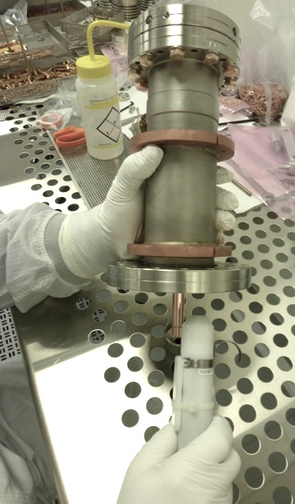
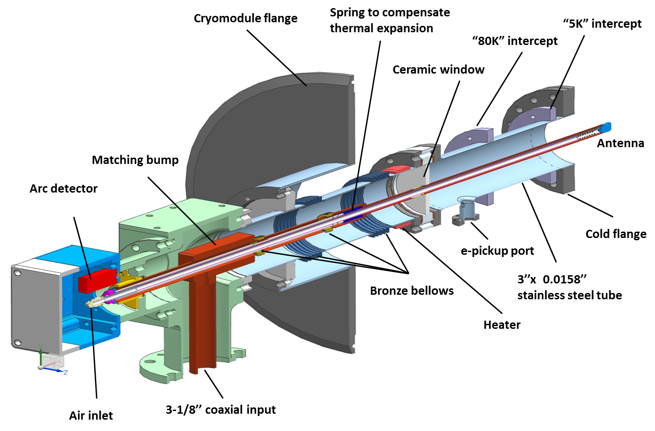
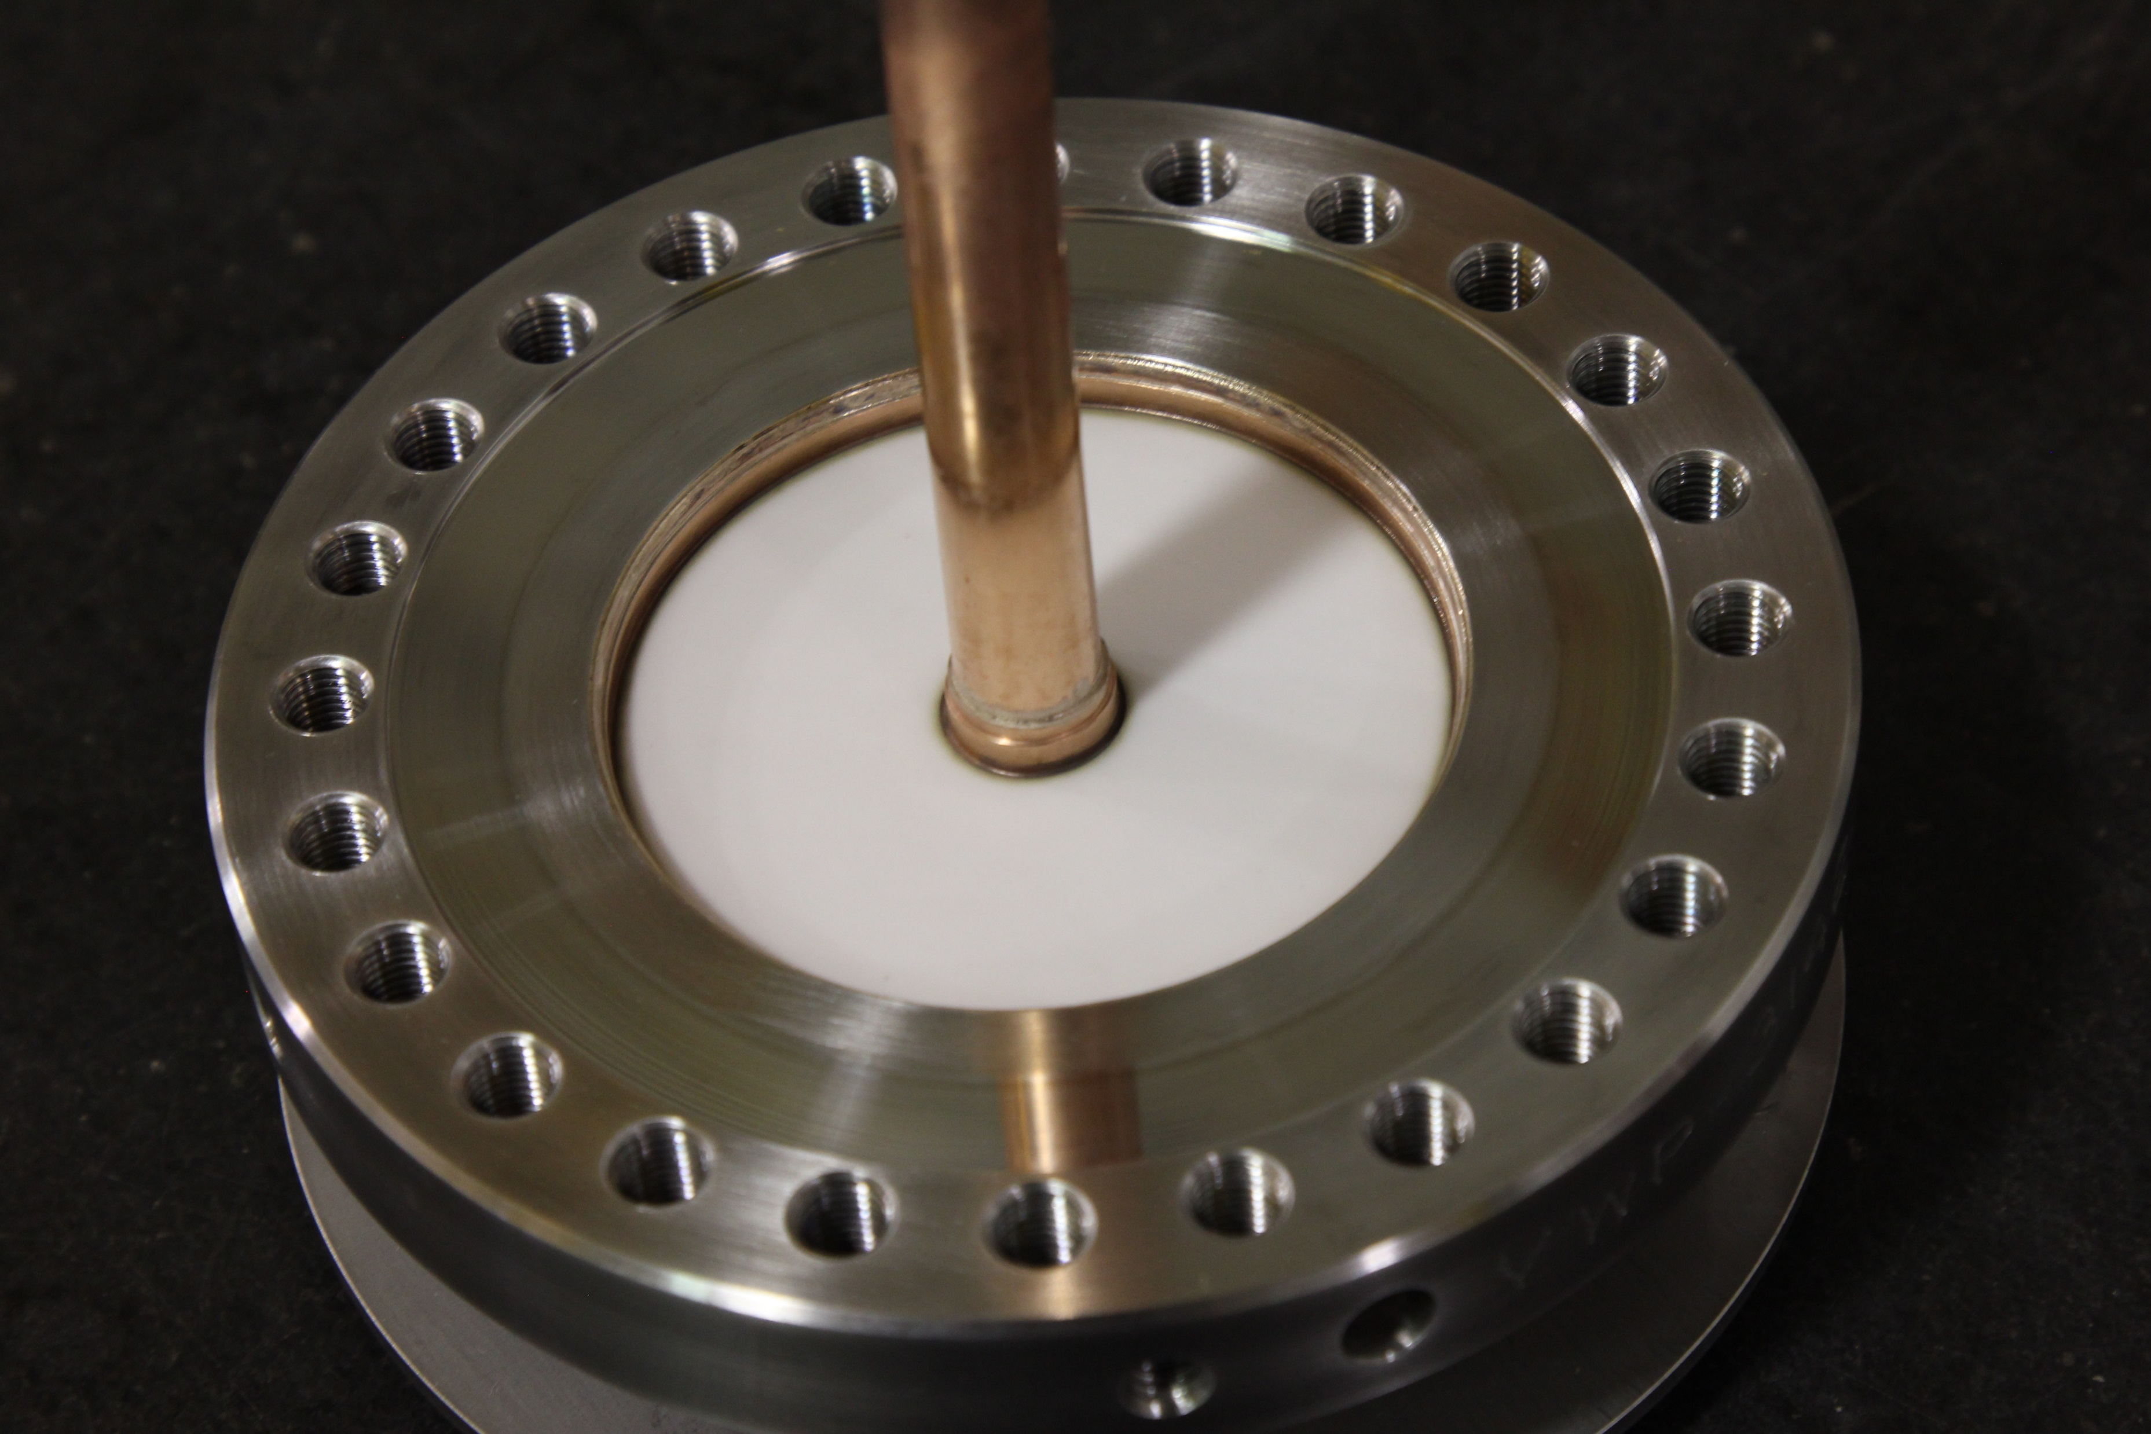
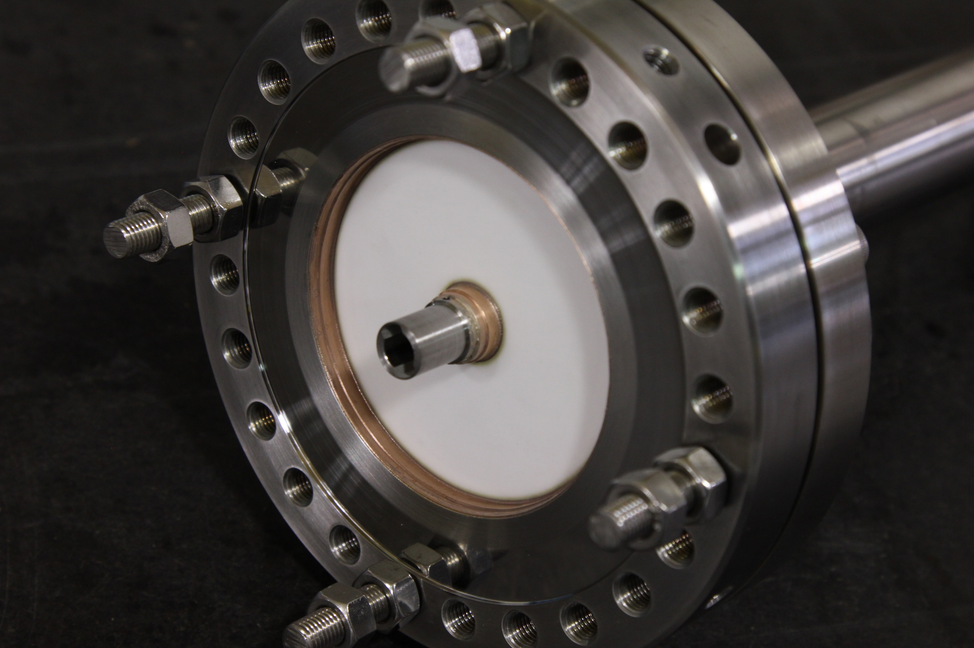
SSR1 cold-end couplers
Status
6 outer conductors passed QA/QC
5 CPI vacuum end couplers were received:
  2 vacuum-ends (CPI-4, CPI-5) were qualified at room temperature
  2 vacuum-ends (CPI-1, CPI-3) passed visual inspection → next qualif. at room temp.
  1 failed during qualif. at room temperature (testing power reduced to 10kW)
5 Coorstek vacuum-end couplers: still not received. Now 8 months late
New order: 8 cold-end + outer conductors from CPI (a quote is coming…)
  Lead time 1.5 months for the first units
Legacy
Prototypes
  Three prototype antennas were made
  Two antennas were successfully tested up to 30 kW, CW, full reflection.
  One antenna was tested to failure at 47 KW, CW, full reflection.
  One antenna was successfully used to qualify cavity S107 (R&D phase).
Production couplers
  First order: four couplers were received and successfully tested on the test stand up to 20 kW, CW, full reflection but the use of Vacseal (a material not SRF compatible) was evident on some joint. It might be the source of contamination that leaded to have cavities with strong radiation due to field emission.

Slide 10
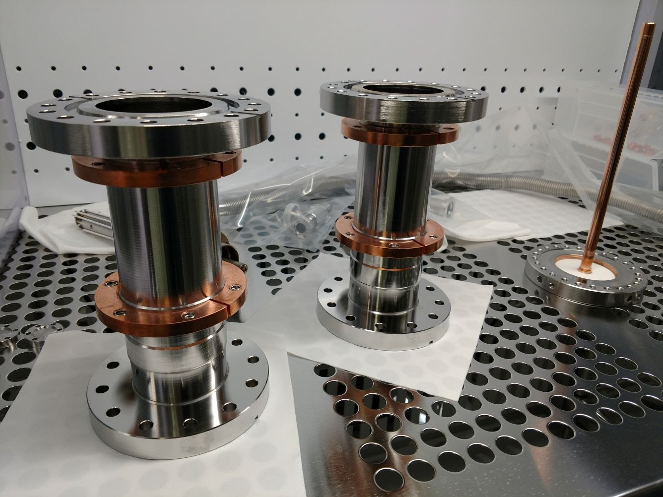
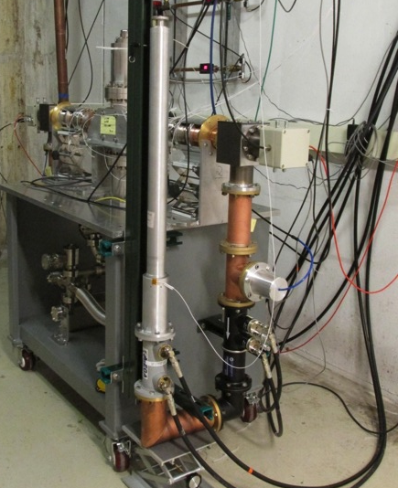
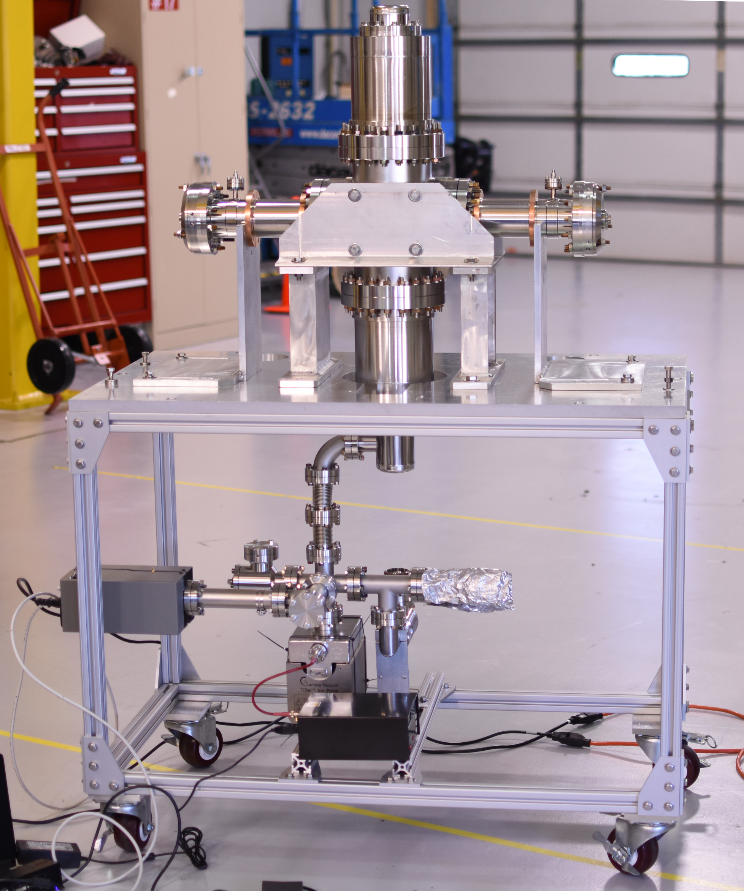
SSR1 cold-end couplers: processing/qualification plan
RF conditioning at room temperature
  Visual inspection and leak check
  Cleaning and installation of the vacuum end assembly on the RF test stand in cleanroom
  120C baking 48 hours
  Testing up to specified power (10kW) in full reflection to check the structural performance of the ceramic window.
  During the test we check the RGA scan to monitor the emission of undesired substances (i.e. hydrocarbons) from the antenna.
  All activities of assembling/disassembling take place in the cleanroom
Fully integrated test at cold temperature
  After qualification at room temperature, the vacuum-end coupler is cleaned, installed on the jacketed cavity in class 10 cleanroom and undergo to 120C baking 48 hours

Slide 11
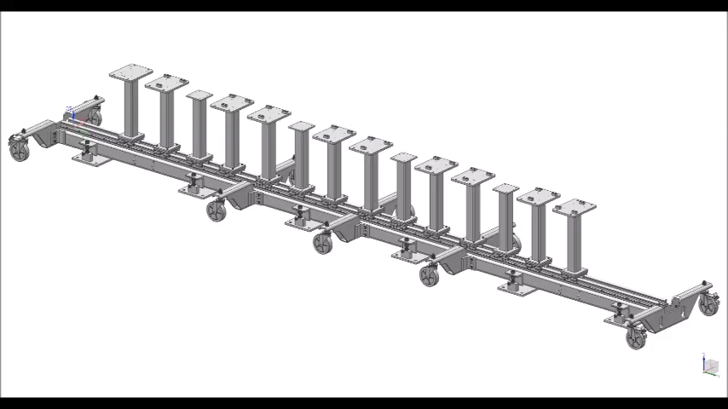
From sting assembly to final cryomodule…
Link

Slide 12
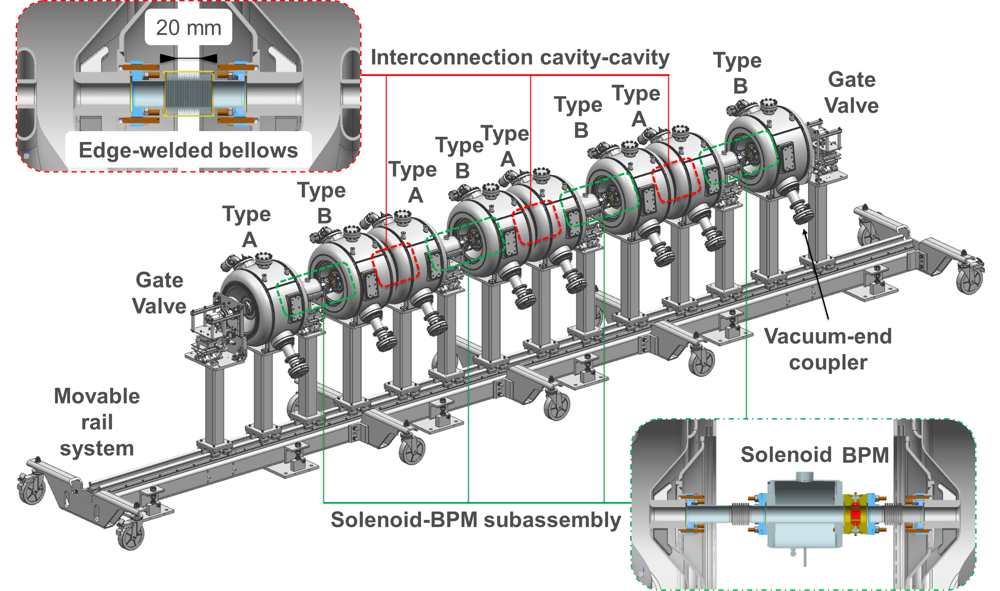
SSR1 CM-1: string assembly

Slide 13
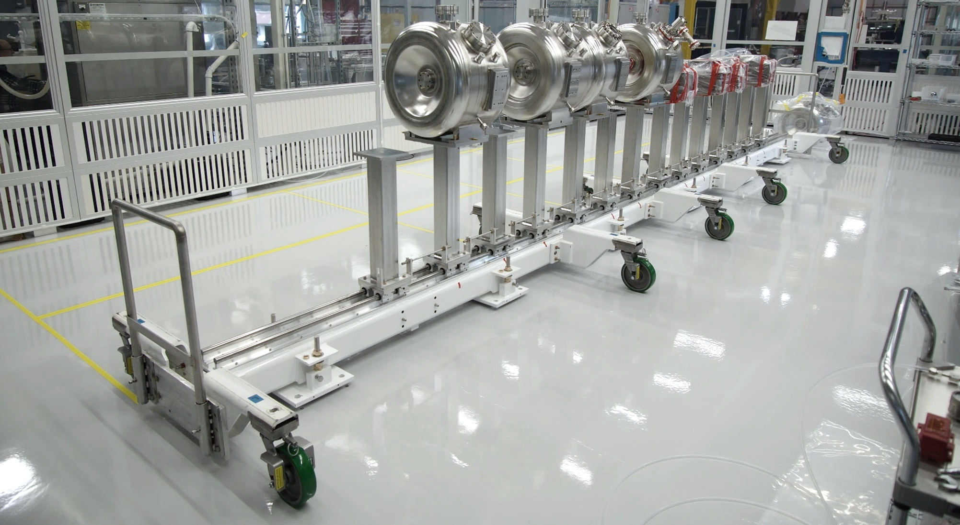
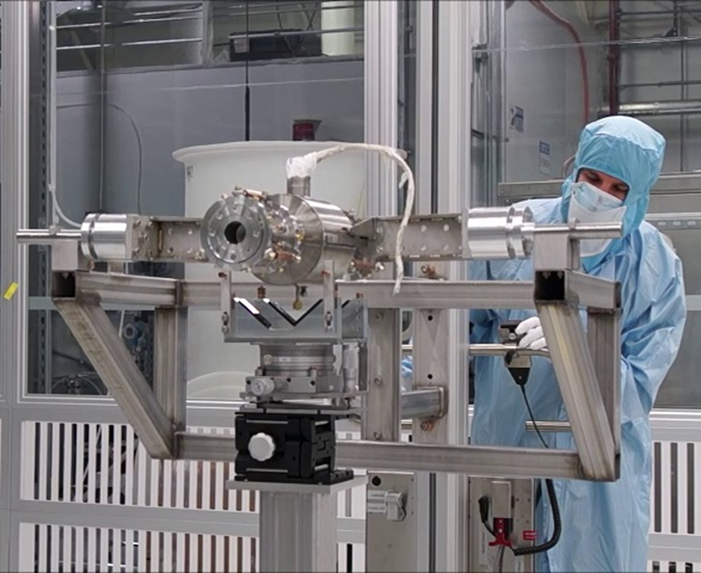
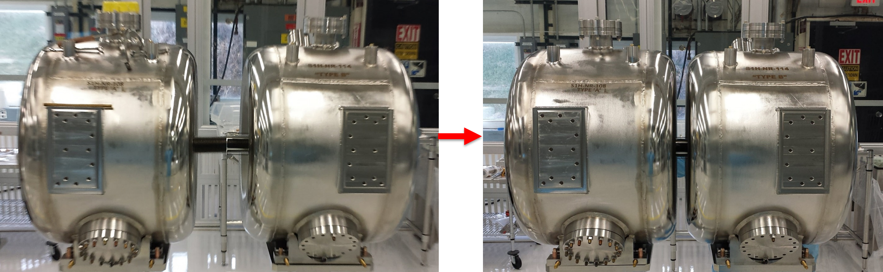
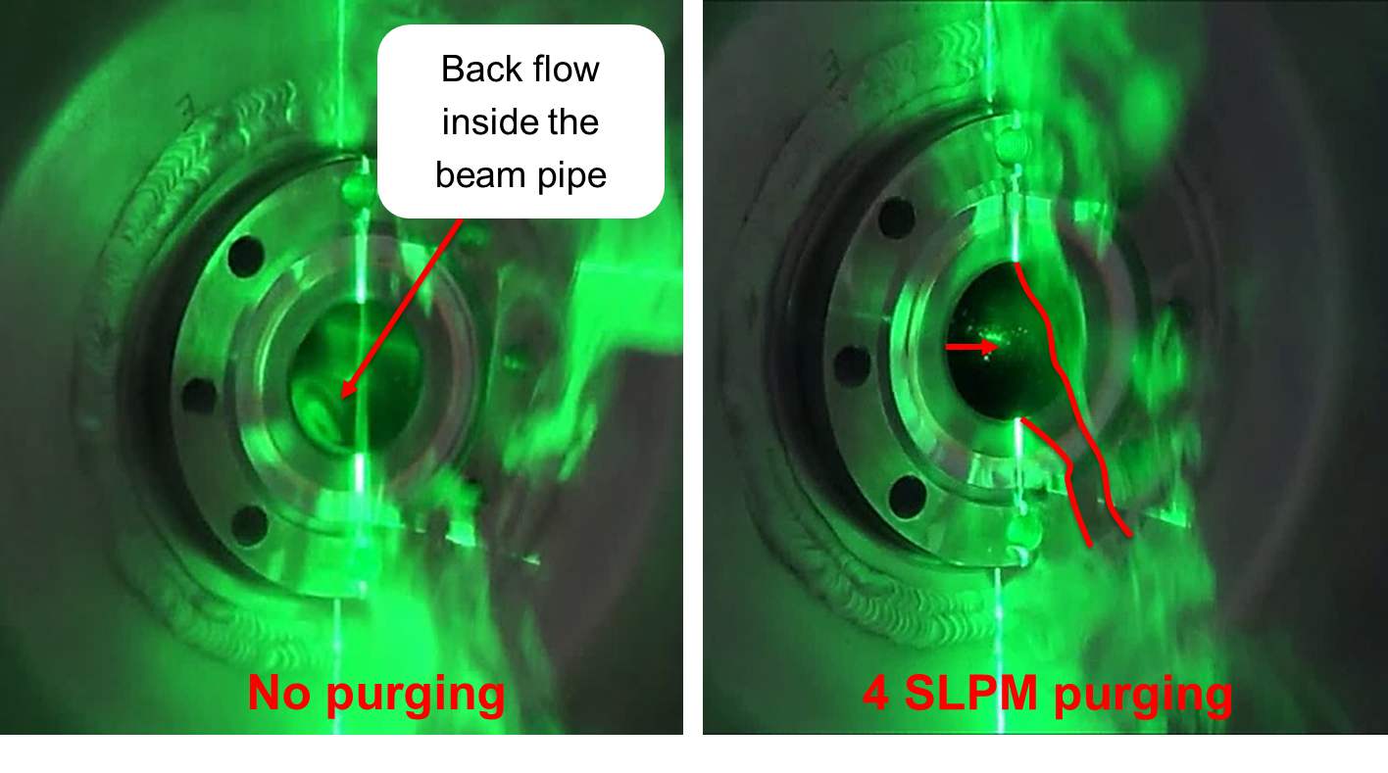
SSR1 CM-1 string assembly: cleanroom dry-run
Cavities on the movable rail system in Lab 2 cleanroom
Checking tooling performance in cleanroom
Cavity to cavity connection with edge-welded bellows
Studies of nitrogen purging vs. no purging

Slide 14
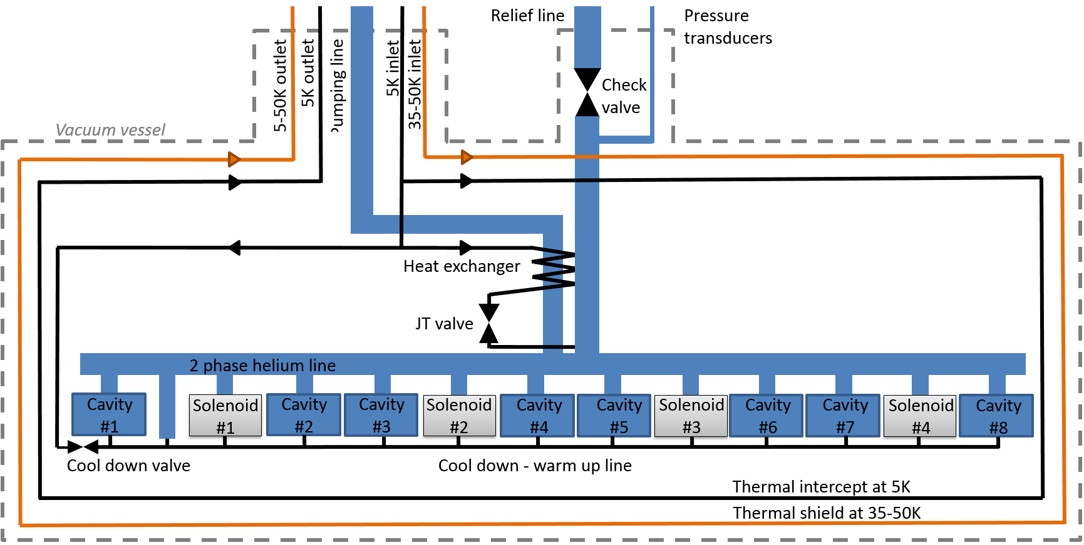
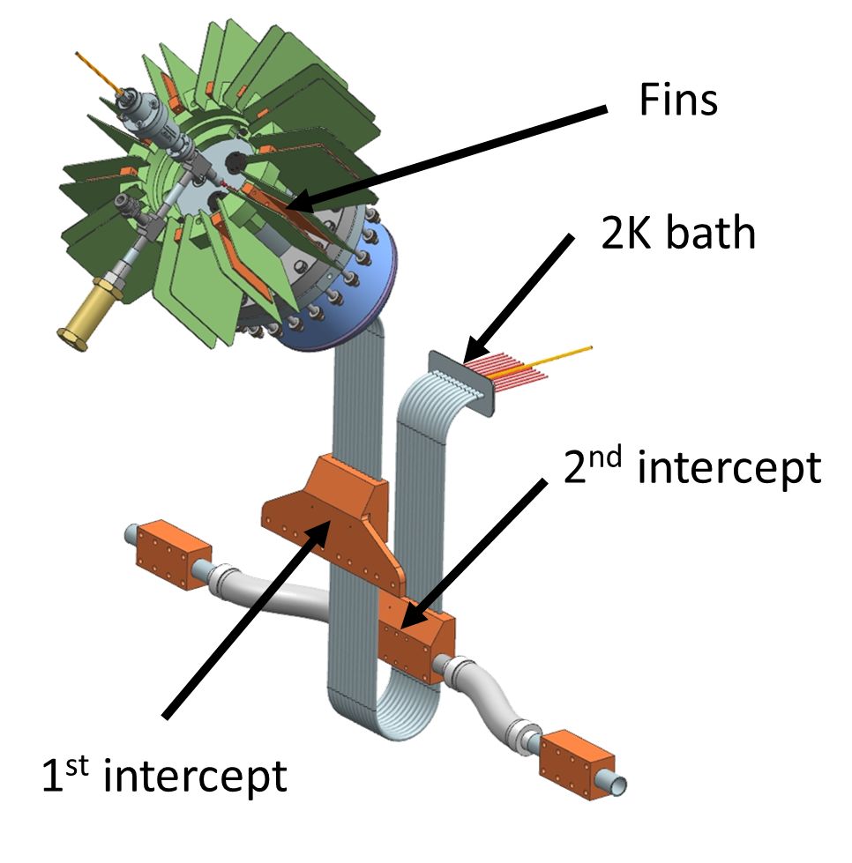
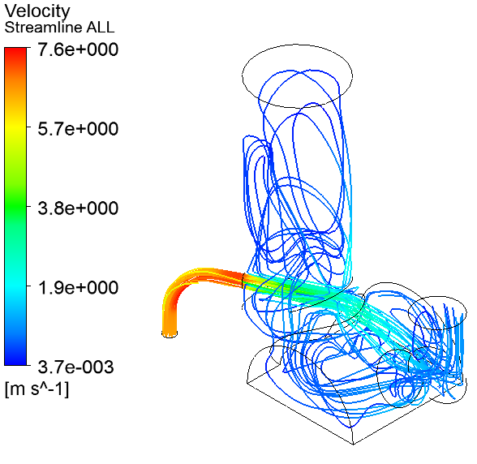
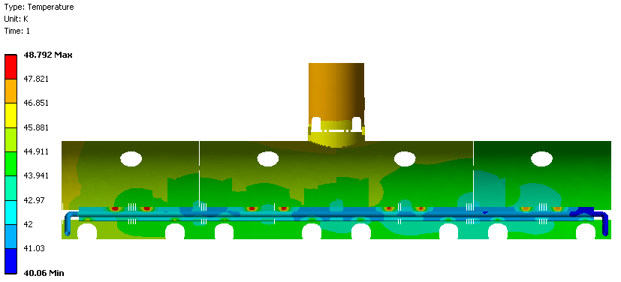
SSR1 CM-1: coldmass final design
FDR/PRR held in January. Team awaiting final ColdMass review report and action items. After the review several technical discussion (i.e. external interfaces) were solved.
Releasing drawing and documents to begin the procurement cycle.
Layout of the cryogenic lines
Current leads
Temperature distribution of the thermal shield
Flow distribution and velocity of the helium

Slide 15
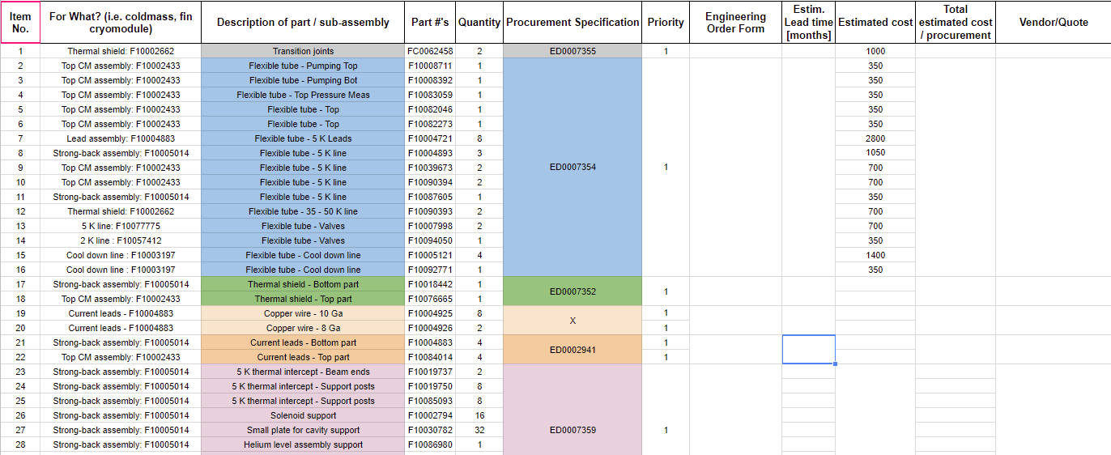
Coldmass and final cryomodule procurement
Coldmass
  Design completed
  Procurement: to be done (~$550k)
Final cryomodule assembly
  FDR by end of April
  Procurement: to be done (~$450k)

Slide 16
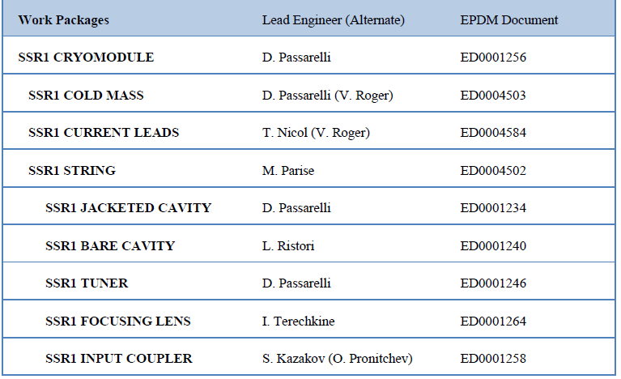
Meetings and technical documentation
SSR1 cryomodule team weekly meeting (Indico link)
Travelers (Vector) and SRF e-log (link)
EPDM for each work package in Teamcenter:

Slide 17

Thanks for your attention…

