Slide 1
University of Texas at Arlington
Jaehoon Yu
ICARUS Collaboration Meeting
May 13, 2018
Outline
Introduction to UTA HEP Group
People
Physics Interests
Detector System Interests

Slide 2
UTA High Energy Physics Group
Created in early 90’s in preparation for the SSC
Consists of
9 Experimenter Faculty: Jonathan Asaadi, Andrew Brandt, Kaushik De, Amir Farbin, Haleh Hadavand, Benjamin Jones, David Nygren, Andy White & Jae Yu
Working on ATLAS Experiment, Cosmic Frontier and Intensity Frontier Experiments
Invented and constructed gap calorimeters for D0 and ATLAS
Led the first implementation of D0 grid computing and has been playing leadership roles in ATLAS computing and software
Hosts an ATLAS Tier 2 and Tier 3 computing center
Software development for grid computing (PANDA) and ATLAS analysis tools
Has been developing new detector technologies for ILC & other use
Led LBNE R&D and been co-leading the LArIAT experiment
Just completed installation of the ProtoDUNE DP field cage

Slide 3
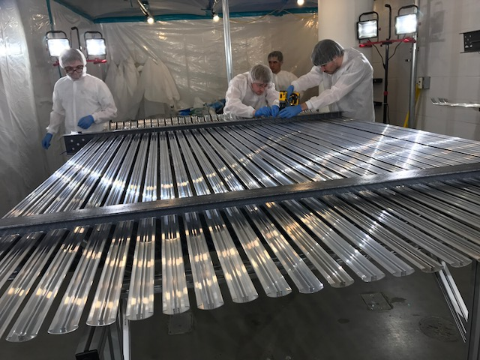
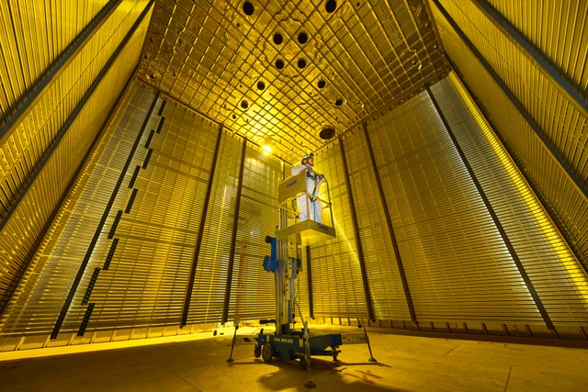
ProtoDUNE DP FC
Field cage parts preparation @ UTA
Installed FC @ CERN

Slide 4
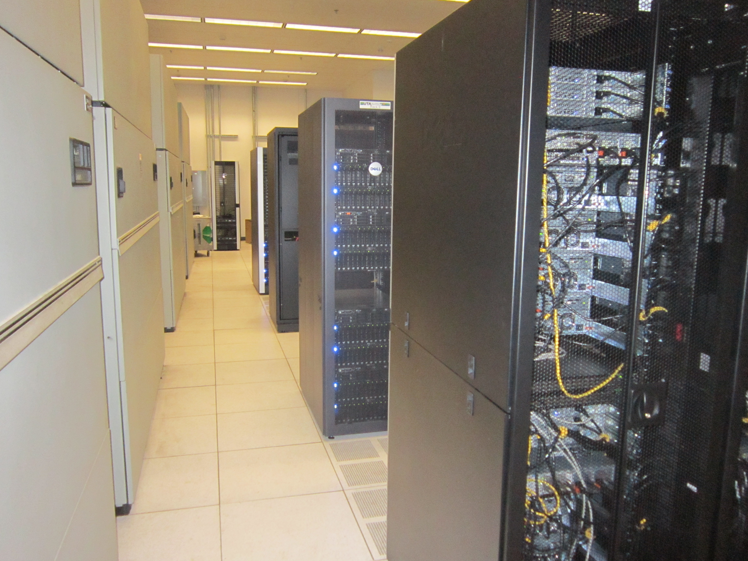
Infrastructure
A 500ft² gas detector development lab
A 500ft² TPC and Cold test lab
A 6000ft² detector construction area with 5 ton building crane
2000 ft² ATLAS Tier 2 center that hosts over 4000 cores and 2 PB of disks
A large office area for senior researchers, postdocs, graduate and undergraduate students
A 300ft² video conferencing room

Slide 5
People
2 Faculty
Jaehoon Yu (IR): DUNE, ICARUS, SBND + LArIAT & MiniBooNE data analysis
Jonathan Asaadi: LArIAT, MicroBooNE, ArgoNeuT, SBND, ICARUS, DUNE
2 PostDoctoral Fellows
Animesh Chatterjee: DUNE, ICARUS, SBND
Andrea Falcone: ICARUS, LArIAT, SBND
3 existing + 1 incoming Graduate Students
SBN program + DUNE
Undergraduate Students: A large number of high quality UG students available ➔ Currently over 10 students involved in IF projects

Slide 6
Faculty – Jae Yu
DUNE
Responsible for ProtoDUNE DP Field Cage and working on HV System and the Charge Readout Plane, Co-leading the BSM physics group
LBNE:
Coordinated detector R&D & Created the BSM physics group
ATLAS Experiment:
Led grid computing operations and user services; Contributed to Higgs discover and property measurements
ILC & Detector Development:
Led detector R&D test beam efforts and serving on the physics panel; Technical Board chair of the CALICE collaboration
NuTeV Experiment:
Led in-situ calibration construction, commissioning, operation and publication; Worked on LNV and sin²θ_{W} measurements
D0 Experiment:
Led commissioning of the upgraded D0 detector, Led design and implementation of the grid computing offline system; Search for Higgs

Slide 7
Faculty – Jonathan Asaadi
MicroBooNE and SBND
Led construction, installation, and commissioning of the MicroBooNE experiment as lead TPC expert
Involved in cross-section analyses on MicroBooNE
Co-spokesperson on the Liquid Argon in a Testbeam experiment (LArIAT)
First measurement of pion-argon hadronic cross-section
Commissioning and operating LArTPC’s & Opportunity to leverage joint studies of ICARUS & LArIAT
Collaborator on ArgoNeuT experiment
Lead analyzer on the first neutrino neutral current π⁰ measurement ever done on argon
Phys. Rev. D 96, 012006 (2017), arXiv:1511.00941
Contributor/Reviewer to many other analyses done by ArgoNeuT
First measurement of the cross section for ν_{μ} and ν_{μ} induced single charged pion production on argon using ArgoNeuT: Submitted to PRD, arXiv: 1804.10294
First Observation of Low Energy Electron Neutrinos in a Liquid Argon Time Projection Chamber: Phys. Rev. D 95, 072005 (2017), arXiv:1610.04102
The detection of back-to-back proton pairs in Charged-Current neutrino interactions with the ArgoNeuT detector in the NuMI low energy beam: Phys. Rev. D 89, 112003 (2014), arXiv:1405.4261
Experience with LArTPC detector R&D and neutrino phenomenology
SBN neutrino phenomenology: Phys. Rev. D 97, 075021 (2018), arXiv:1712.08019
LArTPC light R&D: Accepted by JINST, arXiv: 1804.00011
Pixel Readout for LarTPC’s: Submitted to JINST, arXiv:1801.08884
High Voltage Mitigation Studies: JINST 9 P09002 (2014), arXiv:1406.521

Slide 8
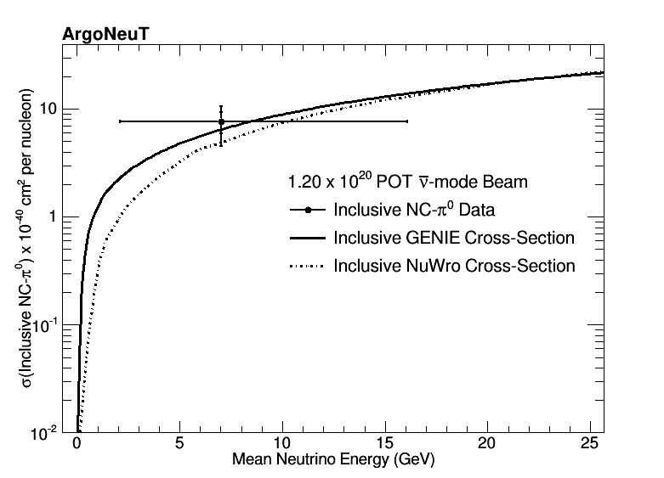
Physics Interests
Low Mass Dark Matter Searches
Search for sub-GeV DM produced in high intensity proton beams & Inelastic scattering of boosted dark matter
Oscillations
Neutral current π⁰ disappearance (SBND/ICARUS)
Leverage experience from previous analyses done on ArgoNeuT
Cross-Sections
NuMI off-axis cross-sections of relevance to DUNE
e.g. Charged Current Coherent Pion production
Starting a similar analysis in MicroBooNE now
Analysis technique which will be used in DUNE near detector
Compare to results published in similar energy regime (e.g. Minerva)
Explore the low-nu method (E_{n} – E_{lepton} ~ “small”) and/or attempt neutrino electron scattering
Energy regime and techniques of interest to DUNE and not previously measured on argon

Slide 9
Detector System Interests
Proposed developing software trigger system
UTA post-doc (A. Falcone) participated in the refurbishment of the PMT system
Currently working on the simulation of the light and the PMT system response
Integrating this work into proposed software trigger
Interested in assisting in the commissioning and operations of the PMT and various TPC systems in general
Leverage experience from MicroBooNE, LArIAT and ProtoDUNE as well as collider experiments

