Slide 1
Installation and Commissioning Overall Schedule
C. Montanari
FNAL – INFN
ICARUS Meeting – May 13, 2018

Slide 2
Foreword (I)
The overhauling activities of the T600 detector are defined in the first MoU between CERN and INFN for Collaboration in the CERN Neutrino Program (Neutrino Platform) signed on November 25, 2014.
This Memorandum details the deliverables required to upgrade the detector as needed in order to operate according to the proposal for the Short Baseline Neutrino Program.
Readout electronics, DAQ and installation at FNAL are not included.

Slide 3
Foreword (II)
An addendum to the Memorandum of Understanding between CERN and INFN was signed the 27th of October, 2016 to cover the detector installation at FNAL, the readout electronics and the other activities required to make the detector ready for operation.
An agreement between DoE/FNAL, MIUR/INFN and CERN was recently signed to define the the delicate matter of ownership of the detector components, that are in part procured by FNAL and that are taken to Fermilab by the European partners.
Additional implementation agreements have to be made to cover the activities of pre-commissioning, commissioning and run of the experiment.

Slide 4
Present status
After the completion of the two detectors overhauling at CERN and their insertion in the new aluminum cold vessels (March 2017), the two detectors have been transported to Fermilab (July 2017).
Between May and August 2017, the lower part of the warm vessel has been assembled inside the Far Detector building at FNAL.
Starting from the second half of 2017, the procurement of materials for the construction of the cold shields, to be installed in the warm vessel before the cold vessels, was initiated. All materials are now at Fermilab and the assembly of the cold shields is expected to be completed by end of May 2018.
The operations for the precise positioning and alignment of the cold vessels have been completed. Installation of the detector supports is in progress.
The contract for moving the two cold vessels in the final position was assigned in March 2018. The rigging plan is expected to be finalized by end of May 2018. As part of this activity, the capacity of two cranes of the building has been recently upgraded to 30 metric tons.

Slide 5
Present status (cont.)
Before moving the cold vessels in the final position, the main doors of the vessels have to be sealed. A helium leak tests will be performed after the sealing. This activity is expected to take place between mid May and Mid June.
The positioning of the two cold vessels is expected to take place by end of June 2018.
Starting from 2016 a number of other activities are being carried out:
The design and procurement of the cryogenics and purification systems (CERN);
The design procurement and test of the wires readout electronics, decoupling boards, feedthrough flanges, power supplies, crates (see A. Guglielmi presentation);
The procurement and test of the PMTs readout electronics, feedthrough flanges, laser calibration system, power supplies (see G.L. Raselli presentation);
The development of the slow control system (see A. Fava presentation);
The design, procurement, test and pre-assembly of the CRT system (see A. Schukraft presentation);
The development of the DAQ architecture and of the trigger system and the procurement and test of related equipment.
Several development activities are being carried on in common with the Near Detector (common Working Groups).

Slide 6
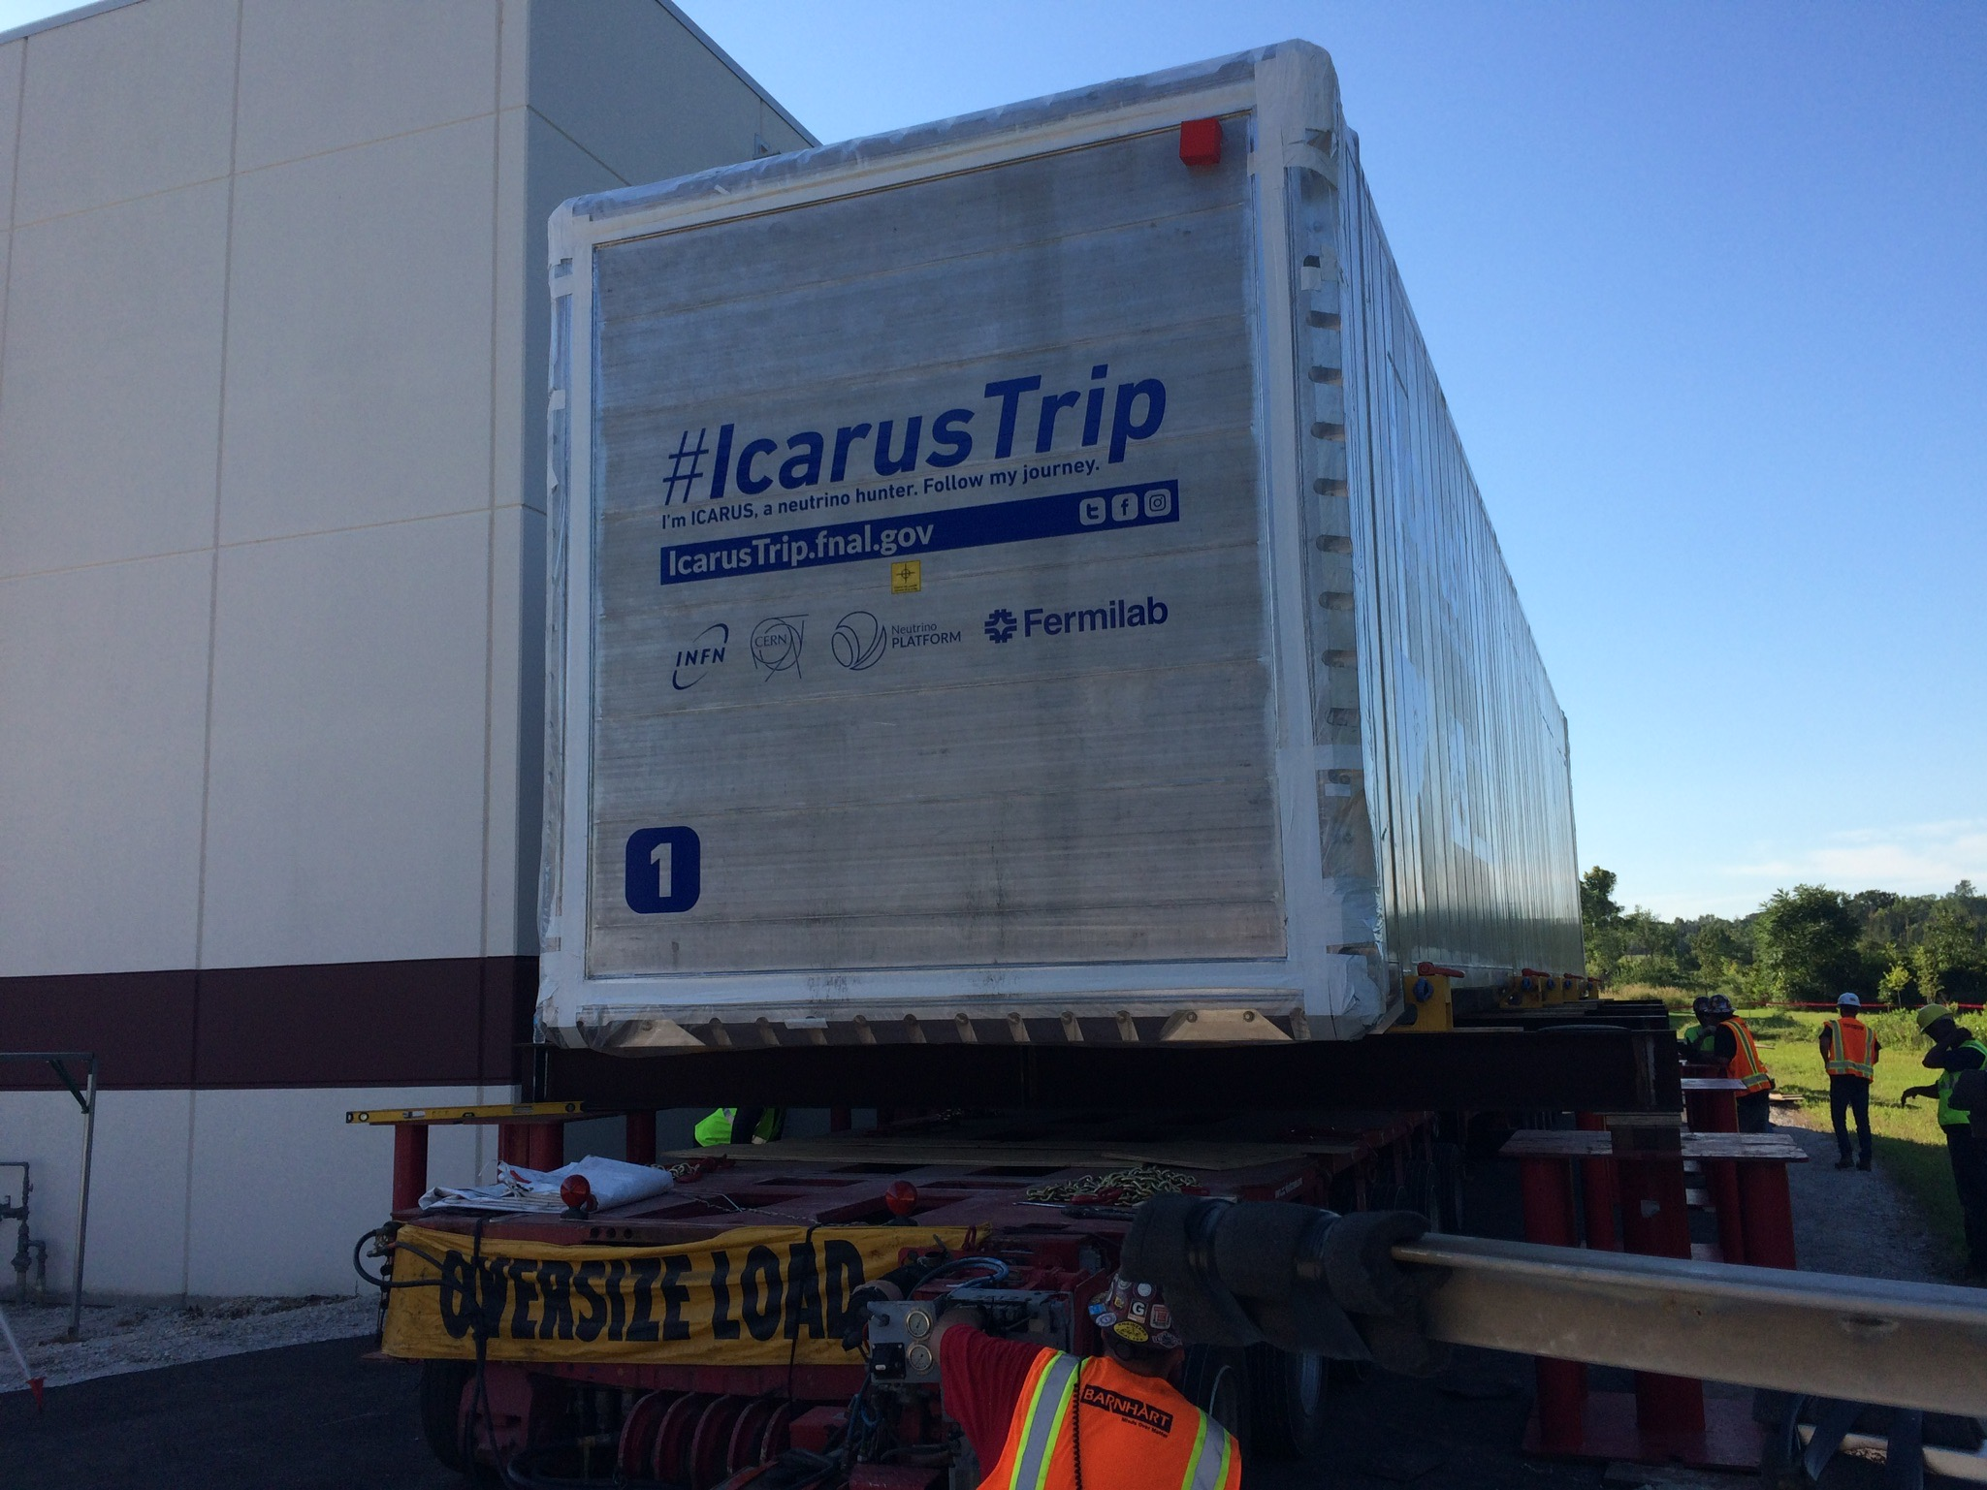
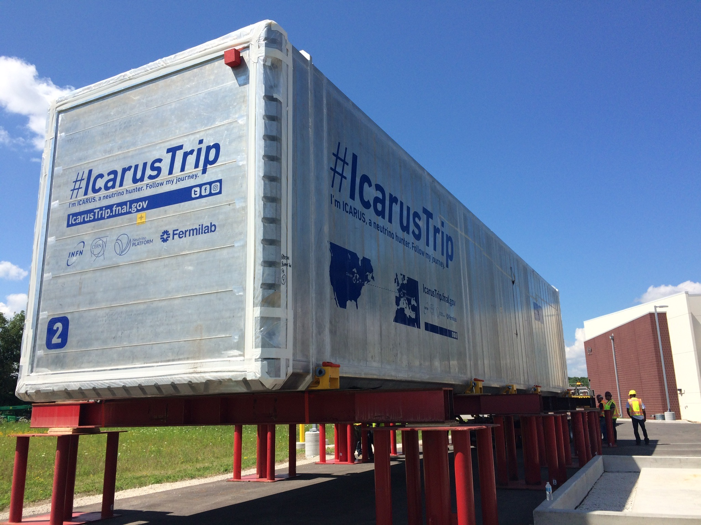
Detectors at FNAL

Slide 7
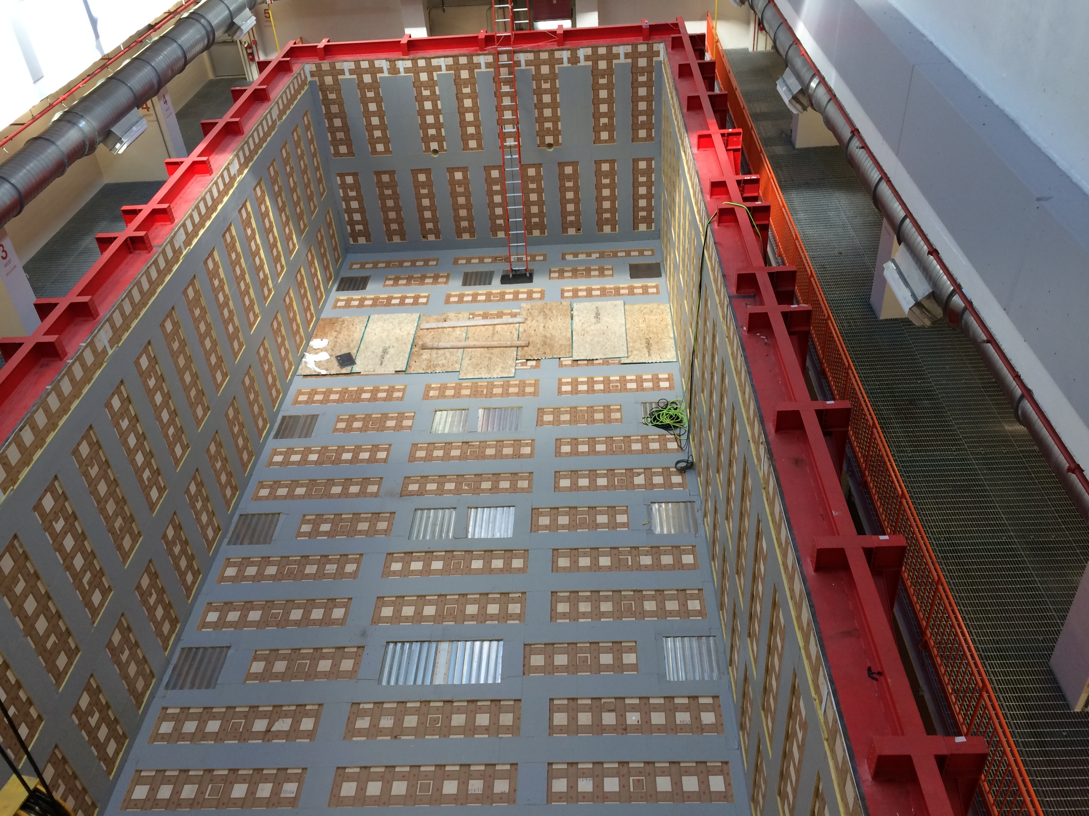
Warm Vessel in the FD building

Slide 8
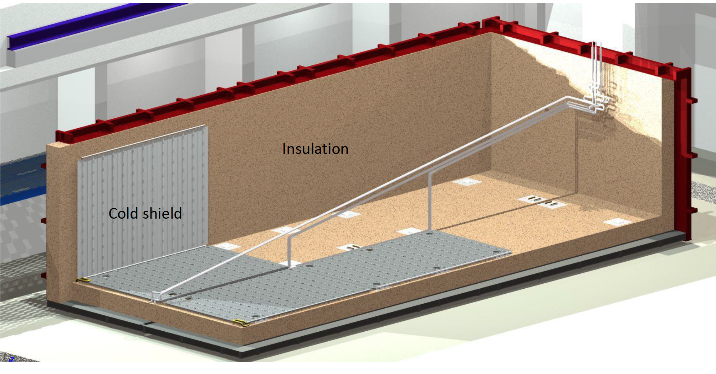
Ongoing/imminent activities
Door welding & vacuum tests
Cold shields assembly & installation

Slide 9
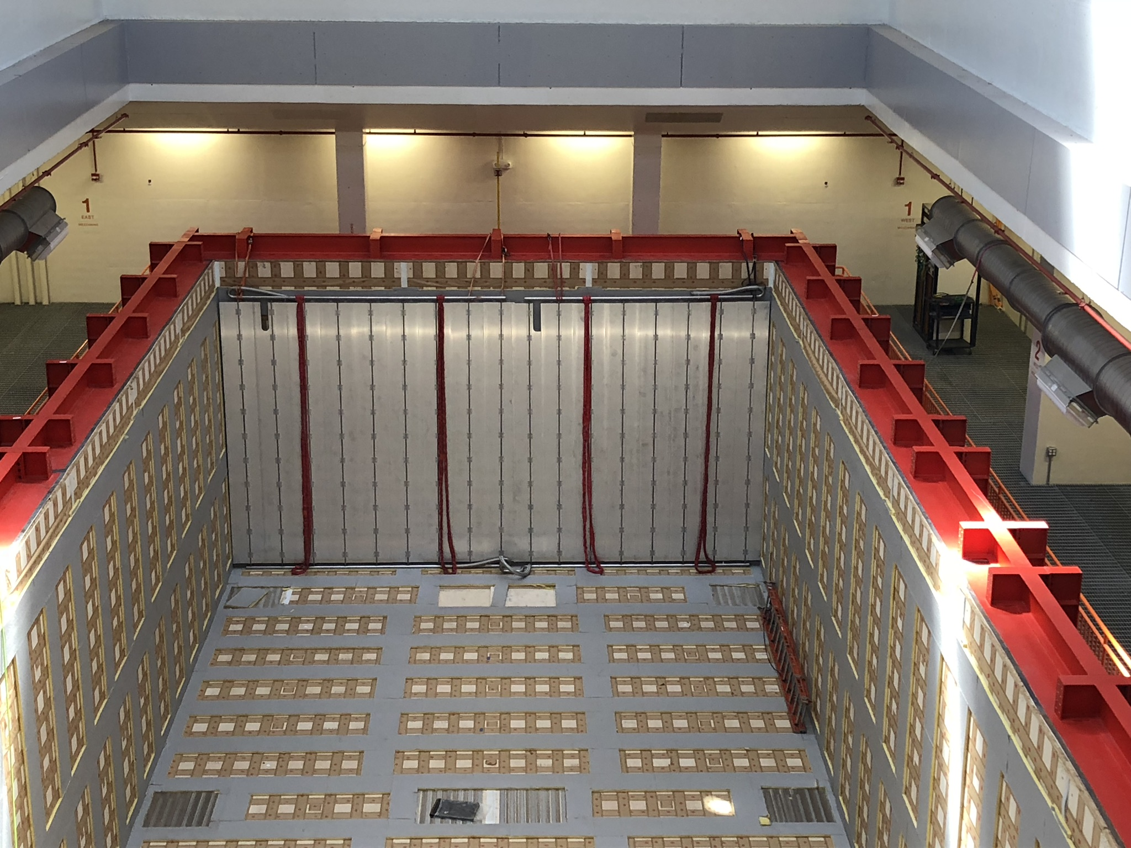
Cold Shield panels on the South Wall

Slide 10
Detector Installation (I)
As soon as the two cold vessels are in the final position, all the connections between the cold vessels and the outside of the thermal insulation (chimneys) have to be installed. At the same time we are going to enter the cold vessels to put in place the resistances of the voltage divider for the drift field and to perform some additional operations. The ports of the manholes will be then welded. A helium leak test on the manholes and on the chimneys will be performed before proceeding with additional installations. Connectivity tests have to be performed as part of the installation of the chimneys (from end of June to end of July).
The top part of the cold shield will be installed and tested, followed by the installation of the top part of the warm vessel (from mid July to end of August).

Slide 11
Detector Installation (II)
As soon as the two cold vessels are in the final position, all the connections between the cold vessels and the outside of the thermal insulation (chimneys) have to be installed. At the same time we are going to enter the cold vessels to put in place the resistances of the voltage divider for the drift field and to perform some additional operations. The ports of the manholes will be then welded. A helium leak test on the manholes and on the chimneys will be performed before proceeding with additional installations. Connectivity tests have to be performed as part of the installation of the chimneys (from end of June to end of July).
The top part of the cold shield will be installed and tested, followed by the installation of the top part of the warm vessel (from mid July to end of August).

Slide 12
Detector Installation (III)
Starting from September 2018 the installation activities on top of the detector will take place. These include:
Installation of the crosses;
Installation of the decoupling boards;
Installation of the feedthrough flanges for the wires, the PMTs, the optical fibers;
External cabling;
Installation of the readout electronics for the wires;
Installation of the vacuum pumping system and of the related equipment;
Installation of the CRT modules (can start earlier, installation of modules on the top, the inclined parts, should start in October or November 2018).
Also starting from September, in parallel with the above activities, all the equipment of the cryogenics and purification systems will take place and will require several weeks.
The electronics for the supply and readout of the PMTs and for the DAQ will be located on the mezzanine.
The possible interferences between the various activities are being and will be analyzed in detail as the work will progress.
As part of the installation activities a number of pre-commissioning tasks and tests should be performed. While pre-commissioning tasks are unavoidable, the extent of the testing during this and the following commissioning phases critically depends on the availability of people. The quality of the data run will be, most likely, strongly affected.

Slide 13
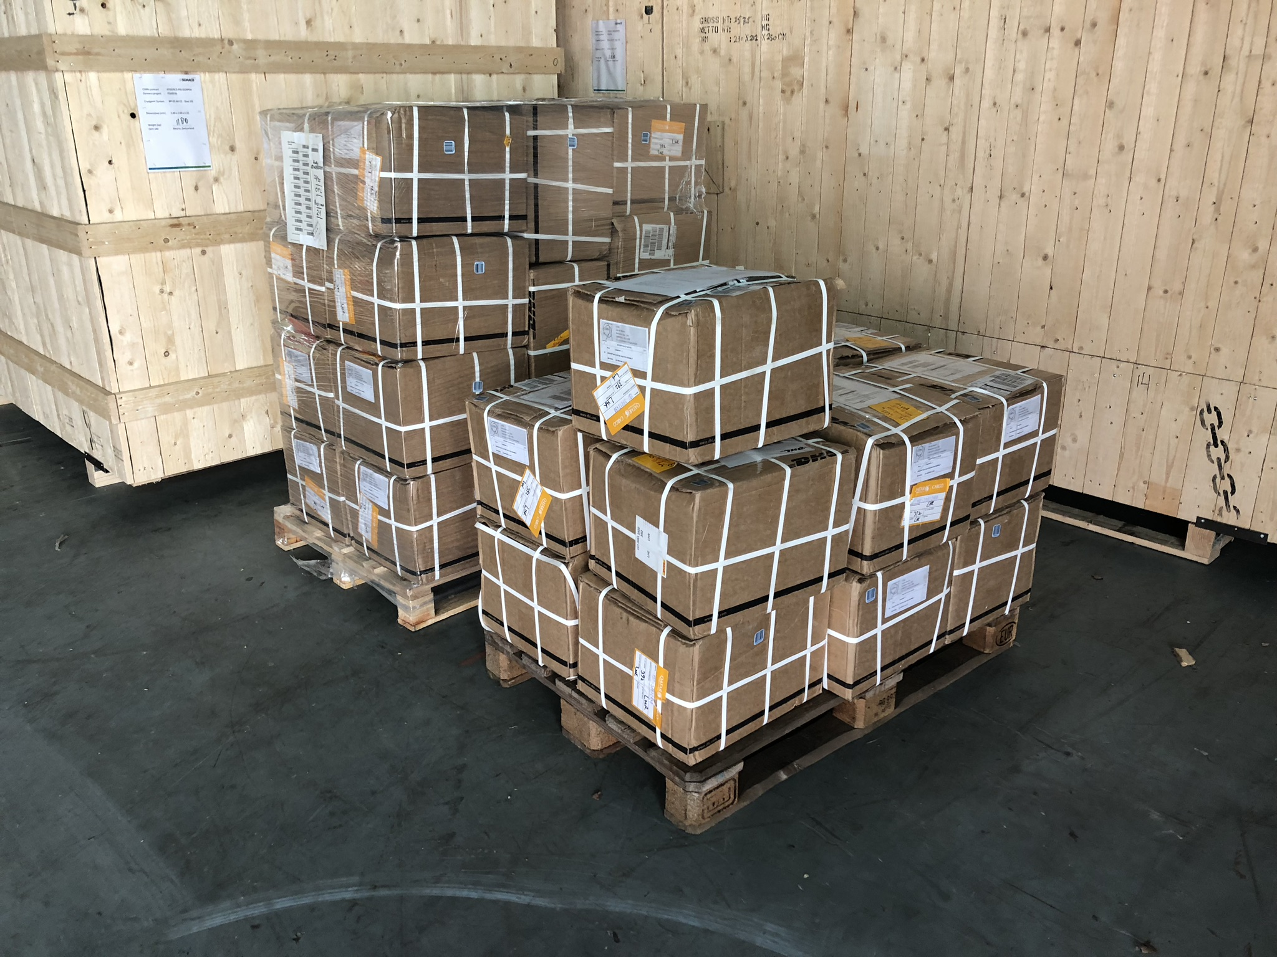
Lot of materials still to be transported from Europe
Cryogenics and purification systems
Crates for electronics
Top of the warm vessel; Electronics, Power Supplies,
Cables, Racks, Flanges, Crosses, and more..

Slide 14
ICARUS installation…
Design of ICARUS-T600 installation in SBN-FD building

Slide 15
A much less crowded top thanks to the new electronics …
The T600 top in Gran Sasso

Slide 16
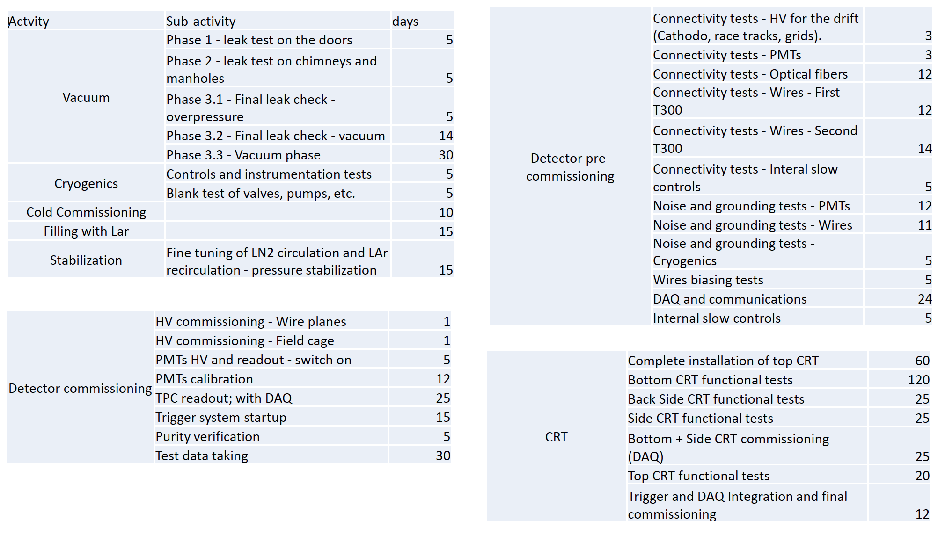
Bird’s-eye view of detector commissioning

Slide 17
Detector Commissioning (I)
Between October and November 2018 we should be able to start pumping the vacuum inside the cold vessels. This phase will last until we will be ready to start the cooldown (January or February 2019).
In this period the testing of the DAQ, noises, PMTs, Slow controls, etc. should continue.
Installation and pre-commissioning of the cryogenic systems will be completed.
Start of cooling is bound to the “clearance to start operation” issued by Fermilab.
Before the start of the final commissioning the organization of the running (run coordination) has to be well defined.

Slide 18
Detector Commissioning (II)
The detector commissioning consists of three phases:
Cryogenic commissioning:
Cooling (15 days), Filling (15 days), Purification (1 month), Stabilization (1 month). Two months in total.
TPC and PMT system commissioning:
HV for the drift, PMTs supply, calibrations, DAQ commissioning, trigger commissioning. (2 months in total).
CRT commissioning:
The installation of the top part of the CRT will be completed after the stabilization of the cryogenics and purification systems;
The other parts of the CRT can be installed and commissioned in parallel with the activities for the completion of the cryogenics and the TPC and PMT system commissioning.

Slide 19
Conclusions
The two cold vessels should be moved in their final location during June 2018.
The operations for installation on top of the detector will start between June and July 2018 with the installation of the chimneys. They will continue with the installations of all the rest of the equipment, starting from September 2018 and until the start of the final commissioning of the apparatus that will take place, hopefully, at the beginning of 2019.
In this phase, pre-commissioning and thorough test of the detector sub-components will be crucial for a successful physics run.
The organization of the detector run is an important phase of the detector pre-commissioning and commissioning.

