Slide 1
T600 HV System for the Drift Field
C. Montanari
FNAL – INFN
ICARUS Meeting – May 14, 2018

Slide 2
Foreword
The HV system for the drift field is composed by:
  Cathode;
  Race-tracks;
  Feedthrough;
  Divider chain;
  Power supply;
  Control system.
All equipment has been procured and is already part of the TPC or ready for installation.
The installation, pre-commissioning, commissioning and handling of the HV system for the drift are specific responsibilities to be taken from the Collaboration.
The one of the HV system for the drift is the most delicate Single Point Failure of the LAr TPC.

Slide 3
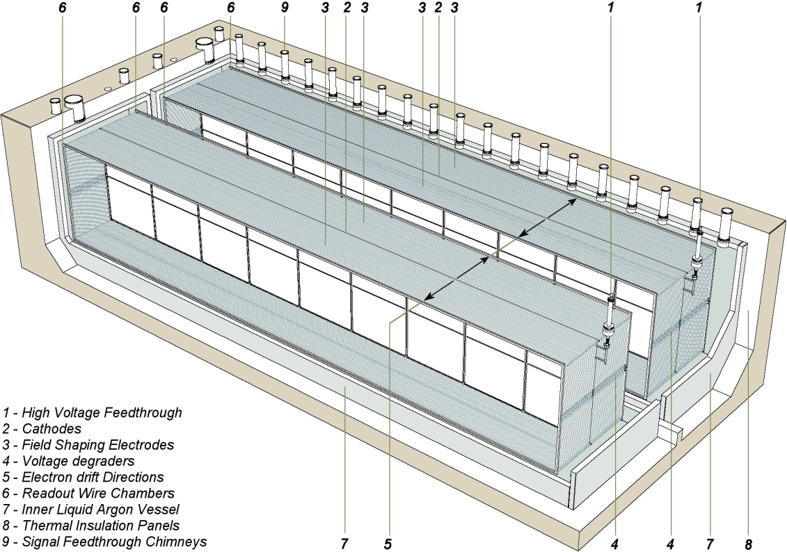
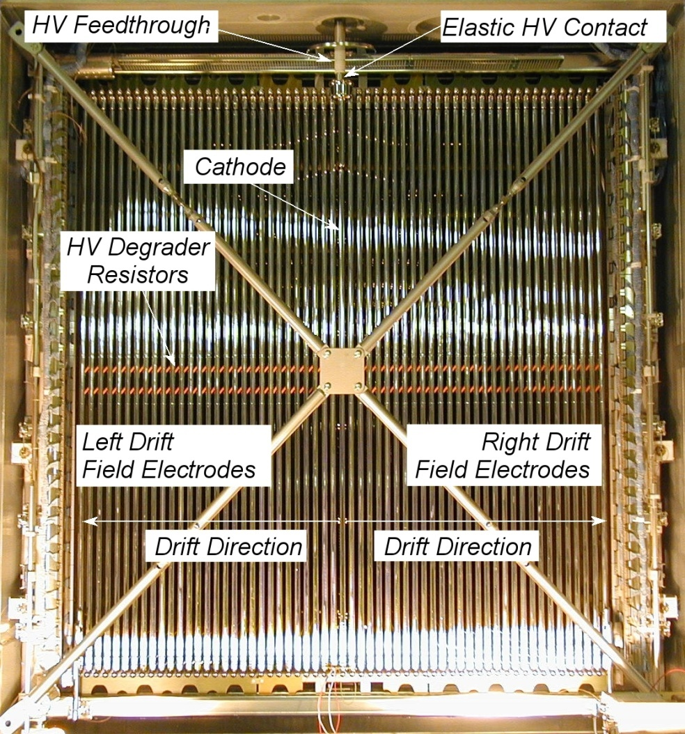
HV system for the ICARUS T600 detector
3m
3.2m
18.1m
3

Slide 4
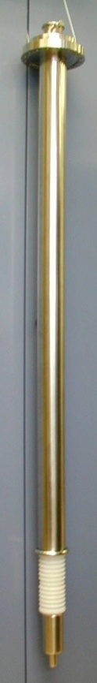
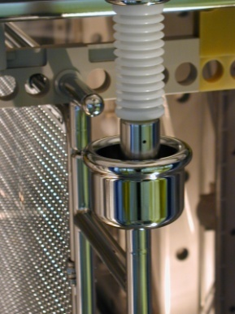
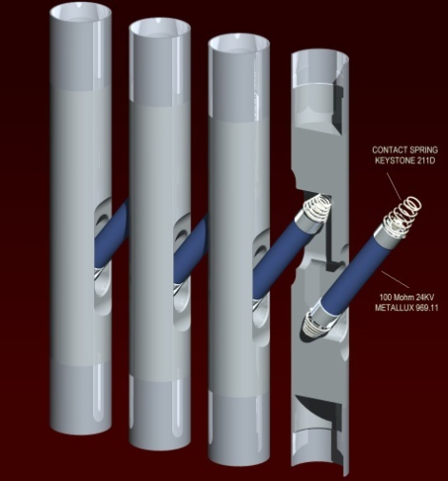
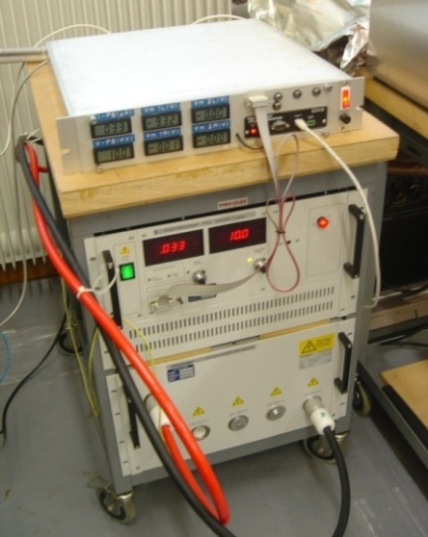
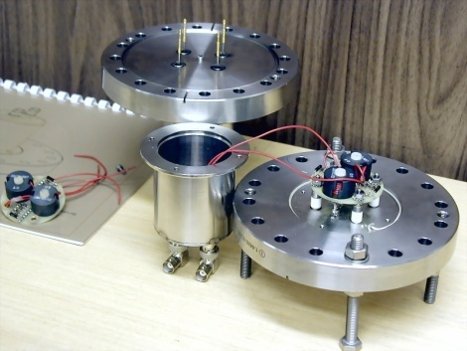
ICARUS – HV system
  HV monitoring at the end of the voltage degrader resistive chain
  HV FT
  HVFT-Cathode Elastic HV contact
  Design of field shaping electrodes and HV degrader.
  Each half-module is surrounded by 30 filed rings. Between each pair of field rings there are 4x100 MOhm resistors in parallel (= 25 Mohm).
  One of the 4 resistors between the last ring and GND has an intermediate contact with 0.3 Mohm vs GND.
  Vmon = 0.0004 Vcathode (40V for Vcathode=100kV)
  LV monitor FT
  HV PS, HV distributor, remote control module
4

Slide 5
ICARUS – HV distribution and control system for one half-module
5

Slide 6
ICARUS – HV distribution for 2 half-modules and Residual ripple filter
HV cable 2-L
HV cable 1
HV cable 3-R
  Residual ripple attenuation
  @ 37.45 KHz : 1/28
  @50 Hz : 1/3.5
6

Slide 7
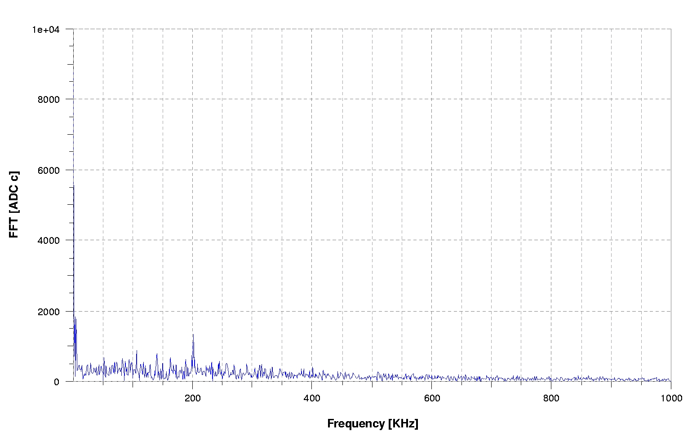
ICARUS – FFT on 1st induction plane
Run: 818
Event: 2
Plane: INDUCTION 1/LEFT
Wire: 50
HV: –75 kV
37.45 kHz
Power Supply Switching Frequency
7

Slide 8
ICARUS – HV Operation at LNGS during ~3.14 years
Automatically registered:
21/05/2010 – 25/05/2010 4 days Left M: 75 kV / 185 uA Right M: 3.4 kV / 22 uA
26/05/2010 – 27/05/2010 2 days 0 kV 7 0 uA 0 kV / 0 uA
28/05/2010 – 01/06/2010 5 days 75 kV / 400 uA 3.4 kV / 22 uA
01/06/2010 – 01/06/2010 1 day 99.9 kV / 501 uA 99.9 kV / 509 uA
01/06/2010 – 27/06/2010 27 days 75 kV / 400 uA 75 kV / 413 uA
27/06/2010 – 21/07/2010 25 days 76.850 kV / 400 uA 76.760 kV / 413 uA
21/07/2010 – 03/08/2010 14 days 0 kV / 0 uA 0 kV / 0 uA
03/08/2010 – 07/12/2010 127 days 76.750 kV / 400 uA 76.680 kV / 413 uA
07/12/2010 – 19/12/2010 13 days 0 kV / 0 uA 0 kV / 0 uA
19/12/2010 – 23/01/2011 39 days 76.640 kV / 400 uA 76.540 kV / 413 uA
24/01/2011 – 16/02/2011 24 days 0 kV / 0 uA 0 kV / 0 uA
16/02/2011 – 09/04/2011 59 days 76.620 kV / 400 uA 76.560 kV / 413 uA
09/04/2011 – 05/06/2011 58 days 0 kV / 0 uA 0 kV / 0 uA
05/06/2011 – 16/02/2012 257 days 76.600 kV / 400 uA 76.500 kV /413 uA
16/02/2012 – 16/02/2012 1 day 0 kV /0 uA 0 kV / 0 uA
16/02/2012 – 28/03/2013 406 days 76.750 kV / 400 uA 76.700 kV /413 uA
29/03/2013 – 01/06/2013 64 days 0 kV /0 uA 0 kV / 0 uA
02/06/2013 – 02/06/2013 1 day 92.100 kV / 481 uA 92.010 kV / 493 uA
02/06/2013 – 04/06/2013 3 days 74.600 kV / 553 uA 74.460 kV / 551 uA
04/06/2013 – 05/06/2013 2 days 100.026 kV /261 uA 74.500 kV / 551 uA
07/06/2013 – 27/06/2013 21 days 76.750 kV / 401 uA 76.660 kV / 413 uA
Not automatically registered:
June 2013 2 days 150 kV (HV splitter partially disconnected) 74.5 kV /551 uA
8

Slide 9
Conclusions
The HV system for the drift requires a relatively small activity for installation (divider chains, feedthroughs, power supply, control system).
On the other hand it requires a very thorough test and pre-commissioning procedure to minimize the chance of failure.

