Slide 1
TD Operations Status
Guram Chlachidze
All Experimenters and Laboratory Status Meeting
March 26, 2018

Slide 2
Cryogenic Sector
LCLS-II Procurements
Distribution Boxes – Fabrication continues at vendor, delivery expected in July
Surface Transfer Line Procurement – Visited vendor last week to check fabrication progress, delivery expected in May
Providing SLAC with guidance on installation activities for tunnel components
Mu2e Procurement
Distribution Box – Fabrication in progress, delivery expected in early May
Feed Boxes – Best value technical and cost evaluation complete. To be awarded soon
HL-LHC AUP
Working toward understanding the impact of performing all or partial magnet training at Fermilab instead of BNL
Meson Controls Upgrade
Project is underway in parallel with existing controls, preparing for system shutdown in June to switch system over
PIP-II Activities and Procurement
External Cave Transfer Line fabrication in progress (in-house), all sections completed except for final tie-in piece
PIP-II Cave Transfer Line procurement, delivery expected in May/June, visited vendor last week
Preparing for field installation at CMTF beginning with the external cave TL segments and supports followed by cave TL (once it arrives from the vendor)
Sub-Kelvin Cryogenics
SuperCDMS Snolab – CD2/3 ESAAB delayed until May due to budget and funding profile details still to be resolved within the Office of Science
ADMX – Procurement of dilution refrigerator has been delayed due to vendor refusing to sign DOE vendor liability contract. Exploring options with legal
Nexus – Refrigerator delivery later in April, NuMI hall preparations proceeding well
Quantum Lab – Final ORC cryogenic approval given
Facilities:
Meson Detector Building: Spoke cavity testing in STC, 3.9 GHz LCLS-II cavity testing in HTS
Cryomodule Test Facility: LCLS-II F1.3-09 CM measurements finish this week
Industrial Building 1: VTS stands: Five R&D and two LCLS-II cavities tested last week; Stand 3: one LCLS-II magnet
Muon Campus: Supporting g-2 operation
Heavy Assembly Building: Refrigerator cooled down for test cryostat Head B commissioning

Slide 3
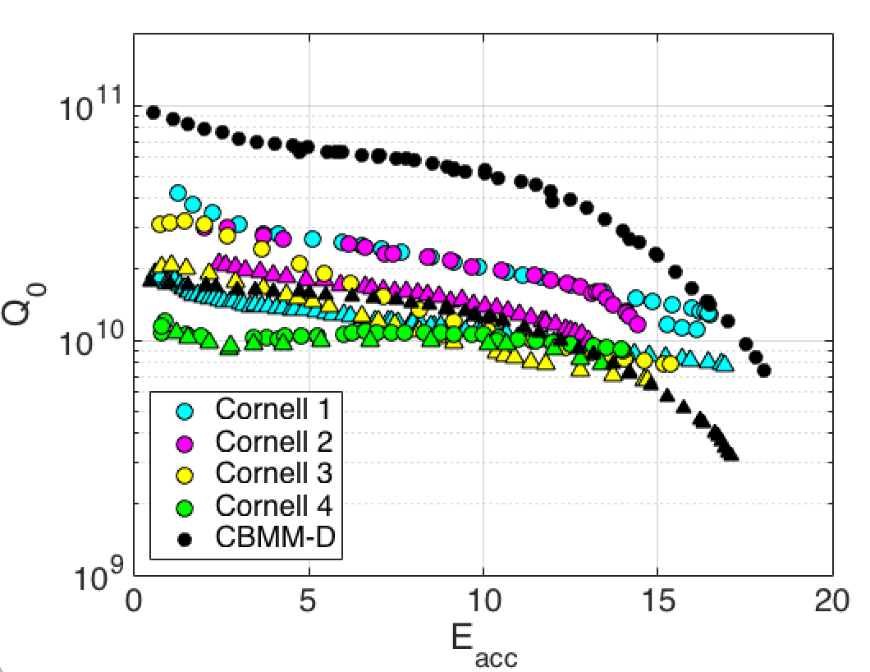
SRF Sector
R&D
Quantum computing measurement continues. A 5 GHz cavity was tested, no global heating was observed. More studies should be conducted to understand the lack of global BSC related cavity heating.
High Q₀ high gradient: Nitrogen infusion program continues.
Nb3Sn group continues cavity preparation and coating. One cavity had a very nice coating appearance. New tests were completed, showing low field Q more than doubled compared to last best result from Cornell University. Q-slope was still present and gradient is low.
High field Q slope: HF rinsing study is in progress
Plasma processing continues.
Nb/Cu vacuum chamber installation is in progress.
S. Posen

Slide 4
SRF Sector
LCLS-II 1.3 GHz Cryomodules
A new BPM assembly procedure and hardware continues to be successful following thermal cycle testing. A Quality Assurance Audit is in progress. Future BPM will use Grade 5 Titanium studs and stainless steel nut. More tests of the BPM assembly procedure are expected this week.
CM03 dis-assembly was completed. Rebuild started as a filler job between cryomodules.
CM02, CM04 and CM05 beam line were back filled and warm end coupler were dis-assembled. They are ready for extraction and repair BPM. Actual repair is pending for approval.
CM06 is still at SLAC due to BPM leak. A dummy cryomodule will be shipped to get vibration data first
CM07 is transported back to ICB to fix BPM. It is being back filled to atmosphere pressure to prepare for BPM fix.
CM08 Helium circuit leak check was completed. BPM fix is planned pending SLAC approval.
CM09 tests at CMTF test cave were completed. A warm-up review is scheduled today.
CM10 is in WS3. BPM fix is on hold before thermal shield weldment.
CM11 WS1 resumed as BPM solution is finalized.
CM12 WS0 completed.
CM13 cavities were identified
LCLS-II Cavity Preparations
1.3 GHz: Fresh vendor cavity CAV0241 and re-HPR CAV0240 were qualified.
3.9 GHz: Tuner test was completed successfully in the Horizontal Test System cryostat. Helium vessel heater test is expected this week.
PIP-II
Spoke Cavity S111 Coupler installation experience a leak that was fixed with a new coupler. Cold test ~Mar 26
Spoke Cavity S112 was qualified in STC with no field emission. Coupler installation next
1-cell 650 MHz cavity encountered electro-polishing issue, investigation in progress.

Slide 5
Magnet Sector
HL- LHC, AUP
Coil fabrication for the LHC inner triplet quadrupoles continues
Electrical checkout of MQXFS1d short model will be completed this week.
Preparation in progress for Magnet Design Criteria Review at CERN.
LCLS II
Test & qualification of the quadrupoles continues: SPQA128 has been warm measured and surveyed. SPQA129 cold test started.
Mu2e
First Transport Solenoid production unit is in-house, electrical part of he incoming inspection is complete. Survey and magnetic measurements are expected this week.
The coils for next TS unit have all been completed, shells are nearly complete.
Dished Head B passed all warm tests in HAB, completed wrapping MLI over He pipes, zero-magnet (shorted bus) cold commissioning test to start this week.
Dished Head A – getting ready for the first production unit test in April.
G-2
Baking the spare MSE core is complete.
Outer coil winding for the new inflector has been begun.
MDP 15-17 T dipole R&D
Coil fabrication for 15 T dipole continues. Reaction of the inner coil started last week.
Mechanical model assembly is complete, set up is prepared for strain gauge studies.
Accelerator Support
Nova M1 dipole integral field measurements completed.
MSD184 sextupole thermal test performed.
Our technicians repaired a leaking dipole magnet at the switchyard.

