Slide 1
Accelerator Division Status
Daniel Johnson
All Experimenters’ Meeting/Lab Status Meeting
26 March 2018

Slide 2
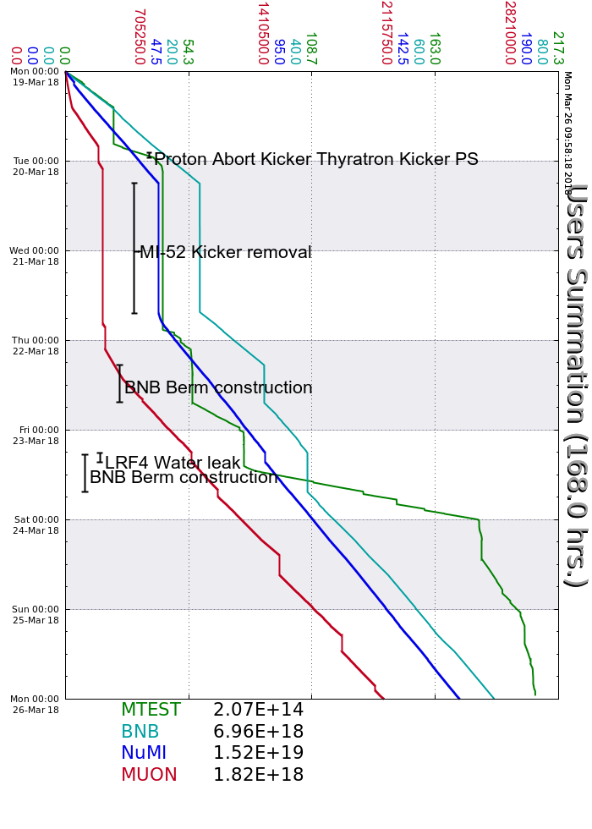
Accelerator Operations Summary
From: March 19, 2018 (0000 hours)
To: March 26, 2018 (0000 hours)
Calendar Week # 12
NuMI Weekly Integrated Intensity 1.52 E19 protons
Beam Hours To NuMI 126.9 hours
BNB Weekly Integrated Intensity 6.74 E18 protons
Beam Hours To BNB 111.1 hours
Muon Weekly Integrated Intensity 1.82 E18 protons
Beam Hours To Muon 105.3 hours
MTest Weekly Integrated Intensity 2.07 E14 protons
Beam Hours To MTest 76.5 hours
MCenter Weekly Integrated Intensity 0.00 E12 protons
Beam Hours To MCenter 0.0 hours

Slide 3
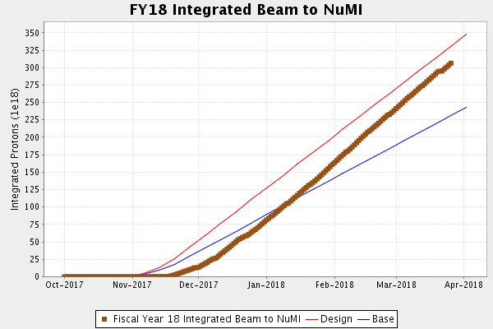
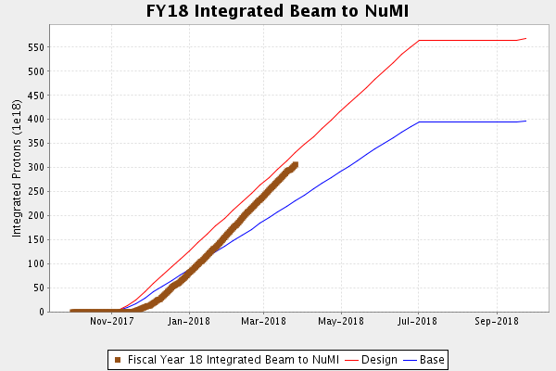
NuMI Operation

Slide 4
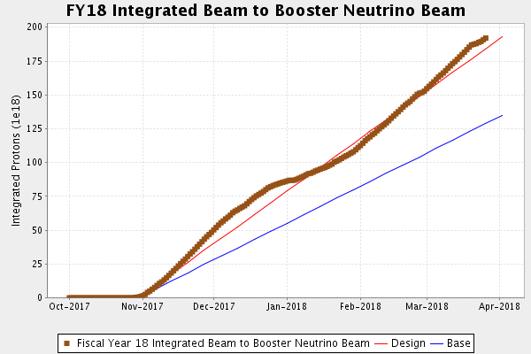
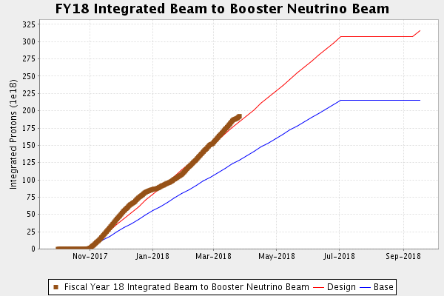
BNB Operation

Slide 5
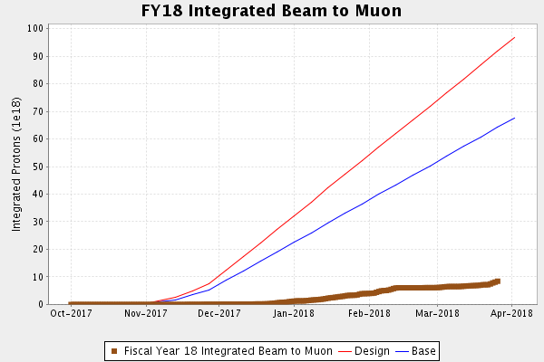
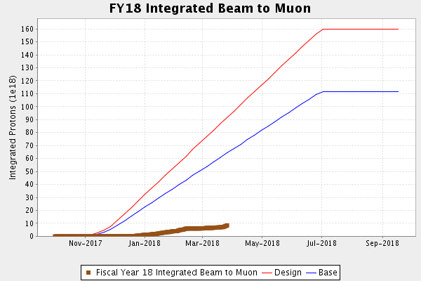
Muon Operation

Slide 6
Complex Status
LINAC
  Laser Notcher operational
Booster
  Tuning continues
MI/RR
  Tuning continues
  Study request
NuMI
  ~650kW with SY
  >710kW without SY
Booster Neutrino Beamline (BNB)
  Stable operation
  BNB off during the day for berm work Monday, Tuesday & Wednesday?
Switchyard
  Meson Test taking beam
Muon Campus
  Tuning & studies
  g-2 operation
  16 pulse test looking good
General

Slide 7
PIP-II Injector Test & FAST/IOTA Status
PIP-II Injector Test
  Starting Up
    All RF components operating in CW mode
    Working on delivering higher power beam to the dump
    Testing MPS operation
    April/May Cryo work shutdown
FAST/IOTA
  All ion pump cables have been terminated.
  BPM terminations are nearly complete at the electrical service building.
  IOTA LCW manifold testing continues.
  Power supplies for the RadialBeam quads should arrive next week.
  Controls installation for the ring power supplies should begin next week.
  Installation of the RF cavity beamtube should be completed within 2 weeks.
  Assembly and leak checking of IOTA vacuum spools continues at CMTF.

Slide 8
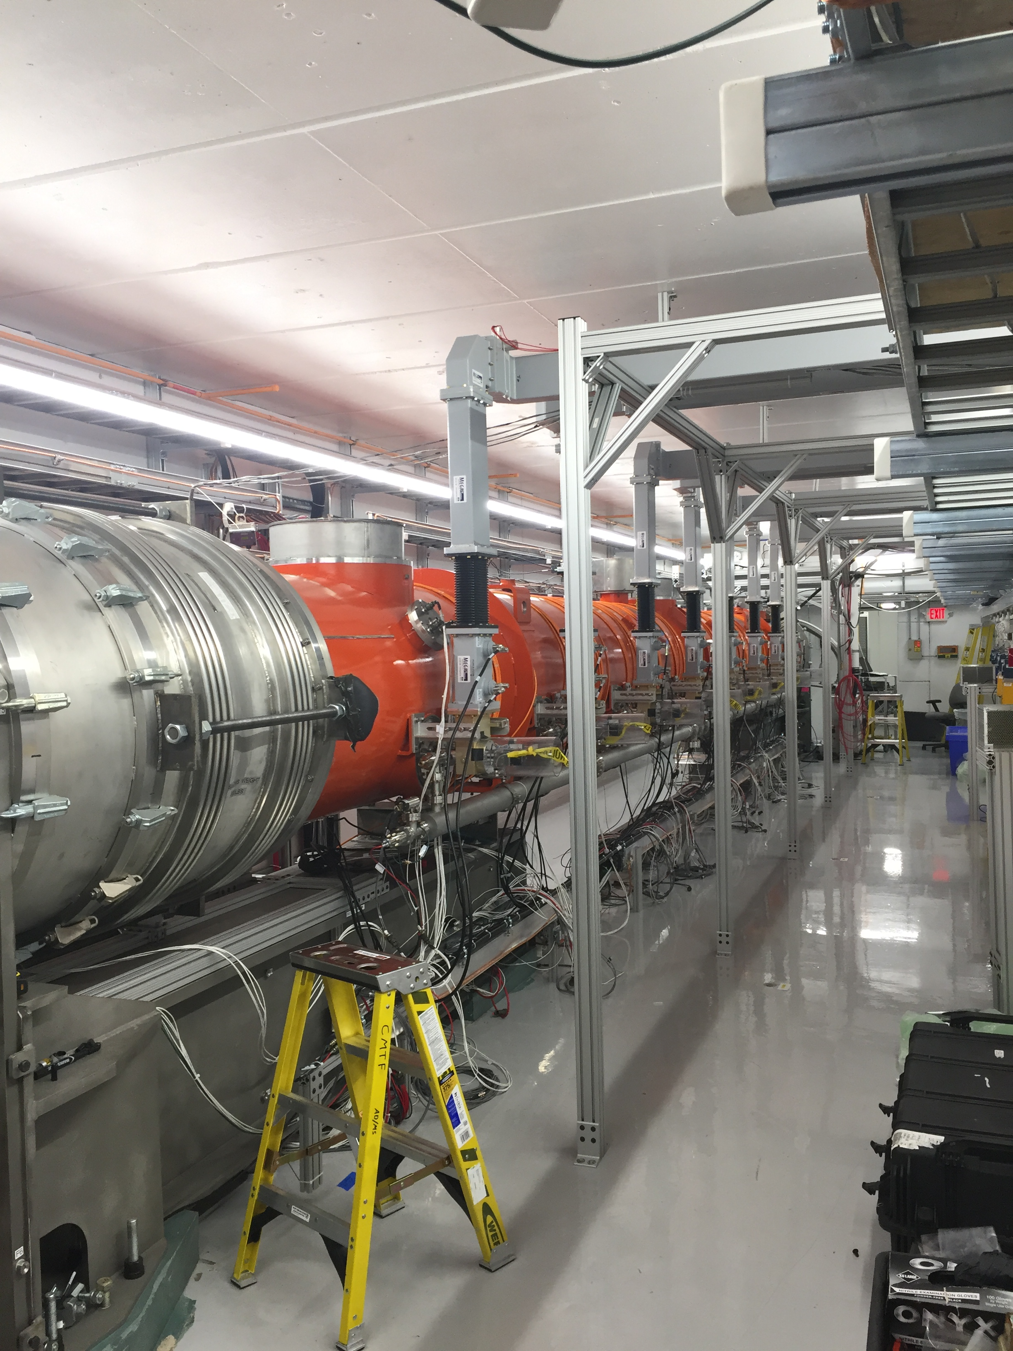
CMTS1 Status
LCLSII Cryomodule F1.3-09
  Testing to conclude this week
  Module has performed well
Cyro Cold Compressor R&D
  2-3 days this week
  Full warm up next week
LCLSII Cryomodule F1.3-07
  Best module
  Being instrumented for move to SLAC

Slide 9
Schedules and Links
Schedule can be accessed from the Operations Department Home Page
  Schedules -> Operations Schedule
Direct link to schedule
  http://www-ad.fnal.gov/ops/schedule.html

