Slide 1
Muon Collider– History and Status
Ronald Lipton
Most analysis by Vito Di Benedetto, Anna Mazzacane, Nikolai Terentiev

Slide 2
Some History
A focused accelerator R&D program, MAP, was launched in 2010 to study the feasibility of a muon-based collider program
  There were a number of earlier studies
  A small detector conceptual study was also launched to study the physics potential and associated detector issues
Snowmass studies were based on a simulation of a 1.5 TeV muon collider, with parametric studies of a Higgs factory.
As a result of the 2013/14 P5 process the MAP program was terminated
  This also led to a termination of physics studies
  Some work was not properly documented
I will not discuss the accelerator design feasibility or status.
  A great deal of work was done – but much work is still needed to validate the concept.

Slide 3
Collider Context
LHC results seem to indicate that any new physics spectrum is likely to be in the multi-TeV range.
This is problematic for e⁺e⁻ machines due to power lost to radiation.
Muon collider seems to be the only high luminosity lepton collider candidate capable of affordably delivering CM energies >3 TeV
Other advantages:
  Narrow beam energy spread can enable precision physics
  Muon Collider has x 40,000 higher coupling for s-channel Higgs
  Precise (~4 MeV) Higgs mass measurement
    Enabled by precise beam energy measurement by g-2 precession (Raja & Tollestrup)

Slide 4
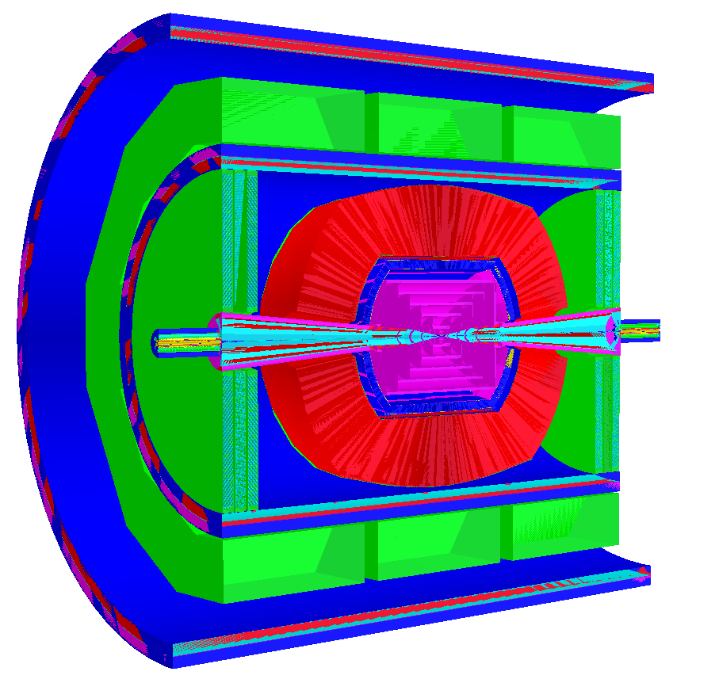
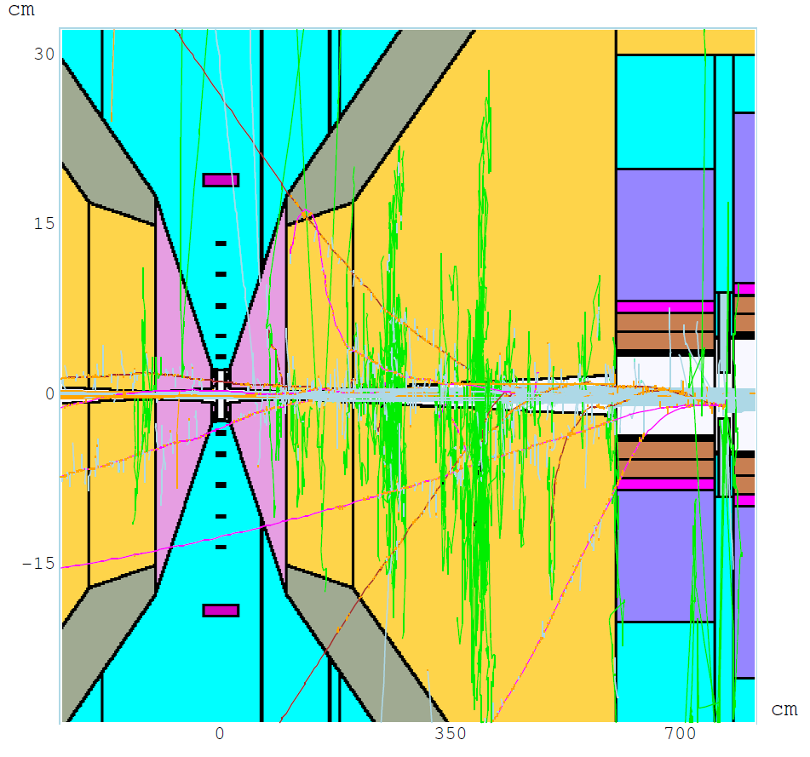
Backgrounds
From the detector side the central issue in a muon collider are backgrounds due to muon beam decays.
For a 0.75-TeV muon beam of 2x10¹²/bunch
  4.28x10⁵ decays/m per bunch crossing
  0.5 kW/m.
ILCROOT Detector Model
Θ = 10º 6 < z < 600 cm x:z = 1:17
MARS simulations
Q1
W
BCH₂

Slide 5
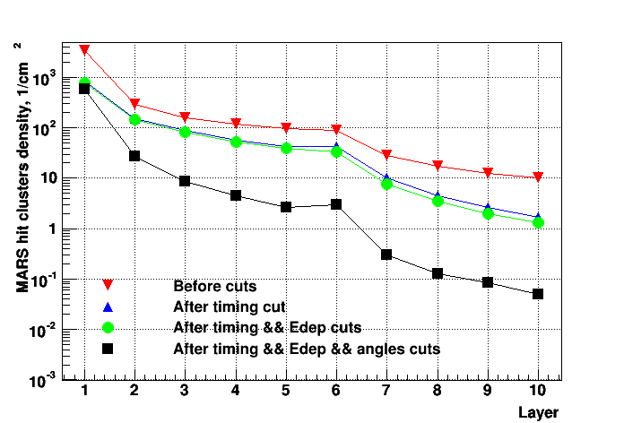
Background Distributions
We had relied heavily on timing for background rejection
A timing bug in MARS meant we had to revise physics analyses after Snowmass
  The peak level in the tracker at t=0 is about 4 orders of magnitude higher than before
  The effects in the calorimeter are less dramatic
(N. Terentiev)

Slide 6
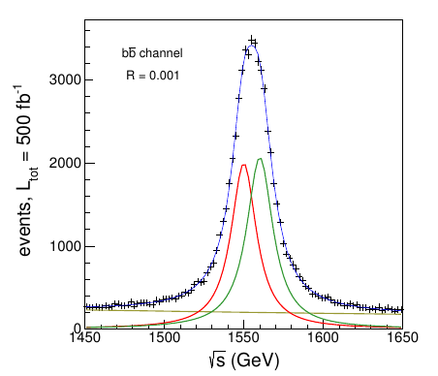
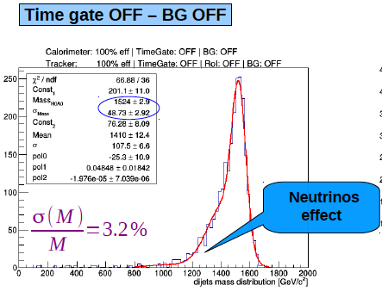
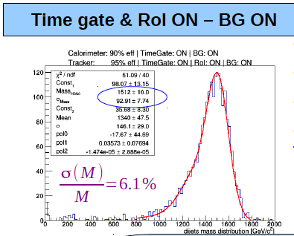
Physics Signal Analysis
Heavy Neutral Higgses (H/A) and charged Higgses (H±) are a simple possibility of New Physics beyond the Standard Model.
At e⁺e⁻ colliders they must be produced in association with other particles, such as Z, since the electron Yukawa coupling is too small for s-channel production.
H and A can be produced as s-channel resonances at a Muon Collider. (Eichten and Martin arXiv:1306.2609).
Reconstruct H/A decay into 2 B jets
(V. Di Benedetto, A. Mazzacane)

Slide 7
Summary
The physics reach of a Muon collider has tantalizing promise, with many unknowns
It is challenging for both accelerator and detector technologies
The utility of such a machine depends on the physics context
  Precision physics > 3 TeV
  Precision Higgs mass studies
  Z’
  ?
A clear understanding of the capability of such a machine would take a significant focused effort for several years (CLIC example)
Summaries MAP 2014 winter meeting: https://indico.fnal.gov/event/8959/other-view?view=standard
Talks by Di Benedetto, Terentiev, and Lipton

