Slide 1
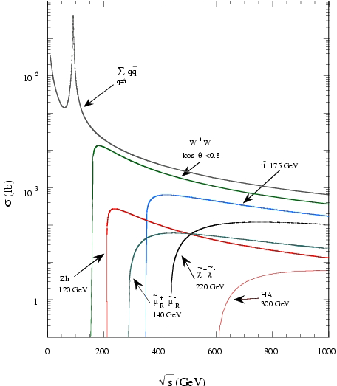
Energy vs Luminosity: Lepton Colliders
Cross sections vs energy
for e⁺e⁻ collider
Point-like particles
Radius ~ Wavelength = h/E_{beam}
Cross sections ~(radius)² = ~1/E_{beam}²
Cross sections are going down as 1/E_{beam}²
Need higher luminosity to produce reasonable number of collisions at higher energies
Example
ZH cross section is ~0.3 pb at 250 GeV
At luminosity 10³⁴cm⁻²sec⁻¹ it corresponds to one ZH event every 5 minutes or ~100k events per year of running
High luminosity is critical!

Slide 2
Energy vs Luminosity: Hadron Colliders
10⁻⁴
More complex case as hadrons are not point like particles
Parton density functions have sharp rise at low x providing more opportunities to create heavy particles when beam energy increases
Heavy objects cross sections are raising faster vs soft backgrounds providing better S/B at high energies
With reasonable luminosity mass reach for direct searches is ~1/2 of the full collider energy
No simple rule that luminosity has to increase as (E_{beam})² as for the lepton colliders
Each specific physics scenario has to be studied to define required luminosity vs energy
“Energy is better vs luminosity” - Snowmass rule

