Slide 1
SRF Cavities at the Energy Frontier
Sam Posen
Energy Frontier WG Meeting
April 3, 2018

Slide 2
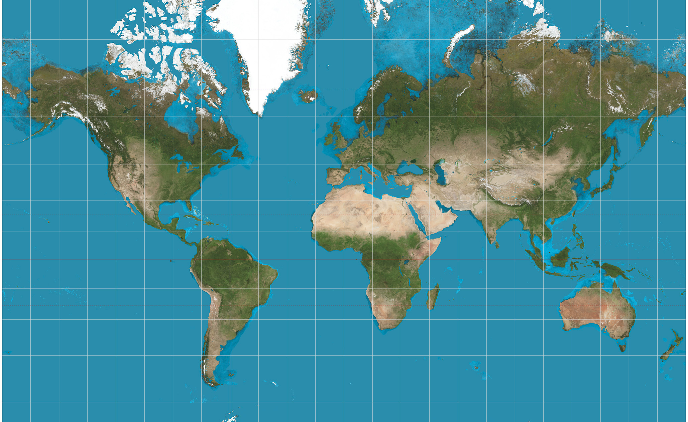
SRF Accelerators Around the World
ESS
ISAC
CLS
FRIB
ALICE
BESSY
ILC
EIC
SPIRAL2
ELBE
C-ADS
PIP-II/III
CESR
Soleil
XFEL
RAON
LHC
FLASH
CEBAF
FCC
TARLA
BEPC-II
LIPAc
HIE-ISOLDE
ALPI
cERL
LCLS-II
ATLAS
SNS
SC-LINAC
CepC-SppC
J-PARC
MaRIE
SARAF
ANURIB
TLS
ADS
ISNS
Circular
Linear
USP
ANU
Light src
HEP
NP
<10 cavities
10-100 cavities
100-1000 cavities
Oper’n
Produc’n
Planning
>1000 cavities
Sam Posen
Map from Wikipedia. Non-exhaustive facility list.
Notes:
survey
I hope this shows how many accelerators there are around the world that use SRF cavities, but also… MANY UPCOMING

Slide 3
Future HEP SRF Accelerators Under Discussion
ESS
ISAC
CLS
FRIB
ALICE
BESSY
ILC
EIC
SPIRAL2
ELBE
C-ADS
PIP-II/III
CESR
Soleil
XFEL
RAON
LHC
FLASH
CEBAF
FCC
BEPC-II
LIPAc
HIE-ISOLDE
ALPI
cERL
LCLS-II
ATLAS
SNS
SC-LINAC
CepC-SppC
J-PARC
MaRIE
SARAF
ANURIB
TLS
ADS
ISNS
Circular
Linear
High DF
Need High Q₀
USP
Low DF
Need High Gradient and High Q₀
ANU
Light src
HEP
NP
<10 cavities
10-100 cavities
100-1000 cavities
Oper’n
Produc’n
Planning
>1000 cavities
Sam Posen
Map from Wikipedia. Non-exhaustive facility list.
Notes:
The goal of this talk is to very briefly give you an idea of progress in SRF progress over the past 40 years, overview the current status, and give you an idea of what we’re working on for the future

Slide 4
SRF Performance Improvements Driven by R&D
2013 - N-doping: high Q₀ at medium field [6]
1979 – elliptical shapes: prevent multipacting [1]
2017 - N-infusion: high gradient and high Q₀ [7]
1998 – 120C bake: prevent high field Q-slope [5]
1983 – control of impurities at welds: prevent thermal breakdown [2]
1989 – electropolishing: smooth surfaces to nm-scale [3]
1992 – High pressure rinsing: prevent field emission [4]
[1] IEEE Trans. Mag. 15 1
[2] IEEE Trans. Mag. 19 3
[3] K. Saito, Proc SRF
[4] Proc EPAC 1269-1271
[5] TESLA DESY 98-05
[6] Supercond. Sci. Tech. 26 102001
[7] Supercond. Sci. Tech. 30 094004

Slide 5
SRF Performance Improvements Driven by R&D
2013 - N-doping: high Q₀ at medium field [6]
1979 – elliptical shapes: prevent multipacting [1]
2017 - N-infusion: high gradient and high Q₀ [7]
1998 – 120C bake: prevent high field Q-slope [5]
1983 – control of impurities at welds: prevent thermal breakdown [2]
1989 – electropolishing: smooth surfaces to nm-scale [3]
1992 – High pressure rinsing: prevent field emission [4]
There is a strong historical trend of SRF R&D leading to substantial advances in cavity performance
[1] IEEE Trans. Mag. 15 1
[2] IEEE Trans. Mag. 19 3
[3] K. Saito, Proc SRF
[4] Proc EPAC 1269-1271
[5] TESLA DESY 98-05
[6] Supercond. Sci. Tech. 26 102001
[7] Supercond. Sci. Tech. 30 094004

Slide 6
SRF Performance Improvements Driven by R&D
LCLS-II, 1st year of operation ~2019
XFEL, 1st year of operation 2017
2013 - N-doping: high Q₀ at medium field [6]
1979 – elliptical shapes: prevent multipacting [1]
2017 - N-infusion: high gradient and high Q₀ [7]
1998 – 120C bake: prevent high field Q-slope [5]
1983 – control of impurities at welds: prevent thermal breakdown [2]
1989 – electropolishing: smooth surfaces to nm-scale [3]
1992 – High pressure rinsing: prevent field emission [4]
CEBAF, 1st year of operation 1992
SNS, 1st year of operation 2007
There is a strong historical trend of SRF R&D leading to substantial advances in cavity performance
Stronger performance improves the feasibility of building new accelerators with unprecedented scientific reach
[1] IEEE Trans. Mag. 15 1
[2] IEEE Trans. Mag. 19 3
[3] K. Saito, Proc SRF
[4] Proc EPAC 1269-1271
[5] TESLA DESY 98-05
[6] Supercond. Sci. Tech. 26 102001
[7] Supercond. Sci. Tech. 30 094004

Slide 7
Pushing Gradient – Beyond H_{sh} of Niobium
Limitation observed currently is consistent with superheating field H_{sh} of niobium (maximum of metastable flux-free state)
At high field, if magnetic flux penetrates, it moves through superconductor at RF frequencies; strong dissipation occurs
Several pathways expected to push beyond H_{sh} of bulk Nb:
  Engineered thin layers (e.g. a dirty layer of Nb on top of clean Nb) to modify the maximum metastable limit – already showing early signs of success via N-infusion
  New SRF materials with higher H_{sh} than Nb (e.g. Nb₃Sn)
  Prevent flux penetration by using materials with long flux nucleation time relative to RF period
B_{applied}

Slide 8
Pushing Gradient – Beyond H_{sh} of Niobium
Limitation observed currently is consistent with superheating field H_{sh} of niobium (maximum of metastable flux-free state)
At high field, if magnetic flux penetrates, it moves through superconductor at RF frequencies; strong dissipation occurs
Several pathways expected to push beyond H_{sh} of bulk Nb:
  Engineered thin layers (e.g. a dirty layer of Nb on top of clean Nb) to modify the maximum metastable limit – already showing early signs of success via N-infusion
  New SRF materials with higher H_{sh} than Nb (e.g. Nb₃Sn)
  Prevent flux penetration by using materials with long flux nucleation time relative to RF period
B_{applied}
Fermilab SRF R&D has active programs in all of the above

Slide 9
In-Accelerator Operating Gradient
In an accelerator cryomodule, additional restrictions tend to reduce accelerating gradient in operation, including:
  Cryogenic power (dissipated power scales with E_{acc}²), especially for high duty factor accelerators (i.e. not short pulses)
  Field emission (from dirt during cavity string assembly), heating or arcing of RF antennas
Low duty factor SRF linacs with hundreds of cavities
*CEBAF is CW but limited at ~5 MV/m due to field emission
PIP-III

Slide 10
In-Accelerator Operating Gradient
In an accelerator cryomodule, additional restrictions tend to reduce accelerating gradient in operation, including:
  Cryogenic power (dissipated power scales with E_{acc}²), especially for high duty factor accelerators (i.e. not short pulses)
  Field emission (from dirt during cavity string assembly), heating or arcing of RF antennas
Low duty factor SRF linacs with hundreds of cavities
*CEBAF is CW but limited at ~5 MV/m due to field emission
Substantial and steady progress over the last decades. Still room to progress within H_{sh} of bulk niobium
PIP-III

Slide 11
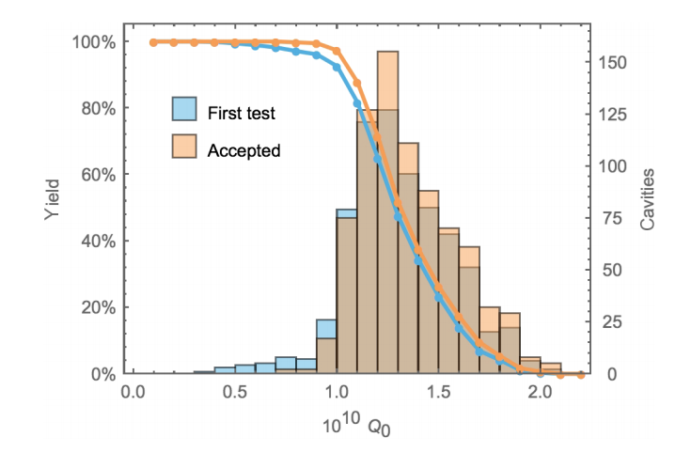
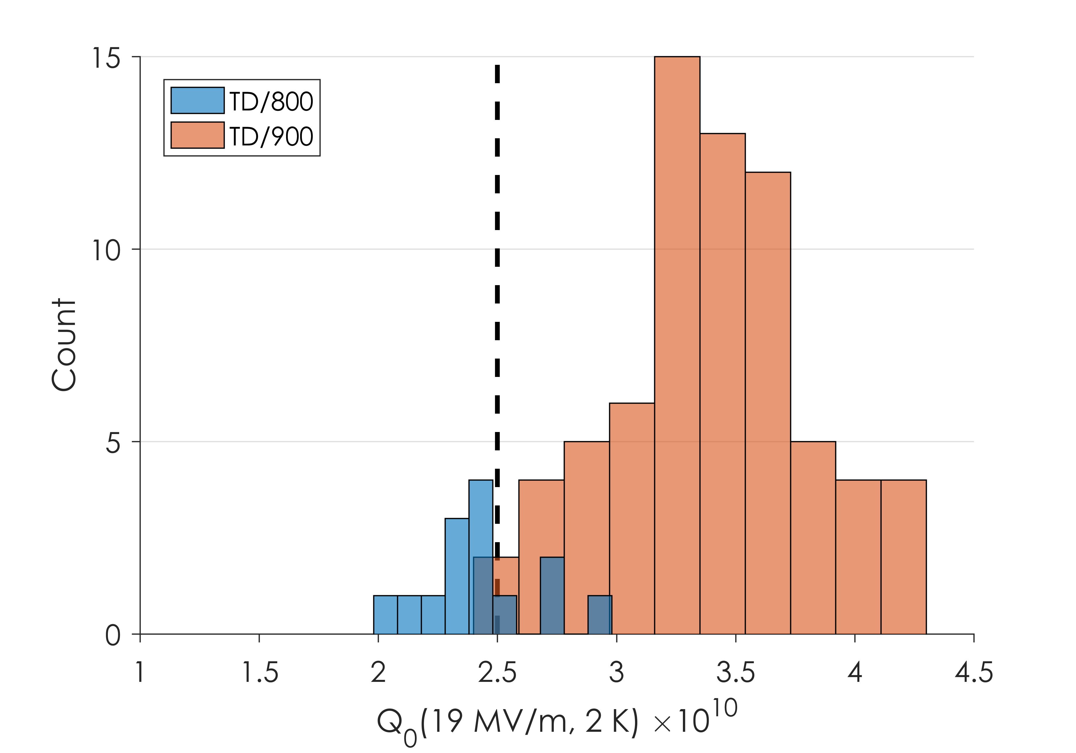
High Q₀ Cavities for High Duty Factor Applications
In high energy e⁺e⁻ storage rings (e.g. FCC-ee, CepC) and some linac applications (e.g. PIP-II) – RF is always on – Q₀ is crucial to keep cryogenic costs reasonable
Major progress in last 5 years: >2x higher Q₀ at relevant gradients with N-doping
Collaboration with CERN to study 800 MHz cavities for FCC-ee under N-doping and Nb₃Sn coating
Red: after improved recipe implemented for production
European XFEL Production – 120 C bake
LCLS-II Production – Nitrogen Doping

Slide 12
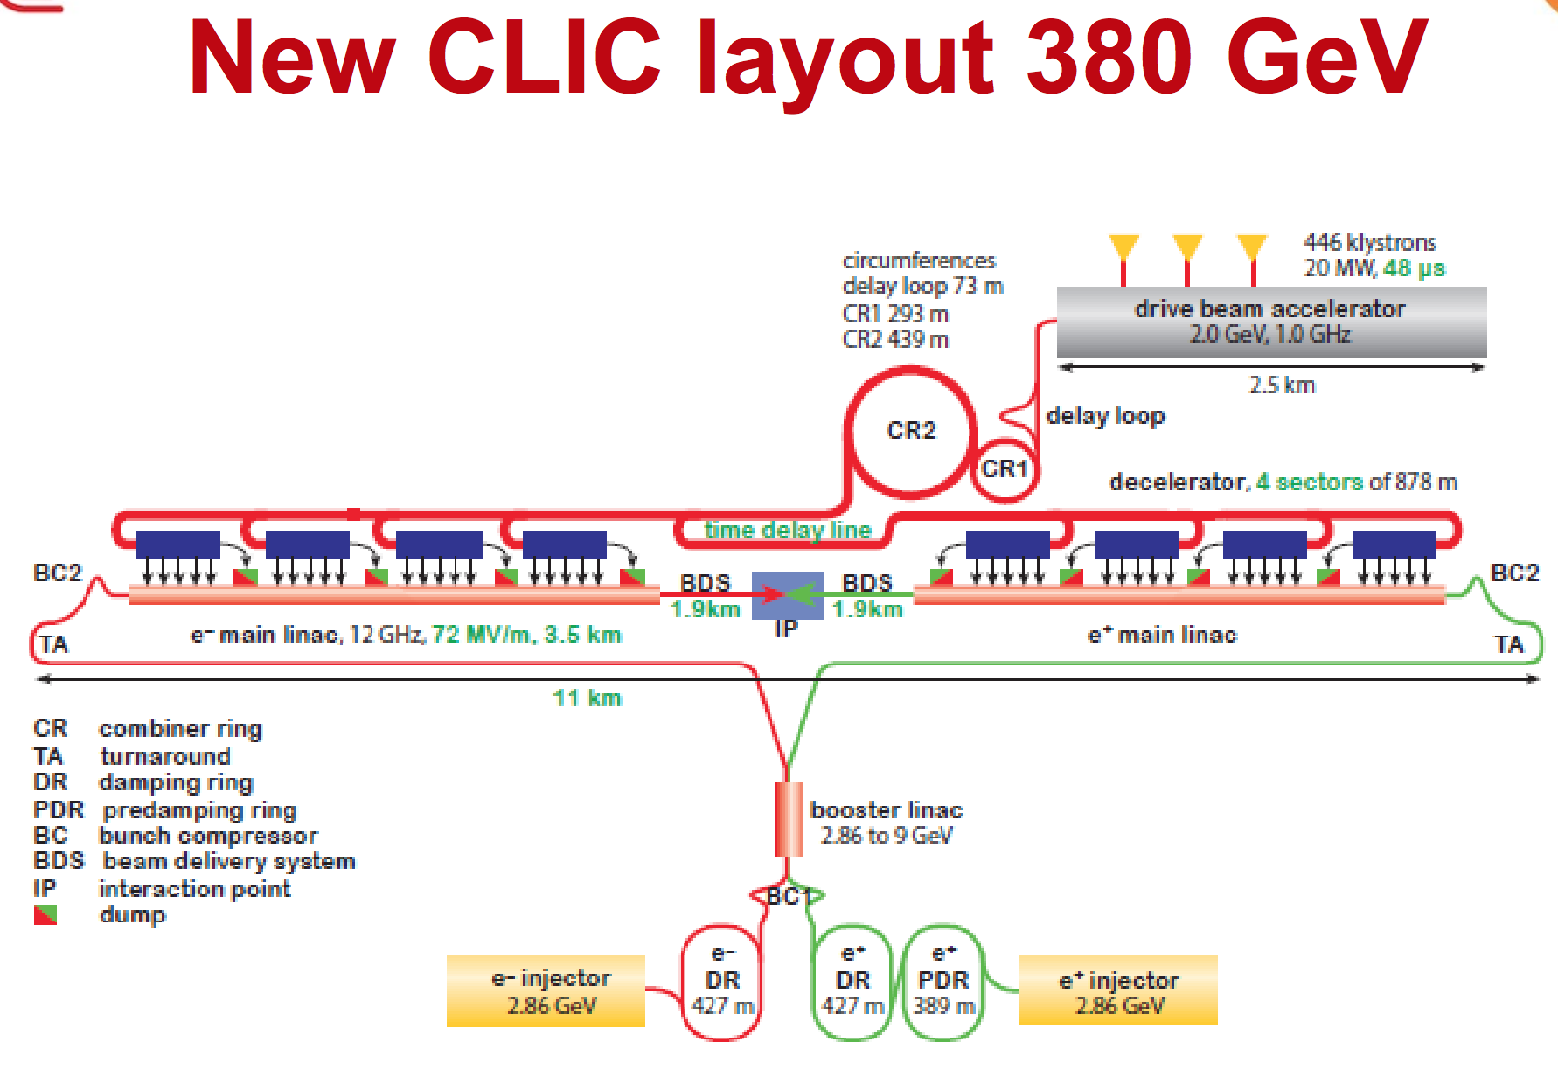
Normal Conducting RF High Energy Linac
70 MV/m demonstrated with limited breakdown frequency
Very high peak power dissipation in walls (10s of MW/m for CLIC vs ~100 W/m for ILC) pushes into regime with small duty factor (~1e-5 [ILC ~1e-2]) and high peak current
  Complicated RF compression system involving secondary “drive beam” and combiner rings to generate high power RF
  Detectors must be able to handle very high peak event rate
  High frequency (small) cavities: decreased aperture
  Strong HOM damping and focusing required
Very challenging alignment (over 200 m, CLIC ~10 μm vs ILC ~300 μm)
As a result, many unproven aspects for NCRF HE linac, whereas for SRF e.g. EXFEL is prototype for ILC

