Slide 1
MICE/MTA results and the
Heavy Electron Particle Accelerator Program
David Neuffer
April 2018

Slide 2
Outline
MAP - MICE results and MTA results
  MICE data
    H₂ , LiH, Poly wedge cooling measured
  MTA: High gradient rf in high magnetic fields (!)
Next Heavy Lepton Program
  PIP-II customer(s) …
  ? precision Higgs ??
  High energy colliders ??
    up to ~14 TeV in LHC tunnel
    or ??
Upgrade Path(s)
  to High-Energy Heavy Electron Program

Slide 3
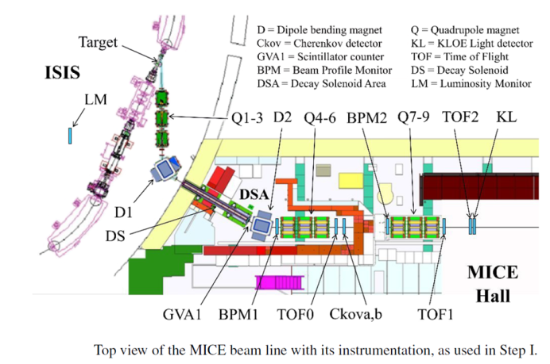
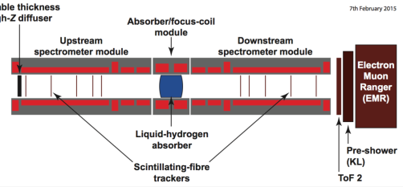
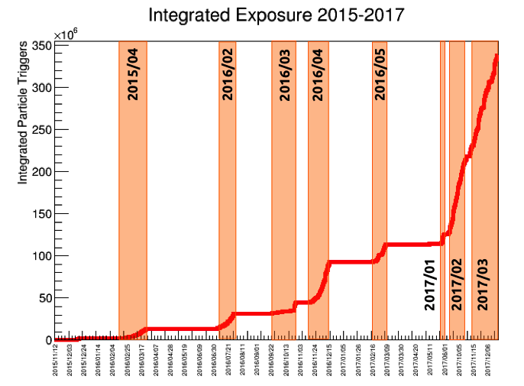
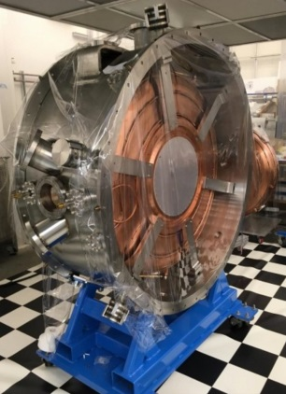
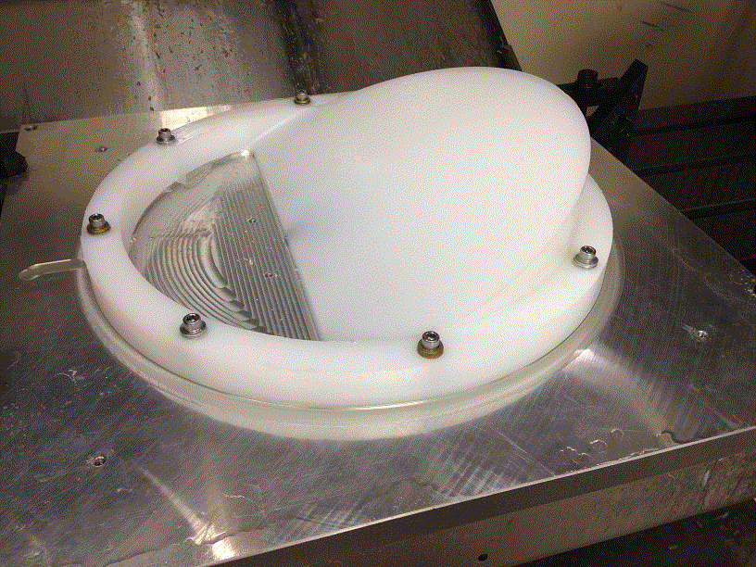
MICE experiment at RAL Results
MICE data ended 12/17
  340 10⁶ particle tracks
  demonstrates ionization cooling in LH₂, LiH
  C₂H₄ wedge for emittance exchange
  Need to analyze data & publish
    statistical evaluation of cooling
  next step with rf was not done
ε_{L}
ε_{x}
20 MV/m rf

Slide 4
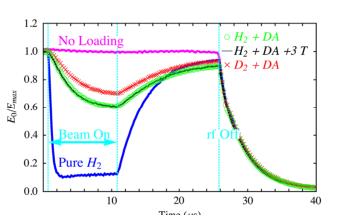
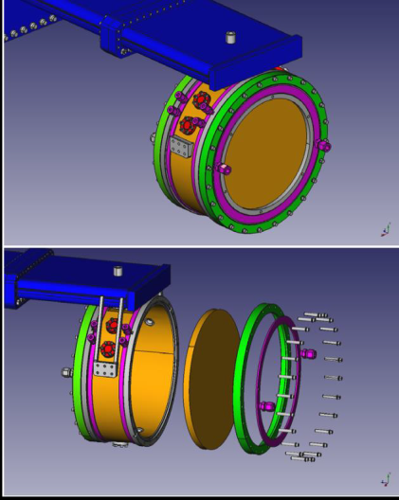
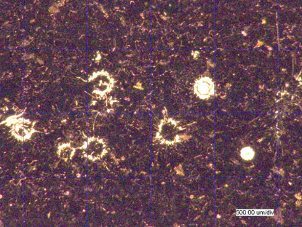
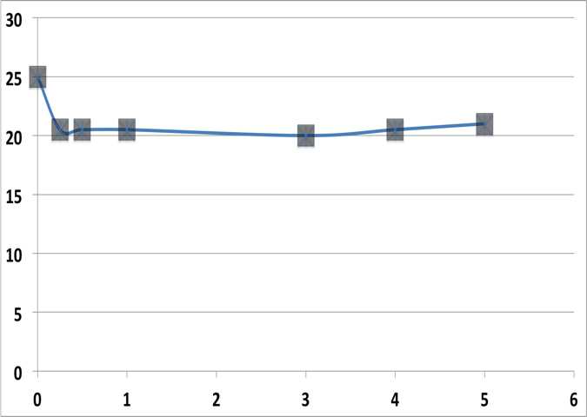
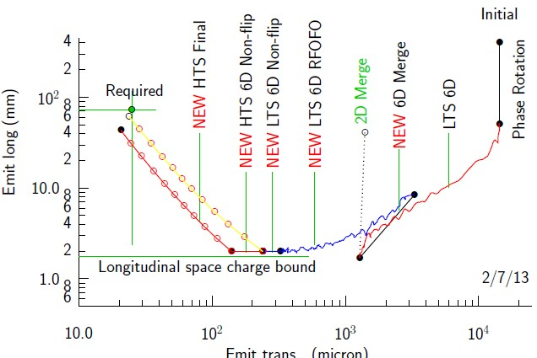
MTA experimental results
High gradient rf in magnetic fields
  Breakdown possible
  suppressed in gas-filled rf
Pillbox rf cavity Cu or Be endplates
      A. Kochemirovskiy, et al. (preliminary)
  Cu endplates: <20MV/m at 3 T
    damage from breakdown
  Be endplates >40 MV/m at 3T
    (almost) no breakdown, no damage
rf for collider-level cooling is possible
>40 MV/m operation
in up to 5 T B-field

Slide 5
MAP → HEPAP status
MAP produced initial designs for muon storage ring neutrino sources and heavy lepton colliders
  -including initial beam delivery design for mu2e and nuSTORM
P5 happened –MAP did not fit 2013 physics priorities
  too ambitious for US resources
US Flagship is DUNE

Slide 6
Future HEPAP possibilities
Potential Customer of PIP-II
  muon programs are only identified users: mu2e-II → ?
    other intensity frontier expts. μ→ 3e, eγ ?? (PIP-III users)
Precision determination of neutrino parameters
  nu- factory beam to DUNE detectors ?
  ~nuSTORM redux
Precision Higgs mass and width
  from 125 GeV μ⁺μ⁻ - also Z_{0,} tt*, …
Higher Energy Discovery Collider
  up to 14 TeV in LHC tunnel

Slide 7
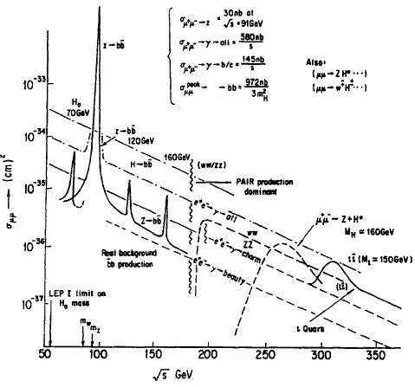
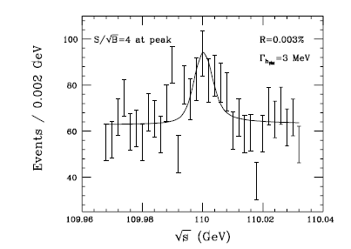
  μμ → H Higgs Factory
  Barger, Berger, Gunion, Han, Physics Reports 286, 1-51 (1997)
Higgs Factory = s-channel resonance μ⁺μ⁻ → H
measure Higgs mass and width by spin precession (frequency)
  δE: 0.1MeV → 0.005 MeV
at L=10³², t=10⁷s →50000 H
Would start collider at Z_{o} (91GeV)
  easier starting point
  300 Z/day at L=10²⁹
  Useful Physics at Z ?
    E, ΔE to ~0.1 MeV or less
    μ⁺μ⁻ → Z₀

Slide 8
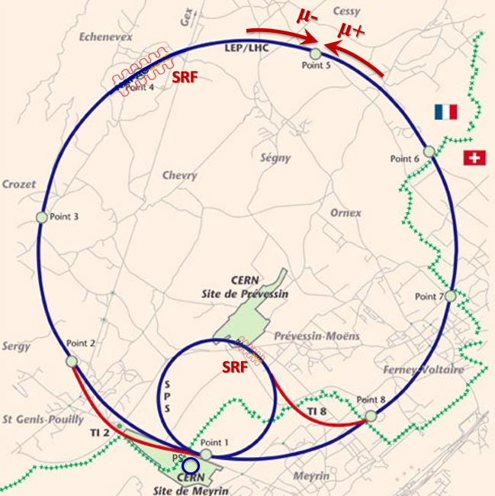
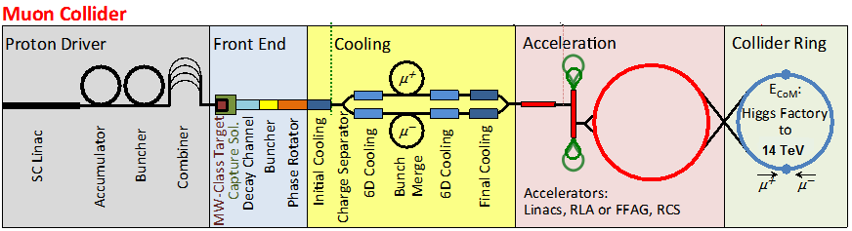
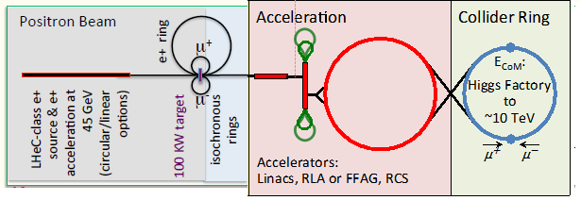
High Energy to 14 TeV at LHC
CERN is interested in μ⁺μ⁻ site-filler
  fits in LHC tunnel
Could consider for muon source:
  PS-based proton source + cooling
  MAP 8GeV 2MW p + cooling
  threshold 45 GeV e⁺ ring + e⁻ production
    LEMMA- Boscolo et al. –no cooling
  1-pass MAP cooler → ring coolers
  …
Shiltsev & Neuffer, IPAC 18
Parameter | “PS” | “MAP” | “LEMC”
Avg. luminosity | 1.2·10³³ | 3.3·10³⁵ | 2.4·10³²
Beam δE/E | 0.1% | 0.1% | 0.2%
Rep rate, Hz | 5 | 5 | 2200
N_{μ}/bunch | 1.2·10¹¹ | 2·10¹² | 4.5×10⁷
n_{b} | 1 | 1 | 1
ε_{t,N} mm-mrad | 25 | 25 | 0.04
β* , mm | 1 | 1 | 0.2
σ*(IR), μm | 0.6 | 0.6 | 0.011
Bunch length, mm | 0.001 | 0.001 | 0.0002
μ production source | 24 GeV p | 8 GeV p | 45 GeV e⁺
p or e/pulse | 6·10¹² | 2·10¹⁴ | 3·10¹³
Driver beam power | 0.17MW | 1.6MW | 40 MW
Acceleration, GeV | 1-3.5, 3.5-7 RCS | 1-3.5, 3.5-7 RCS | 40 GV, RLA 20 turn
Ν rad. (unmitigated) | 0.08 | 1.5 | 0.015 mSv/yr

Slide 9
Thank you for your attention

