Slide 1
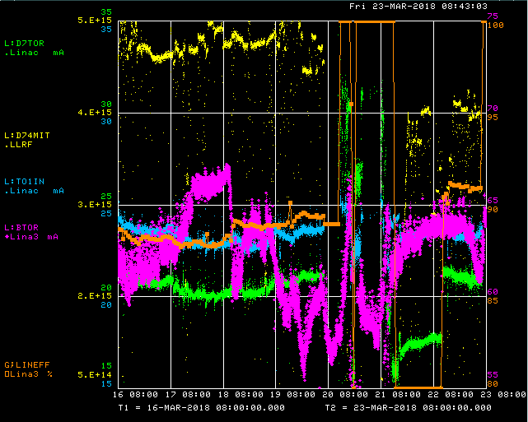
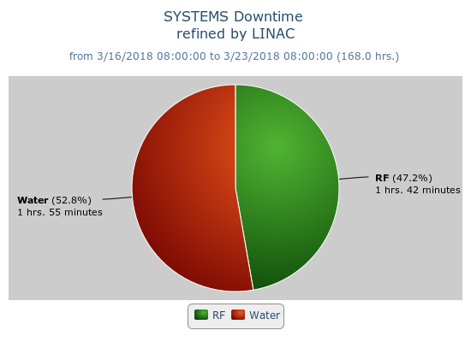
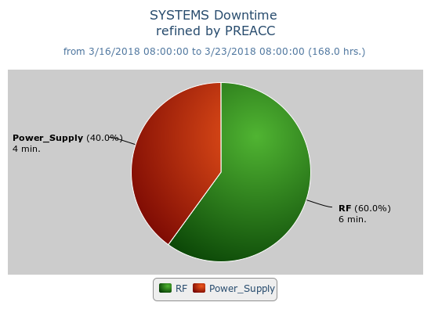
Preacc/Linac Weekly Performance
Maintenance period on Tuesday, ~6 hrs.
Marx Modulator upgrades, Gen. Maint.
Wednesday – Beam to NIF
Friday – LRF4 PA filament water leak

Slide 2
Current Conditions
Source B – 62 mA
Linac input – 23 mA
Linac output – 21 mA, ~4.7E12 p/pulse

