Slide 1
Future Conventional Neutrino Beams
Robert Zwaska,
First 2018 Neutrino Working Group Meeting
5 April 2018

Slide 2
LBNF, The Last Neutrino Beam?
LBNF may well be the last conventional long-baseline neutrino beam built
  Must be built so as to explore necessary physics
  Will have some measure of flexibility
If there are to be future beams, it depends on what we learn
Plan for this talk:
  Neutrino Beam Features
  Neutrino Beam Challenges
  Neutrino Beams in Action
  Future Possibilities
Our knowledge and ability of neutrino beams will improve over the next decade, for existing and future neutrino beams

Slide 3
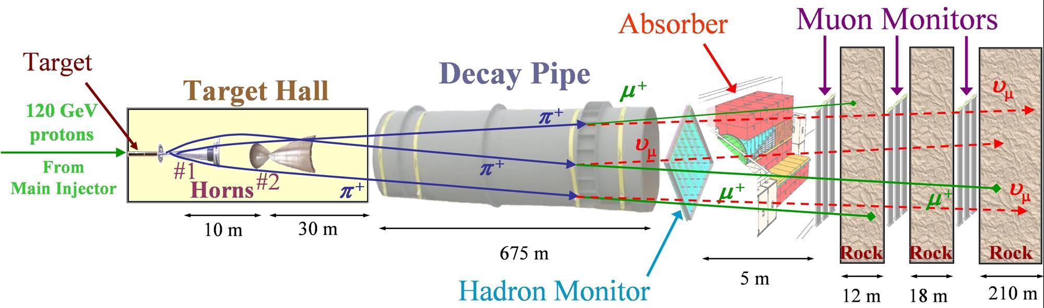
Neutrino Beam in a Nutshell (NuMI)
Absorbs ~ 40 % of beam power
Allows high-energy muons to penetrate
2 m diameter
Roughly decay length for 10 GeV π⁺
He-filled
2 interaction length, C target
Produces π⁺, K⁺ mesons
400 kW design average power
700 kW upgrade for NOvA
1MW future
σ ∼ 1-2 mm
Pulsed focusing horns @ 200 kA
Toroidal magnetic field
Parabolic inner conductor profile
Focuses meson momentum band
Measure hadron & muon fluxes
Arrays measure distributions
Notes:
Go light on horn description, other details

Slide 4
Pion Decay
Neutrinos produced at random direction in pion rest frame
  Boosted in the direction of the beam
  Ultimate energy determined by the decay angle with respect to the boost, in the lab:
  Muon carries the balance of the energy
Flux is also affected such that the beam is strongly directed in the direction of the pion velocity:
All two-body decays have this functional form. Three body-decays are boosted in the same way, but are complicated by the decay kinematics

Slide 5
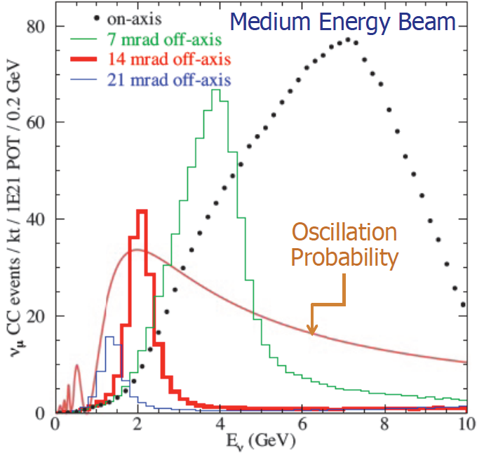
Off-Axis Beam
Technique used by T2K, NOvA (first proposed by BNL)
  Fewer total number of neutrino events
  More at one narrow region of energy, tuned to oscillation probability
  For ν_{μ} to ν_{e} oscillation searches, backgrounds spread over broad energies

Slide 6
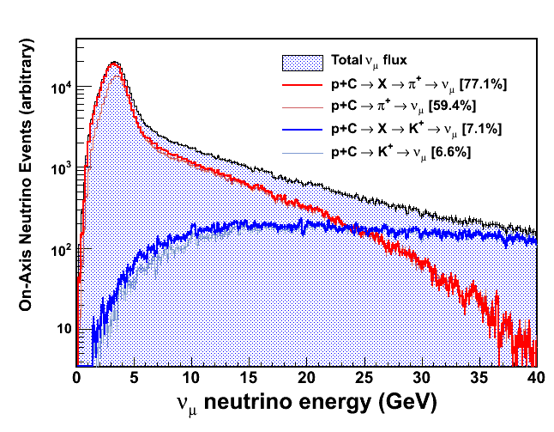
Challenge: Hadroproduction
Simulations give a spectrum
  But, what is the uncertainty?
Hadroproduction experiments can constrain simulations, or directly give input to experiments’ flux estimation
Presently, NA-61 at CERN is exploring hadroproduction
  Gradual series of measurements – not an exhaustive program
  Some detector limitations mean that some important distinctions in parameter space can’t be made
Solution: a dedicated, exhaustive program of hadroproduction measurements could dramatically improve neutrino beam simulation
Modelling codes and expertise require maintenance and evolution

Slide 7
Challenge: Proton Beam
SNS & NuMI proton beams to scale:
200 mm x 70 mm vs. 1.3 mm x 1.3 mm
  SNS target experience is not directly transferrable
Greatest challenge for windows and targets
  Significant challenges for peripheral devices

Slide 8
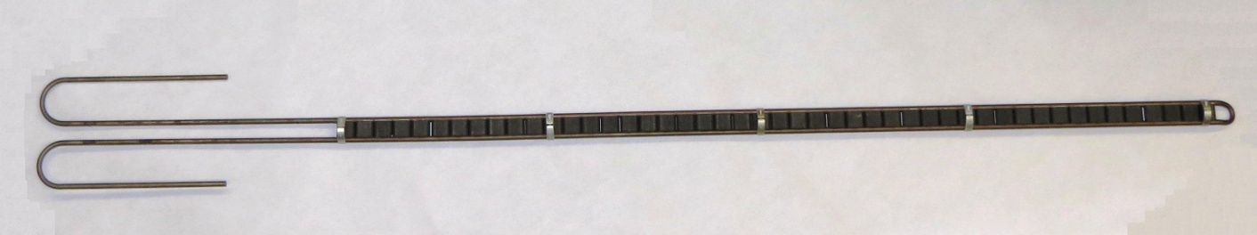
Challenge: Targets
Optimal target:
  Low-Z to optimize pion production (minimize energy deposition in target & horn)
  High density to stay within the Horns’ depth of focus
  Roughly two nuclear interaction lengths long
  The optimized width to allow a certain amount of reinteraction, but limit absorption
But, the target must survive for a non-negligible duration
  Material must withstand thermomechanical shock
  Material must withstand radiation damage
  Heat must be removed
  Supporting materials (e.g. water & pipes) must be far enough from the beam to avoid boiling
Above contradictions drive us to graphite & beryllium
  Water cooling is the baseline, but air is not out of the question
  R&D has a substantial capability to improve the efficiency of neutrino production

Slide 9
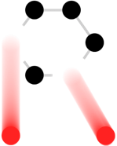









RaDIATE
Collaboration
Radiation Damage In Accelerator Target Environments
www-radiate.fnal.gov
Broad aims are threefold:
to generate new and useful materials data for application within the accelerator and fission/fusion communities
to recruit and develop new scientific and engineering experts who can cross the boundaries between these communities
to initiate and coordinate a continuing synergy between research in these communities, benefitting both proton accelerator applications in science and industry and carbon-free energy technologies

Slide 10
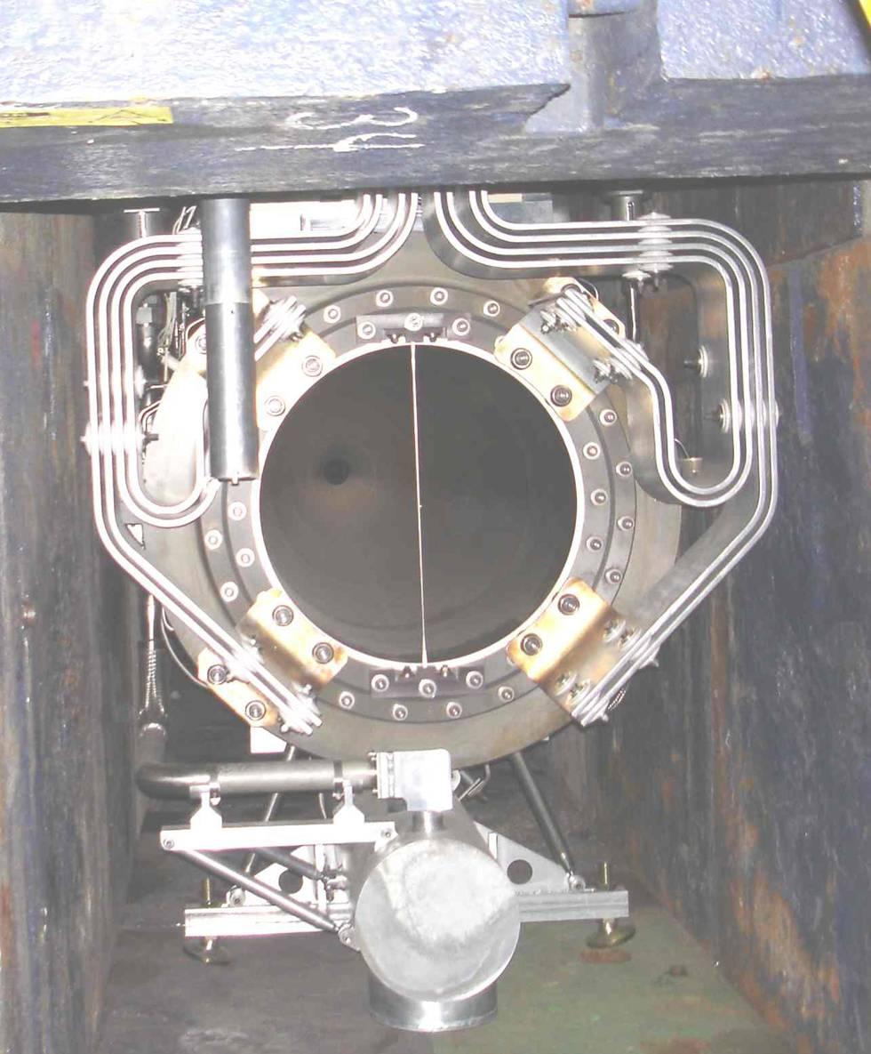
Challenge: Horn Focusing
Horns have a limited depth of focus
  For a particular momentum in NuMI, roughly:
    ± 5 mm transversely
    ± 15 cm longitudinally
  Target is much longer in z !
    Not so bad: want a broad energy range
  Overall, horn focusing is very efficient
Horn currents are limited by ohmic and beam heating (~ 200 kA)
  Higher currents would allow more efficient focusing
Corrosion and radiation damage of materials
Aluminum horn materials cause absorption and heating
  Beryllium is an R&D option (exotic)

Slide 11
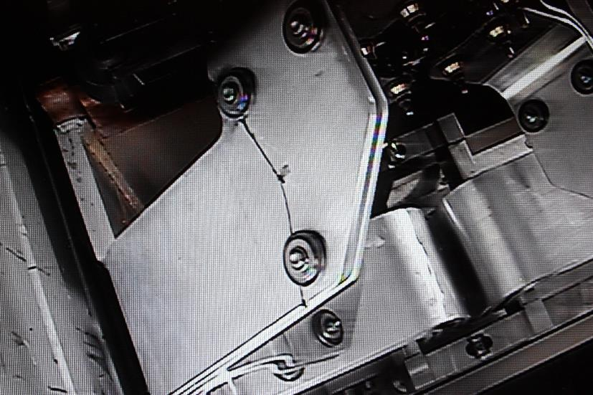
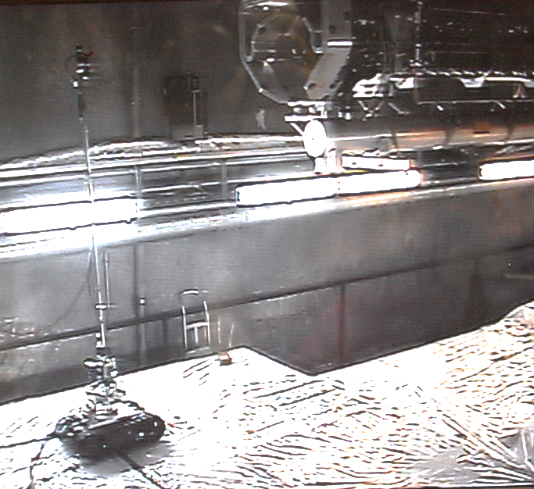
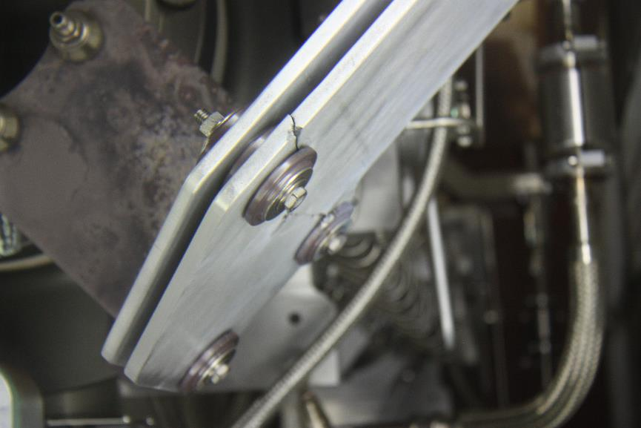
NuMI Horn 1 Failure
Replaced NuMI Horn summer 2016 due to failed stripline
  First 700 kW capable horn, in service since Sept. 2013, accumulated ~ 27 million pulses
Failure was due to fatigue, likely enhance by vibrations
P. Hurh
Talk Thursday

Slide 12
ALARA (As Low As Reasonably Achievable)
NuMI Horn exchange was a hot job even after 8 weeks of cool-down
More power -> hotter jobs -> more changeouts
  ALARA applied, with some expense of time and effort

Slide 13
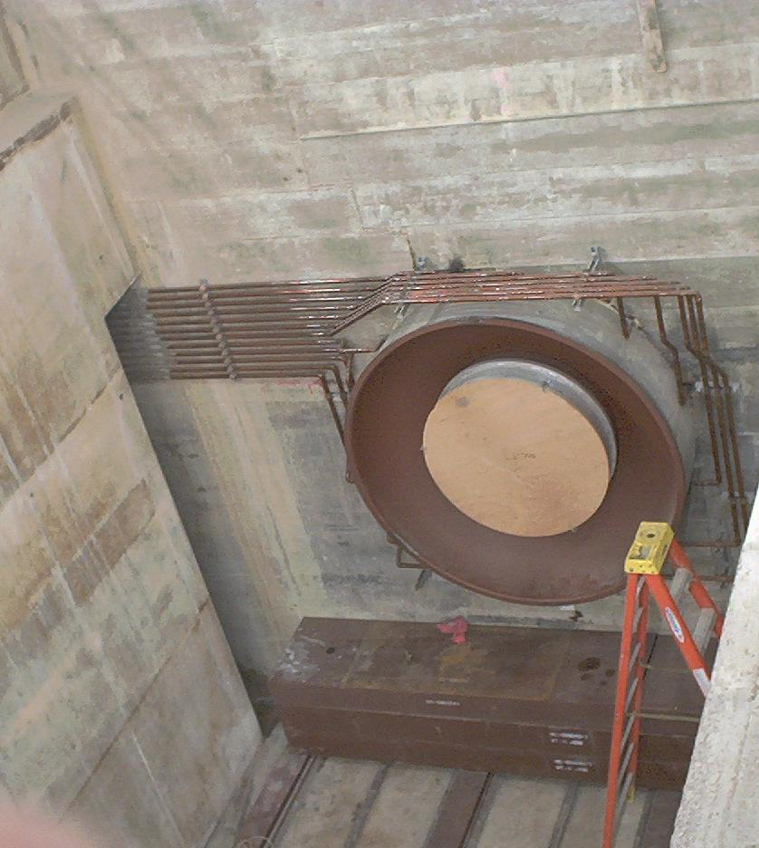
Challenge: Radiation/Radionuclide Management
Extensive shielding to deal with high-energy particles
  Radioactivation of shielding and components
Air-borne radiation:
  Lifetimes of hours, must not be emitted
Creating of longer-lived mobile isotopes: tritium, Na-22
  Immediately mobile produced in air, fluid, and some solids
  Sequestered radisotopes slowly work there way out
  May become faster with temperature or other factors
Radiolysis and production of corrosive compounds
  Many materials degrade with radiation, metals and ceramics more robust
  Ozone, Nitric acid, and other compounds can be created in gas and fluids

Slide 14
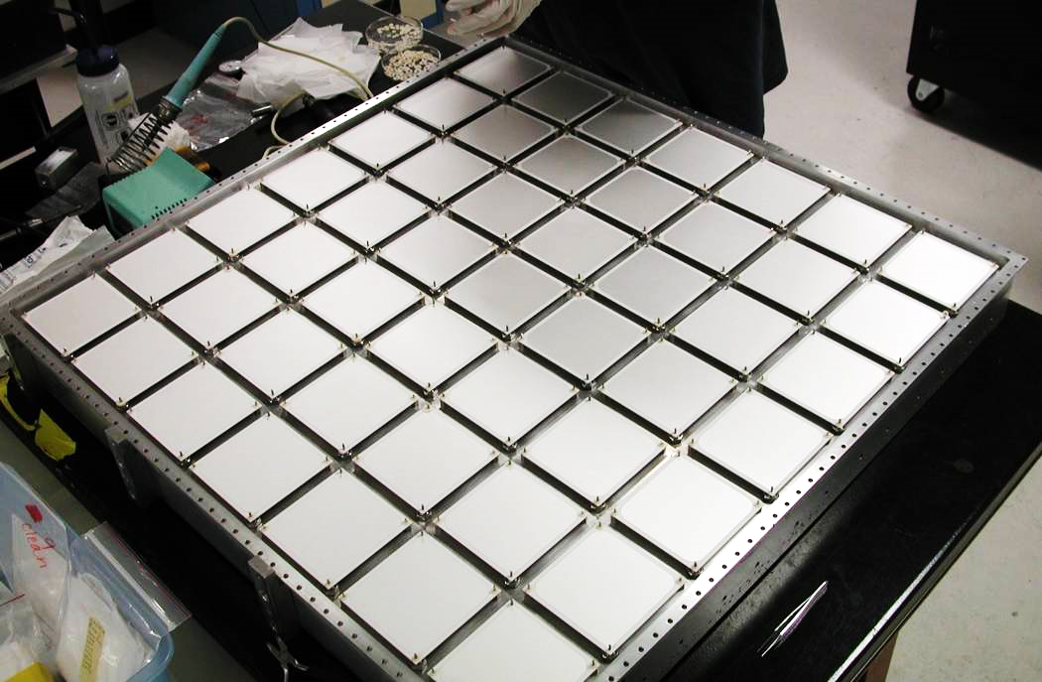
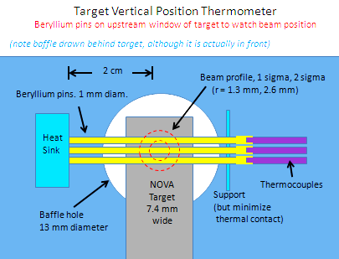
Challenge: Instrumentation
Instrumentation can be used to measure beamline variations and to reduce the experimental limitations from them
This instrumentation often needs to live within the secondary beam
  Radiation-hard
  Large signals
  Cooling
R&D on high-radiation instrumentation would improve the precision of neutrino experiments
NuMI Hadron Monitor

Slide 15
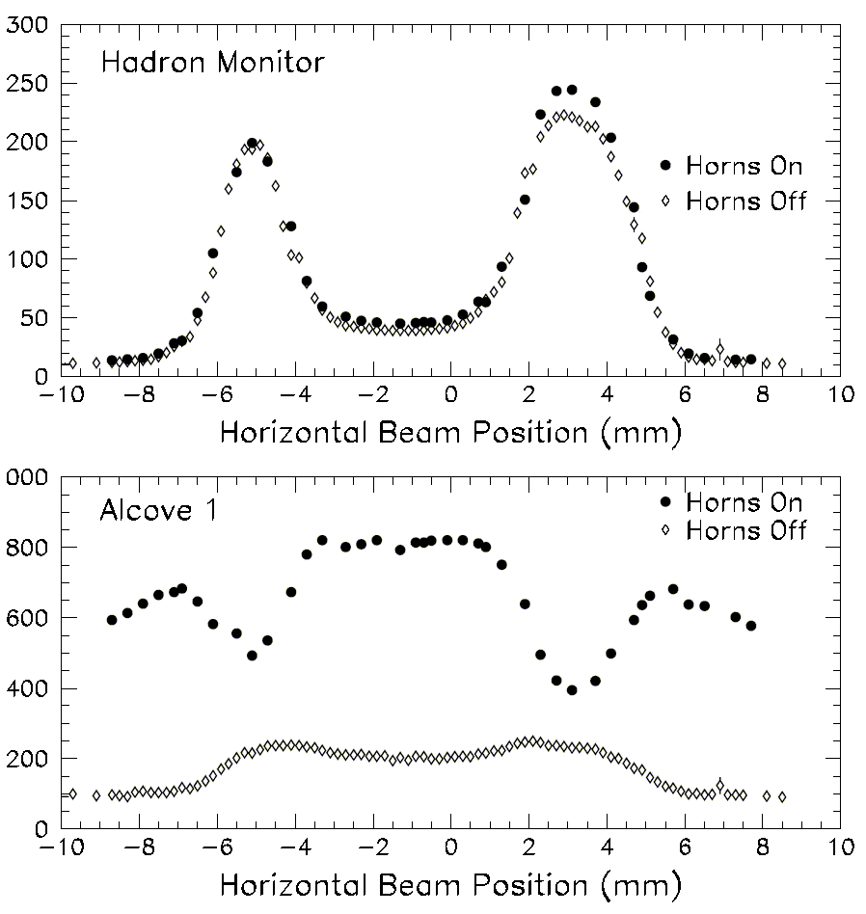
Challenge: Precision Alignment
Proton beam scanned horizontally across target and protection baffle
Hadron Monitor used to find the edges
Measured small (~1.2 mm) offset of target relative to primary beam instrumentation.
Systematic effect of this misalignment would exceed statistical uncertainties
Baffle
Horn
p
Target
π
baffle
baffle
target
Graphite protection baffle
Water cooling line
Pulse Height in Chamber (arb.)
Horizontal Fin
21.4 mm
15.0 mm
11.0 mm
baffle
baffle
target
6.4 mm
Graphite target
Notes:
Harp on implementation

Slide 16

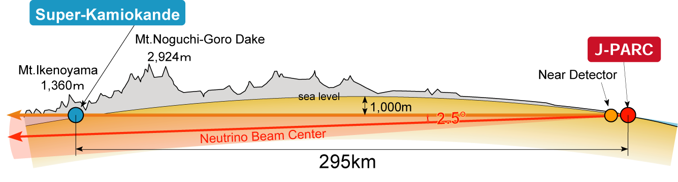
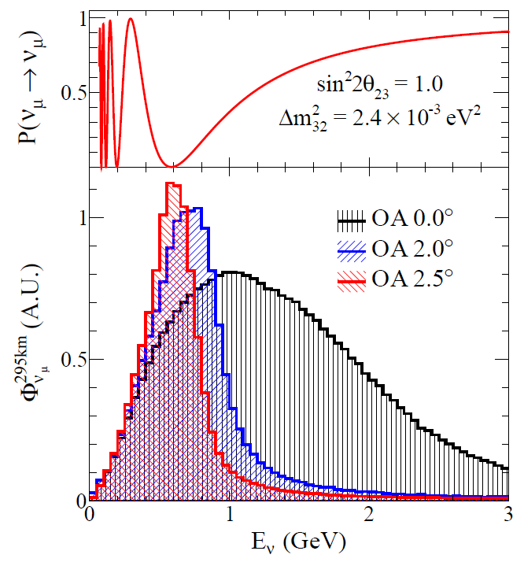
Layout of the T2K experiment
π
Near
detectors
p
μ-monitor
ν
Oscillation
Maximum
off-axis
on-axis
2.0~2.5º
Decay volume
0m
120m
280m
295 km
Conventional “horn-magnet-focused” ν beam
  30GeV Protons on a graphite target
  daughter π⁺ → μ⁺+ν_{μ} (π⁻ → μ⁻+ν_{μ} )
  Anti-neutrino production by inverse polarity
First application of Off-Axis(OA) beam: 2.0~2.5º wrt. the far detector direction
  Low-energy narrow-band beam
  peak tuned to oscillation maximum
  Small high-energy tail: reduce inelastic bkgs

Slide 17
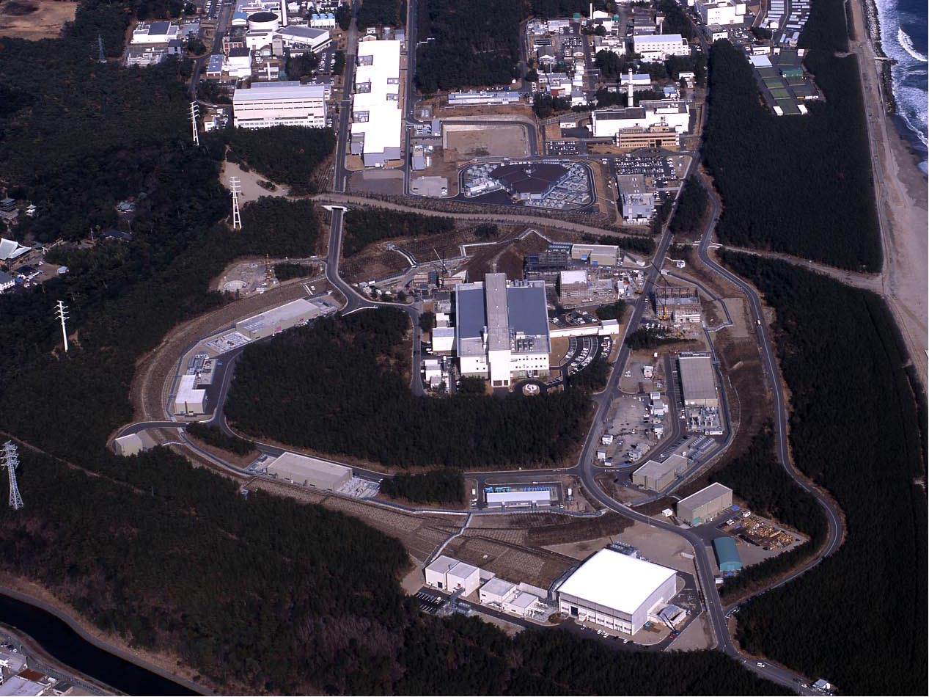

Japan Proton Accelerator Research
Complex
400 MeV H⁻ Linac
3 GeV Rapid Cycling Synchrotron (RCS)
25Hz - 1MW
Neutrino Experimental facility (ν)
30 GeV Main Ring Synchrotron (MR)
A round: 1,568m
Materials & Life Science Facility (MLF)
MR First Extraction to NU
Design beam power : 750kW
30 GeV beam kinetic energy
2.0×10¹⁴ protons per pulse
[ 8 b x 2.5 x 10¹³ ppb in 4.2 us ] Repetition Cycle 1.28sec
Hadron Experimental Hall (HD)

Slide 18
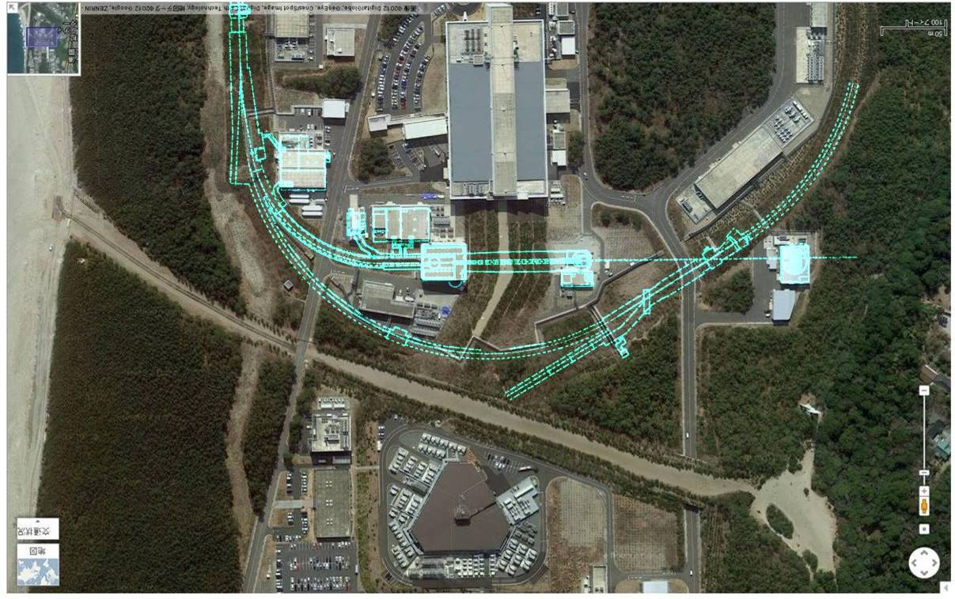
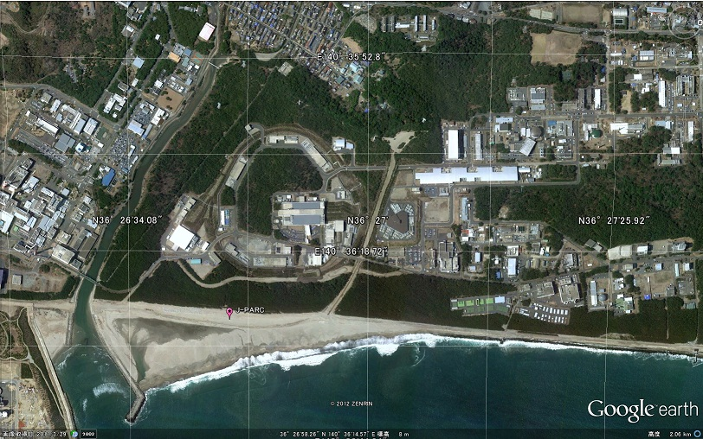
Neutrino experimental facility at J-PARC
Conventional horn-focused neutrino beam-line, designed/constructed for T2K long base-line neutrino oscillation experiment and future Hyper-Kamiokande project
J-PARC, Tokai
N
RCS
Near Neutrino
Detectors
Beam
Dump
Decay
Volume
Muon
Monitors
Target
Horns
ν
μ
π
Main
P
295km
To Kamioka
Ring
110m
Primary
Beam-line
280m
Design beam power
750kW
Future upgrade aiming to
1.3MW
MLF
Extraction
Point

Slide 19

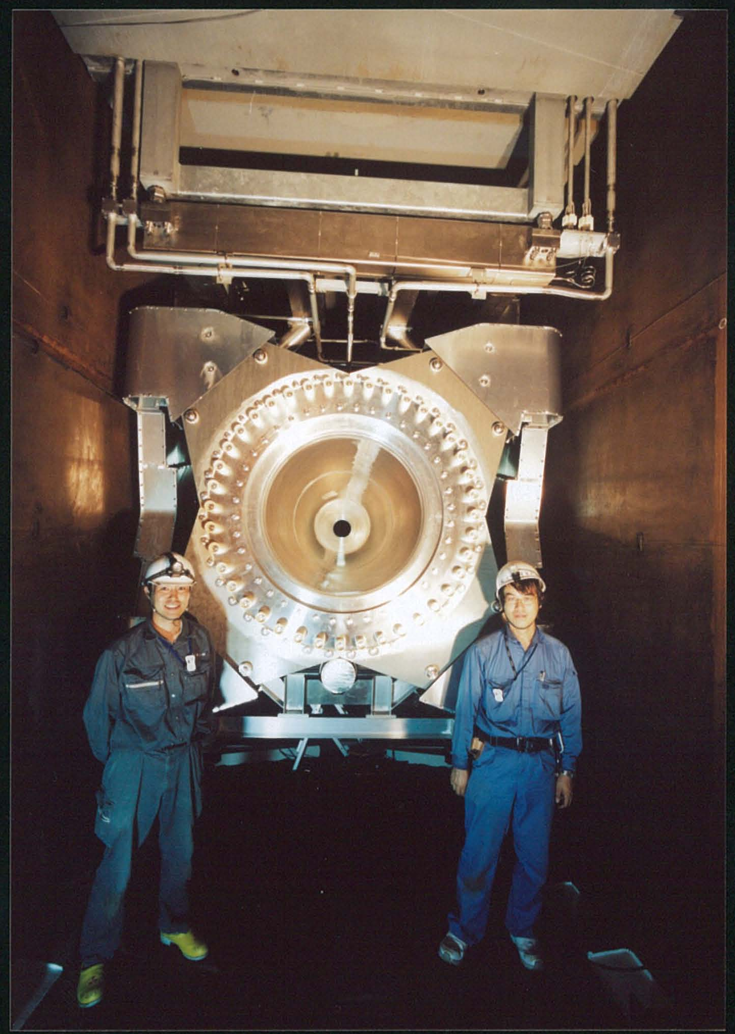
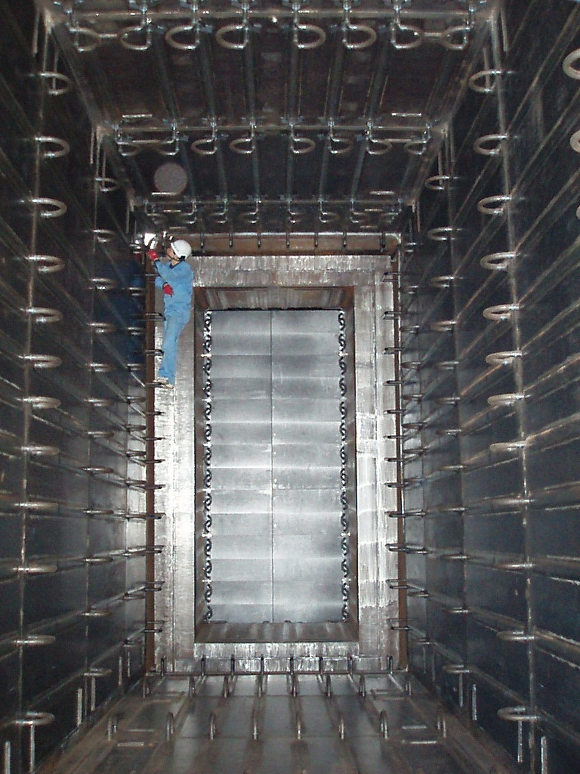
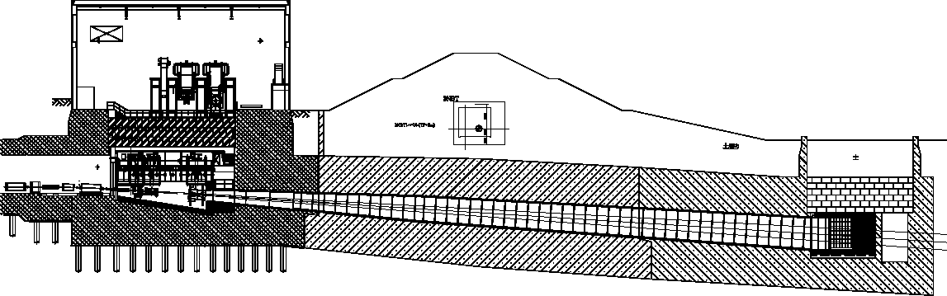

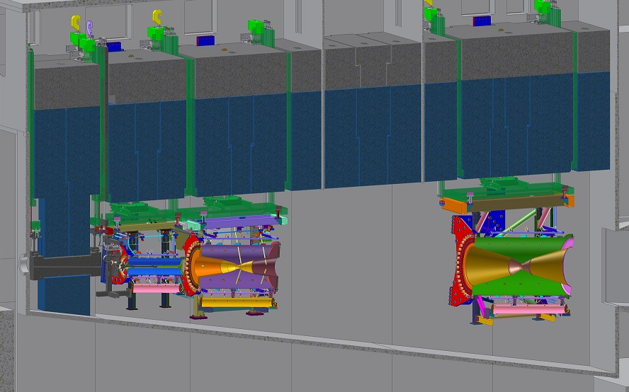
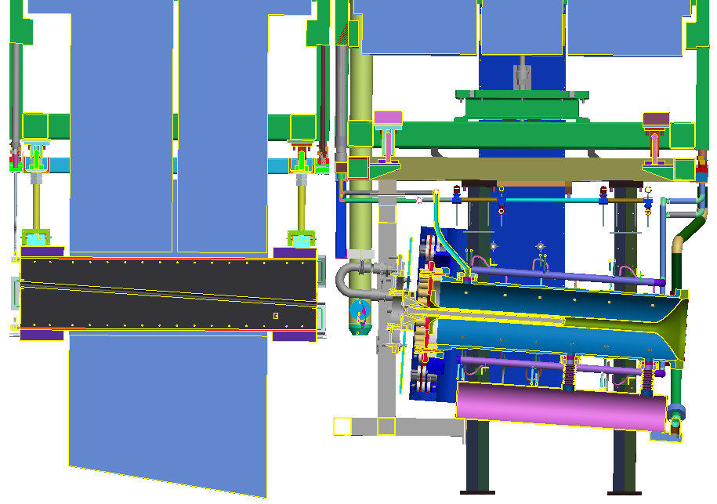
Target Facility (Secondary Beam-line)
Horn-3
Hadron Absorber
Helium Vessel
L=110m, V=1,300m³
Target Station
Beam Dump
Decay Volume
OA
2º
2.5º
[3º]
15.0m
OTR beam
monitor
Target
Beam
window
Horn-3
Baffle
Horn-1
Horn-2
Horn-1

Slide 20
Power upgrade scenario / T2K-2 and Hyper-K
MR power upgrade : Higher repetition rate scheme is adopted to achieve the design beam intensity (750kW) as mid-term upgrade plan
  Rep. rate will be increased from 0.4Hz to 1Hz by replacing magnet PS’s and RF cavities.
  Budget for Magnet power supply upgrade has been secured in JFY2016, and new PS’s to be operational from JFY2018
  Recent accelerator improvements / intensive studies : > 1MW is well within the scope, to be realized in 2020-25.
  Goal of the mid-term plan is to realize 1.3MW operation, corresponding to full RCS 1MW-equivalent beam, injected/extracted with 1.16 sec cycle.
T2K-2 : EoI submitted to J-PARC PAC (Feb.2016)
  Interconnect “desert” between T2K/NOVA and DUNE/Hyper-K era
  Accumulate 2 x 10²² POT by around 2026
  Another 50% increase of statistics by increasing horn/current, analysis upgrades
  > 3 sigma CPV sensitivity
target / window
is designed
Hyper-Kamiokande project
  X ~20 fiducial volume
  1.3MW beam power
  10 sigma (7 sigma) sensitivities for δ_{CP} = ±90 (45) degrees
  Hopefully to be started from JFY 2026, assuming budget approval in JFY2018
Beam Powe | ppp | Rep. cycle
390kW (achieved) | 2.0 x 10¹⁴ | 2.48 sec
750kW (proposed) | 2.0 x 10¹⁴ | 1.3 sec
750kW [original plan] | 3.3 x 10¹⁴ | 2.1 sec
1.3 MW (proposed) | 3.2 x 10¹⁴ | 1.16 sec

Slide 21
[J-PARC / T2K]

Slide 22
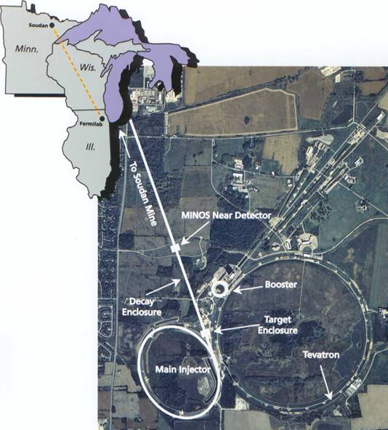
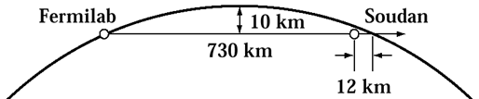
The NuMI Facility
High-power neutrino beam for oscillation experiments
  Beam tilted 3.3°down into the earth
Neutrino beam travels to northern Minnesota
  735/810 km baseline
  Intense source at Fermilab
  Oscillated source in Minnesota
Commissioned in 2004
Operating since 2005
Designed for 400 kW
  Upgraded to 700 kW in 2012 for NOvA
  Upgrading to 1 MW-capable by ~ 2021
>35e20 POT delivered to date
Neutrino beam
Near Detector
Far Detector
5

Slide 23
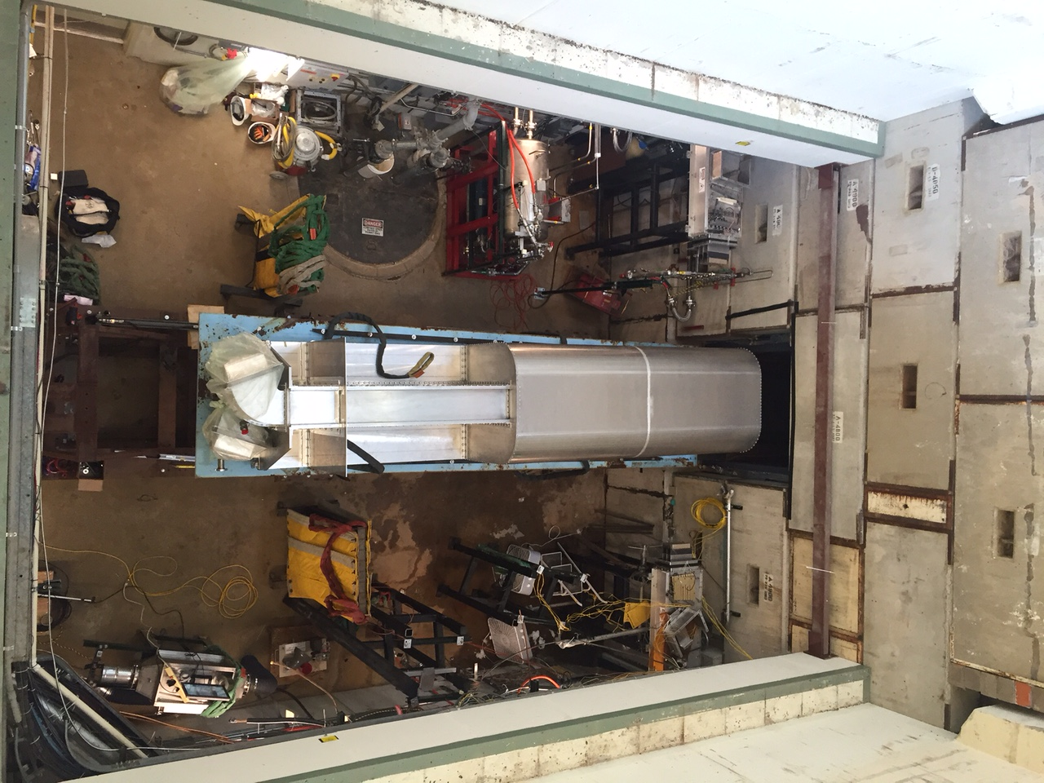
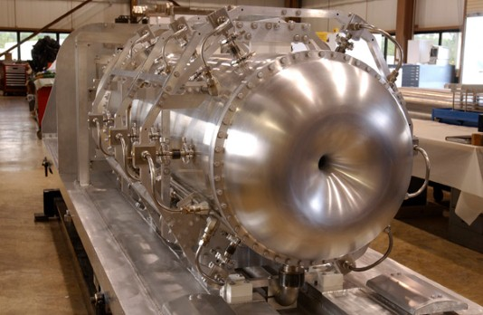
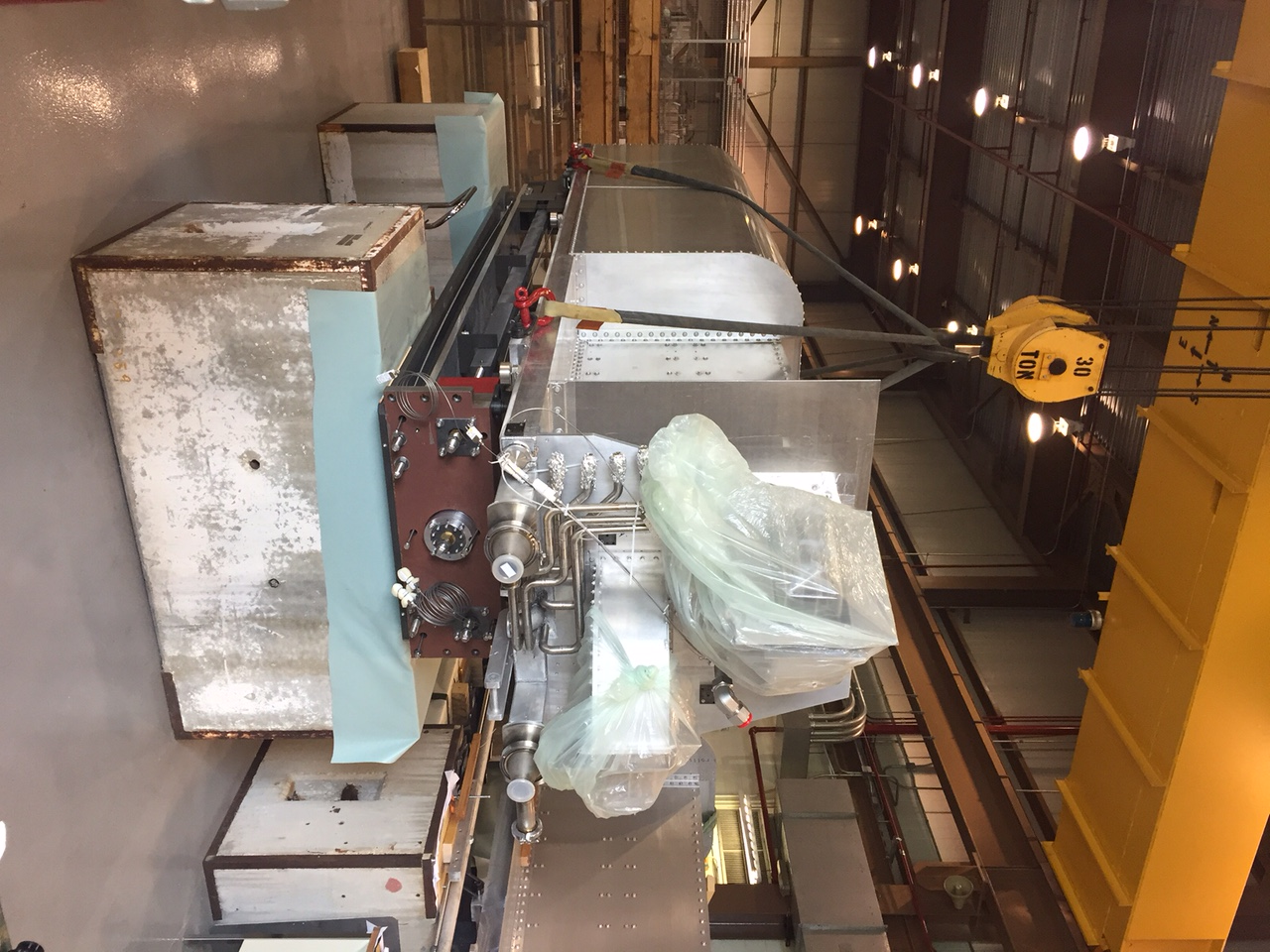
Booster Neutrino Beam (BNB)
Uses 8 GeV beam from the Booster, operating since 2002
  Up to ~ 30 kW of beam (5e12 ppp)
  27e20 protons deliver to target – to date
Two target/horn assemblies have been replaced (water, uncoated aluminum corrosion)
  2nd horn which lasted ten years and >400M pulses
    Design lifetime was about one year and 100M pulses
  Had to also redesign and replace adjustor platform and horn extraction mechanism (corrosion)
  5th horn under starting construction

Slide 24
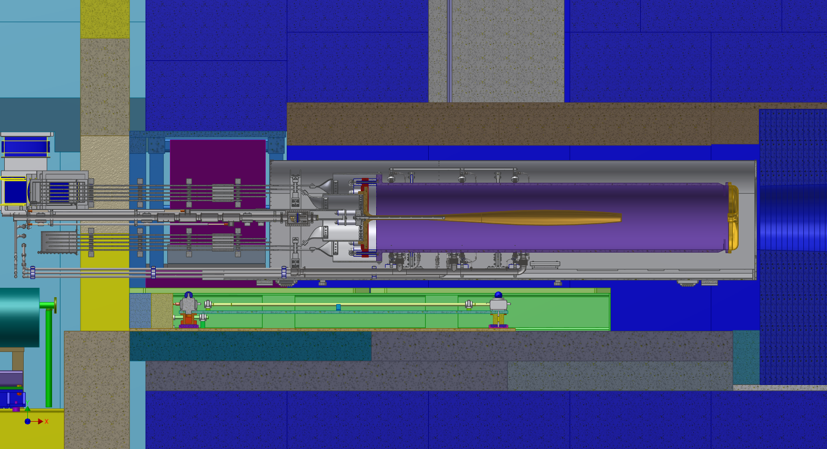

Up to 3.5m Horn to fill in the available space, improve focusing – not presently pursued
The shutter blocks need to close around the stripline to reduce the open aperture for backscattered radiation.
Requires to be in two parts:
Horn and Service Module
The target moves upstream to allow the 3.5m horn room US of the collimator. Shortened the striplines to attach them at the original location in the upstream area.
(The inner conductor is not finished in this model.)

Slide 25
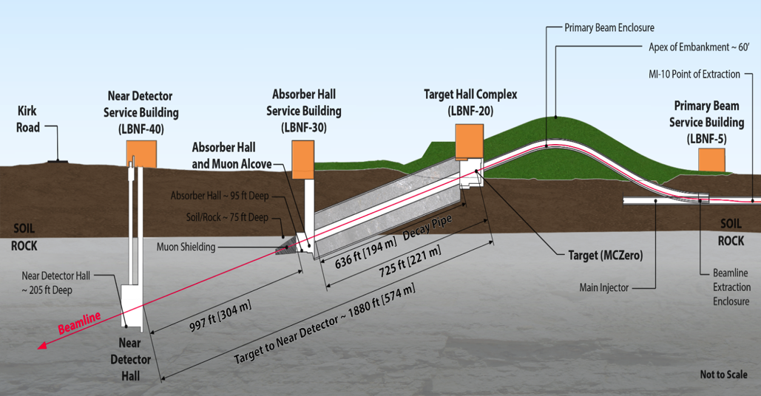

The LBNF Beamline
Facility designed for initial beam power of 1.2 MW, upgradeable to 2+ MW
Proton beam extracted from Fermilab’s Main Injector in the range of 60 – 120 GeV every 0.7 – 1.2 sec with pulse duration of 10 μs
Not to scale
Protons per cycle:
1.2 MW era: 7.5x10¹³
2.4 MW era: (1.5-2.0)x10¹⁴
Beam size at target tunable between 1.0-4.0 mm sigma

Slide 26
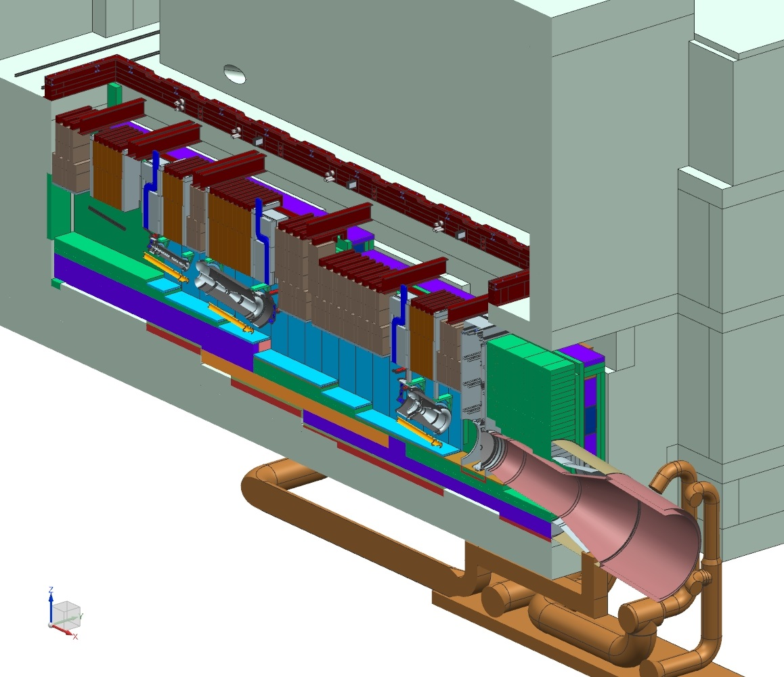
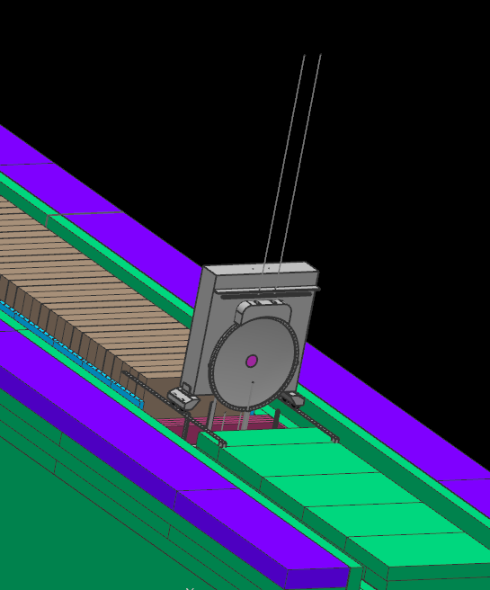
Target Hall Shield Pile Layout – Optimized Design
~ 52% of beam power in target shield pile
Primary
BEAM
Decay Pipe
Upstream
window
N₂
Baffle
Horn A with Target
Nitrogen Cooling Lines
Horn B
Cooling Panels
He
Decay Pipe Snout
Horn C
Target Chase: 2.2 m/2.0 m wide, 34.3 m long nitrogen-filled and nitrogen plus water-cooled (cooling panels). (It used to be air at CD-1R and 2017 IPR).
Preliminary design work started for the Target Shield Pile in FY18.

Slide 27
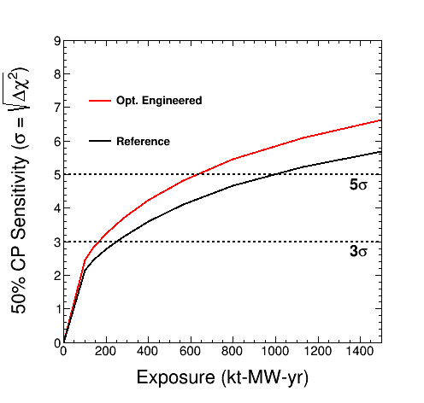
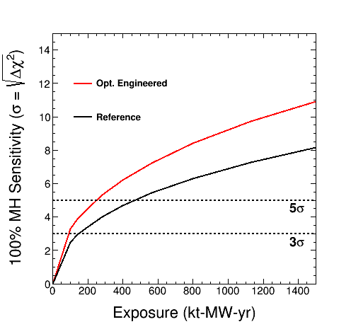
Optimized LBNF design improves beam effectiveness ~ 50%
Improvements are present for all exposures:
CP Sensitivity vs Exposure
MH Sensitivity vs Exposure
Calendar Years

Slide 28
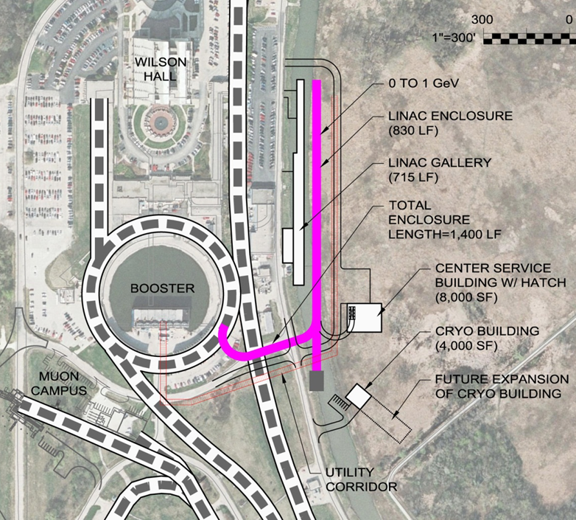
Proton Improvement Plan II (PIP-II)
Increase Main Injector beam power to 1.2 MW.
  Replace the existing 400 MeV linac with a new 800 MeV superconducting linac => 50% increase in Booster intensity.
  Shorten Main Injector cycle time 1.33 → 1.2 sec.
Build this concurrently with LBNF
=> 1.2 MW to LBNF from t = 0.
This plan is based on well-
developed SRF technology.
Developing an international
partnership for its construction
Strong support from DOE
and P5
http://pip2.fnal.gov/

Slide 29
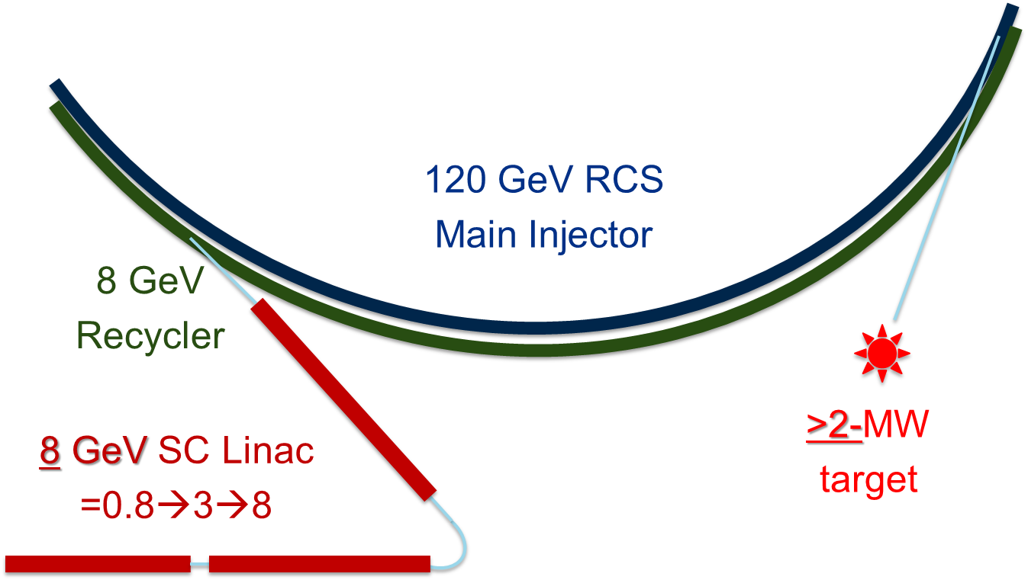
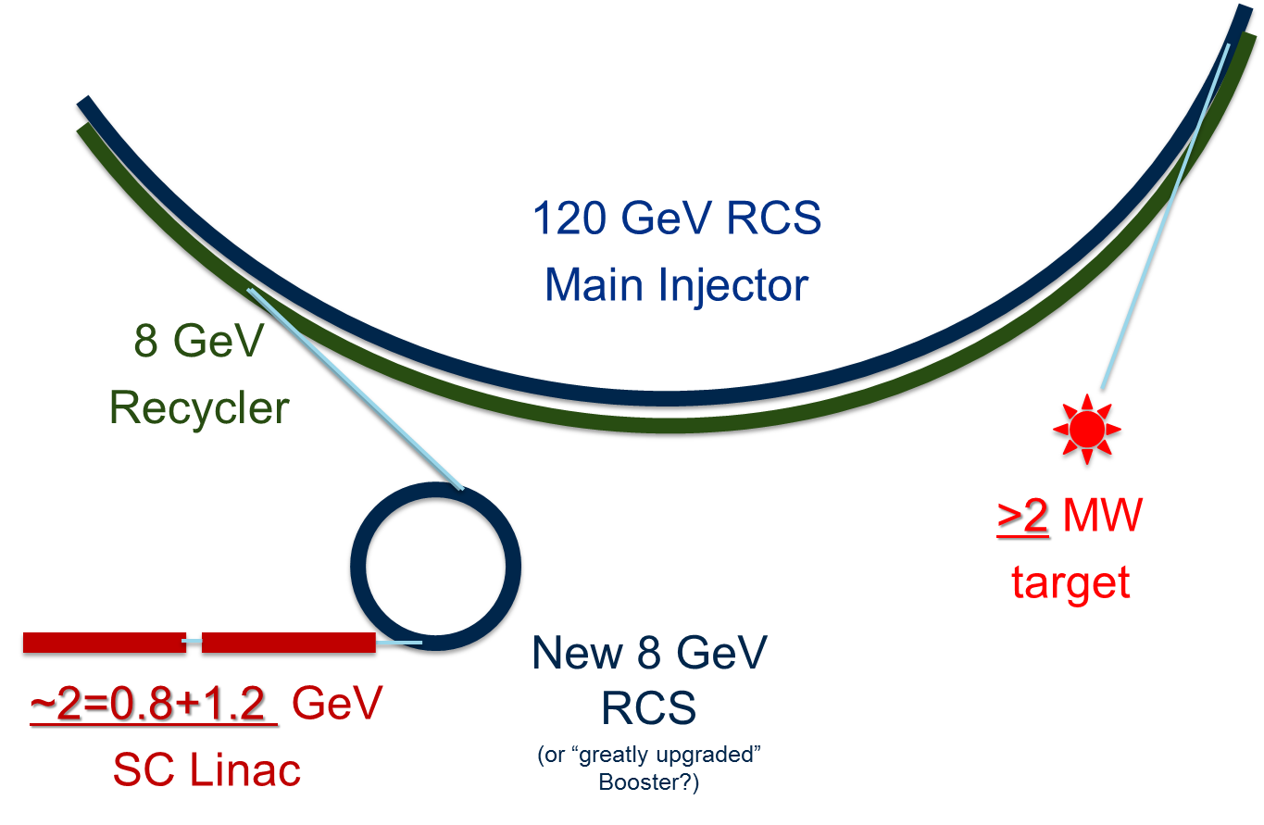
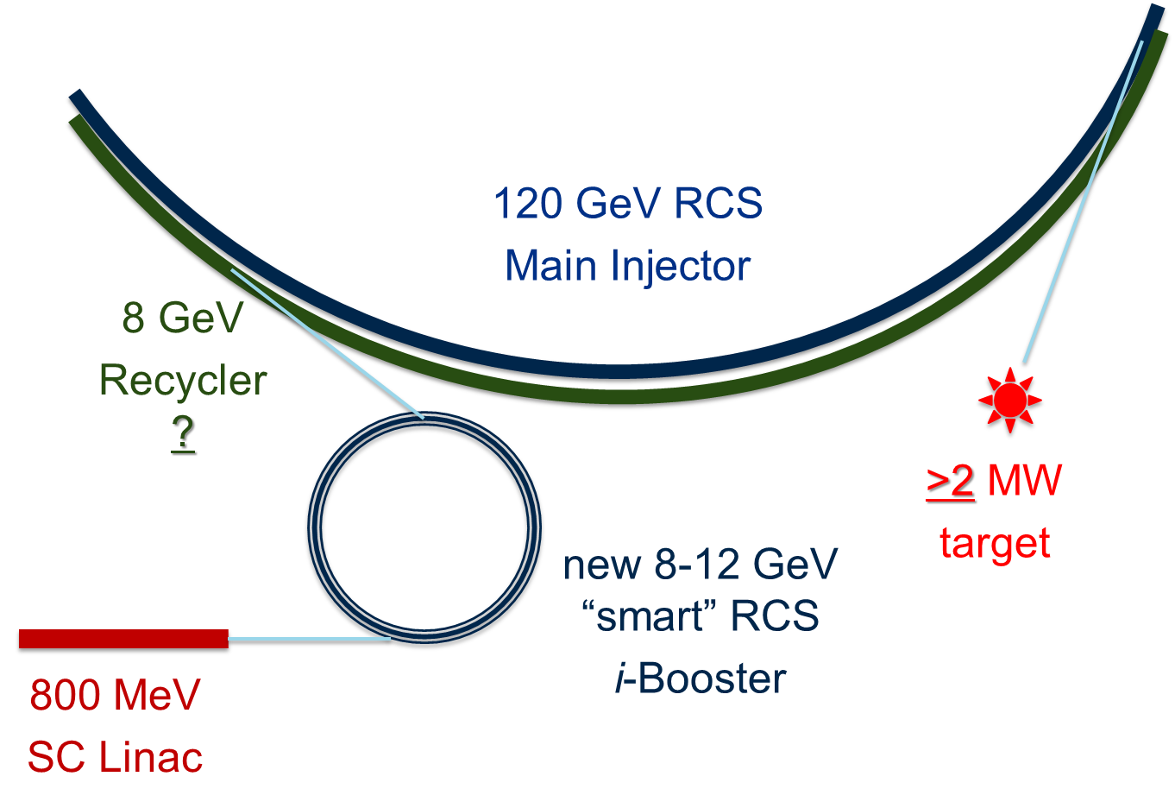
Future Directions – PIP-III
PIP-III is a set of concepts to provide 2-5 MW of beam power for future experiments
Three generalized options:
  Extend Linac to 8 GeV, inject directly to MI/RR
  Extend Linac to ~ 2 GeV, inject into new RCS (or upgraded Booster)
  Develop novel technologies to beat the space charge limit
The approach will be determined by technical and financial factors once PIP-II construction is underway
R&D to inform decision
  Lower the cost of SRF
  FAST/IOTA program

Slide 30
Balancing Conventional Options and Limits
Options
Higher Power
Greater Focusing
  Perfect Focusing
  Tailored Focusing
Off-Axis
  Other narrow band options
Longer-Baseline
Flavor-enhanced
  Suppress Muon decays to suppress electron neutrinos
  Suppress tertiary interactions to suppress wrong-sign neutrinos
  Tau neutrinos from higher energy or oscillations
Short Baseline
Alternate Focusing
Limits
Pion Decay Angle
Hadroproduction
  Also, angle from production
Beam devices (Targets, Windows, & Horns)
  Radiation Damage
  Internal Stresses
Heat Rejection
Radioprotection
Precision
Instrumentation
Reliability

Slide 31
Neutrino Beams beyond LBNF
Conventional beams are approaching their limits, barring new measurement needs or applications
Obvious improvements
  Higher Power (< 10x improvement)
  Focusing (< 2x improvement)
Customization
  Baseline
  Flavor composition
  Energy spectrum
Challenges (numerous)

Slide 32
Future Conventional Neutrino Beams
Robert Zwaska,
First 2018 Neutrino Working Group Meeting
5 April 2018

Slide 33
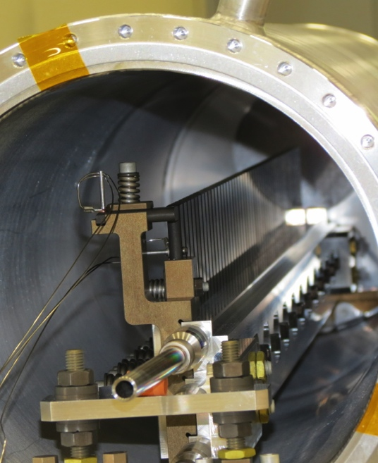
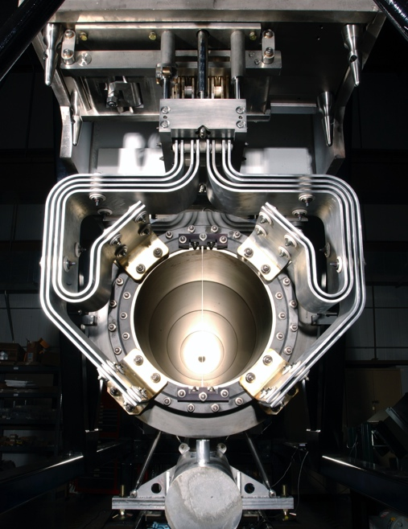
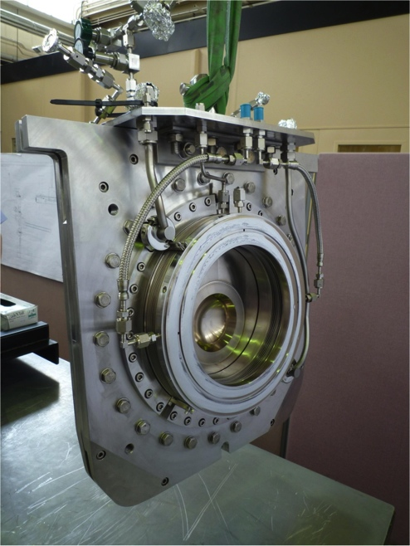
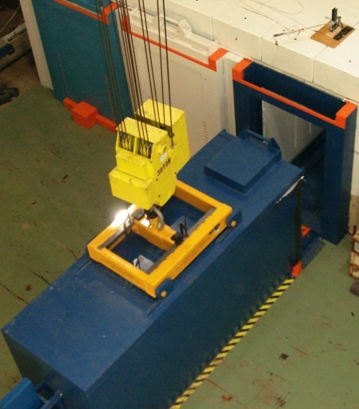
High Power Targetry Scope
R&D Needed to Support:
Target
  Solid, Liquid, Rotating, Rastered
Other production devices:
  Collection optics (horns, solenoids)
  Monitors & Instrumentation
  Beam windows
  Absorbers
Collimators (e.g. 100 TeV pp collimators)
Facility Requirements:
  Remote Handling
  Shielding & Radiation Transport
  Air Handling
  Cooling System
Notes:
Add tie in with 100 TeV pp collider collimator

Slide 34
High Power/Intensity Targetry Challenges
Material Behavior
  Thermal “shock” response
  Radiation damage
  Highly non-linear thermo-mechanical simulation
Targetry Technologies (System Behavior)
  Target system simulation (optimize for physics & longevity)
  Rapid heat removal
  Radiation protection
  Remote handling
  Radiation accelerated corrosion
  Manufacturing technologies

Slide 35
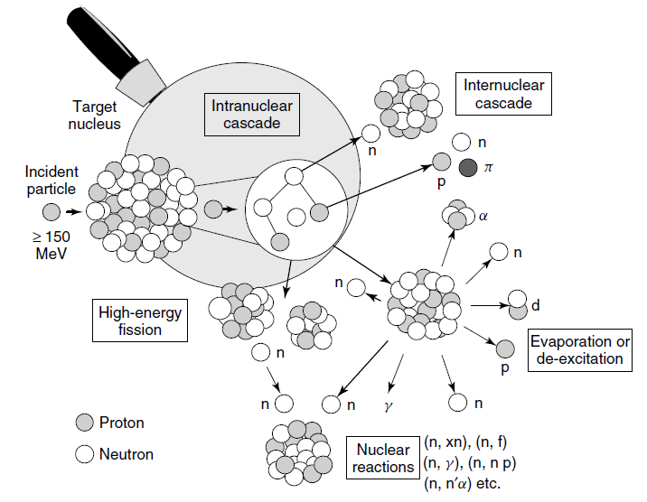
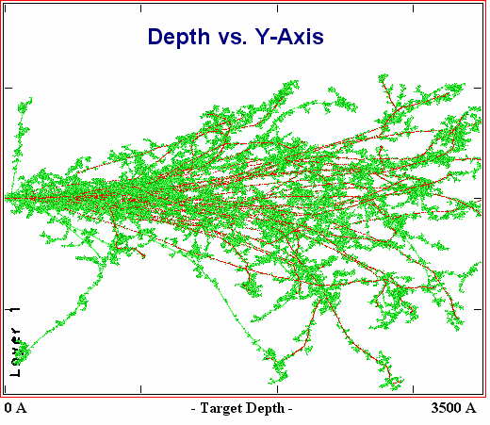
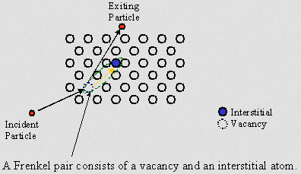
Radiation Damage Disorders Microstructure
Microstructural response:
creation of transmutation products;
atomic displacements (cascades)
  average number of stable interstitial/vacancy pairs created = DPA (Displacements Per Atom)
From D. Filges, F. Goldenbaum, in:, Handb. Spallation Res., Wiley-VCH Verlag GmbH & Co. KGaA, 2010, pp. 1–61.
Slide prepared by V. Kuksenko (Oxford)

Slide 36
HEP HPT Future Needs
Exp/Facility | Laboratory | Time frame (yrs) | “On the books”? | Beam Power (kW) | Comments
ANU/NOvA | FNAL | 0.5 | Y | 700 | Ramping Up!
T2K | J-PARC | 3 | Y | 750 | Ramping Up!
CENF (SBL) | CERN | 5? | ? | 300 | Short baseline nu
LBNF-1.2 MW | FNAL | 10 | Y | 1,200 | PIP-II enabled
HyperK | J-PARC | 10? | ? | 1,660+ | 2+ MW upgrade??
ILC | Japan? | 15? | N | 220 | photons on Ti
Next-Gen Nu Facility –2.5 MW | FNAL | 20? | N | 2,500? | Mid-Term
Next-Gen Nu Facility - 5 MW | FNAL | 30? | N | 5,000? | Longer-term
Other low power (but high intensity) target facilities will also be needed. Notably follow-on experiments to Mu2e/COMET, g-2, etc… These are still challenging targets due to high-Z targets and small beam spots, but are not listed here.
Notes:
Change LBNF at 2.5 and 5 to post-PIP-II nu facility

