Slide 1
Muon Collider– History and Status
Ronald Lipton
Most analysis by Vito Di Benedetto, Anna Mazzacane, Nikolai Terentiev

Slide 2
Some History
A focused accelerator R&D program, MAP, was launched in 2010 to study the feasibility of a muon-based collider program
  There were a number of earlier studies
  A small detector conceptual study was also launched to study the physics potential and associated detector issues
Snowmass studies were based on a simulation of a 1.5 TeV muon collider, with parametric studies of a Higgs factory.
As a result of the 2013/14 P5 process the MAP program was terminated
  This also led to a termination of physics studies
  Most of this work was done by Vito Di Benedetto, Anna Mazzacane, and Nikolai Terentiev with support from the MARS team and Hans Wentzel

Slide 3
Collider Context
LHC results seem to indicate that any new physics spectrum is likely to be in the multi-TeV range.
This is problematic for e⁺e⁻ machines due to power lost to radiation.
Muon collider seems to be the only high luminosity lepton collider candidate capable of affordably delivering CM energies >3 TeV
Other advantages:
  Narrow beam energy spread can enable precision physics
  Muon Collider has x 40,000 higher coupling for s-channel Higgs
  Precise (~4 MeV) Higgs mass measurement
    Enabled by precise beam energy measurement by g-2 precession (Raja & Tollestrup)

Slide 4
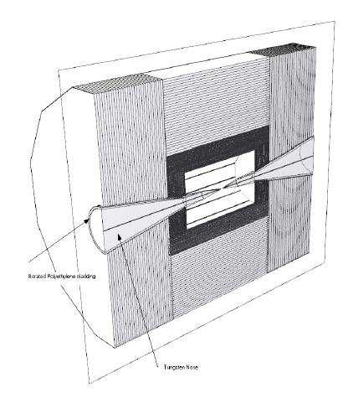
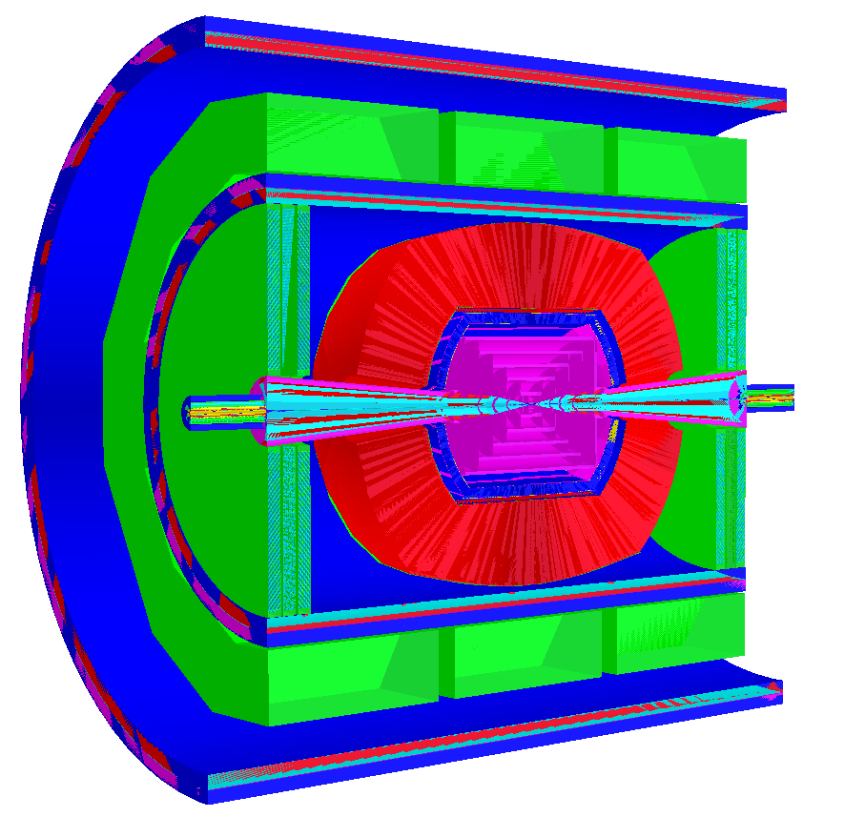
Detector Model
Detector is based on ILC concepts (SiD, ILD, 4th)
Fine pitch pixelated vertex and forward detectors (~20 μm) based on SiD
More coarsely (50 μm) pixelated tracker
  Both with sub-ns timing resolution
Dual readout (scintillator/Cerenkov) calorimeter to optimize hadronic shower resolution
  Based on existing “Adriano” design with realistic parameters – not optimized for timing
  Between 1 and 12 ns timing gates
ILCROOT Detector Model
LCSIM Detector Model

Slide 5
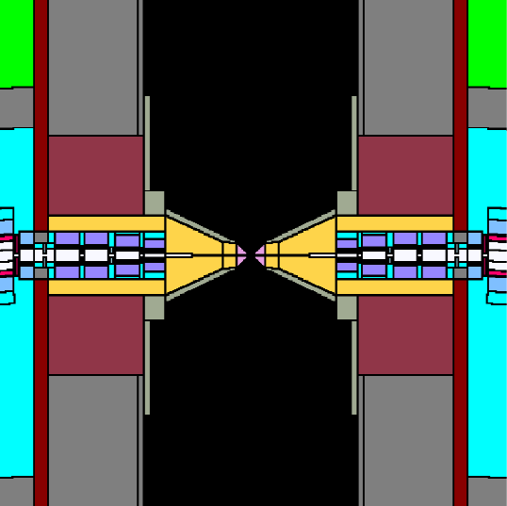
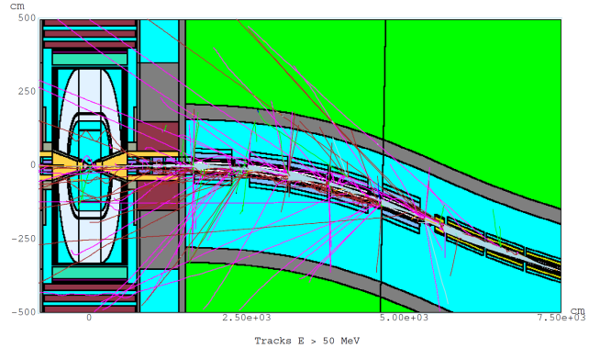
Backgrounds
MARS simulations
From the detector side the central issue in a muon collider are backgrounds due to muon beam decays.
For a 0.75-TeV muon beam of 2x10¹²/bunch
  4.28x10⁵ decays/m per bunch crossing
  0.5 kW/m.
Recalculated with a timing bug fixed in 2014
3.24x10⁸ particles into detector per crossing
  100 keV threshold for γ, e± ,μ±
  and charged hadrons
  0.001 eV for n
MARs-
ILCRoot
handoff
W-poly nose

Slide 6
Background Distributions
Mostly neutrons, photons and conversions

Slide 7
Background Energy Distributions

Slide 8
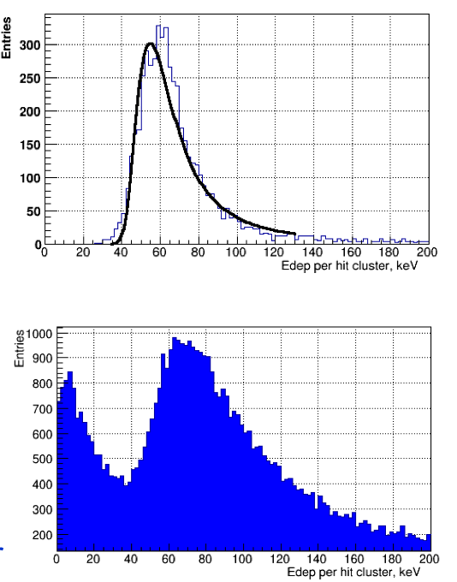
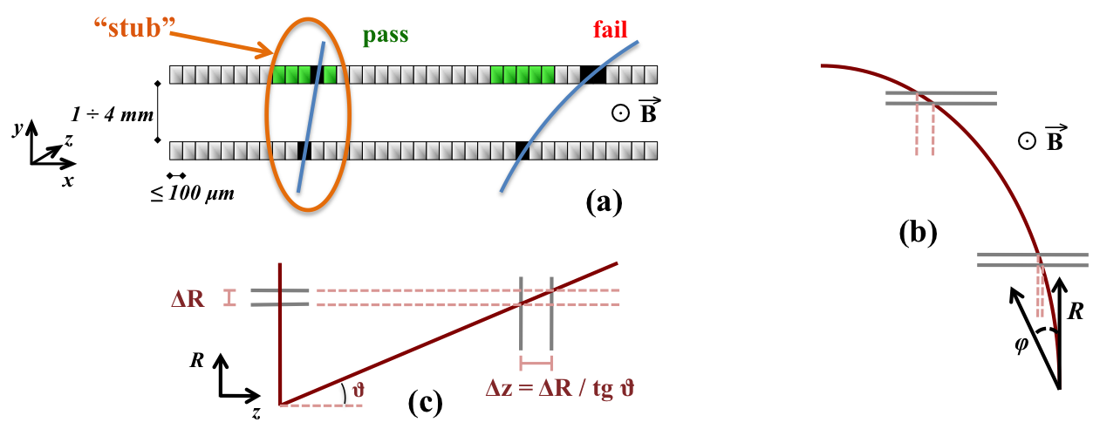
Background Cuts
(N. Terentiev)
We had relied heavily on timing for background rejection
A timing bug in MARS meant we had to revise physics analyses after Snowmass
  The peak level in the tracker at t=0 is about 4 orders of magnitude higher than before
  The effects in the calorimeter are less dramatic
Cuts
  Timing with respect to muon
  Energy deposition
  Angle offsets
Energy cuts
Time cuts
Angle cuts

Slide 9
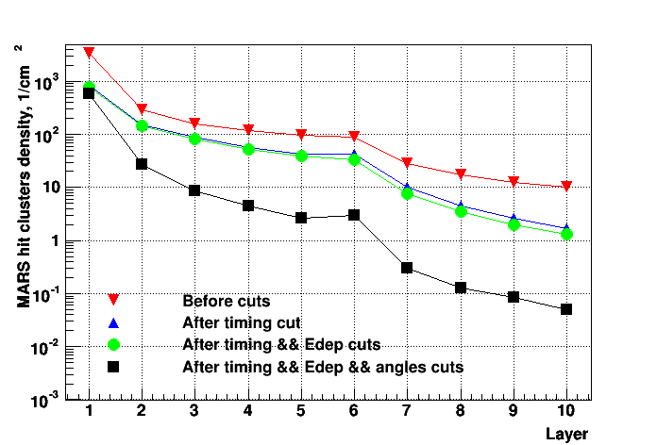
Tracker Cuts
VXD and Tracker cuts
  timing gate width 0.9 ns (VXD) and 0.9 ns – 1.05 ns (Tracker)
  energy deposition, Z, layer dependent
  Delta Phi
  Delta Theta, depends on Z and layer
At IP muon efficiency ~85%
  MARS background fraction is ~17% in the innermost VXD layer
  ~0.5% in the outermost Tracker layer
  The density of MARS surviving hit clusters is ~580 cm⁻² for innermost VXD barrel layer and ~0.05 cm⁻² for outmost Tracker barrel layer.
An additional calorimeter ROI cut had to be used for the physics analysis
Needed – small pixels, fast (50ps) timing, fast correlation of hits in φ and θ

Slide 10
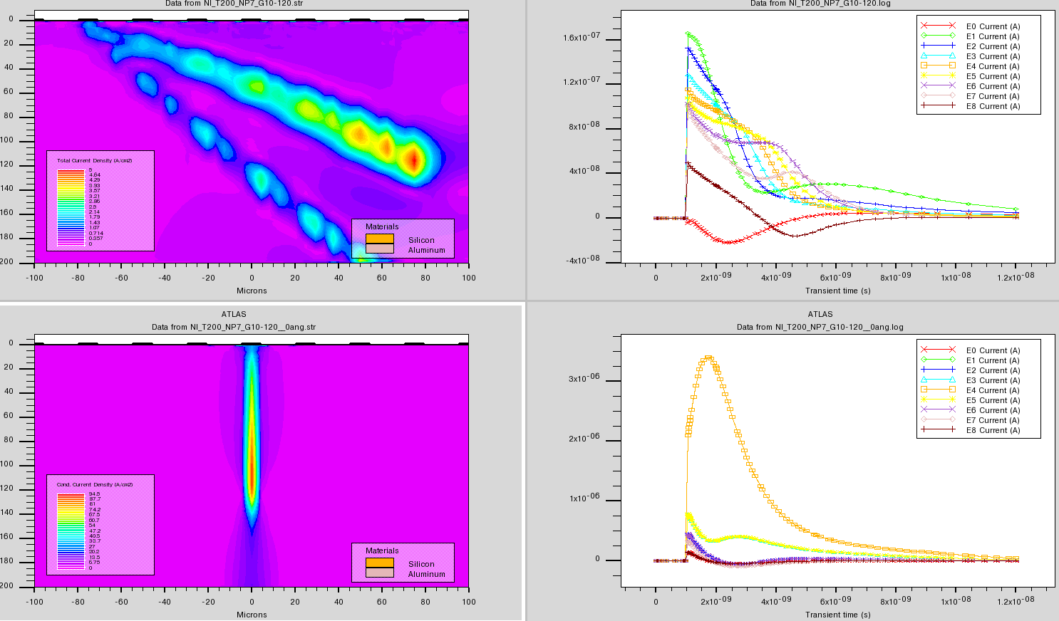
A more sophisticated approach
Analyze the shapes (peak/width) and patterns of the pulses to determine the track angle and timing. Cut differently on φ and θ pixels. Need fast, smart (3D integrated) electronics. This is not far from current capabilities
25 micron pitch 200 micron
thick pixel detector
Background Track path
Electrons
& holes
100 ps after
impact
Current
Pulses
Large angle
background
Signal Track path
Normal
incidence
signal
Current
Pulses

Slide 11
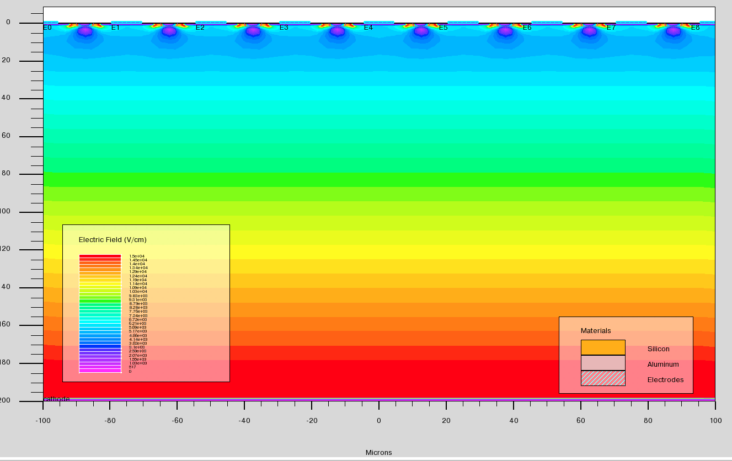
Implementation
Digital tier processes a field of pixels
Analog electronics tier with discriminators
timing and memory
x
25μ
High field (junction) side
shapes induced currents

Slide 12
Calorimeter Backgrounds
Much of the calorimeter background is soft and electromagnetic
  High occupancy in the first few radiation lengths
  2014 study used a time cut and front/back segmentation
  Background pedestal was subtracted.

Slide 13
EM Calorimeter
I have not thought about this too much
Original studies used a dual-readout scheme - can this be improved?
A CMS HGC/Calice design for the EM section with finer sampling seems to make sense
Use deeper layers to define shower position
  Fit to shower longitudinal and transverse shapes to remove background pedestal
  Pointing of showers
Some energy in a hadronic shower is delayed – how do time cuts affect this?

Slide 14
Summary
The physics reach of a Muon collider has tantalizing promise, with many unknowns
It is challenging for both accelerator and detector technologies
  An opportunity to explore and expand limits
The utility of such a machine depends on the physics context
  Precision physics > 3 TeV
  Precision Higgs mass studies
  Z’
  ?
A clear understanding of the capability of such a machine would take a significant focused effort for several years (CLIC example)
Summaries MAP 2014 winter meeting: https://indico.fnal.gov/event/8959/other-view?view=standard
Talks by Di Benedetto, Terentiev, and Lipton

