Slide 1
Future noble liquid dark matter
Criteria
  Scientifically interesting – does it have reach to new parameter space or can it better understand a discovered particle?
  Can Fermilab play a leading role?
  What R&D is needed?
Three potential avenues
  Large liquid noble detector
  Upgrade to LZ
  Liquid helium detector

Slide 2
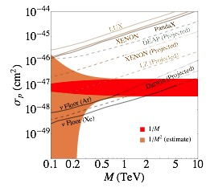
Large future liquid noble detector (LXe or LAr)
Probe down to neutrino floor (what does that mean?) at 100 GeV (x5-10 relative to LZ plan)
At the moment, no real momentum in US, so FNAL could start the US train
  Cryogenics is an obvious
  in, between LZ and DS work.
R&D needed into:
  Liquid purification
  Radon reduction
  Photosensors (SiPMs?)
  Electronics readout (multiplex on cables)
  …

Slide 3
Upgrade to LZ
Doping with Helium, Double beta decay, or extended running with additional background reduction (e.g. radon removal)
He-doping has new reach (in 2025?), extended running can get another factor of 2-3
He-doping would be FNAL led by default, Hugh currently co-chair of future LZ task force
R&D into:
  Photo sensors (SiPMs?)
  Doping techniques
  Cryogenics of mixed fluids
  Radon reduction
  Calibration

Slide 4
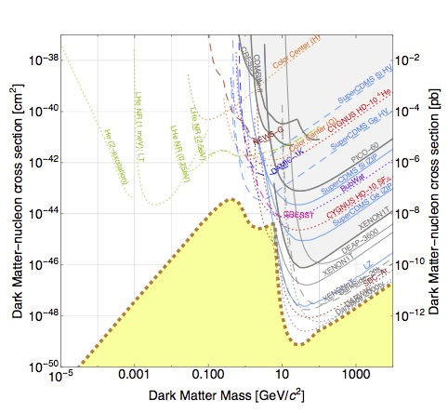
Liquid Helium Detector
Push to low masses, beyond any other current technology
Cryogenic or calibrations role for FNAL, ties in with quantum sensing perhaps
  Politics are interesting – McKinsey at LBL, but not clear that they are pushing it at the lab
R&D into
  Single He atom sensors (TES)
  Calibration at sub 100 eV scales
  Possible use in NEXUS
  Lots of things
From 1707.04591

Slide 5
Future liquid noble dark matter
Three possibilities
  Large liquid noble detector – probably makes the most sense from the lab perspective, but I’m not sure how much support there is yet
  Upgrade to LZ – depends a bit on external factors (my EC proposal, NP/HEP détente)
  Liquid helium detector – possible tie into quantum information, but least current expertise at FNAL – we would need someone to actually think about this with real fraction of time

