Slide 1
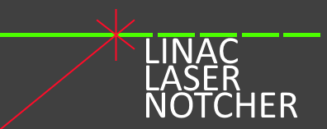
Bunch-by-bunch Neutralization and applications for H- beams
David Johnson, Todd Johnson
US-Japan Collaboration Meeting
14-March-2018

Slide 2
Lasers for Accelerators
Lasers have been used for laser profile monitors; SNS, BNL, JPARC, …and
H⁻ + γ -> Hº + e⁻
3 step process of 2 electron removal (H- Stripping for injection)
SNS Model ${ H}^{−}→H^{0}+e^{−}$ $H^{0}+γ→H^{0∗} (n≥3)$ $H^{0∗}→p+e^{−}$
J-PARC Model $H^{−}+ γ →H^{0}+e^{−}$ ${ H}^{0}+γ→H^{0∗} (n≥3)$ ${ H}^{0∗}+ γ →p+e^{−}$
The first as notcher test here at FNAL linac (first demonstration circa 2000 Ray Tomlin using a 500 mJ q-switch laser on a CW beam in 750 KeV line to create a single notch)
Additional notcher proposals were described in 2005 by Xi Yang to notch the linac beam at the Booster injection RF frequency (FN-0765-AD) and at the revolution frequency utilizing a pumped recirculating cavity (FN-0767-AD). Neither of these proposals were implemented.
The first bunch-by-bunch neutralization system using a laser proposed 2009 for Project X wideband chopper.
“Laser Chopping Concepts” presented to APC SCRF group Nov. 2009
“Linac Laser Notcher in the Proton Improvement Plan” APT seminar Feb 2014
“Fermilab Linac Laser Notcher” IPAC 2015 (poster/paper)
“Linac Laser Notcher for the Fermilab Booster” LINAC 2016 (invited talk/paper)

Slide 3
Laser Landscape
Laser Notcher
Courtesy of Yun Liu, SNS
Laser Stripping Workshop 2013

Slide 4
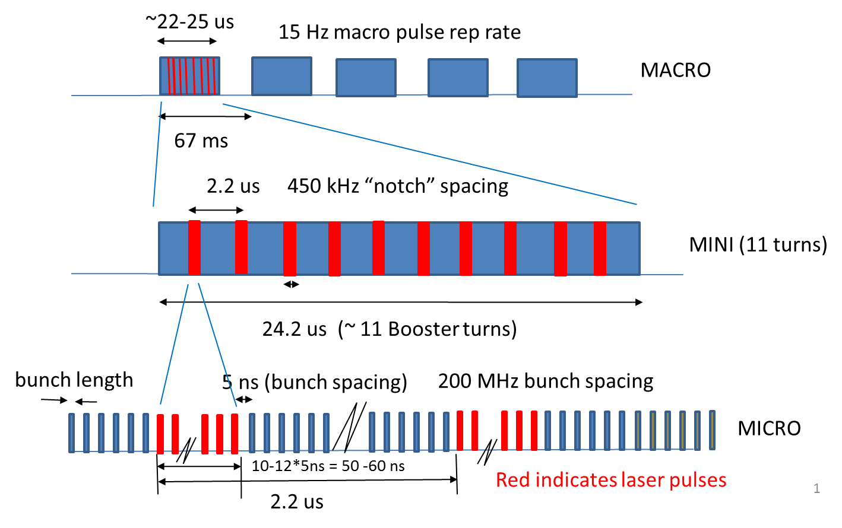
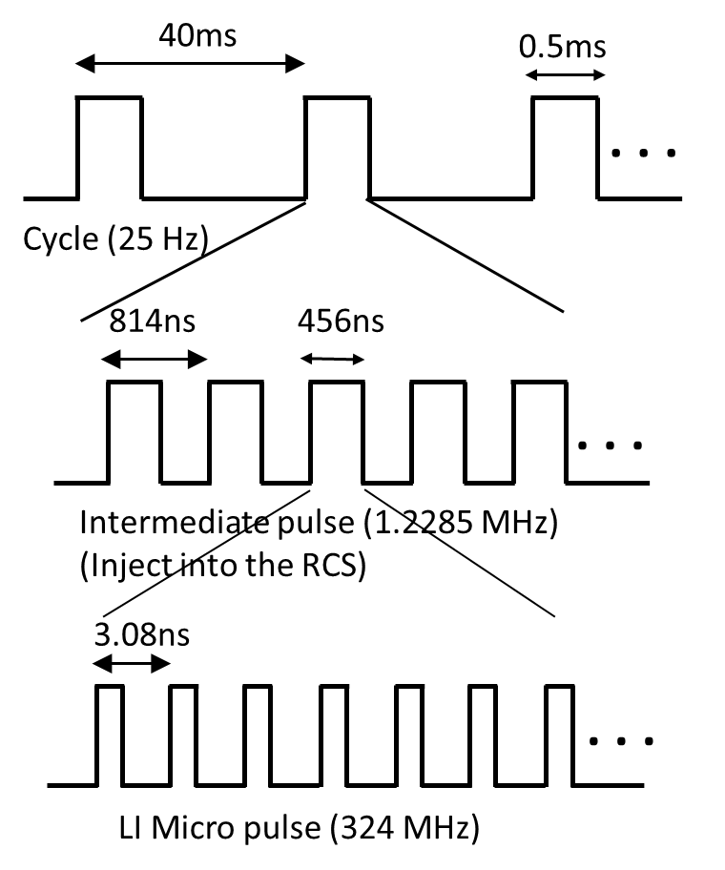
Design ideas (1)
Major questions to determine Laser/Amplifier requirements;
What are we trying to do with our laser interactions of H-ions
Neutralize or strip ?
Ion beam energy
Ion bunch structure –PRF (MACRO, MINI, MICRO bunch structure)
Ion beam size (transverse and longitudinal)
How many bunches do we want to affect?
→ Duty factor
J-PARC LINAC beam parameters:
Pranab K. Saha: 2017/11/08
LI peak current at present: 50 mA
LI pulse width/ repetition: 0.5ms/25 Hz
Duty = 1.25%
Chopper duty on beam: 56%
When ADS will be in operation:
LI repetition will be upgraded to 50 Hz
25 Hz w/ chopper on to the RCS (133 kW)
25 Hz w/ no chop to the ADS
→ 324 (972) MHz micro pulse to the ADS
Beam power to the ADS: 237 kW
To ADS TEF-P target: 10 W at max.
Rest of 237 kW to the ADS TEF-T target
DF 5.3E-4
DE 3.6E-2
DF 0.4
Total DF 7.7E-06

Slide 5
Design ideas (2)
Laser requirements
Wavelength (near IR, MID – IR , UV, deep UV ?)
Pulse length
Pulse energy
Base rep frequency
What type of laser system
Given the laser requirements
Off the shelf (commercial) OR custom system design
Laser system (cavity & gain medium) OR Seed/Amplifier (i.e. MOPA)
Further choices
Bulk gain media OR fiber gain media OR a combination (i.e. hybrid)
CW pumped or pulsed pumped or some combination
Interface – how to interface to your facility
Peak Power
Average Power

Slide 6
Design ideas (3)
Lasers (pumped gain medium in a cavity – CW or pulsed (q-switch)
Source of pulses to be amplified either in fiber or bulk amplifiers
Creation of final pulse requirements
Amplifiers
Requires a seed source
Laser with a given prf (or maybe adjustable)
CW diode laser with external pulse modulation
This allows for a very flexible pulse format
The pulse energy at this stage is VERY low ( 10’s pJ’s)
Requires amplification to get to uJ or mJ pulse energies
How many stages to get uJ or mJ
Assume 1 mJ from 1 pJ → 90 dB → 6 stages
Details get rather complicated at this point as to selection of seed and amplifiers

Slide 7
Example of Amplifier chain

Slide 8
Example of Amplifier layout
Peak Power:
Laser Notcher design
2 mJ/2 ns = 1 mW
Currently ½ to ¾ MW
82 mJ/500ns = 164 kW
Slide from: Andy Clarkson
ORC, Southampton ,UK
SMR 1829-5 (2007)

Slide 9
Laser System Block Diagram for Laser Notcher
MOPA system
Hybrid Amplifiers
Transverse profile shaping
Must lock to 200MHz Linac bunch
Must lock to Booster RF
Cogging system must lock to notch
Booster must lock to existing notches
Design Intensity 2 mJ/pulse for 256 pulses/linac cycle.
Currently running a mean pulse energy of 1 mJ for 272 pulses/linac cycle
PCF gain fiber

Slide 10
Non-resonant interaction cavity to reduce required laser power

Slide 11
Reduction of required pulse energy

Slide 12
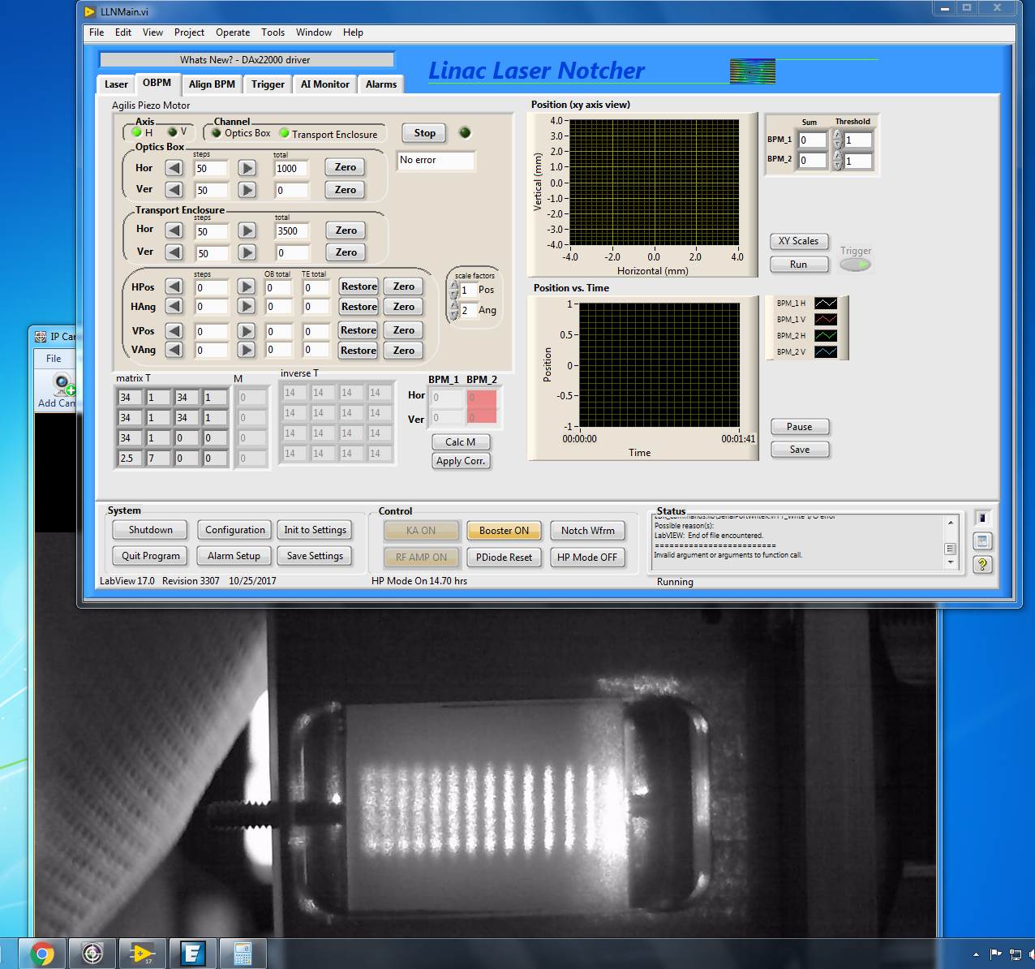
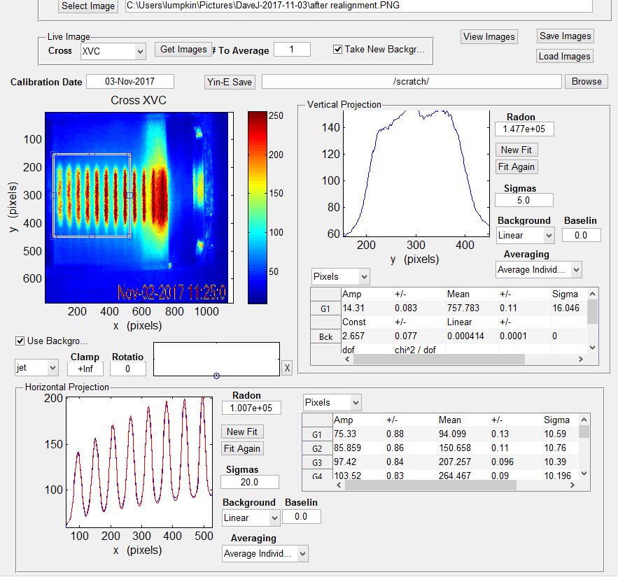
Change number of bounces by adjusting input angle into cavity

Slide 13
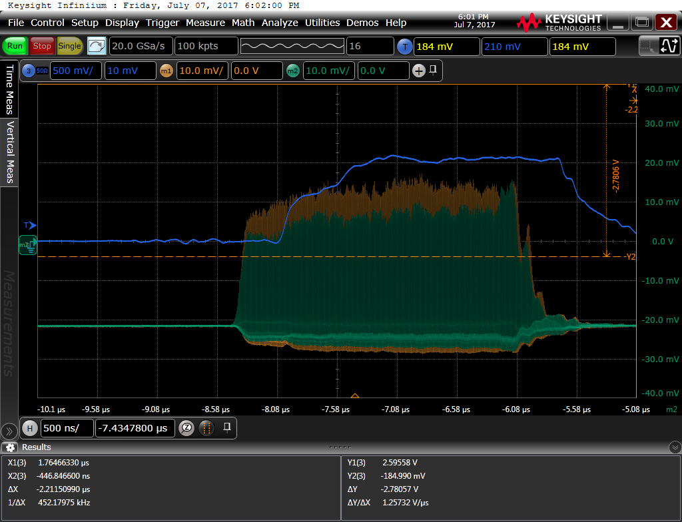
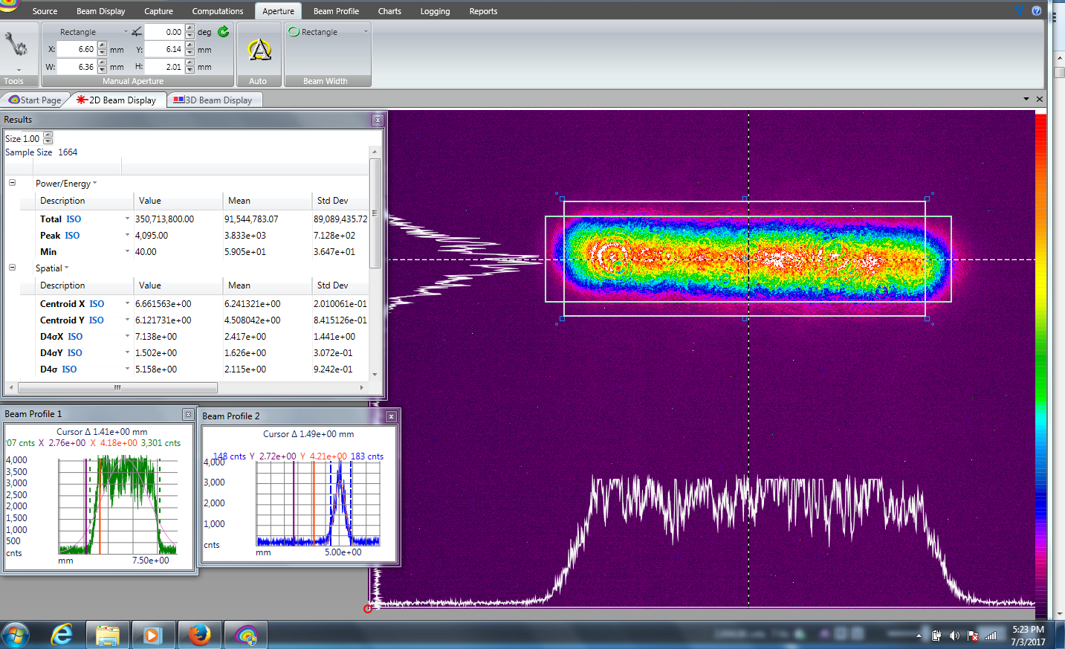
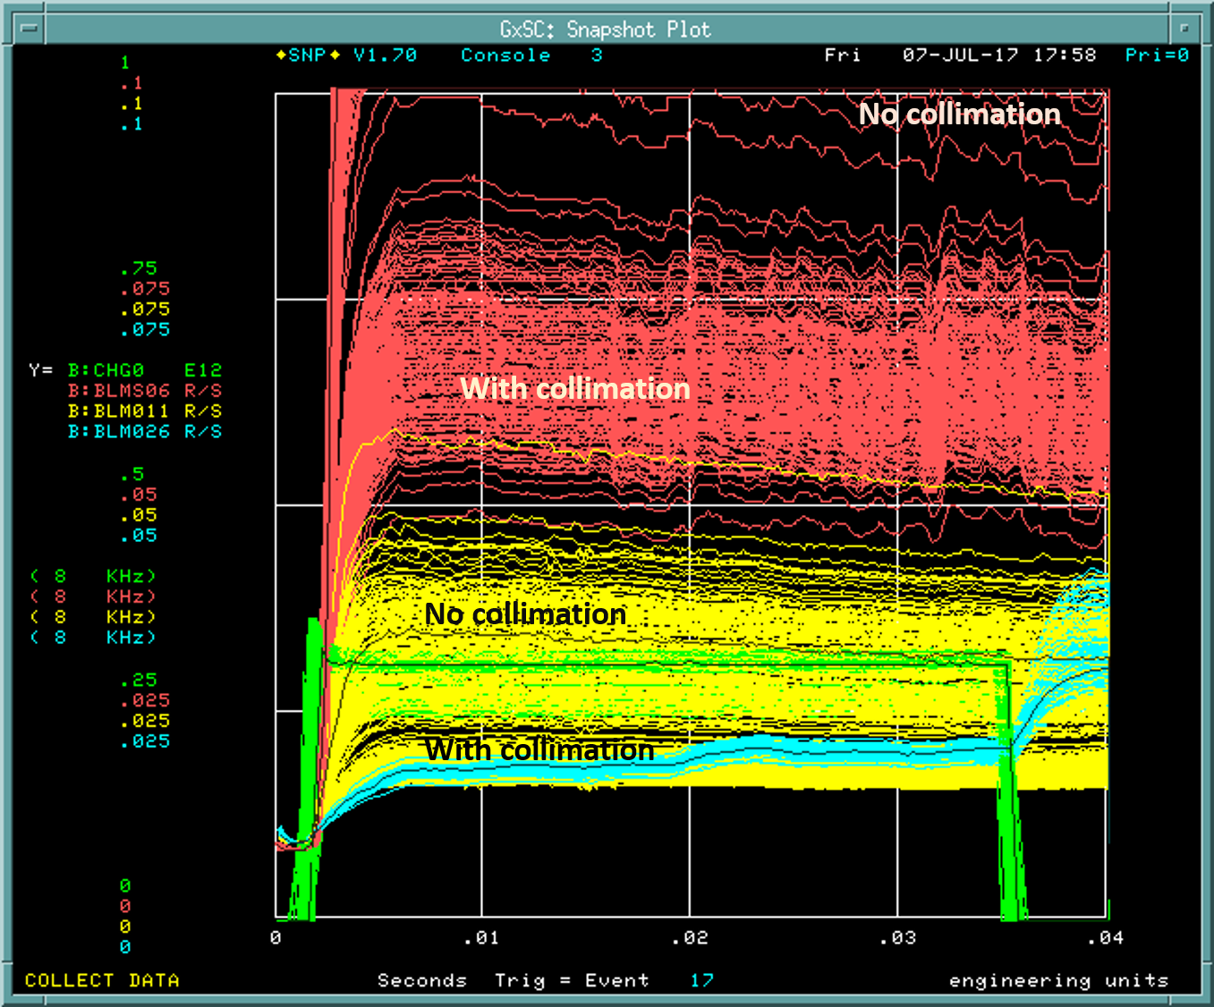
Adjusted our transverse laser profile and collimated the H- in vertical

Slide 14
Development going Forward

Slide 15
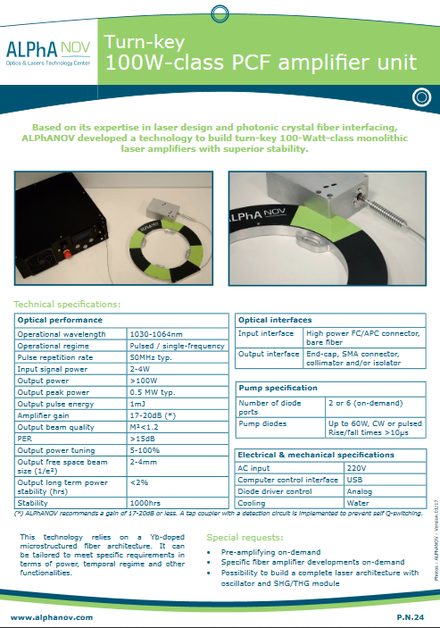
Examples of PCF Amplifier
Version built for MIT runs at ~1 mJ/pulse (3-4 ns)
300 kW peak power 200W average power sustained

Slide 16
Concept for Momentum collimation – shaving longitudinal phase
w
w = 50 us
prf = 15 Hz
DF = 7.5E-4
Linac
prf_{MACRO}
pw
pw = 50 ps each
pE = 15 uJ each
ps = 2 ns
prf = 201.25 MHz
DF = 0.016
ps
prf_{micro}
Laser produces 201.25E6*50e-6 = 10,000 pulses /cycle
For 30 uJ/pulse*10,000 pulses = 0.3 J /pulse
Split amplified pulse→ delay line → recombine
temporally with adjustable spacing (ps)
Create head/tail out of single amplified laser pulse
Peak Power = E/pulse/pulse width
=30 uJ/0.1 ns = 300 kW
Spot size 1mm x 7.5mm
50 passes, 0.59 mm separation, 1.19mm at mirror
cavity length 2.9 cm, laser path 0.73 m,
neutralization 96% with 15 uJ pulse
Average power = Peak power*DF
= 300 kW* 3E-5 = 9W

Slide 17
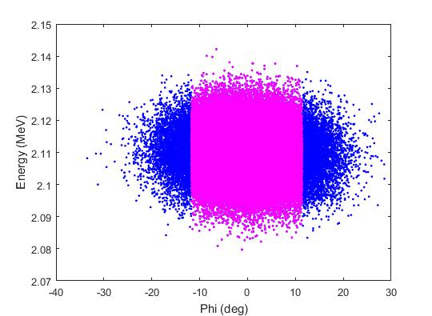
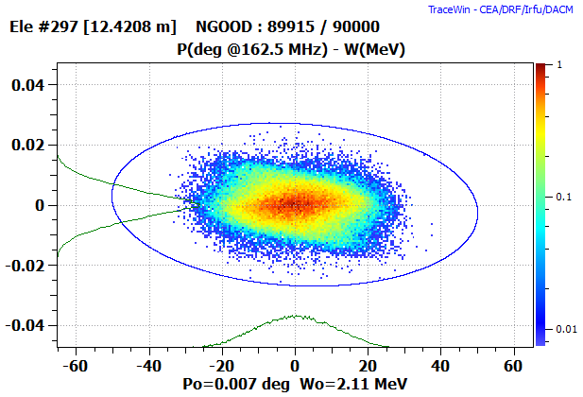
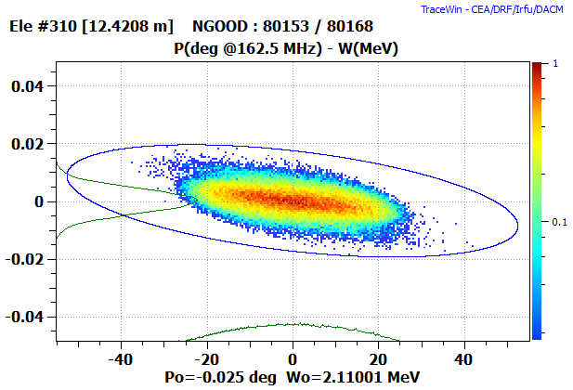
Concept for Momentum collimation – shaving longitudinal phase
w
w = 500 us
prf = 15 Hz
DF = 7.5E-3
PIP-II Momentum collimation
prf_{MACRO}
pw
pw = 100 ps
ps = 1 ns
prf = 162.5 MHz
DF = 0.016
ps
prf_{micro}
Laser produces 162.5E6*500e-6 = 81,250 pulses /cycle
For 10 uJ/pulse*81,250 pulses = 0.8125 J /pulse
Split amplified pulse→ delay line → recombine
temporally with adjustable spacing (ps)
Create head/tail out of single amplified laser pulse
Peak Power = E/pulse/pulse width
=10 uJ/0.1 ns = 100 kW
Spot size 1mm x 1.6mm
100 passes, 1.1 mm separation, cavity length 10.9 cm
Laser path 1.6m, neutralization 99.7% with 5 uJ pulse
Average power = Peak power*DF
= 100 kW* 1E-4 = 10W

Slide 18
Summary
We have demonstrated the ability to neutralize individual bunches with in a bunch train.
This flexibility can be applied to many applications, not only in H- manipulation, but in any application requiring multi-MHz pulses in a continuous or burst mode
Fermilab continues to develop technology in non-resonant interaction cavities.
Fermilab will continue to develop laser system with a high peak, high average power quasi-CW laser systems suitable for full linac pulse neutralization applications.
We see this approach as contributing to the further growth in the utilizing of laser interactions with H- for a variety of applications.

Slide 19
END

Slide 20
Required Pulse Structure
We must match the H- ion 200 MHz bunch structure exiting RFQ.
The width of the 200 MHz burst must be at least 60 ns to allow for rise time of the Booster extraction kicker (we will use 80 ns).
Number of notches = Number of injected turns in Booster – 1.
Each pulse must match H- bunch length out of the RFQ.
Want variable pulse length and roughly uniform spatial and temporal profiles.

Slide 21
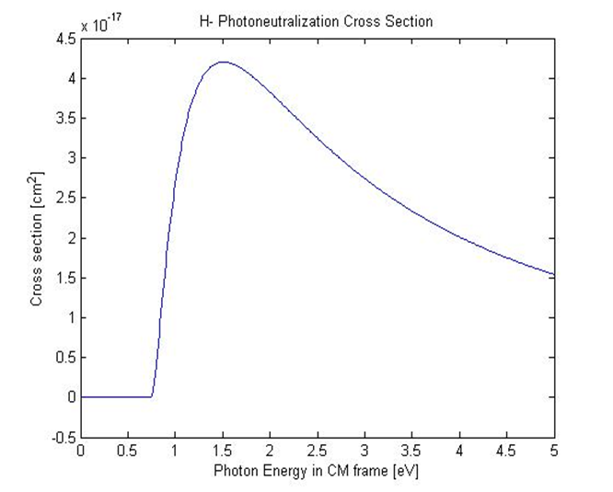
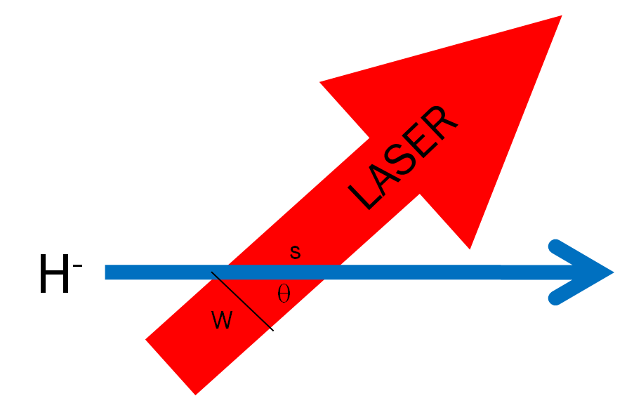
Photoneutralization
The fraction of electrons that are detached from the moving H- ions is:
The photon flux (generated by the laser)
in the lab frame [photons/cm²/sec]
The photon flux in the lab frame is transformed into the
rest frame of moving ion as:
The interaction (crossing) time is just the ion path length/ ion velocity
The neutralization factor for an ion crossing on axis
of the laser beam may be written in terms of lab frame parameters
Total neutralization for N interactions
21

