Slide 1
Perspectives on Laser H⁻ Manipulation
Bob Zwaska
US-Japan Meeting on Laser Manipulation of H- Beams
28 March 2018

Slide 2
Exciting times for Proton and Neutrino Beams
J-PARC
  Nearly 500 kW T2K beam (& 1 MW capable neutron beam)
  Plans to go to 1.3 MW with upgrades
  New neutrino detector
Fermilab
  700 kW NuMI beam
  Plans to go to 1 MW, then further with new machines (PIP-II)
  New neutrino beamline and experiment (LBNF/DUNE)
Worldwide
  SNS proceeding on energy and power upgrade
  Major new proton beams in Europe, US, and China
H⁻ Manipulation will be a major part of the future of high-power beams. It is heartening to see the progress at J-PARC, SNS, and here

Slide 3
Laser Manipulation is how we got started
Produce polarized protons through laser manipulation and stripping of H⁻
  Not injection to synchrotron
Prohibitive lasers

Slide 4
Laser injection sustained interest
An obviously enabling technology to advance high-power proton beams

Slide 5
Success at SNS
The process works, but:
  Microseconds -> Milliseconds
  Single pulses -> 25 Hz
  Experiments -> operations

Slide 6
A Notional Roadmap for Laser Manipulation of H⁻ Beams
Laser
H- Injection
The ultimate, obvious goal

Slide 7
A Notional Roadmap for Laser Manipulation of H⁻ Beams
Laser Notcher
Laser Chopper
Laser
H- Injection
Have shown initial operation at Fermilab
Experiments have proven principle
An Intermediate application

Slide 8
A Notional Roadmap for Laser Manipulation of H⁻ Beams
Off-ramps (Applications)
Instrumentation
Extraction / Beam Splitting
Linac Collimation
Phase Space Sculpting
Ion beams
Technology
Polarization
Laser Notcher
Laser Chopper
Laser
H- Injection

Slide 9
A Notional Roadmap for Laser Manipulation of H⁻ Beams
On-ramps (Enabling Technology)
Laser Technology
  Fiber amplifiers
  Free-space amplifiers
  Modulators
Machine Protection
  Instrumentation
  Control Schemes
  Robust devices
Machine Stability
  Instrumentation
  Filters
  Control Techniques
Off-ramps (Applications)
Instrumentation
Extraction / Beam Splitting
Linac Collimation
Phase Space Sculpting
Ion beams
Technology
Polarization
Laser Notcher
Laser Chopper
Laser
H- Injection

Slide 10
A Notional Roadmap for Laser Manipulation of H⁻ Beams
On-ramps (Enabling Technology)
Laser Technology
Machine Protection
Machine Stability
Off-ramps (Applications)
Instrumentation
Extraction / Beam Splitting
Linac Collimation
Phase Space Sculpting
Ion beams
Technology
Polarization
Laser Notcher
Laser Chopper
Laser
H- Injection
Peer Systems
Laser-Plasma Wakefield Acceleration
Photoinjectors
Optical Stochastic Cooling
Light source Seed lasers
High-Energy-Density Physics
Photon Colliders
Interferometers
Electron Back-scatter

Slide 11
Evolving the field of H⁻ Manipulation
Progress has been strong on several fronts, it needs to be organized together to justify future developments
Continued exchange in US-Japan program
Communal development of a roadmap and white paper that enumerates and organizes the various opportunities
  Funding agencies and collaborators are interested in this field

Slide 12
Perspectives on Laser H⁻ Manipulation
Bob Zwaska
US-Japan Meeting on Laser Manipulation of H- Beams
28 March 2018

Slide 13
US/Japan HEP Collaboration
Started in 1978 to foster:
  Joint use of existing high-energy facilities
  Joint program of accelerator and Instrumental Research and Development
  Future contributions to the construction of accelerators and expansion of auxiliary equipment
Japan-U.S. Neutrino Task Force formed in 2013
  Identified neutrino physics as a “pillar field”, established working groups from accelerators to theory
  Our group’s focus is Accelerator R&D for MW beam power and neutrino beams
    Targetry issues are (mostly) considered in a parallel track
Joint US-Japan proposal in 2016

Slide 14
Joint US-Japan Proposal (2016, 2017, …)
Proposals submitted to both KEK and DOE
Proposers are:
  KEK / J-PARC
  Fermilab
  University of Colorado
Focus on five areas of development:
  Gated ionization profile monitor
  Laser manipulation of H- beams
  Beam dynamics studies for beam loss reduction
  Extracted beam monitoring
  High-power target facility issues
2016 proposal was approved (funding arrived at end of FY17)
Goal for this workshop is to discuss progress and identify areas for future collaboration.

Slide 15
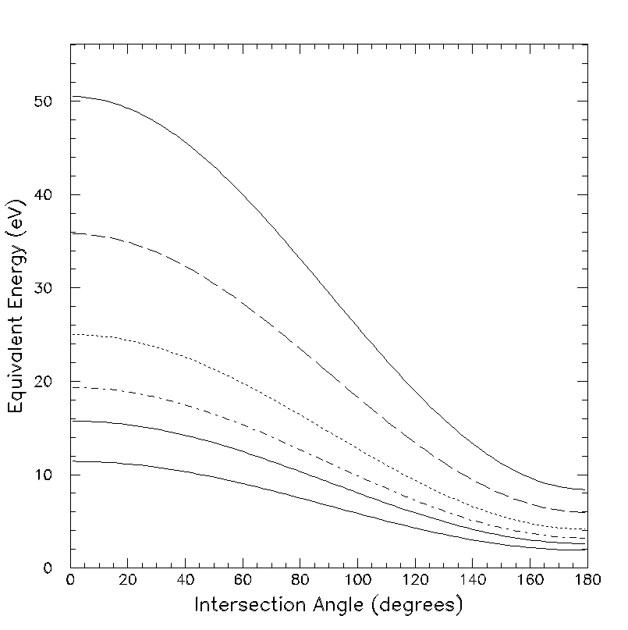
Lasers for 400 MeV POP
Commercial lasers probably good enough for basic measurements
  Technology has advanced enough that many wavelengths are available off-the-shelf
Intensity requirements are minimal to simply measure cross-sections
Higher intensity needed to observe collective effects & multiple interactions
He (20.6)
e-Excimer Lamps
Ne (14.6)
H₂ (10.2)
F₂ (7.89)
ArF (6.42)
Excimer Lasers
Nd-YAGx4 (4.66)

