Slide 1
Status of TEF-P and Developments of H⁻ Beam Extraction System Based on Neutralization by Using Laser
US-Japan Meeting on Laser Manipulation of H⁻ Beams
March 28 2018 at FNAL
J-PARC/JAEA Shin-ichiro Meigo and Hayanori Takei

Slide 2
Contents
Background
  TEF: Transmutation Experimental Facility
Development beam extraction system based on pulsed Laser
  Experiment at RFQ test stand
  Long run test of Laser equipment
Development beam extraction system based on pulsed Laser
Summary

Slide 3
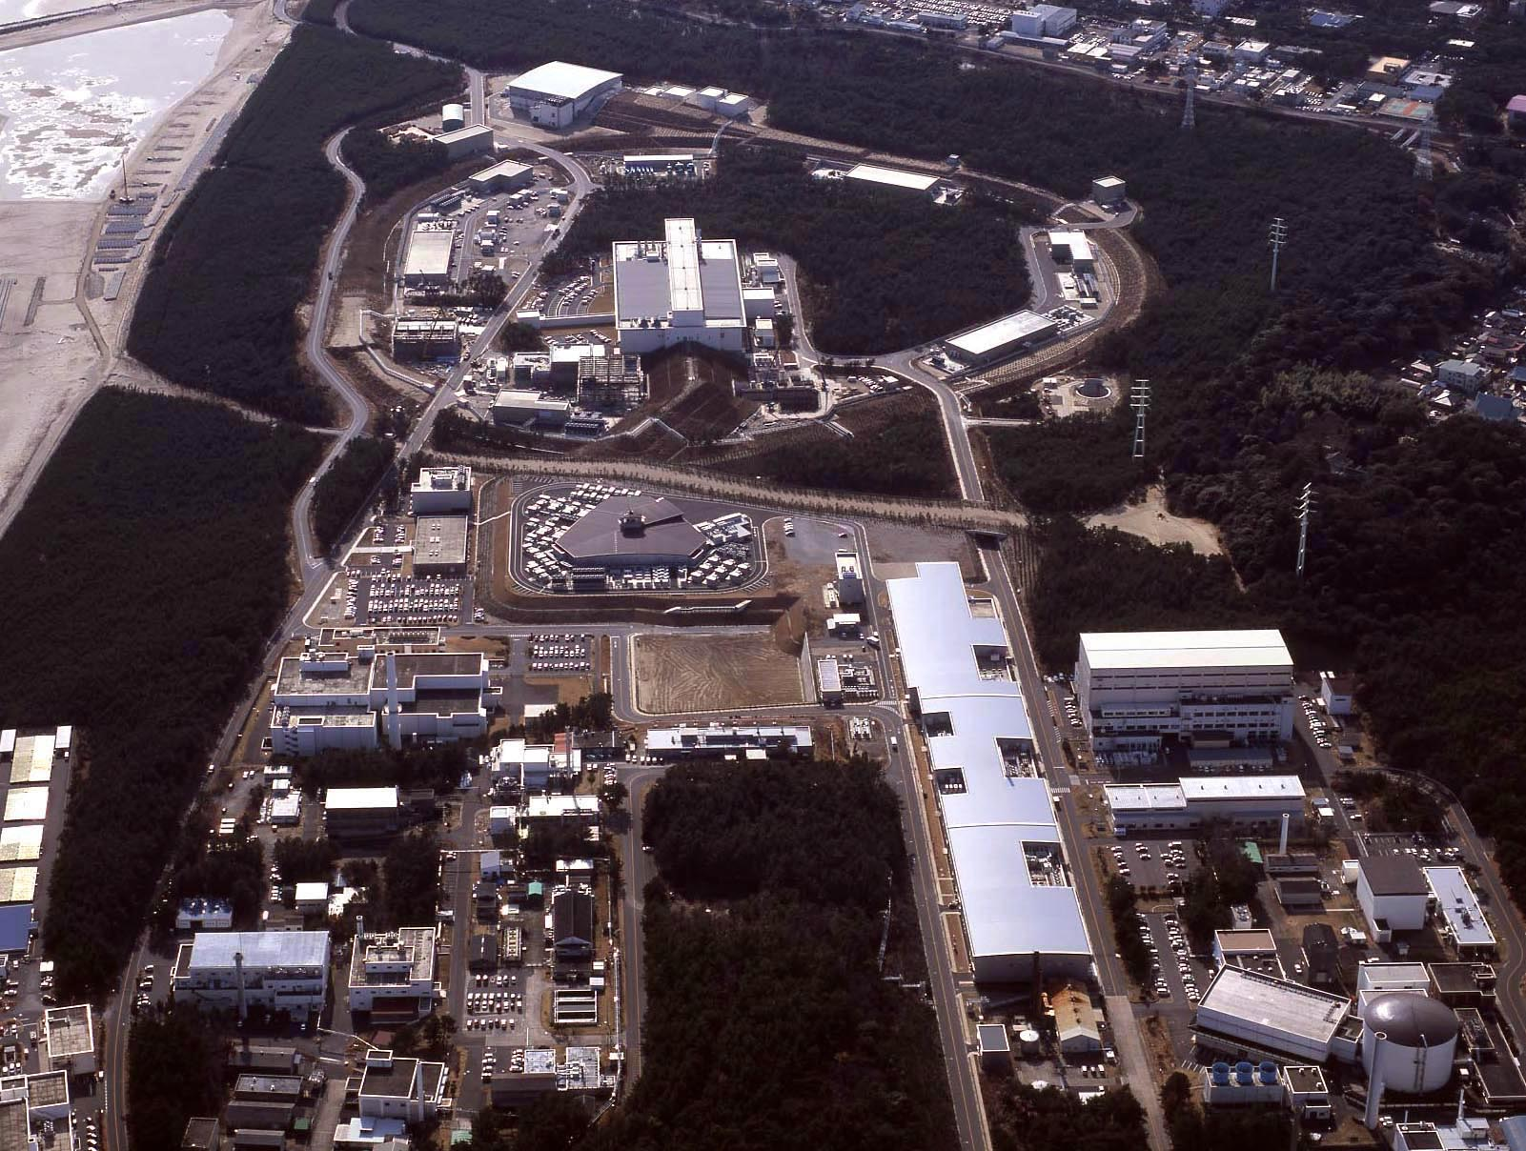

Hadron Experiment Facility
30GeV Synchrotron
MR (0.75MW)
Materials & Life Science Facility (MLF)
Bird’s eye photo
3GeV Synchrotron
RCS (25Hz,1MW)
Neutrino Exp. Facility
(294km to Super KAMIOKANDE)
Transmutation
Facility (TEF)
(Phase II）
Linac
400MeV(50mA)
JFY2007 Beam
JFY2008 Beam
JFY2009 Beam
JRR-3M
800m to MLF
Neutron beam lines (23)
J-PARC = Japan Proton Accelerator Research Complex

Slide 4
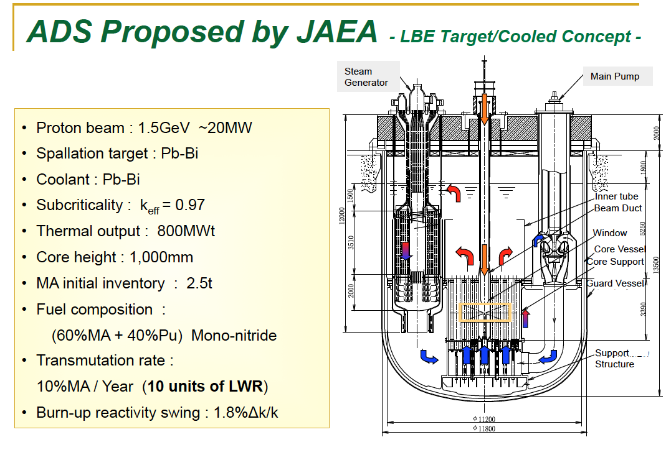
ADS proposed by JAEA
Lead-Bismuth Eutectic
Accelerator Driven System: ADS

Slide 5
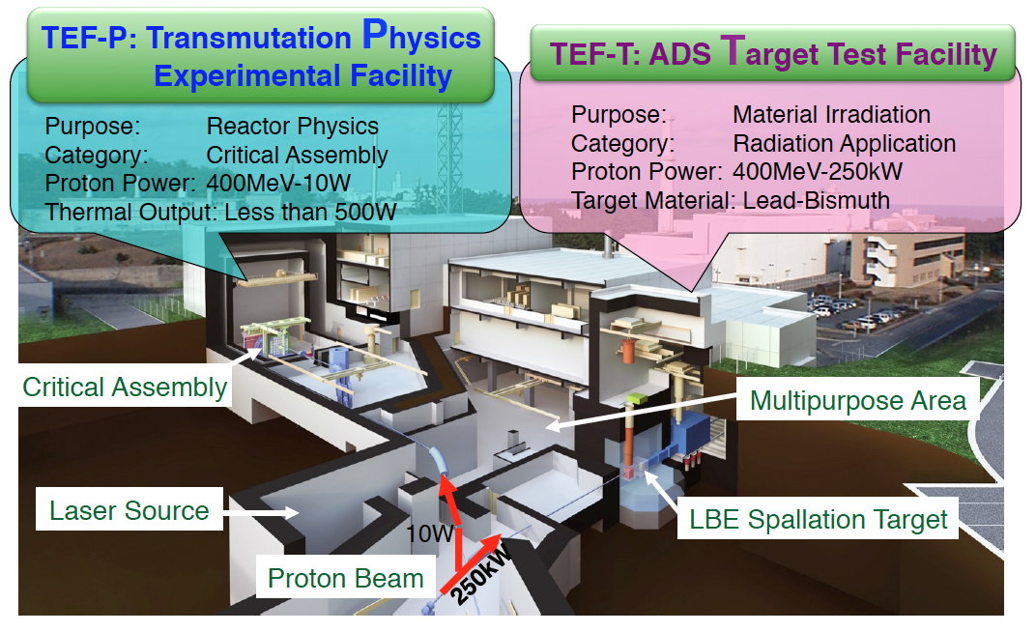
Transmutation Experimental Facility (TEF) in J-PARC
(LBE)
Stable beam extraction required for TEF-P not to exceed 10 W

Slide 6
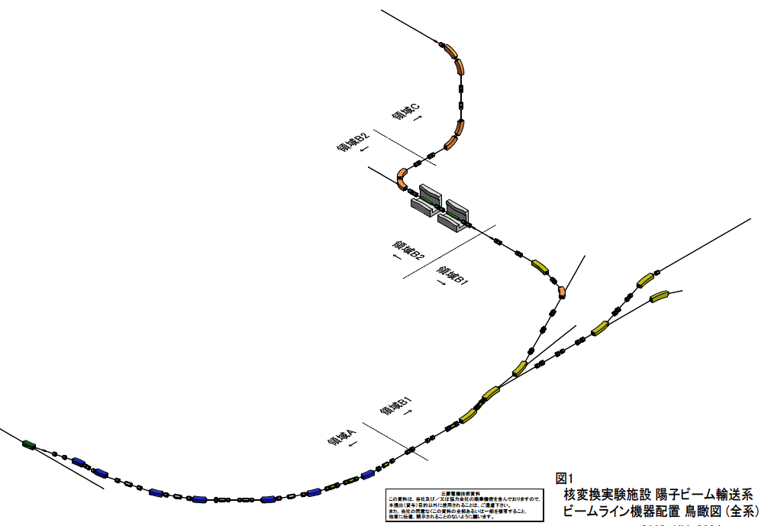
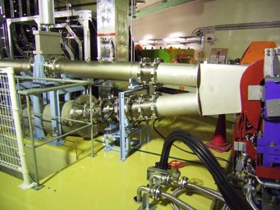
TEF beam transport system
LINAC beam
TEF-P
H⁻ Beam
400 MeV 25Hz 10W
Pulse width ns~ 0.5ms
Peak current 50mA
0.5 ms
Vertical bend
(90 deg）
50mA
25Hz
10W
Dump
Separation
wall
TEF-T
H⁻ Beam of LINAC
400 MeV 25Hz 250kW
Macro pulse 0.5ms
Peak current 50mA
10W
ダンプ
H⁺
8kW
Dump
H⁰ >H⁺ foil
New facility
H⁰
Constraceted
H⁻
TEF-T BT: 130m
3NBT Dump
H⁻
YAG ( 2J/pulse)

Slide 7
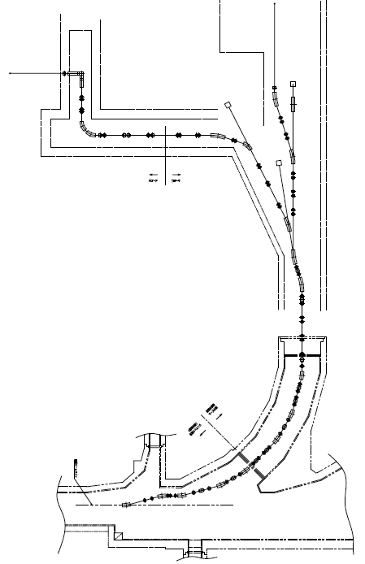
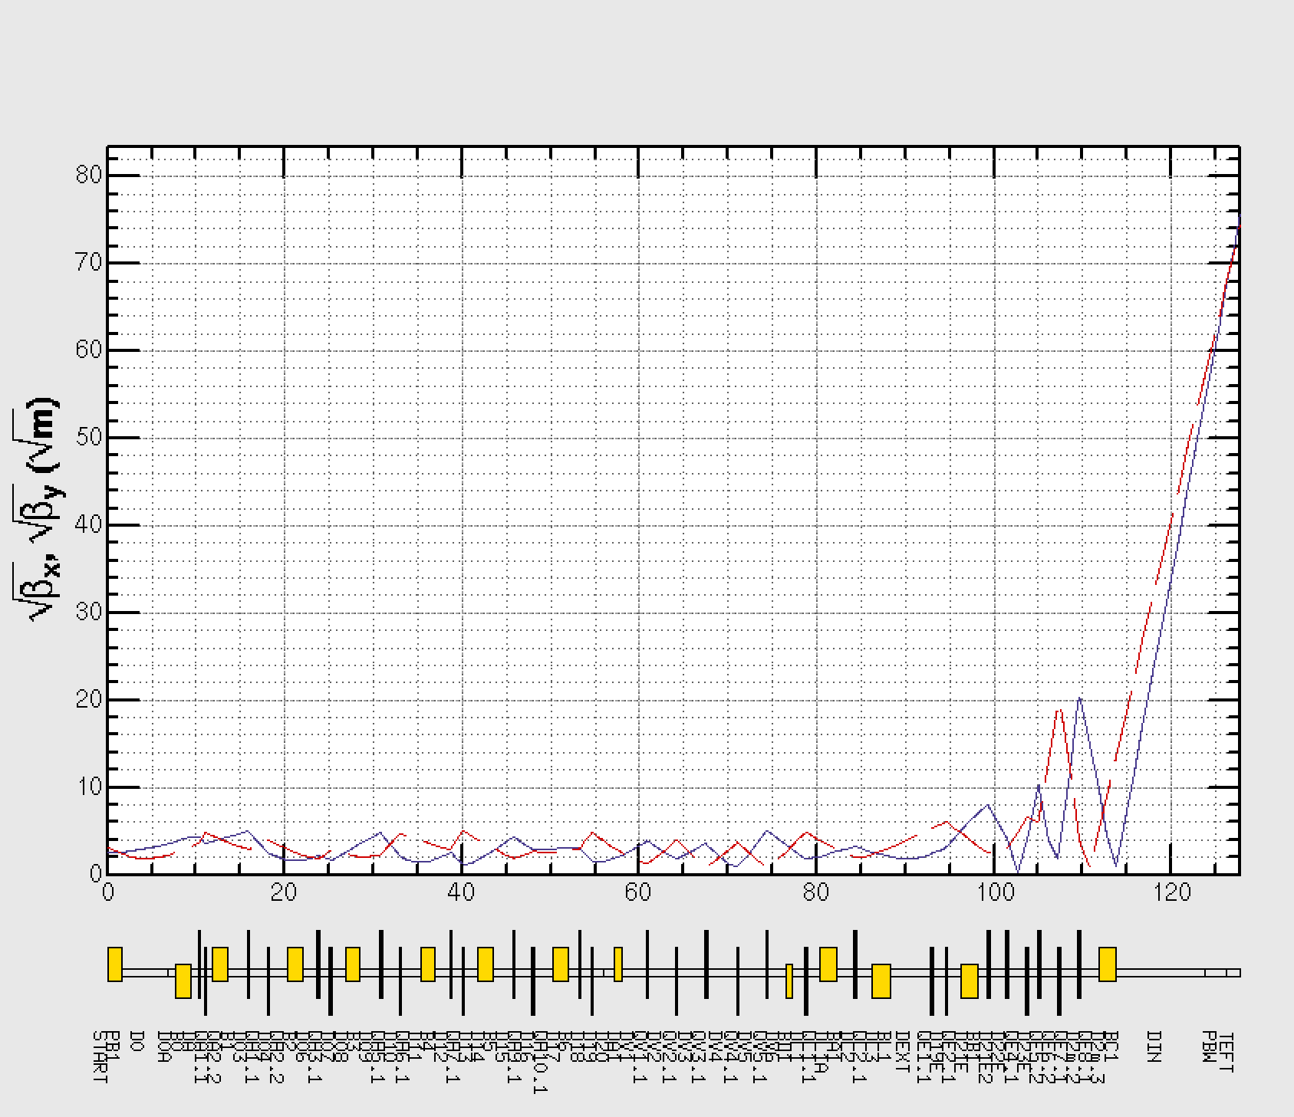
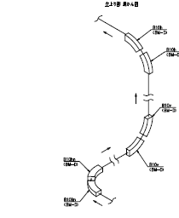
L-TEF BT optics design
TEF-T
  TEF-T: 20-40μA/cm²
    Width at target： 1σ 1.58〜2.23 cm
  TEF-P width beam ~20 mm
H⁻ 250kW
TEF-P
8kWdump
H⁺ 10 W
10W dump
6x10⁹ p
Foil charge exchanger
H⁰ ->H⁺
1.6x10¹⁴ p
TEF-T beam envelope
Bending angle 45 deg each
LASER charge exchanger
H⁻ ->H⁰
H⁻ 250kW
Vertical bending section for TEF-P
LINAC
To RCS

Slide 8
R&D for TEF-P beam extraction based on laser
H. Takei et al., WEPG48 IBIC2016 (2016).
For safety of beam operation, a reliable system guaranteed by physics
Beam extraction by pulse bending magnet and charge exchange foil will jeopardize the J-PARCE in the safety aspect.
Collision point:
  Center of bending magnet for minimization of length to separate H⁰ produced upstream
LASER will be beneath floor for radiation shielding.
Test experiment carried at at J-PARC LINAC RFQ test bench (3MeV H⁻)
Tunnel vertical cross-sectional view
Bending magnet
5 m
LASER

Slide 9
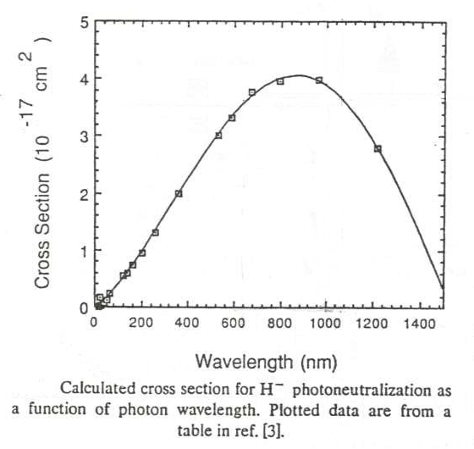
Requirement of laser system
Beam requirement for TEF-P
    ・ Beam power: <10W, ・Repetition: single shot – 25Hz
Extracted beam power: R=Lσ (L: Luminosity between proton and laser,
σ: cross-section H⁻ -> H⁰)
Cross-section of H- -> H0 as a function of wavelength
YAG laser is suitable for charge exchange system.
YAG Laser （λ=1064nm）
Lorentz contraction （λ’=746nm） at 400 MeV proton

Slide 10
RFQ test stand (3 MeV H⁻ 30 mA)
Bending
Diag. Laser
Laser transport
YAGレーザー
RFQ
H⁻ Beam
イオン源
H27.12.17 版

Slide 11
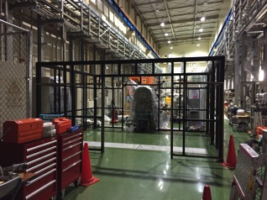
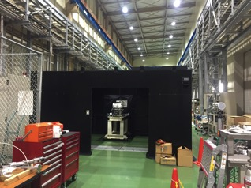
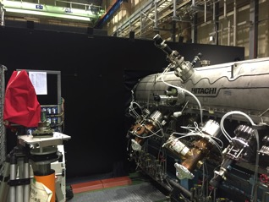
Laser control area at test bench
Upstream
RFQ

Slide 12
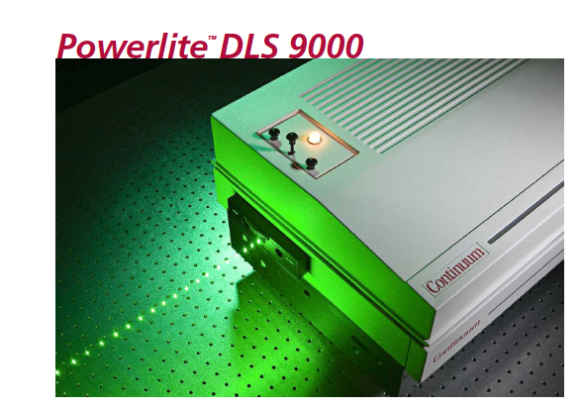
Beam extraction by Pulse laser

Slide 13
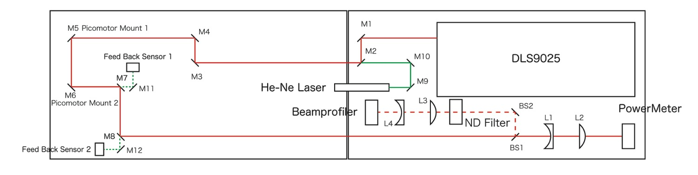
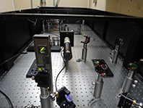
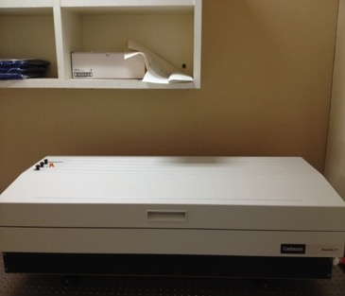
Laser test for cold run
    Total Length of light path: 6.2 m
    Flash-lamp Nd:YAG Laser
Laser light path is automatically adjusted by these mirror with picomotor mount.
    Flash-lamp Nd:YAG Laser

Slide 14
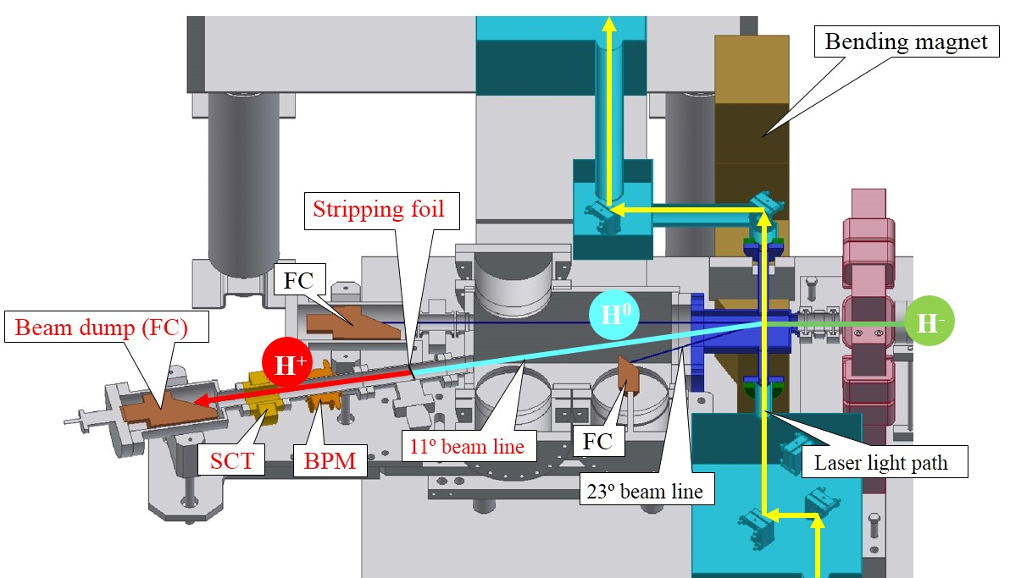
RFQ test stand
324 MHz
Bend
Foil
H⁻
RFQ
IS
H⁰
H⁺
11°
Macro pulse 50 μs
Peak 30 mA
23°
LASER
Faraday Cup

Slide 15
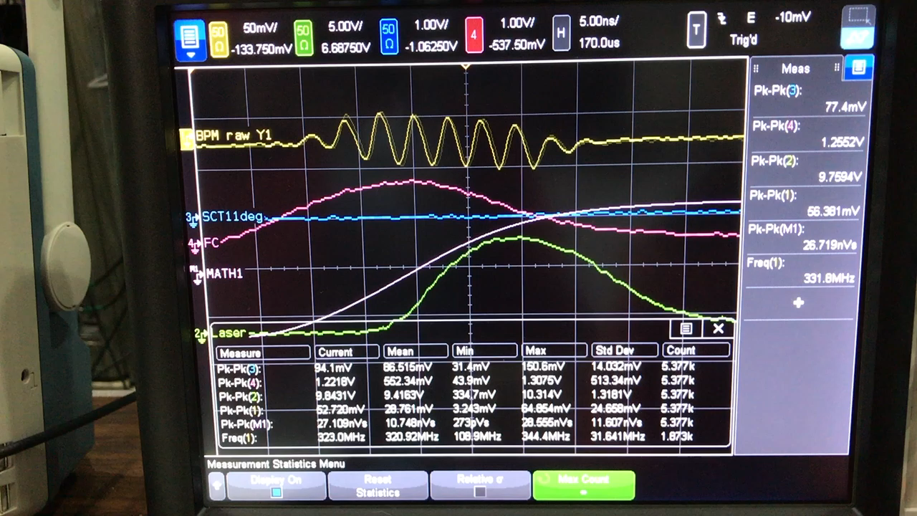
Raw signals of monitors
BPM
FC
Laser

Slide 16
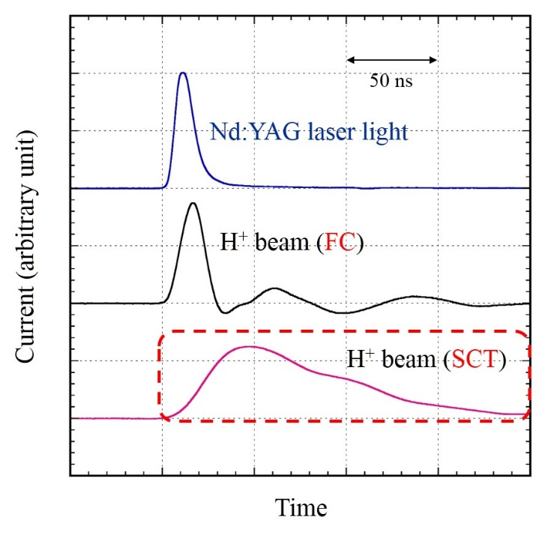
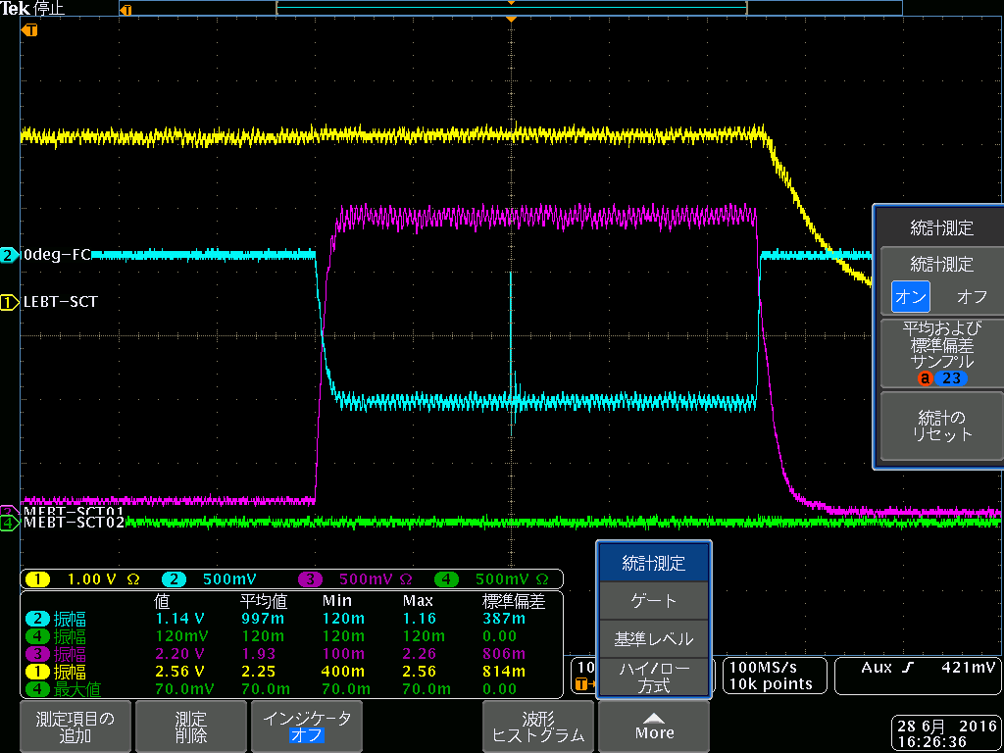

Achieved the 28 hour-long LCE test on last June.
Waveform of the laser pulse and the H⁺ beam
Current waveform of the H⁻ beam observed at the 23º beam dump
10µs
Laser ON
H⁻ beam (FC)
$$0.026(W)×\frac{400 \left(MeV\right)}{3 \left(MeV\right)}×\frac{50\left(mA\right)}{30\left(mA\right)}=5.7(W)$$
Notch part surrounded by white dotted circle is due to the lack of the H⁻ beam caused by Laser
Satisfied the power requirement (< 10 W) of the proton beam for the TEF-P.

Slide 17
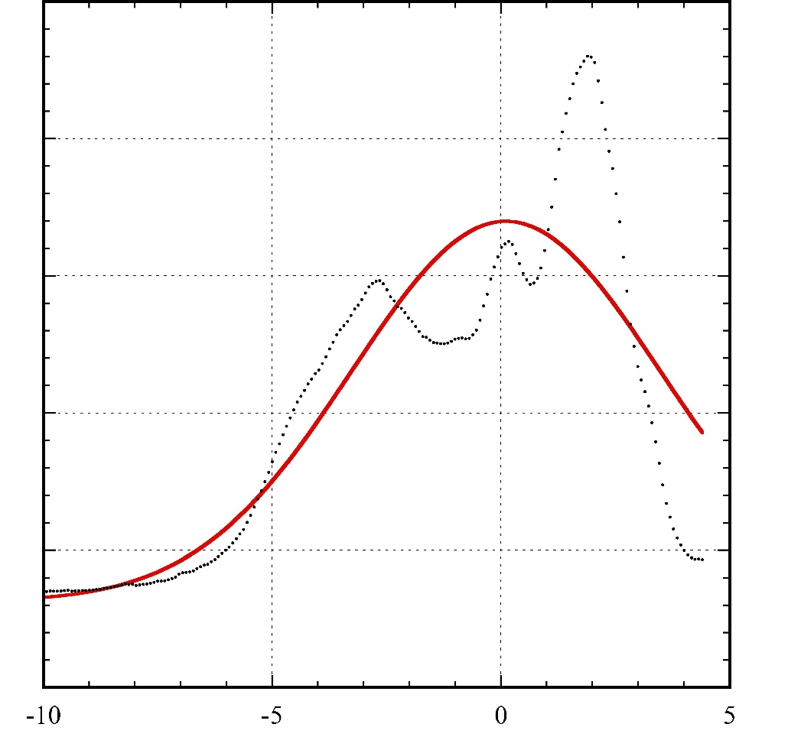
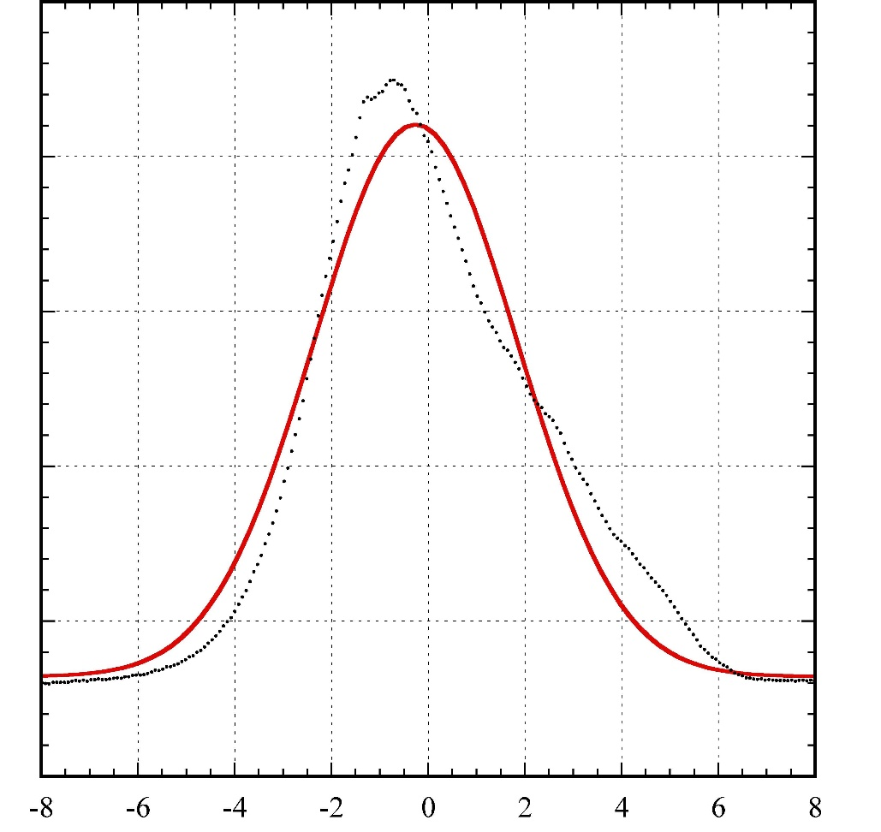
Laser profile (near interaction point)
Horizontal
Vertical
σ_{V}=3.37 mm
σ_{V}=2.10 mm
Intensity (arbitrary unit)
Position (mm)
Position (mm)

Slide 18
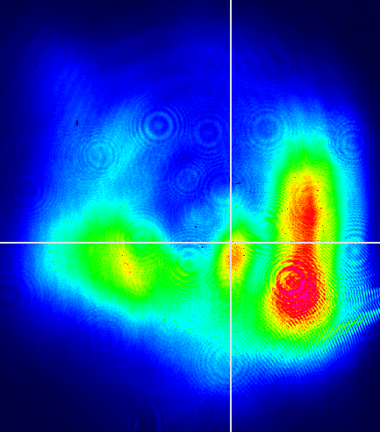
2D Laser profile
Vertical axis
O
H⁻ beam
Horizontal axis
1 mm

Slide 19
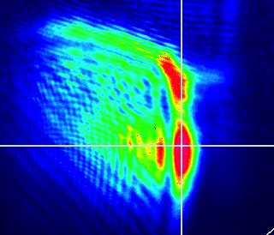
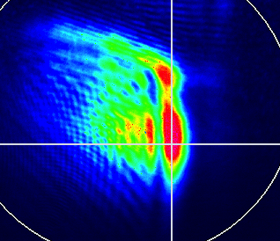
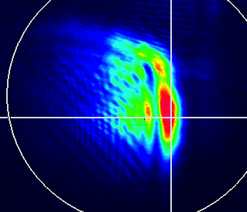
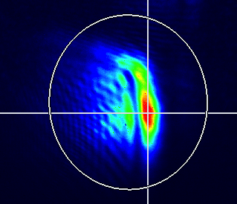
LASER profile for various power
30.6 W
1.2 J/shot
21.3 W
0.85 J/shot
14.7 W
0.59 J/shot
9.2 W
0.37 J/shot

Slide 20
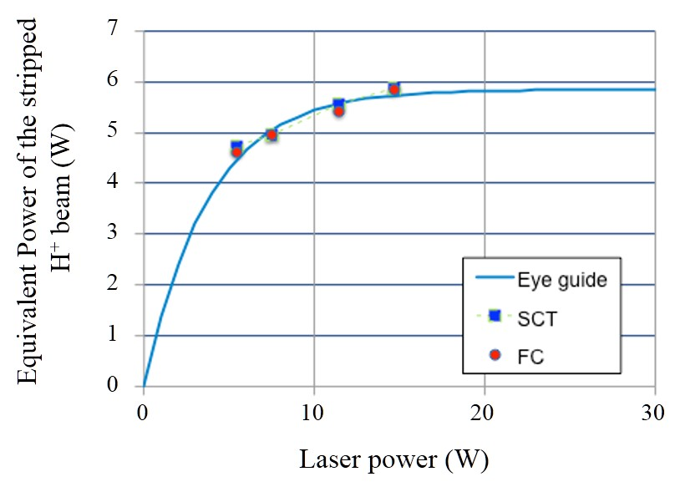
Extraction power for various conditions
Rep 25 Hz (i.e. 10 W = 0.4 J/pulse)

Slide 21
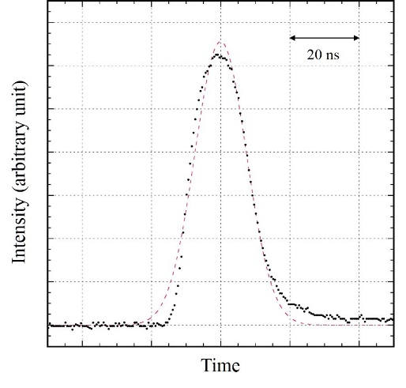
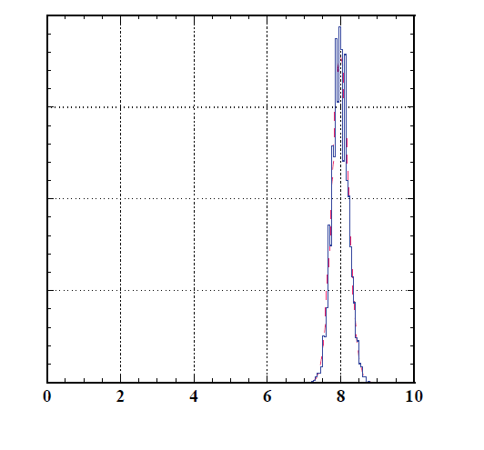
2.8% at 1σ
Pulse width
7.4 ns (1σ)

Slide 22
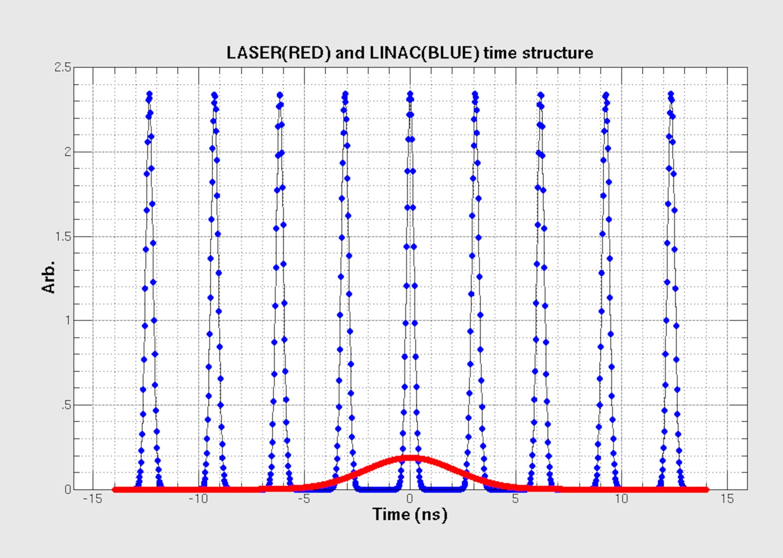
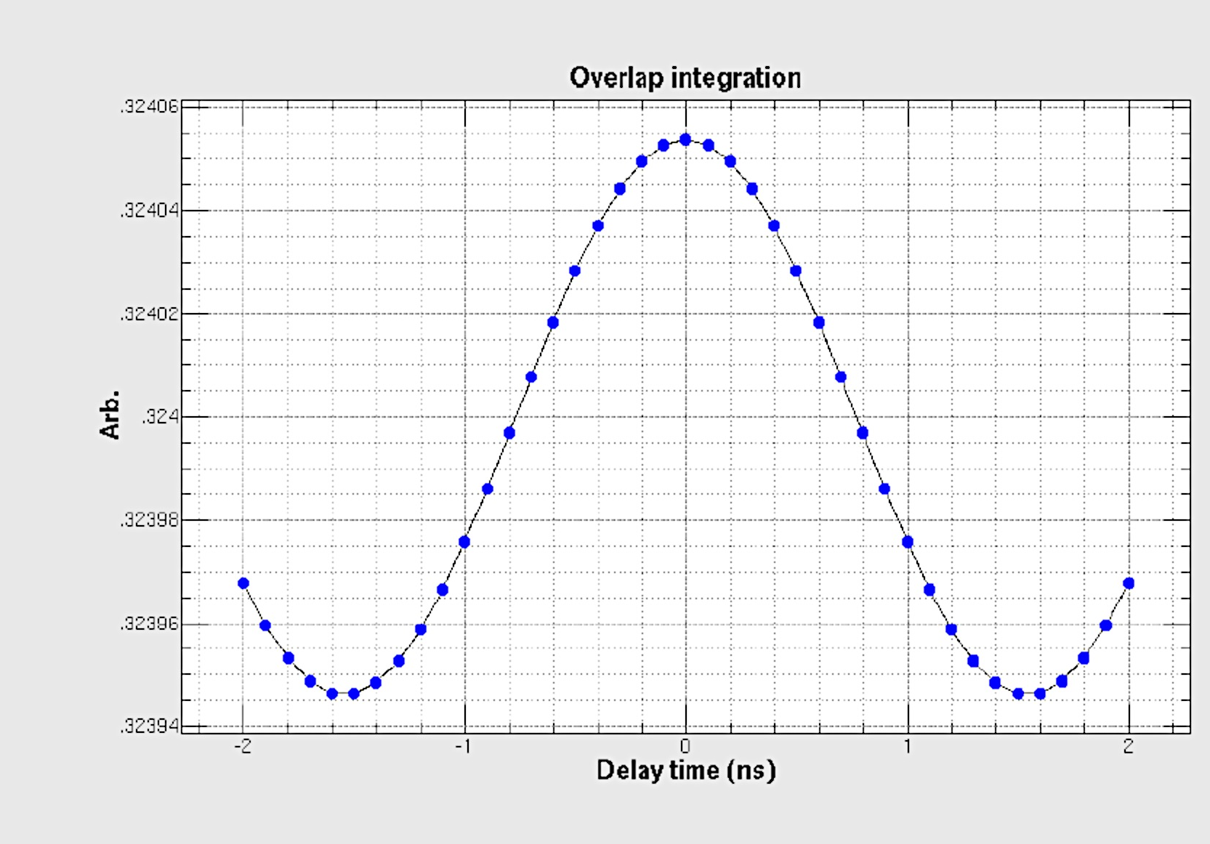
Timing jitter for extraction power
Since laser width is longer the micro bunch, jitter does not significant influence of extracted power.
Calculation shows 0.03% inffluences.
LINACビーム（青）とレーザー(赤）との
時間関係

Slide 23
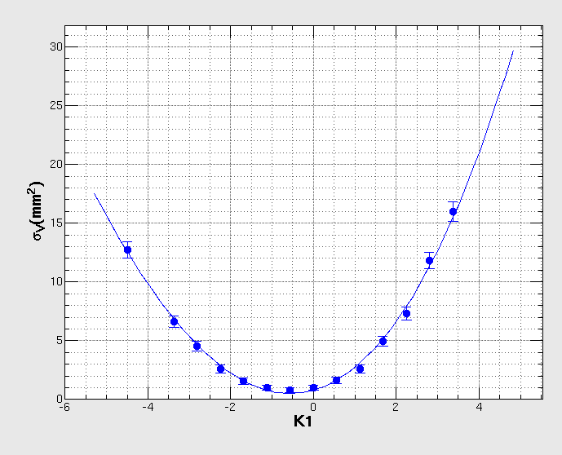
Q scan for H⁻ beam
Transverse emittance at the interaction point of RFQ test bench was obtained by the Q-scan.
Experimental result showed good agreement with the simulation result, which was 0.3 𝜋 mm mrad in the normalized emittance.
Since no instruments existed, the emittance of the extracted beam has not been performed. For the actual LCE, measurement will be performed to the extracted beam with the Q-scan.
Result of Q-scan

Slide 24
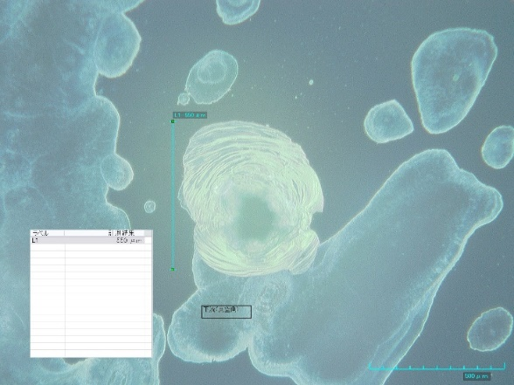
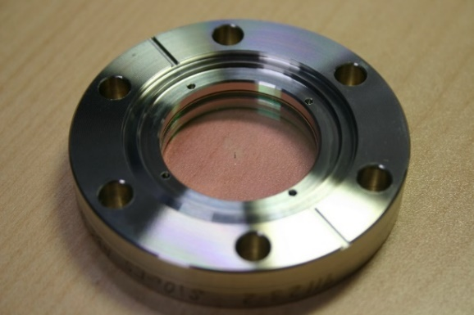
Damage to the quartz window
Pin hole
t: 3 mm
550 µm
Vacuum leak!
After changing another window using another coating, the window stands long duration shown in next page.

Slide 25
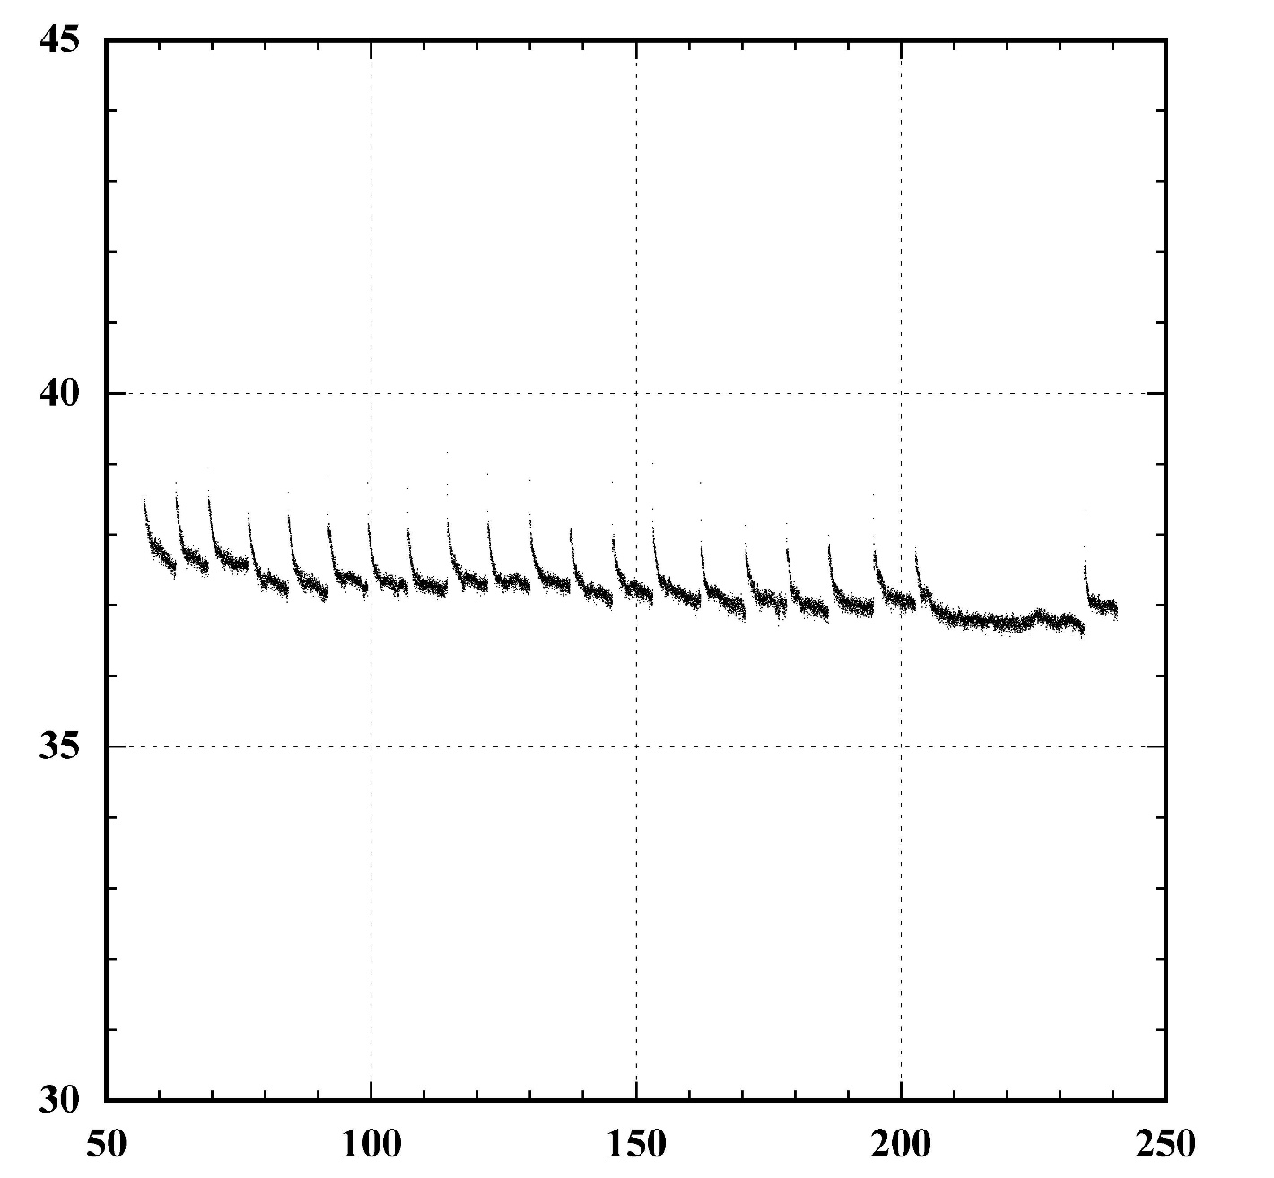
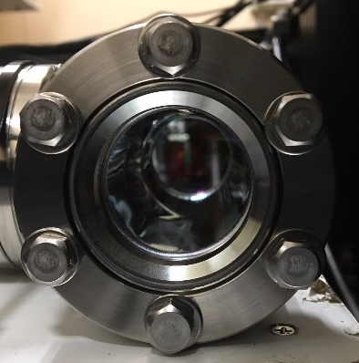
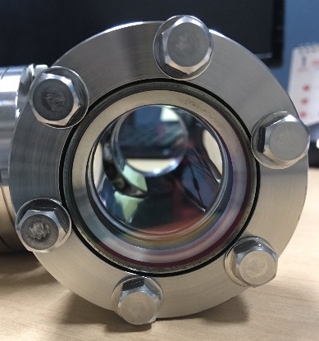
Long run test for Laser
Before
Laser power at downstream (W)
After
Time (h)
Up to 250 hours can operate.

Slide 26
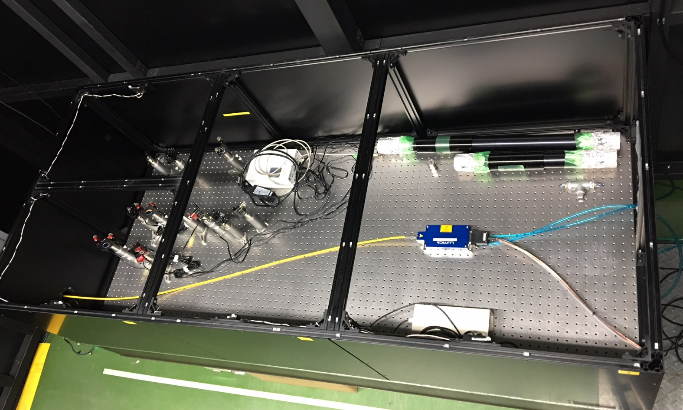
CW Laser extraction
Laser diode
Optical fiber
1064 nm, 230 W

Slide 27
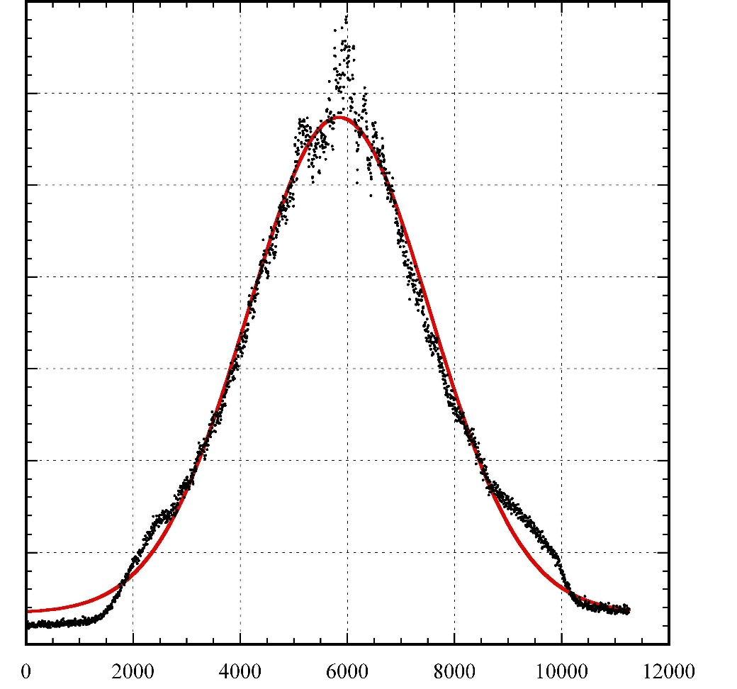
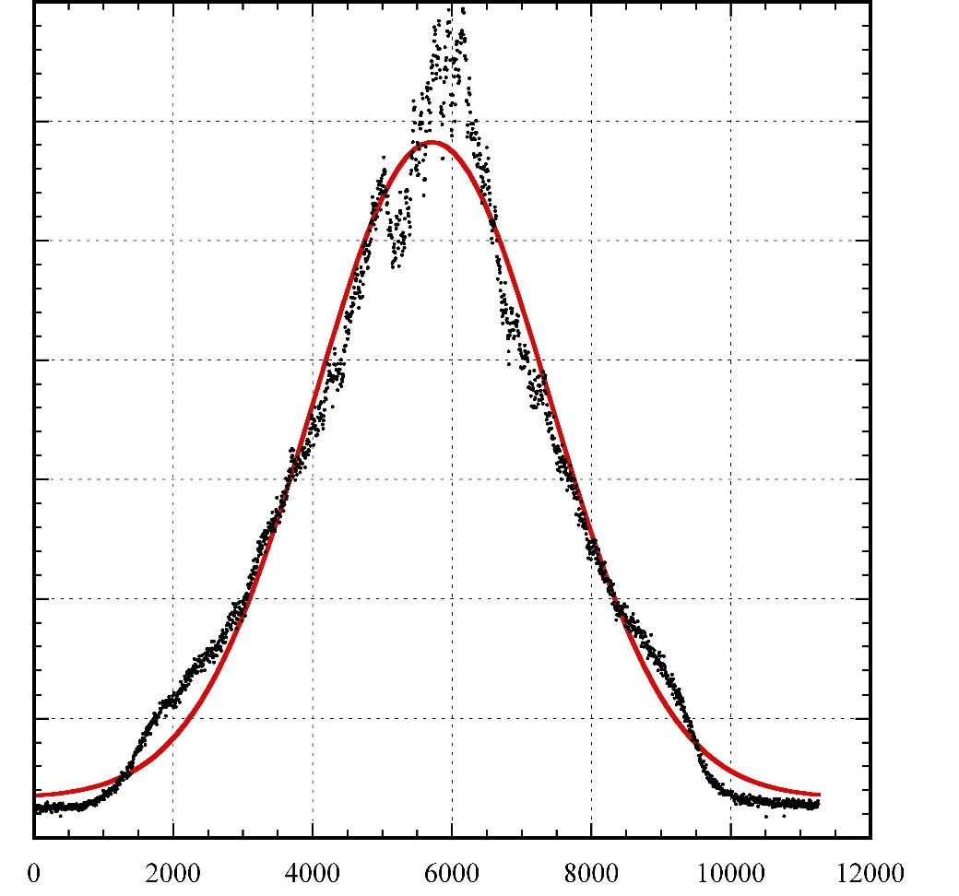
Laser profile
Horizontal
Vertical
σ_{h}=1.70 mm
σ_{V}=1.70 mm
Intensity (arbitrary unit)
Position (µm)
Position (µm)

Slide 28
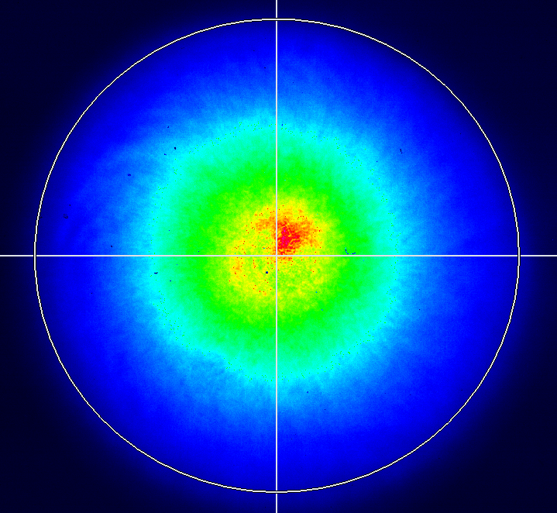
Vertical axis
Horizontal axis

Slide 29
Beam extraction
FC signal amplified x 100
3x10⁻⁴ extracted (7 Weq)

Slide 30
Applicability of reduction of H⁰ beam at upstream
Wire scanner monitor employed to produce H0 at upstream
Amount of H0 was observed by SCT and 0-deg dump using radiation counter.
3% of H⁰ to initial beam was found, which may produce under condition of 10⁻² Pa for 10 m length.
Also no beam extracted to 11 deg was confirmed.
Applicability of safety of the present system was shown.
SCT
H⁺
Bend
H⁻
0°
SCT
RFQ
IS
Radiation counter
WSM
23°
LASER

Slide 31
Summary
Short pulse beam extraction
Long pulse beam extraction
Although theoretical analysis remains, we are ready to deriver the beam to TEF-P
Since budgetary condition at JAEA is not clear, the present system will be actually utilized in J-PARC.
We believe that the similar system can be utilized for the following
  J-PARC LINAC diagnostics for transverse and longitudinal
  J-PARC LINAC beam notcher to reduce extinction of the RCS
  ADS accelerator (30 MW) H+ beam diagnostics

Slide 32
Beam transport from RCS to MLF
600ns
Ep: 3GeV
Power: 1MW
Already demonstrated
Rep.: 25Hz
600ns
Length of BT: 314m
Partial of 25 Hz beam goes to MR
FX: 2.48 s, SX: 5.5 s
50-GeV MR
FWHM ~150ns
road to
coast
Material and Life Science Experimental Facility (MLF)
Dump
Neutrino line
3NBT
MUSE
JSNS
3-GeV
RCS
3-50BT
Muon target
Neutron target

Slide 33
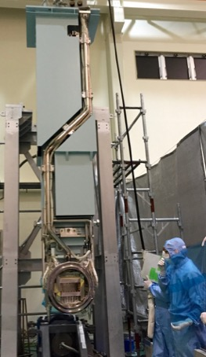
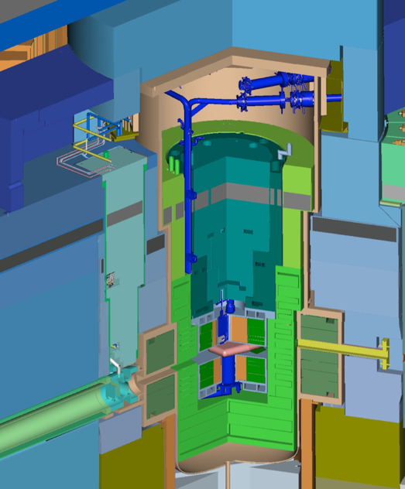
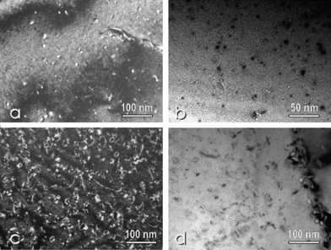
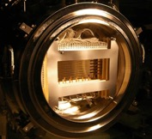
Lifetime of Proton Beam Window
Lifetime estimation based on Post Irradiation Examination (PIE) for safety shroud (AlMg3) at SINQ in PSI
Considering difference of proton energy, to predict lifetime of the PBW with high accuracy for validation of calculation
Result at SINQ/PSI for 0.6GeV
Y. Dai, et al, J. Nucl Mat. 343 184 (2005)
Lifetime of PBW: Determined by He gas production (2000 appm) 2 years
S. Meigo, et al, J. Nucl Mat. 450 141 (2012)
By recent PIE result of the SINQ (3300 apmm), the lifetime may be applicable to 3 years.
Height: 3.8m
Weight：10t

