Slide 1
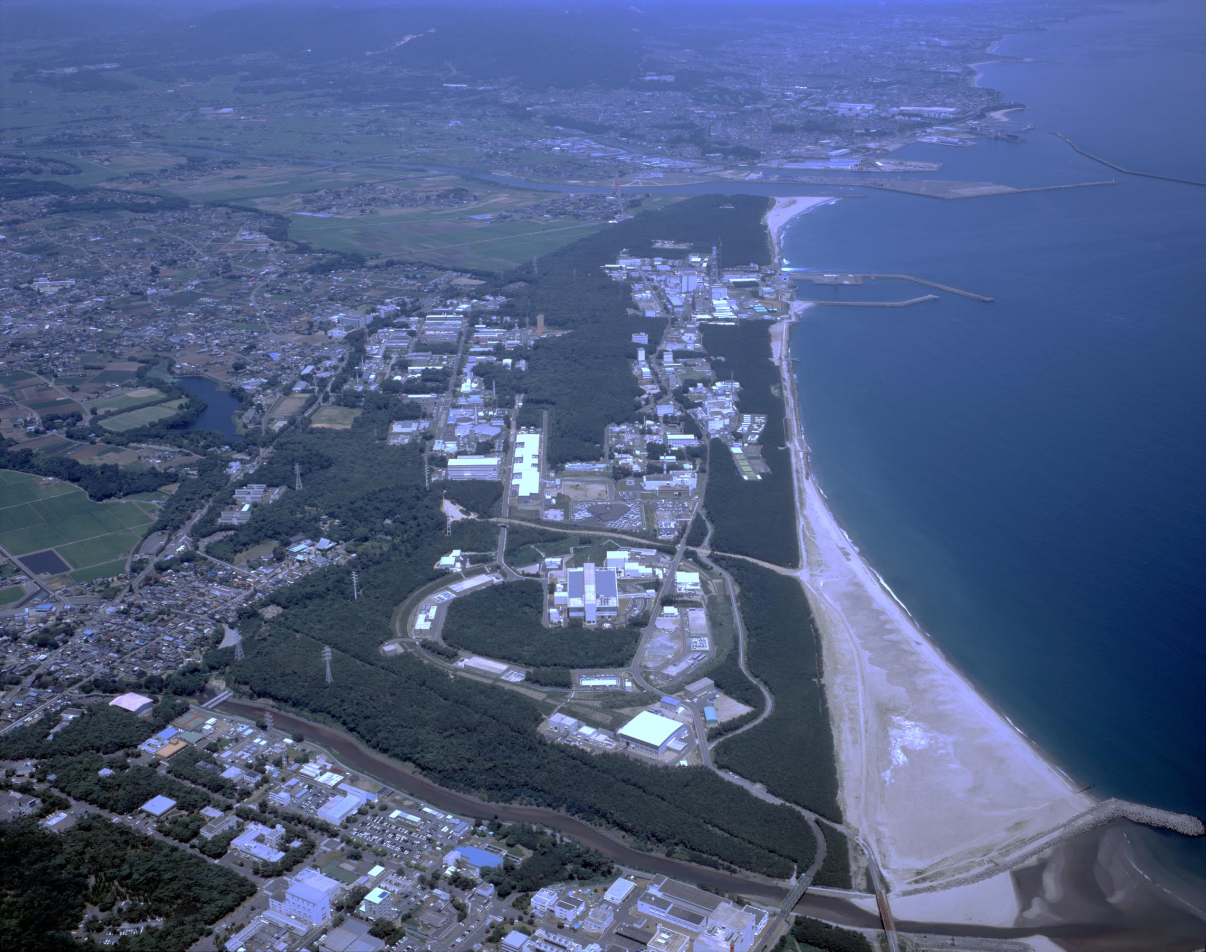
US-Japan Collaboration on high intensity neutrino beams
● Laser manipulation of H⁻ beams
Brief status at J-PARC &
Progress of 400 MeV H⁻ striping to protons
by using only lasers -
Pranab K. Saha
On behalf of J-PARC laser stripping group
US-Japan Collaboration meeting @ Fermi National Accelerator Lab, USA
2018/Mar/28-29

Slide 2
Laser manipulation of H⁻ beams
--- status at J-PARC
Three major activities:
-- Proof-of-principle (POP) demonstration for 400 MeV H- stripping to protons by using only lasers.
Goal to realize laser stripping H- charge exchange system.
-- Developments of H⁻ neutralization system by using laser for J-PARC TEF.
R&D studies at 3 MeV H- now. To be tested for 400 MeV H- and put the system for operation.
-- Multi-laser-wire diagnostic system for measuring H⁻ beam profiles at J-PARC.
R&D stage, Laser stripping chamber will be used.

Slide 3
Outline:
1. Brief introduction of J-PARC and the RCS
2. Motivation of H⁻ laser stripping
3. Principle of H⁻ stripping by only lasers
4. Experimental strategy, progress to date
5. Summary and outlook

Slide 4
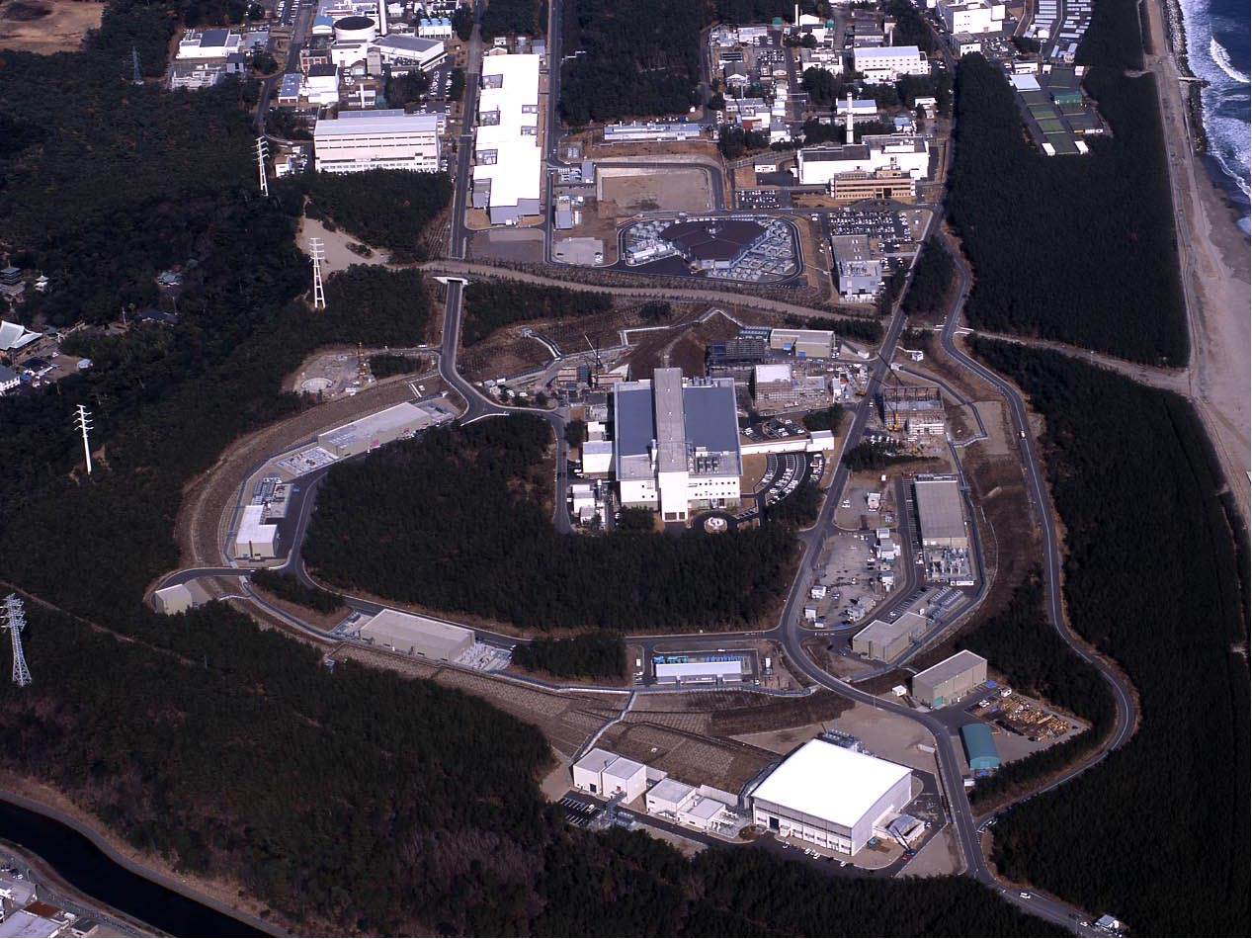
J-PARC
KEK & JAEA)
400 MeV H⁻ Linac
3 GeV Rapid Cycling Synchrotron (RCS)
Neutrino Beam Line to Kamioka (NU)
50 GeV Main Ring Synchrotron (MR) [30 GeV at present]
Materials & Life Science Facility (MLF)
Hadron Experimental Hall (HD)

Slide 5
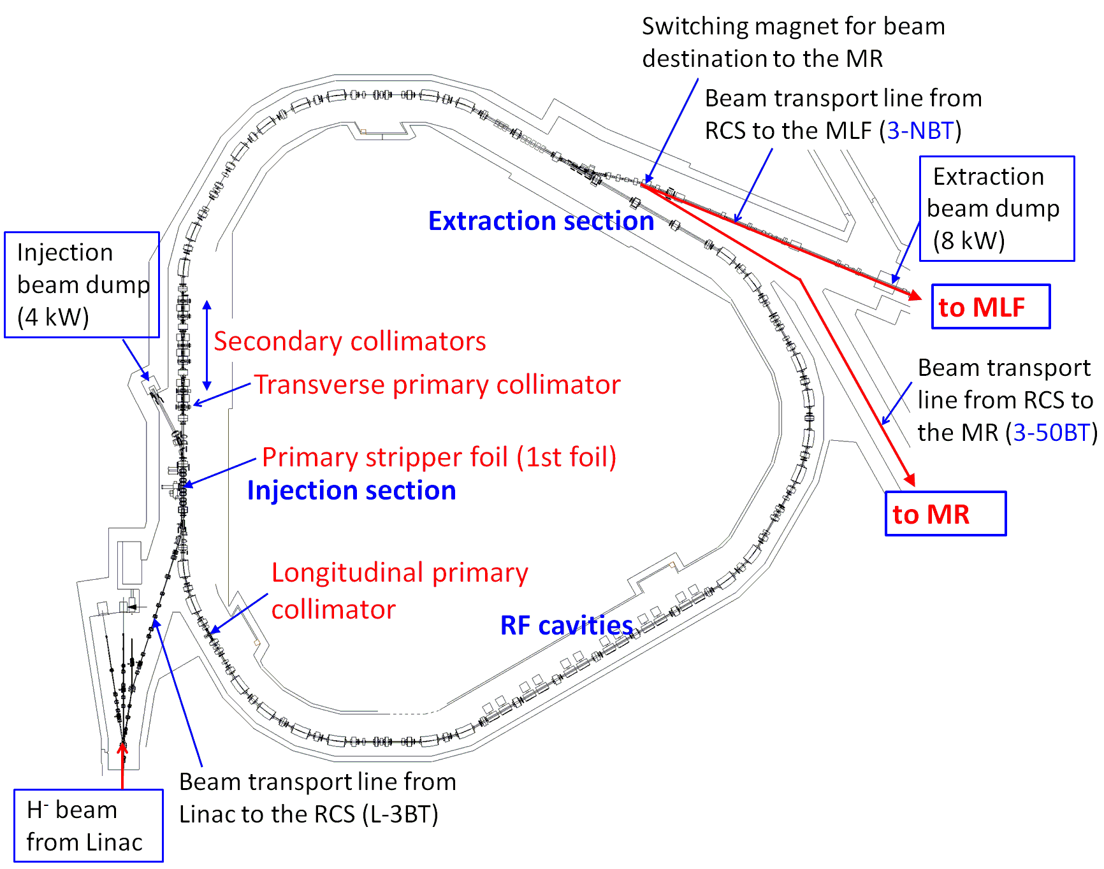
1. Introduction of J-PARC 3-GeV RCS
Mid-term plan for beam power
Upgrade to 1.5 MW!
Two big reasons:
① RCS beam sharing to the MLF and MR.
When MR runs at 1s cycle (~2018), RCS beam
sharing to MLF becomes: (25-4)/25 = 0.84
RCS equivalent beam power to the MLF
should be 1.0/0.84 = 1.2 MW!
② Also planning for a second neutron
production target station at MLF.
Layout of J-PARC 3-GeV RCS
● Multi-turn H⁻ stripping injection.
(stripping efficiency: 99.7% design)
● Injection Energy: 400 MeV
● Extraction Energy: 3 GeV
● Repetition: 25 Hz
● Beam power (design): 1MW
Successfully demonstrated
in the beam studies!
● Feasible scenario:
Peak current: 50 → 60 mA
Injection pulse: 0.5 → 0.6ms
Stripper foil lifetime may be the most
concerning issue!

Slide 6
Motivation
An alternate H⁻ stripping method other than using stripper foil.
→ Laser stripping of H⁻ holds the promise of eliminating
limitation and issues involved of using stripper foil.
Reasons:
■ May be hard to maintain stable and longer foil lifetime for
1 MW routine operation at J-PARC RCS.
■ Foil may not survive at 1.5 MW beam power.
■ Foil scattering beam loss and the resulting high residual
radiation at the injection area is already a serious concern for
hardware maintenance even at lower beam power.
★ Additional collimators had to installed at the downstream of stripper foil.
★ New design of the injection chicane magnets to install radiation
shielding surrounding the foil are in progress.

Slide 7
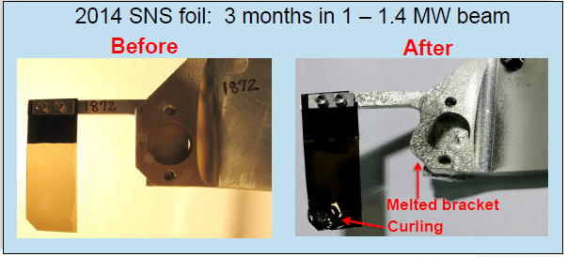
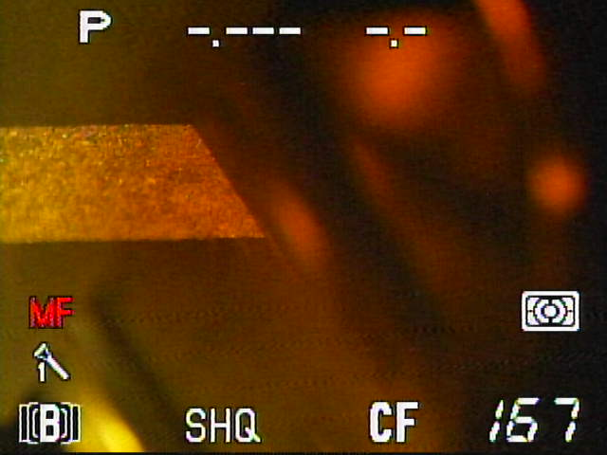
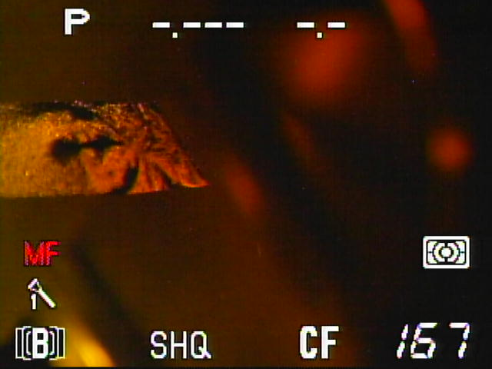
Experience of stripper foil behaviors at the SNS and J-PARC
S. Cousineau (HB2014)
J-PARC: 0.3 MW operation
Avg. foil hit: 10
Foil hit at 1 MW operation (estimation)
Unstripped H⁻ increased
twice more.
To | P_{beam} (MW) | Beam sharing(%) | ε_painting (π mm mrad) | Foil hit
MLF | 1 | 84 | 200 | 10
MR | 1 | 16 | 50 | 70
Waste beam dump
capacity: 4 KW
Normalized avg. foil hit: ~20 but
instantaneous foil heat for MR cycle is extremely high!
If the total charge limit on foil is 10000 C
→ Foil lifetime at 1 MW: 2 weeks at best!!

Slide 8
Energy deposition and foil temperature
(Comparison between RCS and the SNS for 1 MW beam power)
Accelerator | T [GeV] | tinj [ms] | Foil thickness [μg/cm²] | Avg. foil hit | Energy Depo. (dE) [J] | W_{peak} (DE/t_{inj}) [Watts-peak]
J-PARC RCS | 0.4 | 0.5 | 340 | 10 | 0.2598 | 276
SNS-AR | 1 | 1 | 300 | 6 | 0.0712 | 71
W_{peak} and foil temperature (T):
W_{peak} ∞ T⁴
W_{peak} (RCS) / W_{peak}(SNS) = 4
T (RCS) ≈ 1.4 x T (SNS)?
(Rep rate not taken into account)
If stripper foil limits SNS beam
power to 1.5 MW,
it is then may be 1 MW at
J-PARC RCS!!

Slide 9
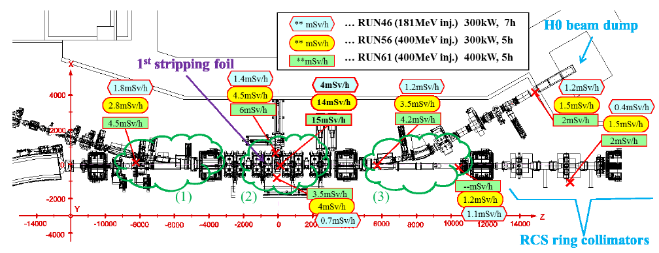
Residual radiation at the RCS injection area
M. Yoshimoto
Residual radiation near the stripper foil is as high as 15 mSv/h
on contact, 4 hours after 0.4 MW routine operation!

Slide 10
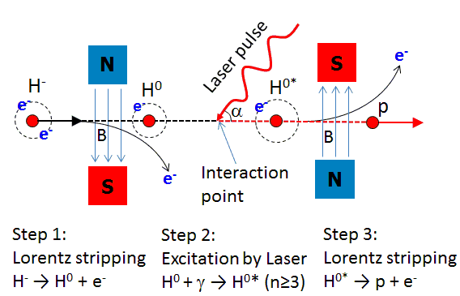
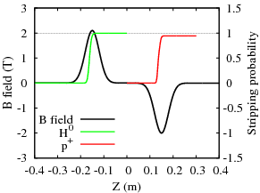
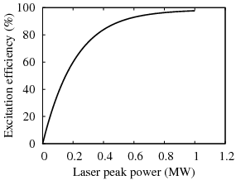
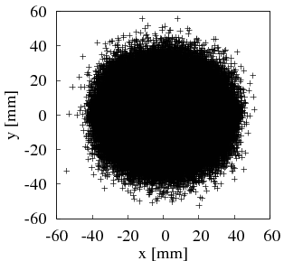
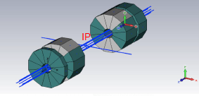
Review of our earlier study for laser assisted
H⁻ stripping at 400 MeV (same as SNS framework)
Peak power: 1 MW
Stripping eff.: 90%
Magnetic field issues:
● In the practical application, the
magnets should have larger radius.
● For 400 MeV H⁻, hard to realize
over 2 T magnetic field.
● Circulating beam size after
injection is quite large!
r ~5 cm!
A. Aleksandrov, HB2014
For SNS 1 GeV H⁻
Magnetic field 1.2T
Inner radius: 0.15cm
J-PARC RCS: 400 MeV injection for 1 MW.
Beam distribution at the end of injection.
( Simulation: TP: none, LP: full )

Slide 11
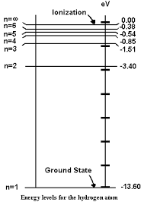
Principle of H⁻ stripping by only lasers at J-PARC
Isao Yamane, Hiroyuki Harada, Saha Pranab and Shinichi Kato
PASJ, Vol. 13, 2016, 1-11 (in Japanese)
Nd: YAG Laser
λ=1064 nm
Nd: YAG Laser
λ=1064 nm
Excimer laser
λ= 193 nm
H⁻
H⁰
H^{0*}
ΔE=12.1 eV
ΔE = hc/λ₀
λ₀= 102 nm
e⁻
p
e⁻
90°
e⁻
63.3°
90°
e⁻
Step 2:
Excitation of H⁰
H⁰ + γ → H⁰* (n=3)
Step 1:
H⁻ + γ → H⁰ + e⁻
Step 3:
H^{0*} + γ → p + e⁻
Process | E_{ph} (eV) | λ (nm) | α (deg.) | λ₀ (nm) | Laser
H⁻→ H⁰ | 1.67 | 1064 | 90 | 743 | Nd:YAG
H⁰→H⁰* | 12.1 | 193 | 63 | 102 | Excimer (ArF)
H⁰*→p | 1.67 | 1064 | 90 | 743 | ND:YAG
Doppler effect of the 400
MeV H⁻ beam:
β = 0.713, γ = 1.426
λ = λ₀ (1 + β cosα)γ

Slide 12
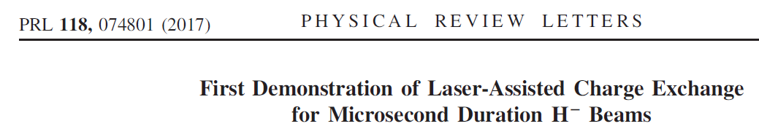
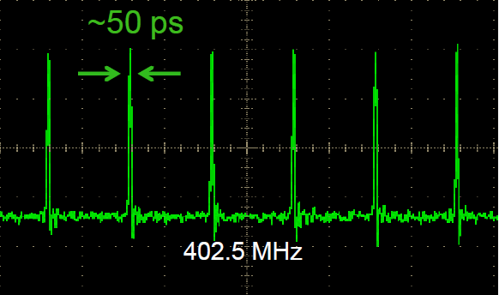
SNS demonstrated 90% stripping
for 1 GeV 10 μs H⁻ pulse
SNS, Oak Ridge
B >1T
H⁻
p
Laser pulse and peak power:
Nd:YAG laser of 1064 nm
→ 3rd harmonic conversion (355 nm)
Synchronized to 402.5 MHz H⁻ pulses.
Pulse energy and width: 50μJ, 50ps
➔ Peak power: 1 MW
Stripping efficiency: Achieved > 90%

Slide 13
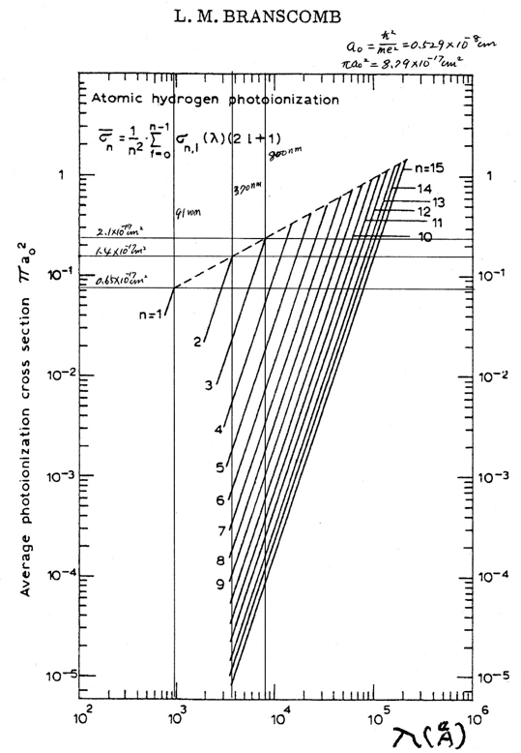
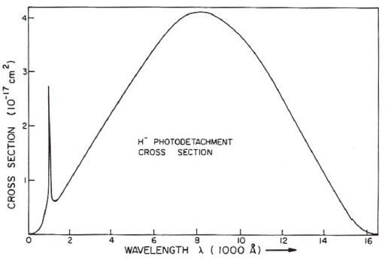
Photodetachment, Photoionization cross sections and the corresponding laser power
L. M. BRANSCOMB, “Physics of the One-And-Two-Electron Atoms”,
Edited by F. Bopp and H. Kleinpoppen, North-Holland, (1969)
800nm
Photoionization
H^{0∗} → p
σ = 4×10⁻¹⁷ cm²
Photodetachment
H⁻ →H⁰
13
σ= 1.8×10⁻¹⁷ cm²
743 nm
E_{ph} = 1.67 eV @ 743 nm
Saturation density Φ^{s} in PRF
Φ^{s} = (E_{ph}/σ) = 6.7×10⁻³ J/cm²
r(H⁻) = 1mm, τ(H⁻)=30 psec
τ_{i}(collision) = 10 psec, τ_{l}(laser) = 40 psec
E(laser) = (Φ^{s}/γ)×(πr²)×(τ_{l}/τ_{i})
= 0.6 mJ → 15 MW
E(laser) = 1.3 mJ → 33 MW
H⁻ neutralization is well studied in many places:
FNAL: Laser notcher system
J-PARC TEF: R&D studies for 3 MeV H⁻.

Slide 14
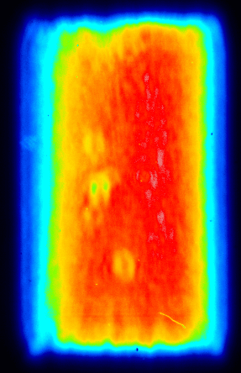
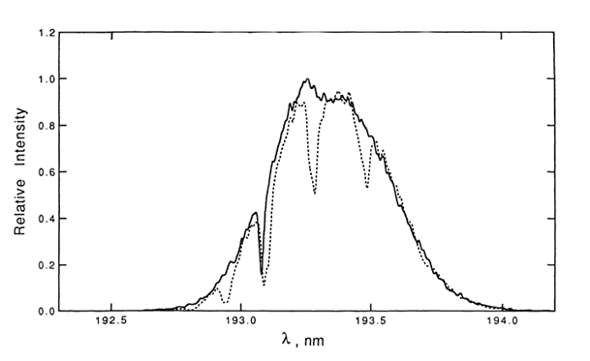
Lasers we have for the POP demonstration
Two Nd: YAG lasers available:
Purpose: 1st (H⁻ → H⁰) and 3rd (H⁰* →p) stripping
1. Nd: YAG 1064 nm, 5-9 ns (FWHM), E= 0.2 ~0.6 J
-- Detail study under progress with 0.2 J
2. J-PARC TEF facility has one more powerful YAG laser
Nd: YAG 1064 nm, 5-9 ns (FWHM), 1.6 J
Test experiments done for 3 MeV H⁻ neutralization.
0.3 ×0.6 mm²
Excimer laser:
ArF 193 nm excimer laser (by Mlase)
Energy= 13 mJ, Pulse length = 5-10 ns (σ)
Bandwidth: ~4THz
➔ P_{peak} > 1 MW can be reached
Excitation efficiency: 90% might be achieved.
If we succeed pulse compression of the ArF laser,
we can reach P_{peak} >> 1 MW
…. Air
N₂ purged
193 194
ArF 193 nm excimer laser
Manufacturer data

Slide 15
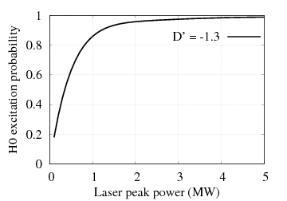
JFY 2017 progress highlights
1. Preparation of POP (Proof-of-principle) demonstration of 400 MeV
H⁻ stripping to protons by using only lasers at J-PARC is under preparation.
--- Vacuum chamber in the beam line is installed.
--- R&D of the lasers are also in progress.
--- Simulation, H⁻ beam manipulations more details from now.
2. For R&D of the lasers we have new collaboration with Kyoto Univ. and
the Univ. of Electro-communications, Tokyo (in progress). ---(H. Harada leading)
3. Dr. Timofey from SNS visited J-PARC
for 2 weeks in March as an invited fellow.
-- Worked with Saha to develop pyORBIT
code for 400 MeV H⁰ excitation.
-- Discussion on the J-PARC laser stripping
strategy, H⁻ beam manipulation, etc.
Laser peak power for
H⁰ excitation
Specially optimized H⁻ beam
→1.3 MW for 90% excitation

Slide 16
Recent status and the strategy in detail
We aim to demonstrate ~90% stripping efficiency
for a single micro pulse.
To do
■ We should study about the expected laser power and
effort to reduce the laser power.
■ Experimental strategy and the measurement techniques
We should use existing devices and monitors for
the POP demonstration.
● Extensive R&D studies of the lasers:
H. Harada, P.K. Saha + other members..
● H⁻ beam manipulation, measurement principles…
P.K. Saha, A. Miura, H. Harada + other members…

Slide 17
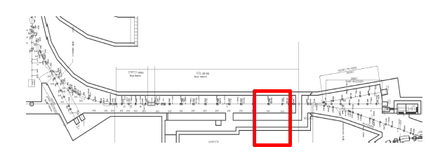
Experimental place, beamline
The POP experiment will be performed at the end section of
L-3BT (Linac to the 3-GeV Beam Transport)
H⁻
p
H⁰
H⁻

Slide 18
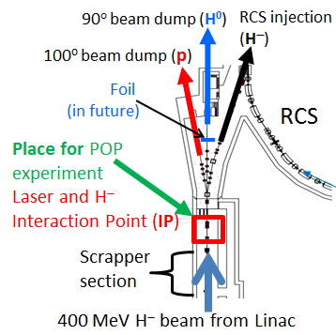
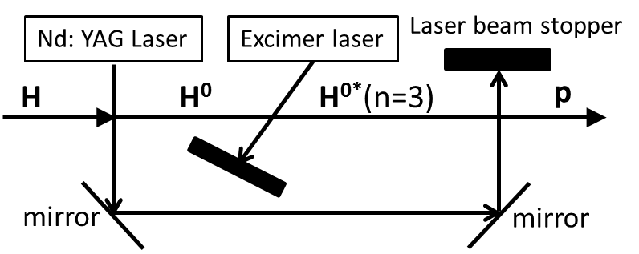
Experimental Setup and strategy
Setup for the POP experiment
(Nd: YAG laser can also be splitted in
the beginning for the 1st and 3rd steps)
● We can simultaneously measure all three charge fractions in three separated beam
lines in the downstream of IP.
● A stripper foil will be installed near 90-deg dump to strip H⁰ to p for measuring it.
For confirmation of H0 excitation, we can also measure emitted lights from H0 decay.

Slide 19
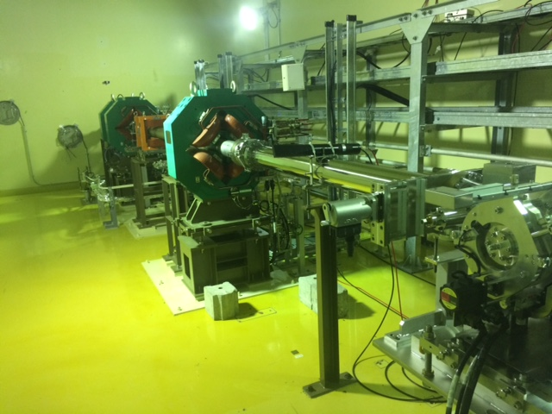
POP experimental devices setup
End section of Linac to 3-GeV
Beam Transport
QM61
~1.5m
Chamber for the
POP chamber
H⁻ beam

Slide 20
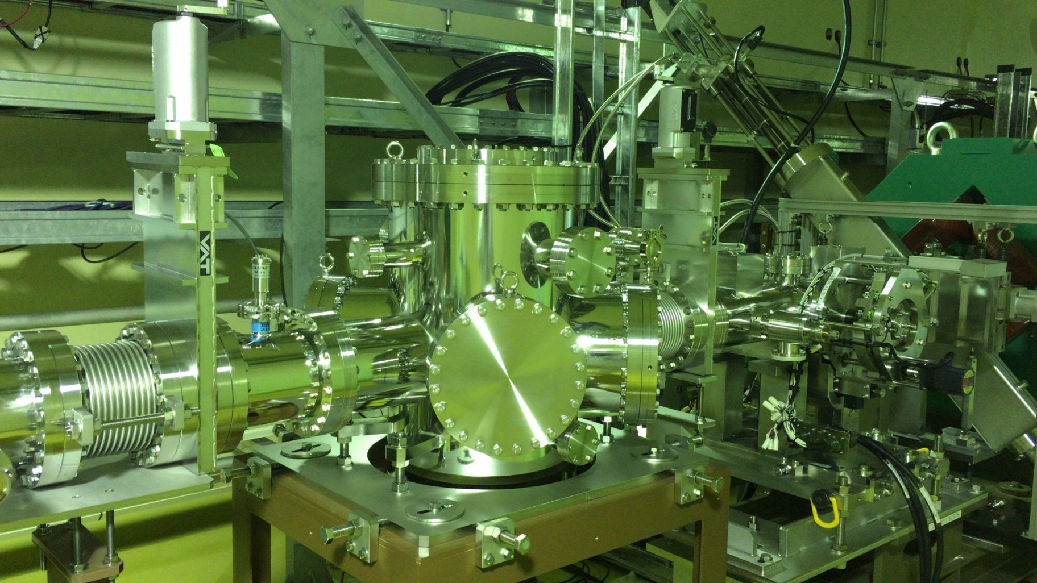
Vacuum chamber for POP experiment installed
H⁻ beam
The chamber is designed for multi purpose laser manipulation of the H⁻ beam.
● Laser stripping of 400 H- beam.
● Multi-layer laser wire monitor.
● Electron impact on H-/p for beam for stripping, monitoring, SC neutralization, etc..

Slide 21
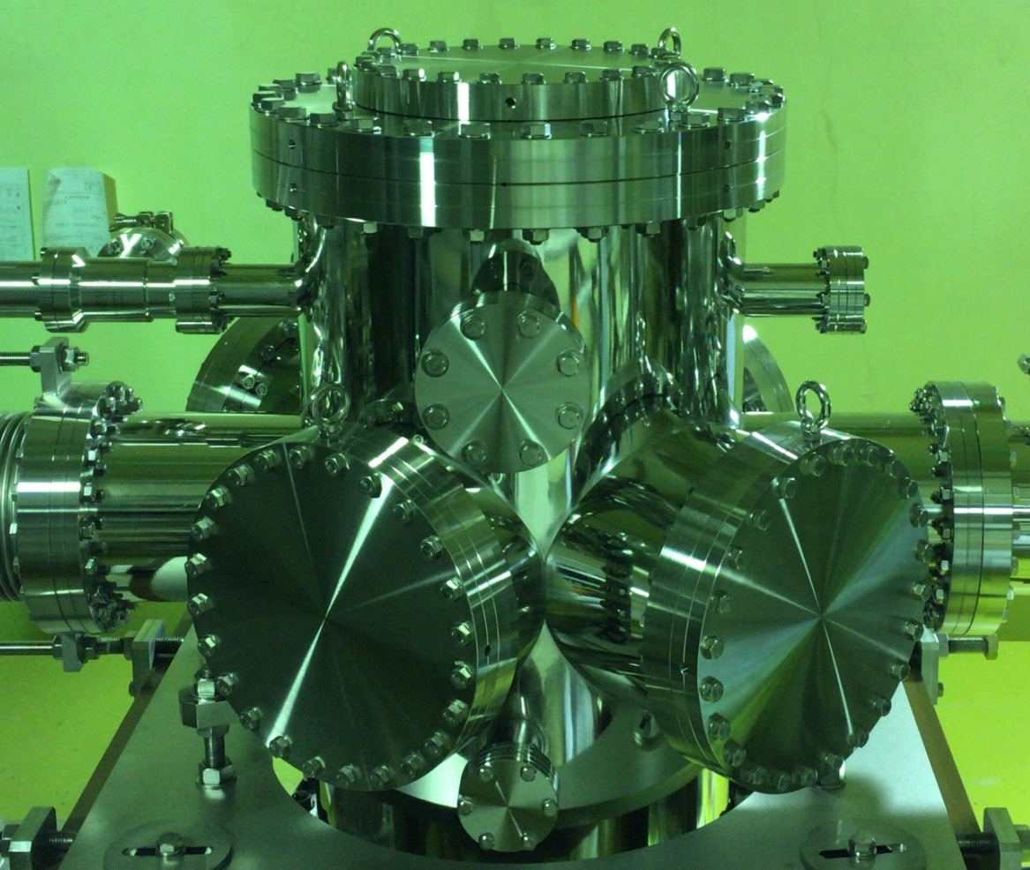
Vacuum chamber: close view
The excimer laser window is made large to try for direct ionization of ground state H0
λ₀ = 91.2 nm, λ = 193nm,
From λ = λ₀(1 + βcosα)γ
α = 47º
Variation range: 67º<α<45º
There are many windows on the chamber
for multi-purpose uses.

Slide 22
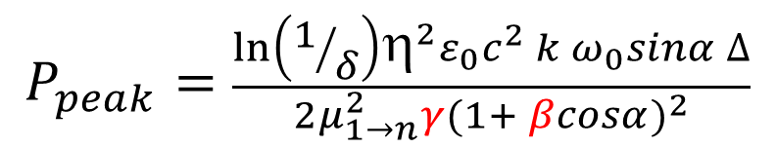
Laser power for 400 MeV H⁰ excitation (n=3) at J-PARC:
-- Based on SNS experience
Laser peak power, P_{peak} for H⁰ excitation n=1→3
$$P_{peak}=\frac{\ln\left(1/δ\right){\text{h}}^{2}ε_{0}c^{2} k{ ω}_{0}sinα ∆}{2μ_{1→n}^{2}γ({1+ βcosα)}^{2}}$$
V. Danilov, PRST-AB 6, 053501 (2003)
Where, δ is the ratio of unexcited and excited atoms. δ <<1 is expected.
P_{peak} = 1 MW for 90% efficiency
At 400 MeV (β=0.713, γ =1.4263), Naively, P_{peak} ~1.7 MW is required 90% efficiency.
To reduce the laser power, extensive manipulations of the H⁻ beam
were done at the SNS:
★ Shorter longitudinal beam size. σ_{z} = 30 ps → Not an issue for our POP expt.
★ Dispersion derivative of the H⁻ beam
★ Minimization of the betatron angular spread
★ Smaller vertical beam size
How much we can optimize
these parameters?

Slide 23
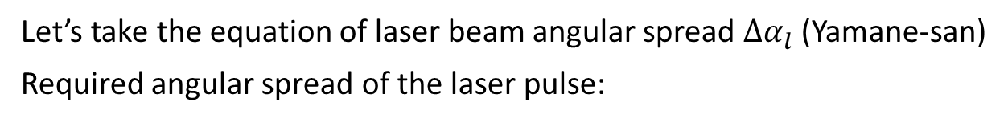
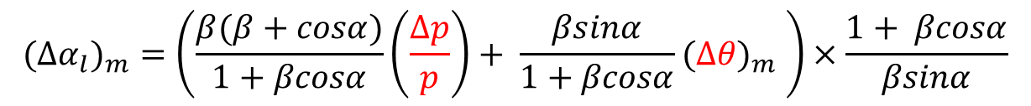
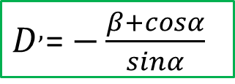
Reduction of laser power
Let’s take the equation of laser beam angular spread ${∆α}_{l}$(Yamane-san)
Required angular spread of the laser pulse:
$$({{∆α}_{l})}_{m}=\left(\frac{β(β+cosα)}{1+βcosα}\left(\frac{Δp}{p}\right)+ \frac{βsinα}{1+βcosα}({∆θ)}_{m} \right)×\frac{1+ βcosα}{βsinα}$$
Introduce dispersion derivative
Reduction of betatron
angular spread (page 14)
0
$$({{∆α}_{l})}_{m}=\left(\frac{β(β+cosα+D^{′}sinα)}{1+βcosα}\left(\frac{Δp}{p}\right)+ \frac{βsinα}{1+βcosα}({∆θ)}_{m} \right)×\frac{1+ βcosα}{βsinα}$$
$D^{,}$= $−\frac{β+cosα}{sinα}$

Slide 24
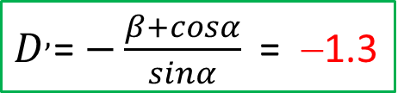
Dispersion derivative of the H⁻ beam
In order to eliminate transition frequency spread, due to the momentum
spread dp/p₀ in the H⁻ beam, dispersion (D) tailoring method is utilized.
Due to the Doppler effect
= λ₀ (1+βcosα)γ
β, γ are Lorentz parameters
α = α₀ – x’, dα = −x’
For reference particle (dp/p₀=0),
α = α₀
For off-momentum particle,
x = D(dp/p₀), x’ = D’(dp/p₀)
From dp/p₀ = (1/β²) dγ/γ
dα/dγ = −D’/β²γ
The dispersion relation becomes,
Uniform laser beam
γ₁
H⁰
γ₂
α
H^{0∗}
γ₀
γ₃
γ_{n}
● Hydrogen atom with different energies have the
same laser light frequency in their rest frame.
● Laser light does not have to have a divergence.
→ Gain on the laser peak power.
$D^{,}$= $−\frac{β+cosα}{sinα}$= −1.3

Slide 25

Optimization of betatron angular spread
{
X’
X’
$$\sqrt{εγ}$$
φ
α = 0
X
X
α = 0, β enlarge
Transverse beam emittance:
ε = γx² + 2αxx’ + βx’²
γ = (1+α²)/β
tan(2φ) = 2α/(γ-β)
α, β, γ, ε are twiss parameters
Angular spread is controlled by optimizing α to zero and also with large β.
As for the vertical size of the H⁻ beam, a smaller size is required to
gain on the beam density. At SNS, σ_{v} = 0.15 mm achieved.

Slide 26
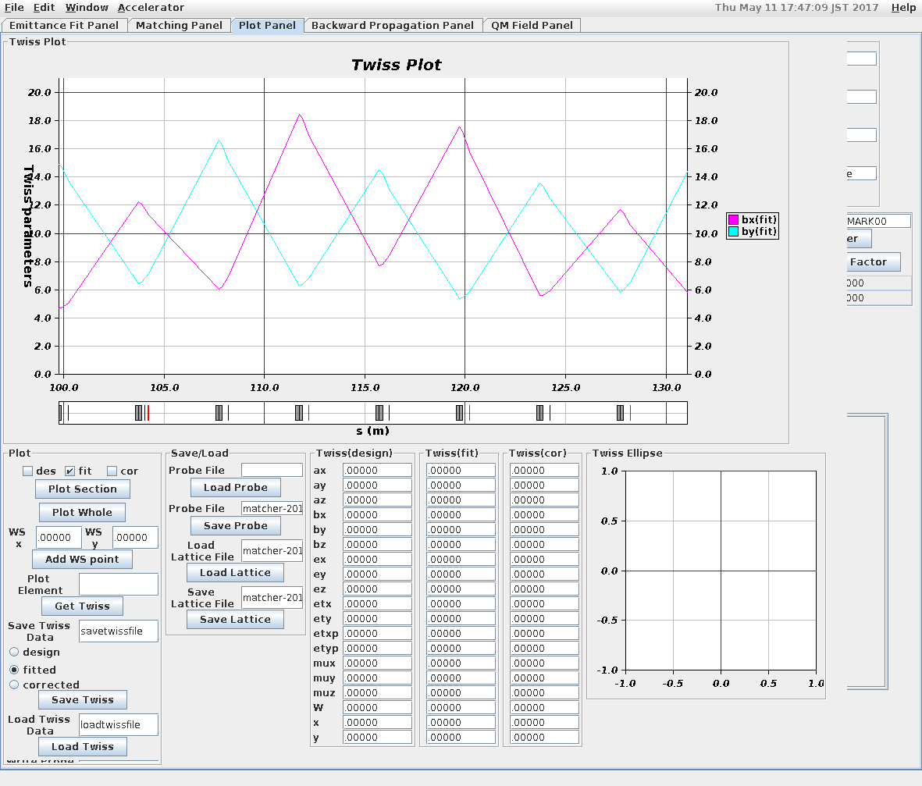
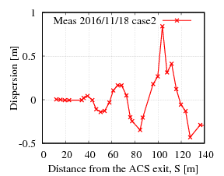
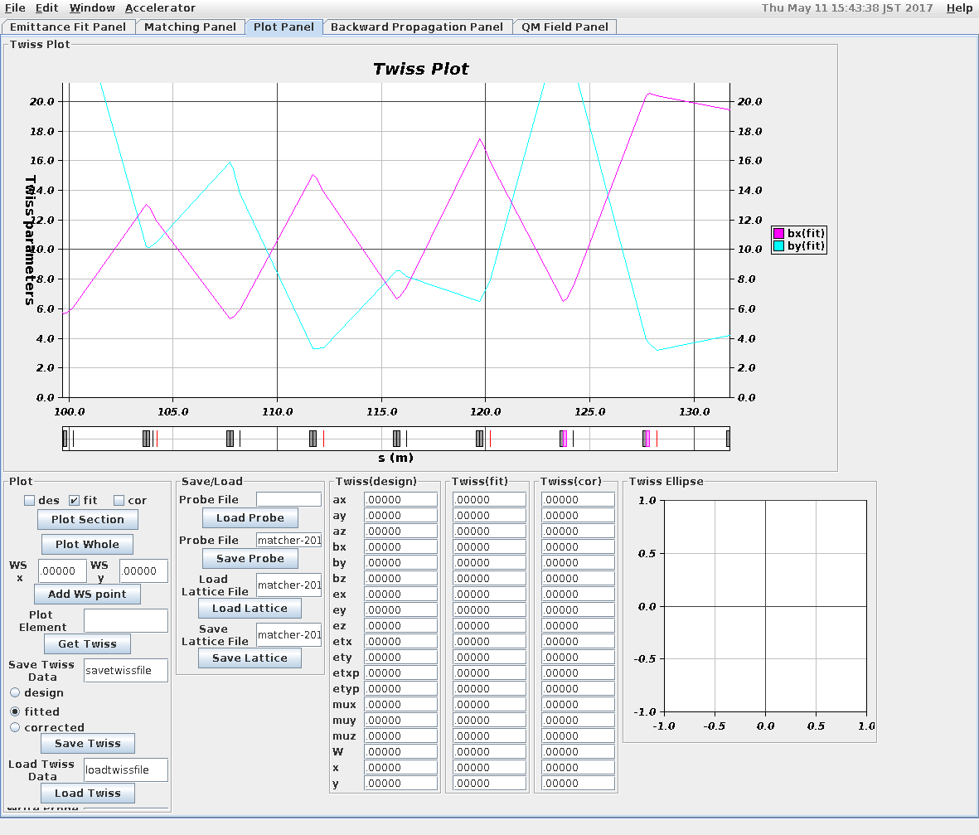
Trial optimization of the H⁻ beam
Transverse beam optimization at the IP
~ Typical
IP
D’ = -0.13
Efforts are ongoing
IP
1st trail of optimized for
POP experiment
Further more studies needed

Slide 27
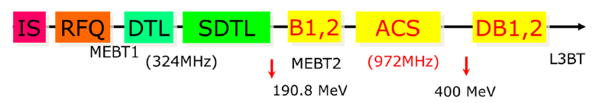
Measurement Strategy for POP demonstration, expected signal
RCS
Excimer laser
pulse
20ns
3ns
40ms
0.5ms
. . .
Cycle (25 Hz)
Macro pulse
H⁻ pulse
814ns
456ns
. . .
Typical 324 MHz BPM electrode signal.
The H⁻ beam signal will be reduced in the laser pulse overlapping region.
The protons go to the 100 deg. dump.
Intermediate pulse (1.2285 MHz)
(Structure @ injecting into the RCS)
3.08ns
Micro pulse (324 MHz)
. . .
We concentrate only on a single micro pulse.
Use stripline BPM signal.

Slide 28
How to cover 0.5 ms (~10⁵ micro pulses) for practical application?
H. Harada
laser output
monitor
toroidal mirror
amplifier
waist
Lens
seed laser
100mJ, 100psec, 25Hz
Splitter mirror
(transmission：~1%)
waist
(IP)
H－beam
waist
One candidate: Laser storage ring, originally
proposed by Isao Yamane.
We plan for detail R&D studies but many issues
to realize full specifications, especially for
the excimer laser.
Amplification, laser life time …
Alternative ideas should come.
amplifier
plane mirror
toroidal mirror

Slide 29
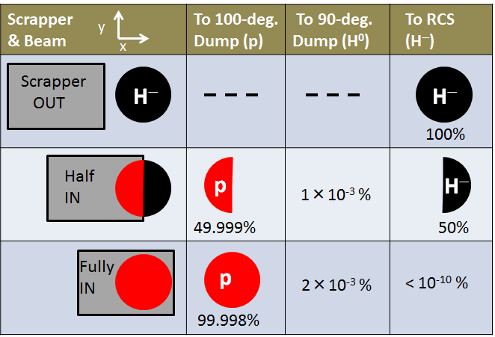
Measurement method of stripping efficiency of a single micro pulse
Checked by inserting L-3BT scrapper at present
(Charge-exchange type transverse beam halo scrapper. Stripped protons go
to the 100-deg. Beam dump)

Slide 30
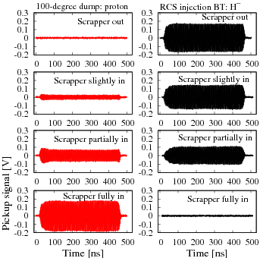
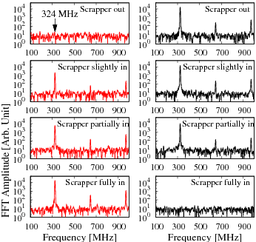
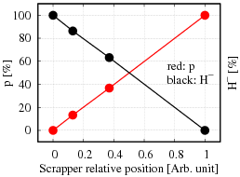
Measurement techniques: Experimental results
FFT
Stripping efficiency of single medium pulse
can easily be obtained by using FFT analysis.
However, we have to obtain stripping efficiency
of a single micro pulse of 324 MHz.
→ Analysis of individual micro pulse

Slide 31
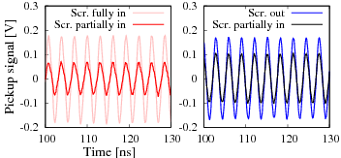
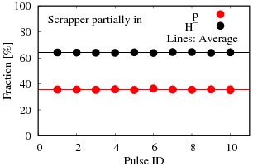
Analysis of individual micro pulse
100-deg. dump (p)
L-3BT line (H⁻)
Fraction p : pink to red
Fraction H⁻ black to blue
● New effort to measure micro pulse stripping
efficiency.
● Can be utilized also for micro pulse stability.

Slide 32
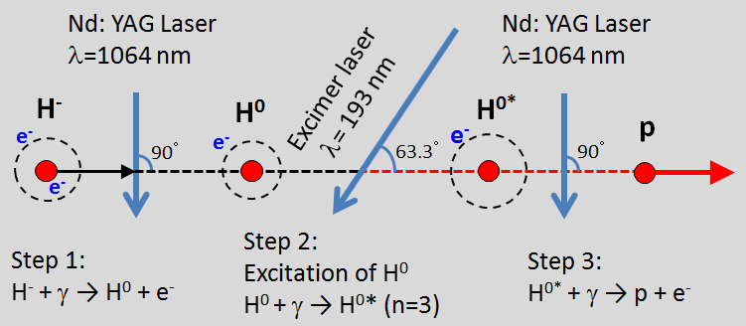
Laser stripping of 400 MeV H- beam
--- Scheduled step by step
H⁻ neutralization
study first.
● The detail studies of ND:YAG laser are in good progress. At present detail of
laser stability, pulse shape up to with 200 mJ are being studied.
★ The ArF excimer laser study just started.
★ We will work for pulse shortening of the lasers.
★ Placing lasers at the acceleration tunnel is big issue!

Slide 33
Summary
The preparation for POP demonstration of 400 MeV H- stripping
by using only lasers at J-PARC is in progress.
The experiment will be carried out in steps.
First trial of complete set of experiment planned within JFY 2018.
Laser and H- beam manipulations more studies needed.
Measurement technique for even a single micro pulse established.
POP final goal: 90% stripping efficiency for a single micro pulse.
Next step, not straightforward to cover ~10⁵ micro pulses.
Candidates:
Laser storage ring synchronized with 324 MHz H- micro pulse.
Many issues for realistic implementation with full specifications.
Other ideas have to come.

Slide 34
Collaboration outlook
■ Laser interaction of the H⁻ beam for utilization in stripping,
chopping, beam diagnostic and other manipulations are an
important subject for the present and next-generation
high-intensity proton accelerators.
■ Non-destructive and highly required not only for the existing
high intensity machines but also to realize multi-MW beam power.
The collaboration aims at
Developing a framework for an effective laser manipulation
of the H⁻ beam
→ Achieve maximum efficiency with a minimum laser power.
Explore for multi-dimensional application.
. . . . . . . . . . . .

