Slide 1
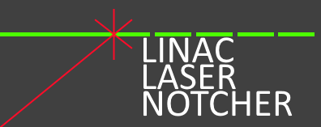
Fermilab Linac Laser Notcher:
Motivation, Method, and First Operational Experience
David Johnson, Todd Johnson, David Slimmer, Kevin Duel, Pat Karns, Brian Schupbach, Kiyomi Seiya, Salah Chaurize, Chandra Bhat, Bill Pellico
US-Japan Meeting on Laser Manipulation of H- Beams
28-March-2018

Slide 2
Motivation
Proton Improvement Plan Intensity Goals
  Ultimate goal: 2.2E17 protons delivered/hr @ 15 HZ by 2016.
  Assuming 90% acceleration eff. -> 1E9/200MHz bunch injected
Booster runs at Administrative loss limit
Notching in the Booster ring deposits the removed bunches into dedicated Absorbers. This represents on the order of 30% of Booster beam power loss ( few % of beam intensity).
Ultimately one needs about 80 ns notch in the beam at extraction time for the extraction kicker rise time and the 8 GeV Recycler injection kicker
In the 200 MHz beam structure this would correspond to ~16 200 MHz bunches every 2.2 us and for 16 turns this would be a total of about 256 bunches or about 1-2% of injected beam.
  When we started in 2011, it was 10-12 bunches and 10 turns…
We would like to remove this loss from the ring and safely dispose of the notched ions.
Techniques developed here may be applicable in other projects such as laser stripping and laser chopping.

Slide 3
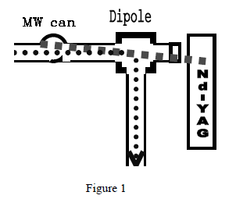
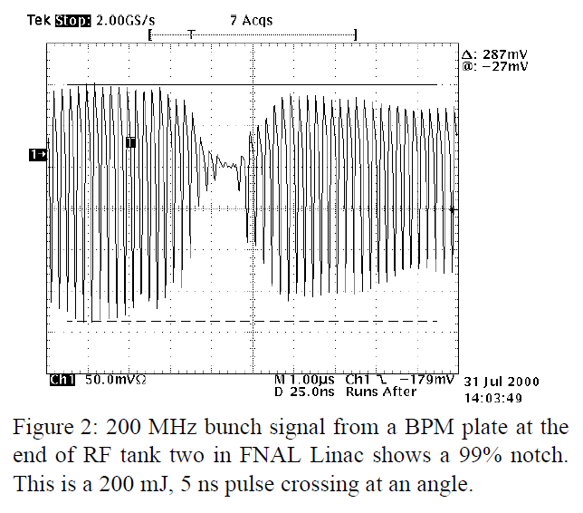
First Laser Notching Experiment
Laser Notching of Linac H- at Fermilab
In 2001, Ray Tomlin reported on a successful experiment to create notches in the CW linac beam in the H- 750 keV beam line and have this notch survive at Booster injection.
He created a 25 ns notch utilizing a 200 mJ 5 ns laser pulse.
To create multiple notches in the linac pulse he
proposed a
  “4 pass bow-tie cavity some 665 meters
  long (with a storage time of 2.22 μs)”. Large Pockels
  cells would shuttle the laser to and from the delay line.
A disk gain section would restore optical losses.
Average laser pulse energy of 103 mJ
Peak power of ~20 MW to strip 99.9% of the ions.
This was not implemented.

Slide 4
Laser Activities at Fermilab
NML Photo-injector (creation of electron beam for SCL cavities)
  Operational
Linac Laser Notcher (bunch-bunch neutralization of H- beams
  Operational
Booster 400 MeV line Laser wire (transverse profile for H- beams at 400 MeV)
  Developed/installed – needs minor mods & re-commissioning
PIP-II Injector low power laser wire (transverse & longitudinal for H- beams 2.1 MeV)
  Development in process
Photo-injector development laser system (IARC)
  Being setup for R&D
Inverse Compton Scattering Experiment at FAST (electrons)
  Proposal for 2019-2020 time frame
Laser Optical Stochastic Cooling Experiment at FAST (electrons
  Proposal (NIU PhD Thesis)
Further development of bunch-by-bunch laser system for longitudinal collimation
  LDRD to start later this year
Holometer Experiment

Slide 5
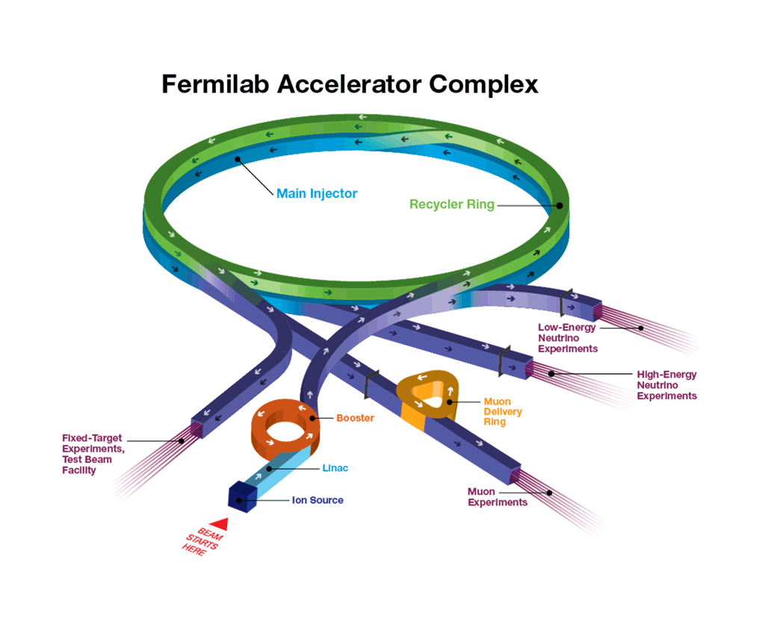
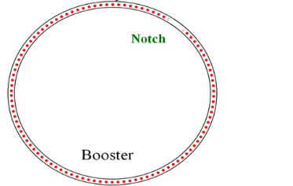
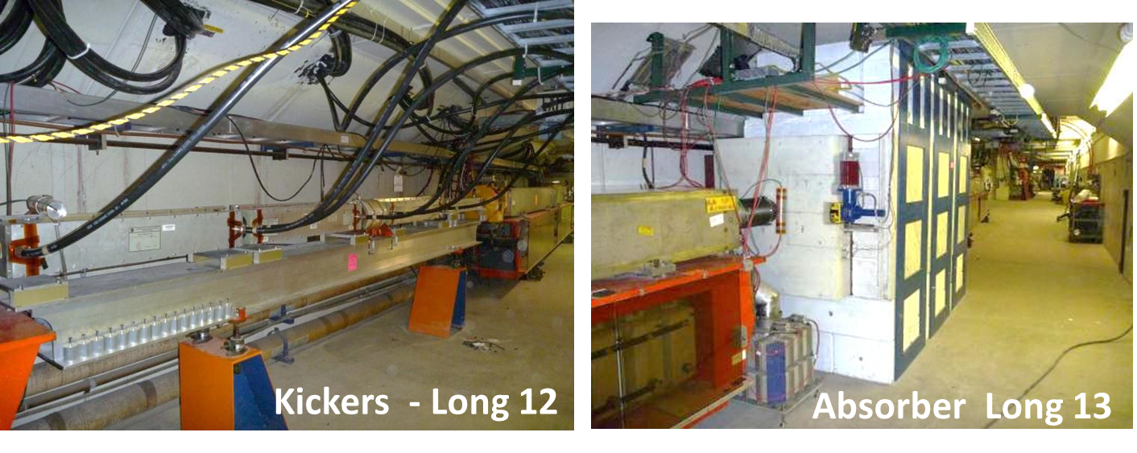
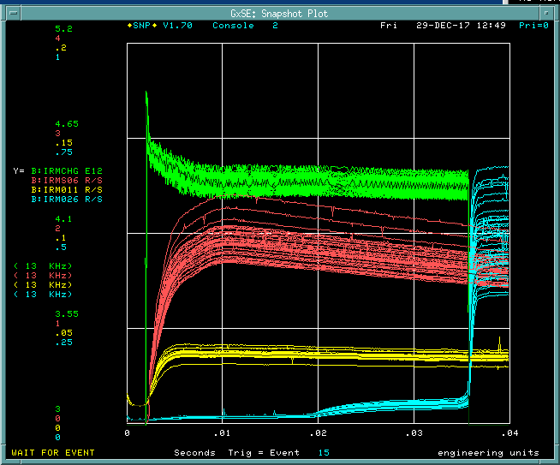
A Little Background
Linac
201.25 MHz
MEBT
RFQ
Ion
Source
400 MeV
750 keV
Laser
Notcher
Notch created in Booster @ 400 MeV
-> 30% total power loss
τ_{REV} ~ 2.21 μs
Loss from Booster Notcher
Booster
8 GeV
F_{RF} (injection) 38 MHz
Move this process out of the Booster tunnel
→ Create Notch in linac at 750 keV
LINAC PULSE
~35.5 us (~ 16 Booster turns)

Slide 6
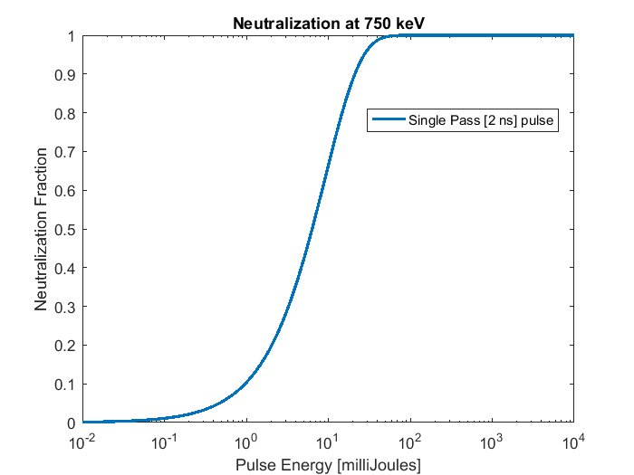
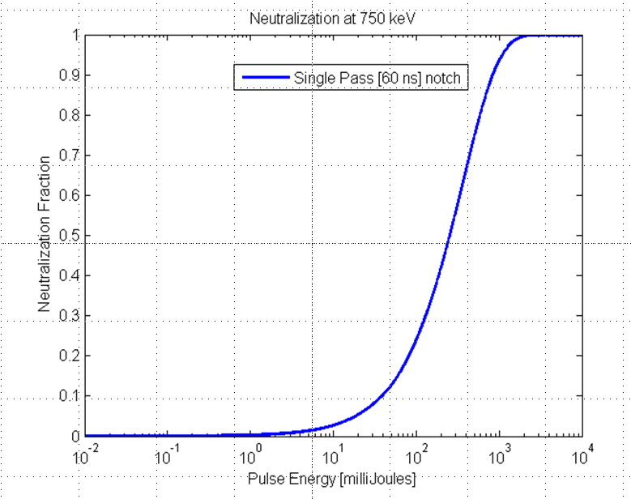
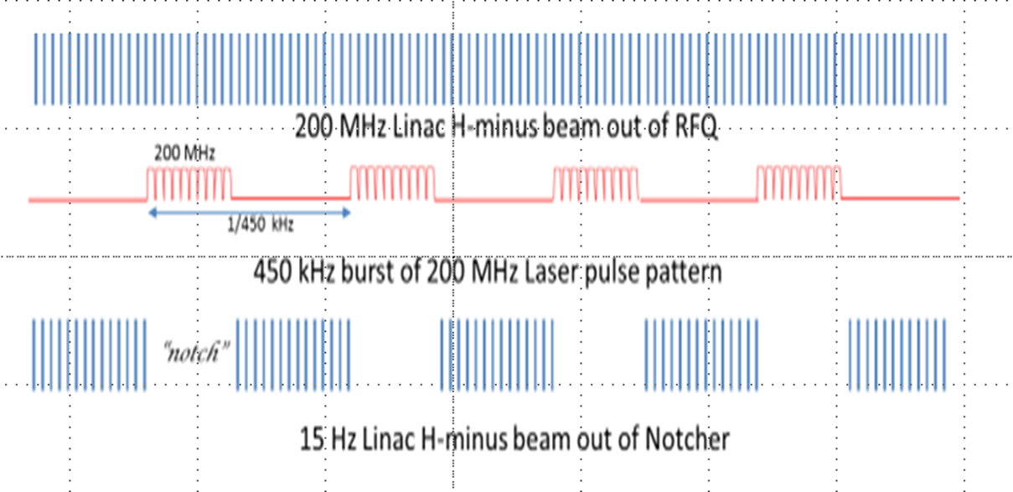
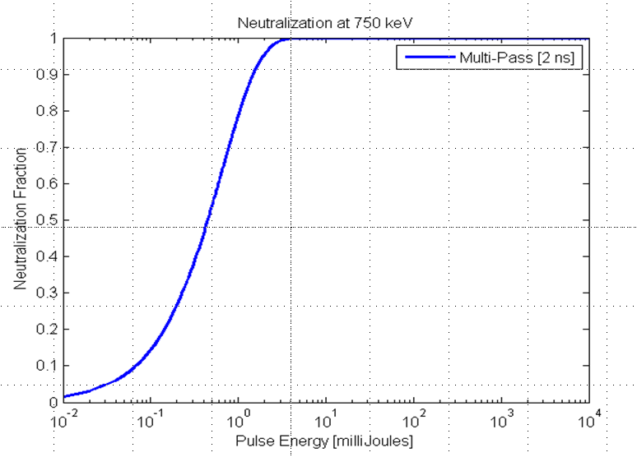
Technique: Photoneutralization
1 micron laser- near peak of cross section
Want to make process efficient -> minimize required laser pulse energy/average power
43 mJ/bunch
Match laser pulses to bunch parameters
1 J
~0.5J/notch
Non-resonant optical cavity (we call a zig-zag cavity)
2 mJ/pulse
32 mJ/notch
H-
Need to develop 2 components: interaction cavity & laser system
Notes:
When the neutralization probability does not depend on the electron intensity
The fraction of neutralized ions is given by… where….
Select 1 micron
3) Laser flux -> reduce area and size
cross section -> constant
interaction time -> maximize
If we create a single laser pulse for each notch (SINGLE PASS …show plot 4)
Rather than a sledge hammer, Create a scalpel. tailor the laser to the bunch…5)
6) To further reduce pulse intensity increase time by increasing the number of interactions -- zig-zag cavity
Ultimately, 2mJ /bunch-> 32 mJ/notch

Slide 7
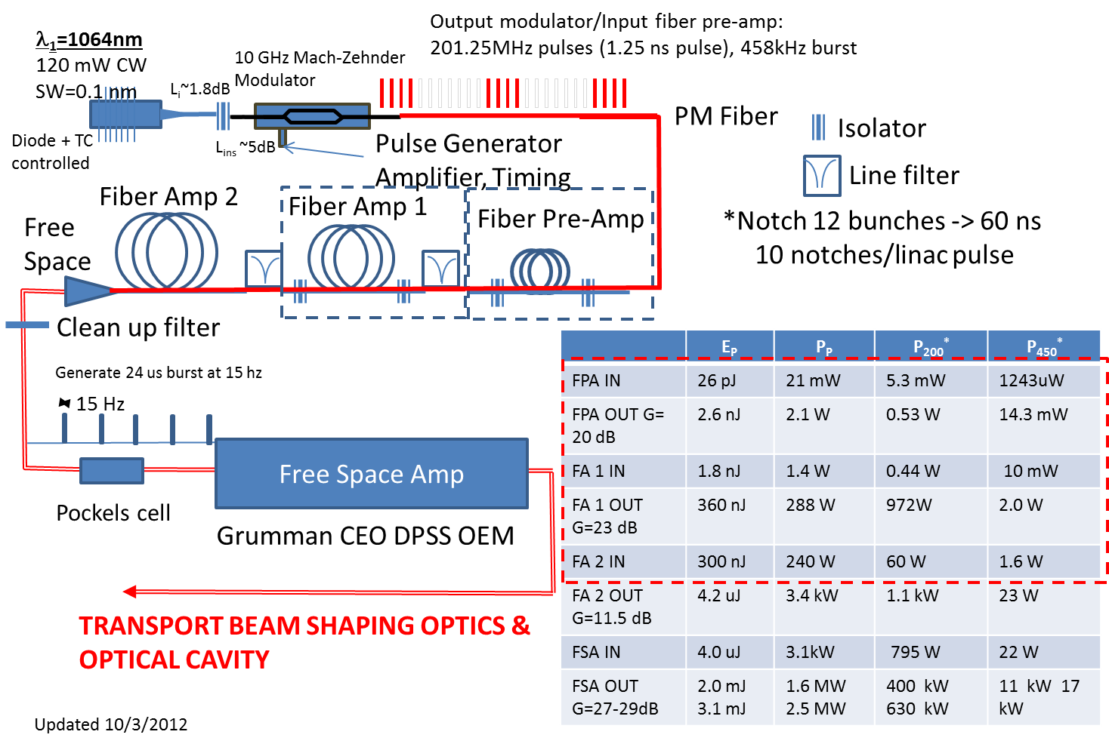
Create a burst mode laser system

Slide 8
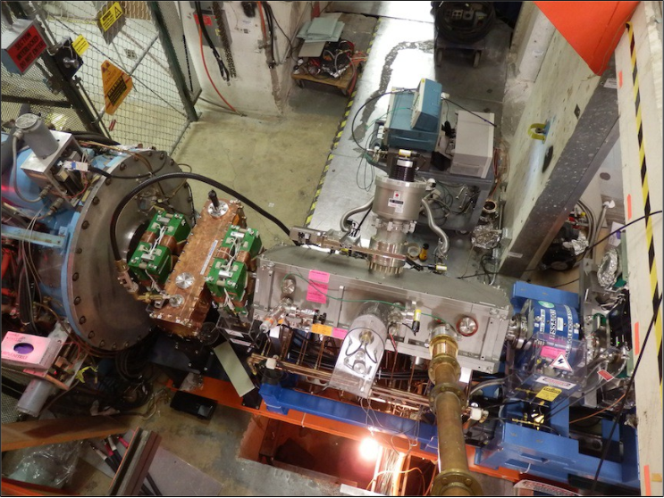
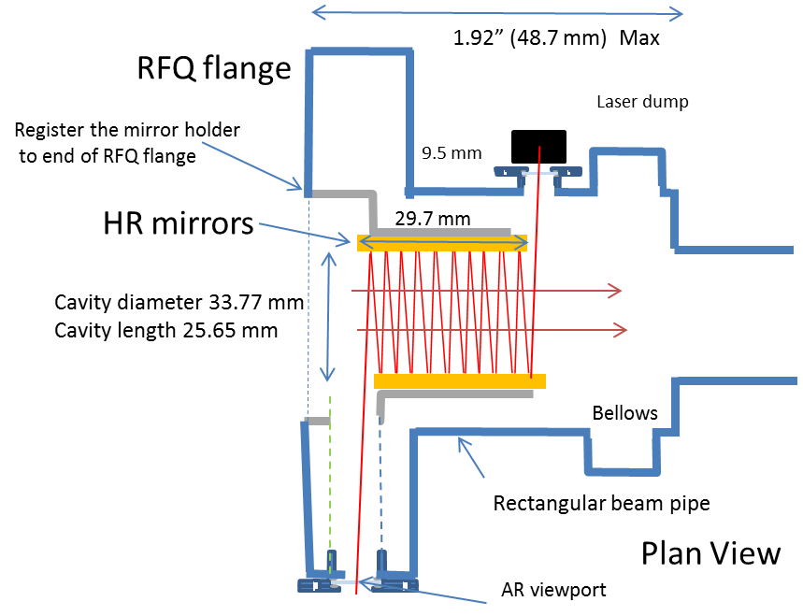
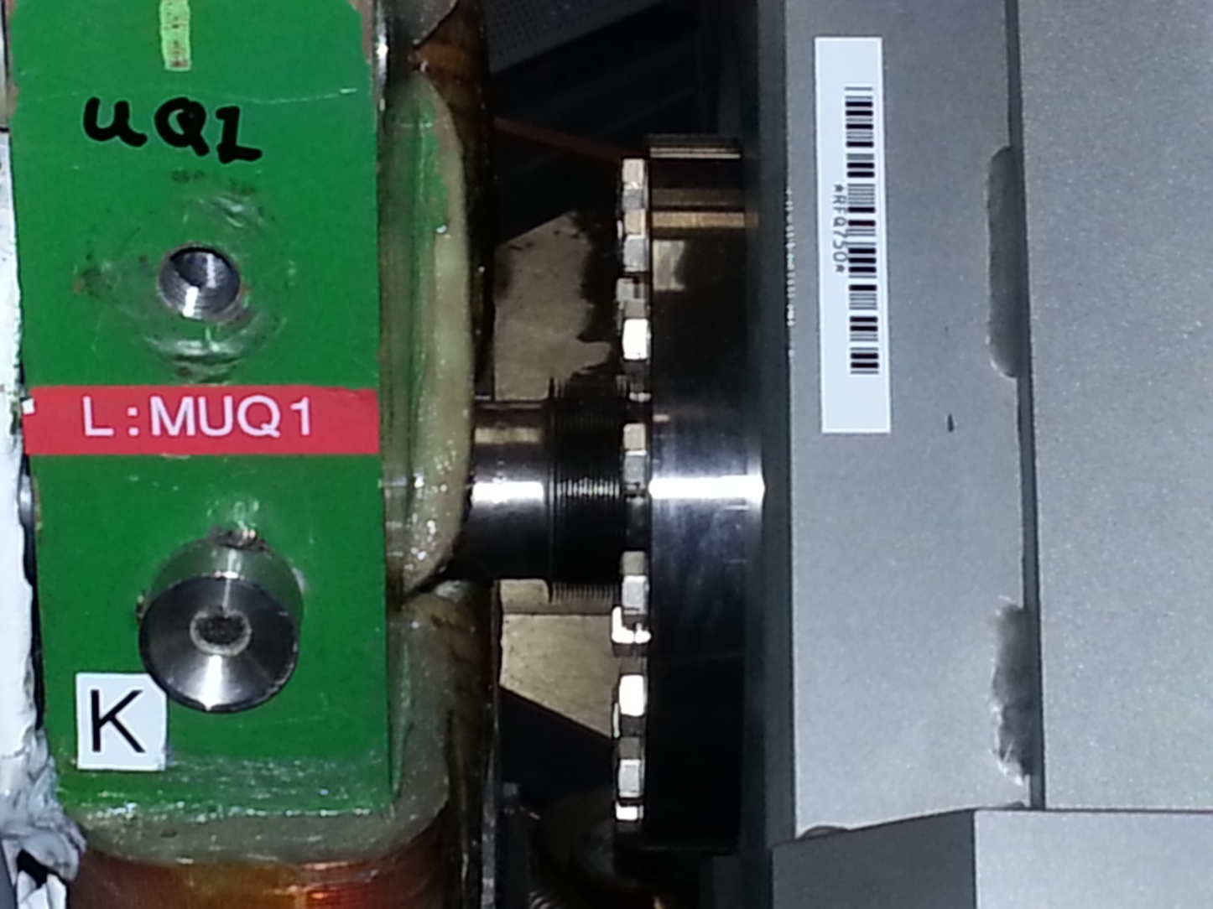
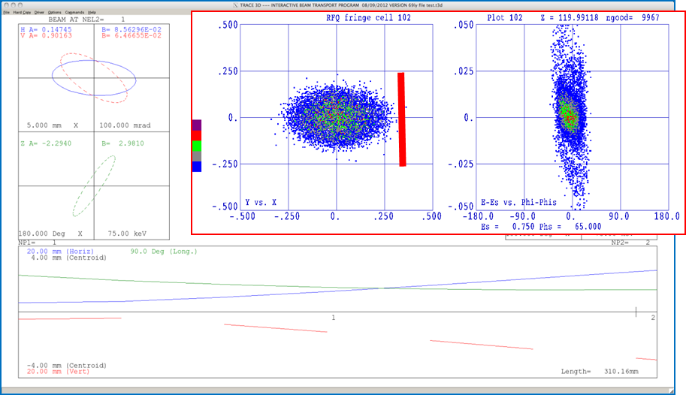
New 750 keV RFQ Injection Line (RIL)
Must fit in this space

Slide 9
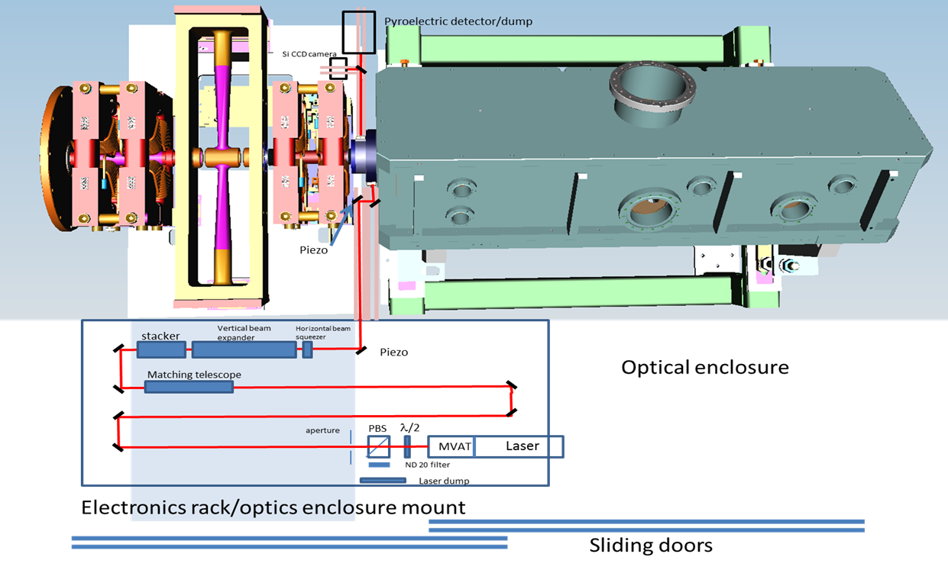
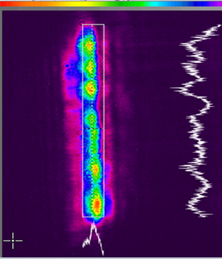
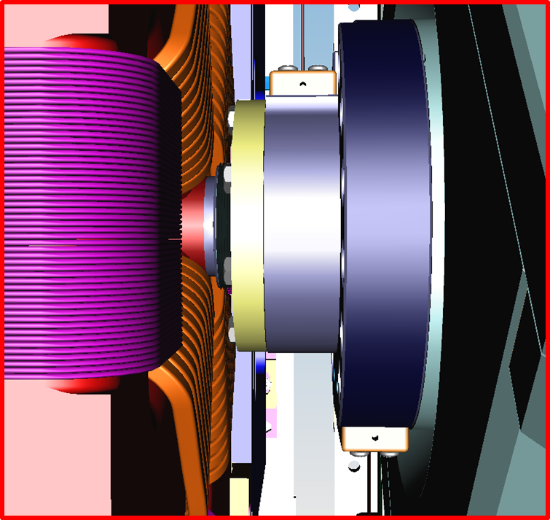
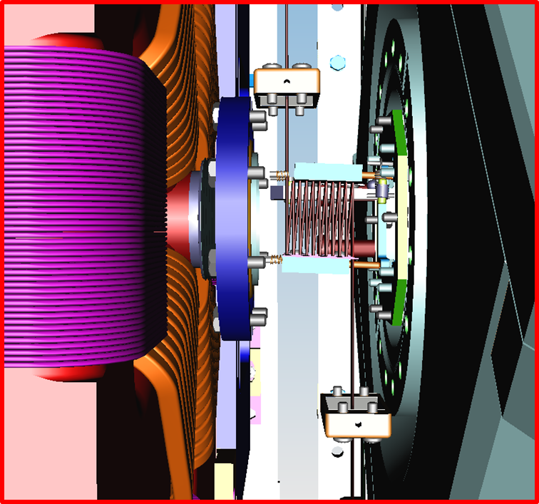
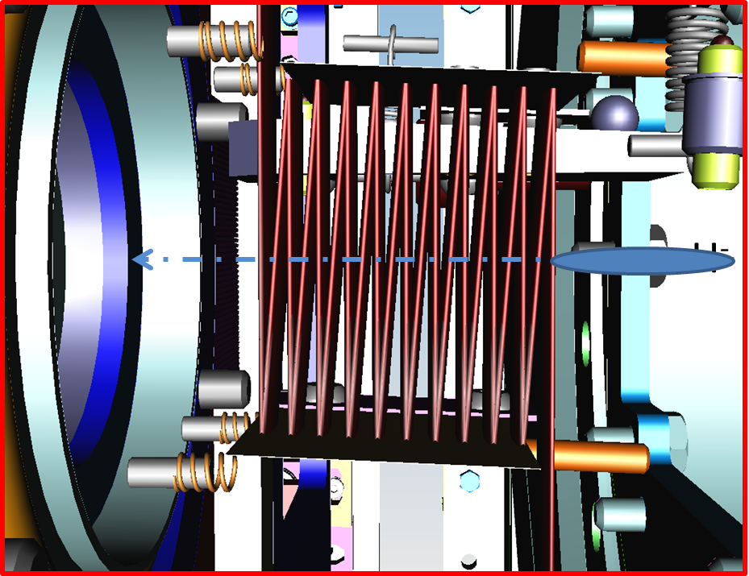
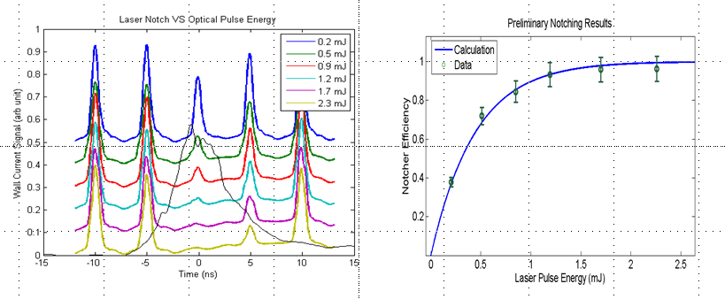
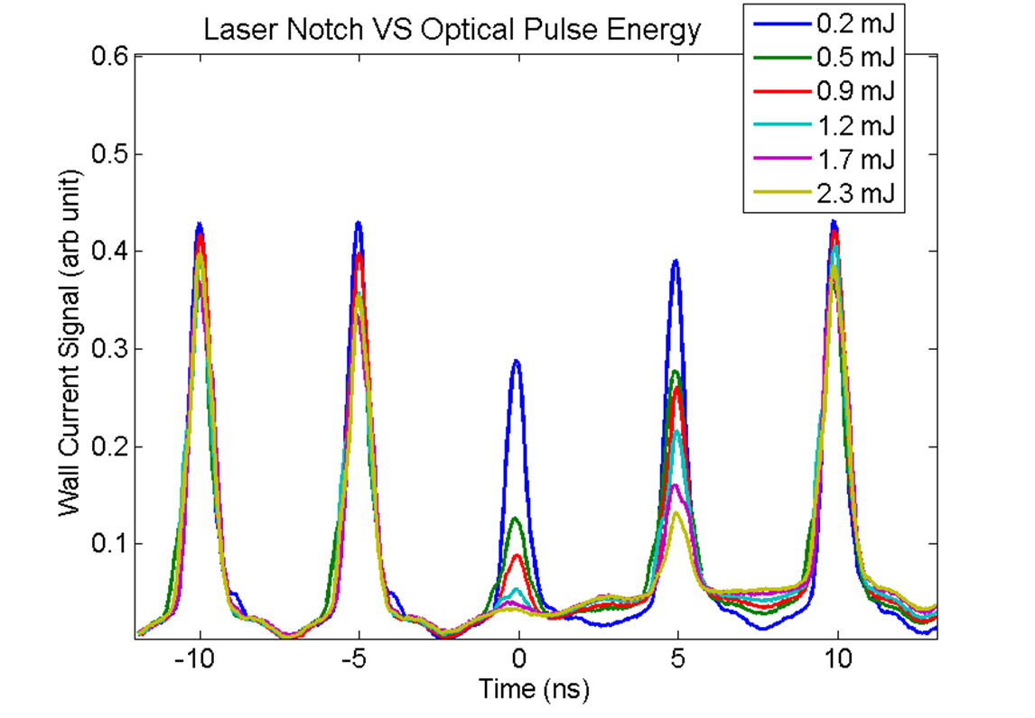
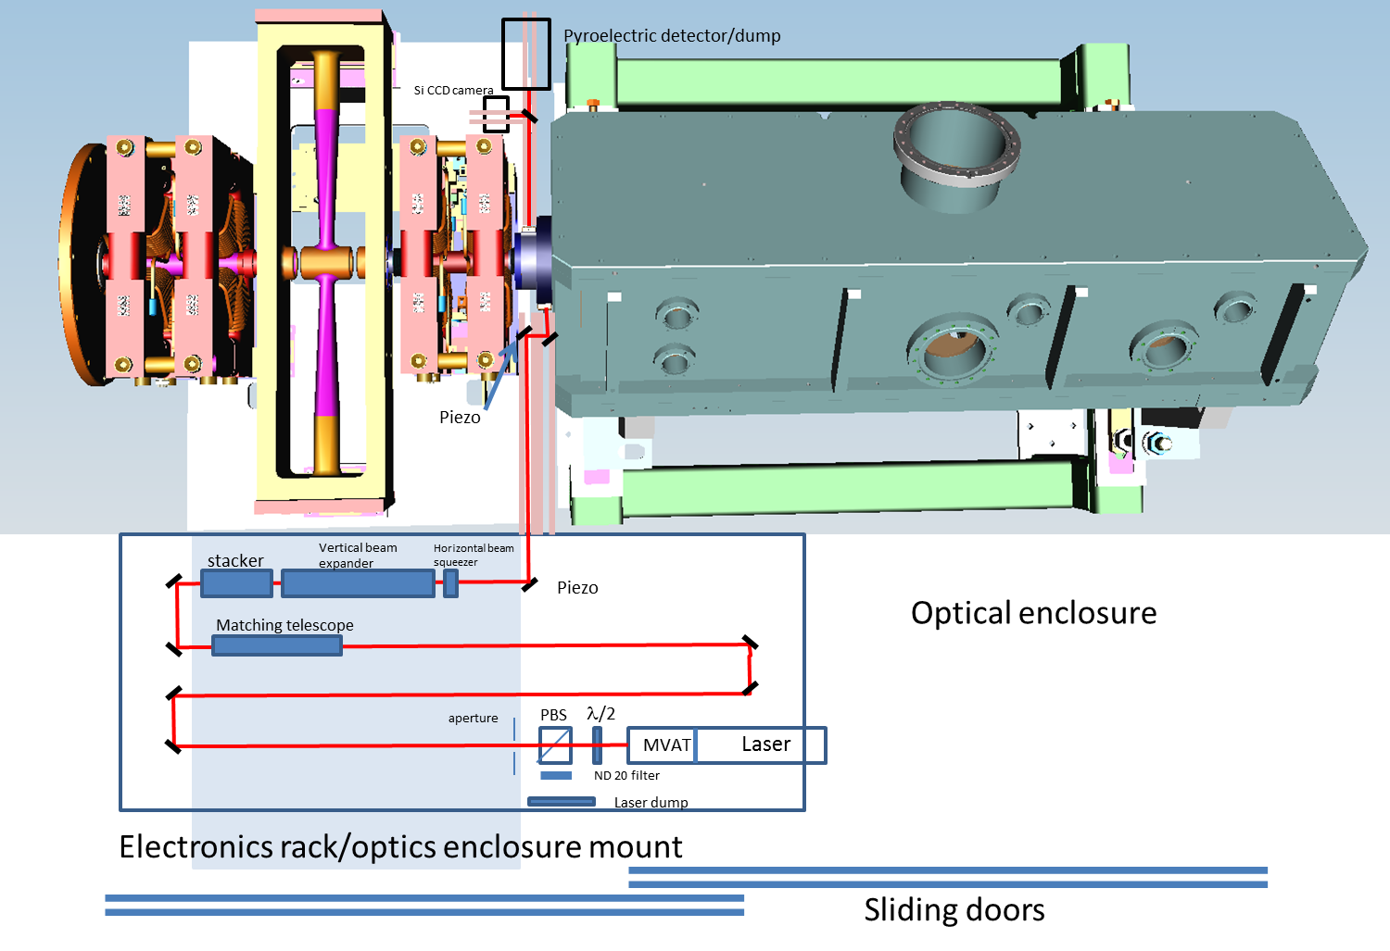
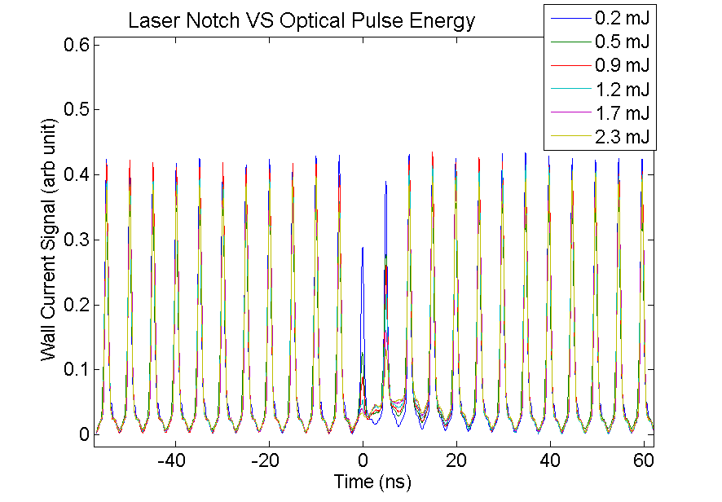
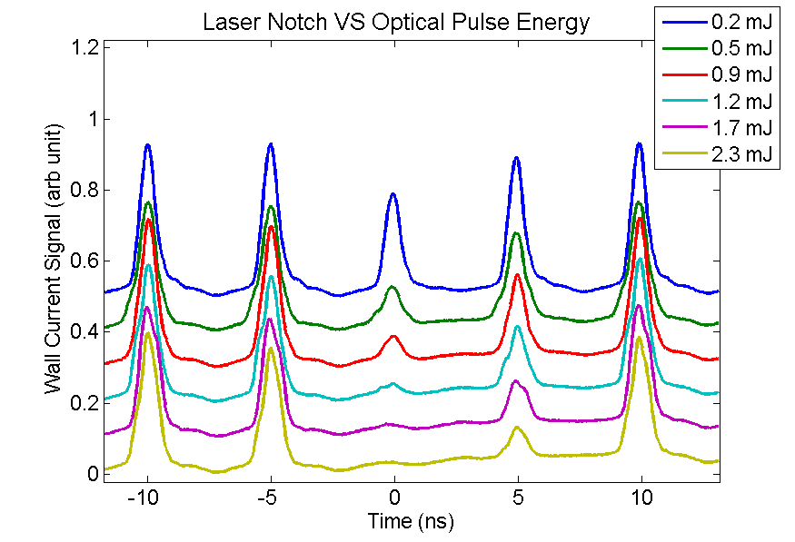
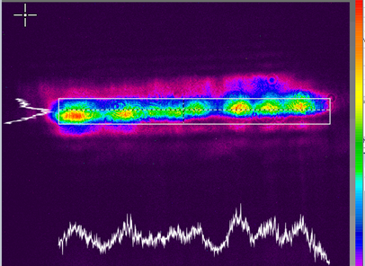
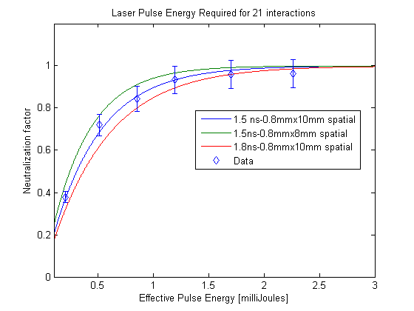
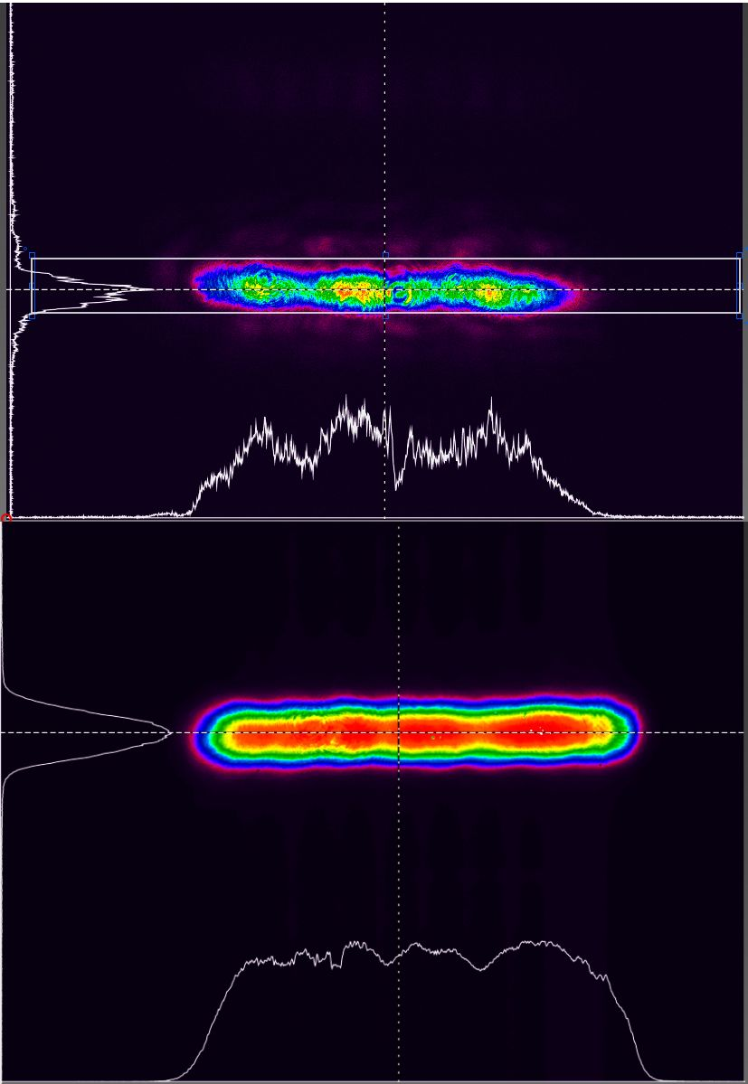
Optical Cavity Test -- Demonstration Experiment (January 2015)
Use zig-zag Optical Cavity with Q-switch laser
Quantel 100 mJ Q-switch laser
Demonstration Experiment
Wall Current Monitor
Laser profile used
in Experiment
We would like to thank the following who
contributed to the success of the Demonstration
Experiment.
Experimental layout using installed Optical Cavity
Demonstration Experiment used
Quantel 100 mJ Q-switched Nd:YAG
laser
Profile from Quanel vs
Diode & fiber amplifier
Comparison with measurement

Slide 10
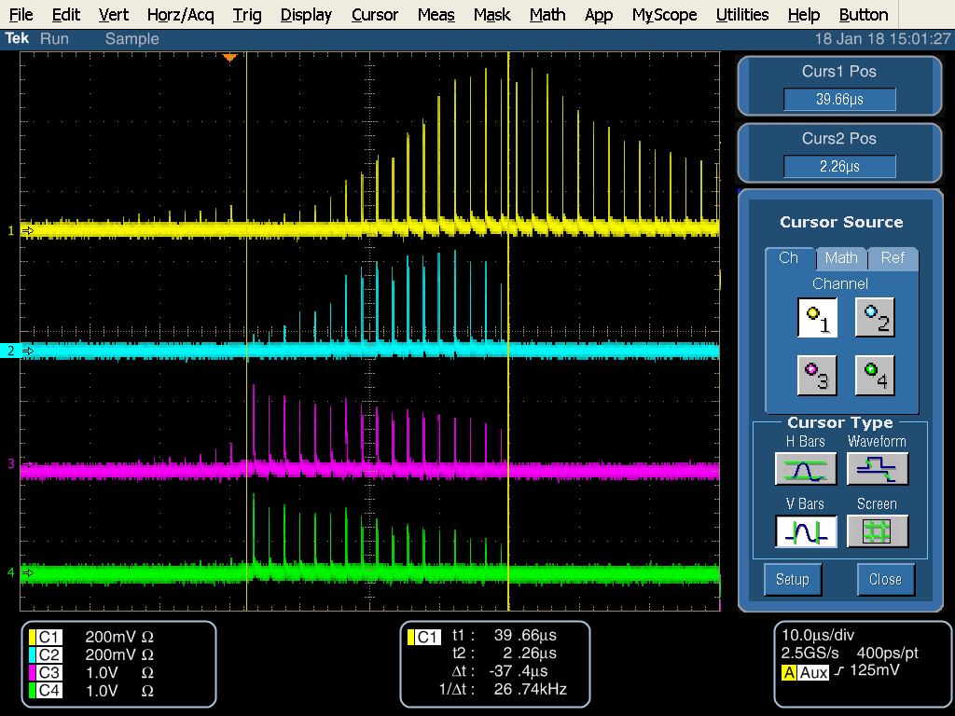
Operational Laser System Block diagram
MOPA system utilizing Hybrid Amplifiers
Pulsed fiber Amp
Must lock to 200MHz Linac bunch
Must lock to Booster RF
Cogging system must lock to notch
Booster must lock to existing notches
1st DPSS
Transverse profile shaping
2nd DPSS
Dump

Slide 11
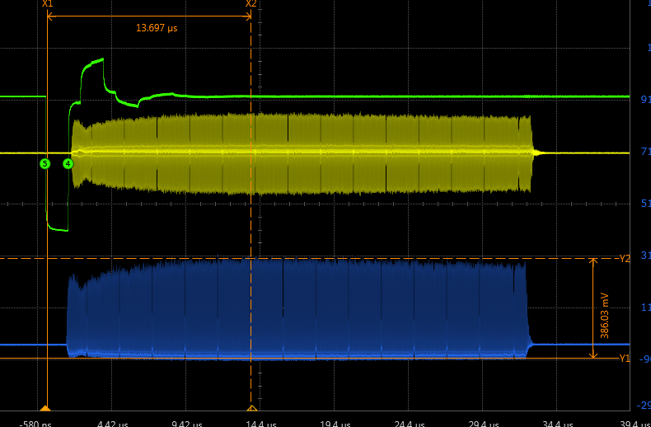
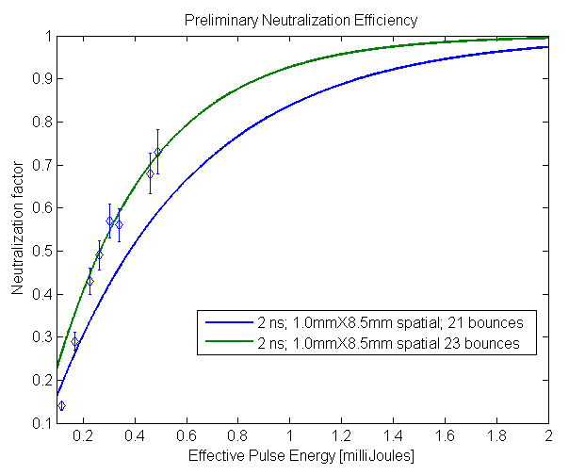
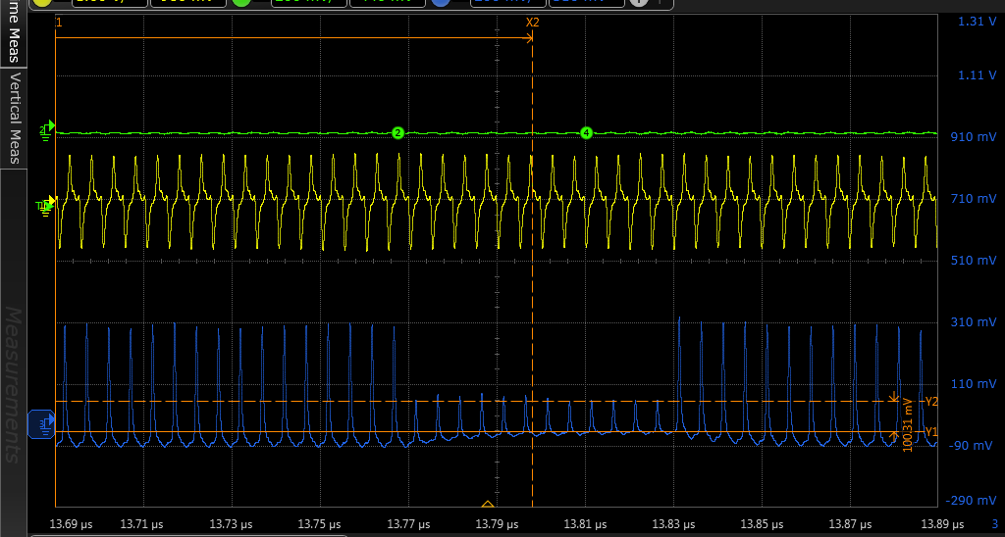
Preliminary Neutralization Efficiency – Summer 2016
Vary laser pulse energy
Compare with estimation
Design goal is 2 mJ/pulse
Notes:
Wanted to measure neutralization vs pulse energy
Varied pulse energy
Measured total energy in dump
Calculated pulse energy
Measured notch depth
Plotted
Using parameters discussed earlier calculate neutralization vs pulse energy for 21 and 23 interactions

Slide 12
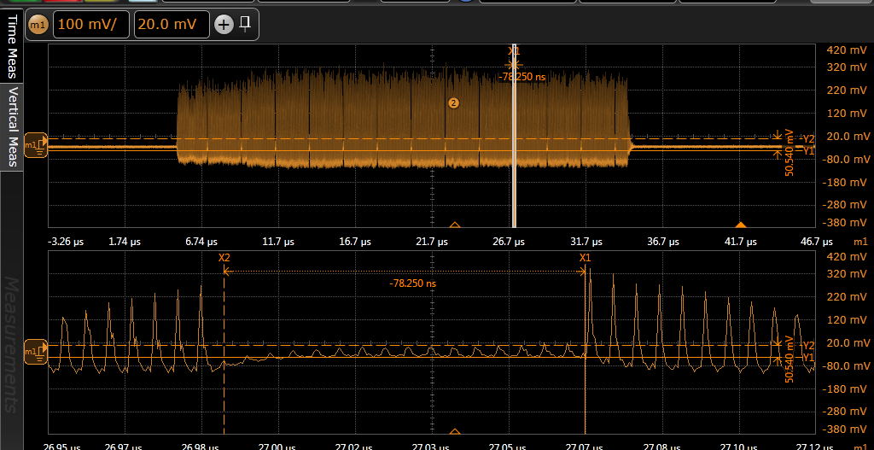
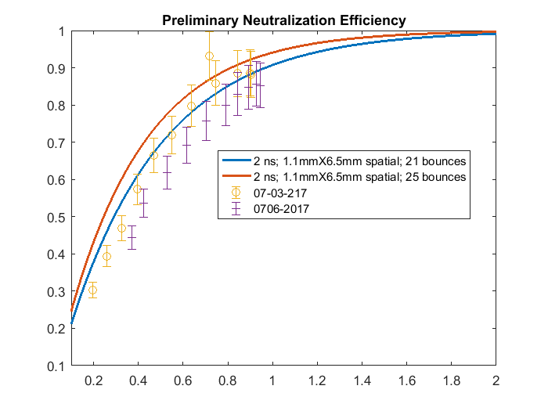
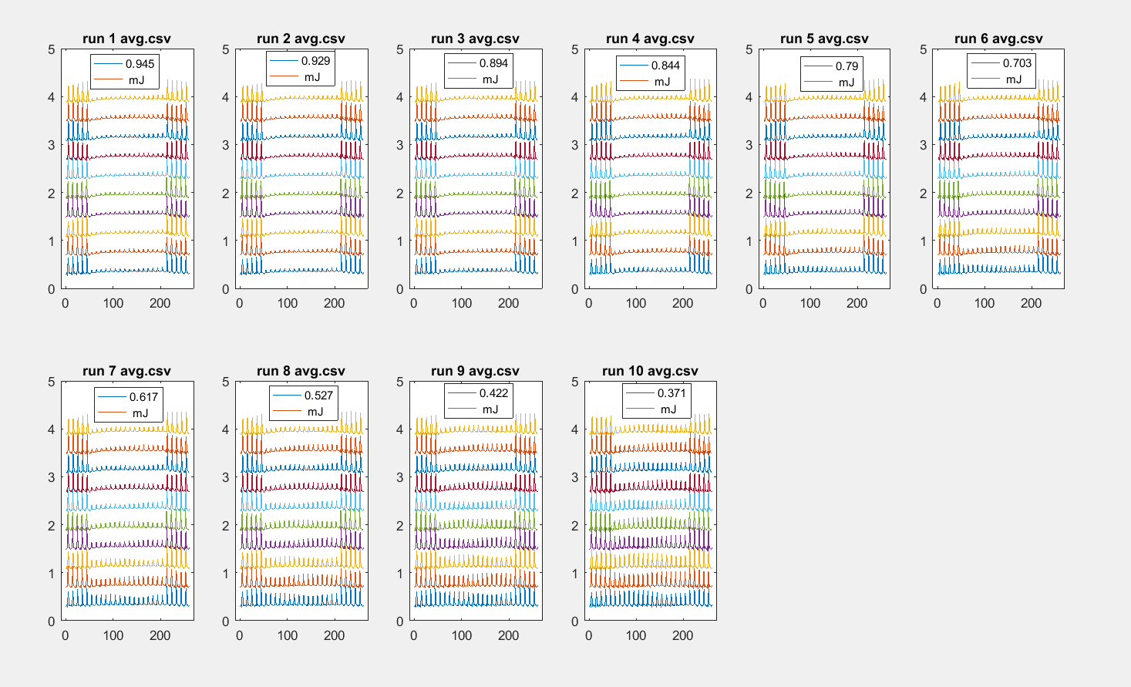
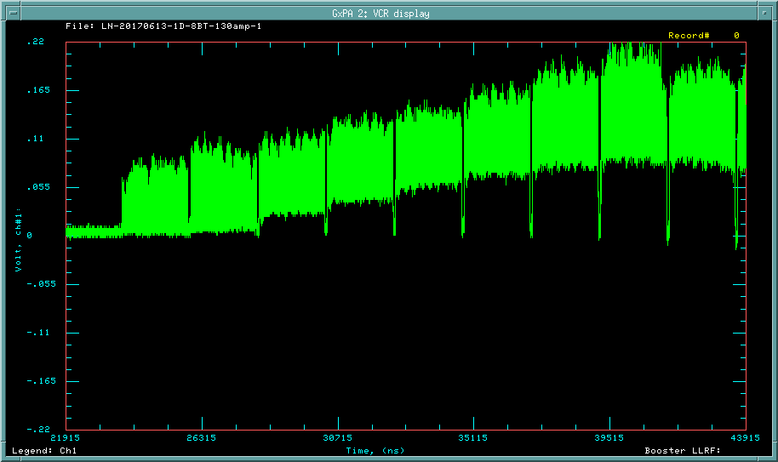
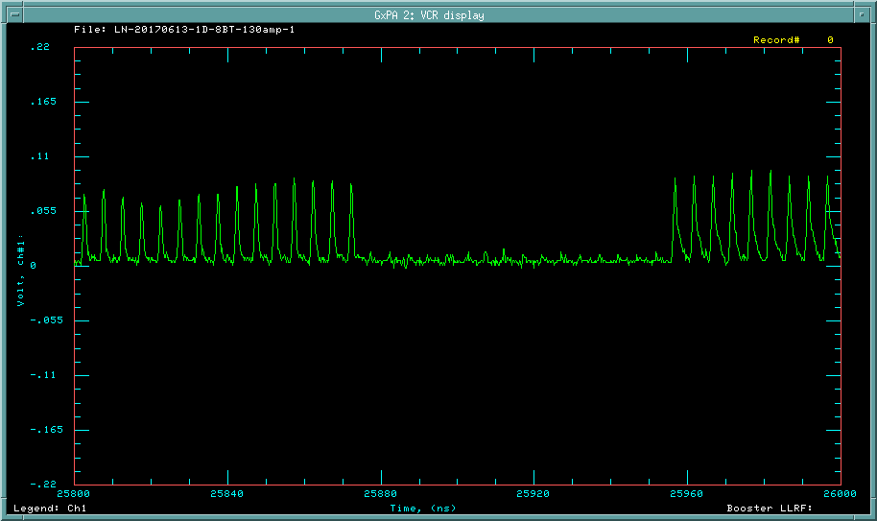
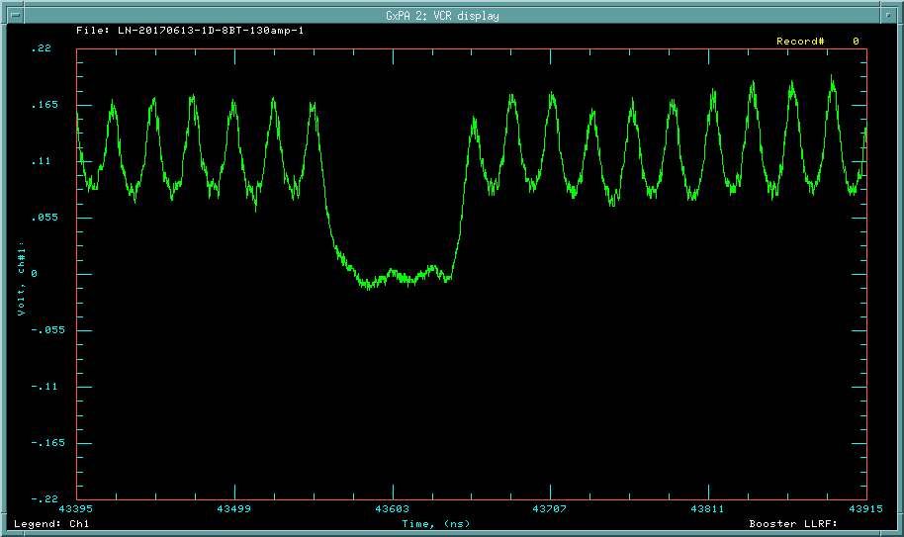
Preliminary Neutralization Efficiency -- Summer 2017
Linac WCM
Booster Phase Detector at injection
Notch data from 07-06-2017

Slide 13
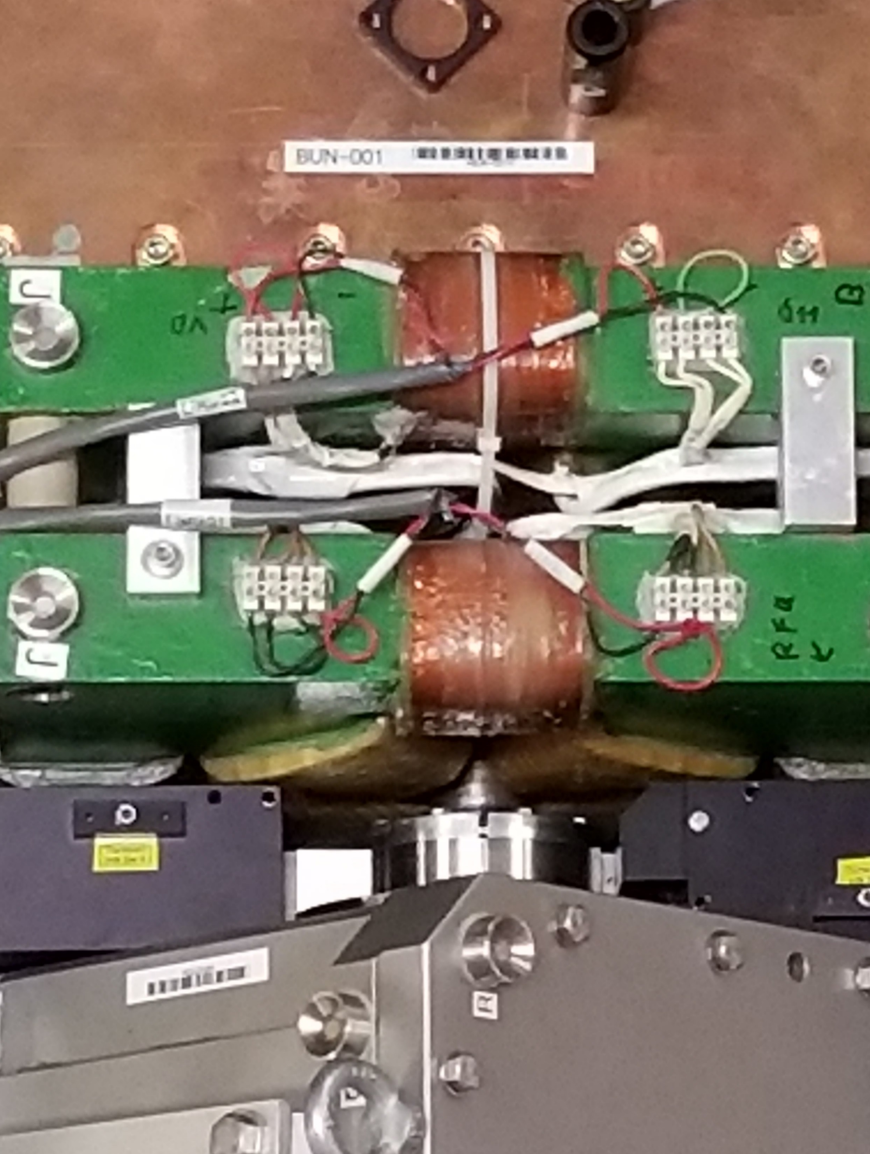
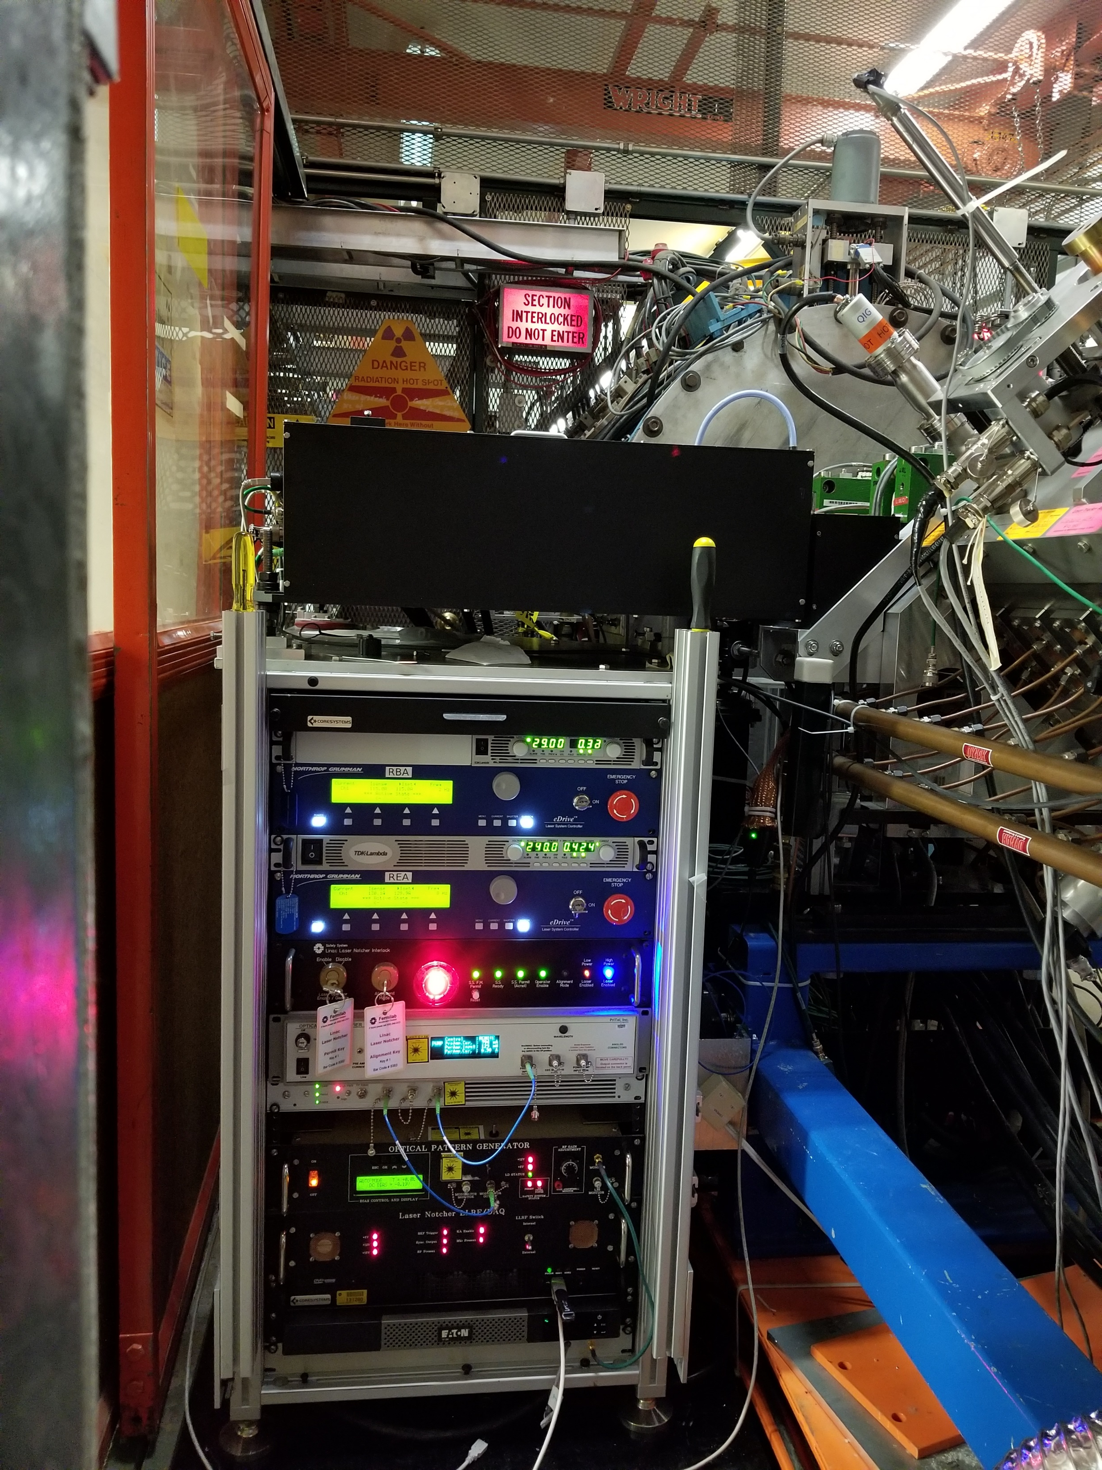
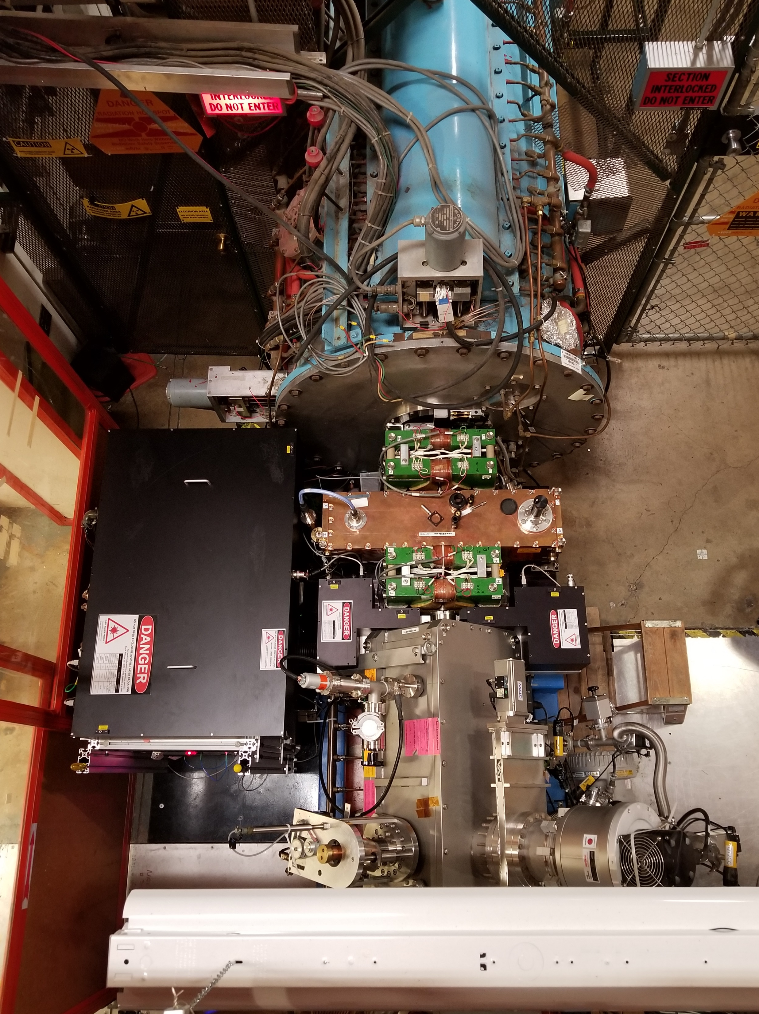
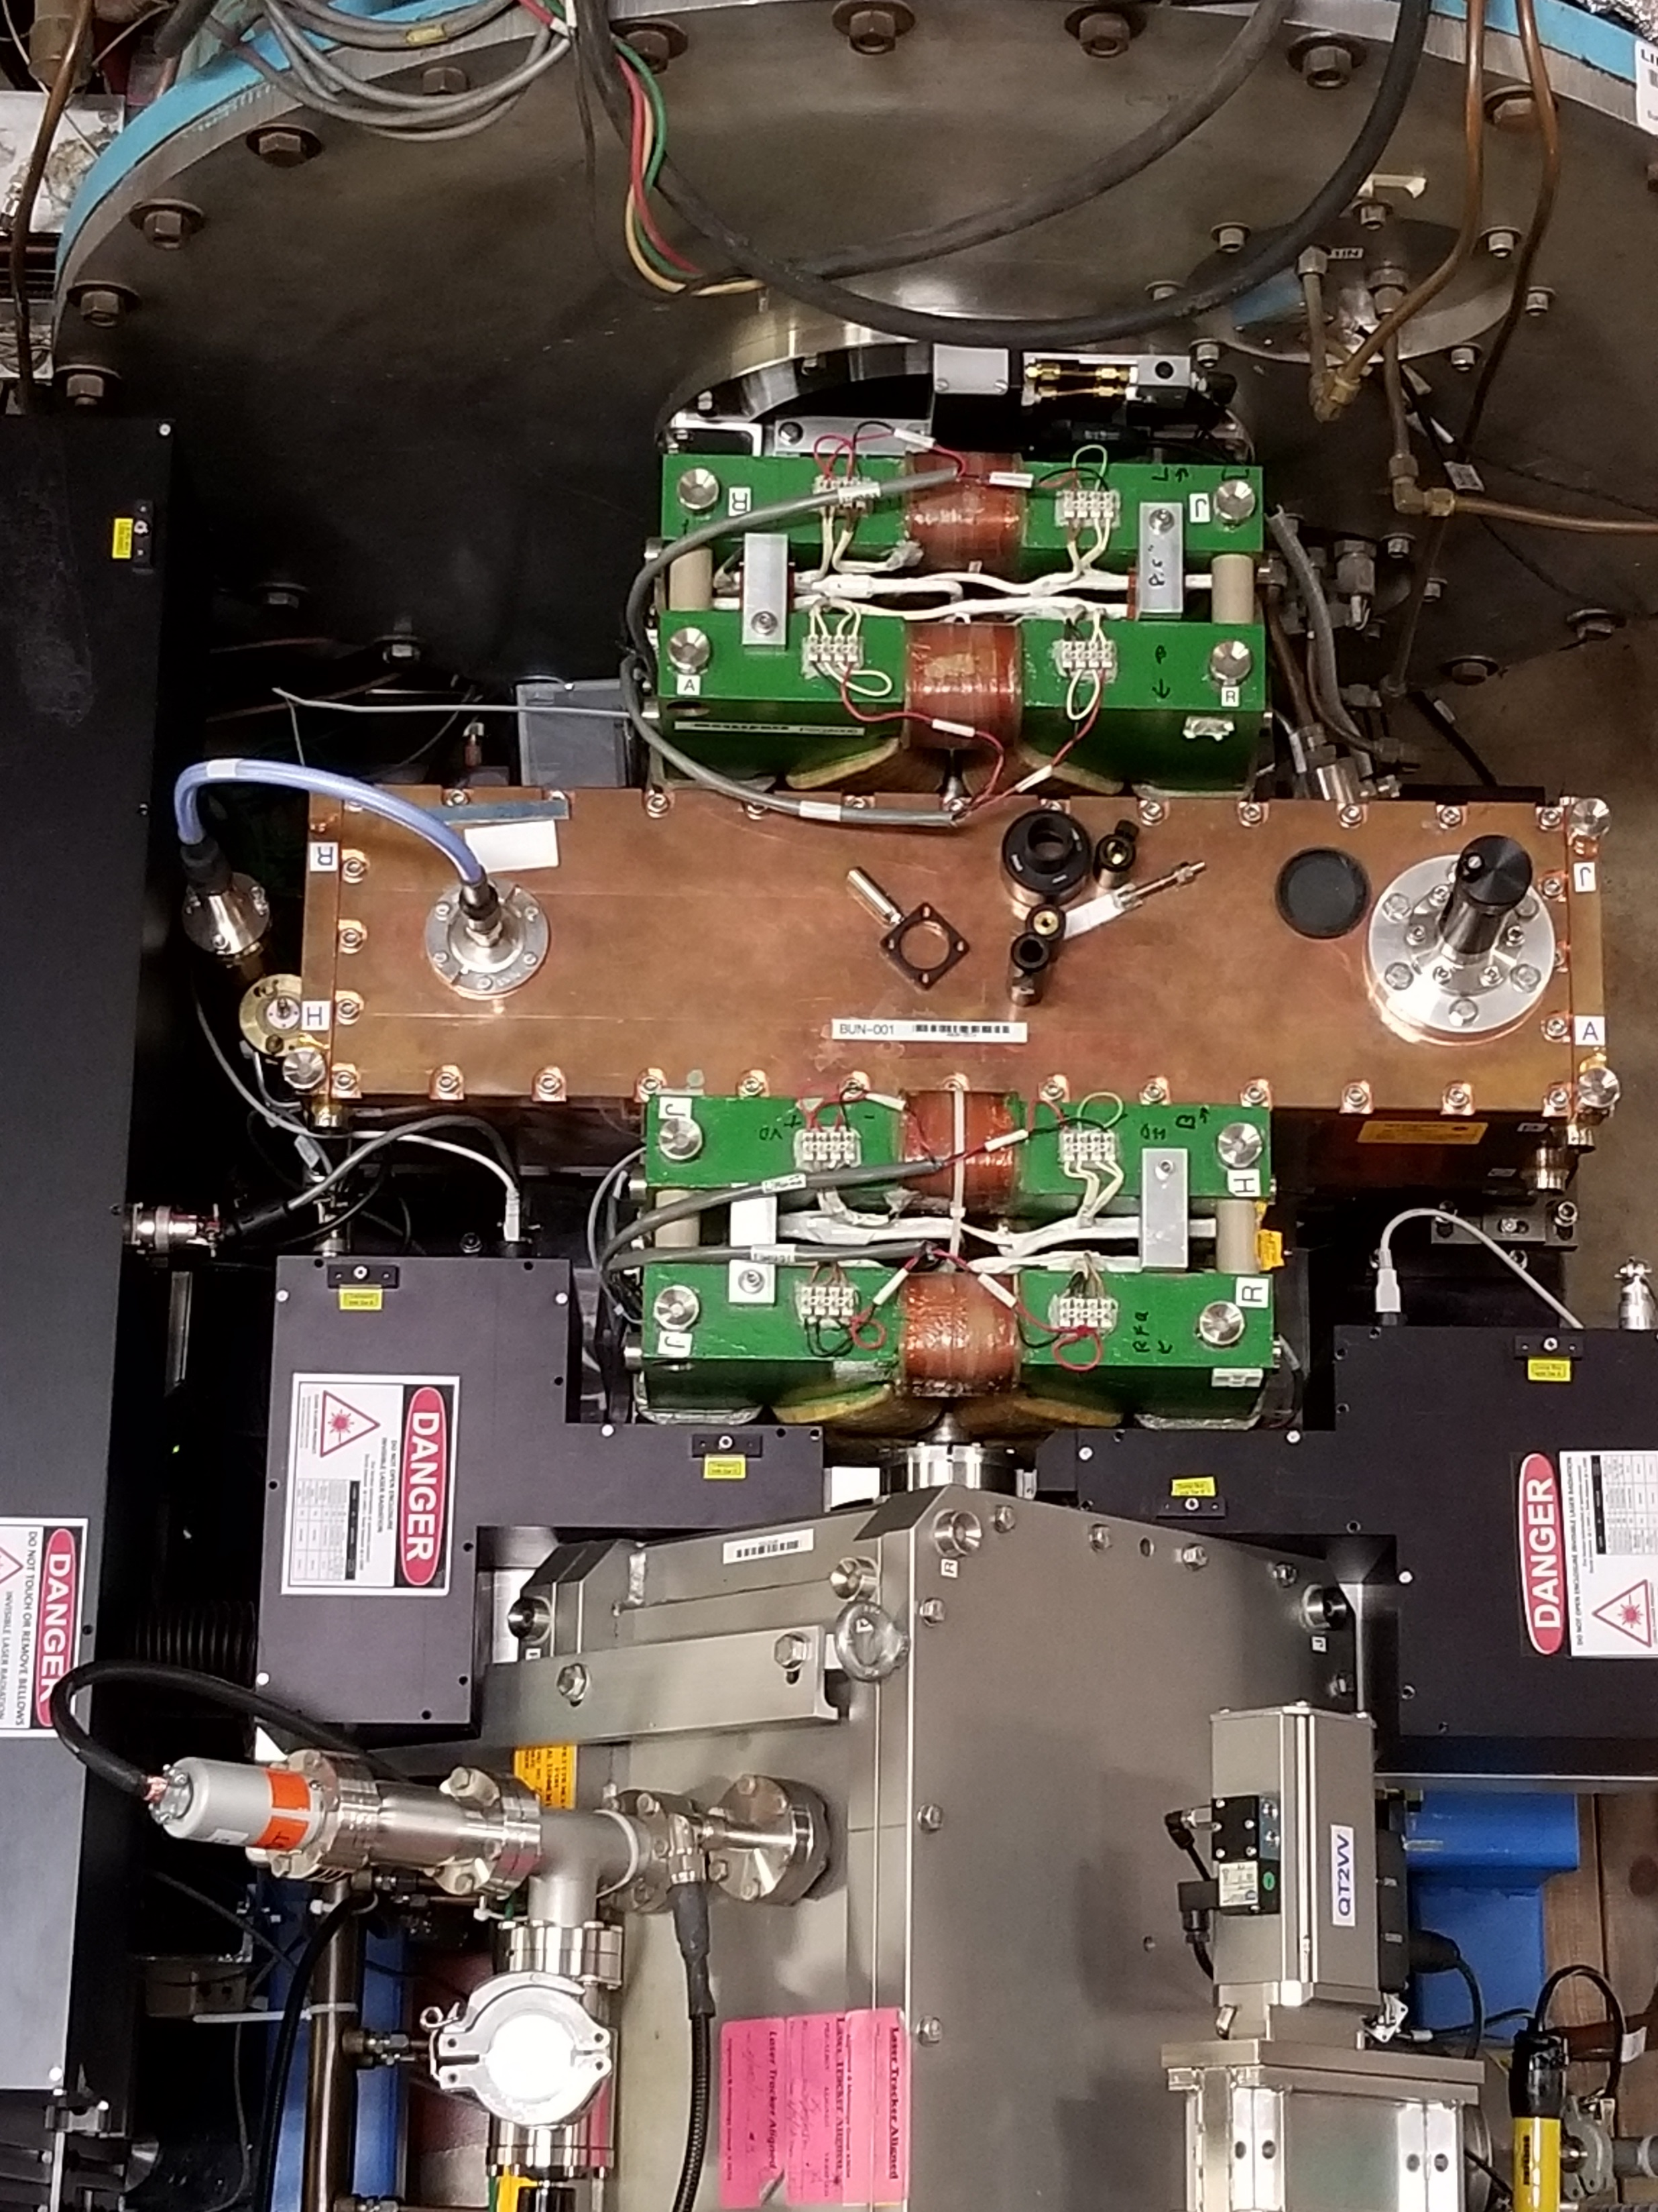
Operational Laser System Installed in Linac

Slide 14
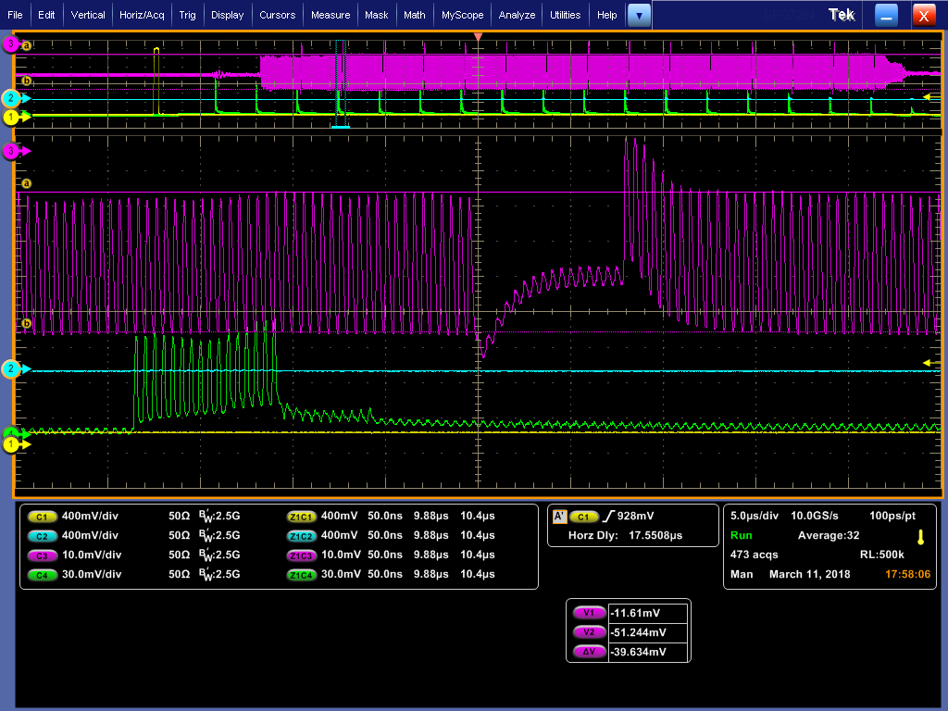
Linac Wall Current Monitor & Photodiode

Slide 15
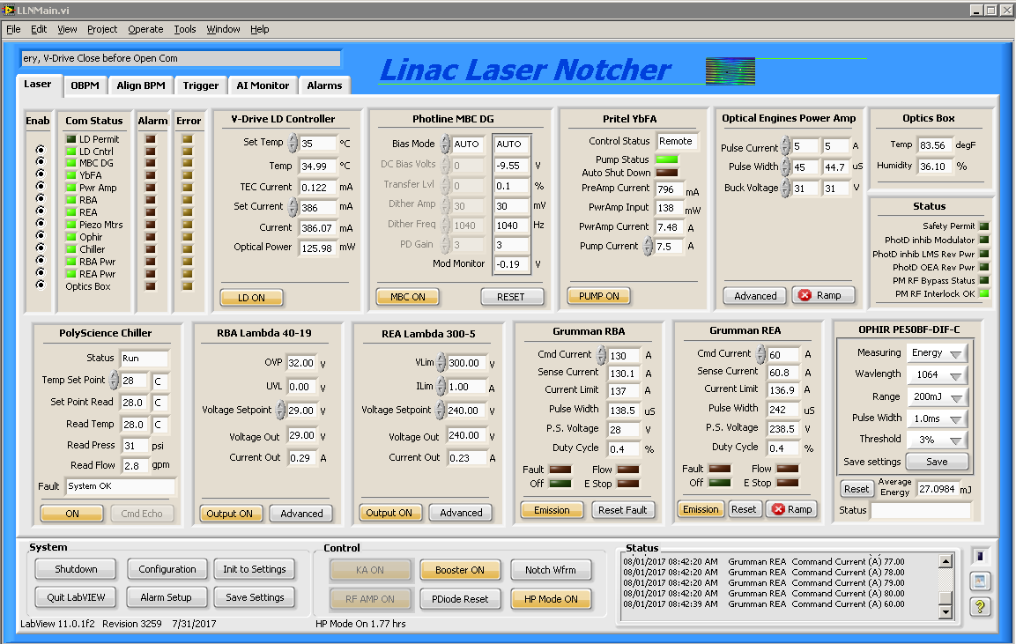
Controls

Slide 16
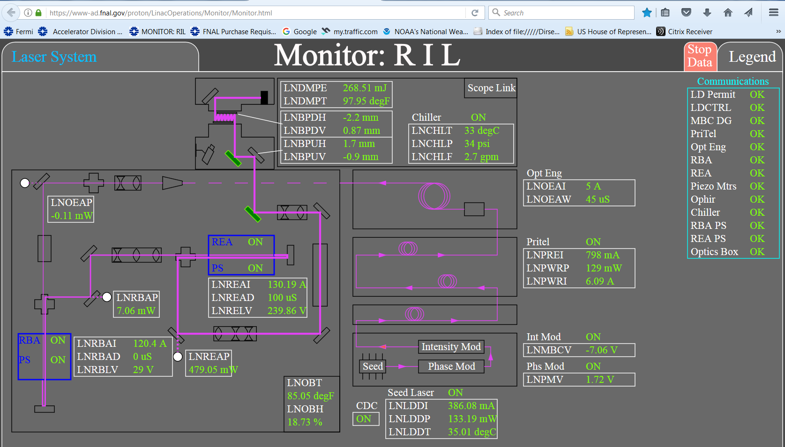
Laser System

Slide 17
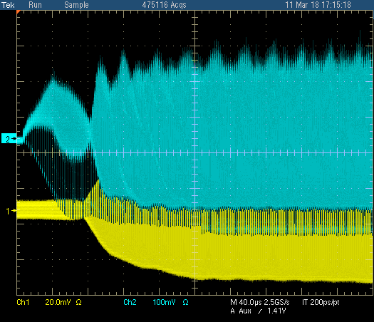
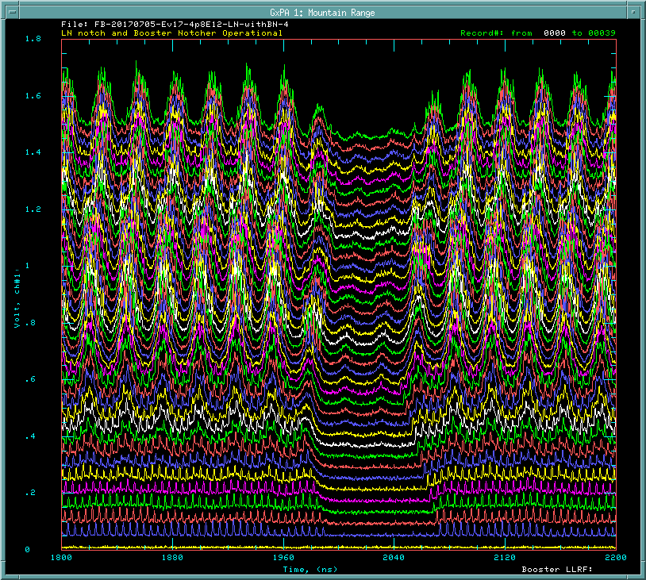
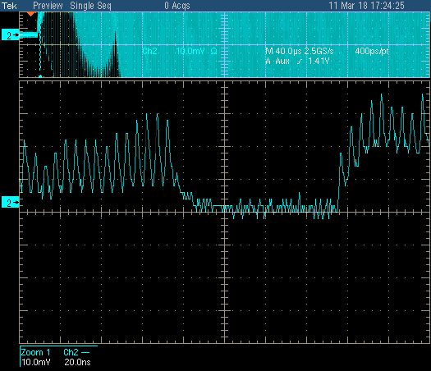
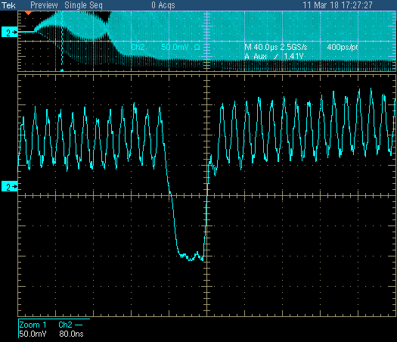
Notch survival in Booster
End of injection
acceleration
200 MHz bunch
38 MHz bunch

Slide 18


Impact of laser Notcher on Booster throughput

Slide 19

Normalized Booster Losses
4.5E12 p/pulse
2.2E17 p/hr
Laser on
Extraction
Collimators
Absorber for
Booster notching
Laser off
Administrative Limit
Injection

Slide 20

Impact on Operational Performance
LASER ON
2.3E+17
Increased protons/hr
Reduced Energy Lost at Extraction
Reduced Loss on notcher absorber

Slide 21
Summary
We have developed a unique bunch-by-bunch laser system for H- neutralization
System was installed for Operation at the end of January 2018.
The Booster losses were ultimately reduced ~30% and the beam throughput to the Experiments (particularly BNB) was increased by ~30%
Improvements continue to be made to the complete system as we gain operational experience.

