Slide 1
Multi-laser-wire diagnostic system for measuring H⁻ beam profiles at
J-PARC
Meeting on Laser manipulation of H⁻ beam under the US-Japan Collaboration for high intensity neutrino beams, Fermilab, Batavia, Illinois, USA
29th, Mar., 2018
Akihiko Miura
J-PARC Linac, JAEA

Slide 2
Contents
Multi-laser-wire diagnostic system for measuring H- beam profiles at J-PARC
Beam specification of J-PARC linac
Introduction / Objective
Design of the multi-laser-wire
Demonstration of the multi-laser-wire formation
Design of the multi-laser-wire profile monitor
Conclusion

Slide 3
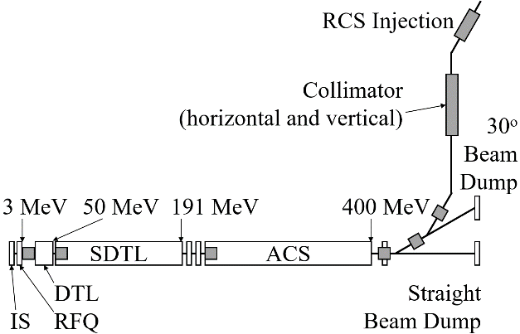
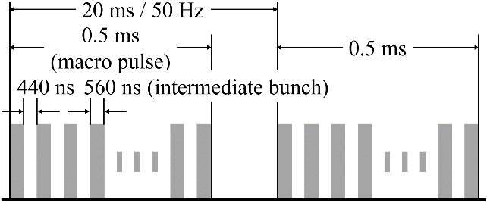
1. Beam specification of J-PARC linac
Beam-line layout of J-PARC linac
Time structure of pulsed beam
: matching section
H⁻ beam is accelerated by 324 MHz RF which is the smallest time structure (3.01 ns).
Intermediate bunch with 560 ns is for the injection to the downstream RCS.
The longest pulse duration is 0.5 ms.
Linac accelerates the H⁻ beam up to 400 MeV.
There are 8 matching sections where the transverse matching is conducted using the wire scanner monitors.

Slide 4
2. Introduction / Objective
Laser-wire profile monitor
Beam profile monitor plays am important role in the high-current and high-brilliance accelerators.
To avoid the thermal damage of the metallic wire scanner monitor and to reduce the radiation during an operation, the laser-wire method is the possible candidate for the profile measurement.
The photon energy with only 0.75 eV is required for the photo detachment to generate H⁰ from H⁻.

Slide 5
2. Introduction / Objective (Cont.)
Multi-laser-wire
A simple optical design with only a pair of concave mirrors brings the multi-laser paths.
No scanning device and no multiple-shots of the accelerated beams are required for the system.
Objective of the study
To design the system for the J-PARC linac, the feasibility check and the demonstration of the multi-laser-wire formation are key missions of our study.

Slide 6
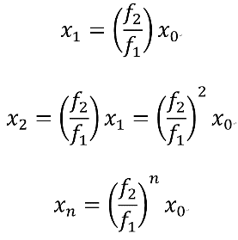


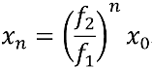
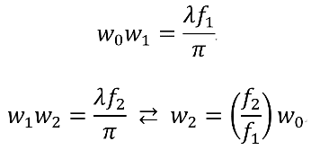
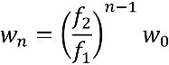
3. Design of the multi-laser-wire
Injecting Beam
f₂
f₁
c₀
d₀
b₂
c₂
Focal Lens
x₀
x₂
axis
a
x₁
The 1/e² radius at c₀, c₁, ……, c_{n} as w₀, w₁, ……, w_{n} using a wave length (λ).
b₁
c₁
d₁
Mirror 2
Mirror 1
A pair of concave mirrors with different diameters to make multi-paths of laser beam, and the beam waists of the laser paths are aligned in principle.

Slide 7
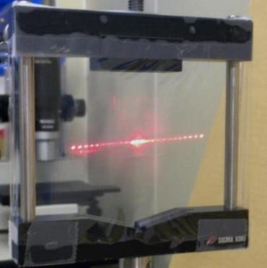
4. Demonstration of the multi-laser-wire formation
Injecting Beam
f₂
f₁
c₀
d₀
b₂
c₂
Focal Lens
x₀
x₂
axis
a
x₁
b₁
c₁
d₁
Mirror 2
Mirror 1
Thin film plane
A thin film plane is inserted to observe the laser paths.
The aligned multi-laser spots on the target is clearly observed.
The laser beam spots is approaching to “a”.
We will use the top-half of the confocal cavity.
The relation w_{n} = (f₂/f₁)^{n-1} w₀ suggests the spot size decreases at f₂ > f₁.

Slide 8

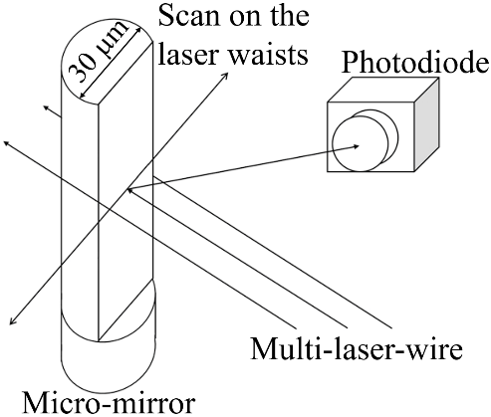
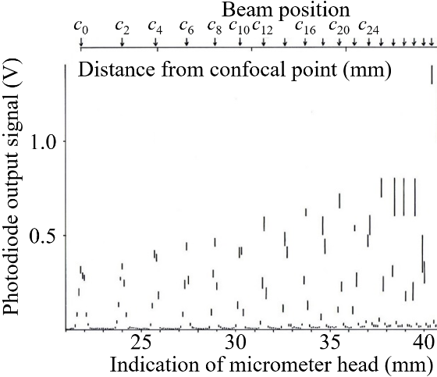
4. Demonstration of the multi-laser-wire formation
laser intensity measurement using a micro-mirror
Photodiode
Micro mirror
A micro mirror is produced by φ30um gold-wire with optical flat surface.
A photodiode is used for the quantitative measurement.
a
Mirror 2
Mirror 1
We could count 24-laser spots at the top-half of the center axis clearly.
Spots are overlapped around the center axis.

Slide 9
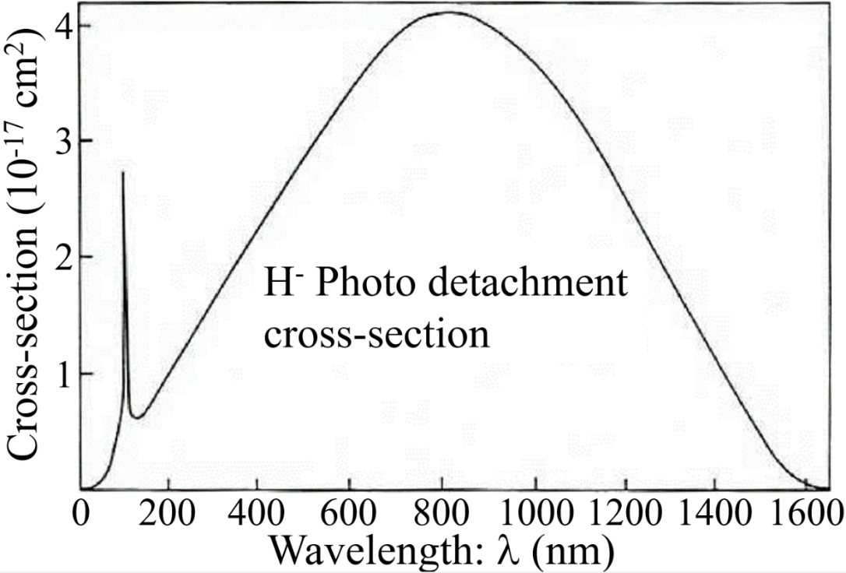

5. Design of the multi-laser-wire profile monitor
Requirements of the laser profile monitor
Wavelength | 400 – 1200 nm
Horizontal resolution | < 0.2 mm
Dynamic range | > 10²
Measurement time | 2.5 mins / profile
Wavelength of laser beam
Wavelength should be matched the cross section of the photo detachment of H⁻ to H⁰.
Visible light (l = 380-800 nm) is included in the large cross sectional region.
When we chose the longer or shorter wavelength, we can take a match to the largest cross section with incident angle described by following eq.
A region for large cross-section
Visible light

Slide 10
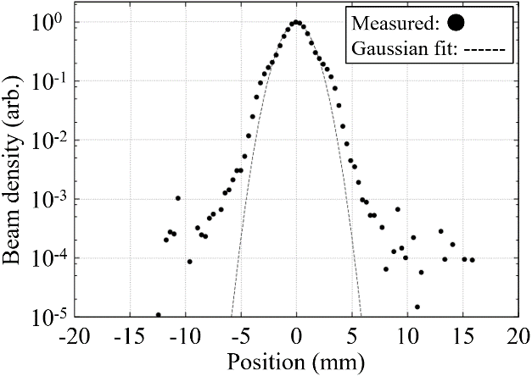
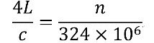
5. Design of the multi-laser-wire profile monitor
Horizontal resolution and dynamic range
Minimum beam size is 2.0 mm RMS. Less than 0.2-mm intervals are required.
The beam halo appears around 1/10 magnitude of the beam core. Over 10² dynamic range is required.
Time intervals
Accelerated beam duration is 3.01 ns intervals due to 324 MHz RF.
Time of the laser beam round trip is 4L/c (L = f₁+f₂).
Laser beam flight time should be in the RF repetition timing, i. e.,
.
Micro mirror
a
Transverse profile taken by WSM
Mirror 2
Mirror 1

Slide 11
6. Conclusion
Advancement of the multi-laser profile monitor
No scanning device is required.
It is non-destructive to the accelerated beam.
Fast data taking.
Summary
Demonstration of the multi-laser-wire formation was conducted.
We set the specification of the laser profile measurement.
We proposed the design policy of the multi-laser-wire profile monitor.
Future works / Discussions
Need to discus how to match a laser and H⁻ beam.
Need to decide the electron detector.
Design, fabrication and test at 3-MeV beam line.
Application to the 400-MeV beam line.
A. Miura, et. al., thal03, IBIC2016, Barcelona, Spain, Sept., 2016

