Slide 1

Optical Stochastic Cooling with Lasers
Northern
Illinois
University
M. Andorf
Northern Illinois University

Slide 2
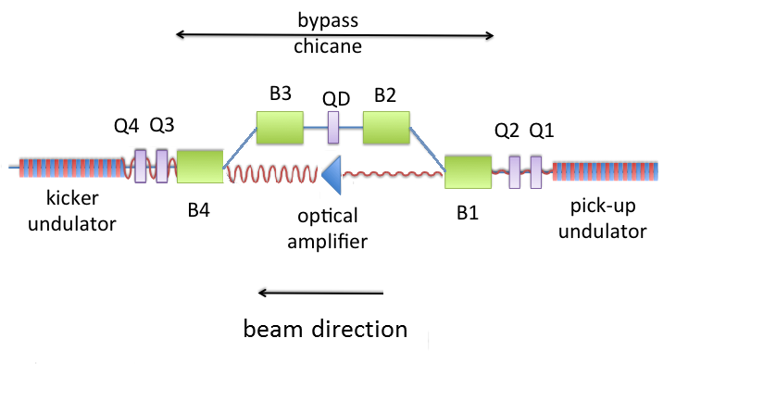
Introduction to Optical Stochastic Cooling (OSC)
First proposed in mid 1990’s as an improvement over stochastic cooling^{1,2}. Working principles are the same as stochastic cooling but movement to much shorter wavelengths increases the bandwidth (W) of the cooling system by ~10⁴.
Ordinary pickup/kicker are replaced by undulators.
Since damping time is inversely related to the bandwidth OSC has the potential to decrease damping times by 3-4 orders of magnitude. However a major challenge to achieving this is the design of the optical amplifier.
Ultimate purpose of OSC is for cooling of protons/ions. However proof-of-principle experiment can be done with low (~100 MeV) electrons as a major simplification.
¹A.A.Mikhailichkenko, M.S. Zolotorev, Optical stochastic cooling Phys. Rev. Lett. 71, 4146 (1993).
²M. S. Zolotorev, A. A. Zholents, Transit-time method of optical stochastic cooling, Phys. Rev. E 50, 3087 (1994)

Slide 3
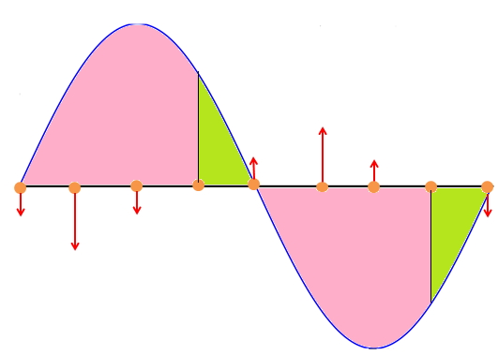
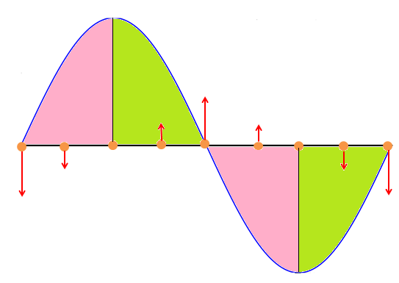
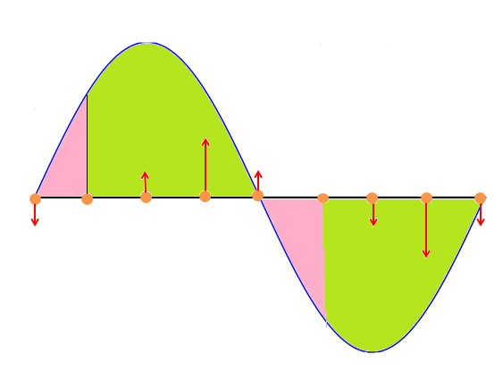
Introduction to Optical Stochastic Cooling (OSC)
The OSC kick is always longitudinal (energy kick). Presence of dispersion in the kicker allows for horizontal cooling. Coupling of x and y outside of cooling insertion allows for full 6D particle beam cooling.
Energy kick is determined by phase between transverse particle velocity and pickup radiation inside kicker.
Radiation wavelength is resonant with electron motion. Leading to continuous energy exchange over total length of kicker.

Slide 4
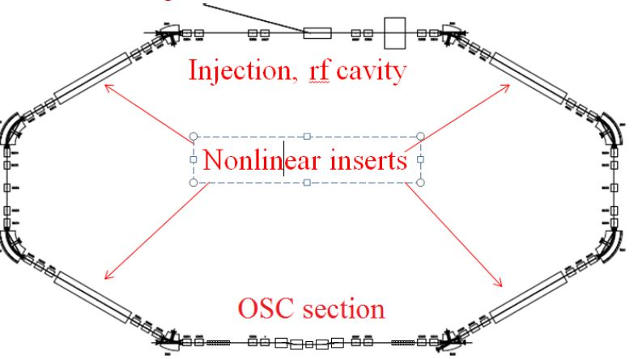
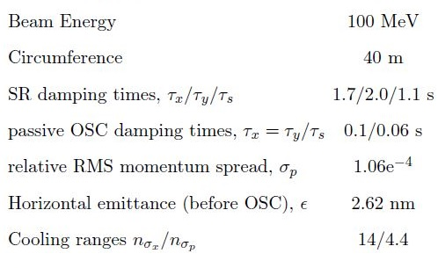
OSC in IOTA
Integrable Optics Test Accelerator (IOTA) at Fermilab has a ~6 m straight section reserved for proof-of-principle demonstration the OSC.
Cooling will be demonstrated on 100 MeV electrons.
Identical 7 period undulators will be used for kicker/pickup. Base wavelength 2.2 μm.
Experiment broken into two phases:
Phase 1 (passive OSC): Bunched cooling using only lenses to focus pickup radiation into kicker. Optics designed to suppress depth of field.
Phase 2 (active OSC): An OA based on Cr:ZnSe is used to amplify pickup signal. Expected to increase damping rates by a factor of 1.8.
-Additionally experiments with single electron are being considered.
OSC damping times assumes x-y coupling outside cooling insertion.

Slide 5
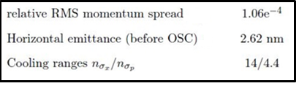
Large Particle Amplitude and the Cooling Range
Cooling ranges can be defined as the ratio of cooling boundaries to rms momentum spread and horizontal emittance:
In the case of equal damping between transverse and longitudinal planes both cooling ranges are linear in wavelength and inversely proportional to total delay of the chicane Δs_{o}.
OSC beam and cooling ranges for IOTA
In order to obtain sufficient cooling ranges we set Δs_{o} =2 mm and the base wavelength of 2.2 μm. This seriously constrains the design of an OA and diagnostics utilizing undulator radiation.

Slide 6
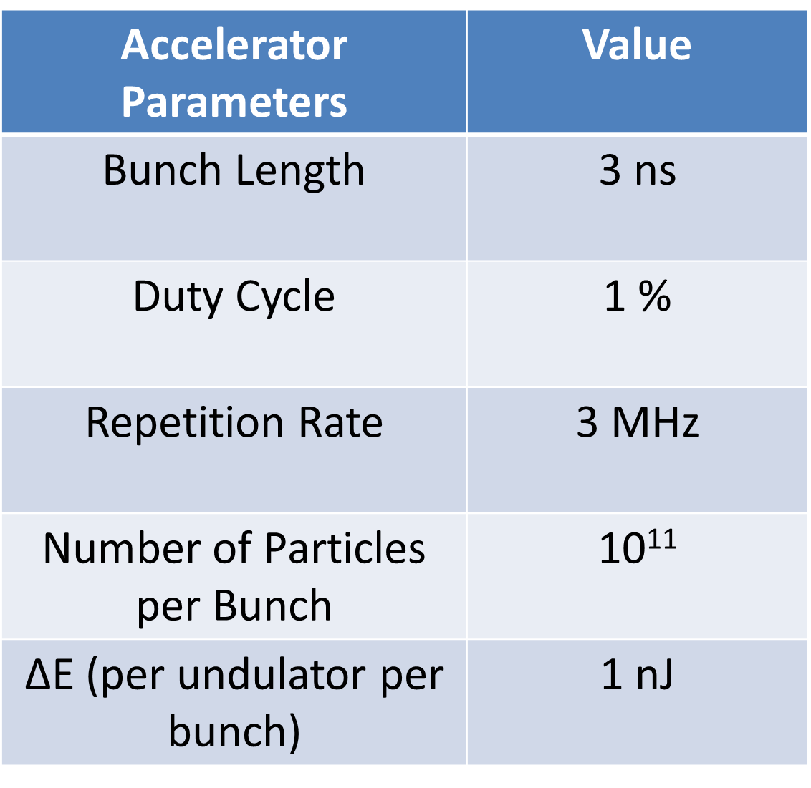
An amplifier for OSC: General remarks
Although passive OSC works for a proof-of-principle demonstration, any real application of the OSC will require an amplifier capable of delivering 20-30dB of gain in a single pass.
For sufficient cooling ranges the amplifier must operate in the mid-IR where, compared to visible wavelengths, lasing crystals are less capable.
For example no mid-IR crystals can match Ti:Sapphire in performance (gain, amplification bandwidth, thermal load handling for short optical delays)
Optical Parametric Amplification (OPA) would make a superb amplifier for OSC (high single pass gain, large bandwidth, virtually no thermal effects).
However in an OPA gain only occurs when signal (pickup radiation) and pump (laser pulse) are overlapping. Which implies a pump pulse on the order of nanoseconds and pump energy of a few mJ. At MHz rep rate this brings the pump laser power to several kW.
One solution to this problem would be to recycle the pump pulse. This is possible since the signal (even at 30 dB gain) is a very small fraction (<0.1%) of pump energy.
Hypothetical Example!

Slide 7
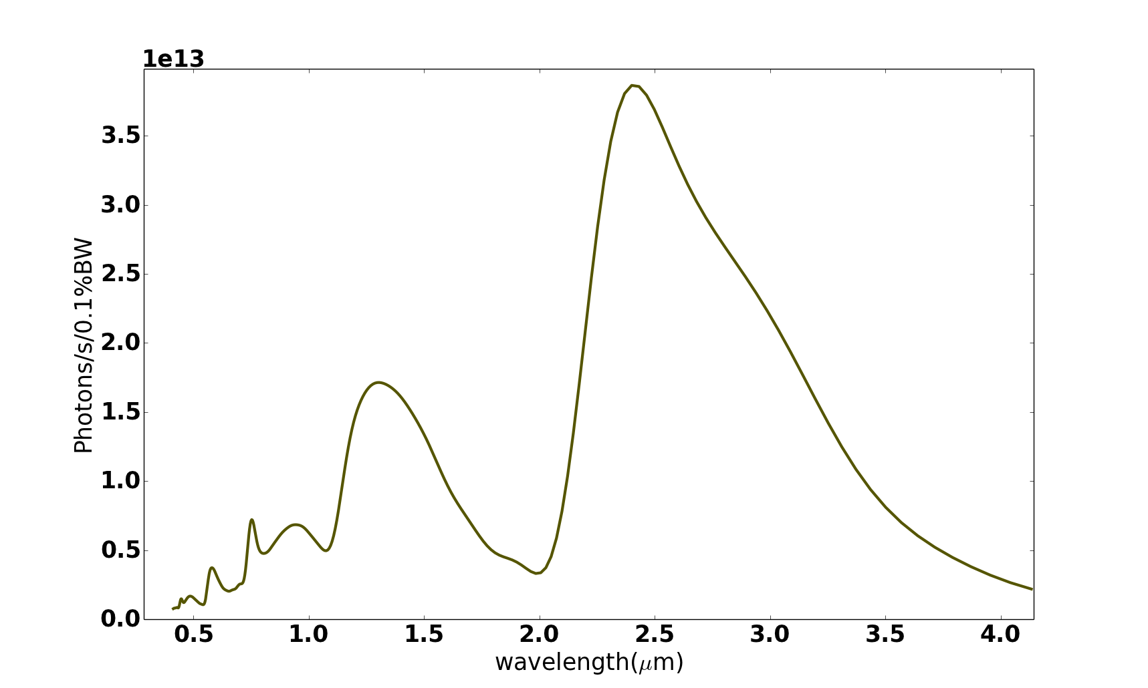
Single Pass Cr:ZnSe amplifier for OSC in IOTA
Image courtesy of IPG photonics
Cr:ZnSe crystal
Center wavelength 2490 nm
50 THz bandwidth
1 mm crystal length (optical delay of 1.43 mm)
single pass gain 7dB
Saturable absorption major limiter in gain
Cr:ZnSe amplifier parameters
Pumped by a thulium fiber laser
Wavelength, 1910 nm
100 W max power
Continuous Wave (CW) operation but capable of 1 kHz frequency modulation (mitigates thermal effects).
M.B. Andorf et al, Single Pass Amplifier for Optical Stochastic Cooling Proof-of-Principle Experiment in IOTA. Proc. COOL’15.

Slide 8
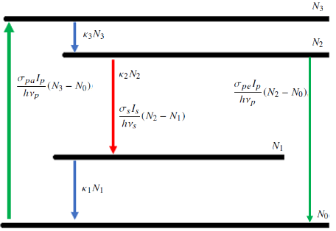
Single Pass Gain for Cr:ZnSe
Energy loss per electron in the pickup ~ 50 meV. For a bunch with 10e⁷ electrons this corresponds to a pulse energy of 80 fJ. If we assume a 100 μm spot size and accounting IOTA’s rep-rate of 7.5 MHz this corresponds to an average signal intensity of 1.9 mW/cm².
De-excitation of N₂ from spontaneous emission happens at a rate ~2e4 times faster than through stimulated emission from the pickup signal.
Thus stimulated emission can be neglected and gain is determined by steady state value of population inversion.

Slide 9
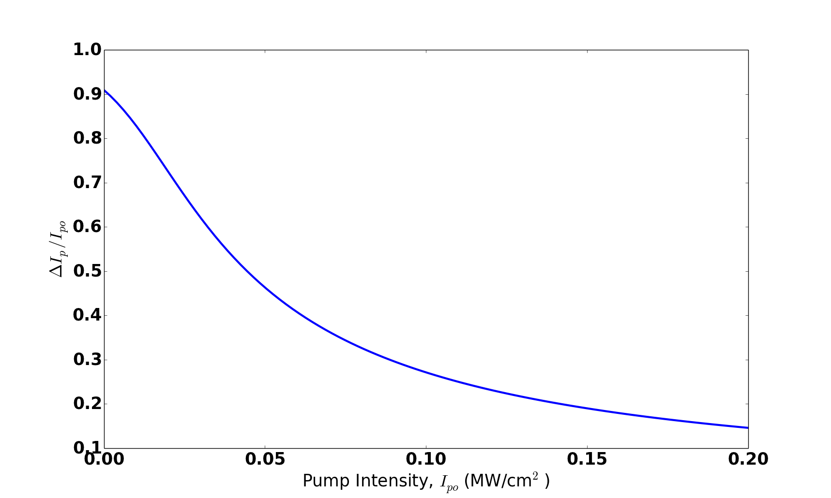
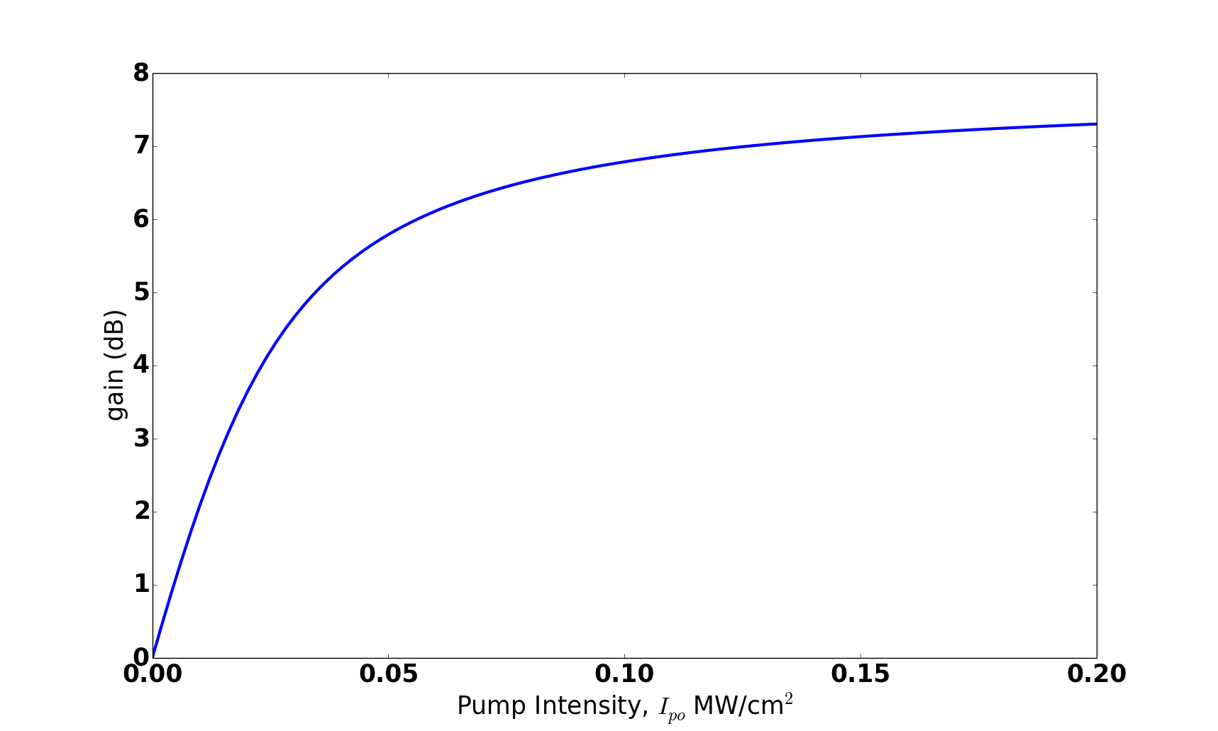
Single Pass Gain for Cr:ZnSe
Amplifier gain is determined by absorbed pump intensity
Which is found by numerical integration of
For low pump intensity, gain goes as the exponent of pump intensity. At intensities around 10 kW/cm² depletion of the ground state energy level becomes non-negligible making transmission dependent on input intensity. Reducing gain growth.
For 7dB of gain pump intensity is 125 kW/cm² and pump transmission is 78%. Pumping past this point results in essentially no gain growth.

Slide 10
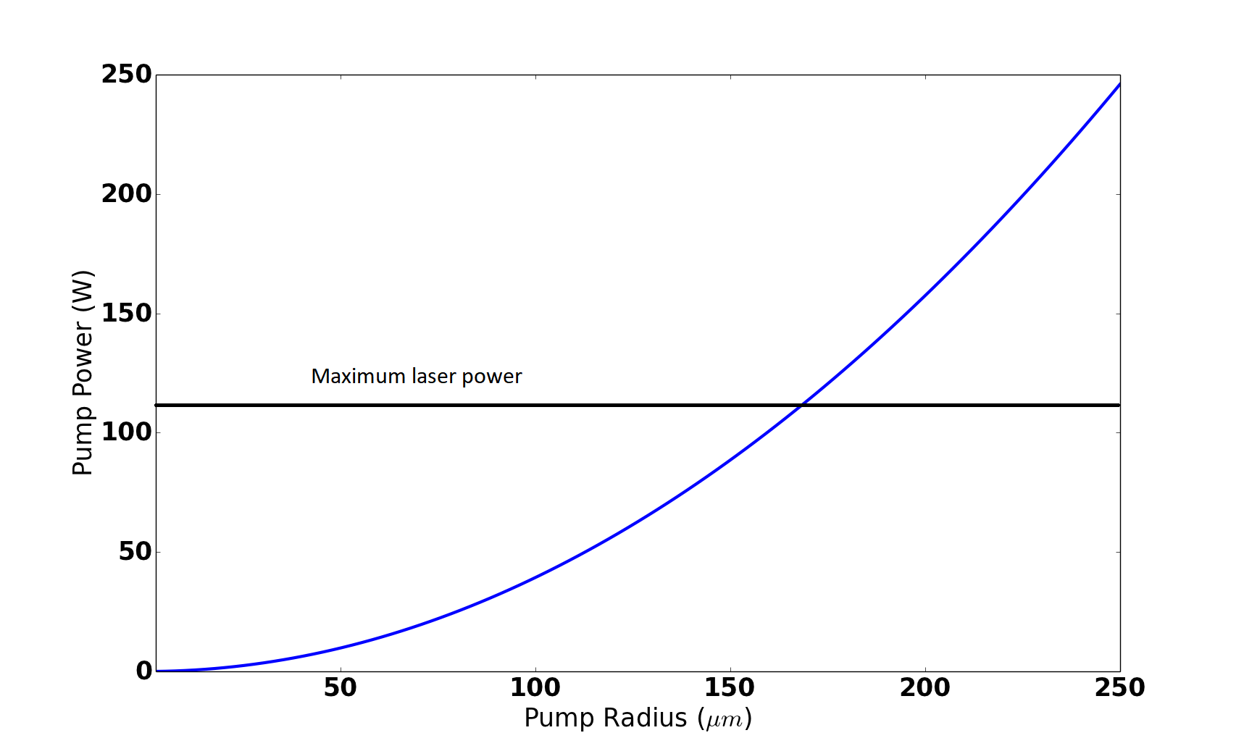
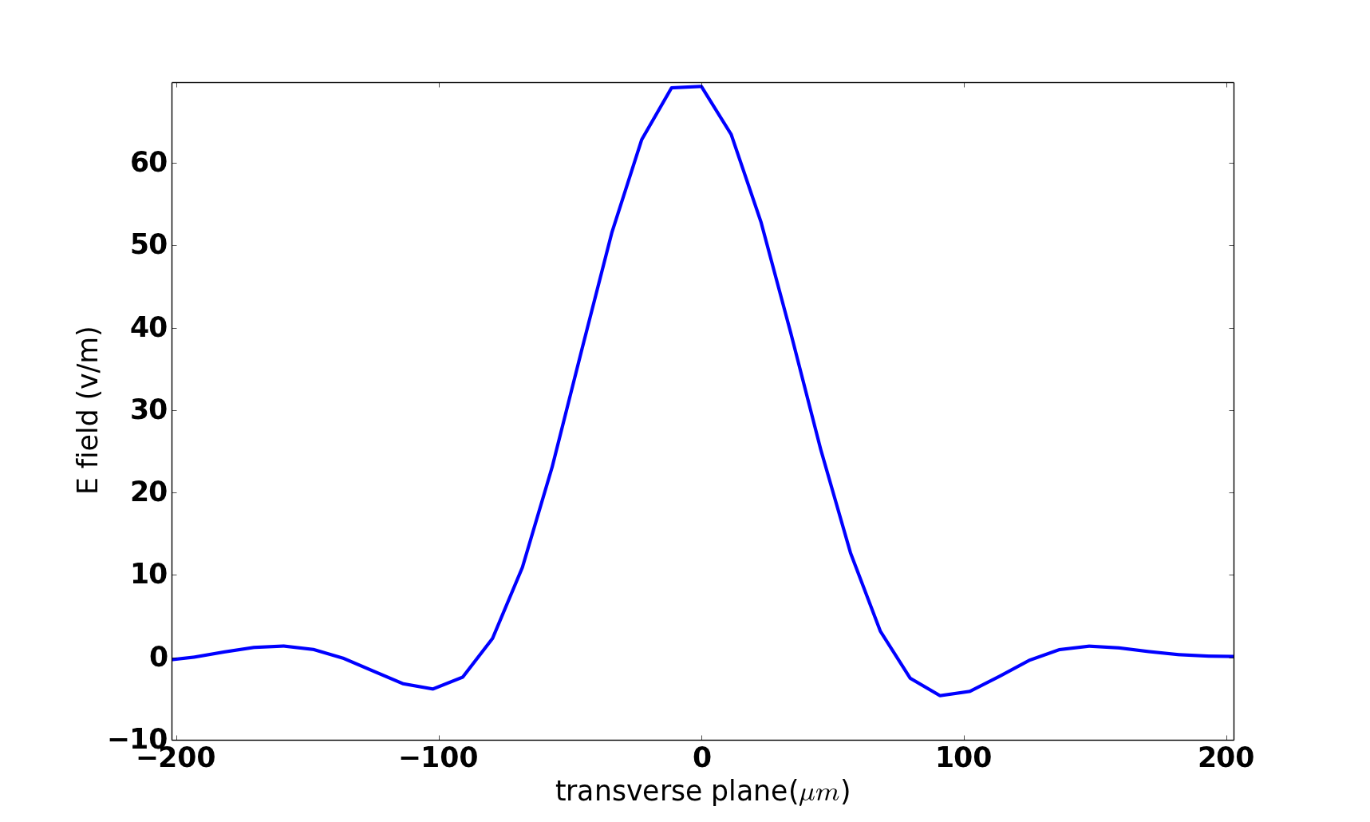
Light Optics for the active OSC Test
In passive OSC, light optics only purpose is imagining pickup radiation in the kicker. Giving a lot of flexibility.
For active OSC pickup spot size at the amplifier must also be considered to keep laser pump power reasonable. In the case of IOTA’s geometry this ruled out the –I transfer matrix. Instead the +I transfer is used
Using SRW the spot radius (time domain) at the crystal is found to ~100 μm for workable lens placements.
Telescope parameters
Pump power requirement is found to be 40 W.

Slide 11
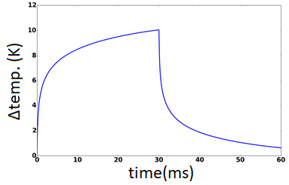
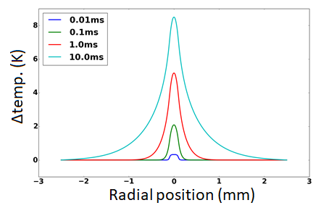
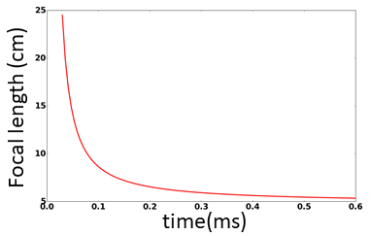
Thermal effects for the Cr:ZnSe amplifier
The photon energy of the pump is higher than emitted photons of amplifier, remaining energy goes into heat:
Of the 40 W of pump power only 8.8 W is absorbed and 2 W go into heating the crystal.
Liquid nitrogen cooling increases thermal conductivity by~5 making temperature change from the center to edge acceptable
Assuming a flat-top pump distribution after a ~50 μs the temperature profile develops an r² dependence. The index of refraction is linear in temperature giving a thermal lensing effect.
Focal length at equilibrium is 5.2 cm. Must be accounted in design of telescope.

Slide 12
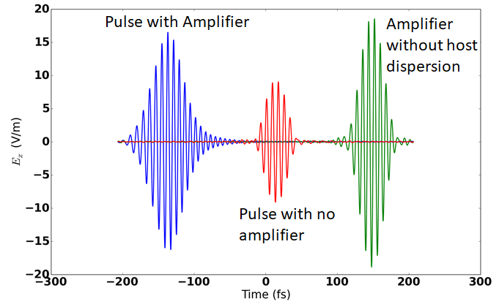
Synchrotron Radiation Workshop (SRW) simulations for the active OSC test
The predicted 7 dB gain is for a plane wave at the emission peak and does not directly give the amplitude growth of the undulator wave packet.
Pulse amplitude is reduced mainly by two effects:
Spectrum narrowing from finite bandwidth of the amplifier. Amplitude is reduced by 14%.
GVD in the host material lengthens the pulse. Amplitude is further reduced by 12%
Overall amplitude is increased by factor of 1.8. Since kick depends linearly on E_{x} the amplifier is increasing the damping rate by this same amount.

Slide 13
BACK UP SLIDES

Slide 14
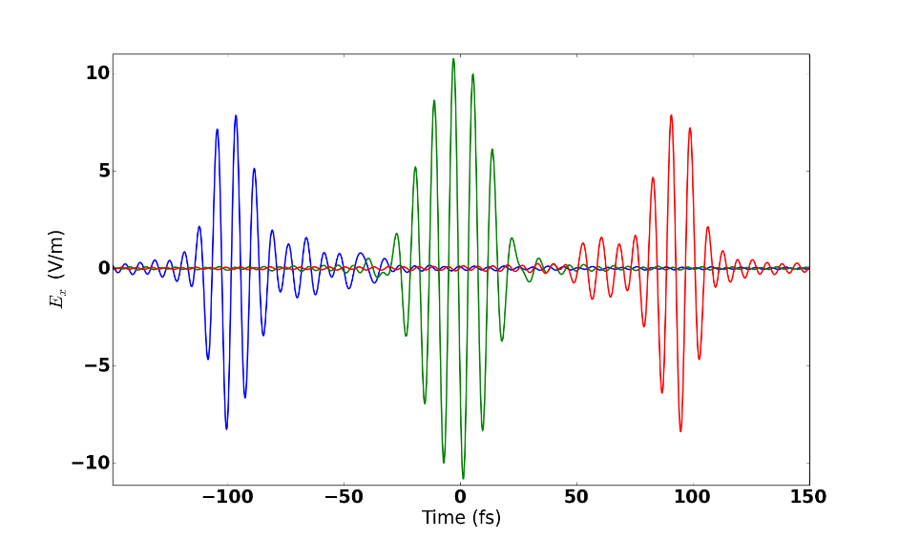
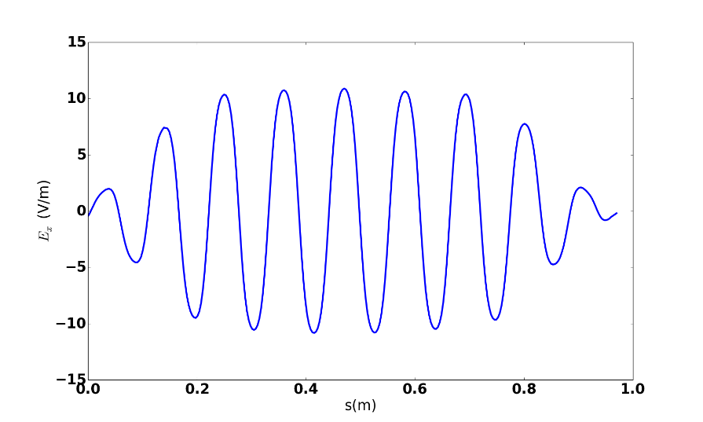
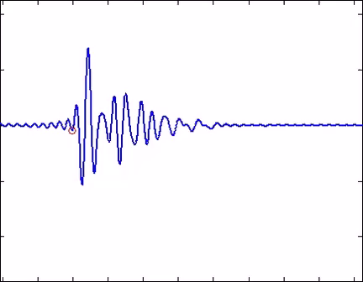

IOTA telescope parameters
Simulations with the OSC telescope for IOTA
Wave packet modulates in shape during its propagation through the kicker as light that was emitted from a location within the pickup is focused to the corresponding point in the kicker.
When the arrival of particle and wave packet is timed properly the particle follows peak of packet modulation. And thus sees a nearly constant field amplitude.
Amplitude decreases slightly away from kicker center. For light emerging from the edges of the undulator the effective aperture of the telescope has been reduced from γθ_{m} =0.8 to 0.62. Reducing kick ~10%

Slide 15
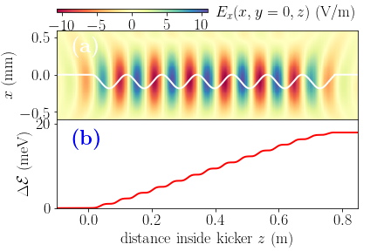
Simulations with the OSC telescope for IOTA
is now evaluated numerically.
The electrons transverse amplitude is 93 μm, at this distance the field is reduced by ~5% However transverse field dependence reduces the kick by ~1%.
This is explained by noting that coupling between field and electron is strongest on axis since v_{x} is maximum and off axis v_{x} is reducing towards zero.
The envelope of the kick value as a function of arrival time of the electron can be approximated as a Gaussian and used to estimated the number of particles per ‘slice’
The bunch length in IOTA (before OSC) is expected to be 14.2 cm and σ_{τ}=13.5 fs
Giving N_{s/}N=7.1x10⁻⁵ .

