Slide 1
Status for FAST drive laser system and Inverse Compton scattering
Jinhao Ruan

Slide 2
Time structure
f_{mac}
Intensity
f_{b}
Bunch
Macropulse

Slide 3
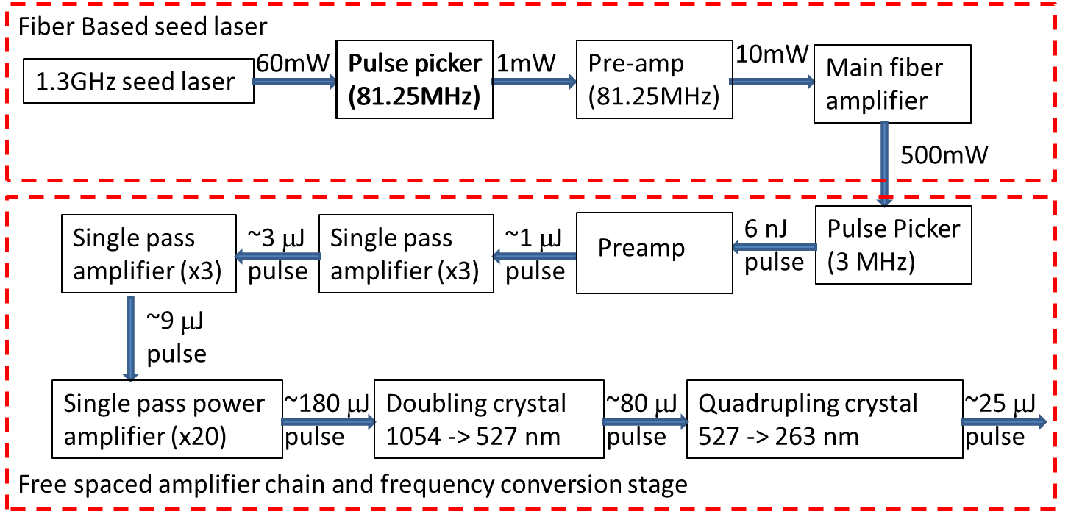
System Diagram

Slide 4
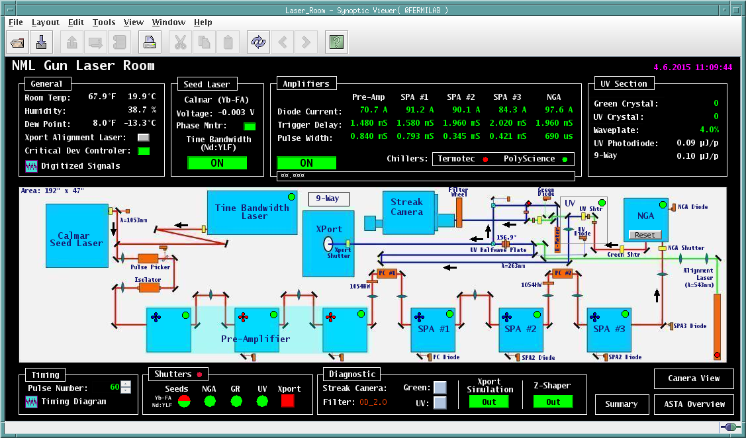
User Interface

Slide 5
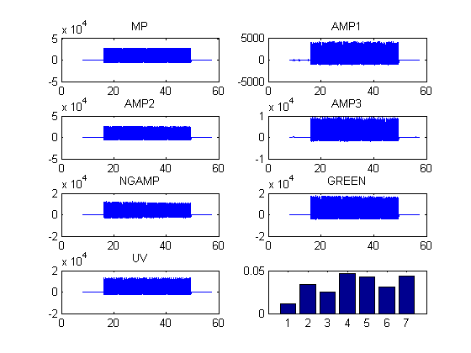
System Performance

Slide 6
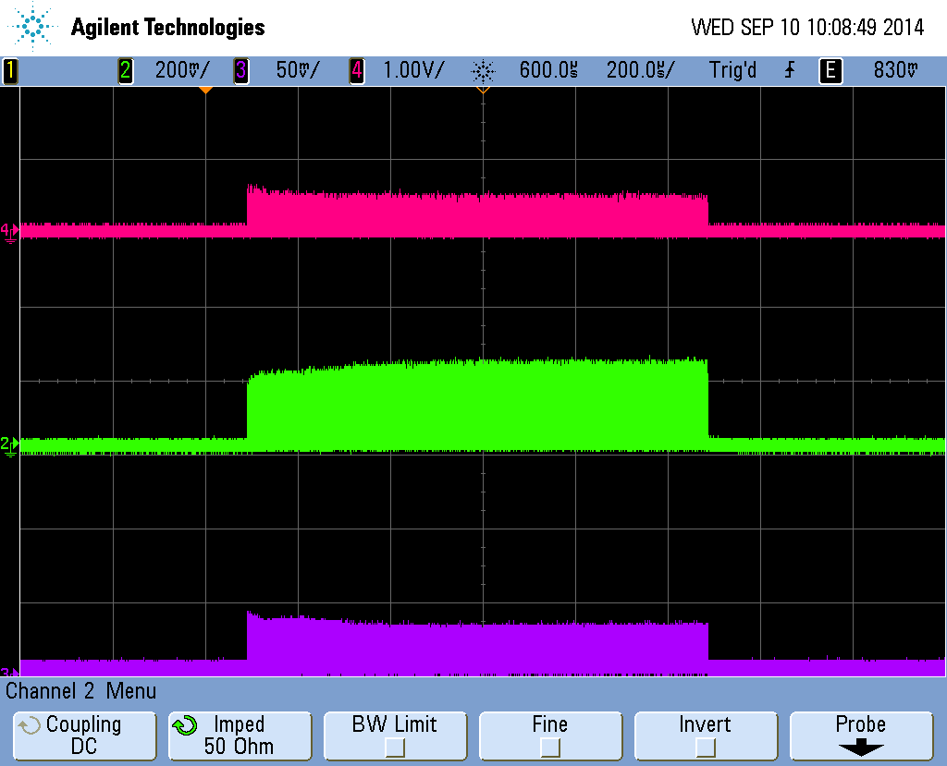
Long pulse result
IR
Green
UV

Slide 7
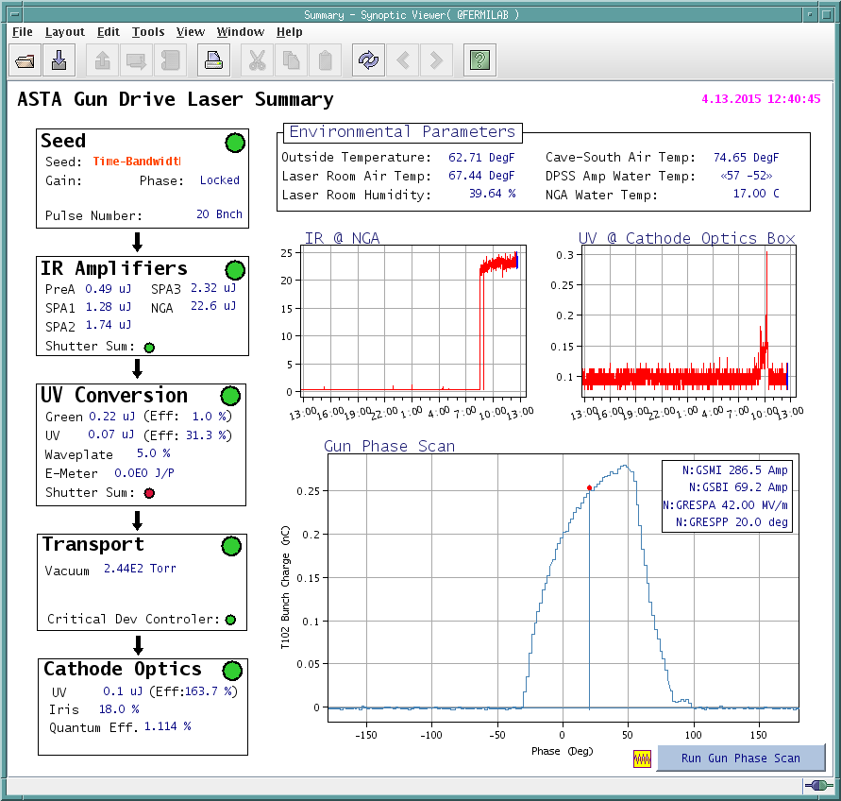
Laser status Monitor

Slide 8
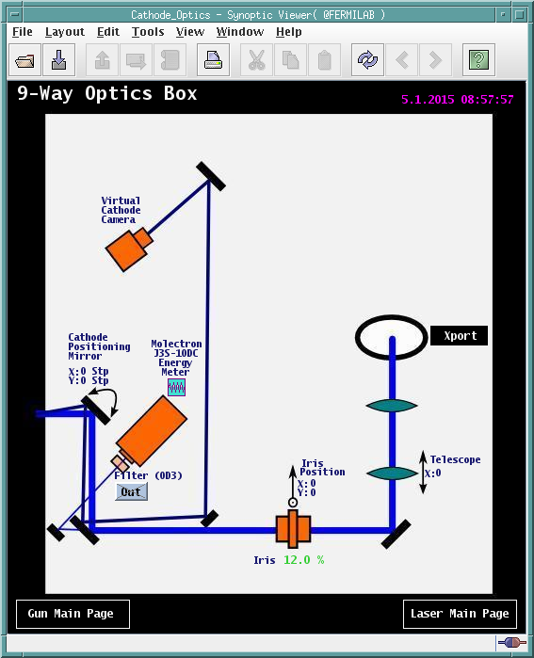
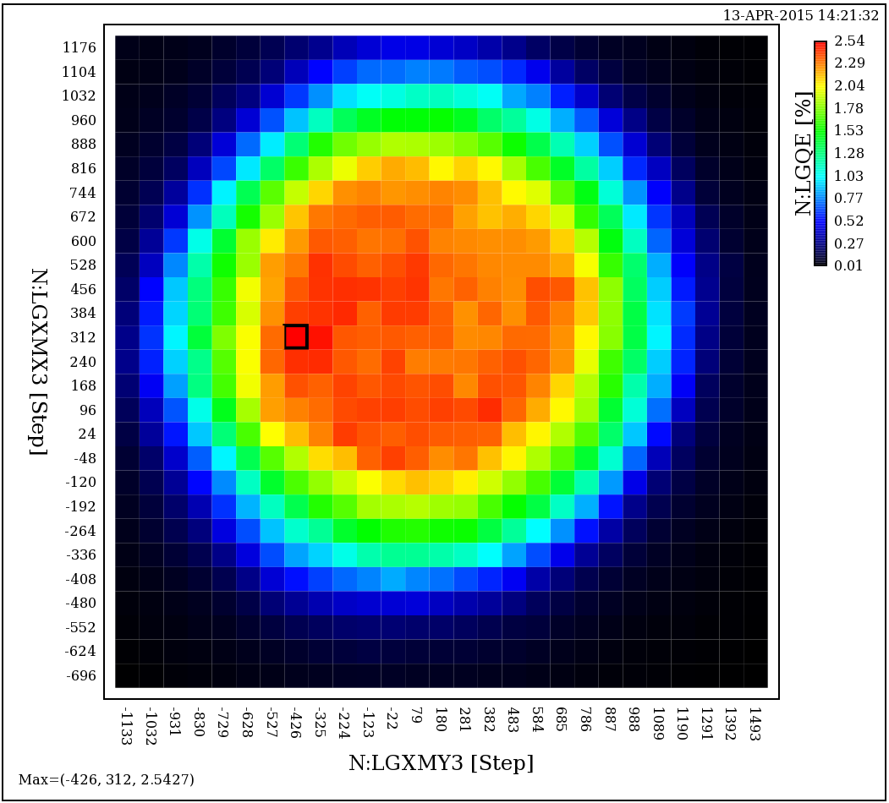
QE scan

Slide 9
Current Status
Laser is up running with 3MHz pulse train and 5Hz repetition frequency
User interface is set up
The longest flat pulse could be easily up to 200~300μs. Some extensive tuning (~3-4 hours) would be needed for 500~600μs long pulse train with lower chargies.

Slide 10
Inverse Compton scattering
Incident laser
Light ε₁
Relativistic Electron Ee
θ₁
π-θ₂
Scattered
Photon ε₂
$$ε_{2}=ε_{1}\frac{1+β\cos{θ_{1}}}{1+β\cos{θ_{2}+\frac{ε_{1}}{E_{e}}\left[1−\cos\left(θ_{2}−θ_{1}\right)\right]}}$$
$$ε_{2}=4γ^{2}ε_{1}$$
Head on case

Slide 11
Inverse Compton scattering
Tunable and near-monochromatic gamma rays can be obtained over the entire spectrum.
The gamma rays can be produced in ultra-short pulses.
A much lower electron beam energy- on the order of 300 times lower- is needed to produce a given photon energy, which means that the device can be relatively compact and inexpensive than conventional light sources.
Conversely, photons with much higher energy than are available through the conventional light sources (>1 MeV) can be produced.
The bandwidth can be small and is not limited by the length of an undulator.
The peak brightness scales as γ5 due to quadratic growth of photon energy, quadratic narrowing of the opening angle and linear reduction in the e-beam source area.
The gamma ray polarization is easily adjusted by changing the incident laser polarization.

Slide 12
Inverse Compton scattering
Linac approach
limits repetition rate to several hundred Hz
Ring approach
Low energy of the electron, limited by ring size and technology, consequently limits the usefulness of this form of gamma ray source as other non-ICS based approaches are rapidly developed in this range, as shown in figure 3.
Circulating electron bunch length tends to be relatively long, which make these ICS sources unsuitable for experiments designed to probe sub-picosecond phenomena.
Intrabeam scattering leads to degradation of the circulating beam resulting in a subsequent degradation in the gamma ray source. Fresh beam is typically injected to maintain quality.

Slide 13
FAST capabilities
High repetition-rate: FAST accelerates 1 millisecond-long bunch trains, with 3 MHz micro-pulse repetition rate, with up to 3000 bunches per train
High average power: FAST accelerates 1 millisecond-long bunch trains at up to five pulses per second, providing the highest beam power and highest average brightness of any accelerator test facility in the U.S.
High energy: FAST accelerates beam to nearly 1 GeV. As noted previously, this is crucial for the design of high energy gamma ray experiment.
Extremely stable beams: FAST, based on ILC technology, is capable of providing exceptional beam stability, which has been demonstrated at the FLASH facility at DESY.
Superconducting technology: FAST necessarily brings SRF and beams together. As nearly all future large scale accelerator facilities will rely on SRF technology, FAST will be the only GeV-scale test facility which is capable of supporting R&D in prototypical conditions. Although designed to be a pulse SRF LINAC, FAST is also expected to support R&D efforts for a continuous-wave (CW) SRF LINAC as required for the ongoing LCLS II project.

Slide 14
Beam parameter and anticipated flux
Incident laser parameters
Wavelength λ | 1.054 μm
Pulse Length (rms) | 3 ps
Peak power P₀ | 10 TW
Intensity
Spot size | 50 μm
Raileigh Length | 5 mm
Electron pulse parameter
Beam Energy E_{b} | 250 ~ 800 MeV
Beam charge | 0.1~1 nC
Beam pulse length (rms) | 5 ps
Beam radius (rms) at IP | 20 μm
Beam energy spread (ΔE/E_{b}) | 0.1%
Normalized beam emittance | ~ 5 mm mrad
Beta function | ~ 10 cm
Anticipated gamma ray parameter
Photon Energy E_{g} | 0.8 ~ 9 MeV
Photo pulse length (rms) | 3 ps
Rep Rate | 3 MHz
# of bunches in Macrobunch | 3000
Average photon flux in 1% bandwidth | 10¹² cps
Photon / bunch | 3.3×10⁸
Peak brightness (0.1% bandwidth) | 10²³ photons/(s mm² mrad²)
Angular spread (1/γ) | 2 ~ 0.7 mrad

Slide 15
Laser cavity
$$F=\frac{{Δω}_{FSR}}{{Δω}_{FWHM}}=\frac{π\sqrt{R}}{1−R}$$

Slide 16
Schedule and problem we faced
Currently laser transport is putted in. Experiment results is expected at later FY2019 without enhancement cavity first.
Laser repetition rates still too low
3MHz means 90 meter travel distance, very long compare to normal enhancement cavity(~2m).
Possible solution (current working on)
Even high repetition rates, 9MHz possible, can we run even higher?
To make up length for the cavity we may need to build a active cavity

