Slide 1
Linac Laser Notcher Instrumentation
Todd Johnson
JPARC-FNAL meeting
29 March 2018

Slide 2
Instrumentation Requirements
The scope of practical diagnostic laser work is limited due to high optical power and unsecure installation area. We would therefore like to have the following information available without opening the laser enclosures:
Power / energy readbacks for each amplifier stage.
Beam position monitors for laser trajectory adjustment and stability monitoring.
Infrared cameras to monitor the laser propagation through the cavity and into the dump.
High speed photodiodes to monitor pulse uniformity.
Temperature sensors for each module and for monitoring environmental changes.

Slide 3
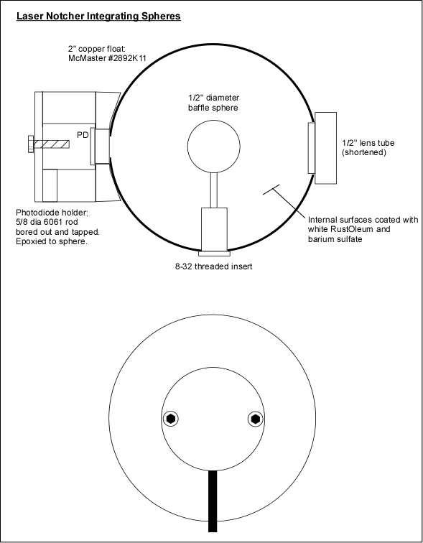
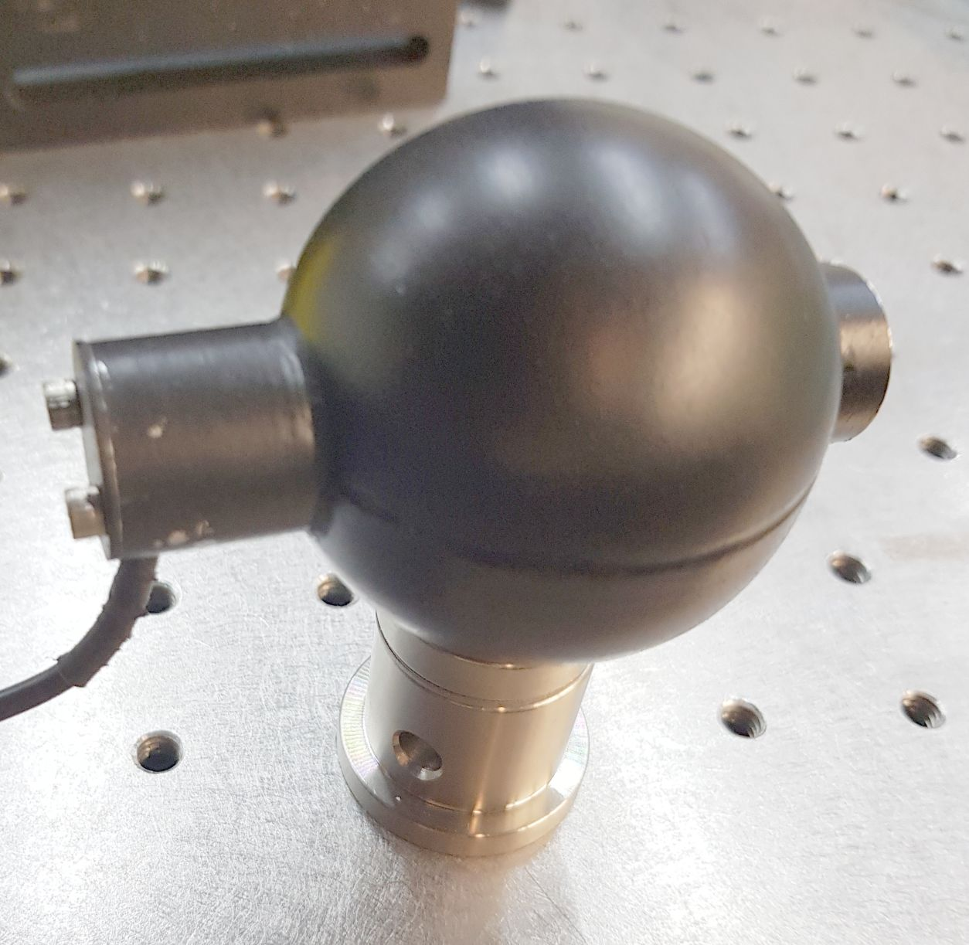
Energy monitors for pulsed free-space amplifiers
It was desired to use integrating spheres to reduce effects of beam steering on the energy readings. Spheres were fabricated in-house from 50mm copper floats internally coated with a BaSO4 reflective layer and fitted with a central spherical baffle and a photodiode.
Spheres sample laser light leaking through existing mirrors.
Photodiode currents are integrated during each Linac cycle. (40 uS every 66mS)

Slide 4
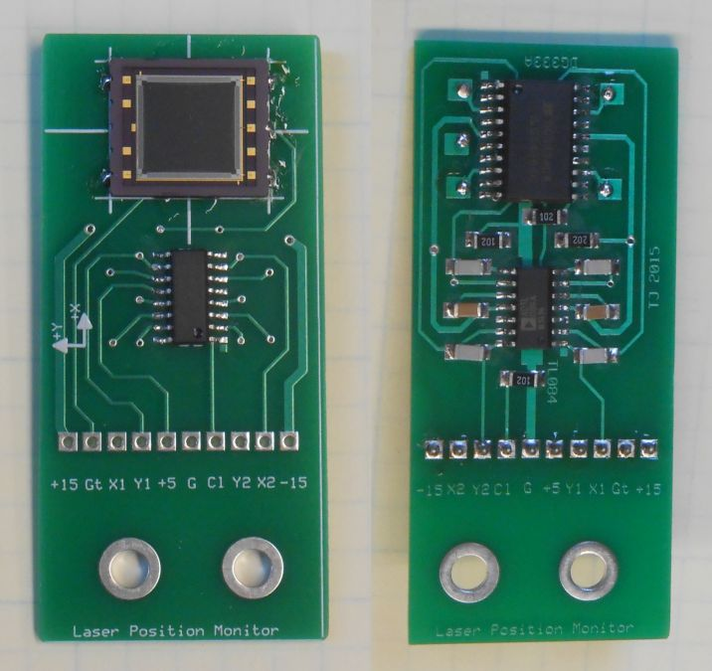
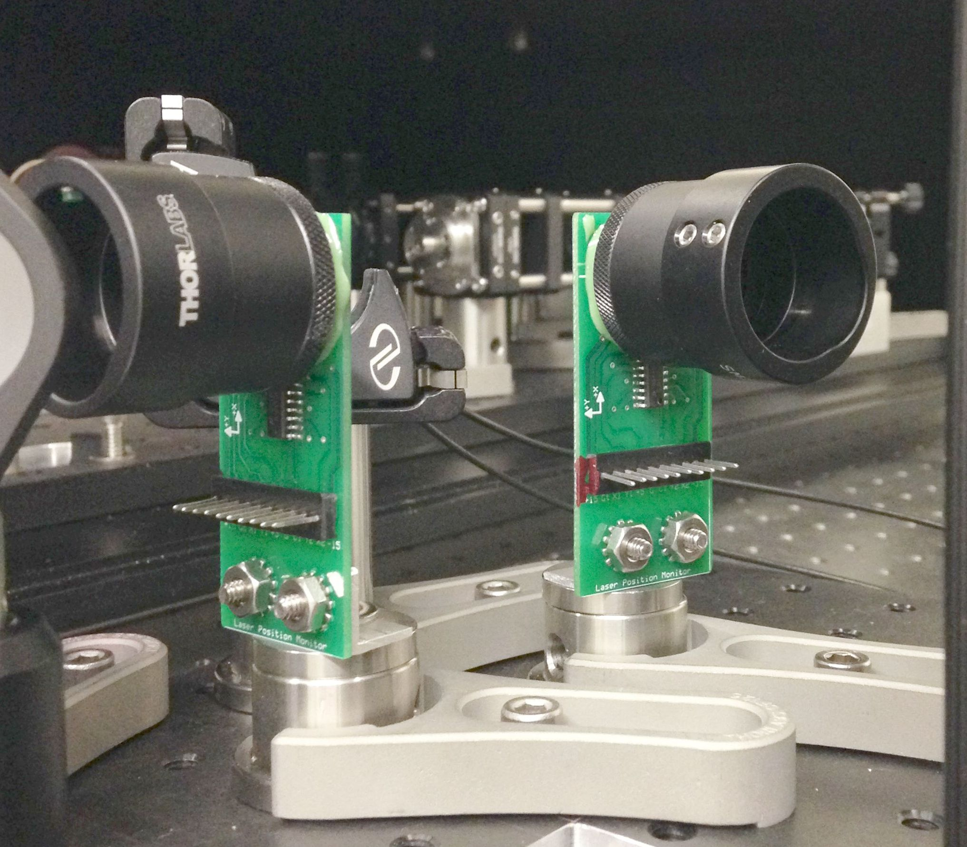
Optical Beam Position Monitors
Based on Hamamatsu position sensing detectors (PSD) with 9 x 9mm active area. Readings are integrated during each Linac cycle.
Measures laser light leaking through a mirror or reflected from an AR coated window.

Slide 5
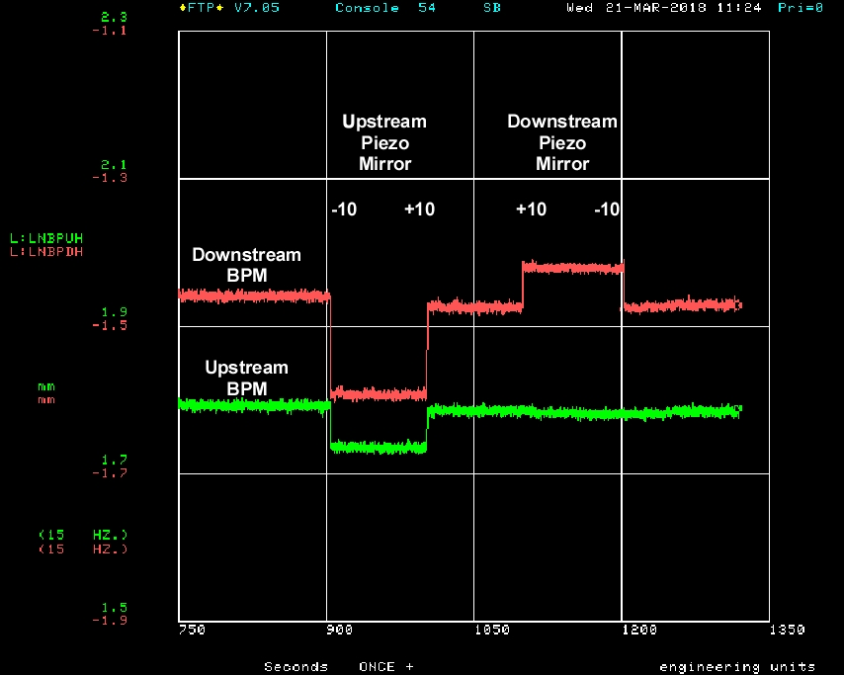
Optical Beam Position Monitors

Slide 6
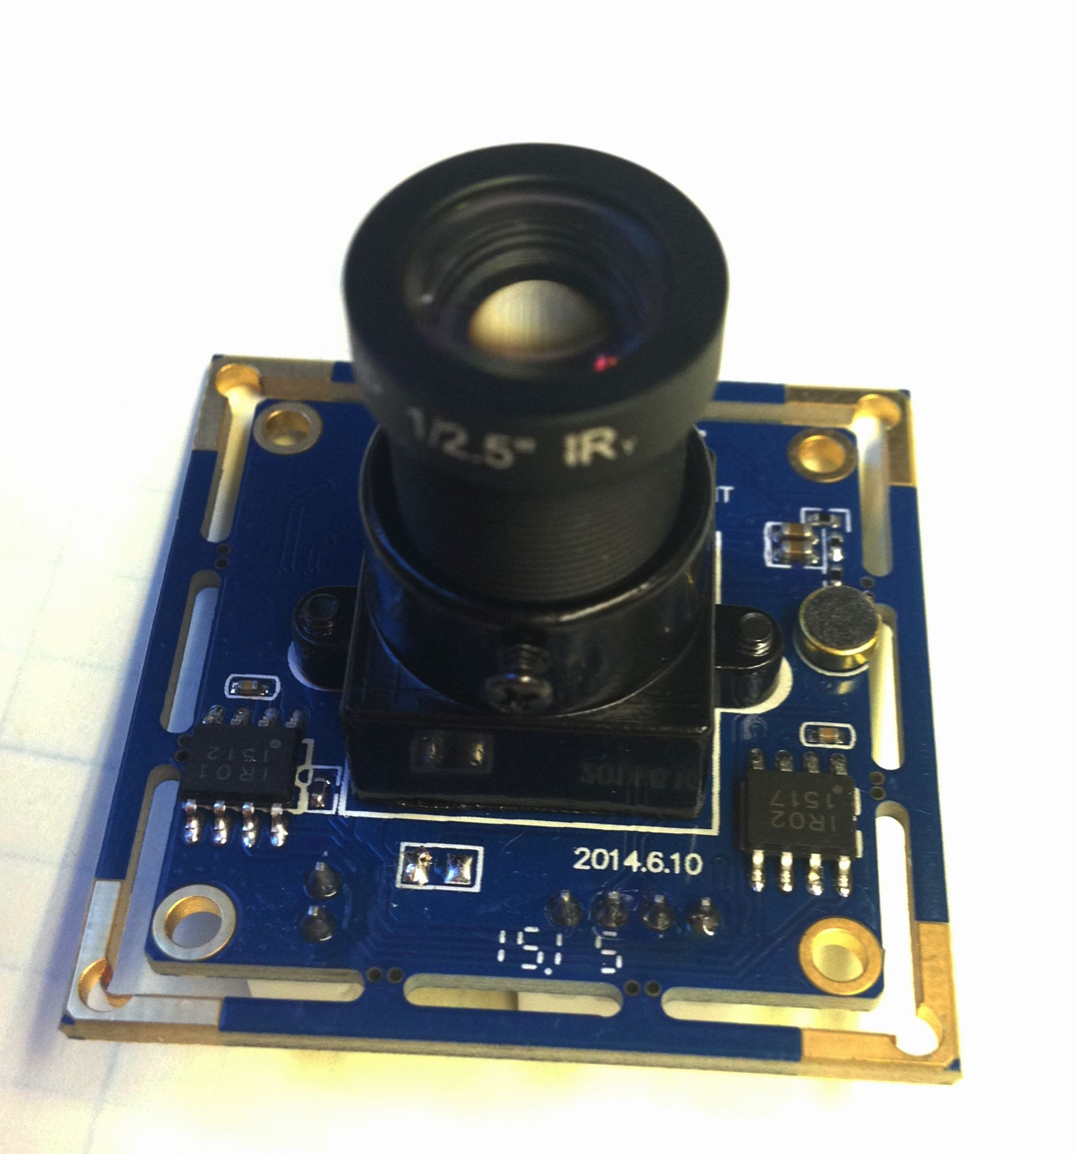
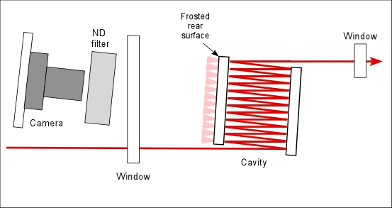
Infrared cameras
We use an inexpensive monochrome webcam
with the IR filter removed.
0.05% of the laser light leaks through the first cavity mirror and projects onto the frosted rear mirror surface, and is then imaged by the camera.

Slide 7
Camera image permits convenient inspection of the number of cavity bounces, cavity mirror alignment, and beam profile uniformity.

Slide 9
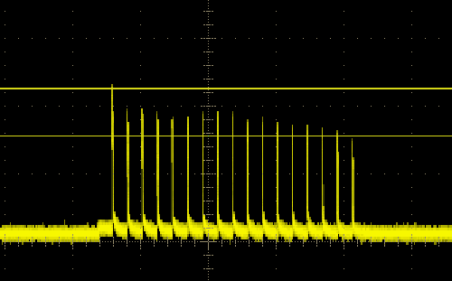
High speed photodiodes
Commercial photodiodes look at light leaking through mirrors to monitor uniformity of intensity after each pulsed amplifier. As with the other instrumentation, signal connections are available on the outside of the laser enclosure.

Slide 10
Thank you for your attention!
Questions?

