Slide 1

Serial Ganging of Two sensL 3mm x 3mm C series SiPMs
PRELIMINARY
Kurt Francis
3/28/2018

Slide 2
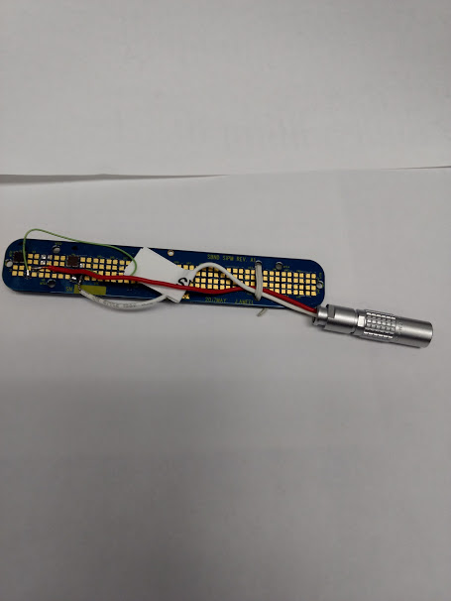
Sensl 3mm x 3mm C series are ¼ size versions of
The 6mm x 6mm for protodune
Vbr = 24.2V to 24.7V (~24.5)
Estimate two stacked should be 49V warm
The 6mm x 6mm were around 21V at LN2 temp.
Estimate two stacked should be 42V at LN2 temp.

Slide 3
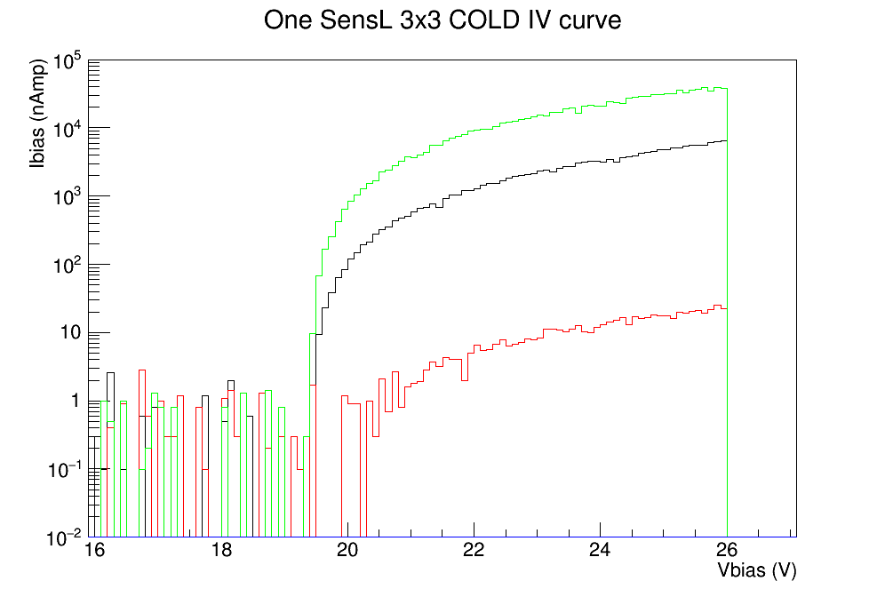
Can’t measure dark current
At LN2 temperature,
Not enough charge carriers,
So we turn on the LED
LED SETTING:
Red: 1.5V
Black: 1.7V
Green: 2.0V
Vbr ~= 19.5V

Slide 4
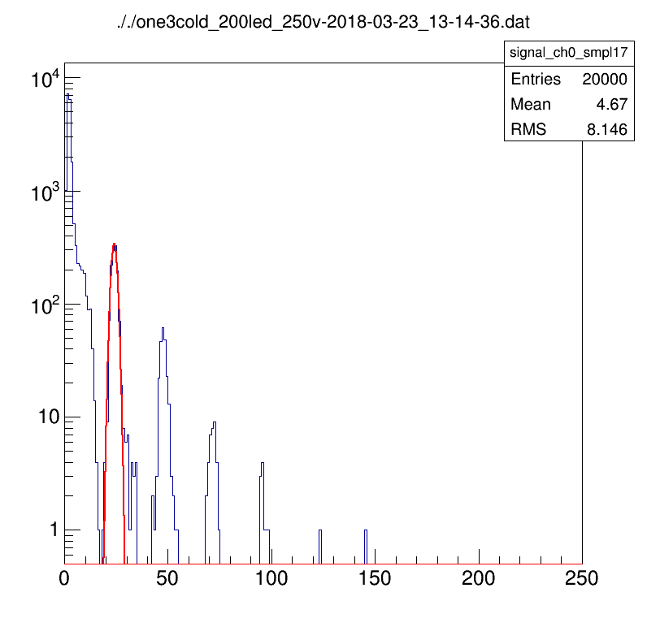
Bias = 24.75V
Bias = 24.75V
Vovr = 5.25V
Gain = 24ADC/PE

Slide 5
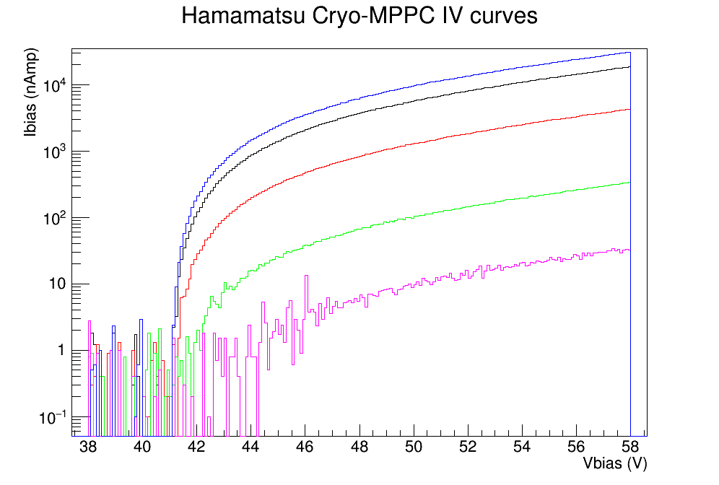
TWO SensL 3mm x 3mm ganged at CryoTemperatures
Can’t measure dark current
At LN2 temperature,
Not enough charge carriers,
So we turn on the LED
LED SETTING:
Purple: 1.5V
Green: 1.6V
Red: 1.7V
Black: 1.9V
Blue: 2.1V
New FEB readings are
more unstable at
Low nAmps

Slide 6
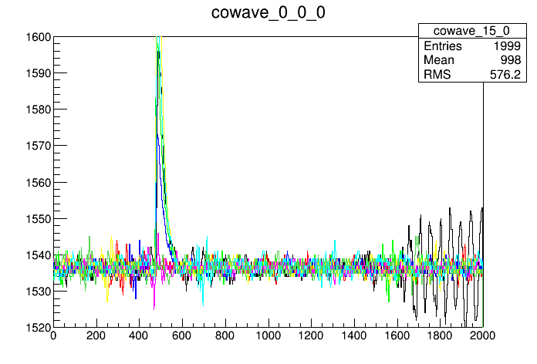
Vovr_combined = 12.75V
Vovr_individual = 6.35V
TWO SensL 3x3 COLD bias=54V

Slide 7
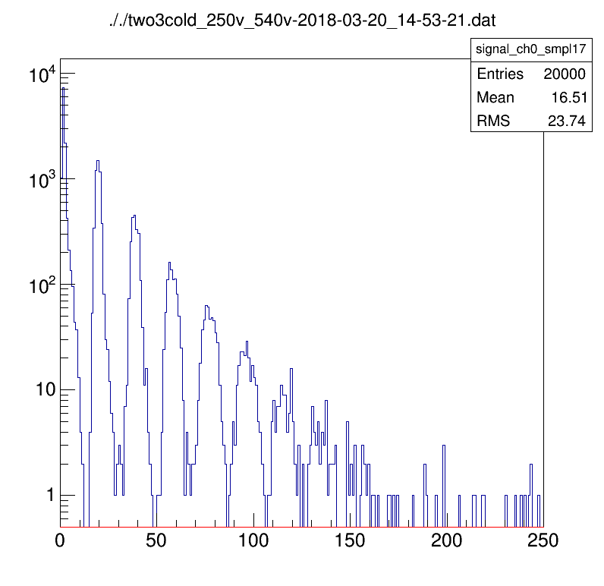
Actually 53.77V
Vovr_combined = 12.75V
Vovr_individual = 6.35V
Gain = 19.5 ADC/PE

Slide 8
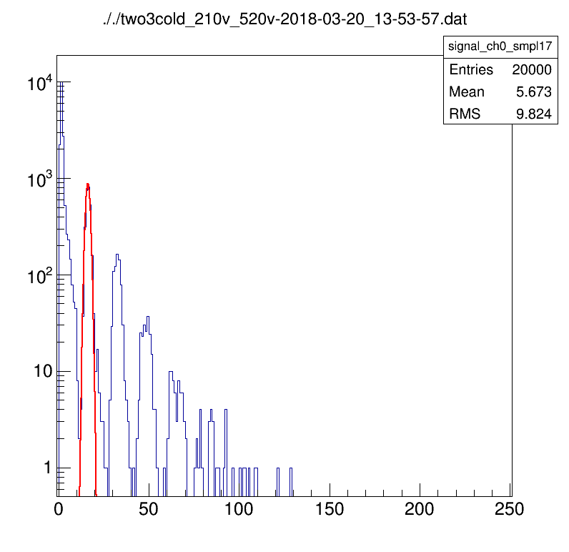
Vovr_combined = 10.75V
Vovr_individual = 5.35V
Gain = 16.3 ADC/PE
For Comparison
The single device at Vovr=5.25
Gain = 24.0 ADC/PE

