Slide 1
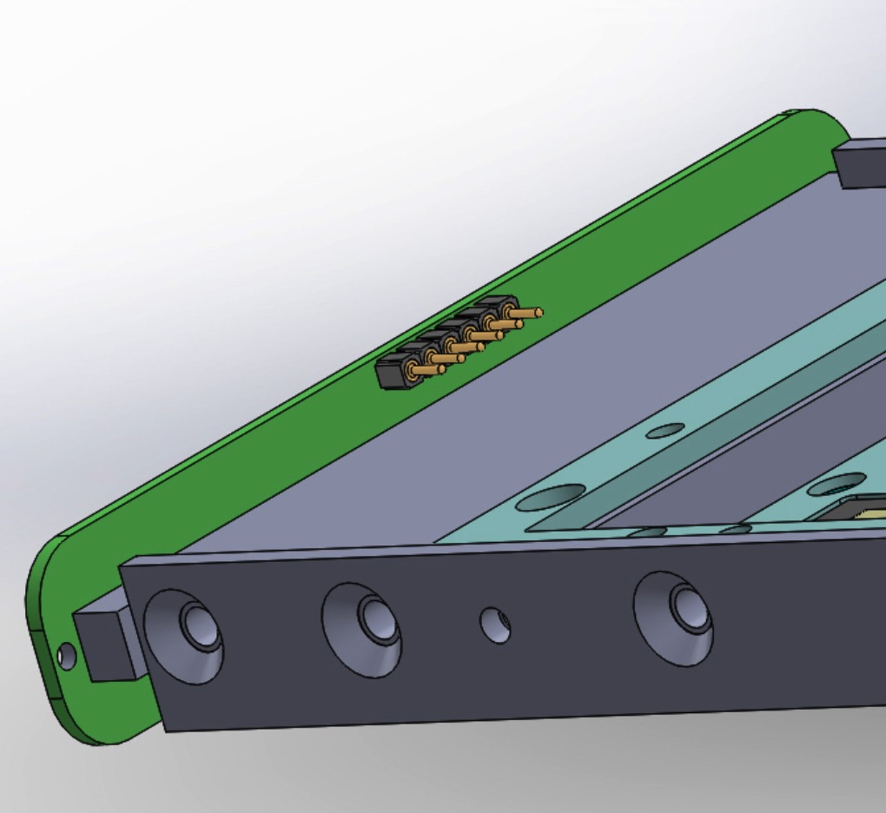
Module End Connectors
Readout Pins
(Both sides of board)
2 gnd + 4 signal pins per side
4 and 8 total connections

Slide 2
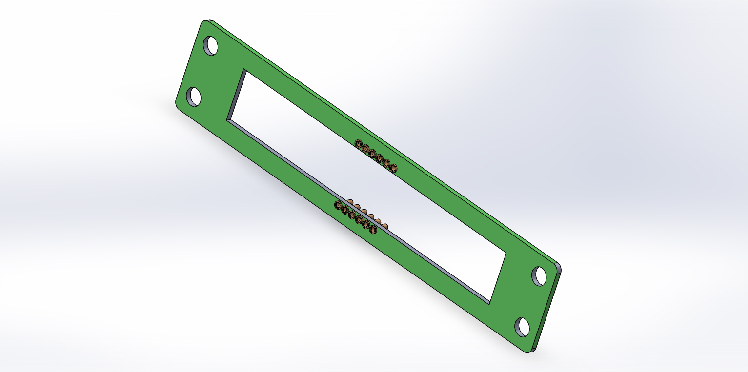
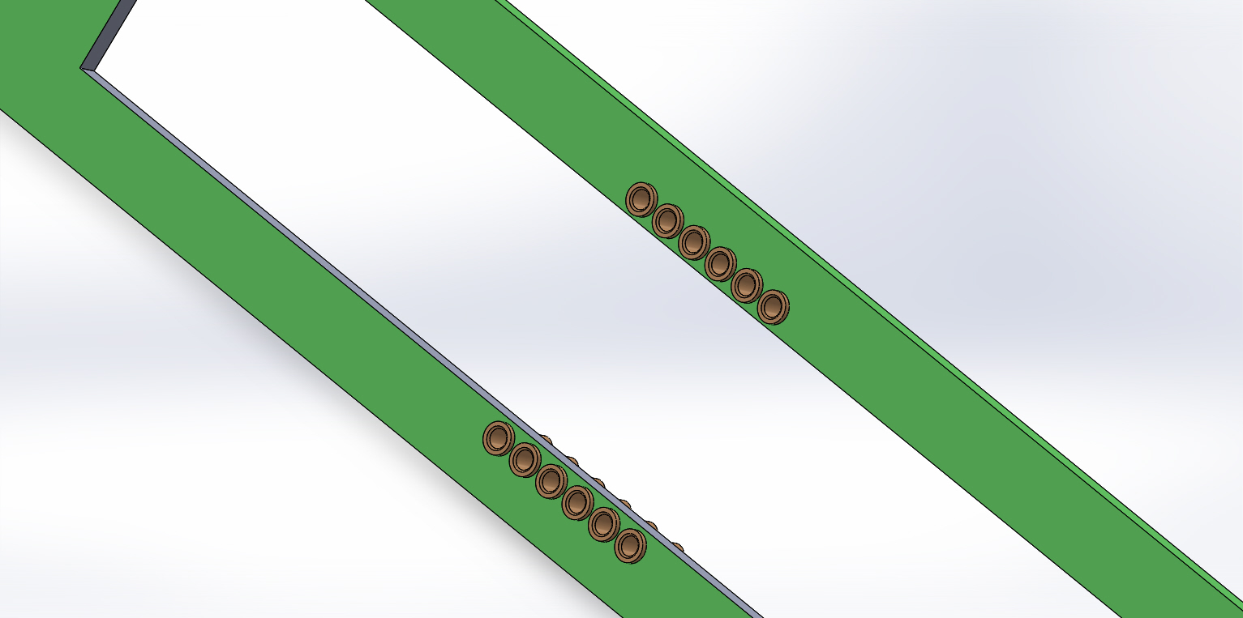
FR-4 G-10Board mounts on inside of
APA tube
Pin socket openings face into
Tube inside
Cables solder to
Backside of board

Slide 3
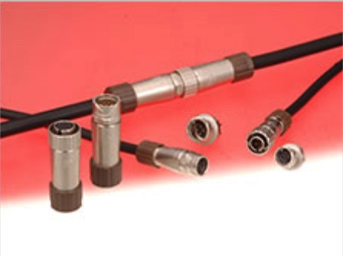
Inline Connector Candidate
Inline connectors will connect upper and lower APA PD cables
Inline connectors will also connect long haul cables to PD cables inside APAs (at top of top APA)
Hirose LF-series connectors are a primary candidate (same as ProtoDUNE)
Still need to figure out where to put connectors between top and bottom
Hirose LF-series connectors

