Slide 1
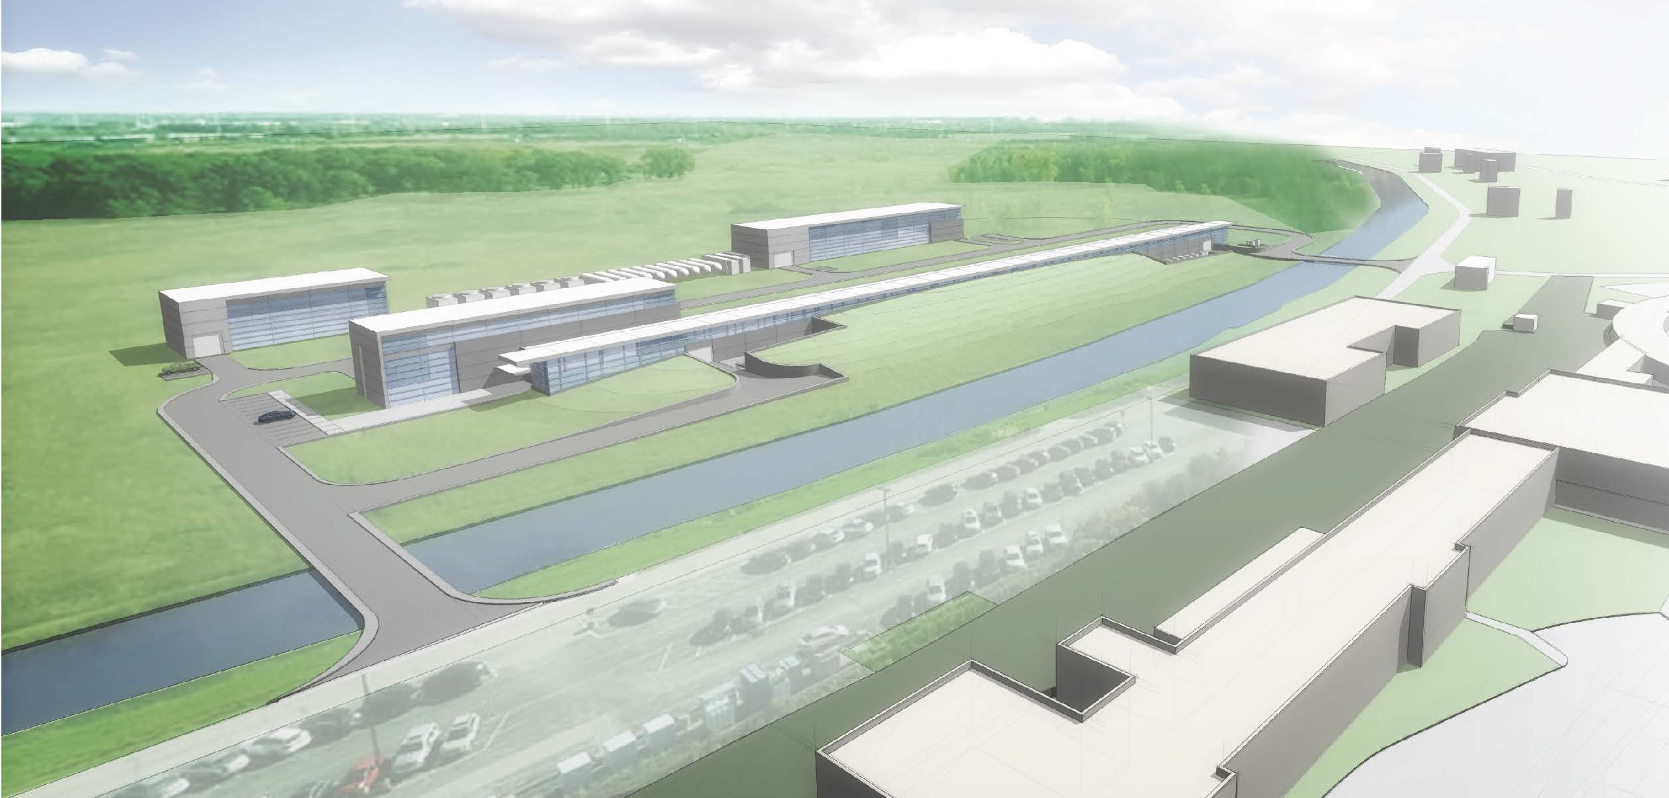
PIP-II technical workshop with France
View from IN2P3
Jean-Luc BIARROTTE, CNRS/IN2P3
Scientific Director for ‘Accelerators & Technologies’
jlbiarrotte@admin.in2p3.fr

Slide 2
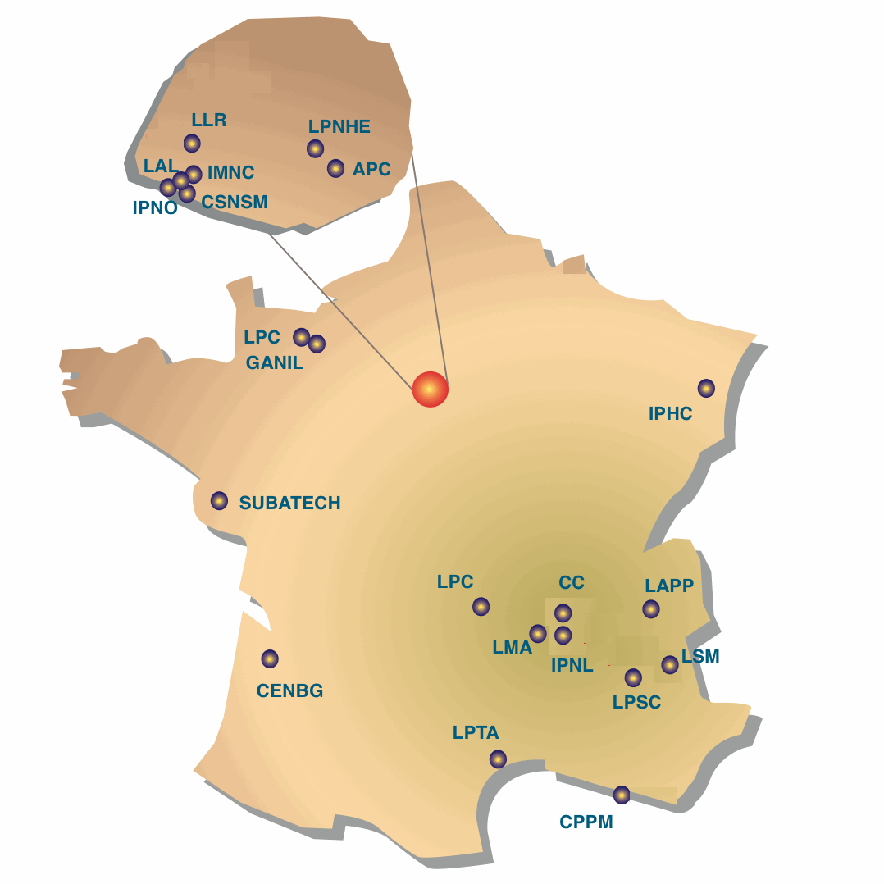
Accelerator R&D labs in France
3
labs
IRFU
SOLEIL
about 300 FTE on accelerators (incl. GANIL-CNRS) in 13 labs
about 200 FTE on accelerators (incl. GANIL-CEA)
Orsay / Saclay
Caen / Normandie
Total of about 500 FTE
Strasbourg
+ARRONAX
+ 2 French « sociétés civiles »
Nantes
ESRF
Bordeaux
Grenoble / Alpes
International (21 partners, FR 7.5%)
French (CNRS 72%, CEA 28%)
2

Slide 3
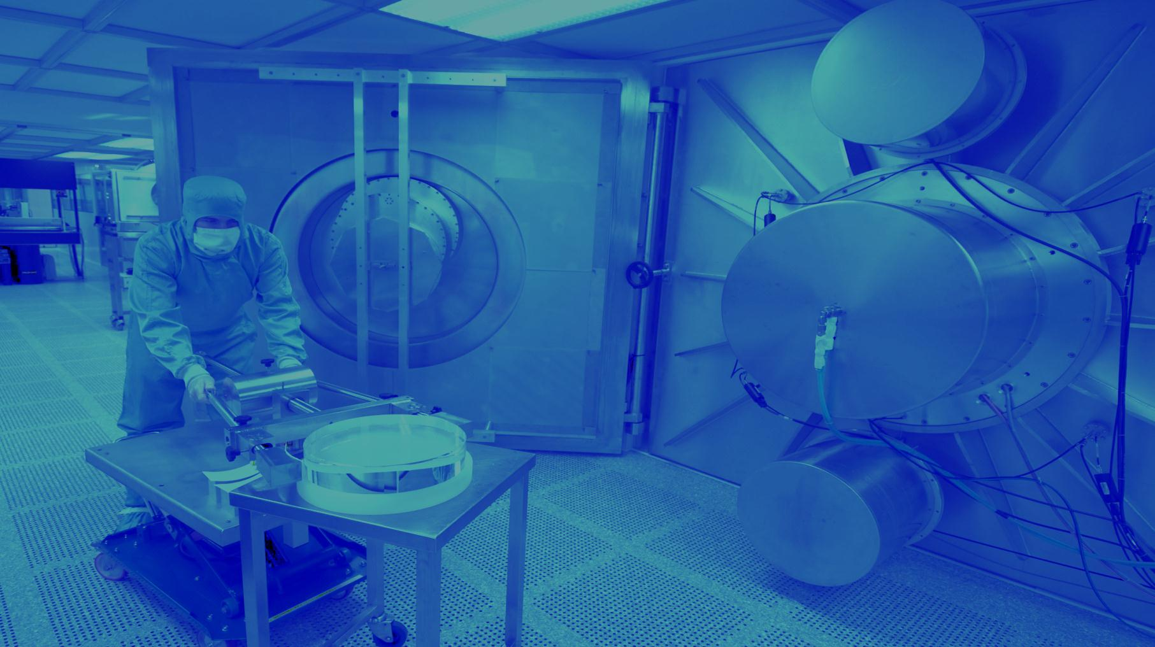
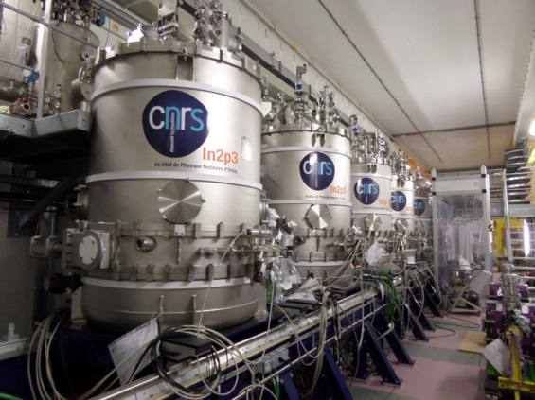
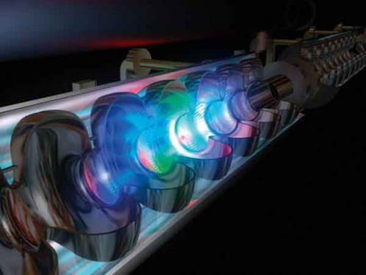
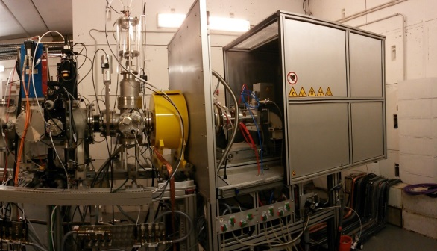
Accelerator R&D @ IN2P3 – Main skills
5
ACCELERATOR R&D
ACCELERATOR RESEARCH & DEVELOPMENTS
Superconducting accelerating cavities and cryotechnology
Sources & injectors
Radioactive beams
Beam dynamics, colliders final focus
Plasma acceleration, laser/beam interactions
Beam instrumentation
Related technologies (RF, vacuum…)
© CSNSM/Jean François Dars, Desy Hamburg, Ganil, CNRS/IN2P3 Conception graphique : Anna Thibeau (IPNL)
INTENSE BEAMS
LASERS
SUPERCONDUCTING
ION SOURCES
PLATFORMS
CRYOTECHNOLOGY
3

Slide 4
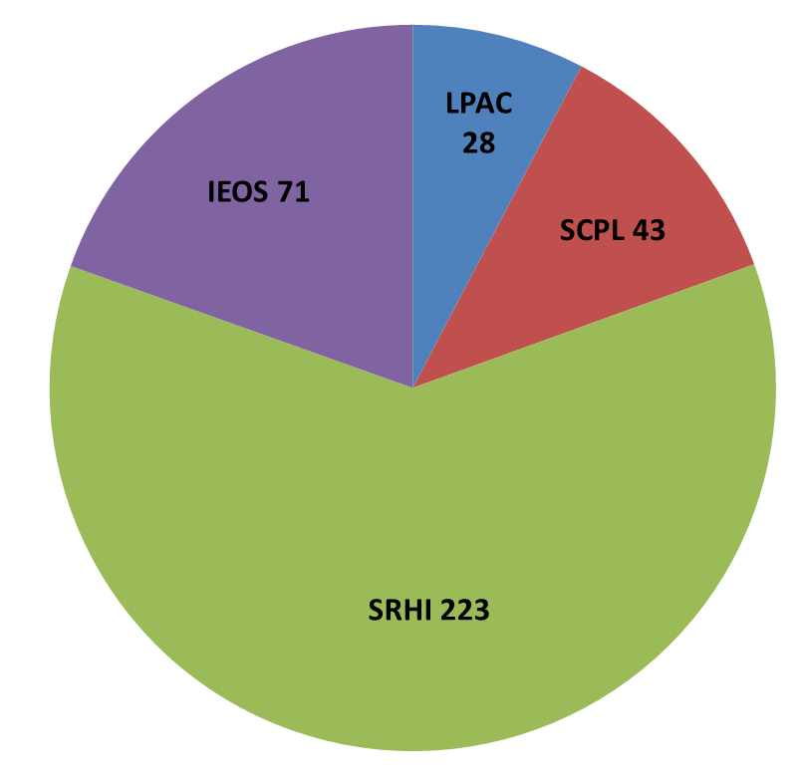
Accelerators at IN2P3: key figures
3
4 research programs
LPAC Laser Plasma Acceleration, high-energy Colliders, synchrotrons
IELS Innovative Electron and Light Sources
SCPL Superconducting RF Cavities, high-power Proton Linac & ADS
SRHI Stable & Radioactive Heavy-Ions production & acceleration
FTE 2016

Slide 5
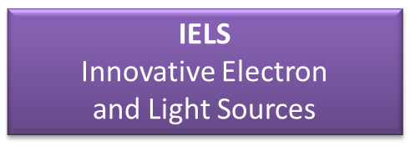
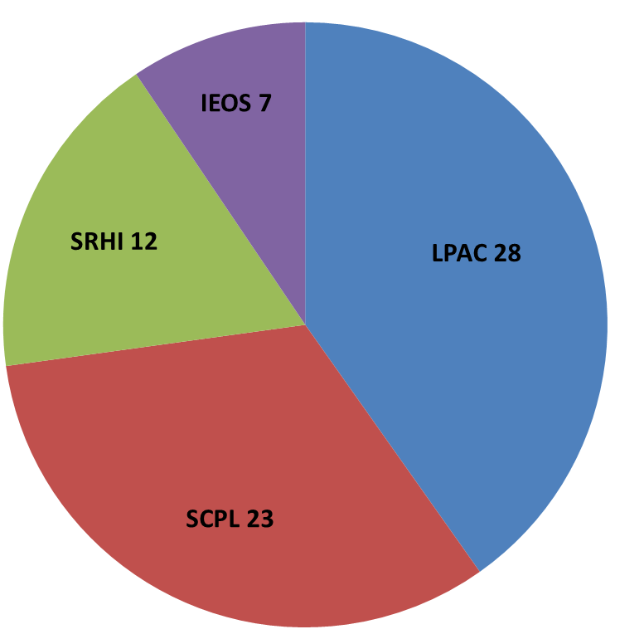
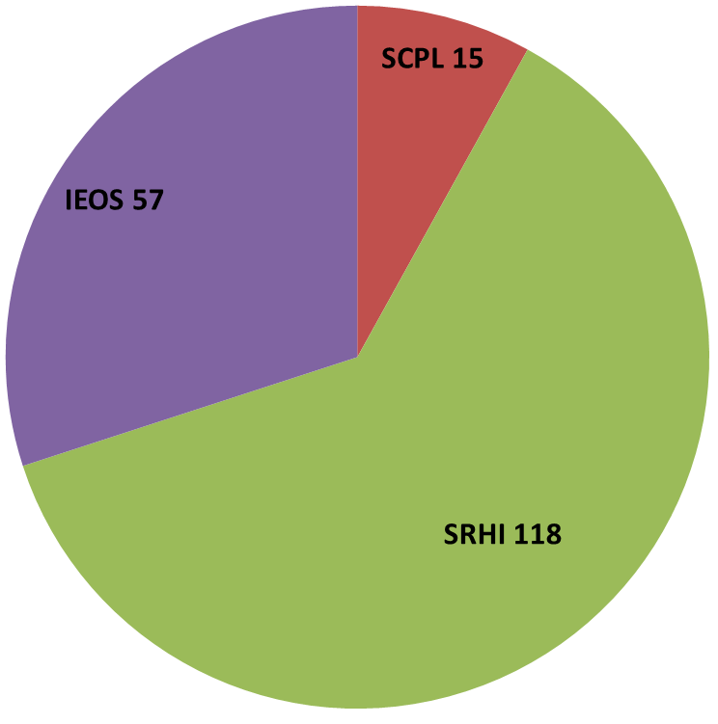
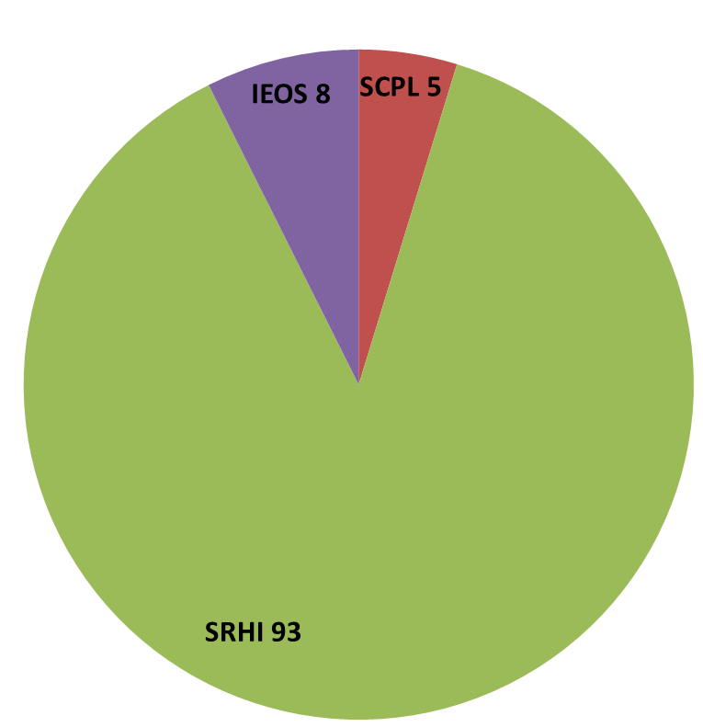
Accelerators at IN2P3: key figures
R&D 70 ETP
XFEL
THOM-X
PHIL
SUPRATECH
ELI-NP
ESS
Construction 190 ETP
Platform operation 110 ETP
SPIRAL 1 upgrade
GANIL
SPIRAL 2 linac
ALTO
S3
DESIR
FTE 2016
Multi-disciplinary platforms

Slide 6
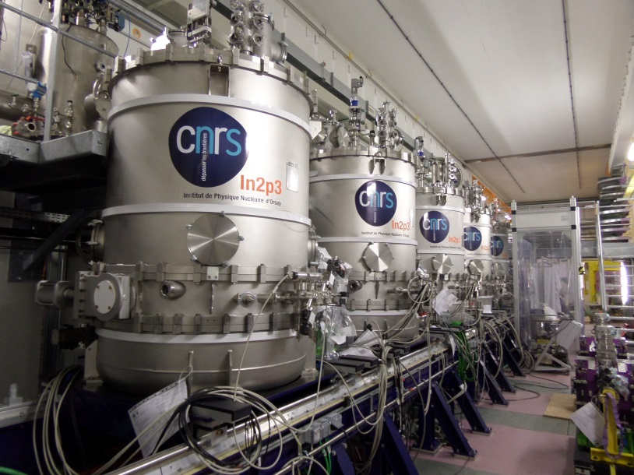
Recent SRF contributions – SPIRAL2
3
SPIRAL-2 SRF linac @GANIL
200kW ion SRF linac 14.5MeV/u
Presently in commissioning phase
Close collaboration with CEA
IN2P3 In-Kind contribution to SPIRAL-2 linac
Accelerator design & commissioning
Heavy-ion injector
High-beta SRF cryomodules (88MHz QWR: 7 cryomodules, 14 cavities)
Cryogenic plant & distribution
Beam instrumentation & dump
6

Slide 7
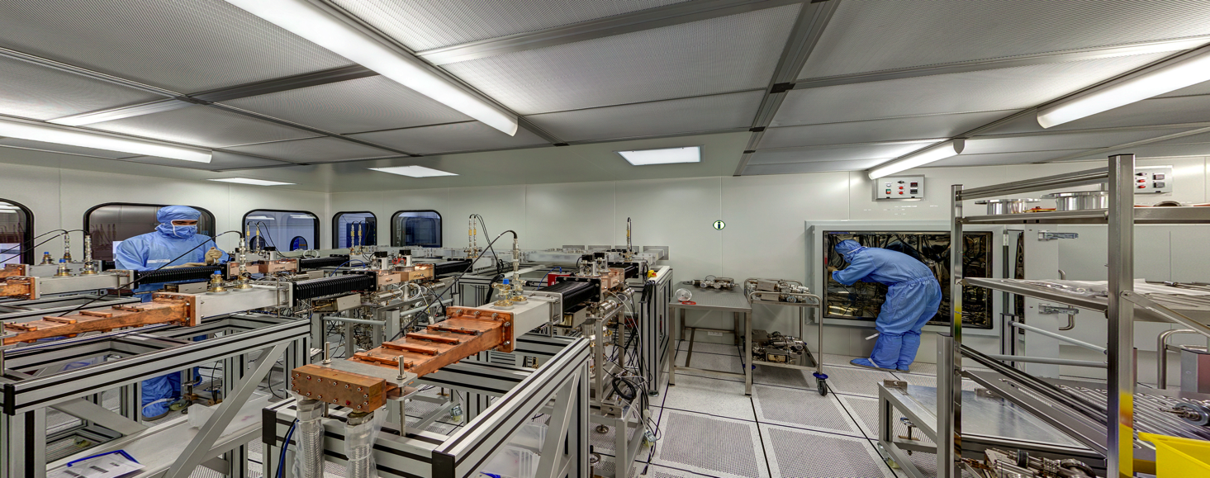
3
Recent SRF contributions – XFEL
IN2P3 In-Kind contribution to XFEL
Conditionning & delivery of 800+ RF couplers @1.3GHz
Close collaboration with CEA
First XFEL beam in 2017
Present related activities: expertise for LCLS2 couplers, R&D for ILC…
7

Slide 8
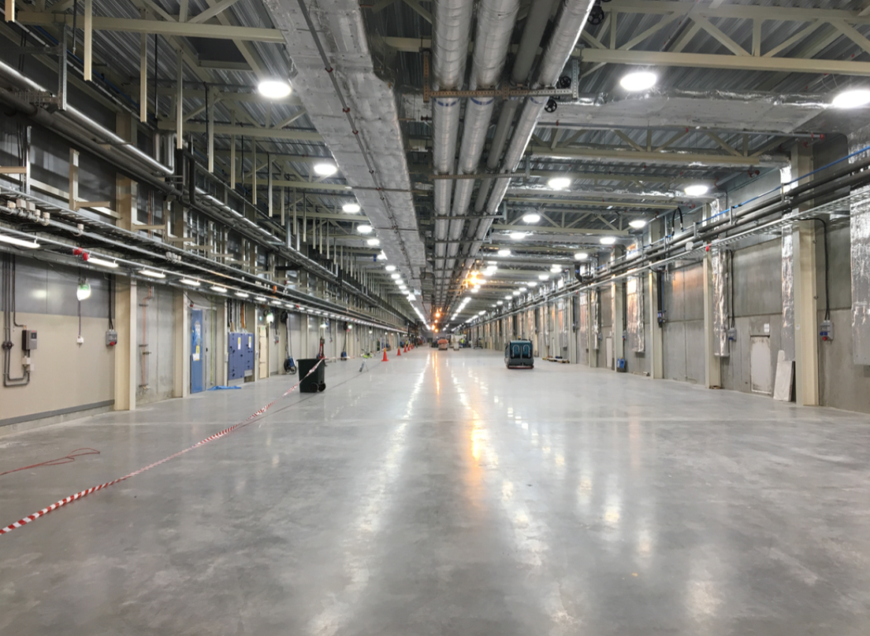
3
Present SRF contributions – ESS
European Spallation Source
5MW 2 GeV proton SRF linac
Construction has started
First beam planned in 2020
8

Slide 9
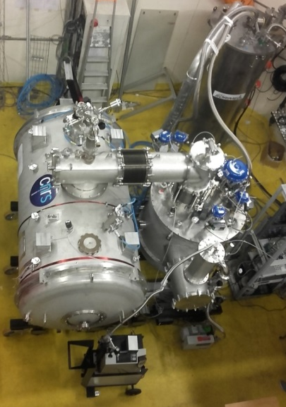
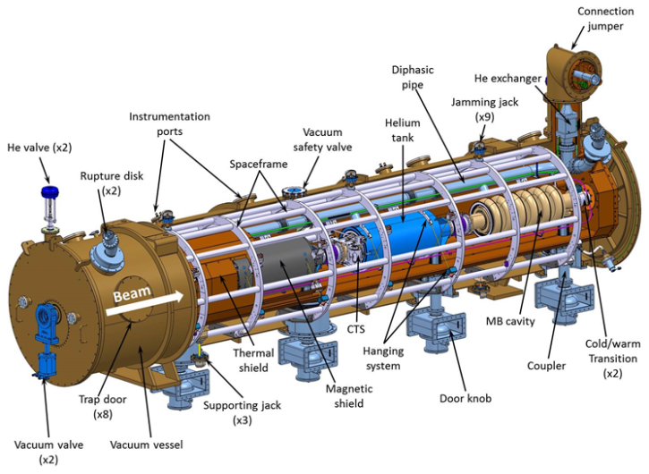
3
Present SRF contributions – ESS
IN2P3 In-Kind contribution to ESS
13 spoke cryomodules 352MHz (26 cavities) and associated valve boxes
Cryogenic control & command for full SRF linac
Design of the medium and high beta elliptical cryomodules together with CEA
9

Slide 10
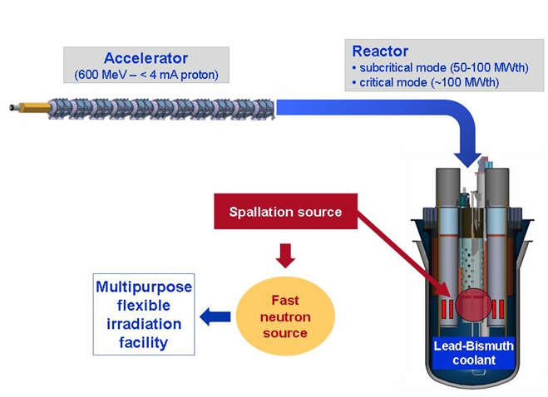
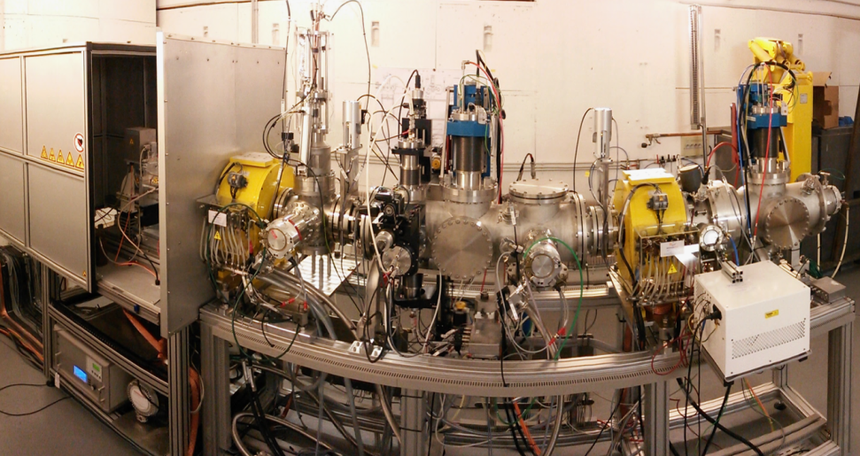
Present SRF contributions – MYRRHA
3
Multipurpose hYbrid Research Reactor for High-tech Applications (SCK*CEN, Mol, Belgium)
Demonstration of the ADS concept at high power
2.4MW, 600MeV SRF CW linac
Main issue = reliability
10

Slide 11
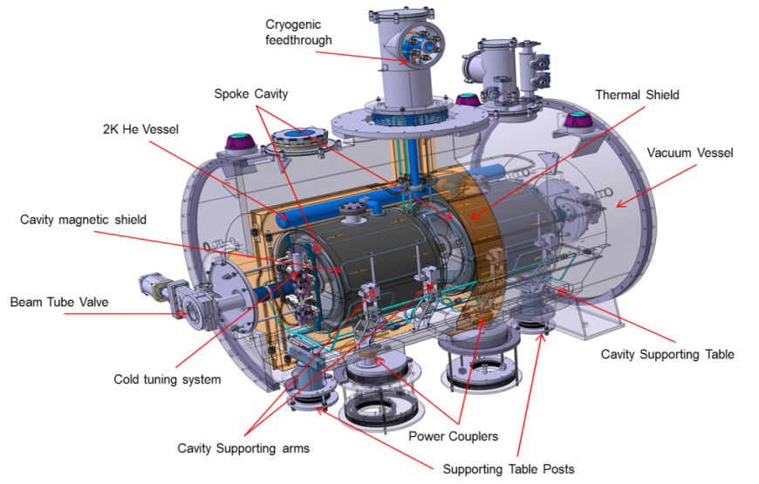
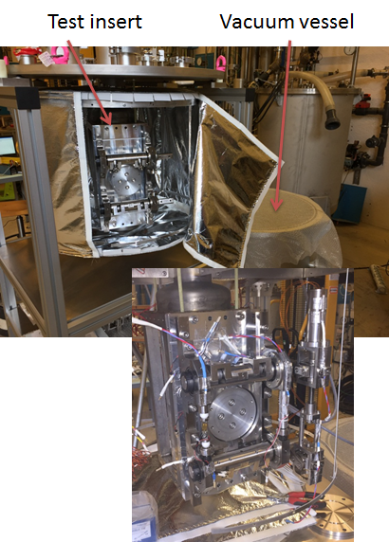
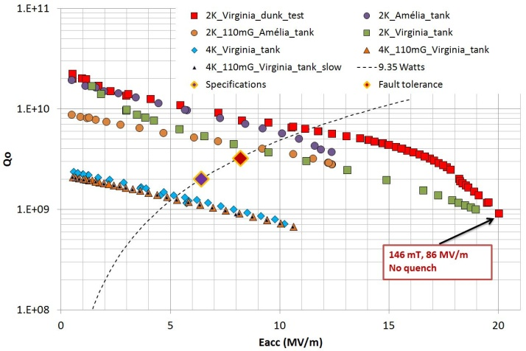
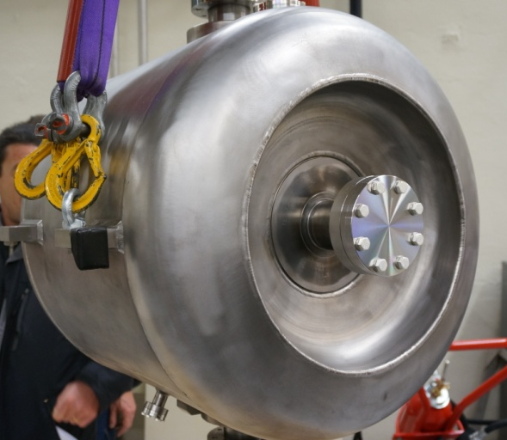
Present SRF contributions – MYRRHA
3
IN2P3 SRF R&D contribution to MYRRHA
SRF linac design
R&D on spoke cryomodule (beta 0.4, 352MHz) incl. Cavities & Couplers
R&D on innovative fault-tolerant systems incl. Cold Tuning System & LLRF developments
11

Slide 12
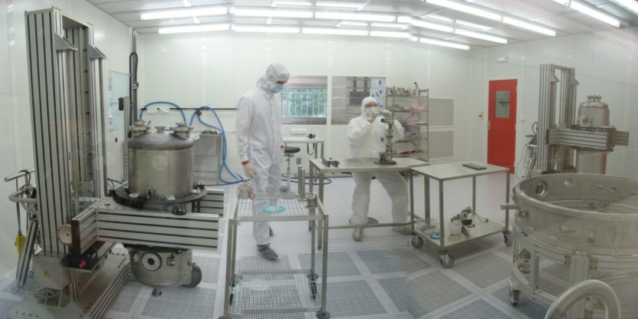
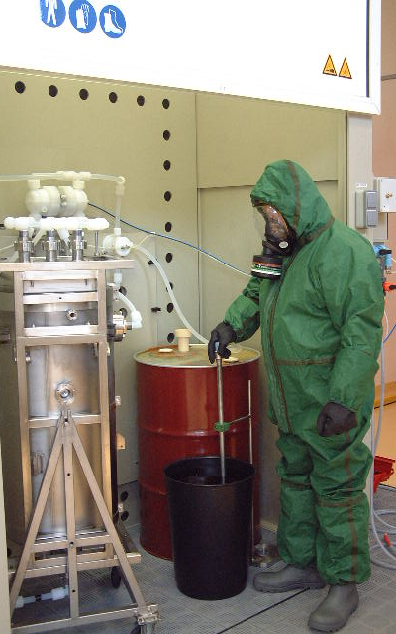
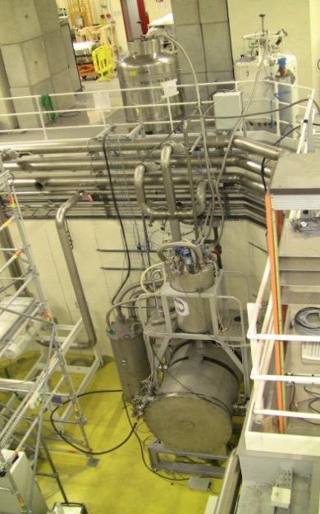
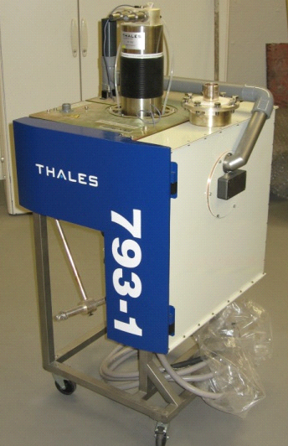
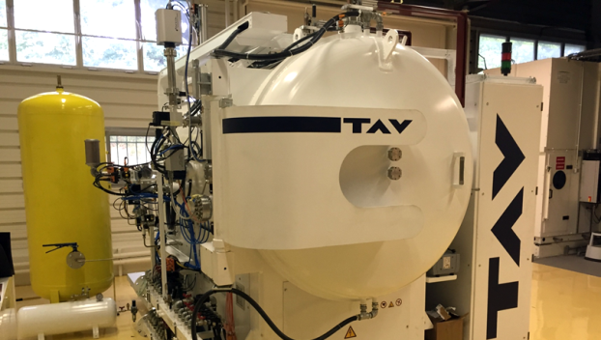
SUPRATECH SRF platform
3
SUPRATECH platform (Orsay)
85m2 ISO4 clean room
Surface treatment lab
Helium liquifier (70l/h) & 2K pumping
1400°C heat treatement station
Cryogenic test halls (several cyostats) & temperature sensor calibration station
Material characterization platform
Power couplers lab incl. 70m2 ISO5 clean room
RF power systems (e.g. 80kW 700 MHz IOT, 2.8MW 350MHz & 5MW 1.3 GHz klystrons)
12

Slide 13
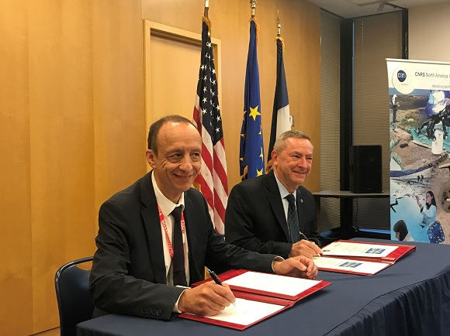
View from IN2P3 on a possible commitment in PIP-II
3
LBNF-DUNE is of major scientific interest for CNRS/IN2P3
about 30 neutrino physicists & engineers presently involved in our labs, and growing
new CRADA signed with Fermilab last October 26th
This interest naturally extends to a possible participation to the construction of PIP-II, that aligns perfectly well with IN2P3 experience on SRF technologies (SPIRAL2, XFEL, ESS, MYRRHA…)
13

Slide 14
View from IN2P3 on a possible commitment in PIP-II
3
Preliminary discussions have been initiated since October 2017 between Fermilab and IN2P3 on potential contributions. Two areas of interest identified:
Preferably: SSR2 cavities & ancillary components
Eventually: couplers for LB650 (together with CEA & INFN)
Our available resources are presently limited for the next 2 years (ESS in production phase in particular) but…
…IN2P3 is definitively interested to get involved in PIP-II development
Initial involvement (next 2 years) could include participation in targeted R&D areas tbd (R&D program + prototyping of SSR2 components)
In parallel, work toward defining, jointly with CEA, a possible FR In-Kind participation to be discussed at the French ministry level
14

Slide 15
Institut National de Physique Nucléaire et de Physique des Particules
THANK YOU FOR YOUR ATTENTION!
jlbiarrotte@admin.in2p3.fr
JL Biarrotte, DOE project review of PIP-II CD1, 12/12/2017

