Slide 1
Muon Campus Status
Brian Drendel
Weekly Status
April 6, 2018

Slide 2
Beam to g-2 this week

Slide 3
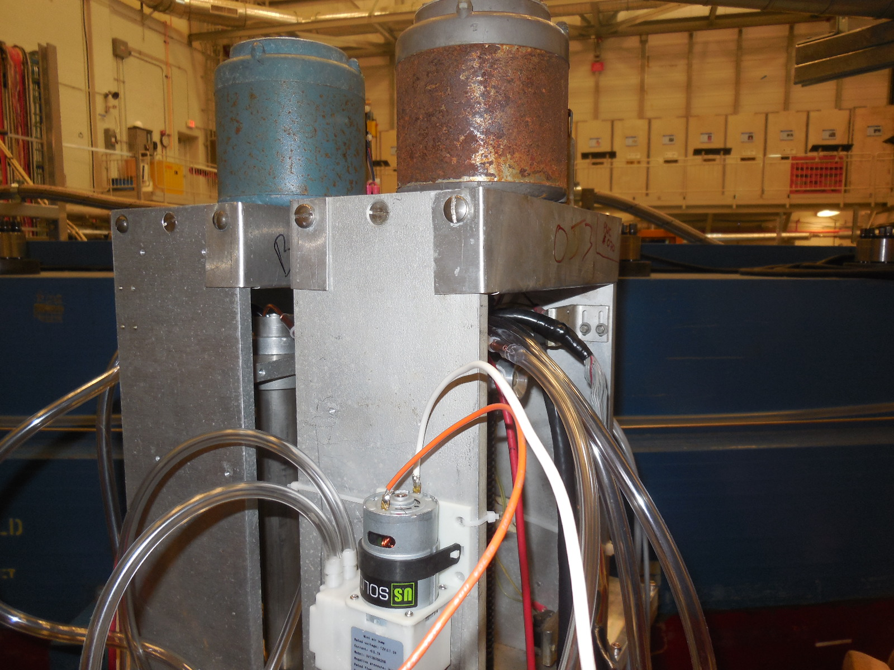
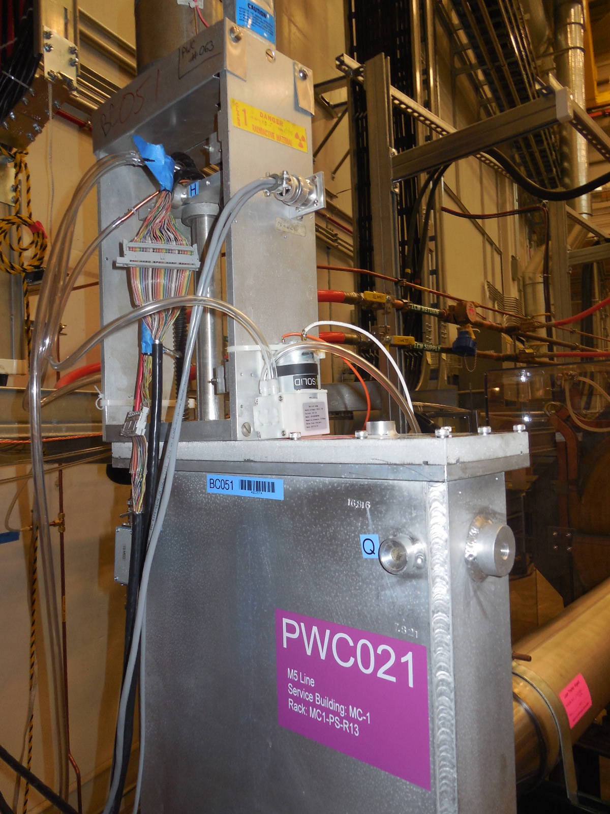
This week
Second full week of running full repetition rate resulted in fairly steady running.
Ion chambers upgraded to faster digitizers
We have improved proton on target readback with new controls devices that use M:Tor107 and trigger off the TCLK $82
  D:G2POT[0:16]
  D:POTAVE
  D:POTMIN
  D:POTHR
  D:POTDAY
Added purge pumps to discharge line on PWCs and Ion chambers
Thursday maintenance (next slide)

Slide 4
Thursday Shutdown Work
MC-1 Hall:
  Chipmunks (White): The chipmunk at the center of the ring was changed out, but the one above the quads was not. A scissors jack will be moved over to allow this chipmunk to be changed out during the next access period.
  PWC/IC purge pumps (Vander/Budlong): Purge pumps and timers were installed on PWC021 and PWC025/IC025. They will purge for 15 minutes every hour. Air samples were taken of the purged air from the antivacuum chamber. It should be noted that a vacuum spike occurred when moving a ladder in the vicinity of the beam pipe, but it started pumping down immediataly.
AP0:
  Target Air Blower Maintenance (Ford)
  Old target module was moved out of the alcove (Ford). Ralph Ford will further document this work in the Target Station Web.
  Li Lens and PMAG resistor change (Quinn): Installed voltage dividers in Lens & PMAG power supplies for maintaining pulse cap banks 'topped off' during long idle periods. This modification is expected to prevent the charging choke over-current trips occurring on first pulse when g-2 events are returned to the timeline.
Power Supply Work
  D:QA04 firing module swap (Wisner)
Motion Control
  AP30 PLC firmware (Peterson): The AP30 Motion Control PLC firmware was successfully updated this morning for both units. Motion with both systems was verified.
Chipmunks:
  Chipmunk outside the M4 gate was changed out (White)
  Two chipmunks at AP30 were changed out (White)
M4 Vacuum investigation
  M4 vacuum valves were closed during the downtime so experts could examine the borderline vacuum.

Slide 5
Upcoming Studies
  Momentum collimation studies (Morgan, Froemming) – 5 to 6 hours - need a healthy ring and DAQ.
    Study involves selecting different momentum slices of beam with the DR momentum scrapers and determine the momentum distribution of the injected muon beam into the g-2 storage ring. Also measure the dispersion in the M4/M5 line. See the above link for the complete study plan.
  M2/M3 Optics Work (Romanov) - Next round TBD.
    This is destructive to the beam, so we will try to plan around experimental downtime.
  AP0 abort SEMs (Drendel, Morgan) –
    Initial timing work will take a half shift and will not impact g-2 operations. Septa changes/moves would take a couple hours and be disruptive to g-2. This work could be done when the experiment is not taking beam.
  Ap0 chipmunk measurements (Drendel): Transparent to operatiosn
    Data is being be collected with a set of temporary chipmunks in various configurations. At this time, this work is completely transparent to operations.
  Delivery Ring Tune Measurement work (Scarpine). Requires 8 GeV operations.
  Dispersion in RR-Target (Nagaslaev, Adamson). Destructive study. 2-4 hours
    Primary 8GeV transport beam line RR-Target. We need to establish a procedure for the dispersion measurement in this line. We will have to do transfers in a slow manner, kind of 20 sec between transfers and run the waterfall display in the RR for each transfer. We will also modify the RF frequency in RR so that the beam will be slightly off momentum. This change doesn't necessarily impact the yield on the target, but may result in increased beam losses, while tuning. This study is opportunistic. Time estimate is 2-4 hours. Will impact the beam delivery to g-2, so needs to be aligned with their planning.

