Slide 1
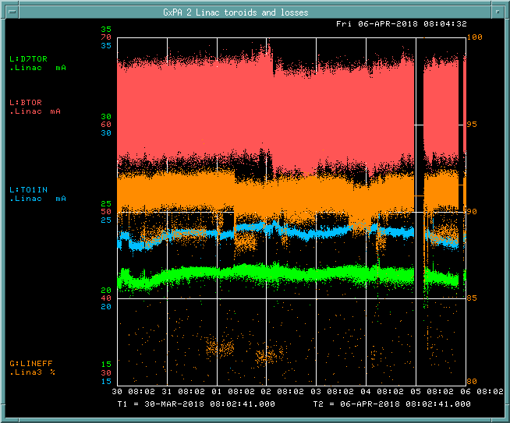
Preacc/LINAC Weekly Performance (Mar. 30 – April 6, 2018)
BTOR: 61.7mA
TO1IN: 22.2 mA
D7TOR: 20.0 mA
LINAC efficiency:
90.9%

Slide 2
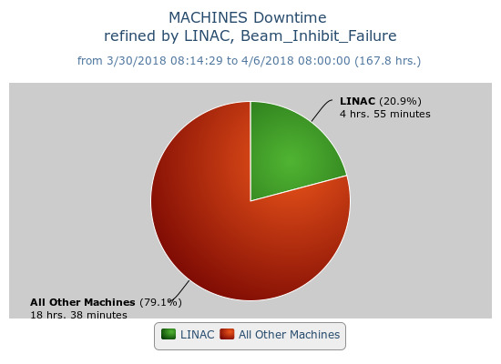
Beam inhibit downtime (4hr 55min)
Shutdown (04/05/18)
LRF2 12 Max cells replacement LRF4 7835, 3 switch tubes and filament hose replacement. PLC code update for LRF1-4 Marx code update for LRF 1-3
Issues
Marx cell#47 in LRF2 was replaced (04/06/18)

