Slide 1
Machine status
Ming-Jen Yang
9:00am Meeting,
April 06, 2018

Slide 2
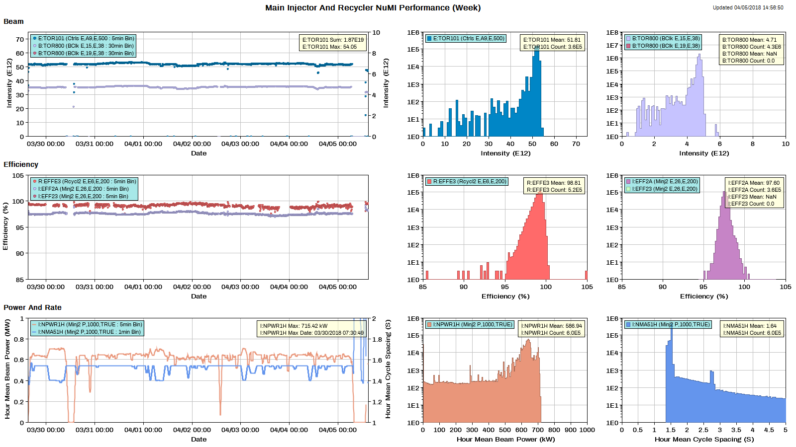
NuMI

Slide 3
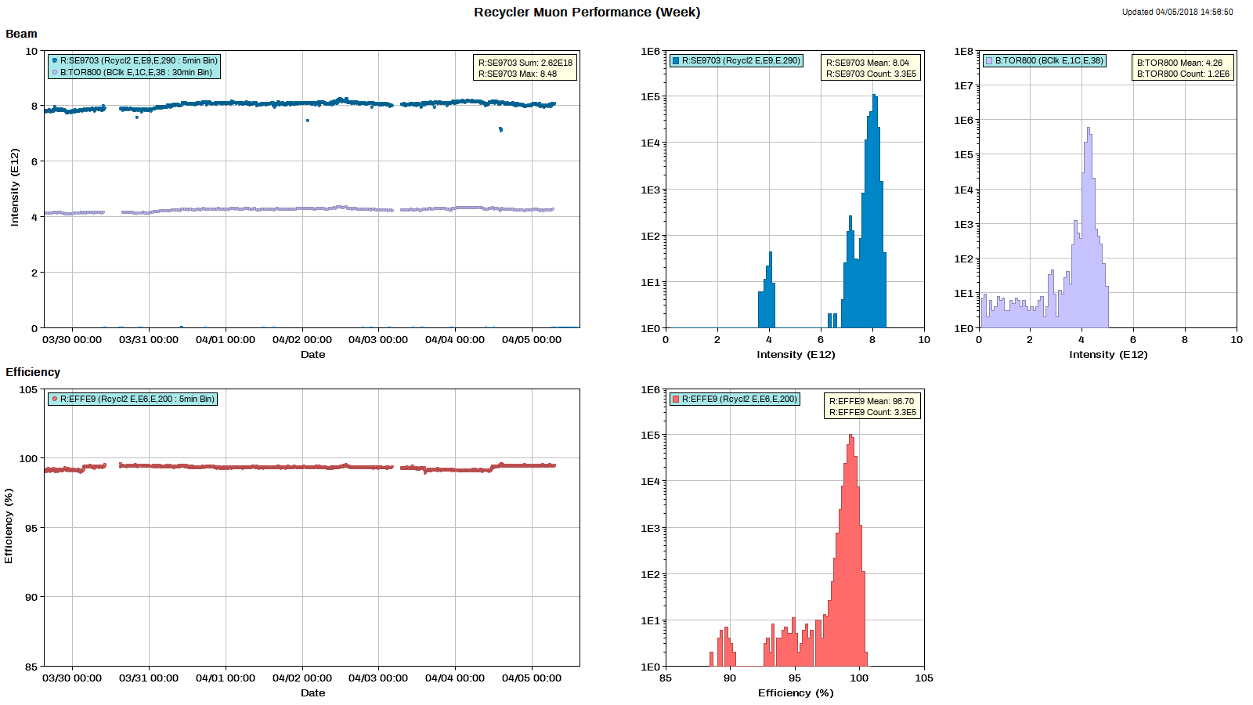
Muon

Slide 4
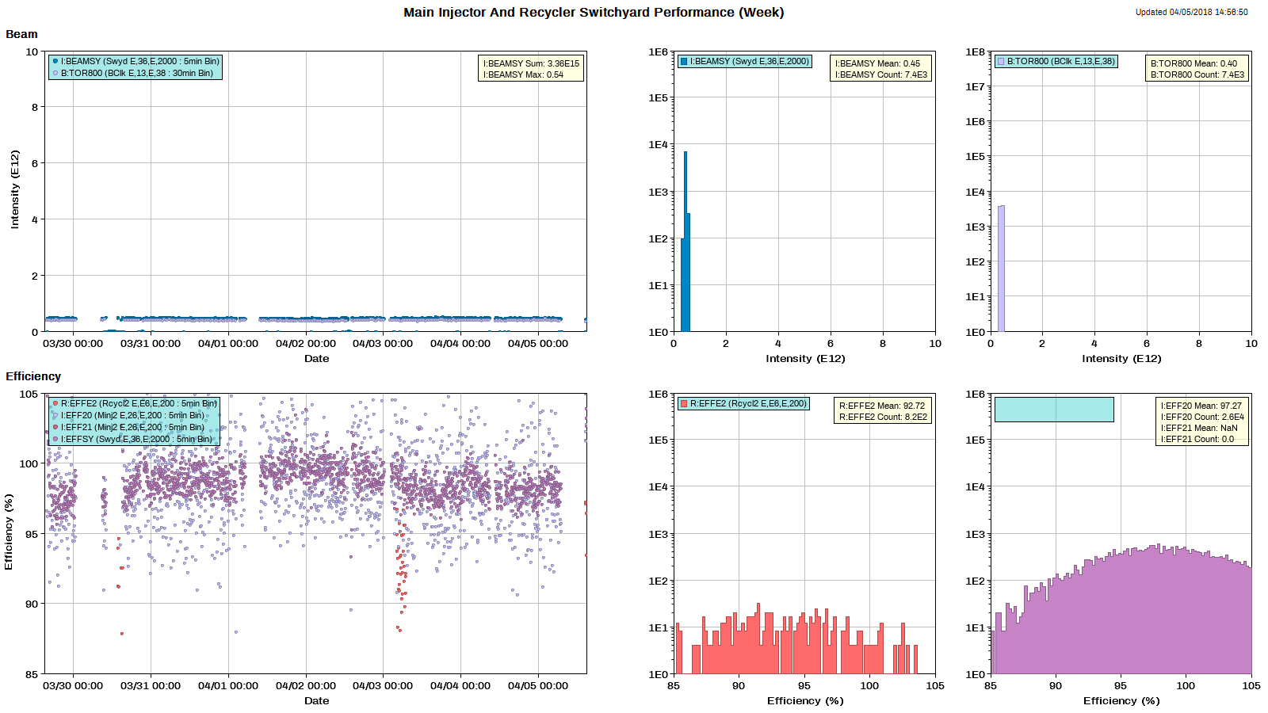
SY

Slide 5
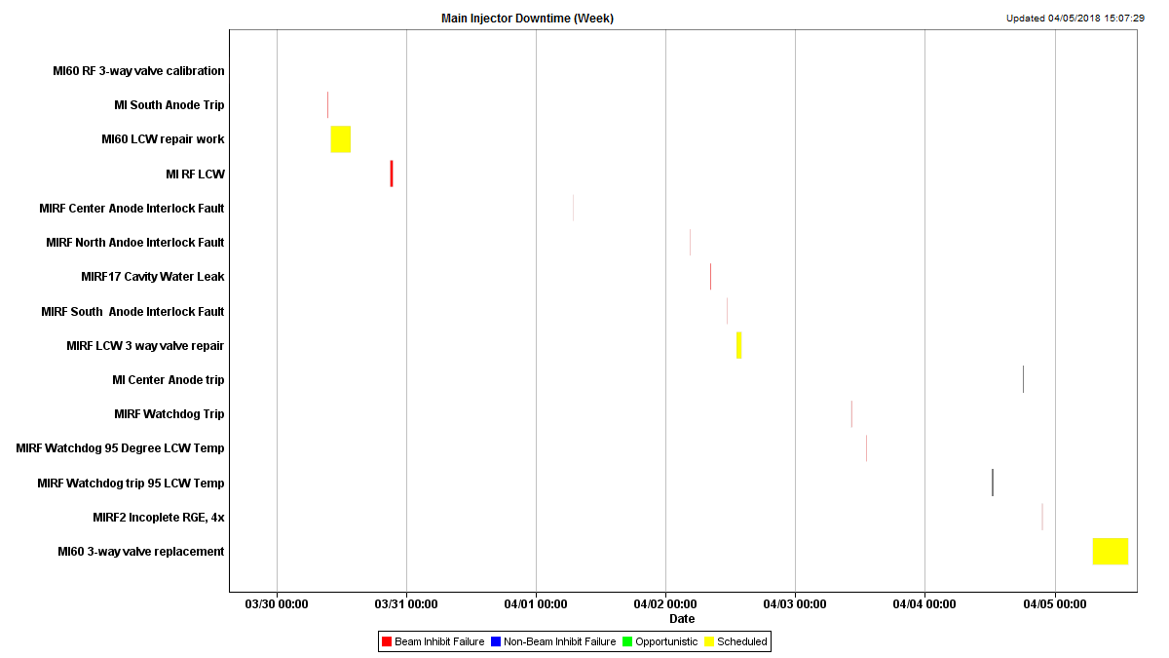
MI downtime

Slide 6
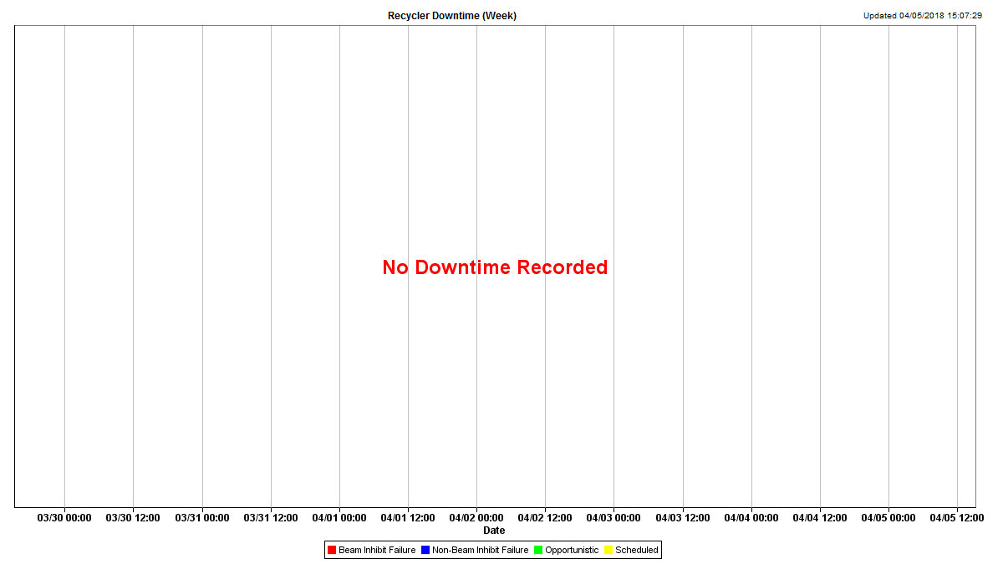
RR Downtime

Slide 7
Thursday's access
Work on the 3-way mixing valve problem
Inspect and fill MI40 abort water tank
Inspect possible RR sextupole position offset
630: found loose BPM cable.
113: did not find any obvious problem.

Slide 8
Studies
Past studies
Sextupole scan
Fast ramp studies
MI8 line collimator study
Study requests
1.2 sec fast ramp.
MI lattice measurement
8-GeV.
RR TBT study.

