Slide 1
Accelerator Status Report
Wednesday - Friday 4/6/2018

Slide 2
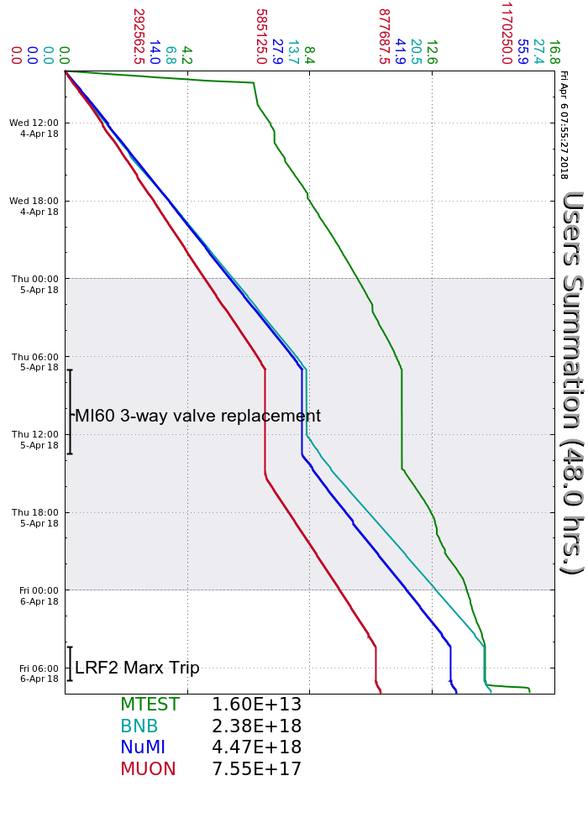
Wednesday quiet
Thursday
Access Thursday!
NuMI beam earlier than advertised
startup
MI20 LCW 3-way valve still a problem
MIRF07
Friday
LRF2 Marx trip.
Some stability issues (RR), tuning, etc.
Your Shift Plot
could be here!
Ask me how!
Friday Update

