Slide 1
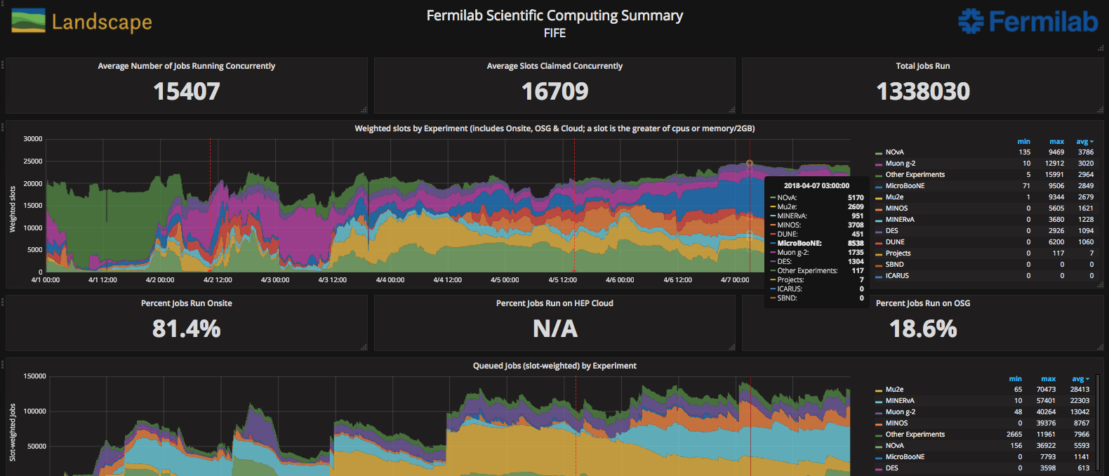
FIFE Operations (combined offsite and onsite)
Computing security scans shut down dcache for 5 hours yesterday

Slide 2
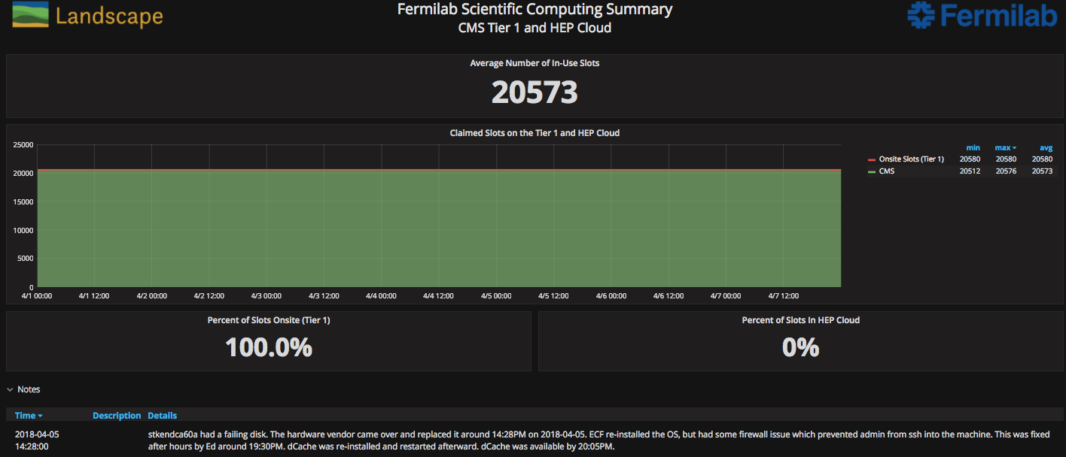
CMS Operations

Slide 3
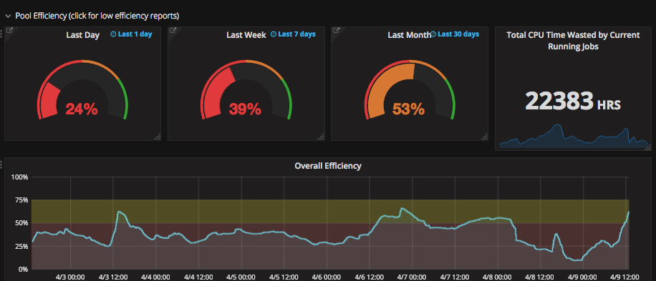
Overall efficiency

