Slide 1
72 Hour Weekend Summary
Donovan Tooke
Monday 09:00 Meeting
April 9, 2018

Slide 2
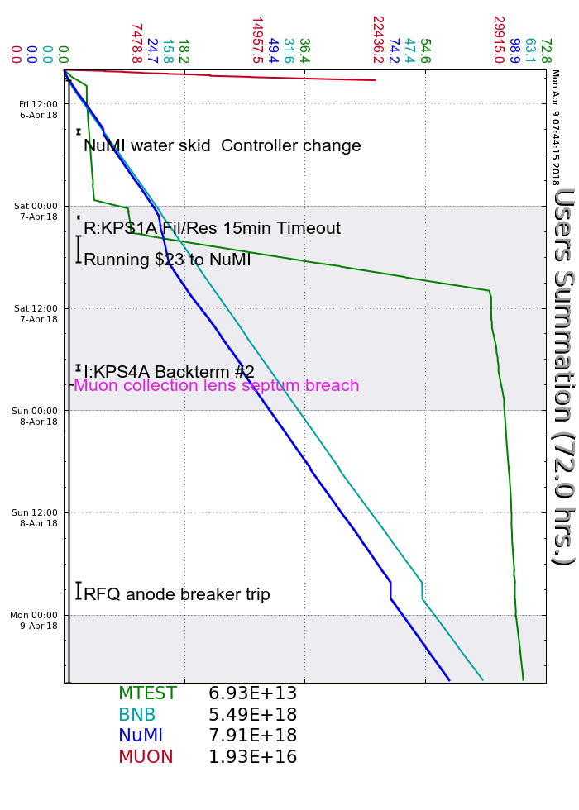
Friday
MI20 LCW regulation issues
Muon Lithium Lens septum breach
NuMI K6COOL skid PID controller changed
Saturday
KRF3 reflected power
R:KPS1A burnt connector (MI only beam)
1.5 hr lower L:D7TOR (RFQ, hi-bay temp?)
MI permit I:V001, MI correctors alarmed
I:KPS4A pre/fail to fire (backterm 2) 30 mins
Sunday
Multiple R:KPS1A thy trg PS faults
Trigger board replaced
RFQ Anode cap fuse and connector replaced

Slide 3
Current Conditions
Beam to NuMI
673.8 kWatts
51.8 E12
Beam to BNB
8.07 E16 p/hr
5 Hz
Beam to MTest
Muon Lithium Lens Investigation

