Slide 1
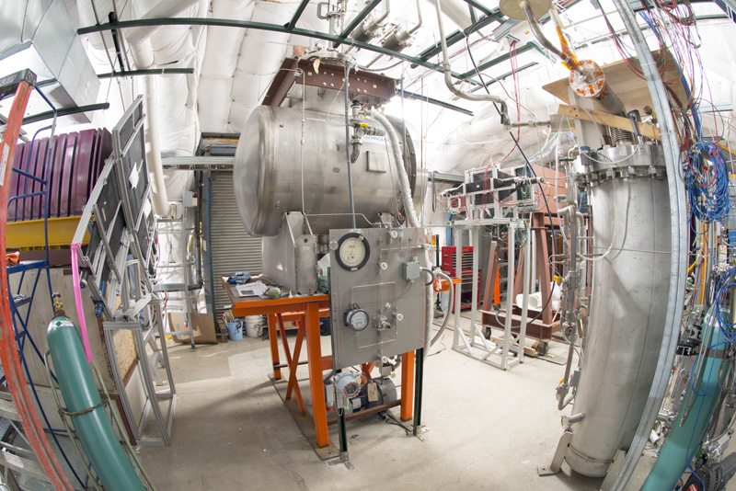
LArG4 refactoring status
Hans Wenzel
10th April 2018

Slide 2
Outline
Requirements
What does LArG4 do?
How to refactor it status thereof/ how to access artg4tk
Selection of physics list, processes etc. fcl parameters
artg4tk how to run it.
How to define a detector in gdml.
Some results

Slide 3
Requirements
Separate Simulation from digitization and detector response
Simulation:
completely depend on tools provided by Geant4 and use the provided interfaces (or work with the Geant4 collaboration to make them available), make sure that they are efficient with regards to CPU and memory (profiling).
Have access to all physics lists and physics constructors and processes provided by GEANT4
Be able to describe complete detector systems → liquid Argon TPC is just one possible sensitive Detector.
Read out optical Scintillation photons from the liquid Argon surrounding the TPC.
digitization and detector response:
Ability to plug in models handling the correlations between ionization and Scintillation (e.g. Nest)
Ability to switch drift model.

Slide 4
LArG4_module
GEANT4
Electron Drift
to Wire
AUX
detectors
Photodet.
(LUT)
Particle in Vol. Filter
AUXDet
SimChannel
SimLite
Photon
MCTruth
MCParticle
SimChannel
Simulation
digitization and detector response
Monolithic hard to work with
Mixes digitization and detector response with simulation
Takes routines out of Geant4 and modifies them instead of using standard interfaces
Physics processes incomplete, stuck with restrictions that existed at the time...
Binds processes to specific material/volume
Read out photons only in TPC volume
...

Slide 5
Refactored
Gun
GEANT4
SimDriftElectrons
Module
(Bill Seligman)
SimChannel
Particle in Vol. Filter
SimEnergyDepositHit
TrackerHit
Photodet.
(LUT) Mod.
SimLite
Photon
PhotonHit
CalorimeterHit
...
AUX
Detectors Mod.
AUXDet
SimChannel
MCTruth
MCParticle
Separate modules
for digitization and
detector response
Simulation, artg4tk
feature/seligman_DriftIonizationElectrons routine larsim/DetSim/SimDriftElectrons_module.cc
https://cdcvs.fnal.gov/redmine/projects/artg4tk
https://cdcvs.fnal.gov/redmine/projects/g4mps/wiki/Phase2_App_01052016#Download-and-install-external-tools-and-build-artg4tk-on-a-generic-node

Slide 6
Physics
Use the new physics list factory:
Available via nusoft
Access to all reference physics list
Extendable to add all the available geant4 physics constructors e.g we use (parameters controlled via fcl ):
Optical physics
Steplimiter for charged particles in active TPC volume.
Time limiter for neutrons.
More precise em physics can be selected.

Slide 7
Configure the Physics in the fcl file
DetectorHolder: {}
ActionHolder: {}
RandomNumberGenerator: {}
PhysicsListHolder: {}
PhysicsList: {
PhysicsListName: "FTFP_BERT"
DumpList: false
enableCerenkov: false
enableScintillation: true
ScintillationByParticleType: false
enableAbsorption: false
enableRayleigh: false
enableMieHG: false
enableBoundary: false
enableWLS: false
}
// Detector(s) for the simulation
GDMLDetector :
{
category: "world"
gdmlFileName_ : "lArDet.gdml"
}

Slide 8
Physics constructor
artg4tk::PhysicsListService::PhysicsListService(fhicl::ParameterSet const & p, art::ActivityRegistry &) :
PhysicsListName_( p.get<std::string>("PhysicsListName","FTFP_BERT")),
DumpList_( p.get<bool>("DumpList",true)),
enableNeutronLimit_(p.get<bool>("enableNeutronLimit",true)),
NeutronTimeLimit_(p.get<double>("NeutronTimeLimit",10.*microsecond)),
NeutronKinELimit_(p.get<double>("NeutronKinELimit",0.0)),
enableStepLimit_(p.get<bool>("enableStepLimit",true)),
enableOptical_(p.get<bool>("enableOptical",true)),
enableCerenkov_( p.get<bool>("enableCerenkov",false)),
CerenkovStackPhotons_( p.get<bool>("CerenkovStackPhotons",false)),
CerenkovMaxNumPhotons_(p.get<int>(" CerenkovMaxNumPhotons",100)),
CerenkovMaxBetaChange_(p.get<double>("CerenkovMaxBetaChange",10.0)),
CerenkovTrackSecondariesFirst_( p.get<bool>("ScintillationTrackSecondariesFirst",false)),
enableScintillation_( p.get<bool>("enableScintillation",true)),
ScintillationStackPhotons_( p.get<bool>("ScintillationStackPhotons",false)),
ScintillationByParticleType_( p.get<bool>("ScintillationByParticleType",false)),
ScintillationTrackInfo_( p.get<bool>("ScintillationTrackInfo",false)),
ScintillationTrackSecondariesFirst_( p.get<bool>("ScintillationTrackSecondariesFirst",false)),
enableAbsorption_( p.get<bool>("enableAbsorption",false)),
enableRayleigh_( p.get<bool>("enableRayleigh",false)),
enableMieHG_( p.get<bool>("enableMieHG",false)),
enableBoundary_( p.get<bool>("enableBoundary",false)),
enableWLS_( p.get<bool>("enableWLS",false)),
BoundaryInvokeSD_( p.get<bool>("BoundaryInvokeSD",false)),
WLSProfile_( p.get<std::string>(" WLSProfile","delta"))
{}

Slide 9
G4VUserPhysicsList* artg4tk::PhysicsListService::makePhysicsList() {
g4alt::G4PhysListFactory factory;
// Access to registries and factories
//
G4PhysicsConstructorRegistry* g4pcr = G4PhysicsConstructorRegistry::Instance();
G4PhysListRegistry* g4plr = G4PhysListRegistry::Instance();
//
// the following should be unneccessary at some point:
//
g4plr->AddPhysicsExtension("OPTICAL", "G4OpticalPhysics");
g4plr->AddPhysicsExtension("STEPLIMIT", "G4StepLimiterPhysics");
g4plr->AddPhysicsExtension("NEUTRONLIMIT", "G4NeutronTrackingCut");
g4pcr->PrintAvailablePhysicsConstructors();
g4plr->PrintAvailablePhysLists();
G4VModularPhysicsList* phys = NULL;
G4String physName = PhysicsListName_;
if (enableOptical_) physName=physName+"+OPTICAL";
if (enableStepLimit_) physName=physName+"+STEPLIMIT";
if (enableNeutronLimit_) physName=physName+"+NEUTRONLIMIT";
std::cout << " Name of Physics list: "<< physName<<std::endl;
if (factory.IsReferencePhysList(physName)) {
phys = factory.GetReferencePhysList(physName);
}
std::cout << phys->GetPhysicsTableDirectory() << std::endl;
if (enableOptical_)
{
G4OpticalPhysics* opticalPhysics = (G4OpticalPhysics*) phys->GetPhysics("Optical");
opticalPhysics->Configure(kCerenkov, enableCerenkov_);
opticalPhysics->SetCerenkovStackPhotons(CerenkovStackPhotons_);
opticalPhysics->Configure(kScintillation, enableScintillation_);
opticalPhysics->SetScintillationStackPhotons(ScintillationStackPhotons_);
opticalPhysics->SetScintillationByParticleType(ScintillationByParticleType_);
opticalPhysics->SetScintillationTrackInfo(ScintillationTrackInfo_);
opticalPhysics->SetTrackSecondariesFirst(kCerenkov, true); // only relevant if we actually stack and trace the optical photons
opticalPhysics->SetTrackSecondariesFirst(kScintillation, true); // only relevant if we actually stack and trace the optical photons
opticalPhysics->SetMaxNumPhotonsPerStep(CerenkovMaxNumPhotons_);
opticalPhysics->SetMaxBetaChangePerStep( CerenkovMaxBetaChange_);
opticalPhysics->Configure(kAbsorption,enableAbsorption_);
opticalPhysics->Configure(kRayleigh,enableRayleigh_);
opticalPhysics->Configure(kMieHG,enableMieHG_);
opticalPhysics->Configure(kBoundary,enableBoundary_);
opticalPhysics->Configure(kWLS,enableWLS_);
}
if (enableNeutronLimit_)
{
G4NeutronTrackingCut * neutrcut = (G4NeutronTrackingCut*) phys->GetPhysics("neutronTrackingCut");
neutrcut->SetTimeLimit(NeutronTimeLimit_);
}
if (DumpList_)
{
phys->DumpList();
phys->DumpCutValuesTable();
}
return phys;
}
using artg4tk::PhysicsListService;

Slide 10
GDML(+ extensions): a complete description of detector configuration (at runtime)
Materials, volumes etc….
Assign step-limits to specific volumes.
Optical properties (bulk and surface)
Assignment of sensitive detectors of predefined type to logical volumes→ automatically trigger the creation and filling of the appropriate hit collections
Assignment of optical surfaces
Visualization attributes (color, solid,….)
Makes use of formulas and loops to keep gdml file compact
Homogeneous electric field (no electric field→ no separation of charge)

Slide 11
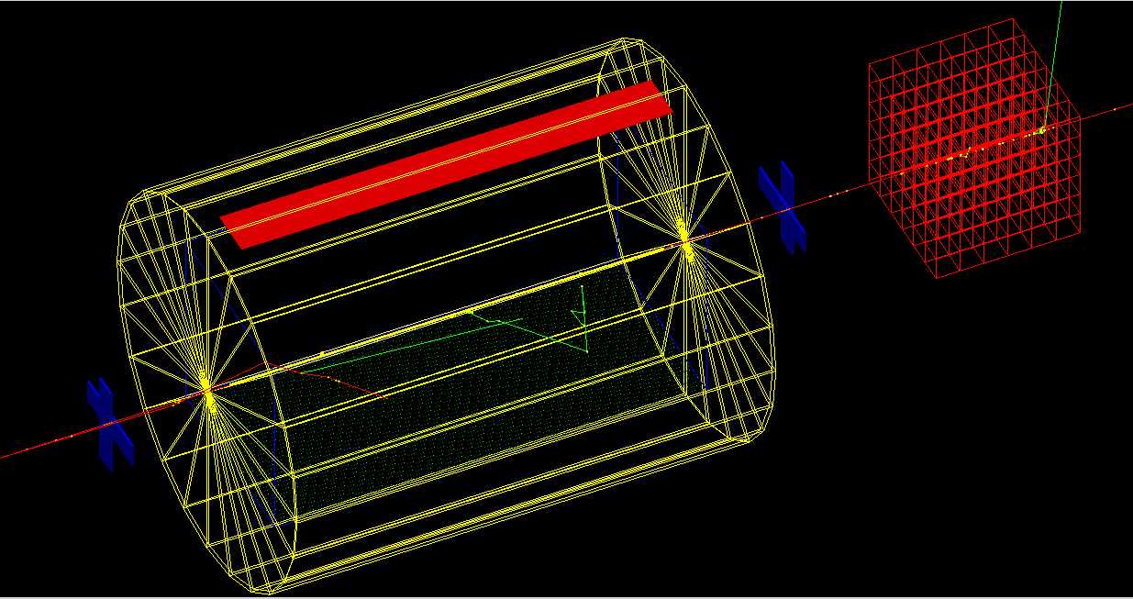
Example:
https://cdcvs.fnal.gov/redmine/projects/artg4tk/repository/revisions/develop/entry/gdml/lArDet.gdml
Tracker
PhotoDetector
Calorimeter
SimEnergyDeposit (TPC)
E-field → Sc. and Ionization
SimEnergyDeposit
(surrounding liquid Ar no E-Field → only Scintillation)
Tracker

Slide 12
Assigning Sensitive detector to a volume:
<volume name="volTPCActiveInner">
<materialref ref="LAr"/>
<solidref ref="TPCVolume"/>
<auxiliary auxtype="SensDet" auxvalue="SimEnergyDeposit"/>
<auxiliary auxtype="Color" auxvalue="Blue"/>
<auxiliary auxtype="StepLimit" auxvalue="0.01"/>
<auxiliary auxtype="Efield" auxvalue="1000."/>
<loop for="i" from="0" to="num" step="1">
<physvol name="psenseWireVolume">
<volumeref ref="SenseWire"/>
<position name="posijk" unit="mm" x="-200.0+(i+1)*5." y="-199.8" z="0"/>
</physvol>
</loop>
</volume>
<volume name="volPhotodetector">
<materialref ref="Silicon"/>
<solidref ref="PhotoBox"/>
<auxiliary auxtype="SensDet" auxvalue="PhotonDetector"/>
<auxiliary auxtype="Color" auxvalue="Red"/>
<auxiliary auxtype="Solid" auxvalue="True"/>
</volume>
<volume name="volArgon">
<materialref ref="LAr"/>
<solidref ref="ArgonVolume"/>
<auxiliary auxtype="SensDet" auxvalue="SimEnergyDeposit"/>
<auxiliary auxtype="Color" auxvalue="Yellow"/>
<physvol name="pCalorimeterVolume">
<volumeref ref="volTPCActiveInner"/>
<position name="Calpos" x="0" y="0" z="0"/>
</physvol>
<physvol name="pvolPhotodetector">
<volumeref ref="volPhotodetector"/>
<position name="photondetectorpos" unit="mm" x="0" y="391." z="0"/>
</physvol>
</volume>

Slide 13
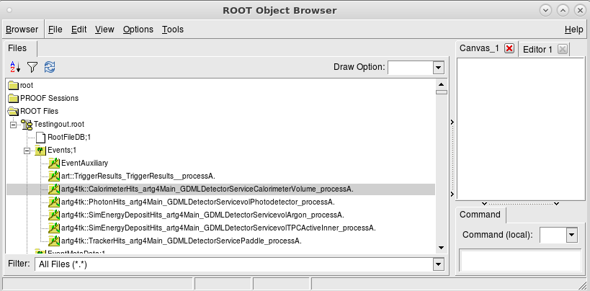
Running artg4tk and Resulting Hit Collections in the EDM
art -c lArDet.fcl

Slide 14
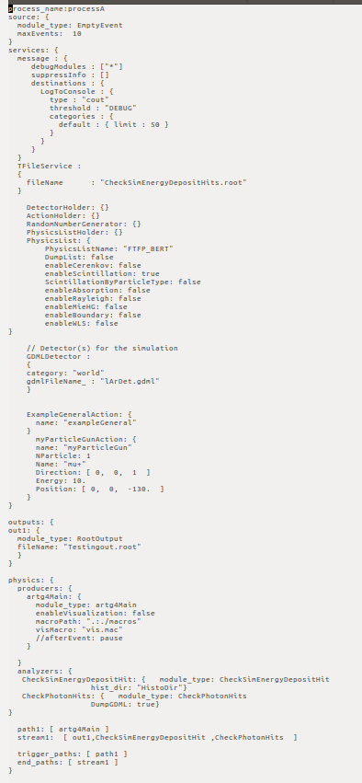

Slide 15
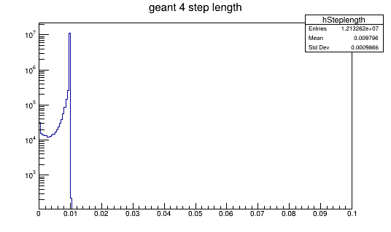
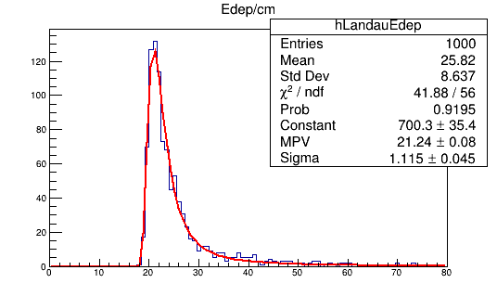
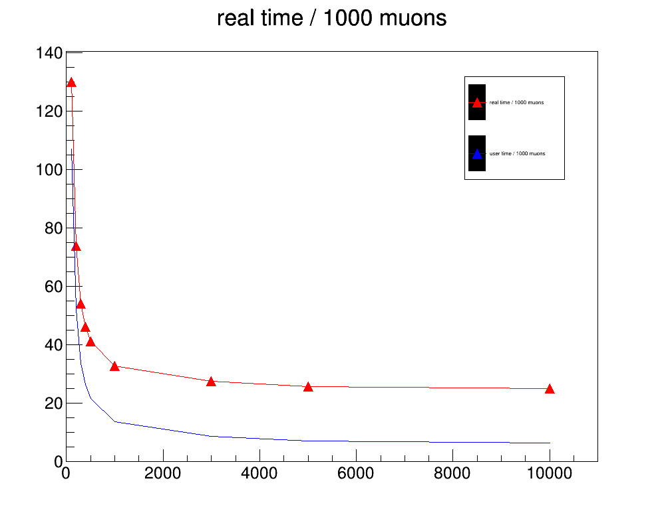
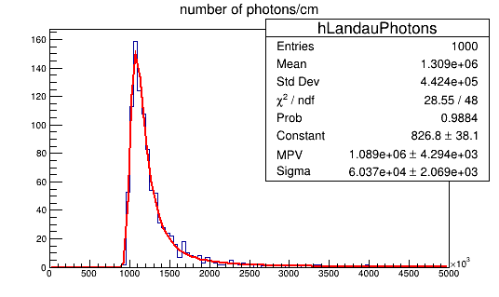
steplength

