Slide 1
Dan the Educator

Slide 2
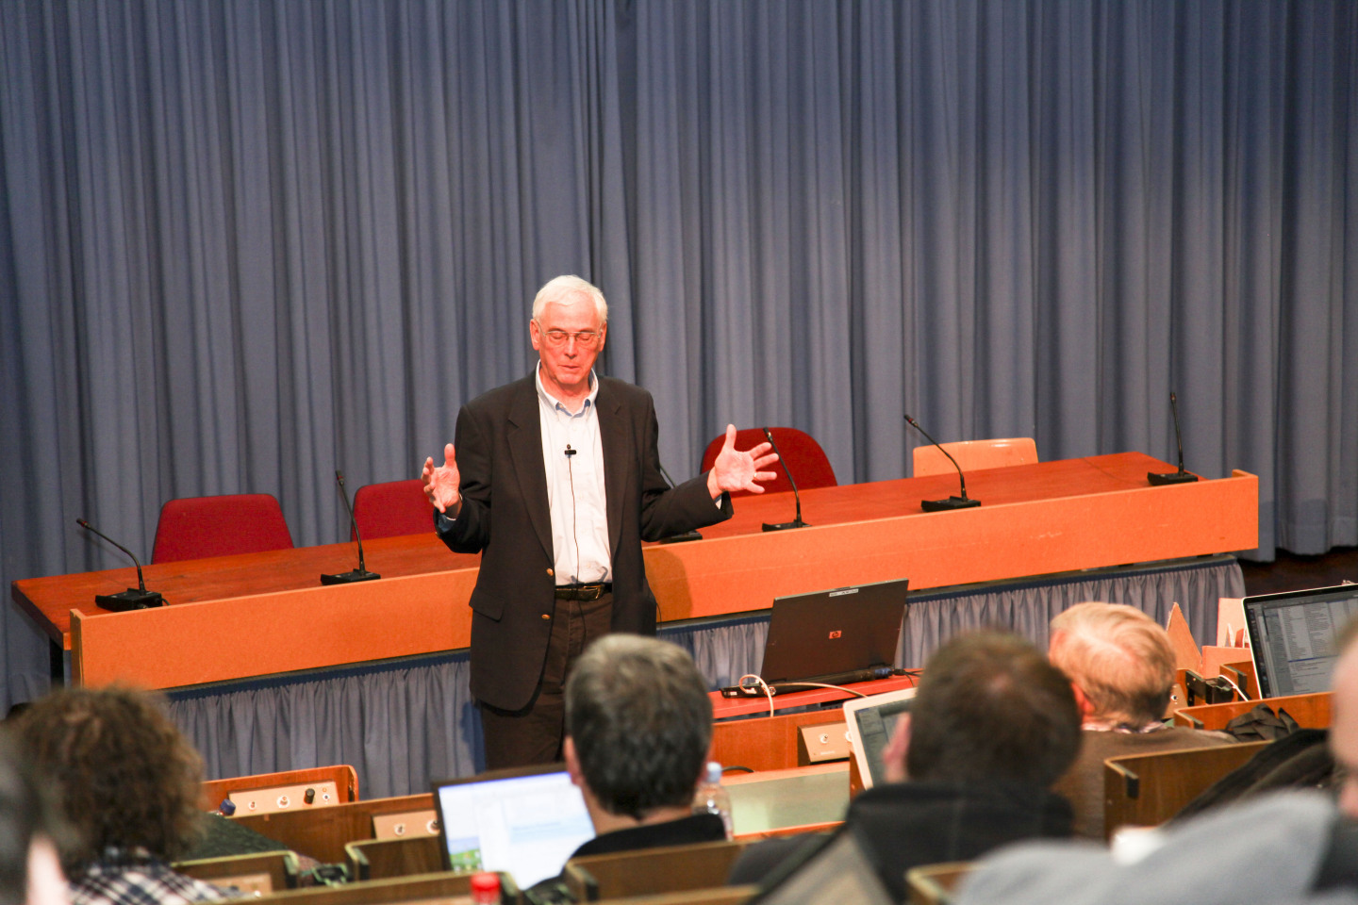

Slide 3
We all know Dan as the project manager and as the physicist but there is another part to his life kept in the background most of the time which is Dan the educator.
Remember that the education scientists and engineers is the most important ‘product’ that we deliver.
While we were all toiling away earning contingency, Dan was busy making Matlab scripts and thinking how to teach physics to the next generation.

Slide 4
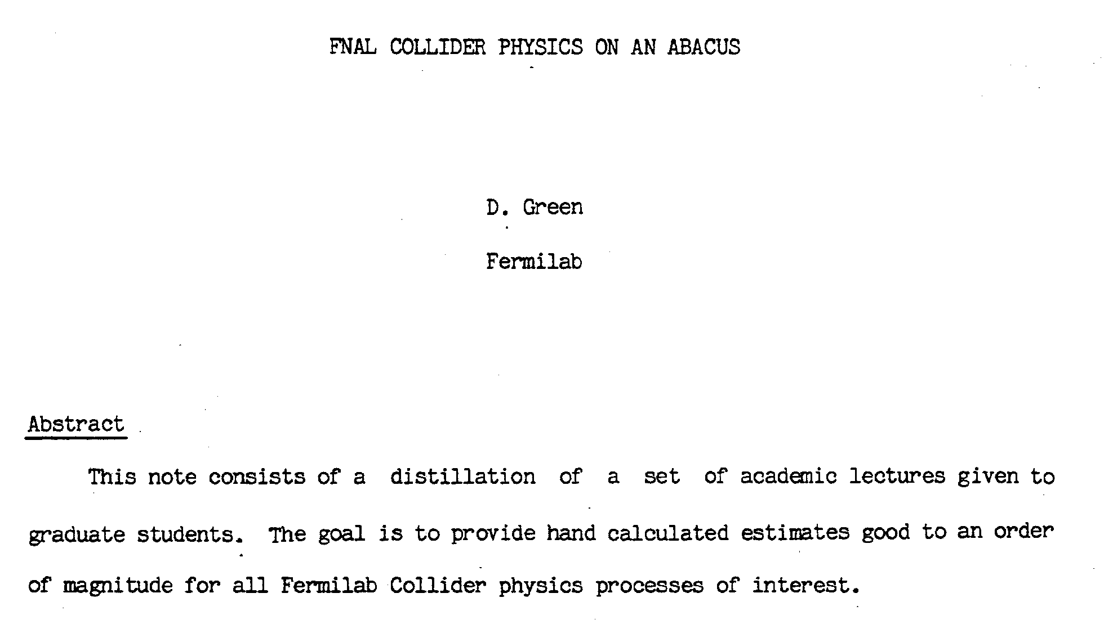
June 1986 Collider Physics on an Abacus

Slide 7
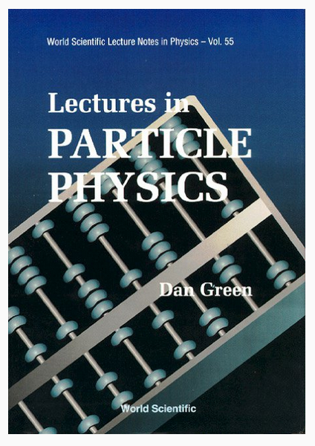

Slide 8
2000
Exercises:

Slide 9
2005
No more Abacus switched to COMHEP -
A nice tool for tree -level estimates.
Exercise from chapter 5: Explicitly evaluate the widths into gluon pars, b-pairs and photon pairs for 150 Gev Higgs.

Slide 10
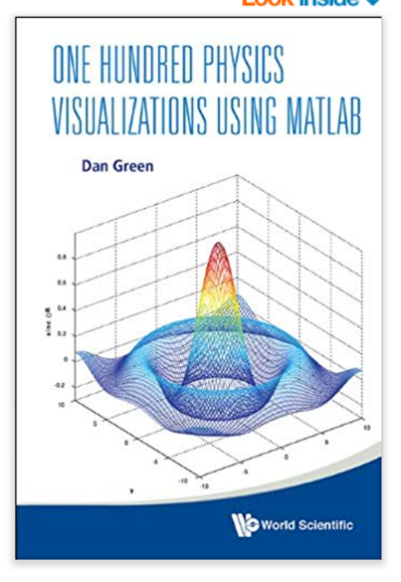
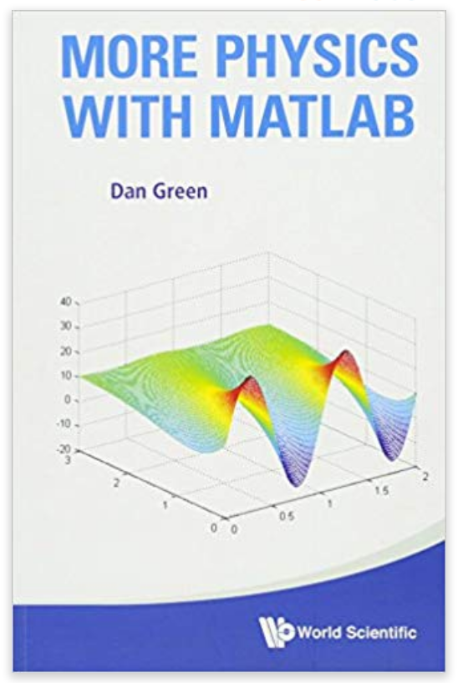
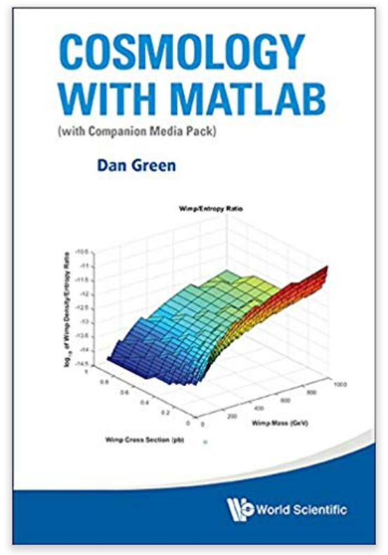
More Books
2013
2015
2016
2018
The aim of using these tools is to create intuition, not to solve a specific problem or to complete a specific number crunching exercise. Indeed, the aim of the text is not to teach physics but to give the user a sense of how the solutions of a given physics problem depend on the parameters of that problem and to show the connections between, say, wave optics and quantum mechanics.

Slide 11
From 100 Physics Visualizations

Slide 12
Maxwell Boltzmann Energy Distribution
Chemical Potential of Helium 4

Slide 13
Personal Note:
Educating me and many like me.

Slide 15
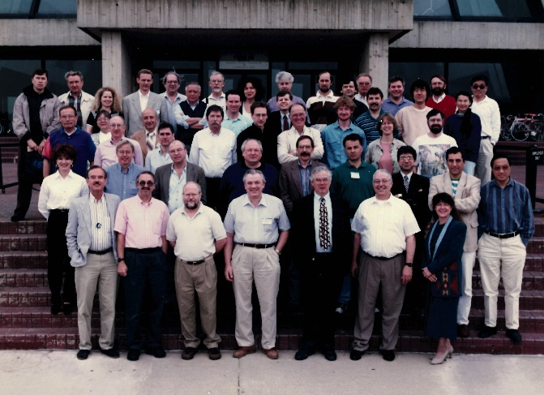
1998

Slide 17
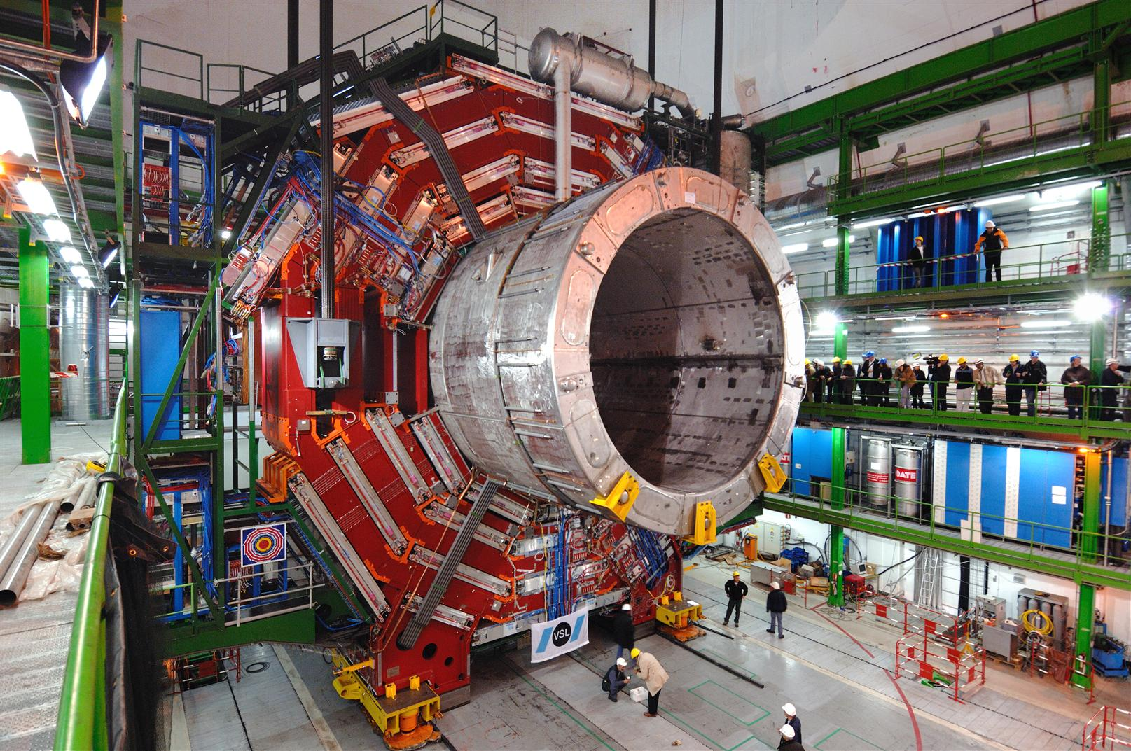

Slide 18
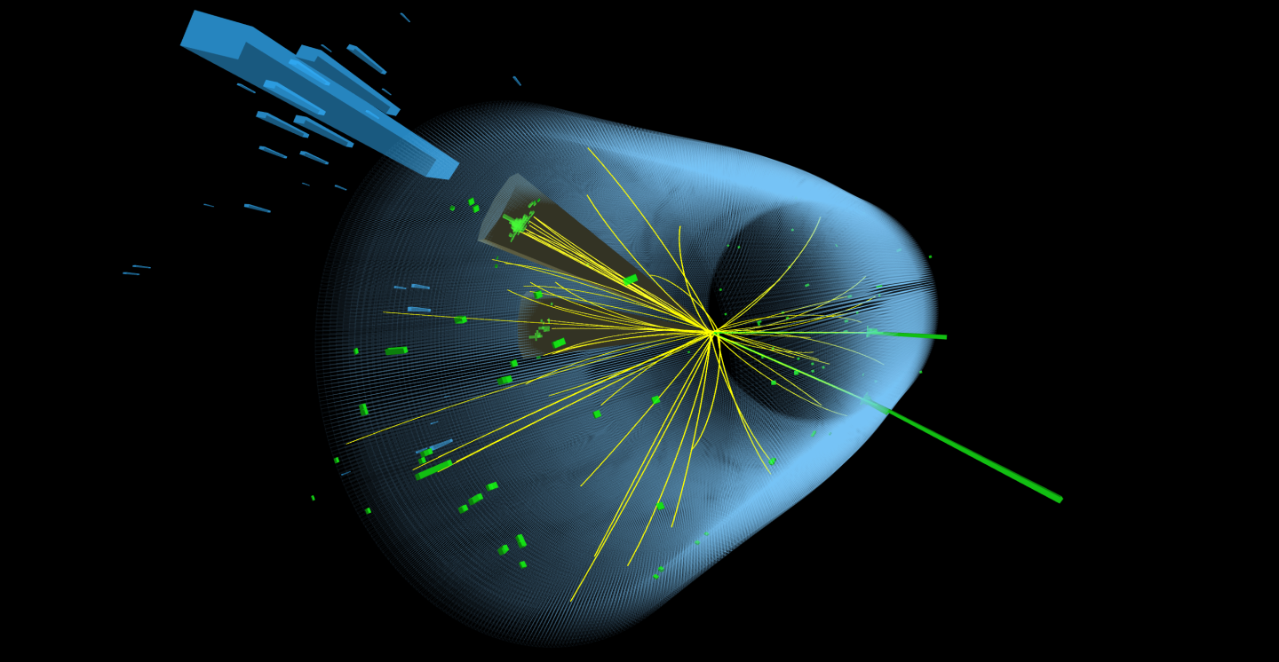

Slide 19
From the SSC days to now it has been a nice ride.
We have learnt a lot from you.
I am sure you will keep on educating us for a while yet.

