Slide 1
Physics at the ISR
Giorgio Bellettini
Dan Green Fest, October 19, 2018

Slide 2
Hadron physics in the 70`s
There was no fundamental theory describing high energy hadron interactions, only phenomenology.
Cosmic ray data seemed to indicate that secondary particles produced in hadron interactions were damped in Pt as suggested by thermodynamic models
The elastic and total cross sections of protons, kaons, and pions on protons seemed to approach constant values with increasing energy.

Slide 3
The first hadron collider
The ISR (1971-1982) have been the first hadron collider.
With 31 GeV top energy per beam, the ISR reached an equivalent lab. energy of 2,000 GeV for fixed target pp collisions.
The machine was a jewel. Beams could circulate for days.

Slide 4
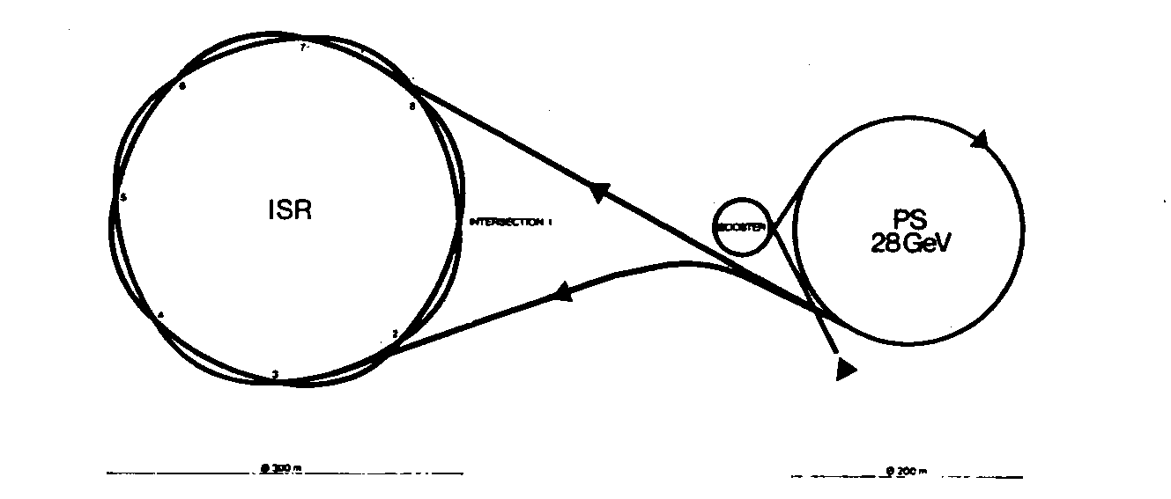
Two stored continuous beams
Eight interaction regions
150 m in diameter

Slide 5
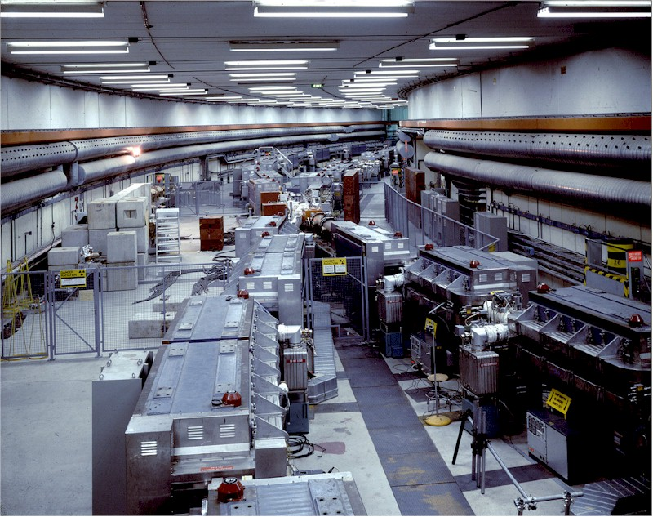
An ISR intersection

Slide 6
ISR parameters
Proton-Proton with beam energy from E=11.6 to E=31.3 GeV
Beams crossing at 15° on the horizontal plane
8 crossing points with c.m.s. radial velocity β_{cm}= sin7,5° = 0,265
20A/beam design current (4.10¹⁴ protons), 50A achieved
Beam width w ≅ 6 cm, height h ≅ 5 mm
Proton density in the beams ≅ 5.10⁸ p/cm³
Collision energy W = 2Ecos(α/2) ≈ 2E
Luminosity lifetime ≅ 70h
Design p-p luminosity 4.10³⁰ cm⁻² s⁻¹, 5.10³¹ cm⁻² s⁻¹ achieved
Run also as pbar-p (L = 2.10²⁸ cm⁻²s⁻¹), p-d, d-d (4,3.10³⁰), αα.
==============================================
W.Schnell, The CERN Intersecting Storage Rings, ISR-RF/68-29
K.Hubner, ISR Performance for Pedestrians, CERN 77-15

Slide 7
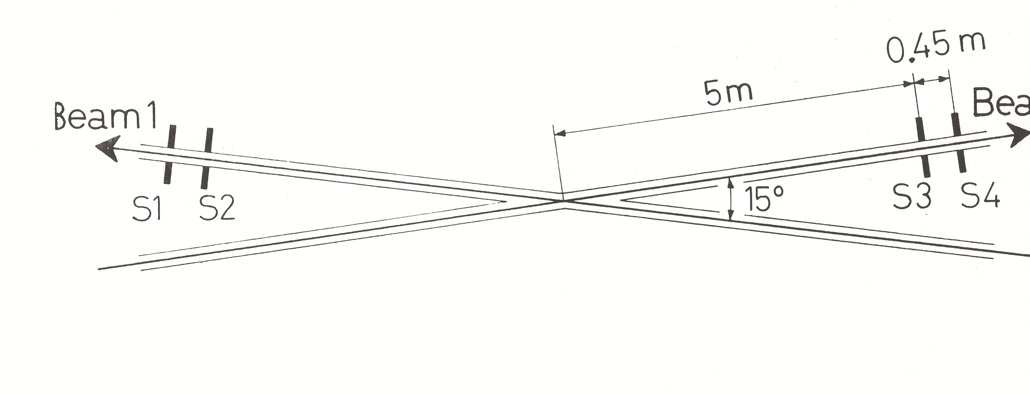
Downstream secondaries in an ISR event

Slide 8
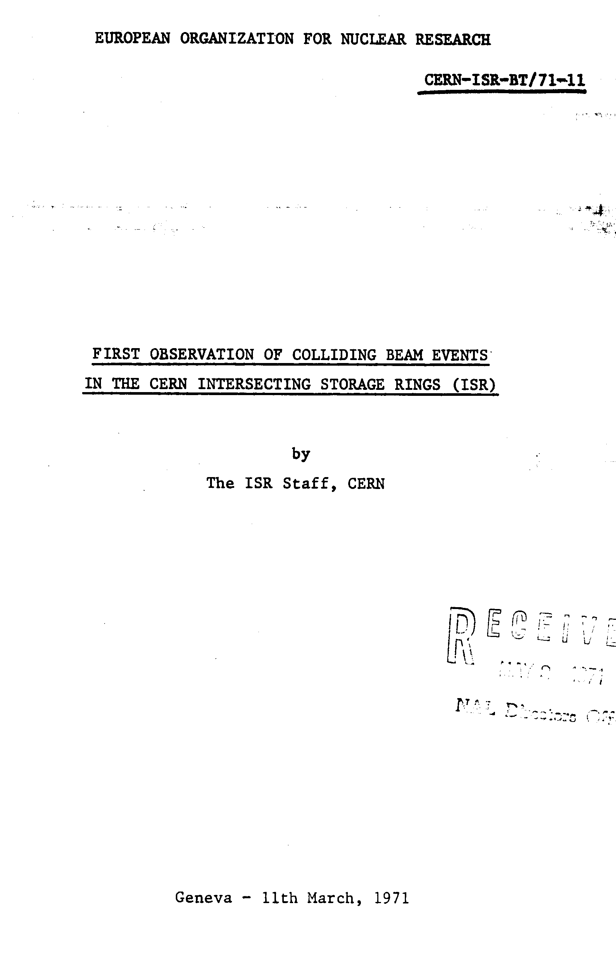
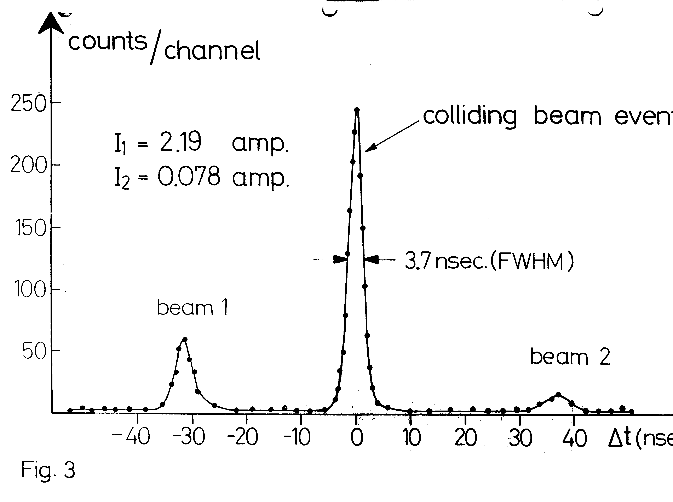
The first publication of the ISR Community
Received on May 8, 1971
CERN-ISR-BT/71-11

Slide 9
Main ISR results
1) ONE DISCOVERY: σ_{T}(pp) growing with energy
(Pisa-Stony Brook and CERN-Rome)
More than expected secondaries at large transverse momentum
Larger than expected rate of high p_{t} electrons and direct photons
4) σ_{t}(pbar-p) ≈ σ_{t}(p-p) (the death sentence for pbar-p colliders)

Slide 10
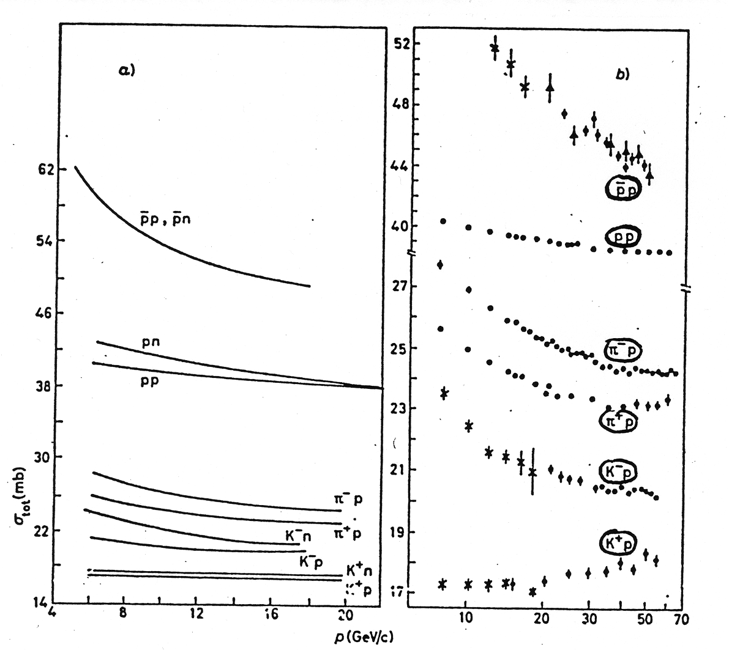
Hadron cross sections before the ISR
With increasing energy the hadron cross sections seemed to decrease and point to “asymptotia”.
σ_{t}(K⁺p) was an exception.

Slide 11
p-p total cross section measurements
Two Collaborations measured σ_{t}(pp):
Pisa-Stony Brook (R801) and CERN-Rome (R601)

Slide 12
The birth of the Pisa-Stony Brook (PSB) collaboration
Guido Finocchiaro and I were brother-like friends. We shared a rented apartment in Rome as fresh postdocs, from 1958 to 1960. Before submitting the proposal In 1969 I called Guido in the USA, described the detector layout. He accepted to collaborate with a Stony Brook group.
My strong bounds with American physicists begun then.
The skill of those colleagues was amazing:
Guido Finocchiaro, Paul Grannis, Dan Green, Robert Mustard, Rudy Thun.
They did not have a major role in the construction of the detector, but were essential in making it work and in analyzing the data.
.

Slide 13
The Pisa-Stony Brook method
Event rate
L = incoming particle flux (s⁻¹ ) times density of target particles (cm⁻²).
Measure N and L and compute N/L = σ_{t}
PROBLEMS:
how to measure N_{el+inel}
How to measure the ISR luminosity
.

Slide 14
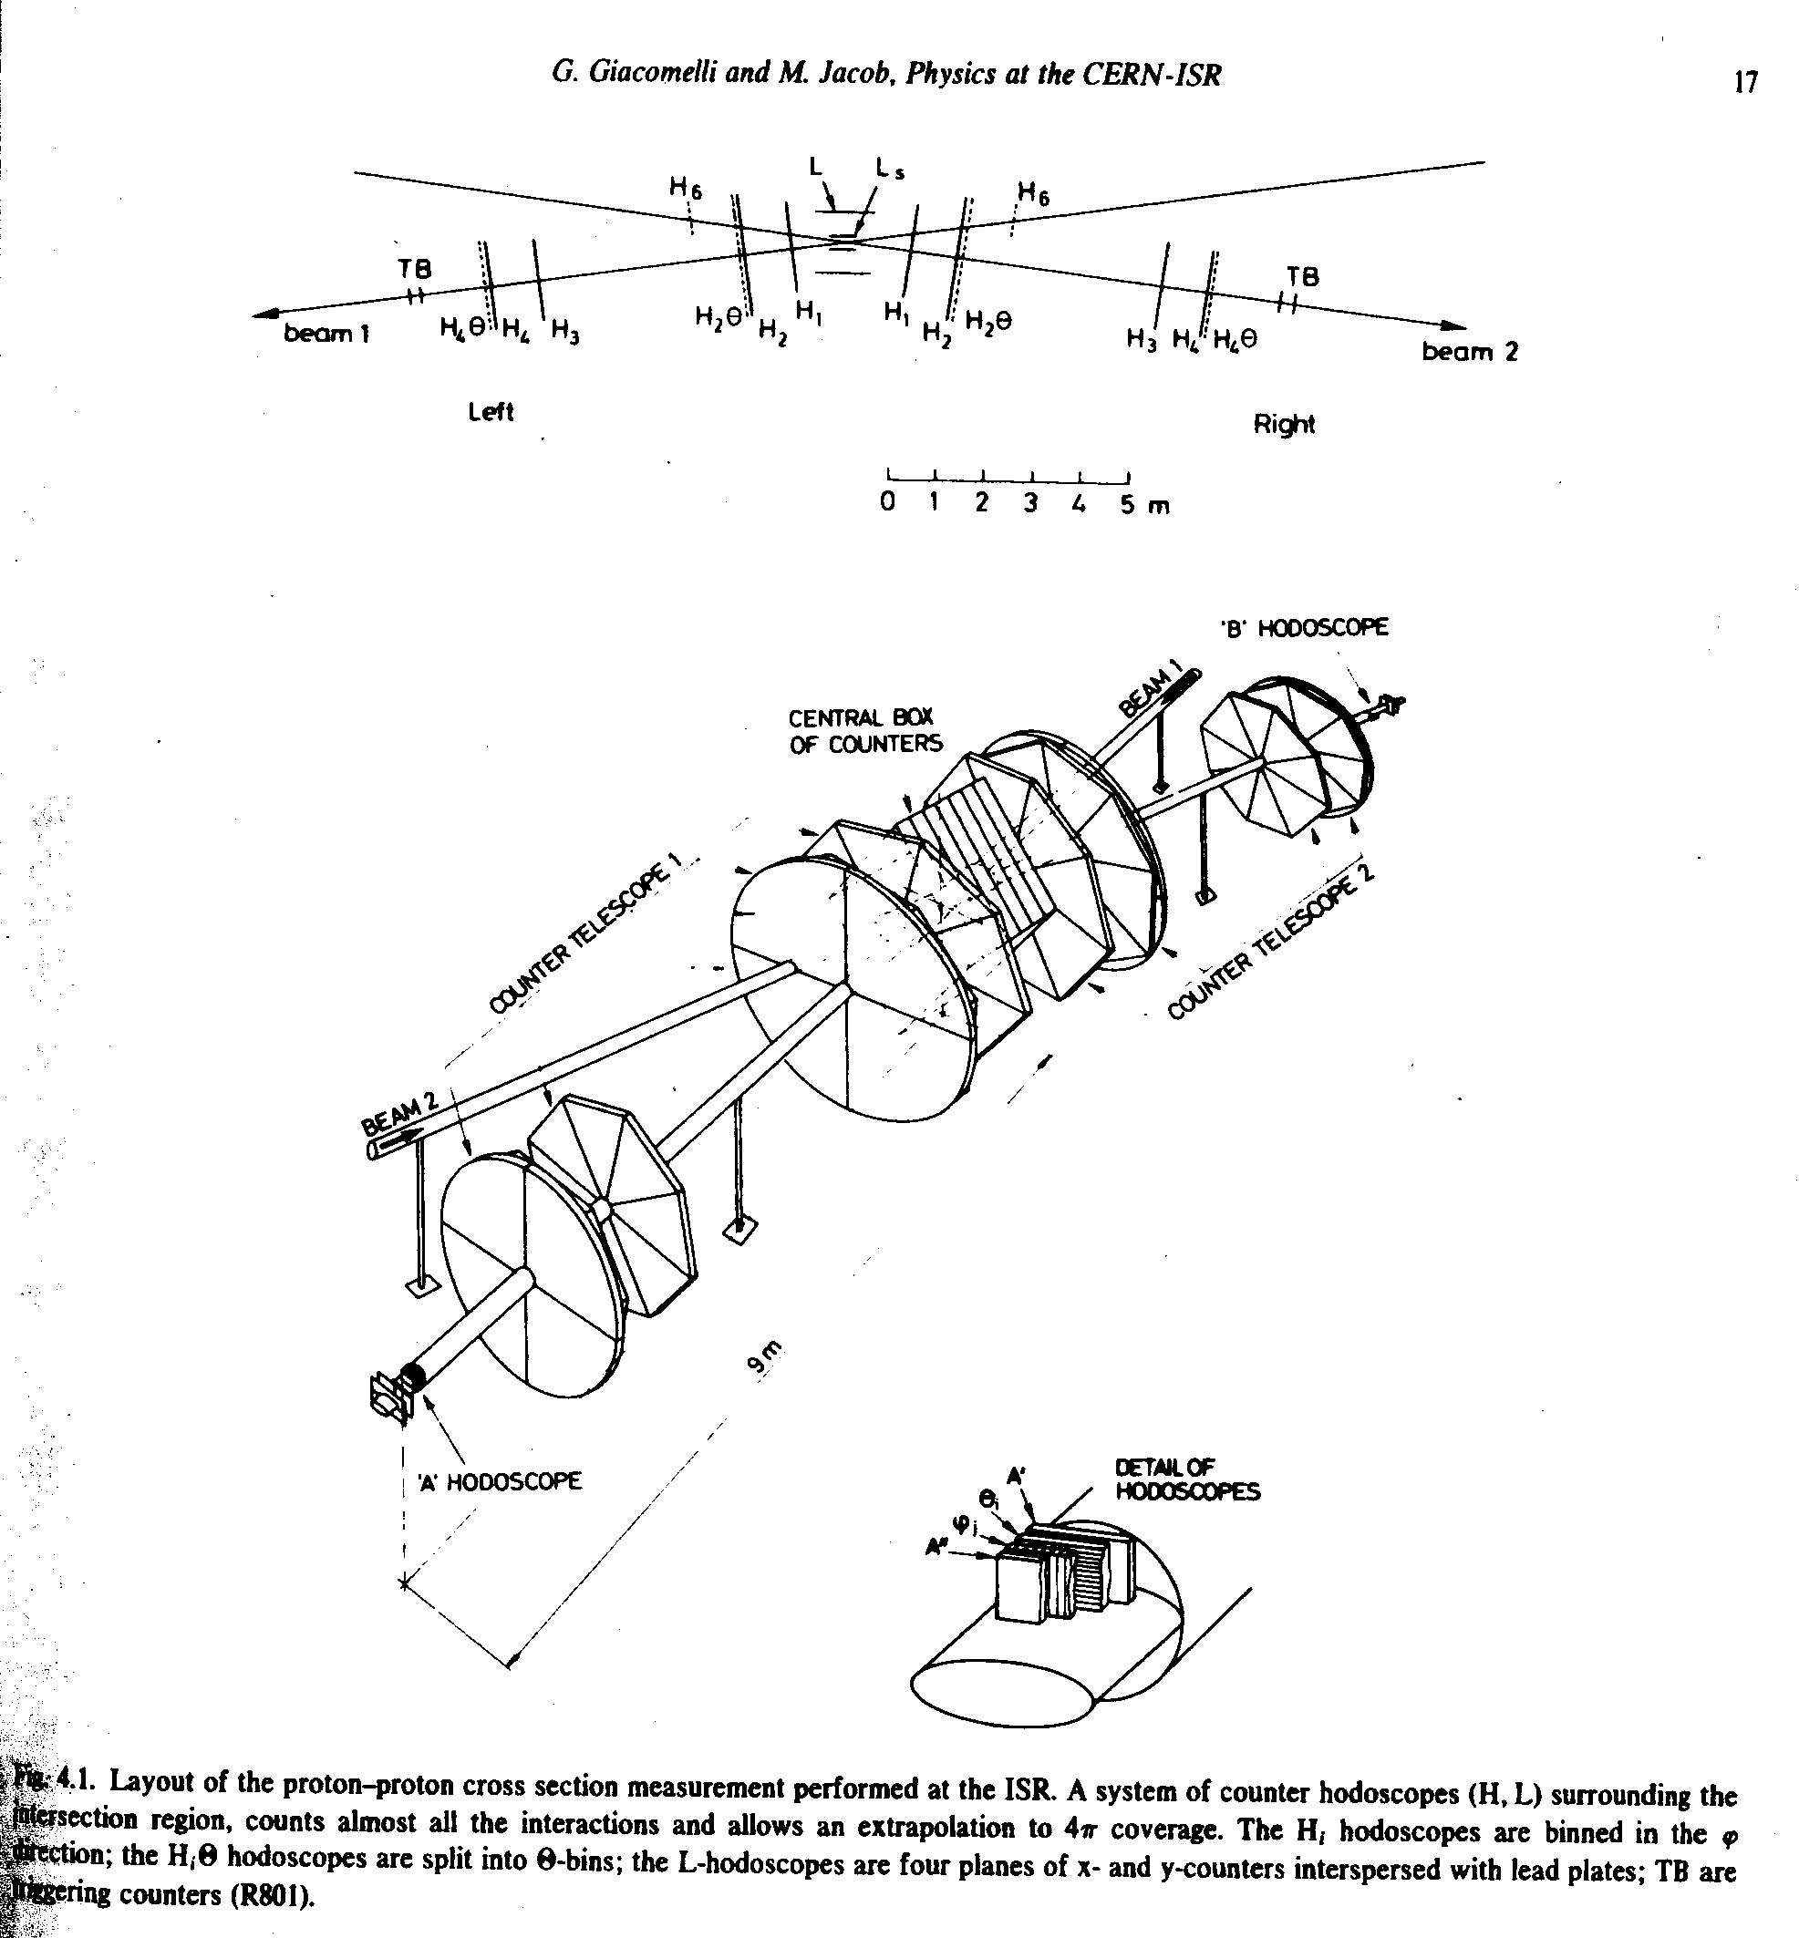
Layout of R801
~ 500 θ, φ bins of plastic scintillation counters.
A cyclopean undertaking for Pisa at that time.

Slide 15
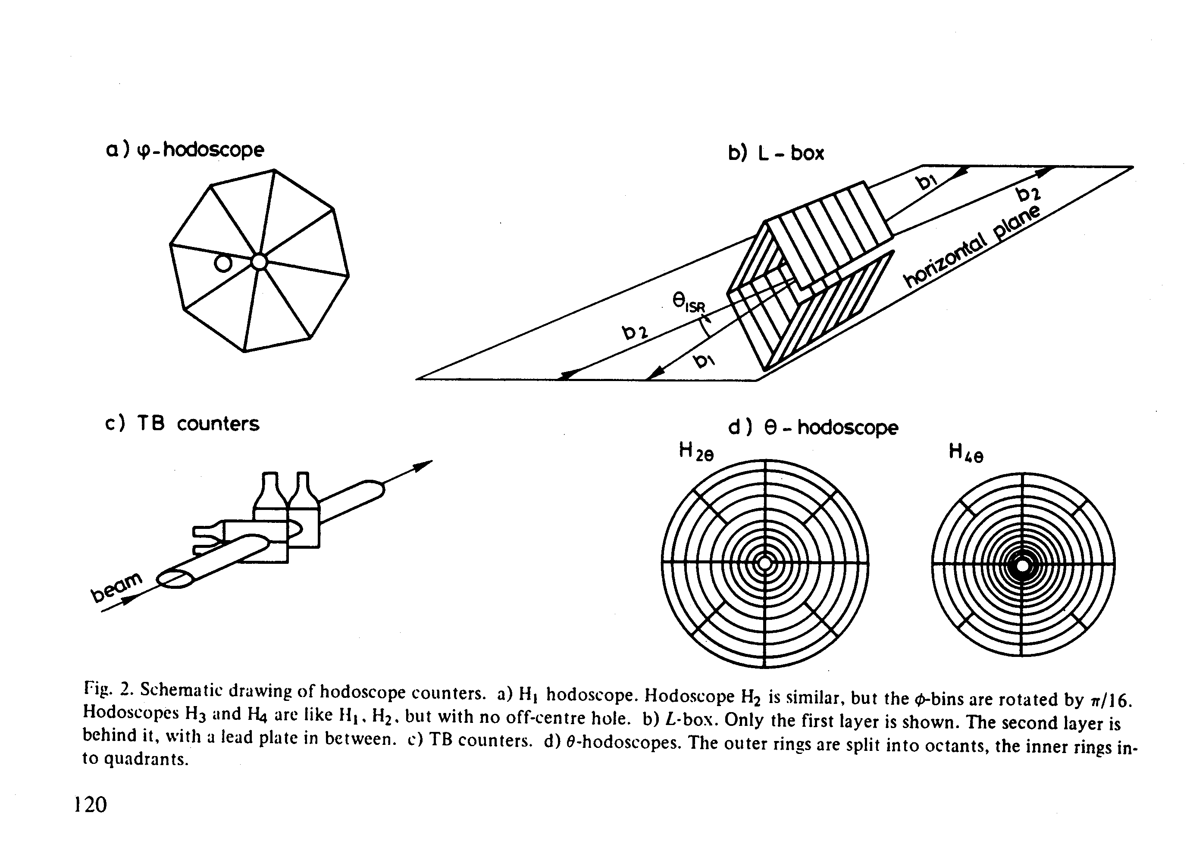
Elements of the PSB counter hodoscopes

Slide 16
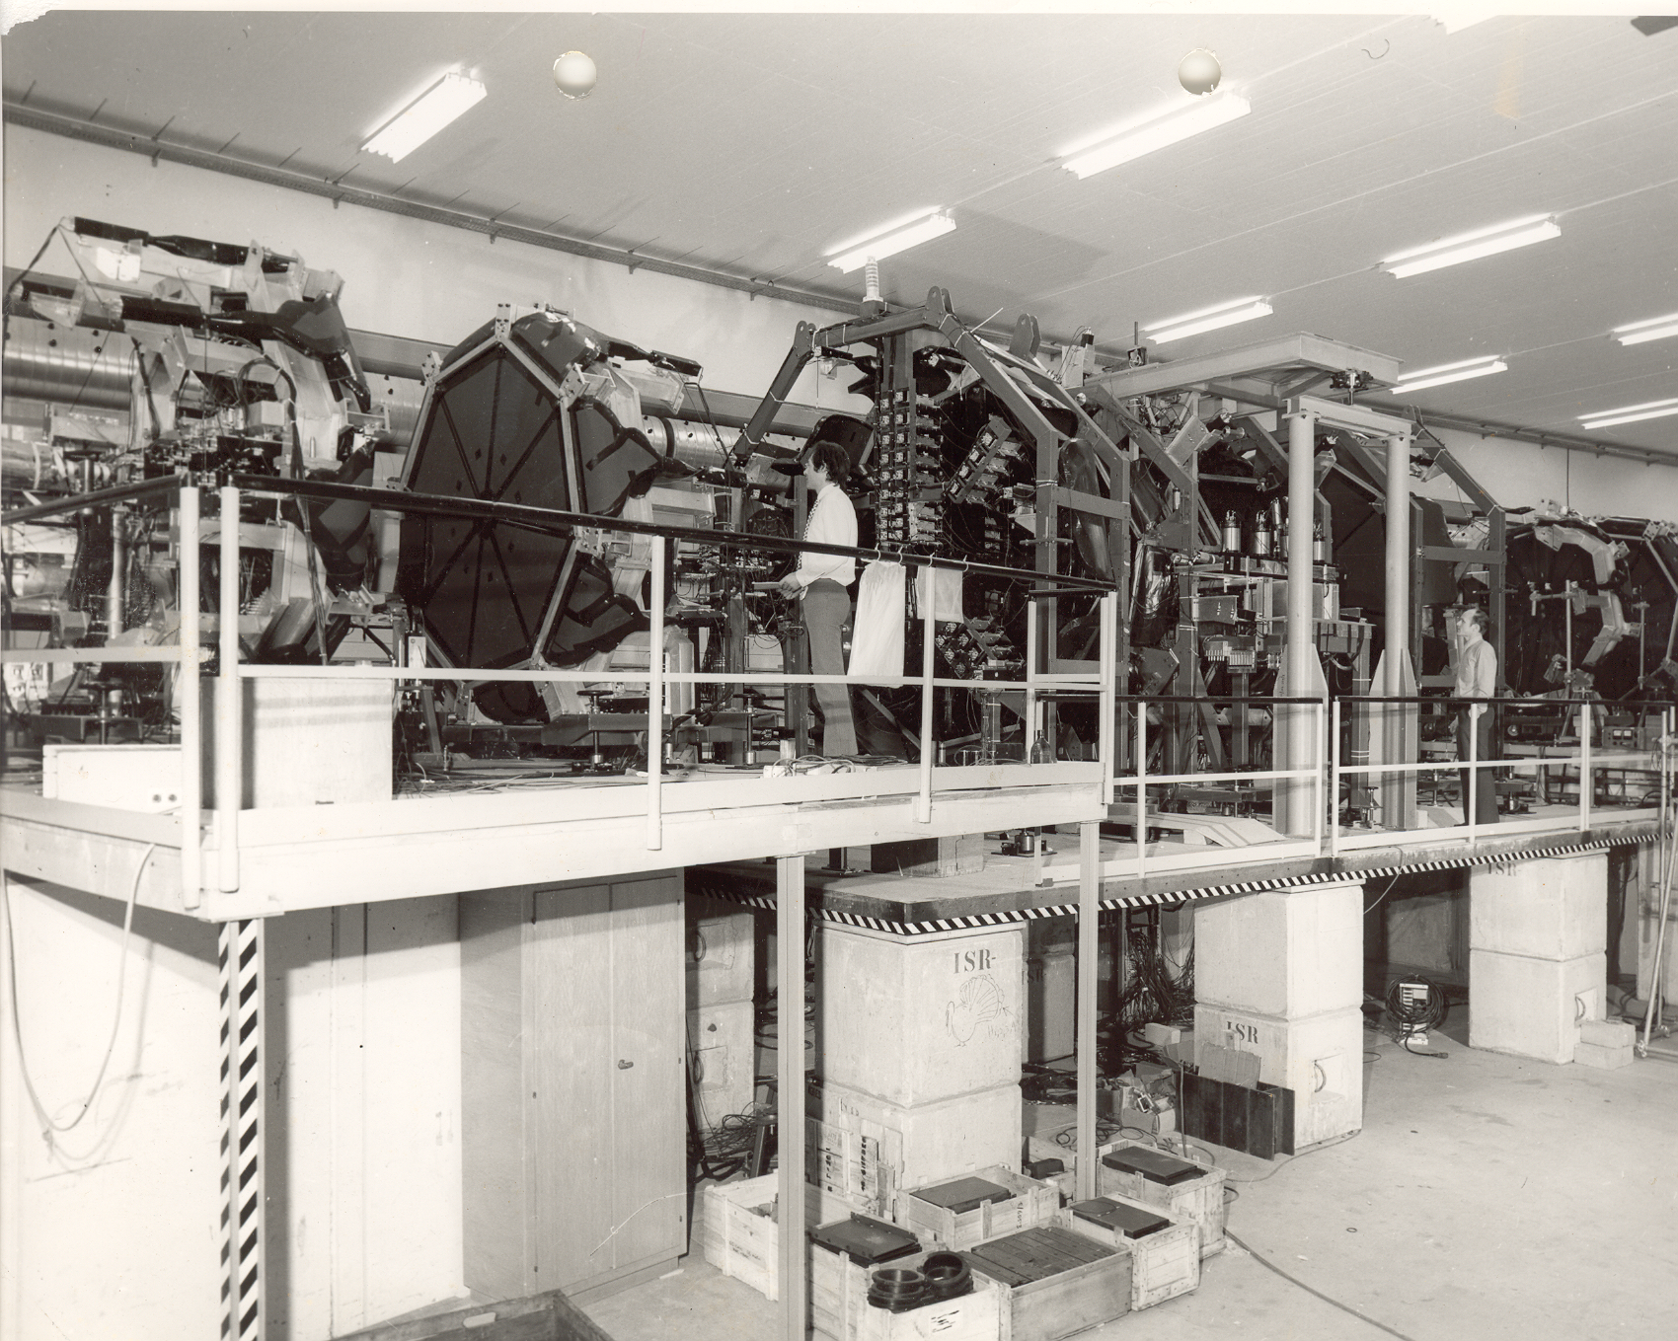
The R801 detector
The first approved experiment at the ISR.
The first 4π detector at a hadron collider.

Slide 17
Total event rate in Pisa-Stony Brook
The detector counters were shaped as θ-bins to allow extrapolating the rate of events lost at small and at large angles. The interaction rate was measured by the left-right and the side-center coincidence rates.
The loss at large angles was found to be negligible.
At small angles the loss of elastic and inelastic events was found by extrapolation to be ~ 2%.
The total systematic error was < 2%.

Slide 18
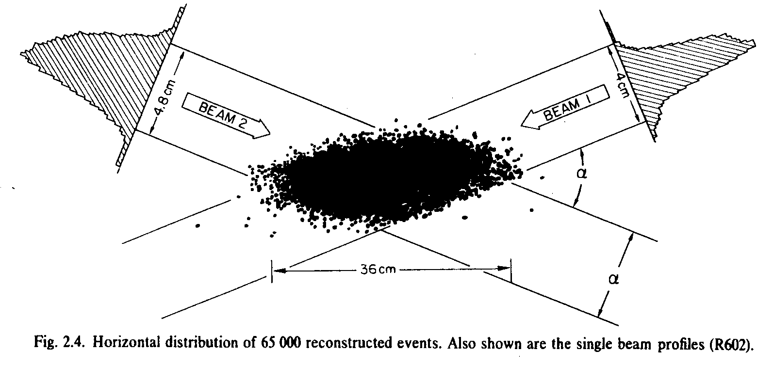
ISR luminosity
L up to 10³² cm⁻² s⁻¹
Over to 20 amps per beam
Up to ~ 4x10⁶ s⁻¹ interactions
N₁, N₂ stored beam protons, I_{1,} I₂ stored beam currents, ρ₁(z), ρ₁(z) current density in the vertical z direction at the crossing point.

Slide 19
Measuring h_{eff}
1/h_{eff} is defined in terms of the vertical densities of the beams:
Initial measurements of h_{eff} were rather inventive:
sweeping wire method,
beam-gas method.

Slide 20
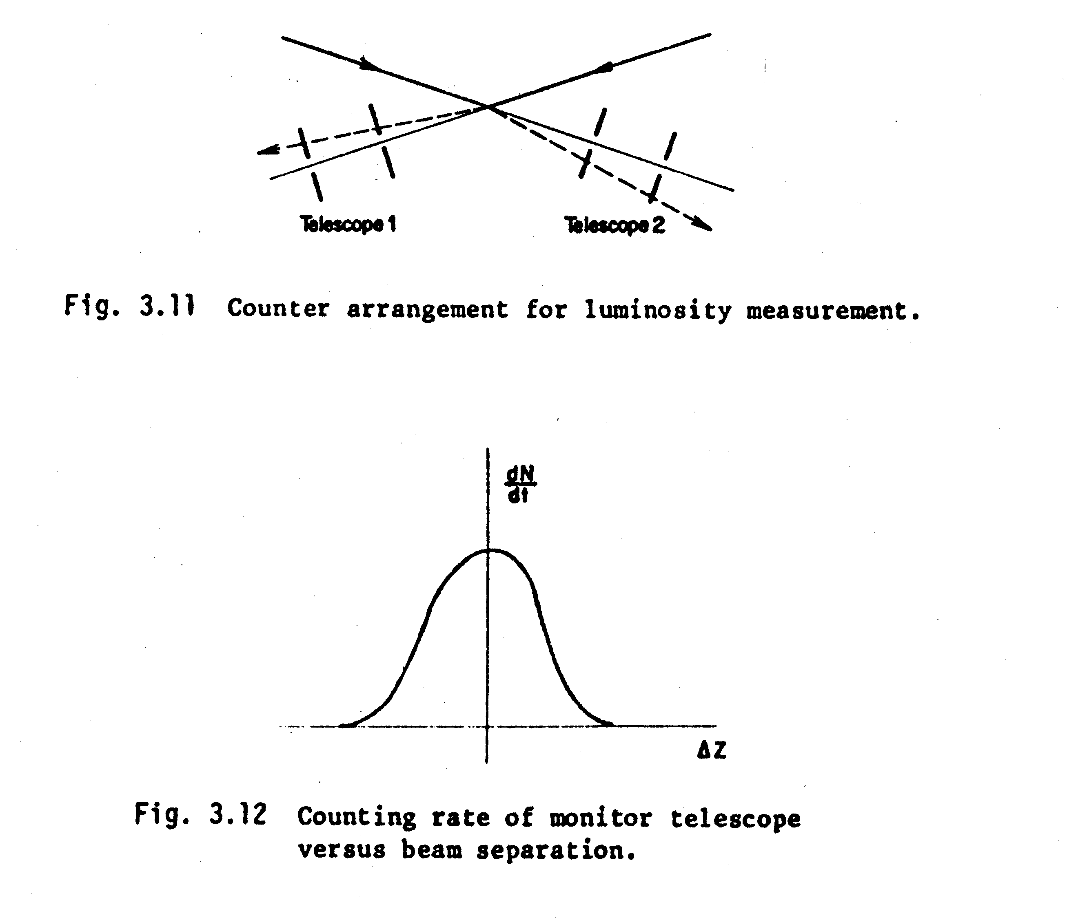
Beam sweeping method (“Terwilliger scheme”)
Measure the rate of any beam-beam process as a function of relative vertical distance of the two beams.
N
S

Slide 21
The Pisa-Stony Brook total cross section paper

Slide 22
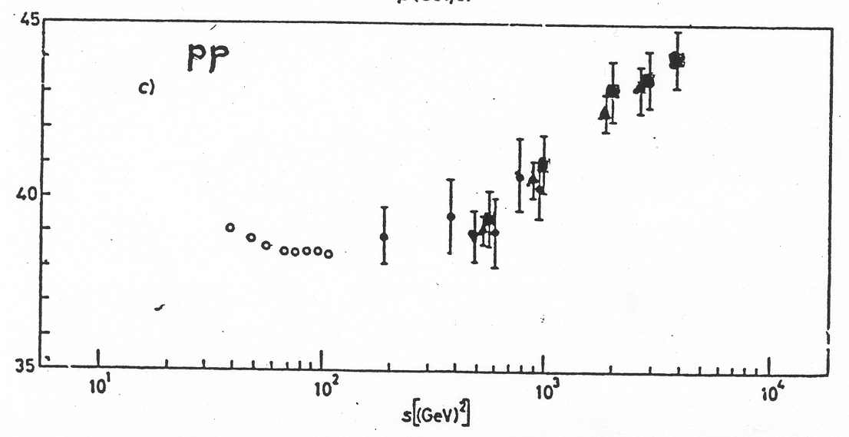
The Pisa-Stony Brook total cross section
The measurement was repeated several times as a check of the surprising result.

Slide 23
The growth of hadron cross sections at high energies
When better external beams of momenta of several hundreds GeV became available it was found that even below the energy domain explored by the ISR all hadron total cross sections increase with energy.
Even today (2018) there is no fundamental theory explaining this phenomenon.

Slide 24
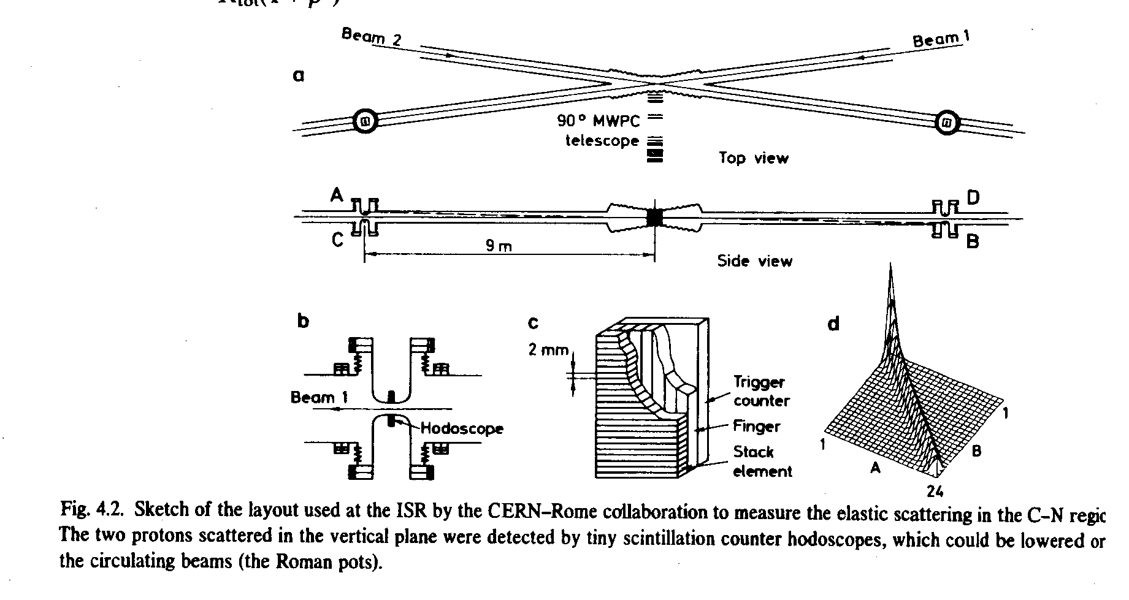
The CERN-Rome detector

Slide 25
Parametric expression of the small angle cross section
The small angle scattering cross section written in terms of σ_{t}
The CERN-Rome σ_{t} result was fully consistent
with R801

Slide 26
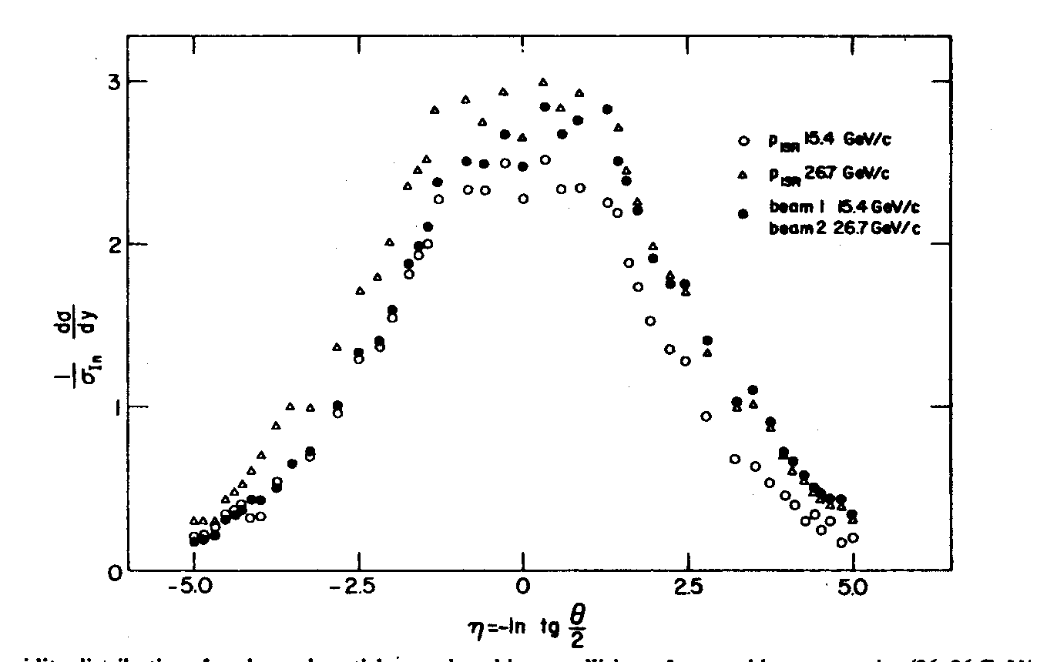
Limiting fragmentation with R801
Inclusive rapidity distributions al 15 on 15 and 26 on 26 beam energies, are compared to data of 15 on 26 run. The downstream particle distribution depends only on the energy of the upstream beam

Slide 27
Short range correlations
The rapidity correlation function is defined as the difference between the two-body density and the product of two uncorrelated single-body densities:

Slide 28
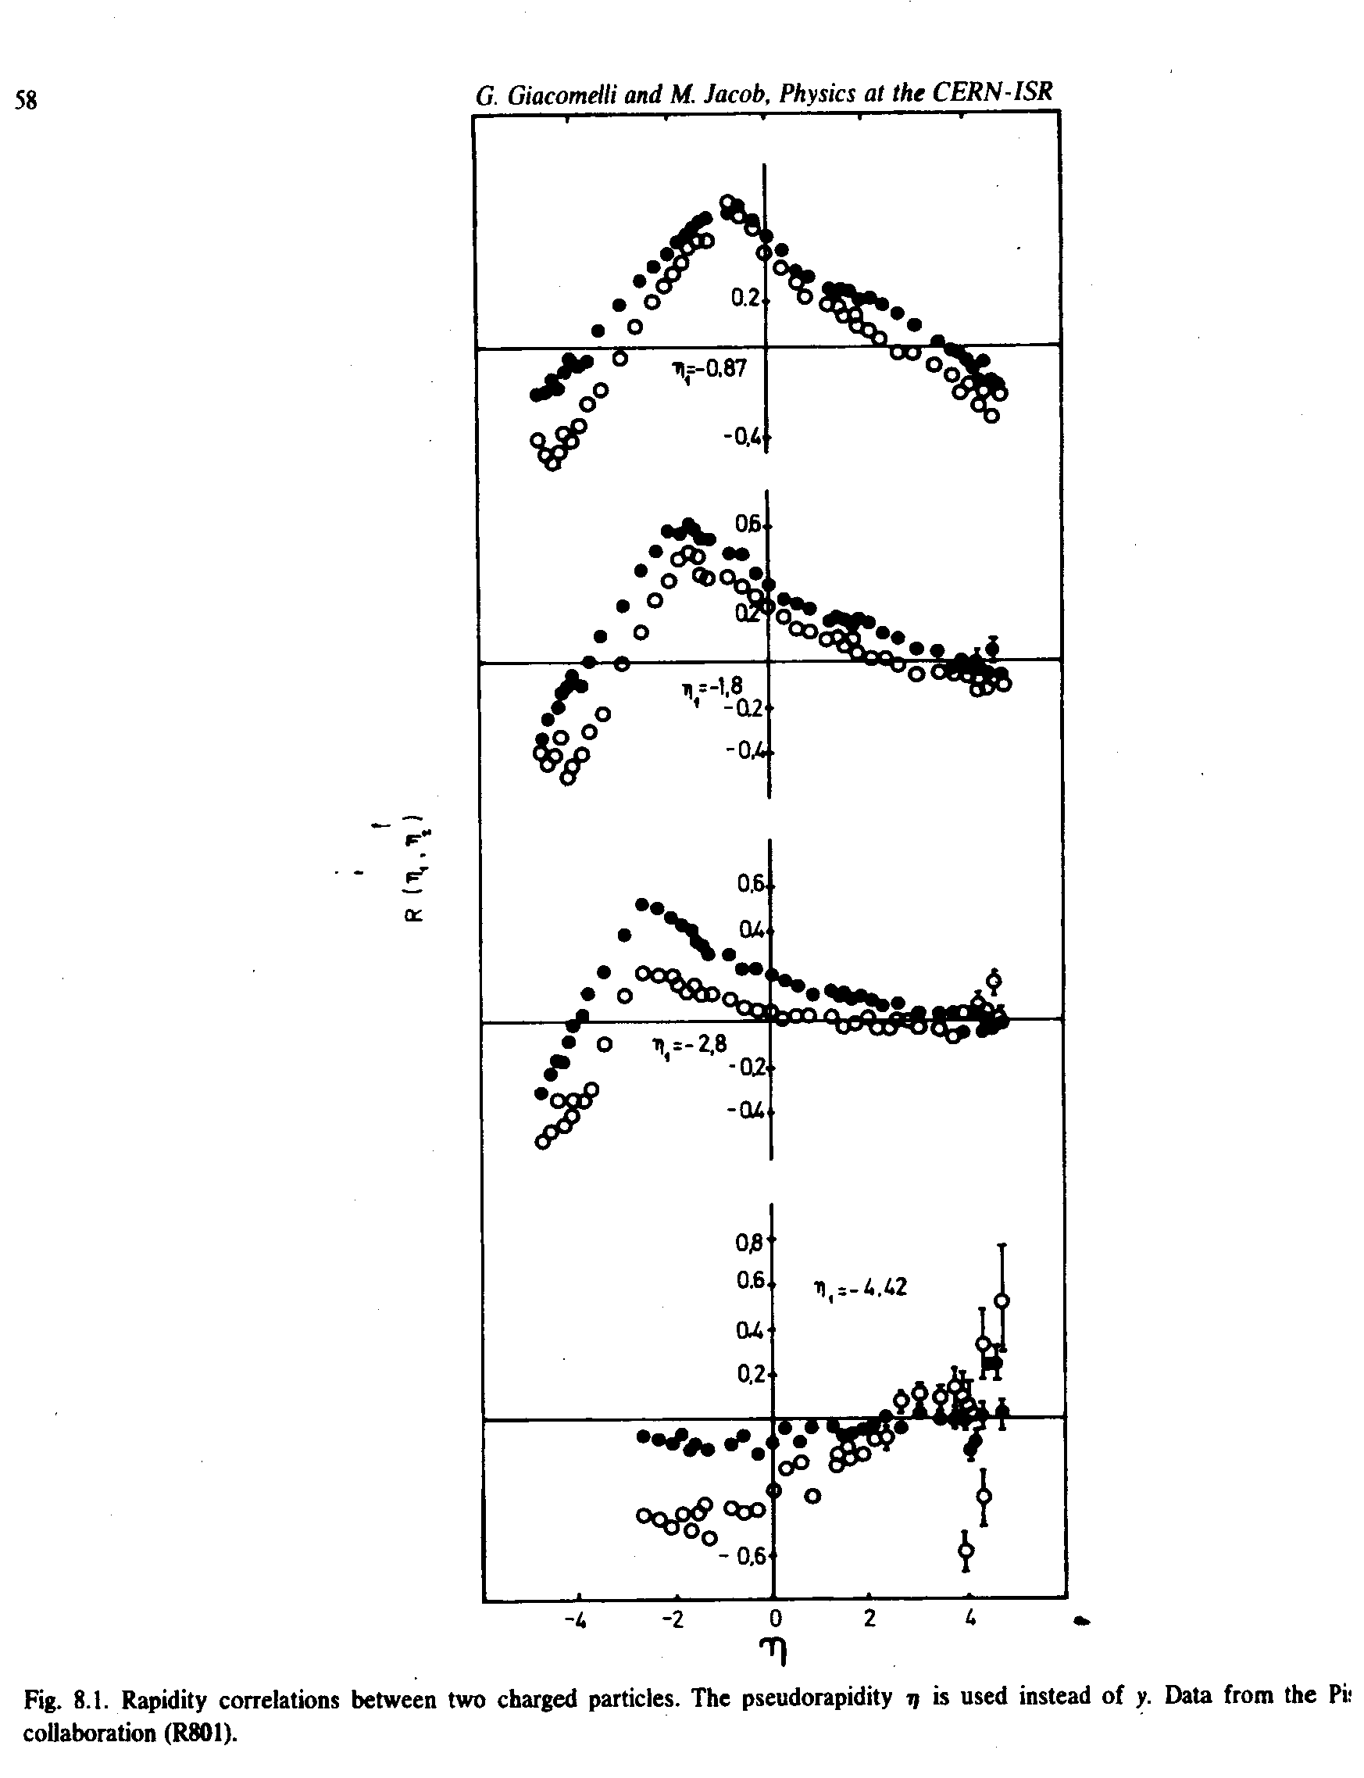
Short range correlations in R801
Circles p_{ISR}=11 GeV/c, dots p_{ISR}=31 GeV/c
The probe particle is moved from small to large pseudorapidity (top to bottom),

Slide 29
Second generation experiments (samples)
The initial ISR program emphasized forward physics.
In a second generation an effort was made to study large angle physics, but no general purpose 4π detector could be built.

Slide 30
The split field magnet
Two forward magnetic spectrometers

Slide 31
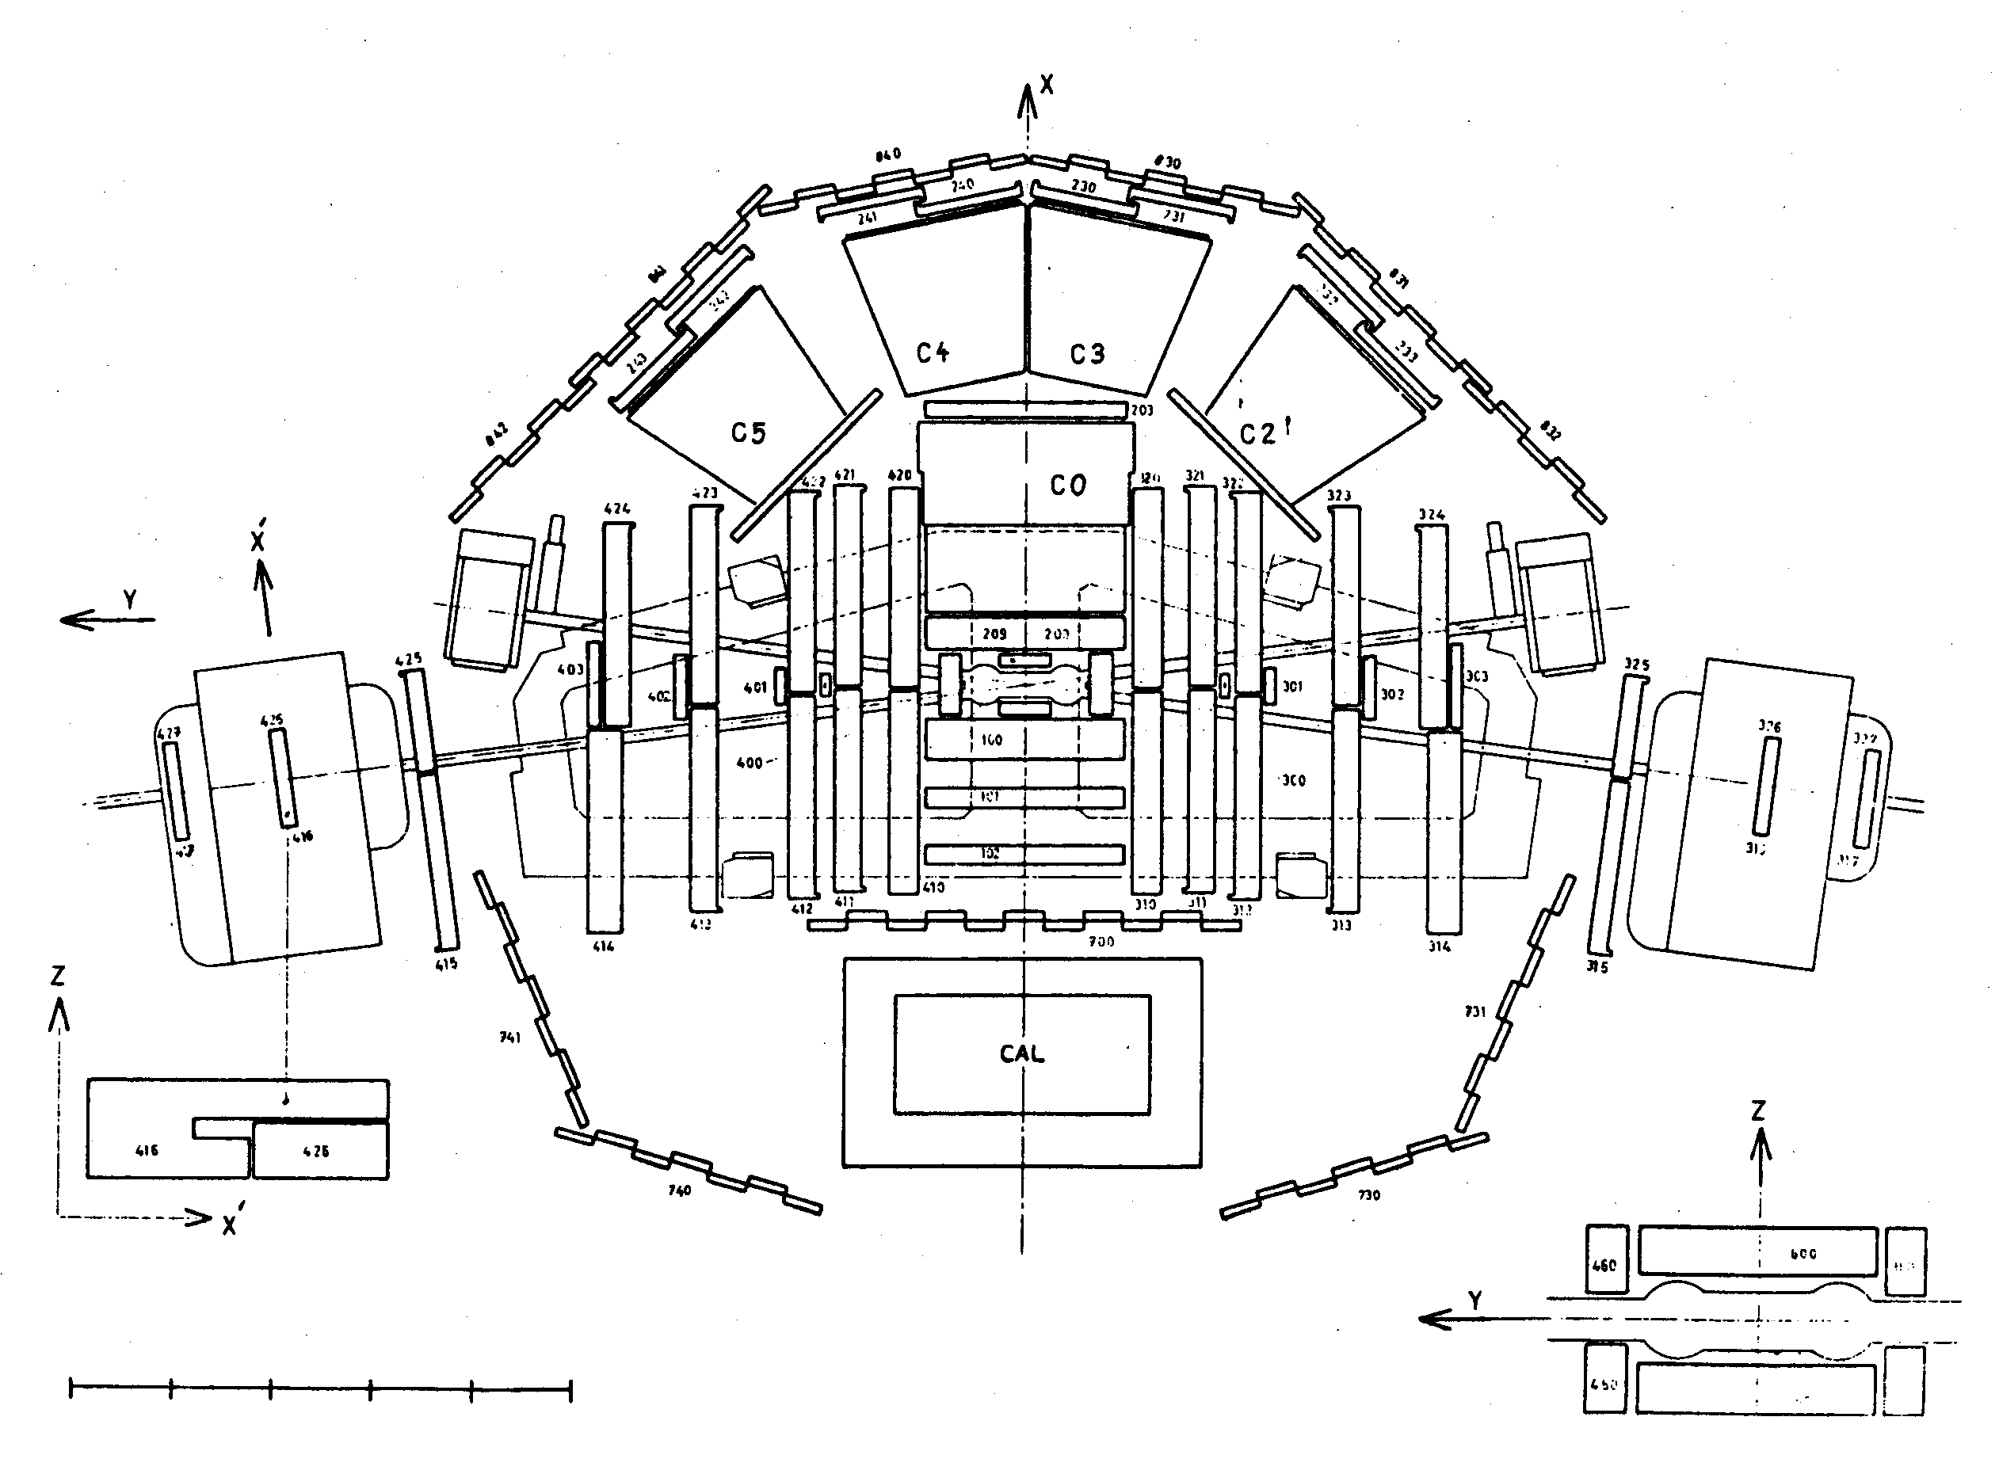
Study of large angle electron events in the second generation SFM
The SFM was equipped with a 90⁰ e.m. calorimeter and Cerenkov counters to study the structure of events with a large angle electrons.
Liquid argon
calormeter

Slide 32
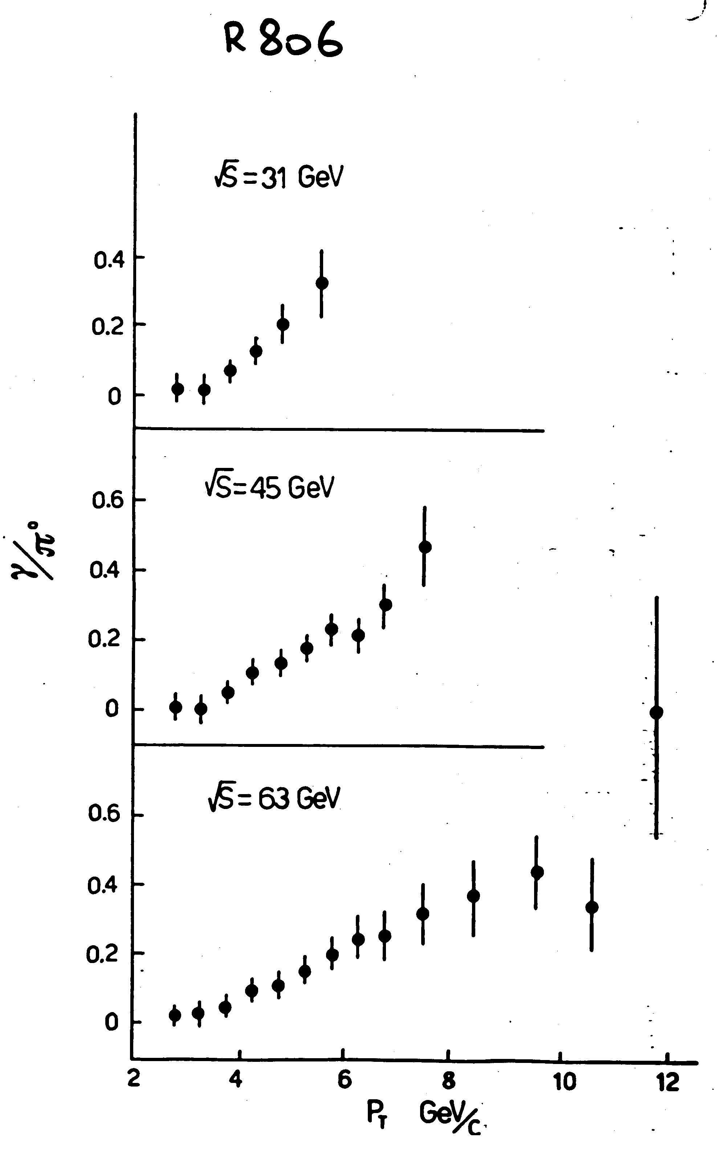
Large direct photons rate in R806
It was found that the γ/ π° ratio depended little on energy and increased with transverse photon energy.

Slide 33
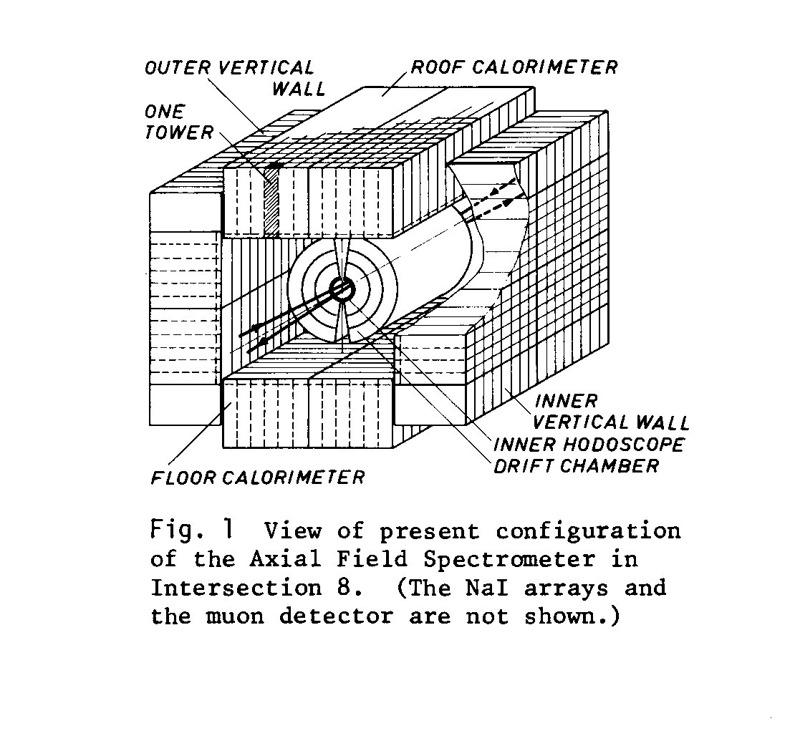
The axial-field magnet of R807/808
Because of its ability to study the neutral component of large angle events this detector had an important role in the second generation ISR.

Slide 34
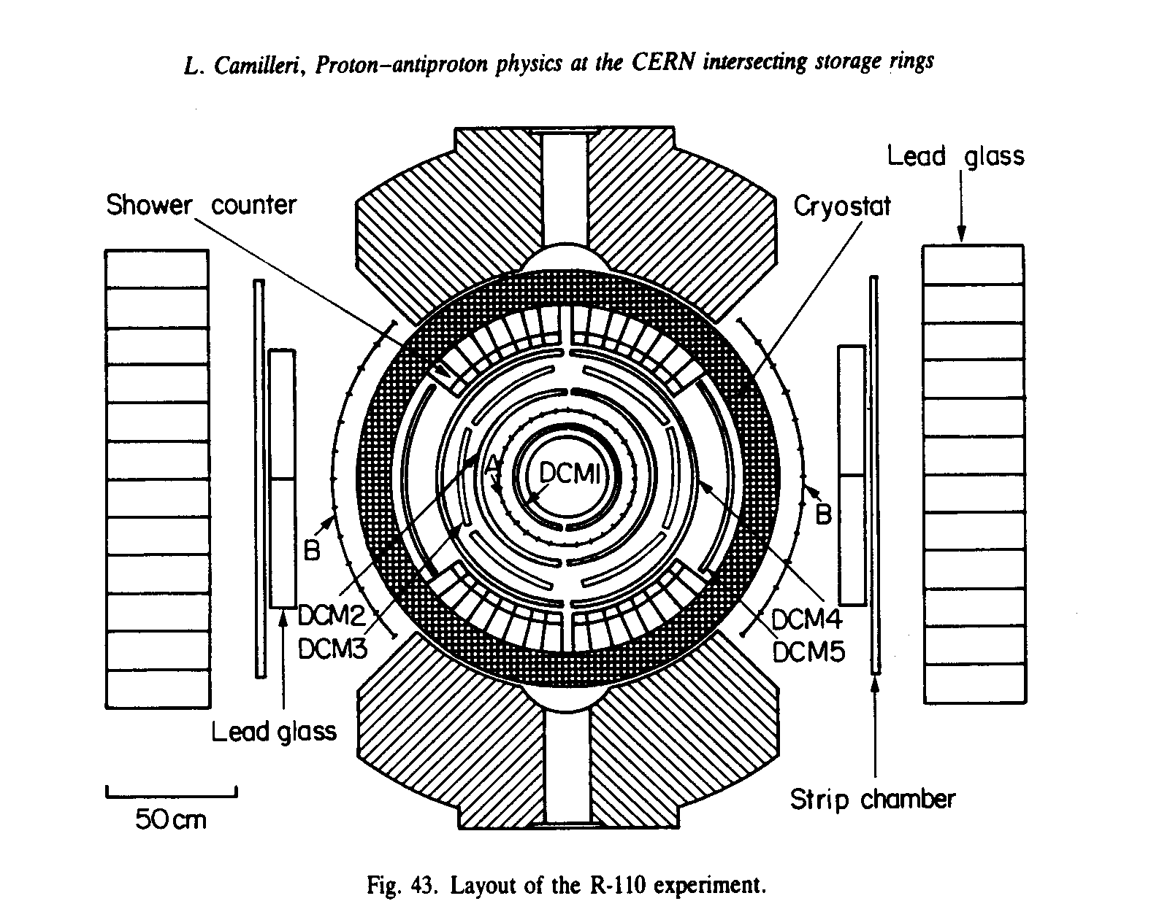
The upgraded R110 detector
The CERN-Cumbia-Rockefeller experiment R110 was later equipped with a pre-converter for a better measurement of high energy photons.
preconverter

Slide 35
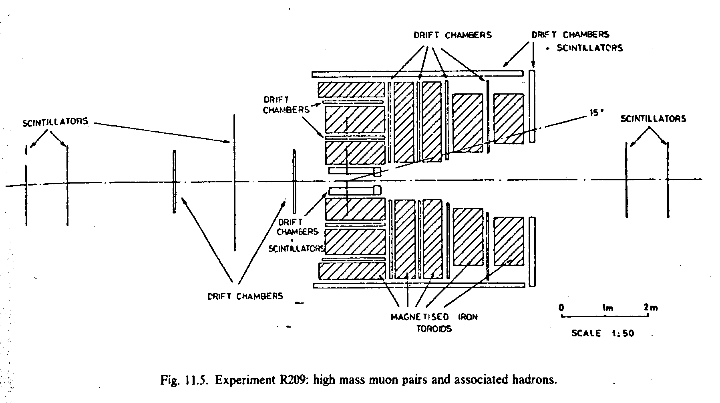
Z→μμ search with R209
Muon pairs were detected at 20° <θ< 90°
in magnetized iron toroids

Slide 36
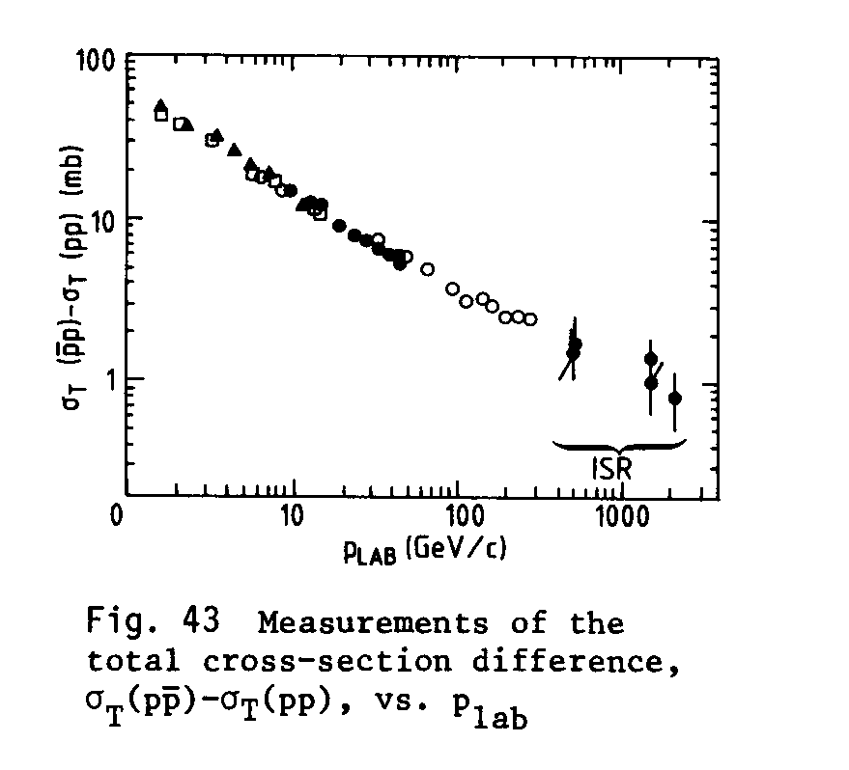
Antiprotons in the ISR
σ_{t} (pbar-p) - σ_{t} (p-p) versus energy in a log-log scale

Slide 37
Final remark
The beautiful ISR machine paved the way to high energy hadron colliders.
The ISR experiments brushed against but could not enter the domain of hard parton interactions.
The pbar-p results spread the feeling that using pbars for a high energy hadron collider would not be worth the effort.

Slide 38
SPARES

Slide 39
The CERN-Rome measurement of dσ/dt
This distribution in the range 0.001 < t < 1 (GeV/c)² can be fitted to determine the optimal values of L, of Imf_{n}(θ) and of ρ = Ref_{n}/Imf_{n} , that is considered a constant in that small θ range.

Slide 40
PLANE WAVE AS A SUM OF SPHERICAL WAVES
A plane wave can be written as the sum of a series of incoming and one of outgoing spherical waves on the basis of the Legendre polynomials P_{l} of angular momentum l, with l-dependent amplitudes:
The scattering at z=0 generates an additional outgoing spherical wave whose amplitudes η_{l} depend on the physics of the interaction:
In turn this wave generates a number of elastic scattering events dn_{el} within the solid angle dΩ
where dr/dt is the velocity of a relative to b in the c.m.s.

Slide 41
THE ELASTIC SCATTERING CROSS SECTION
The elastic scattering amplitude is defined as
Such that, since the relative velocity in terms of the c.m.s. velocity v is dr/dt = 2v, one gets
Since the incoming flux is also dn_{in} = 2v, one gets for the angular cross section the expression:

Slide 42
THE TOTAL ELASTIC CROSS SECTION
The total elastic cross section is obtained as
which using the definition of the scattering amplitudes is
The Legendre polynomials are an ortho-normal set normalized as
and therefore one gets

Slide 43
THE INELASTIC CROSS SECTION
The difference between the incoming (the plane wave) and the outgoing (generated elastic) fluxes gives the inelastic cross section:
and the total inelastic cross section
with

Slide 44
THE TOTAL INELASTIC CROSS SECTION
By making use once more of the orto-normality property of the Legendre polynomials one gets the total inelastic cross section as a sum of contributions by angular momentum channels:
and finally
For physical reasons in all channels the contribution to the cross section must be null or positive, i.e.:

Slide 45
THE TOTAL CROSS SECTION
The total cross section is the sum of the elastic and the inelastic ones:
Remarkably, an expression similar to this one is found if one computes the imaginary part of the elastic scattering amplitude in the forward direction:

Slide 46
The Optical Theorem
The final state can de described as the interference of the interacting angular momentum waves, and one derives the
optical theorem:
k = c.m.s. momentum, F_{n} = amplitude of nuclear scattering

Slide 47
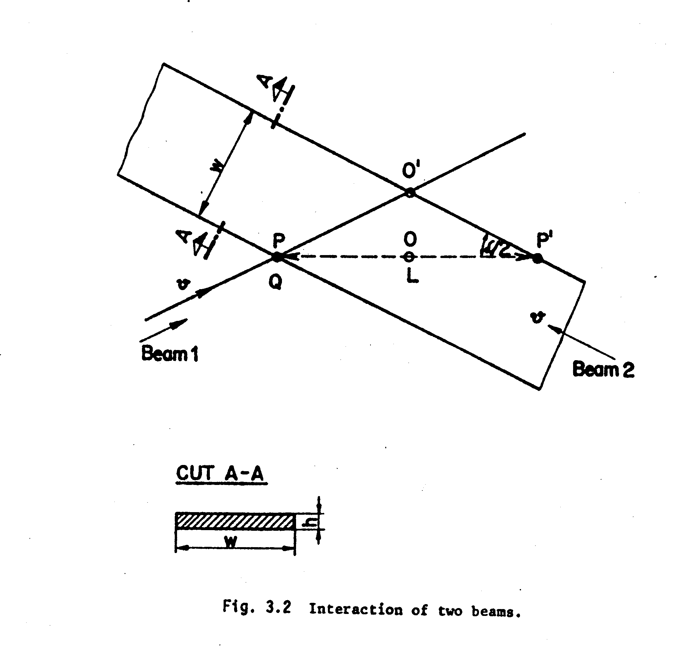
THE LUMINOSITY FORMULA
While crossing beam 2, beam 1 protons move from P`into O`. The proton-proton c.m. moves from O into O` with velocity c.sinα/2. The motion of the c.m. away from the projectile beam lowers the target density by the corresponding γ_{cm} Lorentz factor.

Slide 48
THE LUMINOSITY FORMULA, cont.1
We assume that the beam sections are identical, with width w and height h and with uniform volume densities n₁, n₂. The effective beam 2 width is l = w/sin(α/2), since all targets along the PP’ path can be hit. All together the target density is seen as:
The luminosity can be obtained by multiplying by the incident flux by n₁hwc:
where R = ISR radius, N_{1,2} = 2πRhwn_{1,2} = total number of beam protons, e = proton charge, I_{1,2} = en_{1,2}hwc = beam currents.

Slide 49
THE LUMINOSITY FORMULA, cont.2
A more realistic approach is to assume z-dependent (z=vertical coordinate) ρ₁(z), ρ₂(z) densities in the beams, normalized as
The previously derived luminosity formula will still be valid for infinitesimally thin beams of width dz, with contribution dL ~ (ρ₁dz)(ρ₂dz)(1/dz). The full luminosity will be obtained by integrating over z:
If the ρ(z) distributions are normalized to 1 to express only beam shapes one gets:

Slide 50
EFFECTIVE HEIGHT OF THE INTERACTION REGION
In a measurement of the vertical beam density the normalization of ρ₁, ρ₂ will depend on what is measured. However, the correct normalization is restored by computing
This parameter has the dimensions of an inverse length. The parameter h_{eff} has the significance of the effective height of the beam-beam overlap. The smaller h_{eff} is the more precise is the beam-beam vertical tuning and the higher is the luminosity.

Slide 51
HOW TO MEASURE h_{eff}
In the early ISR times h_{eff} L was measured in a number of ways:
By displacing vertically the beams relative to each other and measuring the z-dependence of beam-beam interaction rate;
By sweeping a thin wire vertically across the beams and measuring the beam-wire rate;
By measuring the z-dependence of single beam interaction rates close to the intersection on the residual gas in the pipe.
A simplification of method 1), the “Terwilliger scheme”, was soon
generally adopted.

Slide 52
PROVE OF THE TERWILLIGER SCHEME
When beam 2 is displaced vertically by δ relative to the nominal z position the beam-beam interaction rate is
The beam-beam rate is maximum at δ = 0:
The area covered by the function N(δ) is
Since only ρ₂ depends on δ one can separate the integrals:

Slide 53
PROVE OF THE TERWILLIGER SCHEME, cont.
The integral on δ gives the ρ₂ area, independent of z. This shows that the area S covered by N(δ) can be written
Applying the definition of h_{eff} one finds
Therefore: the effective height is found by dividing the area of the beam-beam rate distribution by the maximum rate value.

Slide 54
The beam gas method
In this method the two beams were first separated vertically from each other. The charged prongs produced in their interactions on the residual gas were tracked in telescopes at right angle on the horizontal plane.
A small Ti sphere inside the pipe was heated to create as much Ti gas as needed for a speedy measurement. By projecting on the median machine plane the tracks detected in the telescope one measured the convolution of the unknown beam densities with the known (∝1/r²) density of the Ti gas. The densities ρ₁(z), ρ₂(z) were then obtained by a suitable de-convolution.
A correction based on the known machine optics was applied to compute the small ρ₁(z), ρ₂(z) changes when the beams were displaced back to the proper position for running.

Slide 55
The sweeping wire method
In this method a thin metal wire was shot at known speed vertically across the beam overlap region in such a way that the wire position z was known as a function of time. The left-right random coincidence rate N_{1x2}(z) and the single-side rates N₁(z), N₂(z) downstream each beam were measured in two telescopes as a function of z. The integral single-side rates are proportional to the beam currents I₁ , I₂. The random coincidence rate is proportional to the product of beam densities at the same z and its integral is proportional to I_{1x2}. In these measurements geometrical and time acceptances of the telescopes are the same and are cancelled when computing the luminosity. One could thus obtain the effective height as

Slide 56
The CERN-Rome cross section analysis
At t < 10⁻³ (GeV/c)² the cross section is dominated by f_{coul}², which is well known in absolute units. The experimental rate determines L;
At 10⁻³ < t < 10⁻² (GeV/c)² the interference between f_{coul} and Ref_{n} is largest and the data are most sensitive to ρ (a 10% effect);
At 10⁻¹ < t < 1 (GeV/c)² the cross section is fully nuclear and can be fit to an exponential that can be extrapolated to t=0. A correction is applied to allow for the value of ρ and the optical theorem is used to find σ_{t, nuclear}. The result was fully consistent with Pisa-Stony Brook.

Slide 57
Coulomb scattering amplitude
The interaction between the particle electrical charges contribute to forward scattering with amplitude, which to a good approximation is purely real
where α is the fine structure constant and t the squared four-momentum transfer.

Slide 58
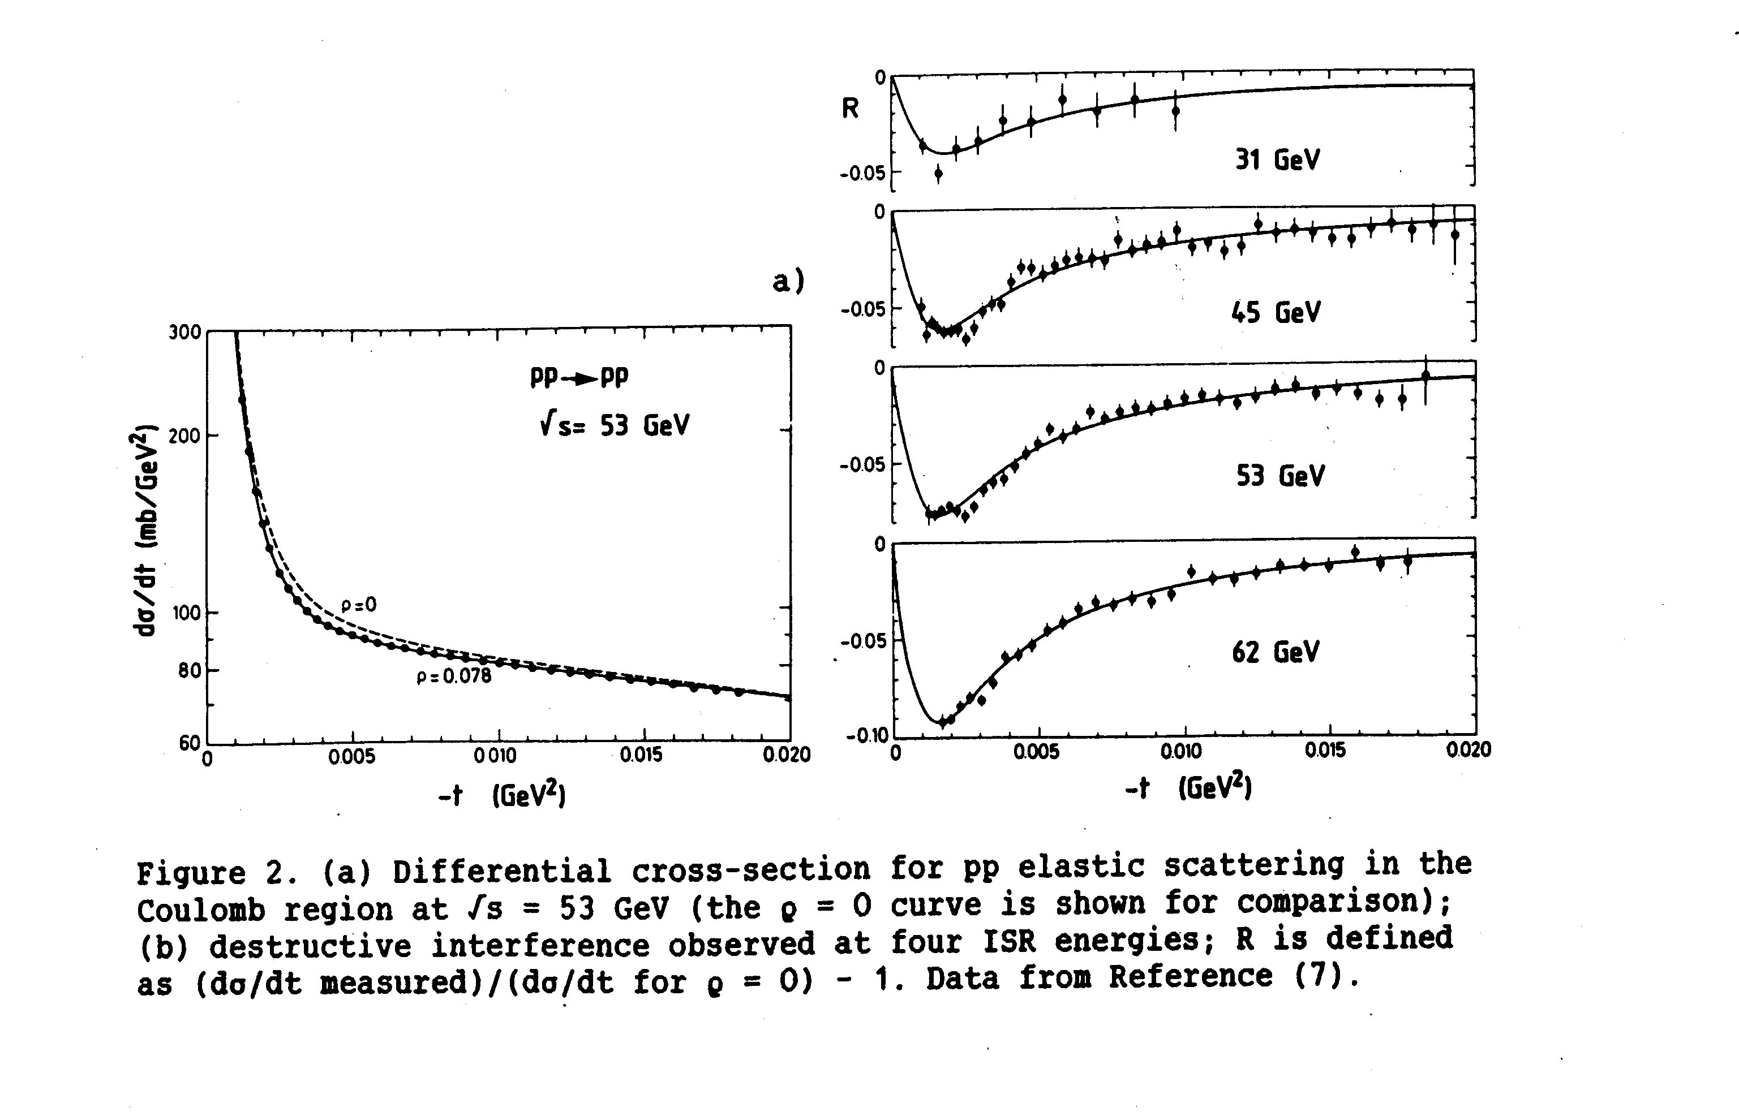
The CERN-Rome measurement of the real part
The σ_{t} result was fully consistent with R801. The measurement of ρ was unique to this experiment.
ρ was found to be positive and to generate a negative interference term with the real nuclear amplitude reducing the cross section by about 10% in the interference region.

Slide 59
USING THE TOTAL RATE AS A LUMINOSITY MEASUREMENT
Measure the total interaction rate R_{tot} and at the same time dσ/dt in the exponential region dσ/dt , to be extrapolated to t=0. This was a combined Pisa-Stony Brook and CERN-Rome measurement.
This method is luminosity independent: L is replaced by R_{tot}.

Slide 60
DIFFRACTION AS SEEN IN R801
In R801 the correlations among fragments of the diffracted proton were seen in a simple way.
In inelastic events the smallest angle tracks on both sides (likely to be the scattered primaries) were removed. The dispersion δ₂(η) of the remaining tracks was displayed versus their average pseudorapidity in events of fixed multiplicity:

Slide 61
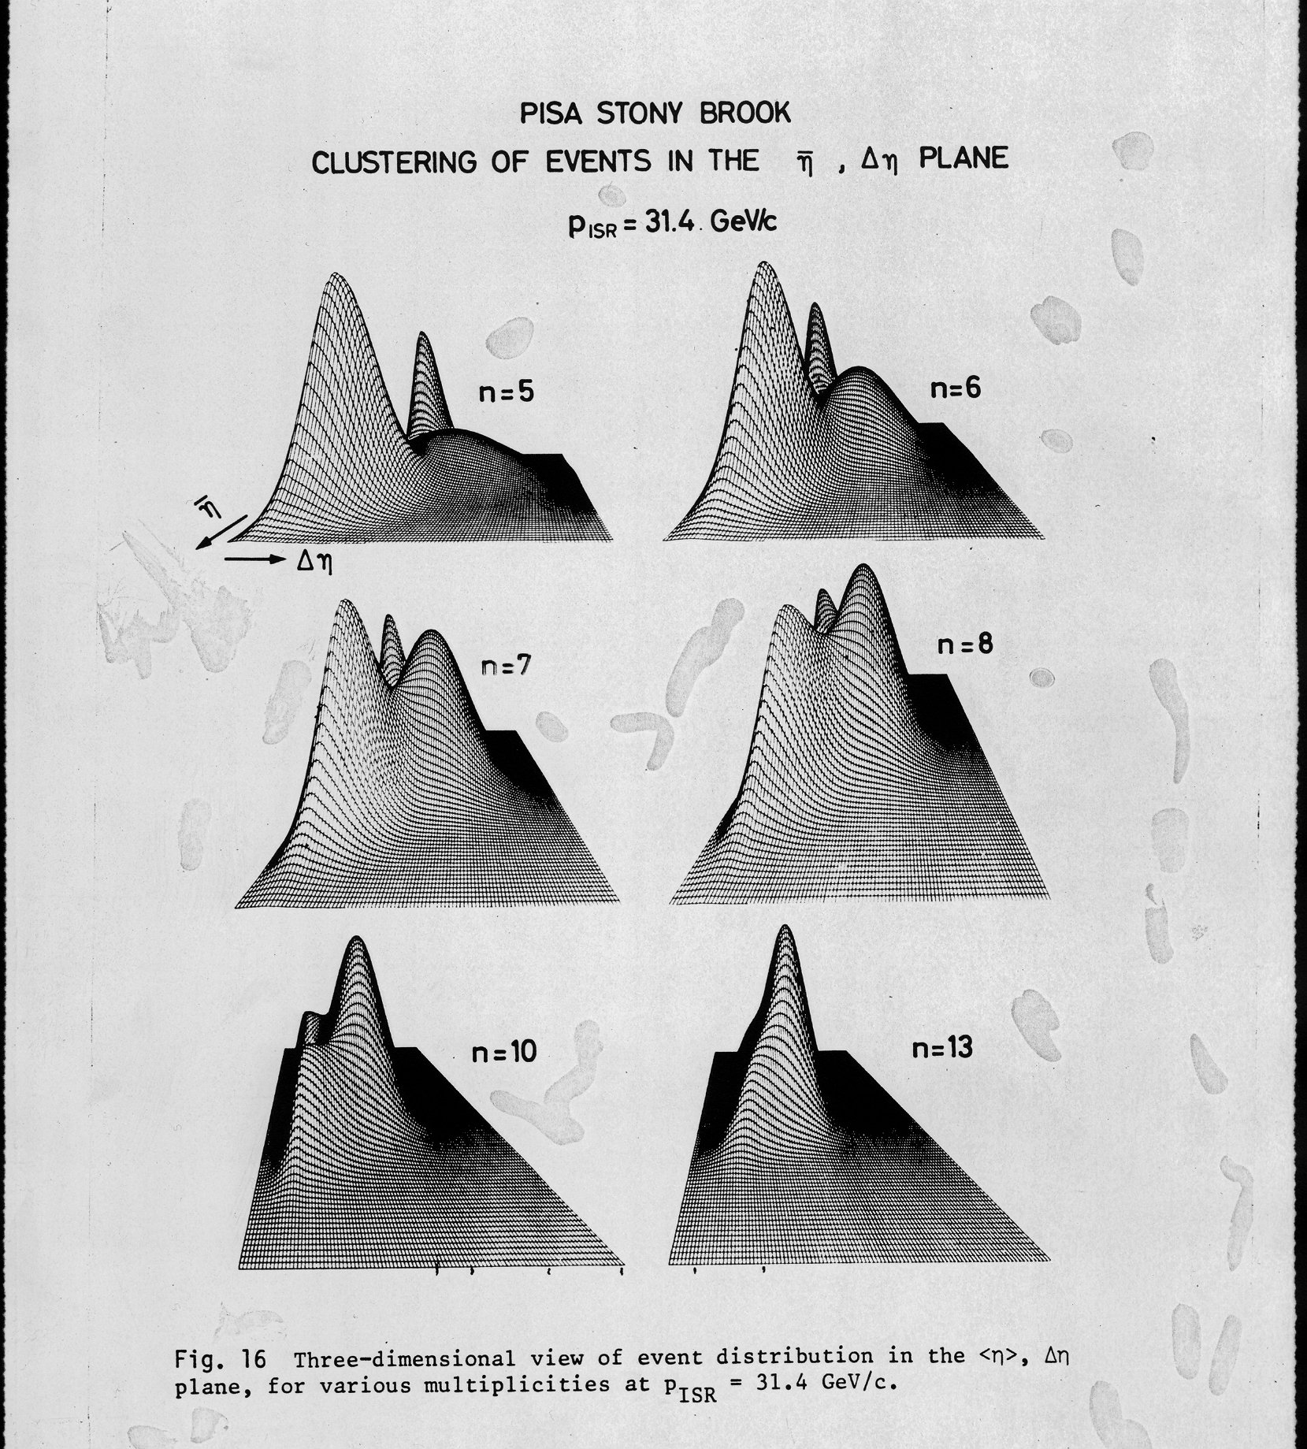
R801 DIFFRACTION STRUCTURES
At low multiplicity a two-bump structure was found with small Δη at small angle relative to the beams.
The total diffractive cross section would be naturally defined as the total volume of the bumps added over n. These operation could not be performed without a substantial uncertainty and the result was never published.

Slide 62
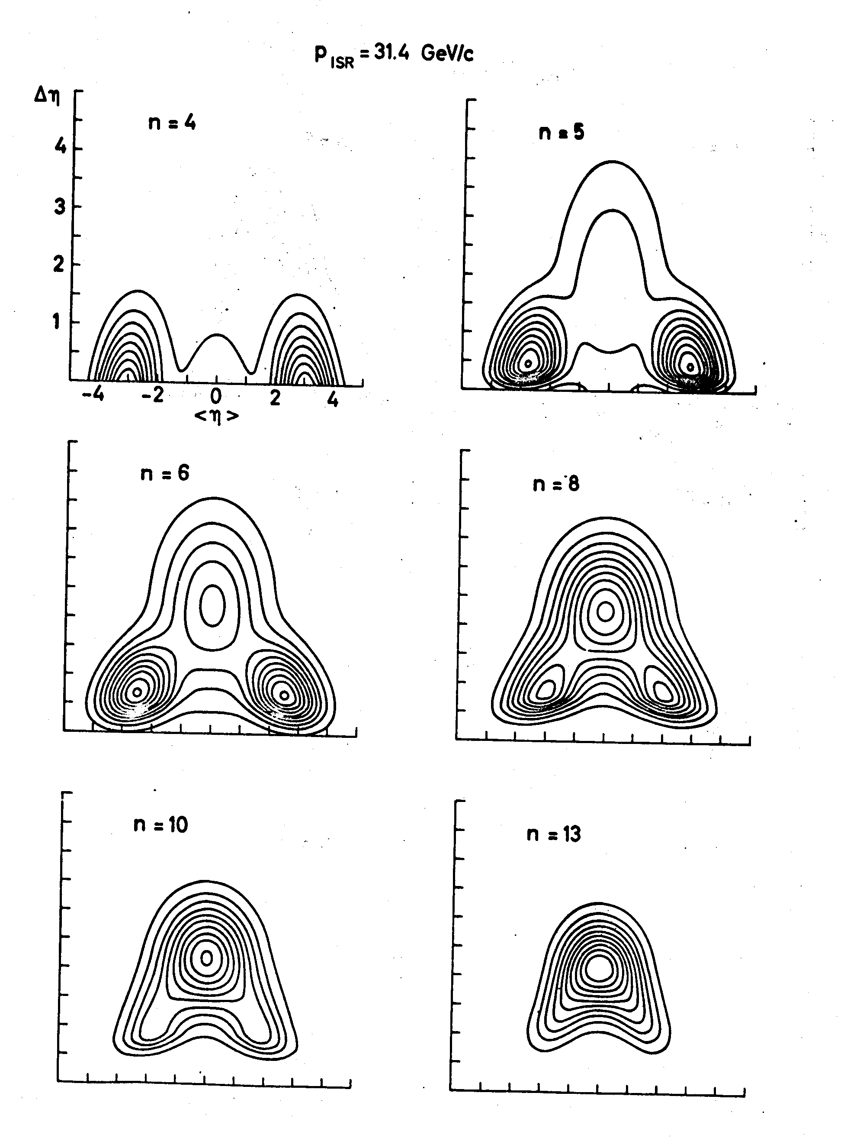
Diffraction prongs in R801
The constant dispersion contours in the <η>,Δη plane show clearly that at small multiplicities particle production is concentrated in two particle jets downstream the beams.
Downstream both beams the track at the smallest angle (likely to be the scattered primary) was removed. In events of small multiplicity, in a two-dimensional plot of track azimuth versus pseudorapidty, the remaining tracks grouped in bumps at a small angle.

Slide 63
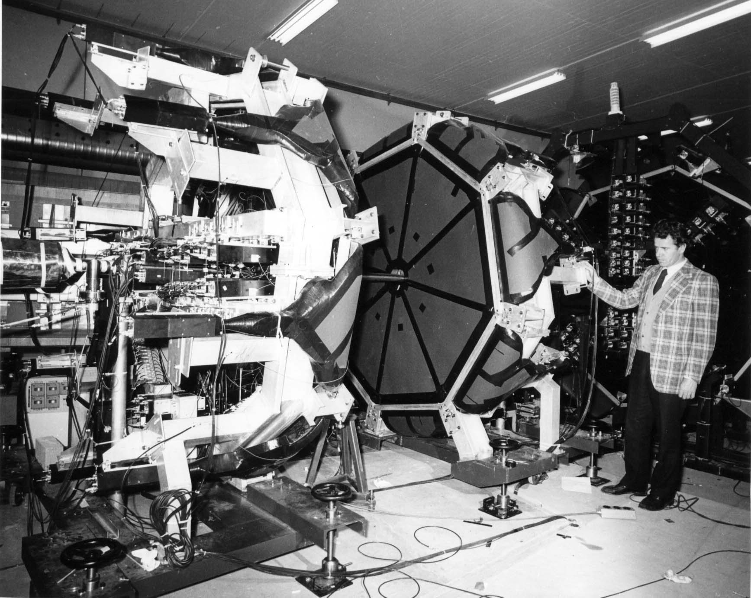
R801 hodoscopes

Slide 64
Second generation SFM arrangement
SFM combined with a large angle magnetic spectrometer

Slide 65
An electron detector
The CERN-Columbia-Rockefeller-Saclay experiment on large angle electron production, first and second generation.

