Slide 1

The Higgs Discovery*
Danfest
19 October 2018
Joe Incandela
* Title chosen by organizers

Slide 2
A tale of two sides (to every argument)
How it all played out:
The hay day of colliders:
  ISR→Spps
  → LEP+SLC+Tevatron
  →(SSC)+LHC
Experiments
  ISR Lessons become
  UA1 and UA2, inspiring
  CDF and DZero
  ALEPH, DELPHI, L3,OPAL also inspiring CDF and Dzero upgrades
Pulling it altogether:
  CMS and ATLAS
Theory:
  beautifully minimal and elegant phenomenology
    for the history of how it came to be I recommend the talk by Jojn Illiopolous at Higgs Hunting 2012 in Orsay
  That’s incredibly unnatural
Accelerator:
  Hadron colliders, broad-band production for discovery
  versus Lepton Colliders – narrow-band for control and precision
Experiment:
  Calorimetry versus tracking
  Data-driven versus Monte Carlo
  Particle Flow versus ?

Slide 3
The history of particle physics
Parallel experimental and theoretical developments
  Discovery of several layers of fundamental particles
  Realization of the importance of Gauge symmetries
  And some accidental symmetries…
Top quark Observation in CDF: 10th topical workshop on pp collider physics: 9 May 1995 FNAL

Slide 4
Gauge Fields
EM: field potentials ⇒ gauge freedom
  ∂_{μ}F^{μν} = j^{ν} = (ρ, j) F^{μν} = ∂^{ν}Α^{μ} - ∂^{μ}Α^{ν}
  ∂^{μ}∂_{μ} Α^{ν} - ∂^{ν} (∂_{μ} Α^{μ}) = j^{ν}
  Invariant for: Α^{μ} → Α′ ^{μ} = Α^{μ} + ∂^{μχ},
QM: phase invariance tied to gauge invariance
  ∂_{μ} → D_{μ} = ∂_{μ} + iqΑ_{μ} ≡ covariant derivative
QFT: Fields become operators
  QED Free massless photon Lagrangian
  L_{em} = -1/4 F^{μν} F_{μν} ( F^{μν} ≡ ∂^{ν}Α^{μ} - ∂^{μ}Α^{ν} )
  L_{em} = -1/4 F^{μν} F_{μν}+(m²/2)Α^{μ}Α_{μ} is not gauge invariant !
  Covariant derivative prescribes particle interactions
  Lagrangian for free Dirac spinors:
  L_{D} = Ψ(iγ^{μ} ∂_{μ} -m)Ψ
  Gauge/phase invariance ∂_{μ} → D_{μ} = ∂_{μ} + ieΑ_{μ}
  L_{D} → L_{D}’ = L_{D} + j^{μ} Α_{μ} where j^{μ} = e Ψγ^{μ}Ψ
  L= -1/4 F^{μν} F_{μν} + Ψ(iγ^{μ}∂_{μ} - m)Ψ + j^{μ} Α_{μ}
  Euler-Lagrange→ ∂^{μ}∂_{μ} Α^{μ} - ∂^{μ}(∂_{ν} Α^{ν}) = j^{μ}
SU(3)_{c}⊗SU(2)_{L}⊗U(1)_{Y}
Gauge theories
  Classical EM Gauge Invariance
  Quantum Mechanics Phase Invariance
    Presence of Aμ
  Quantum Field Theory
    QED - U(1)
      gauge invariance implies massless photon
    QCD - SU(3)_{c}
      Gauge invariance implies massless gauge quanta (8 gluons)
      Quark confinement → jet production
What about the weak nuclear force ?
Higgs Hunting with Hadron Colliders, May 2000

Slide 5
Weak Force & EWK Symmetry Breaking
Weak Nuclear Force
  Hints of SU(2) gauge symmetry
    Doublets, Universal Coupling G_{F}
  But short-ranged ⇒ massive gauge quanta
    Interactions only observed over short distances (effectively contact interactions)
    Coupling G_{F} ~ 1/M²
  How to reconcile ?
Example from Nature: Superconductivity
  j^{μ} = (−q²/m) ⏐ψ⏐²A^{μ} (London)
  ∂^{μ}∂_{μ} Α^{ν} - ∂^{ν} (∂_{μ} Α^{μ}) = j^{ν} = (−q²/m) ⏐ψ⏐²A^{ν} ≡ − m²A^{ν}
Cooper pair (boson) wavefcn ψ with non-zero
constant ground state → massive photon
Supercurrents screen the em field making it
effectively short-range
You can have massive gauge quanta when the gauge symmetry is broken
Glashow Weinberg Salam SU(2)⊗U(1)
L = -1/4 W^{μν ⋅} W_{μν} - 1/4 B^{μν} B_{μν}
  W^{μν}_{i} = ∂^{ν} W^{μ} _{i} - ∂^{μ} W^{ν} _{i} + gε^{ijκ}W^{μ} _{j}W^{ν}_{k}
  B^{μν} = ∂^{ν}Β^{μ} - ∂^{μ}Β^{ν}
Add a scalar doublet field
  φ† = 2^{-1/2} (φ₁-iφ₂,H-iφ_{ο}) with potential
  V(φ) = μ²φφ†+ λ⏐φφ†⏐² ( λ > 0 )
  Most general SU(2) invariant and renormalizable (e.g. Gibb’s free energy in ferromagnetism)
  μ² > 0 symmetry retained (T > T_{c})
  μ² < 0 ⇒ ⟨φ⟩_{o} ≠ 0.0 (T < T_{c})
  L_{φ} = (D_{μ} φ)†(D_{μ} φ) − V(φ)
    where D_{μ} = ∂_{μ} + ig (τ/2)⋅W_{μ} + ig′/2 Β_{μ}
    choose gauge: φ† = 2^{-1/2} (0,v+H), ⟨H⟩_{o}= 0
  ⇒ Lagrangian expressed in terms of 3 Massive Vector Gauge Bosons and massless photon:
  W_{μ}± = 2^{-1/2} (W_{μ}¹ ± W_{μ}² ) ;
  M_{W}² = 1/4 g²v²
  Z_{μ}^{ο} = (g²+g′²)^{-1/2}(-g′B_{μ}+gW_{μ}³ ) ;
  M_{Z}² = 1/4 (g²+g′²)v²
  A_{μ} = (g²+g′²)^{-1/2}(gB_{μ}+g′W_{μ}³ )
  M_{A}² = 0
Higgs Hunting with Hadron Colliders, May 2000

Slide 6
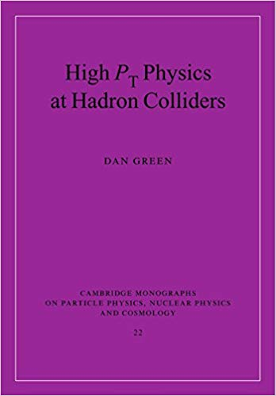
The Higgs & its couplings
Electroweak Couplings satisfy
    gsinθ_{W} = e = g′cosθ_{W} (M_{Z} = M_{W}/cosθ_{W})
    From μ decay G_{F}/2^{1/2} = g² / 8M_{W}² = 1 / 2v²
    M_{W} ~ 80 GeV
Also generate masses for fermions:
  L = λ_{d} Q_{L} φ d_{R} λ_{d} = 2^{1/2} m_{d}/v ~ m_{d}/M_{W}
The coupling is proportional to the fermion mass
  λ_{t} = 2^{1/2} m_{t}/v = 2^{1/2} (174.1)/(246) ~ 1
  Γ(H →ff) = (N_{c}g²/32π) (m_{f}² / M_{W}²)(1-4m_{f}²/M_{H}²)M_{H}
  Γ(H → WW) = (g²/128π) (M_{H}² / M_{W}²)f(x)M_{H}
    where f(x) = (1-x)^{1/2} (1-x+3x²/4) x = 4 M_{W}² / M_{H}²
Γ(H → WW) / Γ(H →ff) ~ M_{H}² / m_{f}²
And there’s also the Higgs term itself:
  2v²λ H² ⇒ M_{H} = (2λ)^{1/2} v
We know everything about the Standard Model Higgs except
  its mass (λ)
  whether or not it exists
The physics and search
Strategies are laid out
Nicely in Dan’s book!
See chapters 1 and 5
Higgs Hunting with Hadron Colliders, May 2000

Slide 7
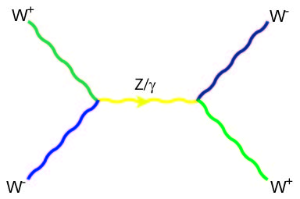

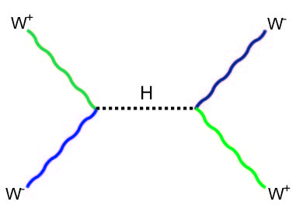

Could we have massive gauge bosons without the Higgs ?
W⁺W⁻ scattering via Z/γ
Unitarity is violated at E > 1 TeV
Including the Higgs:
  So one way or another, something has to show up at the LHC

Slide 8
Hierarchy Problem
The Higgs mass:
  Standard Model particles contribute to the Higgs mass like the top quark does to the W mass but the effects are huge, because the Higgs has no spin:
    δm ~ m_{Planck} ~ 10¹⁹ GeV
  This is a problem … we think ...
    Something is needed to cancel this out
    Or is the universe ‘impossibly’ fine-tuned?
Notes:
Higgs must have mass at the weak scale to avoid unitarity violation in WW scattering.

Slide 9
“Fundamental scalars are fundamentally pathological”
m² =
  36,127,890,984,789,307,394,520,932,878,928,933,023
  -36,127,890,984,789,307,394,520,932,878,928,917,398
= (125)²
No other examples of anything this finely tuned in nature…

Slide 10


THE EXPERIMENTS
ALEPH
ATLAS
OPAL
DELPHI
L3
SLD
UA1
UA2
ISR

Slide 11
“The ISR missed the J/ψ and later missed the ϒ “
  Maurice Jacob at the last meeting of the ISR committee, January 27,1984*
  “...it took a long time to overcome two major difficulties of collider physics. The first… the relatively low luminosity… The second…the very wide angle spread over which particularly interesting events, such as lepton pair events, may occur…
  The answer is, of course, sophisticated detectors covering at least the whole central region (45º < θ < 135º) and full azimuth.“
  “ …they stumbled on an unexpectedly strong hadron yield; large-p_{T} production had been discovered, a witness, as we now know, to the pointlike structure within hadrons.
  Early ISR experiments were not prepared for the J/ψ and as they were corrected they got scooped for the ϒ. The next generation would not be a repeat:
The SppS experiments (UA1,UA2), were prepared and on time.
J. Incandela, INSTR99 conference, Hamamatsu-City, Nov. 15,1999
*Maurice Jacob, Kjell Johnsen, “A Review of Accelerator and Particle Physics at the CERN ISR”,
CERN 84-13, (30 November, 1984)

Slide 12
Some Hadron Collider History
  ~5k tons (1/2 in central)
  ~10m each direction
  ~100 Hz readout
  1.4 Tesla magnet
Tracking |η|< 2.0-2.5
  Drift cell tracker |η|<1.1
  ~720k channels Silicon
  Mouns |η|<1.5
Pb/Cu+Scintillator EM/Had calo. |η|<3.2
  JES uncertainty 2-3%
In fact they were originally very different - following the example of UA1 and UA2, resp., who came before them…
CDF and DO performance very comparable at end of Run 2
Central Tracking
  Si Micro-strip Tracker
  Central Fiber Tracker
2 T Solenoid Magnet
Calorimeters
  Central Calorimeter (CC)
  End Calorimeters (EC)
Muon System
  3 sets of detectors
  Scintillating tiles
  Gas Drift Tubes
1.8 T Toroid Magnets
The big change: CDF demonstrated that magnetic spectrometry and high granularity Silicon layers could enable pure and efficient tracking that made up for deficiencies in calorimetry (i.e. P vs E)
Notes:
CDF and D0 initially followed upon the SPPS experience with a spectrometer (CDF following example of UA1) or heavy focus on calorimetry (D0 following example of UA2).
CDF tracking in a 1.5 T field was found to make up for deficiencies in calorimetry relative to D0’s LAr, and the addition of Si vertexing really opened up new vistas in B and Top physics in Run 1
For Run 2, the two experiments were much more similar in capability, with D0 adding a B field and substantial new tracking, including silicon

Slide 13

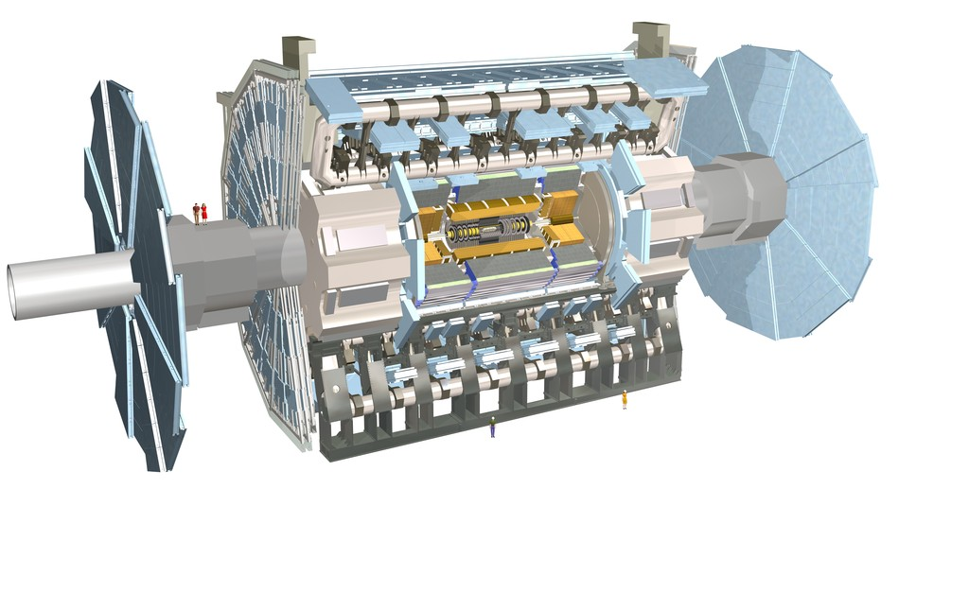
ATLAS and CMS
B field: 2T solenoid, 4T toroid
B field: 3.8T solenoid
 | ATLAS | CMS
Inner tracker : |η| coverage | 2.5 | 2.5
σ(P_{T})/P_{T} at P_{T}=100 GeV | 3.8% | 1.5%
EM calorimeter: |η| coverage | 3.2 | 3.0
σ(E)/E | 10%/√E+0.7% | 3%/√E+0.5%
HAD calorimeter: |η| coverage | 4.9 | 5.2
σ(E)/E (EM+HAD combined) | 50%/√E+3% | 85%/√E+7%
Muon system: |η| coverage | 2.7 | 2.4
σ(P_{T})/P_{T} at P_{T}=1 TeV (standalone) | 12% (|η|<1.5) | 15-40% (depend on η range)
slide courtesy S.-M. Wang
Notes:
At the LHC, CMS focused heavily on all silicon tracking and EM calorimetry in a very high 4 T field but less on Had calorimetry. The high granularity of the all silicon tracking and fine granularity EM calorimetry in high field made particle flow possible. With particle flow, the other tradeoffs were overcome (hadronic energy is the last to be added to jets in pflow, representing only about 15% total, so that even with large uncertainty, one does not have a big impact). This demonstrated the incredible power of combined high granularity tracking and calorimetry…

Slide 14
ATLAS and CMS
B field: 2T solenoid, 4T toroid
B field: 3.8T solenoid
 | ATLAS | CMS
Inner tracker : |η| coverage | 2.5 | 2.5
σ(P_{T})/P_{T} at P_{T}=100 GeV | 3.8% | 1.5%
EM calorimeter: |η| coverage | 3.2 | 3.0
σ(E)/E | 10%/√E+0.7% | 3%/√E+0.5%
HAD calorimeter: |η| coverage | 4.9 | 5.2
σ(E)/E (EM+HAD combined) | 50%/√E+3% | 85%/√E+7%
Muon system: |η| coverage | 2.7 | 2.4
σ(P_{T})/P_{T} at P_{T}=1 TeV (standalone) | 12% (|η|<1.5) | 15-40% (depend on η range)
Built upon experience from Tevatron and LEP: Extensive use of Si pixels and strips, big investments in EM calorimetry, extensive muon systems. Different technologies, but very comparable in performance.
slide courtesy S.-M. Wang
Notes:
At the LHC, CMS focused heavily on all silicon tracking and EM calorimetry in a very high 4 T field but less on Had calorimetry. The high granularity of the all silicon tracking and fine granularity EM calorimetry in high field made particle flow possible. With particle flow, the other tradeoffs were overcome (hadronic energy is the last to be added to jets in pflow, representing only about 15% total, so that even with large uncertainty, one does not have a big impact). This demonstrated the incredible power of combined high granularity tracking and calorimetry…

Slide 15
The Energy Frontier: Hadron Colliders
J. Incandela, INSTR99 conference, Hamamatsu-City, Nov. 15,1999

Slide 16
The Good...
Broadband production
  multiple production mechanisms
    qq,qg,gg (γγ,VV…)
  broad range of CM energy
    with high enough luminosity, one can probe realms far above (and below) the average constituent CM energy
⇒ Discovery machines
J. Incandela, INSTR99 conference, Hamamatsu-City, Nov. 15,1999

Slide 17
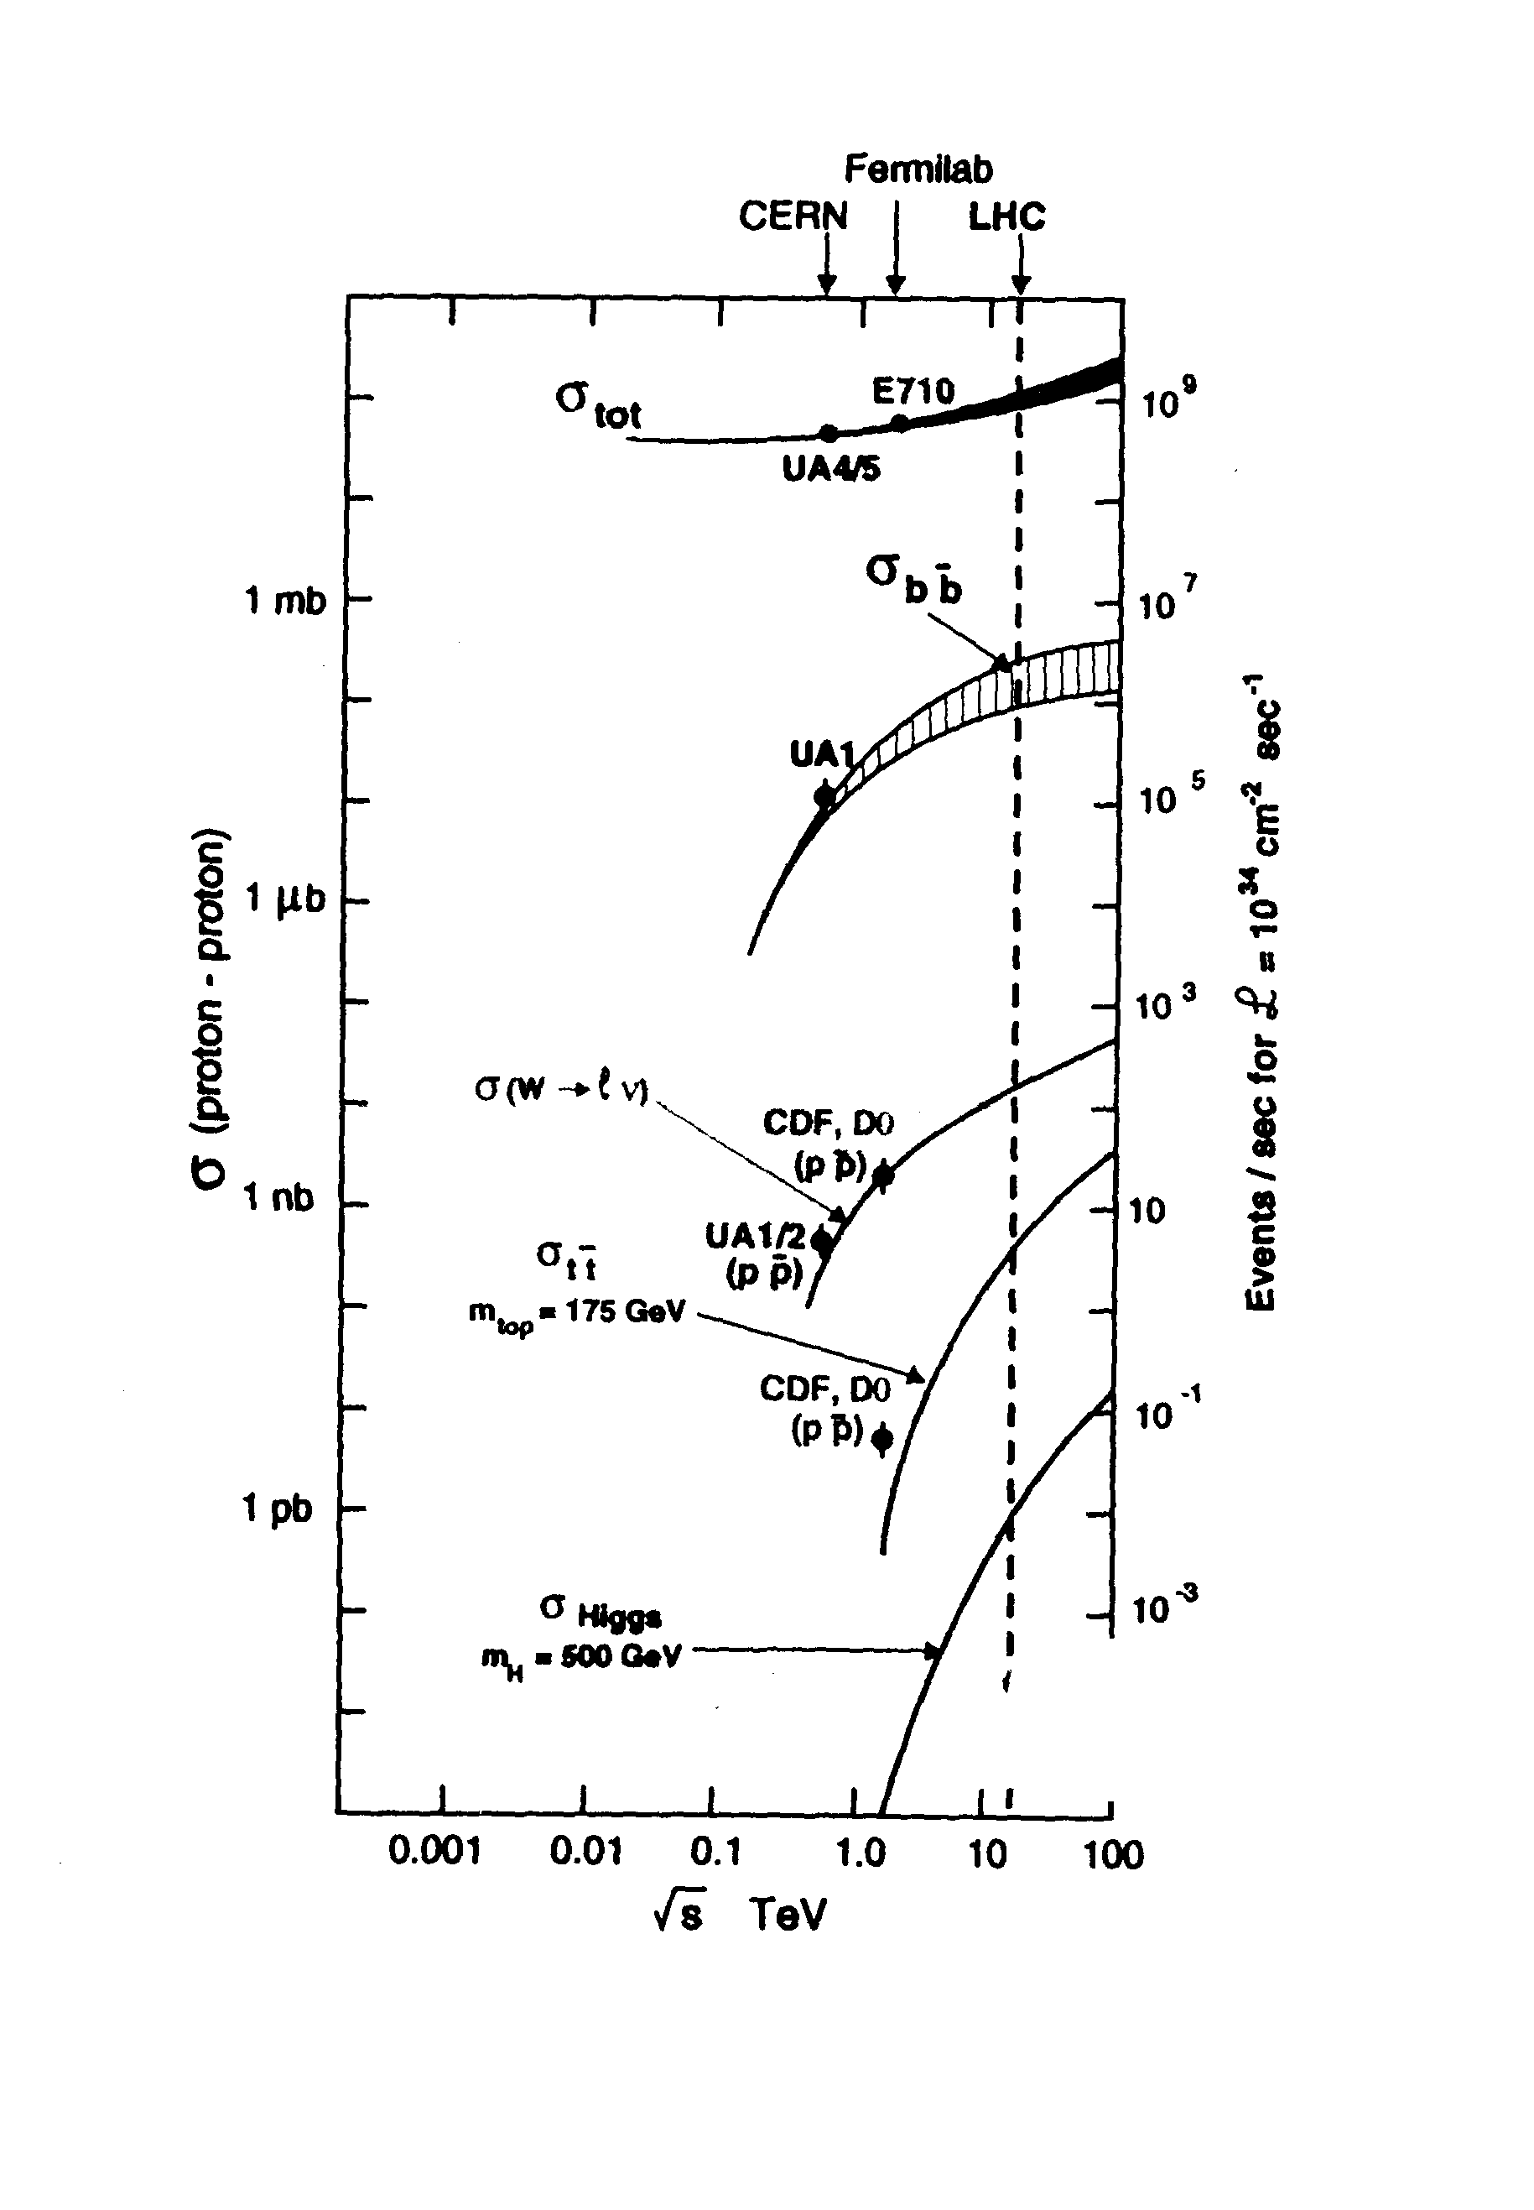
...the Bad...
At the LHC a 500 GeV Higgs has a cross section ratio of ~ 10⁻¹¹ the total cross section.
J. Incandela, INSTR99 conference, Hamamatsu-City, Nov. 15,1999

Slide 18
...and the Ugly.
Charged particle versus pseudorapidity in LHC minimum bias events
Pileup: High Luminosity means multiple interactions.
  At design luminosity, LHC experiments will face roughly 25 minimum bias events per bunch crossing
Parton distributions mean no beam energy constraint
  conservation in the transverse plane only
Initial state radiation (QCD)
  Means even more activity
J. Incandela, INSTR99 conference, Hamamatsu-City, Nov. 15,1999
p_{T} distribution of Charged particles in LHC minimum bias events

Slide 19
W - right where it should be…
The results shown here are old (c. 2002) but make the point

Slide 20
And the Z
χ
J. Incandela, INSTR99 conference, Hamamatsu-City, Nov. 15,1999

Slide 21
W Mass
The cross-section ratio was ~10⁻⁹ at the SPS for discovery of the W by the UA’s.
Yet … UA2, CDF, D∅ achieved high precision mass measurements.
J. Incandela, INSTR99 conference, Hamamatsu-City, Nov. 15,1999

Slide 22
Top Quark
Displaced Vertex b tagging
  CDF and D∅ successfully found the top quark with a cross section of ~ 10⁻¹⁰ the total cross section... They exceeded initial expectations.
CDF
CDF
J. Incandela, INSTR99 conference, Hamamatsu-City, Nov. 15,1999
CDF

Slide 23
Top Event in D∅
J. Incandela, INSTR99 conference, Hamamatsu-City, Nov. 15,1999

Slide 24
CDF: 1st Top Event
Top quark Observation in CDF: 10th topical workshop on pp collider physics: 9 May 1995 FNAL

Slide 25
What’s Next ?
Planned experiments have similar objectives
  SM and SUSY Higgs ⇒ Light Higgs
  SUSY partners
  Precision electroweak measurements
    M_{w}, M_{top}
  B Physics
    CKM and CP Violation
    B_{s} mixing
J. Incandela, INSTR99 conference, Hamamatsu-City, Nov. 15,1999

Slide 26
Higgs at the Tevatron
Accelerator → Main injector upgrade → 2 TeV
  0.5 x 10³² → 5 x 10³²cm⁻²s⁻¹ 396ns → 132 ns: ~1-6 → 3 interactions/xing
  2fb⁻¹ (run 2a) → 10-20 fb⁻¹ (run 2b):
gg→ H dominates but swamped by dijets
qq → HV factor 10 lower but easier to separate from background (tt,Wbb,Zbb,WZ)
J. Incandela, INSTR99 conference, Hamamatsu-City, Nov. 15,1999

Slide 27
Higgs Branching vs m_{H}
Lepton id, b tagging and E_{T} are crucial
TeV 2000 (or Tev33?) report noted
that the Tevatron could achieve 5 σ
observation of a 120 GeV Higgs
with 30 fb⁻¹ of data – ca 1996?
J. Incandela, INSTR99 conference, Hamamatsu-City, Nov. 15,1999
m_{H} < 120: H→bb dominant:
  ⇒ W(lν,qq’)bb, Z(νν,ll,qq)bb final states
m_{H} > 140: H→WW dominant:
  ⇒ W⁺W⁻,W⁺W⁻W±, W⁺W⁻ Z : l⁺l⁻νν, l⁺l′⁺ννjj, l⁺l⁻l′± final states
MSSM: same channels as SM and possible enhanced association to bb at large tanβ

Slide 28
THE LHC

Slide 29
Hadron Colliders (1980-present)
Beginnings are important
2012 guess
2011 est.
Preparing for first data – presentations in 2008-10

Slide 30
Hadron Colliders (1980-present)
Early
discovery
2012 guess
2011 est.
Preparing for first data – presentations in 2008-10

Slide 31
Hadron Colliders (1980-present)
Early
discovery
2012 guess
2011 est.
Preparing for first data – presentations in 2008-10

Slide 32
Hadron Colliders (1980-present)
Early
discovery?
2012 guess
2011 est.
Preparing for first data – presentations in 2008-10

Slide 33
2010

Slide 34
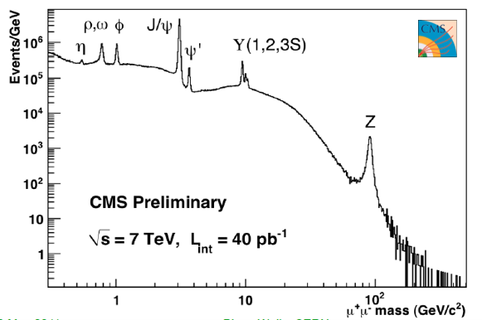
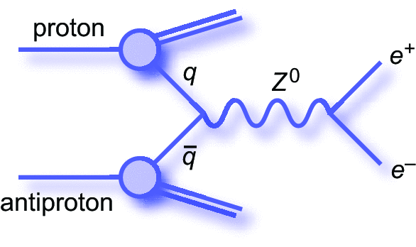
Re-discovery of the Standard Model
[uu]
[dd]
[ss]
[cc]
[bb]
μ⁺
~1960
1974
1978
proton
μ⁻
1983
40 pb⁻¹ collected in 2010

Slide 35
2011

Slide 36
Where we stood summer 2011
July 2011
  M_{t}=173.2 ± 0.9 GeV
  M_{W}=80.399 ± 0.023 GeV
⇒M_{H} = 89⁺³⁵₋₂₆ GeV (68% CL)
Between the red diagonals
a
a
M_{H} < 185 GeV (95% CL)
  But we don’t assume it’s not above 185 without a direct search…

Slide 37
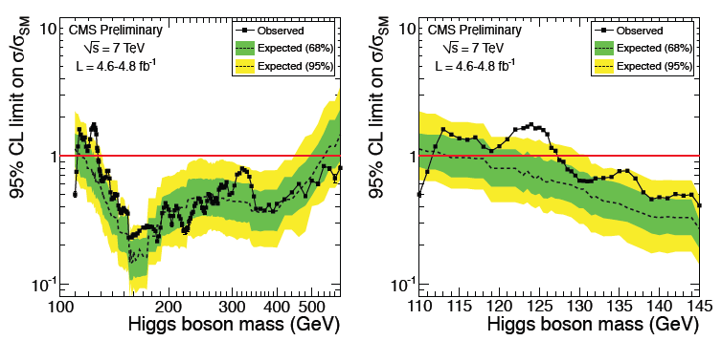
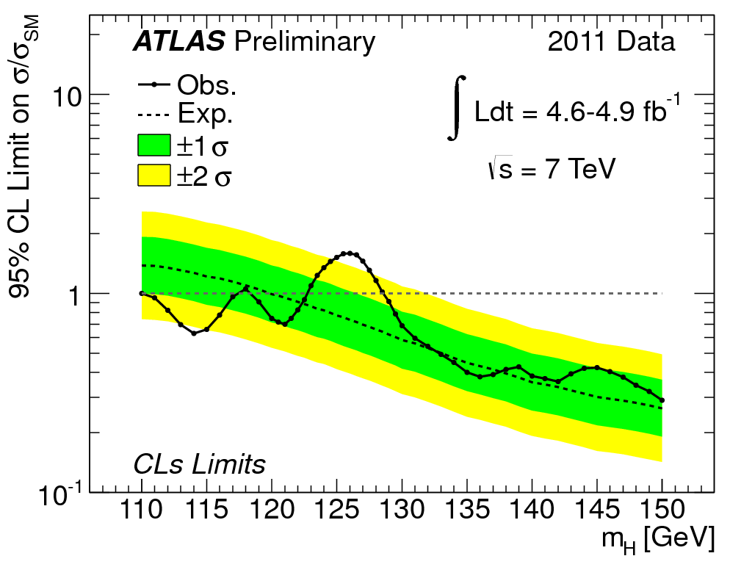
End of 2011
Obviously we need (a lot) more data
  We’re sitting in a very vulnerable position
Coincidental small excesses at 125 GeV …
  We tend to believe something is there because we expect it to be there (given that it’s not anywhere else).

Slide 38
Overview of the 125 GeV region
Results are not so consistent
  Tevatron
      bb: CDF yes, D∅ no
      WW: CDF no, D∅ yes
  LHC
      gg→ H → γγ: CMS not much, ATLAS YES
      VV→ H → γγ + 2 jets: CMS yes, ATLAS not much
      ZZ⁽*⁾: ATLAS YES, CMS a bit
      WW⁽*⁾: ATLAS no, CMS a bit
Or perhaps this is how the Higgs discovery begins
  First sightings are lucky upward fluctuations…

Slide 39
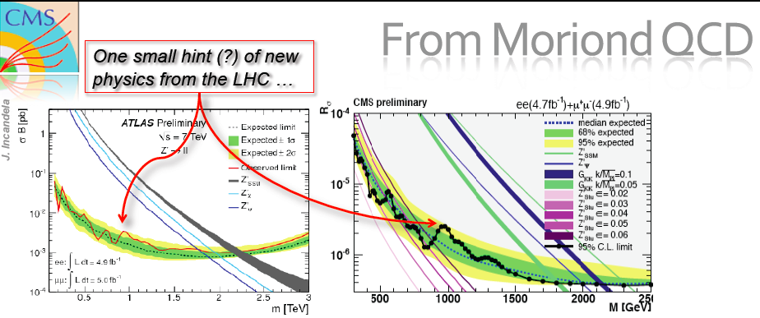
End of 2011
Hopefully we’ll also see something in other searches
  Up to now, it has been surprisingly quiet…
    The rise in √s to 8 TeV gives us some new territory to explore.
Z’ → ll search

Slide 40
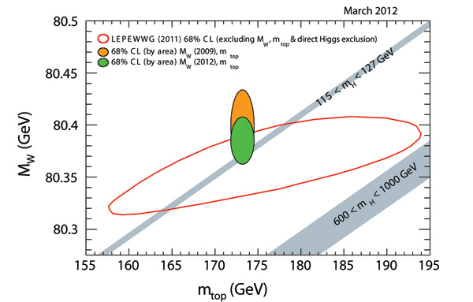
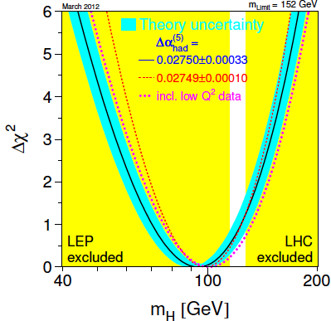

SM Higgs in perspective
M_{top}vs. M_{W}
  Tevatron M_{W} Tours de Force!!
    m_{W} = 80385 ± 15 MeV ( World Ave – Mar 2012)
  Shifts for SM Higgs expectation
Colliders leave little space
Combined precision
Electroweak data
This is the main story of the 2011
We eliminated >450 GeV of the mass range.

Slide 41
Early 2012

Slide 42

The year of the Dragon…

Slide 43
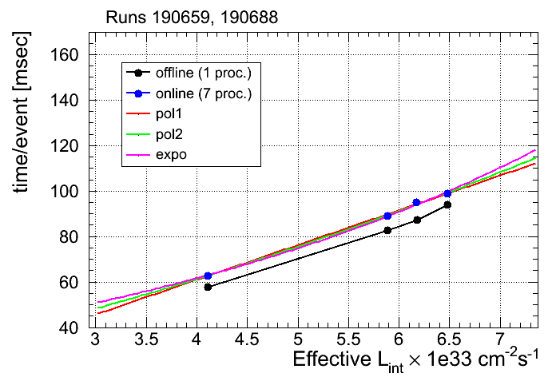
At 5.3E33, heading to 7E33 and beyond (?)
CMS HLT
Peak rate: ~500 Hz @ 5x10³³cm⁻¹s⁻¹
Average : ~385 Hz
PU ~27
Prepared for
7 x 10³³ cm⁻¹ s⁻¹
PU~30
PU ~25
PU ~17
~100 ms per event near is our old limit.
Upgraded HLT farm in early May as have other experiments.
Limit now around 170-180 ms

Slide 44
Pileup Studies for Physics
CMS Studied <PU> ~25
No optimizations as of yet. Just re-run 2011 analyses
  Impact on low mass Higgs
    H → γγ sees about 15% equivalent lumi loss
    Worse (much) for H → ττ, WW
No significant impact on precision top physics
No significant impact on B_{d/s} → μμ

Slide 45
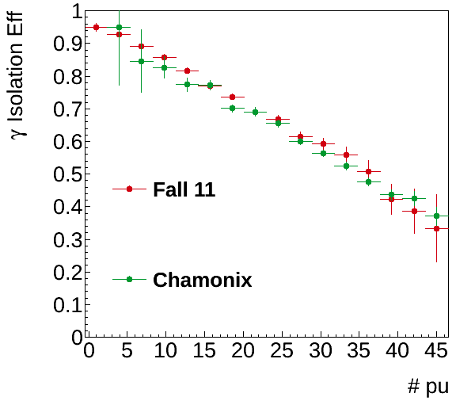
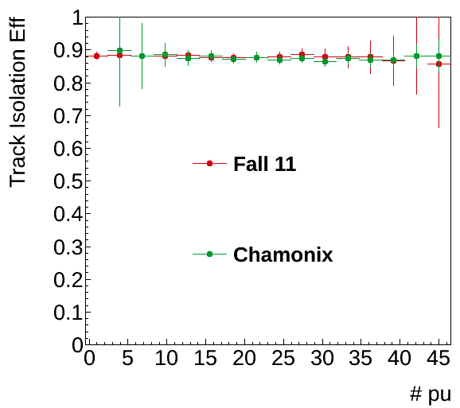
High-PU Effect on γ Isolation
  Photon isolation efficiency (5% relative isolation cut)
  No effect on track isolation (same 5% relative isolation cut)
Calorimeter
Isolation ☹
Tracker
Isolation ☺
CMS Simulation
CMS Simulation

Slide 46
CMS Preparations for 8 TeV and high PU in 2012
Last Autumn
  cpu time for high PU >40 sec/event
  Memory usage well above 2 GB.
    Means we cannot use all the cores!
  Even 200 Hz looked hard!
Task force started December
  Major success!
Improvements
  A factor 2.5 in speed
    Under ~15” per event on average
  Much reduced memory use
    Well under 2 GB
Physics performance unchanged
  Kept our AAA rating:
    E.g. no explicit p_{T} threshold on tracks
Prompt Reconstruction at Tier-0:
Limit on our data-taking rate versus event processing time for low and high memory use cases

Slide 47
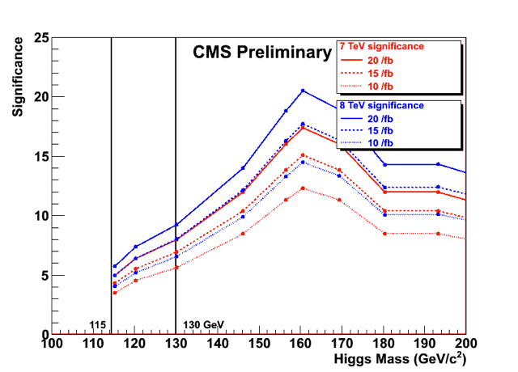
Now what can we expect in 2012?
We should be able to find the SM Higgs or kill it…

Slide 48
June 14-15, 2012

Slide 49
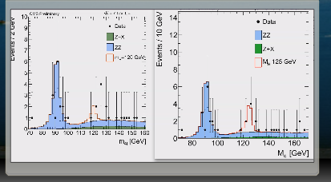
We’ve got it !
Screen shot from the unblinding of the ZZ channel signal region
- evening of June 14th 2012

Slide 50
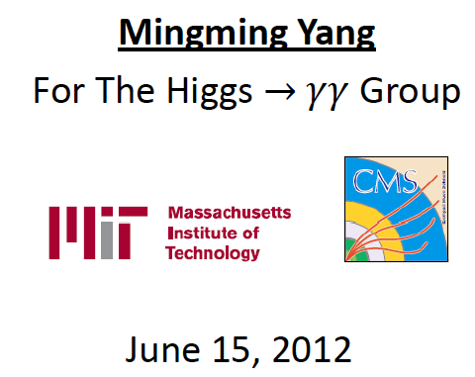
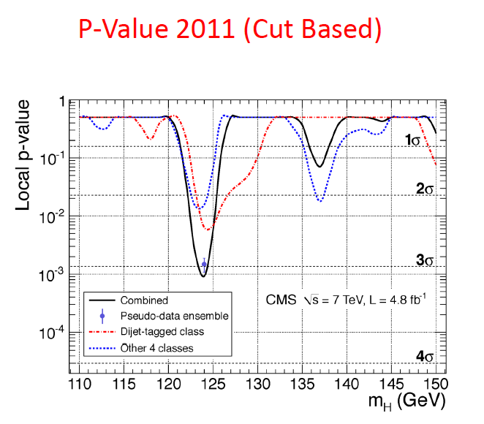
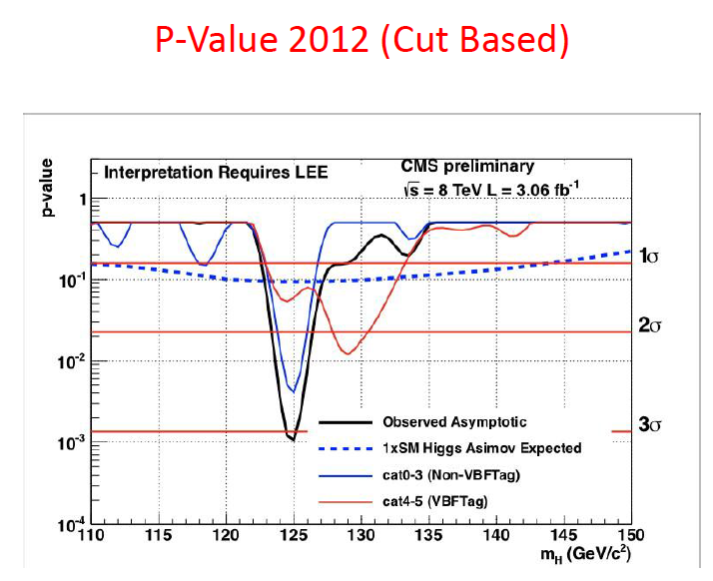
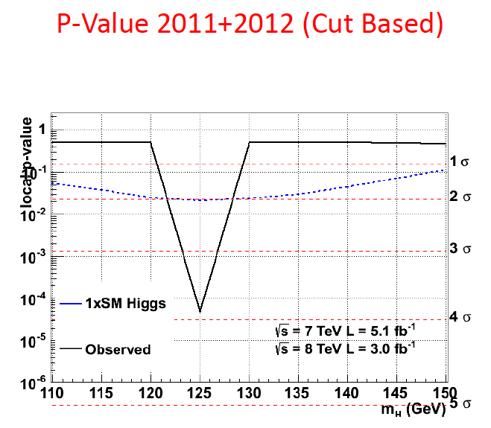
“Are you ready?”

Slide 51
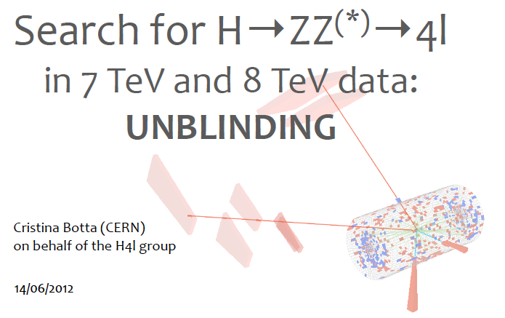
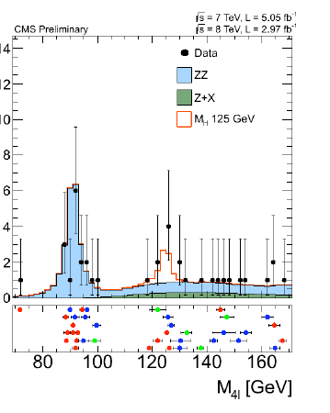
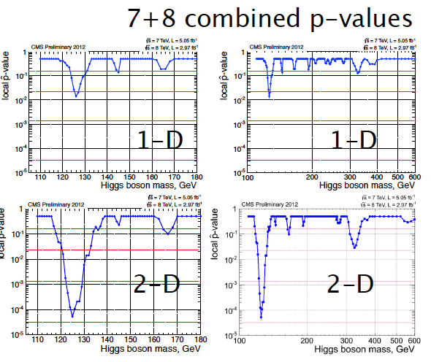
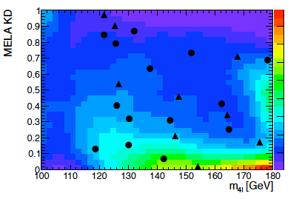
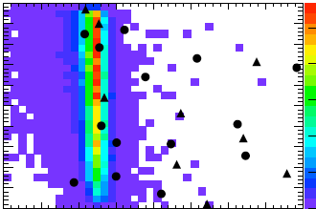

Slide 52
July 4, 2012

Slide 53
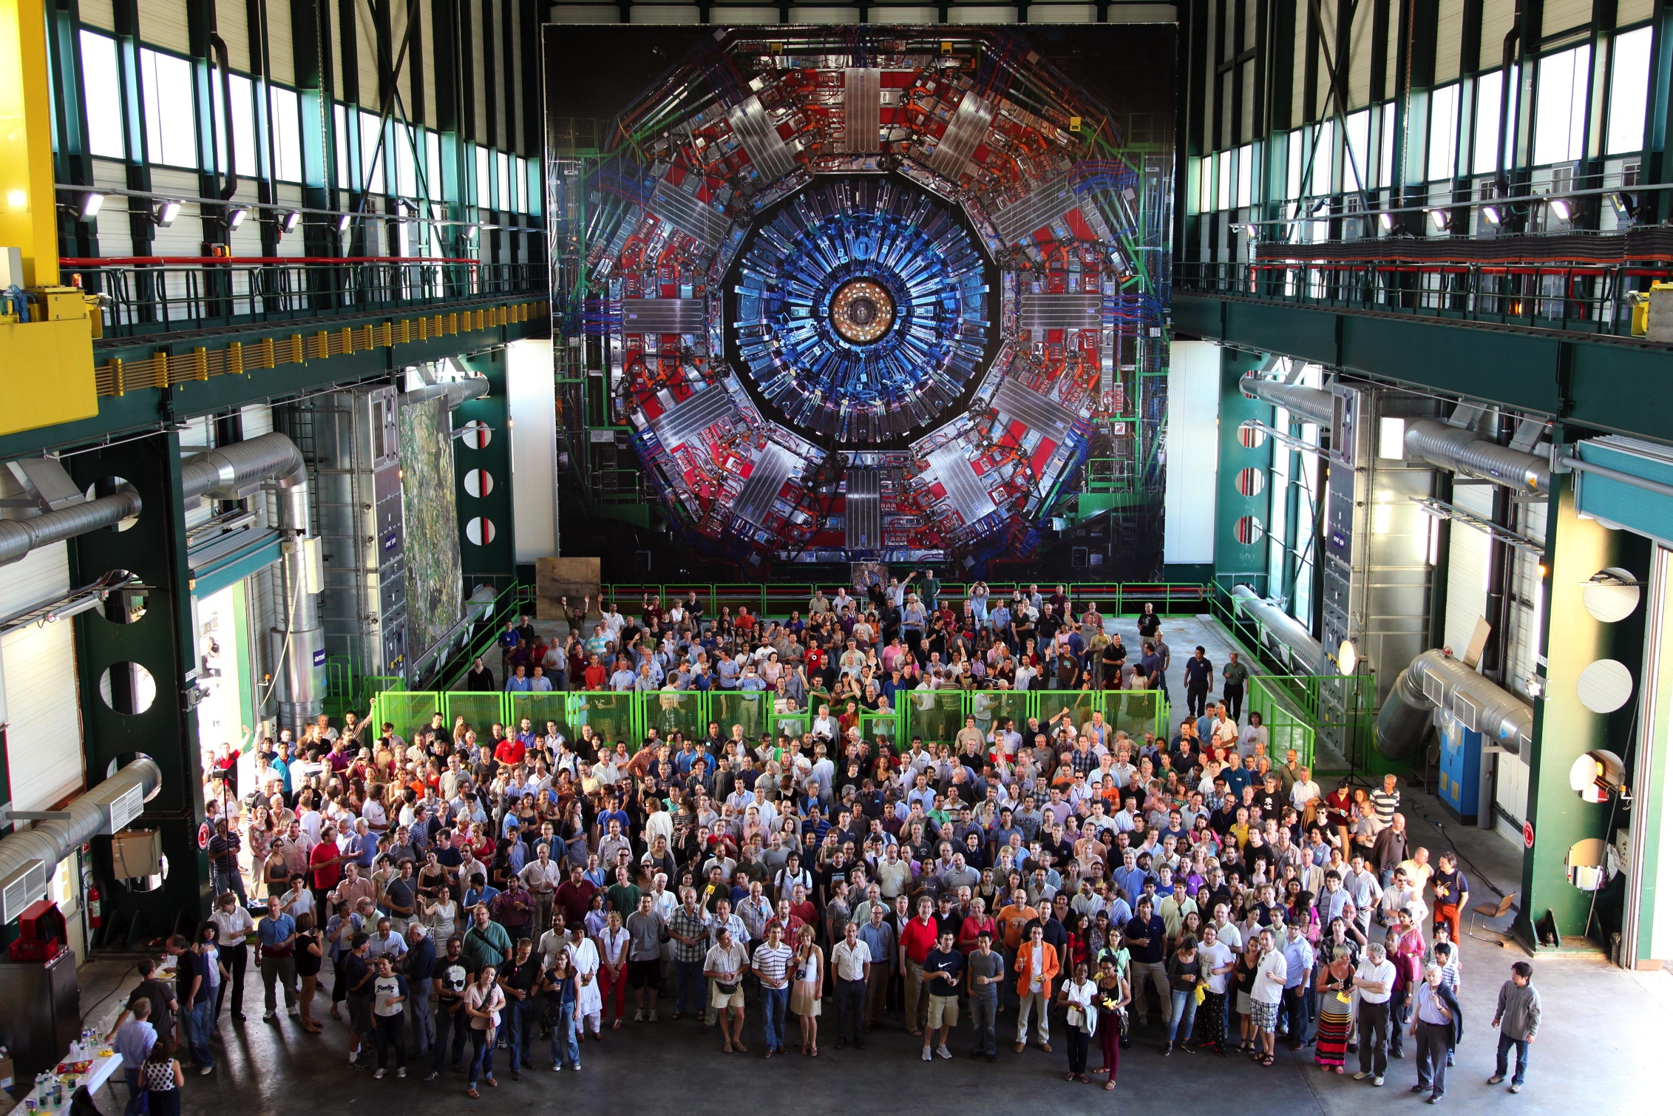
On behalf of the CMS Collaboration

Slide 54
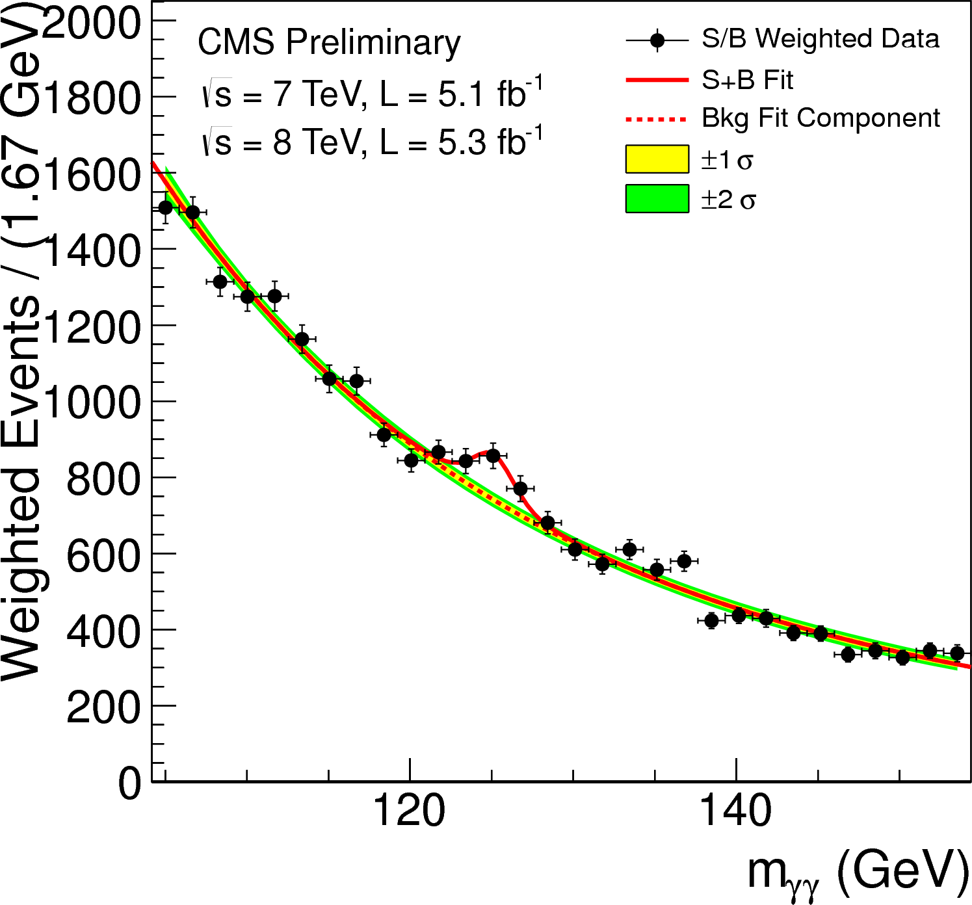
S/B Weighted Mass Distribution
Sum of mass distributions for each event class, weighted by S/B
  B is integral of background model over a constant signal fraction interval
Notes:
The weighting of events is similar to what is used in the final significance extraction

Slide 55
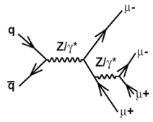
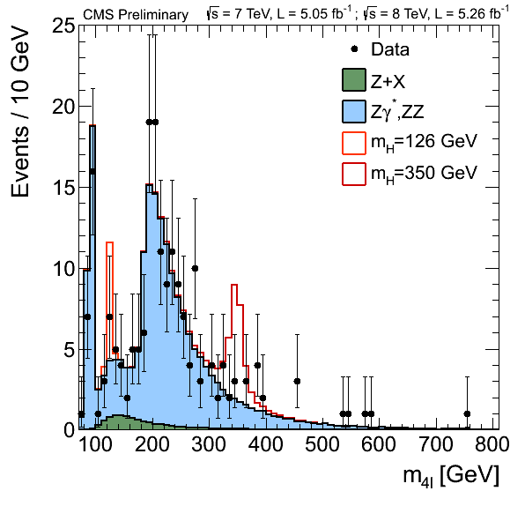
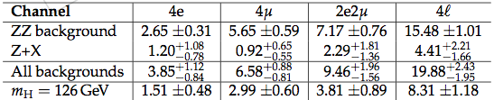
Results: m(4l) spectrum
2011+2012
Yields for m(4l)=110..160 GeV
164 events expected in [100, 800 GeV]
172 events observed in [100, 800 GeV]
Event-by-event errors
55
Notes:
-Z -> 4 l is a standard candle that shows good agreement
and high performance in reconstructing 4 lepton candidates
-Maybe one can stress that the Z peak represents a
cross check on how well we trust what we see in 125
GeV(ATLAS doesnt have it)

Slide 56
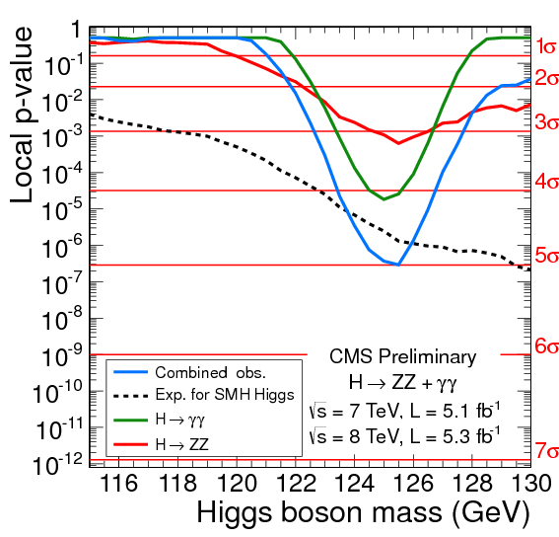
Characterization of excess near 125 GeV
high sensitivity, high mass resolution channels: γγ+4l
  γγ: 4.1 σ excess
  4 leptons: 3.2 σ excess
  near the same mass 125 GeV
comb. significance: 5.0 σ
expected significance
for SM Higgs: 4.7 σ
56

Slide 57
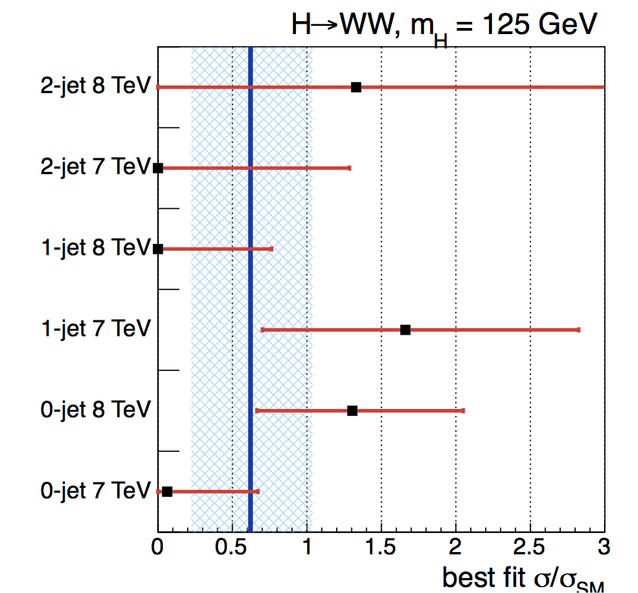
Combination of 7 TeV + 8 TeV
Exclusion range
expected: 123-450 GeV
observed:129-520 GeV
Combined limits from 2011 and 2012
  7 TeV result using a multivariate discriminant and updated with the final luminosity measurement
  2012→ 5% improvement in sensitivity coming from new object definitions and selection optimized for 2012 condition
57

Slide 58
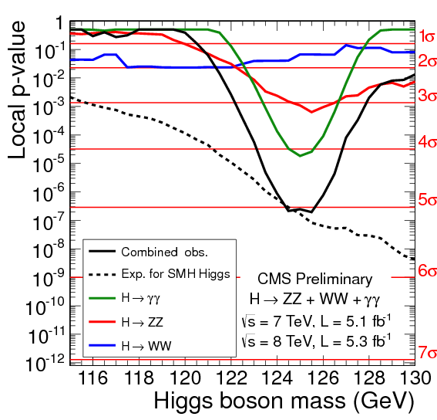
Characterization of excess near 125 GeV
adding high sensitivity, but low mass resolution WW
comb. significance: 5.1 σ
expected significance
for SM Higgs: 5.2 σ
58

Slide 59
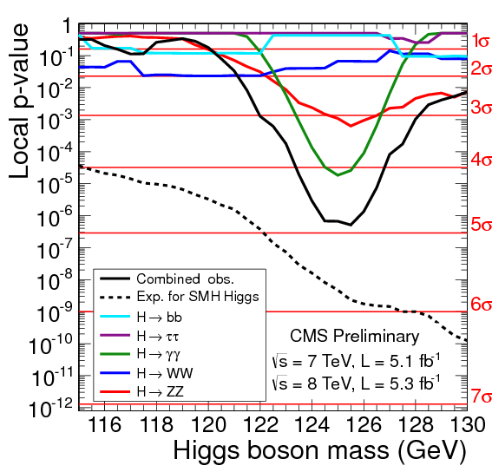
In summary

Slide 60
Thank you Dan!
  Physics first
    Dan made tough choices that were not unanimously appreciated
    But they were crucial to the creation of the best ever collider experiment

Slide 61
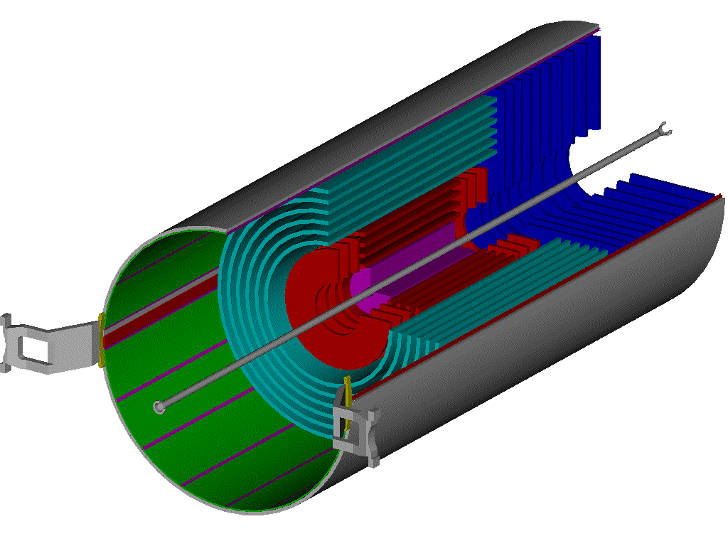
CMS All Silicon Tracker
Outer Barrel (TOB)
Pixels
Inner Barrel & Disks
(TIB & TID)
End Caps (TEC 1&2)
2,4 m
5.4 m
volume 24.4 m³
running temperature – 20 ⁰C

Slide 62
Unprecedented
10,000,000 individual strips
78,000 APV readout chips
26,000,000 wires bonded
207 m² (100 kg) of silicon installed

Slide 63
CMS: The First All Silicon Tracker*
Decision to build an all silicon tracker in 2000
  Widely viewed as risky
    200 m² of silicon when the sum of all silicon previous silicon detectors over 15 years was < 10 m²
  US Tracker group
    1997-1999: plan was to build ~5 m² modules
    This grew to 130 m² by 2005
  Released contingency funds were used to create and then expand the US tracker project
  Dan and I spent what seemed like a century in DOE reviews….
  Thank you Dan for being an outstanding leader

Slide 64
7115 modules built in ~1 year: only 27 were not top grade
  2,644 bad channels out of 4,145,912

Slide 65
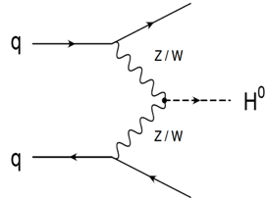
CMS: the best collider detector ever
W+jets
EWK
qqZ
Z+jets
Wγ
tt+jets
Zγ
VBFqqH
WW
t-ch
WZ
tW
ttγ
ggH
ZZ
s-ch
Single top
WWγ , WZγ
VH
EWK
qqW
ttW
ttZ
ttH
EWK W± W±
γγ→WW
Notes:
We also had fantastic measurements of SM processes and excellent MC. We owe a lot of thanks to many theorists who did a lot of work, as well as to all those on the experiments…
This got us really ready for hunting the Higgs. It was going to be found or ruled out for the SM in 2012!

Slide 66


We thank the DOE and NSF for their outstanding steadfast support :
The National Science
Foundation

Slide 67
The end
DanFest - The Discovery of the Higgs –
J. Incandela (UCSB) - 19 Oct. 2018

Slide 68
Problems with the SM
Fermion and Higgs Masses
Gravity
Fundamental Scalars are Fundamentally pathological
  Quadratic divergences in higher order contributions to the Higgs mass
We will return to these in the Part 2

Slide 69
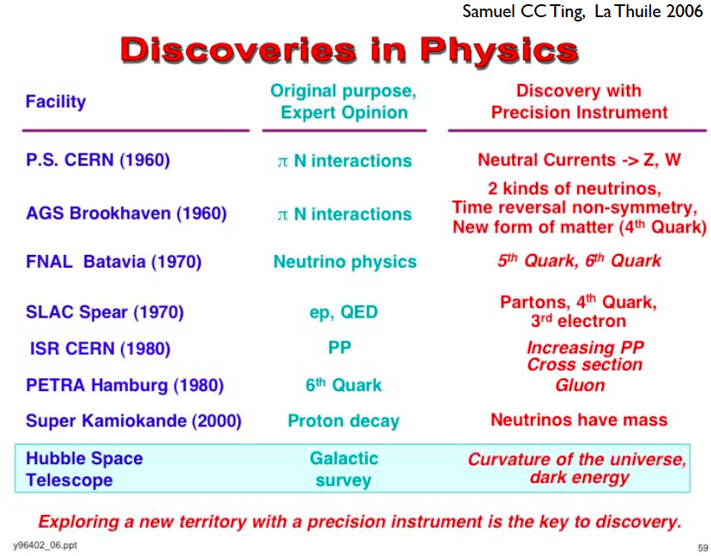
Historical Lessons
From talk by J. Lykken

Slide 70
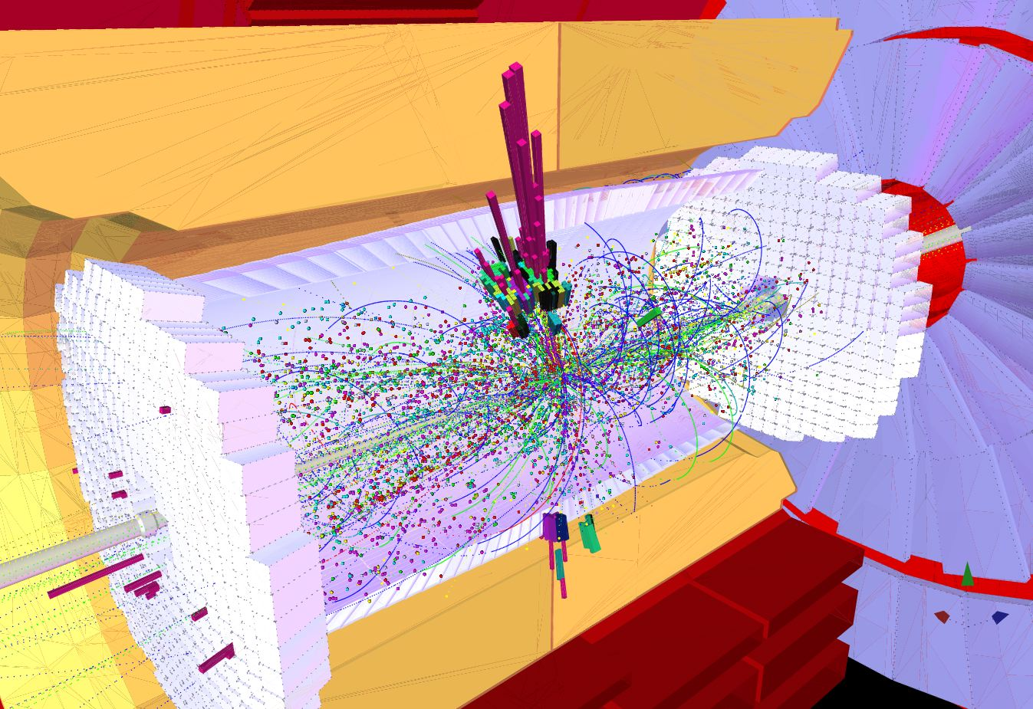
Another step forward: CMS Particle Flow
Reconstruct/identify
  Charged hadrons
  Photons
  Neutral hadrons
  Electrons, muons
    Even non-isolated
  Taus
Use all sub-detector information
  Tracking + fine granularity ECAL+ muons + HCAL
4T field spread particles out
  effectively increasing the granularity
See for instance arXiv:1401.8155

Slide 71
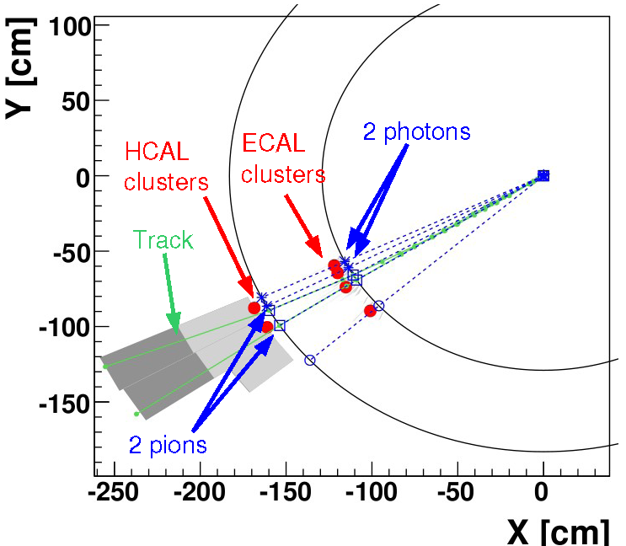
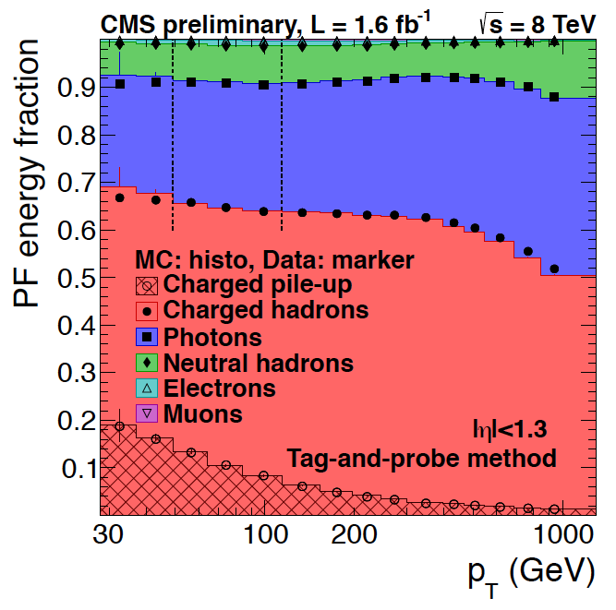
Simple jet example
Algorithm (simplified)
  Tracks (to very low p_{T}) dominate the jet energy.
    Matched to ECAL, HCAL, Muon
    Obtain e’s, μ’s, charged hadrons
  Photons
    ECAL deposits with no track and no significant HCAL deposit
  Finally neutral hadrons
    HCAL deposits -no matched tracks
Use them to build a jet
  Average jet composition versus p_{T} for |η|<1.3 shown at left
  NB: Neutral hadrons ~10% of E

Slide 72
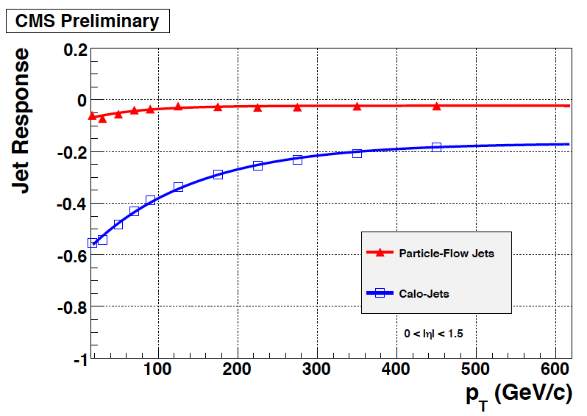
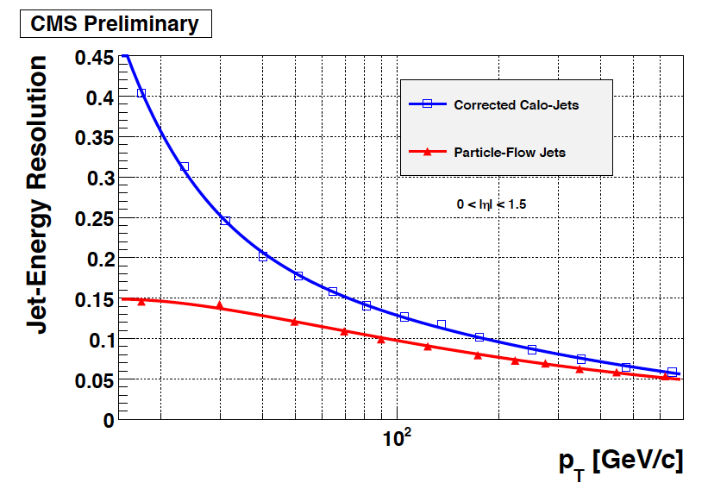
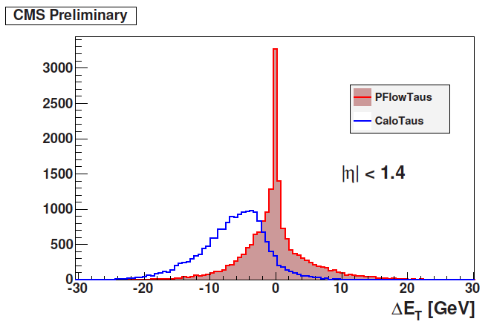
Substantial Improvements
Jet Response & Resolution
  Substantial improvement especially at low p_{T}
  Large improvement also for hadronic τ decays

Slide 73
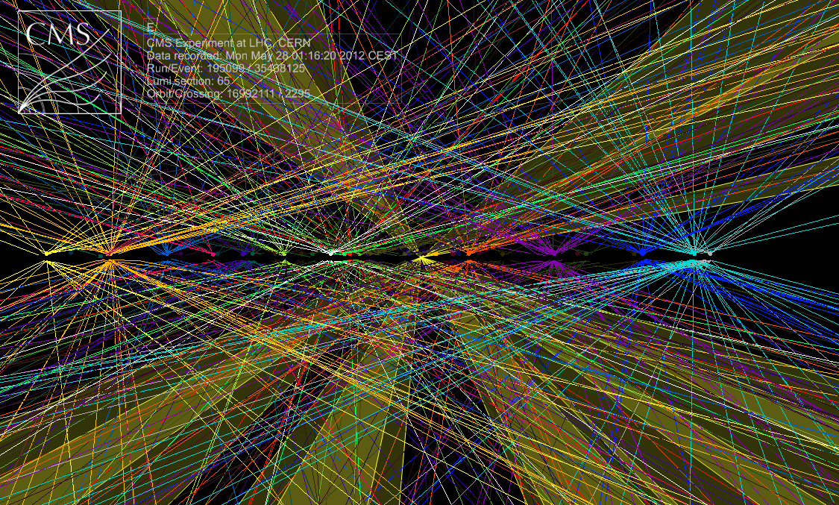
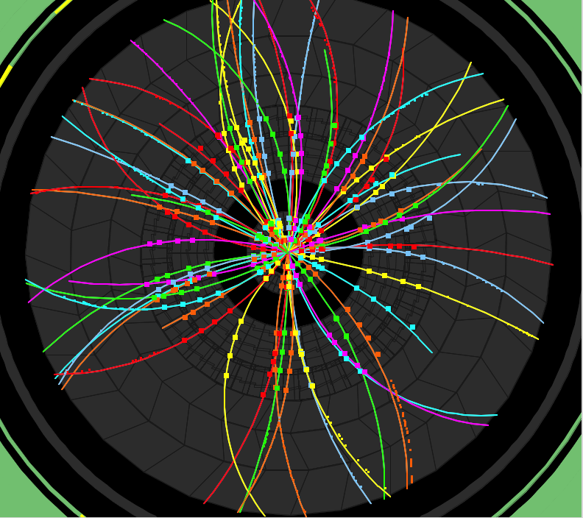
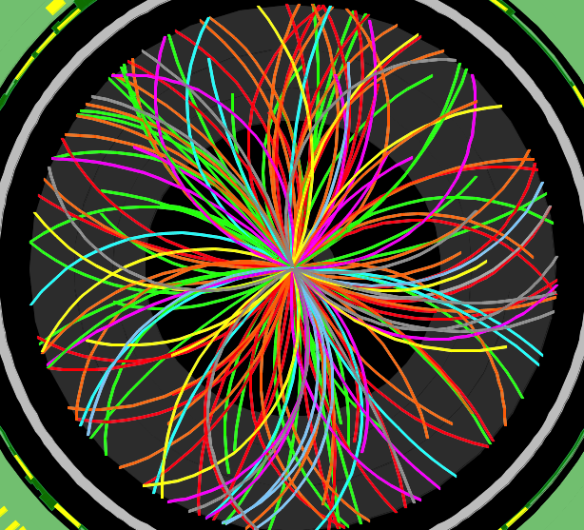

Pileup
Challenge
Events taken at random (filled) bunch crossings
2010
O(2) Pile-up events
150 ns inter-bunch spacing
2011
O(5-10) Pile-up events
50-75 ns inter-bunch spacing
2012
O(20-30) Pile-up events
50 ns inter-bunch spacing
Design value exceeded!

Slide 74
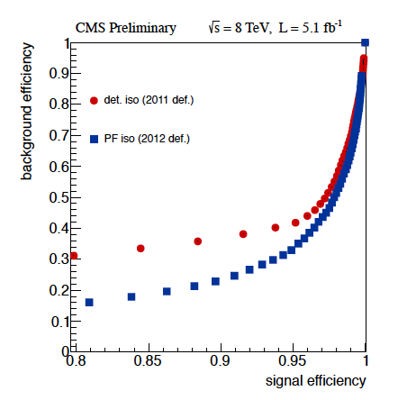
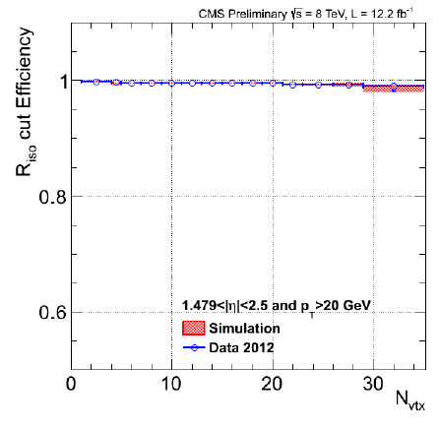
Pflow Electron Isolation, PU
Isolation efficiency is high and stable with number of reconstructed vertices even in the endcaps
  At 87% efficiency have x2 better background rejection
    Charged hadrons contribution does not increase with PU
      Associate primary vertex (PV), use only tracks from correct PV
    Neutrals contribution and total density are both linear with PU
      Former obtained as a constant times the latter and subtracted
      PV Pointing would reduce PU subtraction, reduce uncertainty

Slide 75
Pflow Electron Isolation, PU
Isolation efficiency is high and stable with number of reconstructed vertices even in the endcaps
HL-LHC Pileup will be ~ 140 or higher.
  At 87% efficiency have x2 better background rejection
    Charged hadrons contribution does not increase with PU
      Associate primary vertex (PV), use only tracks from correct PV
    Neutrals contribution and total density are both linear with PU
      Former obtained as a constant times the latter and subtracted
      PV Pointing would reduce PU subtraction, reduce uncertainty

Slide 76
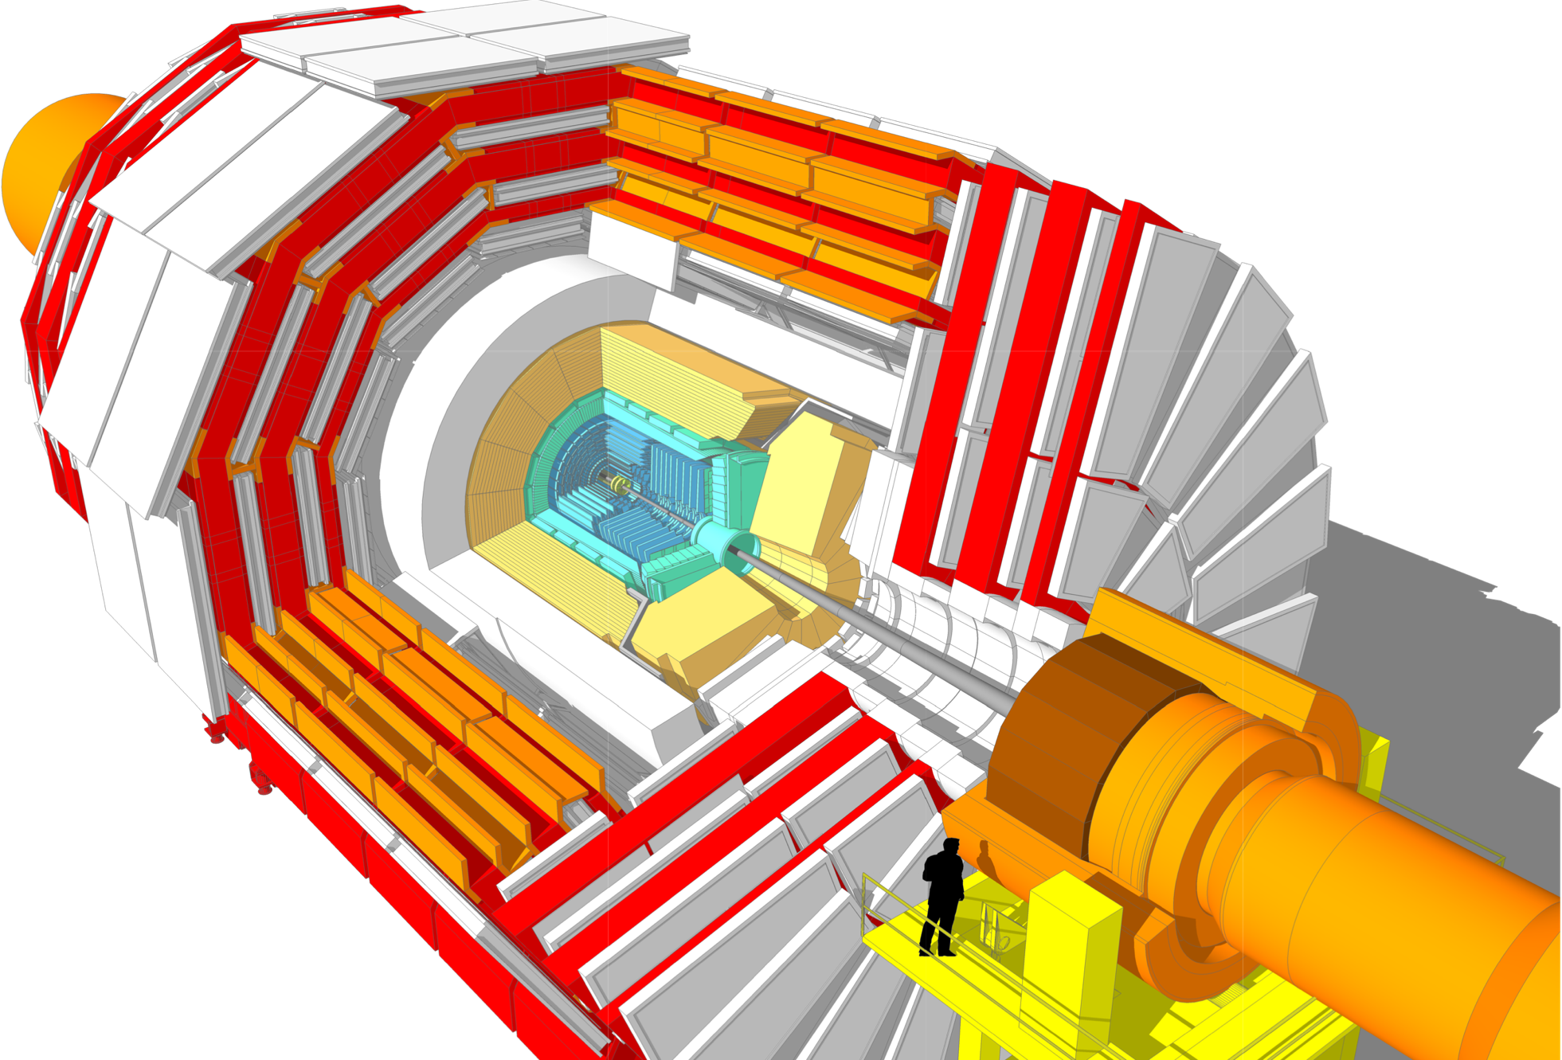
Substantial Opportunity:
Phase 2 Upgrades
Tracker
Muon system
Higher granularity
Less material
Better p_{T} resolution
Extended η coverage
Track trigger at L1
GEM Glass RPCs
Extended η coverage
New DT minicrates
Trigger/DAQ
New FE and RO
L1 up to 1 MHz
HLT up to 10 KHz
Tracking at L1
Replace Endcap Calorimeters

Slide 77

Si-High Granularity Calorimeter:
The next logical step in a decades long trend
Extends Tracking into Calorimeter
Provides good cluster E resolution, very detailed topological information and excellent two-particle cluster res0lving power.
Ideally suited for Particle Flow reconstruction in a high particle density environment

Slide 78


Si-HGC EM Showers
Intrinsic resolution
  Constant term below 1%
  Stochastic term ~20%/√E
    Thin Si for rad-tolerance
      100, 200, 300 μm out of 320 μm physical thickness
  E versus ET
    This is the forward region –may not be a limiting factor for key physics
  This may not be the limit of resolution
Detailed shower evolution available in 3D

Slide 79

Si-HGC EM Showers
EM Shower Evolution
  68% of the shower stays within a few mm radius for ~10 layers!
  Charged and neutral hadrons at distances larger than a few cm can be distinguished

Slide 80
Progress since March 30, 2010 (start of 7 TeV) has been amazing
  Extension of New Physics (NP) searches into new territory is breathtaking
The SUSY searches we have so far performed were not “easy”
  Substantial effort and preparation by many people over many years
Experiments have limited resources
  from trigger bandwidth to seasoned analysts and so require substantial planning and prioritization
Very important:
The LHC program has more “new starts” ahead
  i.e major steps in √s and L
It’s important that we leave no stones unturned at each √s
  We prefer to find something …but what we do not find can provide important constraints on the nature of physics beyond the SM
  It is not very likely we will come back again…
This requires a very systematic approach
  To expand into new and more challenging areas as inspired by new ideas and map out as much signature space as possible
    See the 4 talks from Thursday night for extensive coverage of this topic

Slide 81

Higgs Hunting with Hadron Colliders
ATLAS
UA1
UA2
ISR
J.Incandela/Fermilab
May 2000

Slide 82
Biography: Dan Green received his Ph.D. from the University of Rochester in 1969. He held a post-doctoral position at Stony Brook from 1969 to 1972 and worked for a time at the Intersecting Storage Rings (ISR) at CERN. His next appointment was as an Assistant Professor at Carnegie Mellon University from 1972 to 1978 during which time he was also Spokesperson of a BNL Baryonium Experiment. He has been a Staff Scientist at Fermilab since 1979 and has worked in a wide variety of roles on experiments both at Fermilab and elsewhere. He participated in the D0 Experiment as Muon Group Leader from 1982 to 1990 and as B Physics Group Co-Convener from 1990 to 1994. He led the US compact Muon Solenoid (CMS) Collaboration as Spokesperson and then Project Manager for the US groups working at the Large Hadron Collider (LHC) at CERN. At Fermilab, he was Physics Department Deputy Head from 1984 to 1986 and Head from 1986 to 1990. Beginning in 1993 he served as the CMS Department Head in the Particle Physics Division, and he was Chair of the CMS Collaboration Board from 2008 to 2010.

Slide 83
Gauge Symmetry
Classical EM: Potentials ⇒ gauge freedom
  ∂ _{μ} F^{μν} = ∂ ^{μ}∂ _{μ} Α^{ν} - ∂ ^{ν} (∂_{μ} Α^{μ}) = j^{ν} ≡ (ρ, j)
  Maxwell eqns. invariant under Α^{μ} → Α′ ^{μ} = Α^{μ} + ∂ ^{μ χ}
  Full importance not initially appreciated
Quantum Mechanics: Local U(1) symmetry:
  Lagrangian invariant under Ψ → e^{iθ} Ψ where θ = θ(x), provided that
  ∂_{μ} → D_{μ} = ∂_{μ} + iqΑ_{μ} ≡ Covariant derivative
→ interaction of a charged particle field Ψ with a gauge field Aμ
  e.g. Lagrangian for free Dirac spinors: L_{D} = ·(iγ^{μ} ∂_{μ} -m) Ψ
  Gauge invariance requires: ∂_{μ} → D_{μ} = ∂_{μ} + ie Α_{μ}
  ⇒ L_{D} → L_{D} + j^{μ} Α_{μ} where j^{μ} = e·γ^{μ} Ψ
QFT: Fields become operators
  L_{QED}= -¼ F^{μν} F_{μν} + ·(iγ^{μ} ∂_{μ} -m) Ψ + j^{μ} Α_{μ}
  = -¼ F^{μν} F_{μν} + ·(iγ^{μ} D_{μ} -m) Ψ Where now F_{μν} = [D_{μ ,} D_{ν}]
  L_{GF} = -¼ F^{μν} F_{μν} fixes the gauge:
  To define the covariant derivative D_{μ} one needs to know A_{μ} at every space-time point which, can be given as the solution to a field equation.

Slide 84
Gauge theories continued
C.N. Yang and R. Mills
  Introduced non- Abelian gauge theories to try to make sense of the strong interaction
    Gauge theories with SU(3) symmetry were seen to have the property of asymptotic freedom = observed property of quarks to behave as free particles only at very small distance scales
  → Color charge, Quantum Chromodynamics (QCD) and symmetry group SU(3)_{c}
    Analogous to photon in QED, have 8 massless gluons (8 unique color- anticolor combinations) corresponding to the 8 generators of SU(3)
But massive gauge fields excluded in gauge theories:
  Consider QED free field Lagrangian : L_{em} = -¼ F^{μν} F_{μν}
  If photon were massive this becomes: L_{em} = -¼F^{μν} F_{μν}+½ M_{γ}²Α^{μ}Α_{μ}
  ⇒ The mass term is manifestly not gauge invariant

Slide 85
Gauge theories so far…
    QED - U(1)
      gauge invariance ⇒ massless photon
    QCD - SU(3)_{c}
      Gauge invariance implies massless gauge quanta (8 gluons)
      Quark confinement → jet production
What about the weak force ?

Slide 86
Weak Nuclear Force
  Hints of SU(2) gauge symmetry
    Doublets
    Universal Coupling G_{F}
  But short-ranged ⇒ massive gauge quanta
    Interactions had only been observed over short distances (effectively a contact interaction)
    Coupling G_{F} ~ 1/M² ⇒ massive propagator
  How to reconcile a gauge symmetry with massive field quanta?

Slide 87
An example from Nature: Superconductivity
    j^{μ} = (−q²/m)ψ †ψ A^{μ} (London)
    ∂^{μ}∂_{μ}A^{ν} - ∂^{ν} (∂_{μ} A^{μ}) = (-q²/m)⏐ψ⏐²A^{ν} ≡ -M²A^{ν}
    Cooper pair (boson) condensate has non-zero order parameter ⇒ effective photon mass
      Supercurrents screen the EM field making it effectively short-range
⇒Massive gauge quanta are possible when gauge symmetry is broken.
  Symmetry breaking can always be thought of as being the result of the presence of a specific reference provided by an order parameter.

Slide 88
Electroweak Symmetry Breaking (EWSB)
Glashow Weinberg Salam SU(2) ⊗U(1)
  L = - ¼ W^{μν ⋅} W_{μν} - ¼ B^{μν} B_{μν}
  W^{μν}_{i} = ∂^{ν} W^{μ} _{i}-∂^{μ} W^{ν} _{i} + gε ^{ijκ}W^{μ} _{j}W^{ν}_{k} , B^{μν} = ∂^{ν} B^{μ} - ∂^{μ} B^{ν}
Add a scalar doublet field
  φ† = 2^{-1/2}(φ₁-iφ₂,H-iφ_{ο}) w/potential V(φ) = μ ²φφ† +λ |φφ†|² ( λ > 0 )
      The most general SU(2) invariant and renormalizable potential (e.g. Gibb’s free energy in ferromagnetism)
      μ² > 0 symmetry retained (T > T_{c} )
      μ² < 0 ⇒ ⟨φ⟩_{o} ≠ 0.0 (T < T_{c} )
  L_{φ} = (D_{μ} φ)†(D_{μ} φ) − V(φ)
  where D_{μ} = ∂_{μ} + ig (τ/2)⋅W_{μ} + ig′/2 Β_{μ}
  choose a gauge with φ† = 2^{-1/2} (0,v+H), ⟨H⟩_{o} = 0
    This breaks the symmetry!

Slide 89
Lagrangian now has 3 Massive Vector Gauge Bosons and massless photon:
  W_{μ}± = 2^{-1/2} (W_{μ}¹ ± W_{μ}² ) , M_{W}² = ¼ g² v²
  Z_{μ}^{ο} = (g²+g′²)^{-1/2}(-g′B_{μ}+gW_{μ}³ ), M_{Z}² = ¼ (g²+g′²)v²
  A_{μ}^{ο} = (g²+g′²)^{-1/2}(gB_{μ}+g′W_{μ}³ ) , M_{A}² = 0

Slide 90
Masses
Electroweak Couplings satisfy:
  gsinθ_{W} = e = g′cosθ_{W} (M_{Z} = M_{W}/cosθ_{W})
From μ decay G_{F}/2^{1/2} = g²/(8M_{W}²) = 1/(2v² )
  ⇒ M_{W} ~ 80 GeV and M_{Z} ~ 91 GeV
  Higgs also generates masses for fermions but the couplings (Yukawa), and hence also the masses, vary and are not predicted
  L = λ_{d} Q_{L} φ d_{R} , with λ_{d} = 2^{1/2}m_{d}/v ~ m_{d}/M_{W}
  The top quark is “unshielded” at a mass of 174.1 GeV.
  λ_{t} = 2^{1/2} m_{t}/v = 2^{1/2} (174.1)/(246) = 1

Slide 91
Particle Physics History
2020
100’s of Theories
2000
2000
t
500
W
Z
1980
b
g
Q.C.D. and G.W.S.
100
τ
QUARKS & Leptons
c
SU(3)⊗SU(2)⊗U(1)
u d s
ν_{μ}
1960
20
100’s of Particles
Q.E.D.
1940
μ
U(1)
e⁺
5
ν_{e}
1920
NUCLEI
Nuclear Forces
2
γ
1900
e⁻
ATOMS
1880
1
Electricity & Magnetism:
1880
Gauge Invariance
  Α^{μ} → Α′ ^{μ} = Α^{μ} + ∂^{μ}χ
JI, Top quark Observation in CDF: 10th topical workshop on pp collider physics: 9 May 1995 FNAL

Slide 92
The first well-identified candidate top pair event
Top at LHC, Helmholz Alliance, DESY, December 5, 2007 Joe Incandela
JI and K. Mishima April 1995

Slide 93

Top at LHC, Helmholz Alliance, DESY, December 5, 2007 Joe Incandela

Slide 94

(CDF SVX/SVX’ 1992-1996)
Silicon
5 cm
Top at LHC, Helmholz Alliance, DESY, December 5, 2007 Joe Incandela

Slide 95


“Standalone” Si Tracking in SVX′ c. 1994
JI, Kajfasz, Snider, Stuart…

Slide 96


Delta’s in pp collisions
Notes:
A different event--from collisions rather than cosmics--is http://nucsb03.fnal.gov/~stuart/lgbk/fig116.ps.gz and http://nucsb03.fnal.gov/~stuart/lgbk/fig115.ps.gz

Slide 97

First presentation on ISL design was June 1996
First DOE review Feb. 1997
Completed in 2000 (Above, with much of the group)

Slide 98
SM Higgs Mass Bounds
98
Triviality:
  To avoid having the Higgs self-coupling vanish for a range of larger Higgs masses (which would trivialize the whole concept), you need a cut-off Λ at which new physics is required.
Vacuum stability:
  Require V(φ_{o}) < V(0) - i.e. so that any choice of ground state breaks symmetry as required. For a range of smaller Higgs masses this requires new physics above a scale Λ.
EWK Precision Measurements:
  M_{H} < 200-250 GeV
LEP II direct searches:
  M_{H} ≥ 114 GeV at 95% CL

