Slide 1
Fermilab Experiments and Projects, how INSPIRE can help in the short-term
Heath O’Connell
9th March 2018

Slide 2
Requirements
FIELD | WRITE ACCESS | INFORMATION OWNER(S)
Experiment Number (E, P, T #) | PPO ADMIN | PPO ADMIN
Experiment Name | PPO ADMIN | PPO HEAD, FTBF COORD
Experiment Status (*) | PPO ADMIN | PPO HEAD, FTBF COORD
Date of last Status Change | PPO ADMIN | PPO HEAD, FTBF COORD
Links to Documents (LOI, EOI, Proposal, EOP, TSW, PAC Letters) | PPO ADMIN | PPO HEAD, FTBF COORD, PPO DEPUTY HEAD
Experiment Spokespeople & Terms (**) | PPO ADMIN | PPO HEAD
Experiment Institutions | Spokespeople | Spokespeople
Link to Experiment Webpage | Spokespeople | Spokespeople
Experiment Host | PPO Admin? | PPO? User’s Office?
Validators/Approvers | Users Office | Spokespeople
ITNA/FNAL Contact | PPD Admin? | PPD-Div?

Slide 3
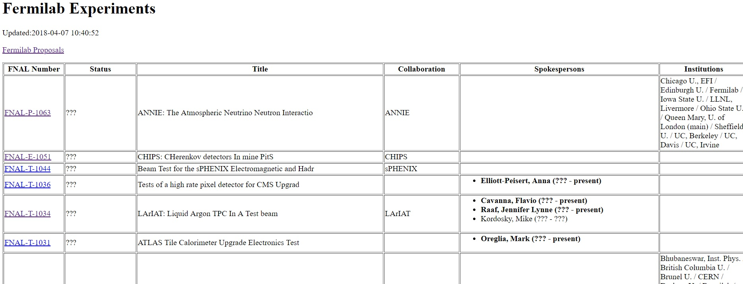
INSPIRE Experiments Database has much of this
http://ccd.fnal.gov/techpubs/fermilab-experiments.html
Records in the database can be easily updated and the html table refreshed. Could be done by PPO Admin or INSPIRE staff (CCD-IR).

Slide 4
Requirements vs INSPIRE
FIELD | WRITE ACCESS | INFORMATION OWNER(S) | Does INSPIRE have it
Experiment Number (E, P, T #) | PPO ADMIN | PPO ADMIN | Yes
Experiment Name | PPO ADMIN | PPO HEAD, FTBF COORD | Yes
Experiment Status (*) | PPO ADMIN | PPO HEAD, FTBF COORD | Would need more information
Date of last Status Change | PPO ADMIN | PPO HEAD, FTBF COORD | Related to above
Links to Documents (LOI, EOI, Proposal, EOP, TSW, PAC Letters) | PPO ADMIN | PPO HEAD, FTBF COORD, PPO DEPUTY HEAD | Could create a place (SP?) to store this information and link to it from table.
Experiment Spokespeople & Terms (**) | PPO ADMIN | PPO HEAD | Yes
Experiment Institutions | Spokespeople | Spokespeople | Yes
Link to Experiment Webpage | Spokespeople | Spokespeople | Yes
Experiment Host | ??? | ??? | Mega-database
Validators/Approvers | UO | Spokespeople | Mega-database
ITNA/FNAL Contact | PPD Admin? | PPD-Div? | Mega-database

