Slide 1
TD Operations Status
Vyacheslav Yakovlev
All Experimenters and Laboratory Status Meeting
April 16, 2018

Slide 2
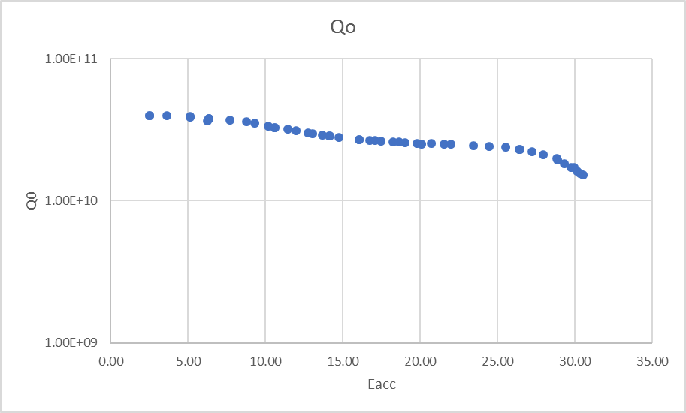
SRF Sector
R&D
Quantum computing measurement continues. Two cavities are in quantum test Dewar and testing is in progress.
High Q₀ high gradient: Nitrogen infusion program continues. One cavity was tested with additional 120C n-infusion after standard n-doping. The additional n-infusion did not help. A second cavity was BCP’d and 120C n-infused. The result was surprisingly good at medium field which exceeds LCLS-II cavity spec. This is BCP process, and we did not expect the Q0 at this level. The high field Q-slope was present however as previously expected.
Nb3Sn group continues cavity preparation and coating. Additional cavity coating is in progress.
High field Q slope: HF rinsing study is in progress
Plasma processing continues.
Nb/Cu vacuum chamber installation is in progress.
2K
N-fusion on a BCP processed cavity, Grassellino, etc

Slide 3
SRF Sector
LCLS-II 1.3 GHz Cryomodules
Retro-fit BPM procedure is still at SLAC review process.
CM03 dis-assembly was completed. Rebuild started as a filler job between cryomodules.
CM02, CM04 CM05 and CM07 beam line were back filled and warm end coupler were dis-assembled. They are ready for extraction and repair BPM. Actual repair is pending for approval.
CM06 is back at ICB, an autopsy procedure is in progress to diagnose the problem areas.
CM08 Helium circuit leak check was completed. BPM fix is planned pending SLAC approval.
CM09 tests at CMTF test cave were completed. Warm-up is completed.
CM10 is in WS3. BPM fix is on hold before thermal shield weldment.
CM11 WS2 started. This is the first cryomodule after LCLS-II restart.
CM12 WS0 completed. It is pending lolli-pop support from CM11.
CM13 cavities were identified
LCLS-II Cavity Preparations
1.3 GHz: No cavity test for the past week..
3.9 GHz: 3HRI03 dressed cavity is being dis-assembled in HTS. 3.9 GHz Design verification is completed.
PIP-II
had a successful test at STC with HP coupler. It is transported to Lab-2 for string assembly.
Spoke Cavity S111 is under preparation for the HP tests; S113-114 will be tested with LP coupler next two weeks.
5-cell 650 MHz cavity was tested, good Q0 but field is a bit low.

Slide 4
Magnet Sector
HL- LHC, AUP – Coil fabrication for LHC inner triplet quadrupoles is progressing well.
After repairing of the short QXFA108 coil preparation for epoxy impregnation continues.
Coil QXFA109 (4.2m) has been moved to the curing to the reaction tooling Coil QXFA109 has been removed from the curing press.
Short model (MQXFS1d) is in the VMTF pit. Warm magnetic measurements are next. Cool down is expected this week.
LCLS II – SPQA129 cold tested is complete, pending the warm survey. Waiting for SPQA130-131 magnets from the manufacturer.
Mu2e –
SSW measurements of the first Transport Solenoid (TS) unit are completed. The relative angle of the coils’ magnetic axes is well within spec. The stretch wire system is also being used to determine the axial center of each coil. Remaining warm tests (leak checks, dimensional measurements, etc.) will be completed this week. Then TS unit will be sent to HAB and attached to Dished Head A. Dished Head B – LN2 + Lhe cool down started, cold commissioning test in progress.
The TS inner bore was successfully leak checked at HAB last week. Leak check of the inner thermal shield piping and dimensional measurements are the remaining incoming QC work.
Milhous Company reports that the first coils for ISA sextupole have been potted.
AS – Coil winding for the Booster biased solenoid will be completed this week. Epoxy impregnations also is expected this week.
G-2 – Winding on the outer coil is half done. Continuing with the second layer of the other coil
MDP 15-17 T dipole R&D - CMM measurements of the recently impregnated outer coil continue. The second outer coil winding is in progress. Preparation for impregnation of the first inner coil continues.

Slide 5
Cryogenic Sector
LCLS-II Procurements
Distribution Boxes – Fabrication continues at vendor, delivery expected in July. Visited vendor last week
Surface Transfer Line Procurement – Delivery expected in July
Providing SLAC with guidance on installation activities for tunnel components – Final welding in tunnel commencing
Mu2e Procurement
Distribution Box – Fabrication in progress, delivery expected in May/June
Feed Boxes – Contract in process of awarding contract
HL-LHC AUP
Began EVMS practice reporting this month. Working on Stand 4 upgrade tasks. Waiting for final docs from CERN.
Meson Controls Upgrade
Project is underway in parallel with existing controls, preparing for system shutdown in June to switch system over
Possibility that shutdown is delayed due to the need for extended cavity testing (awaiting confirmation and schedule)
PIP-II Activities and Procurement
External Cave Transfer Line fabrication in progress (in-house), final tie-in piece in fabrication, all others complete
PIP-II Cave Transfer Line procurement, delivery expected in May/June
Field installation at CMTF have begun with the external cave TL segments and supports followed by cave TL (once it arrives from the vendor)
Sub-Kelvin Cryogenics
SuperCDMS Snolab – Waiting for ESAAB and official CD2/3 which is expected in May
ADMX – Procurement issues with vendor have been resolved (waiving of specific procurement liability clauses), expecting PO to be placed soon with a delivery of about 6 months. Finalizing details of new cold electronics packaging, i.e. optimization of magnetic shielding design for the sensitive electronics
Nexus – Cryogenic review (5032) documents expected in a few weeks
Facilities:
Meson Detector Building: 3.9 GHz LCLS-II cavity testing in HTS and spoke cavity testing in STC completed last week
Cryomodule Test Facility: LCLS-II F1.3-09 CM testing last week. Plant is under repair
Industrial Building 1: VTS stands: Six R&D cavities tested last week, Stand 3: One LCLS-II magnet tested
Muon Campus: Supporting g-2 operation Two compressor trip events last week. Operators recovered w/o quenching
Heavy Assembly Building: Test cryostat Head B cooling down for commissioning

Slide 6
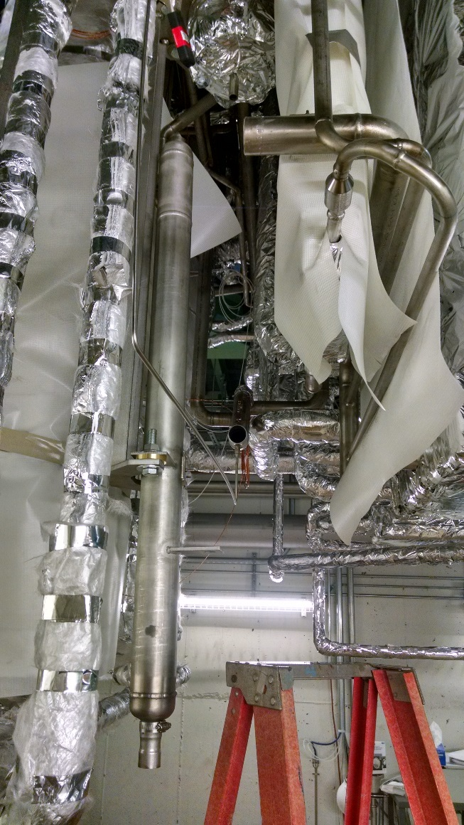
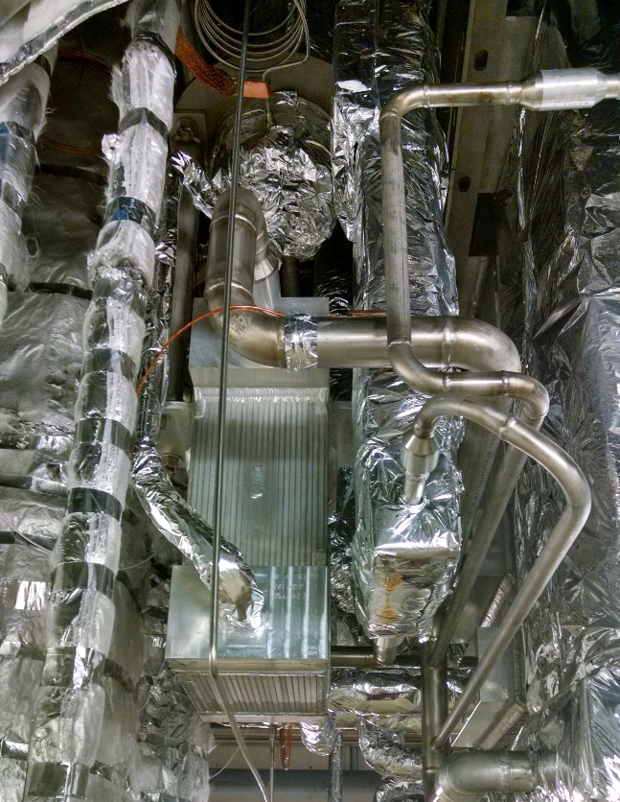
Cryogenic Sector
CMTF Cryogenic Plant Heat Exchanger Failure
Removed cold box vacuum shell
Removed failed heat exchanger
Preparing for leak checking recuperative N₂/He heat exchanger
Preparing piping modifications
At left: Heat exchanger still installed
At right: Heat exchanger removed and heater installed

