Slide 1
Accelerator Division Status
Daniel Johnson
All Experimenters’ Meeting/Lab Status Meeting
16 April 2018

Slide 2
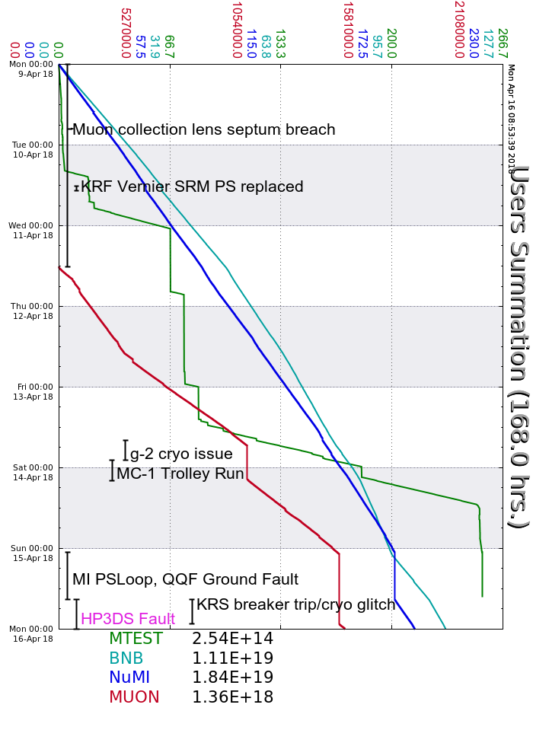
Accelerator Operations Summary
From: April 09, 2018 (0000 hours)
To: April 16, 2018 (0000 hours)
Calendar Week # 15
NuMI Weekly Integrated Intensity 1.84 E19 protons
Beam Hours To NuMI 148.2 hours
BNB Weekly Integrated Intensity 1.07 E19 protons
Beam Hours To BNB 163.0 hours
Muon Weekly Integrated Intensity 1.36 E18 protons
Beam Hours To Muon 83.1 hours
MTest Weekly Integrated Intensity 2.54 E14 protons
Beam Hours To MTest 63.3 hours
MCenter Weekly Integrated Intensity 0.00 E12 protons
Beam Hours To MCenter 0.0 hours

Slide 3
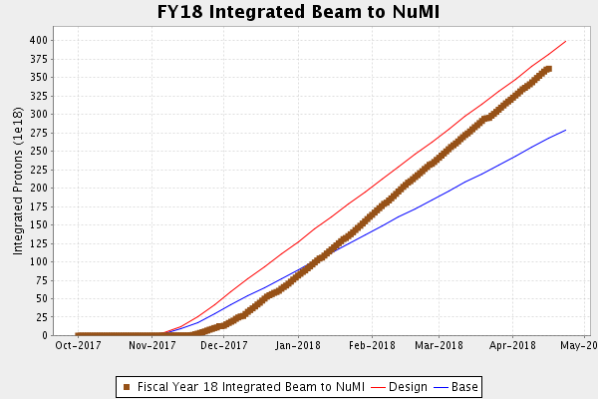
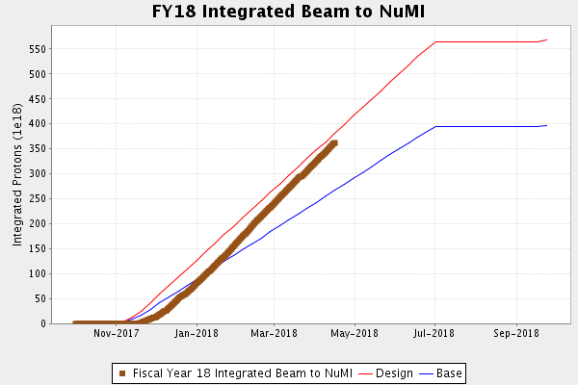
NuMI Operation

Slide 4
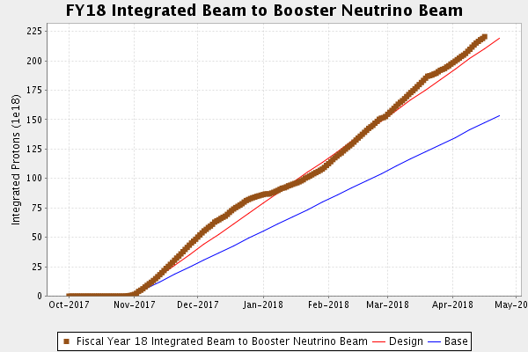
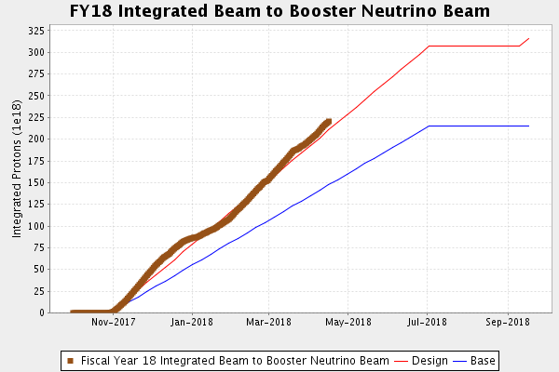
BNB Operation

Slide 5
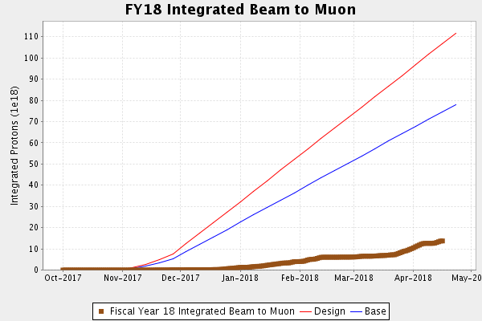
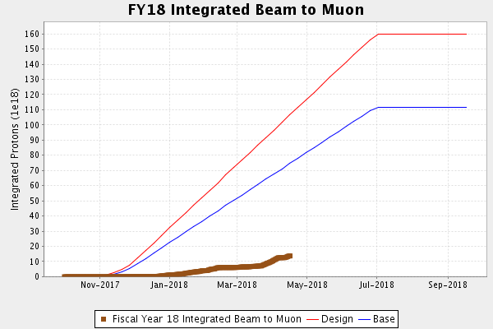
Muon Operation

Slide 6
Complex Status
LINAC
  Laser Notcher operational
Booster
  Tuning continues
MI/RR
  Tuning continues
  MI PS Loop QF Ground Fault
    MI-60 moisture in penetration (poly beads?)
NuMI
  ~650kW with SY
  >720kW without SY
Booster Neutrino Beamline (BNB)
  Stable operation
Switchyard
  Meson Test off
  HP3DS Bus Duct Fault
    Repaired tomorrow
Muon Campus
  Lithium Lens replaced
  Glitched Cryo during HP3DS Fault
General

Slide 7
PIP-II Injector Test & FAST/IOTA Status
PIP-II Injector Test
  Starting Up
    All RF components operating in CW mode
    Up to 5mA, 1.2ms 20Hz
      Upgrading MPS to increase pulse width
    May/June Cryo work shutdown
      Staging cryo piping in preparation
FAST/IOTA
  Ion pump stand installation has begun
  All quad PS connected to their magnets
  Final IOTA cable pull should be complete today
  IOTA RF cavity beam tube was installed this week. This is the first vacuum hardware installation for the ring.
  Stretched wire measurements of the nonlinear insert, locating the magnetic center of each element have been delayed

Slide 8
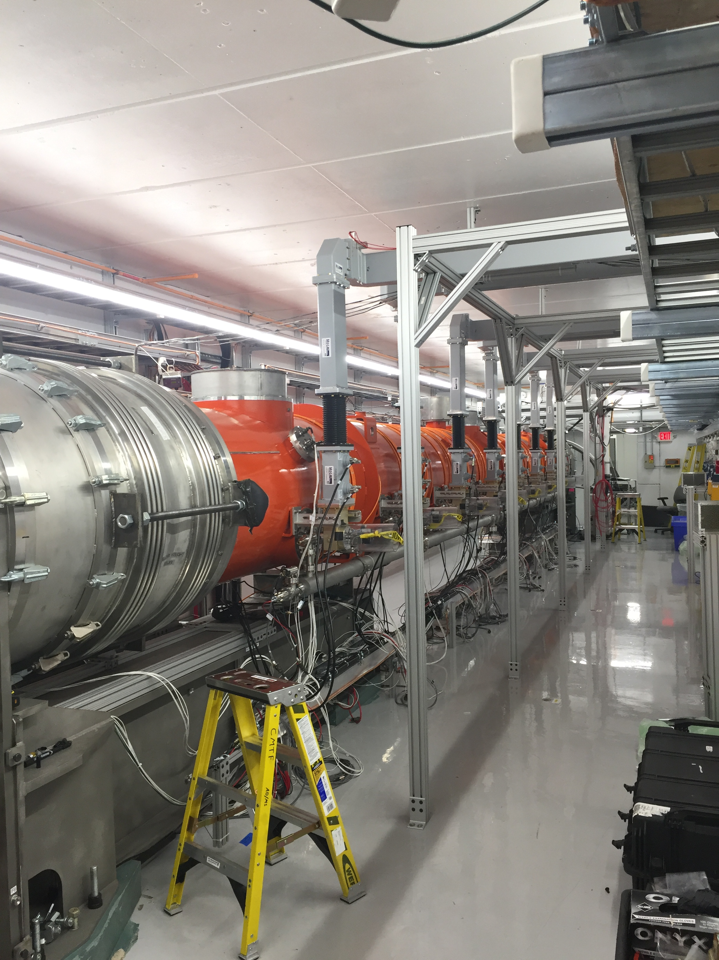
CMTS1 Status
LCLSII Cryomodule F1.3-09
  Testing complete
  Module performed well
  Warmed Up
  Opened up cryo plant to begin repairs
LCLSII Cryomodule F1.3-08
  About 5 weeks away

Slide 9
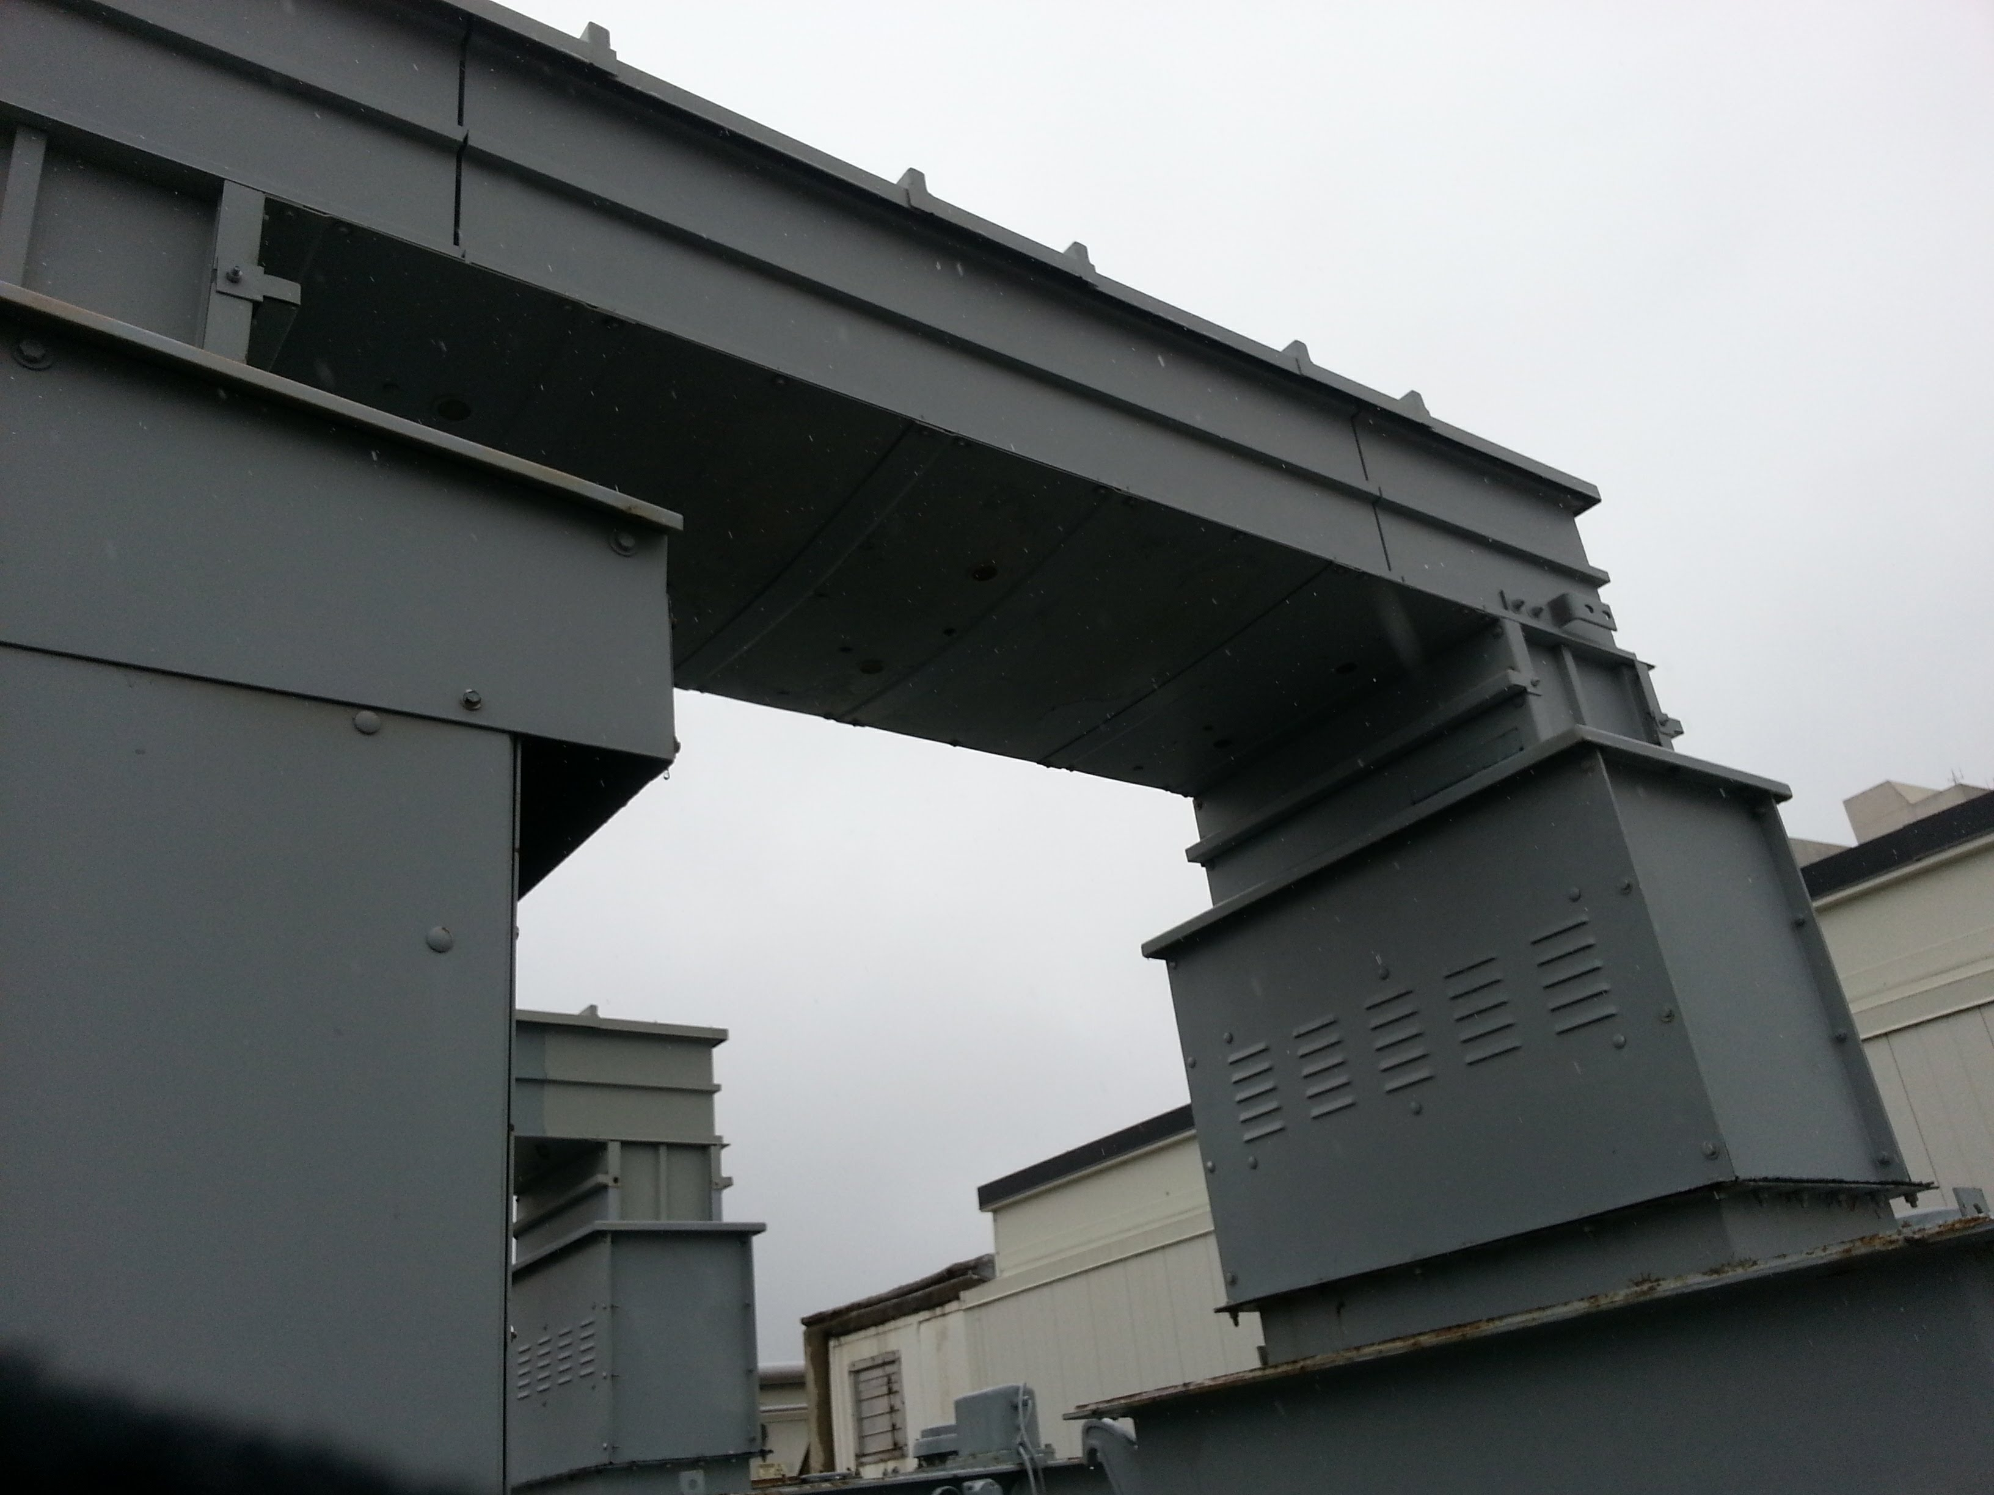
HP3DS Bus
Transformer hipot good
Crane in bus duct replacement tomorrow
Replace switchgear insulators

Slide 10
Schedules and Links
Schedule can be accessed from the Operations Department Home Page
  Schedules -> Operations Schedule
Direct link to schedule
  http://www-ad.fnal.gov/ops/schedule.html

