Slide 1
Wednesday 9:00
2018-04-11

Slide 2
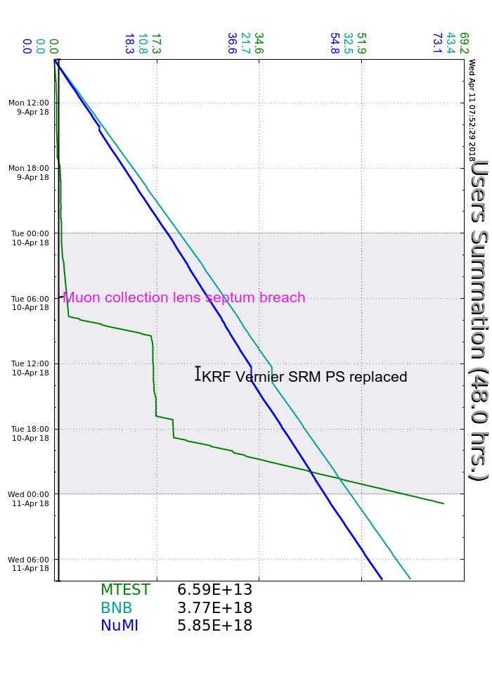
Monday
Muon Lithium Lens repairs
RR Dispersion Measurement and MI 1.2s Ramp Studies
I:KPS4A cabinet inspection
Tuesday
Continued Lithium Lens repairs
LRF5 Marx staging
Fluids bled water/air from LRF water skids
Studies:
SY BPM scans
RR 2.5 MHz cavity study
MI $21 Tuning
RR Dispersion Measurement
8 GeV Autotune
KRF Vernier SRM Power Supply replacement
Wednesday
L:MDQ1 program fault trip, reset ok
Began pulsing Lithium Lens
Current Conditions
Beam to NuMI and BNB

Slide 3
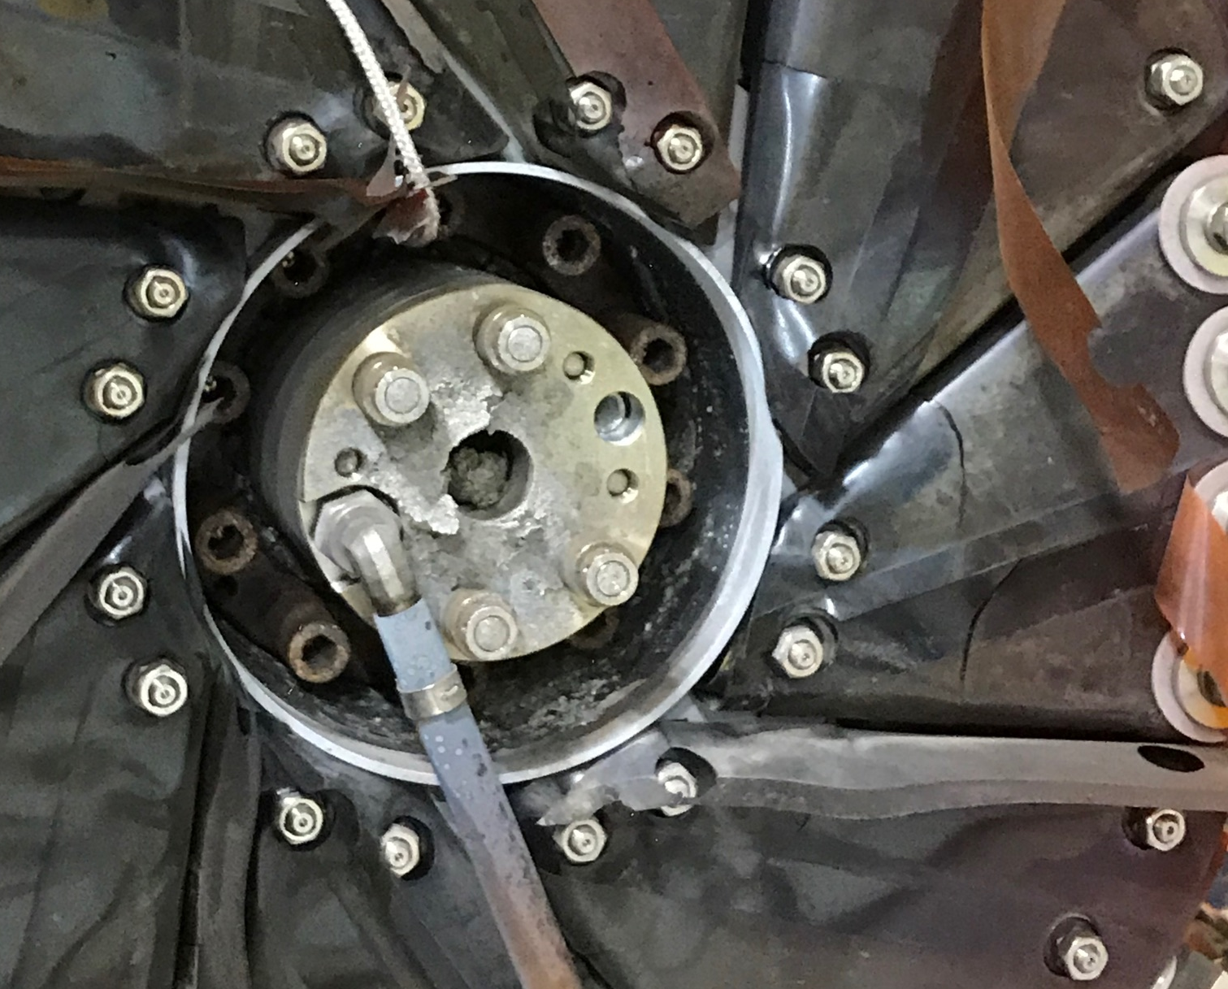
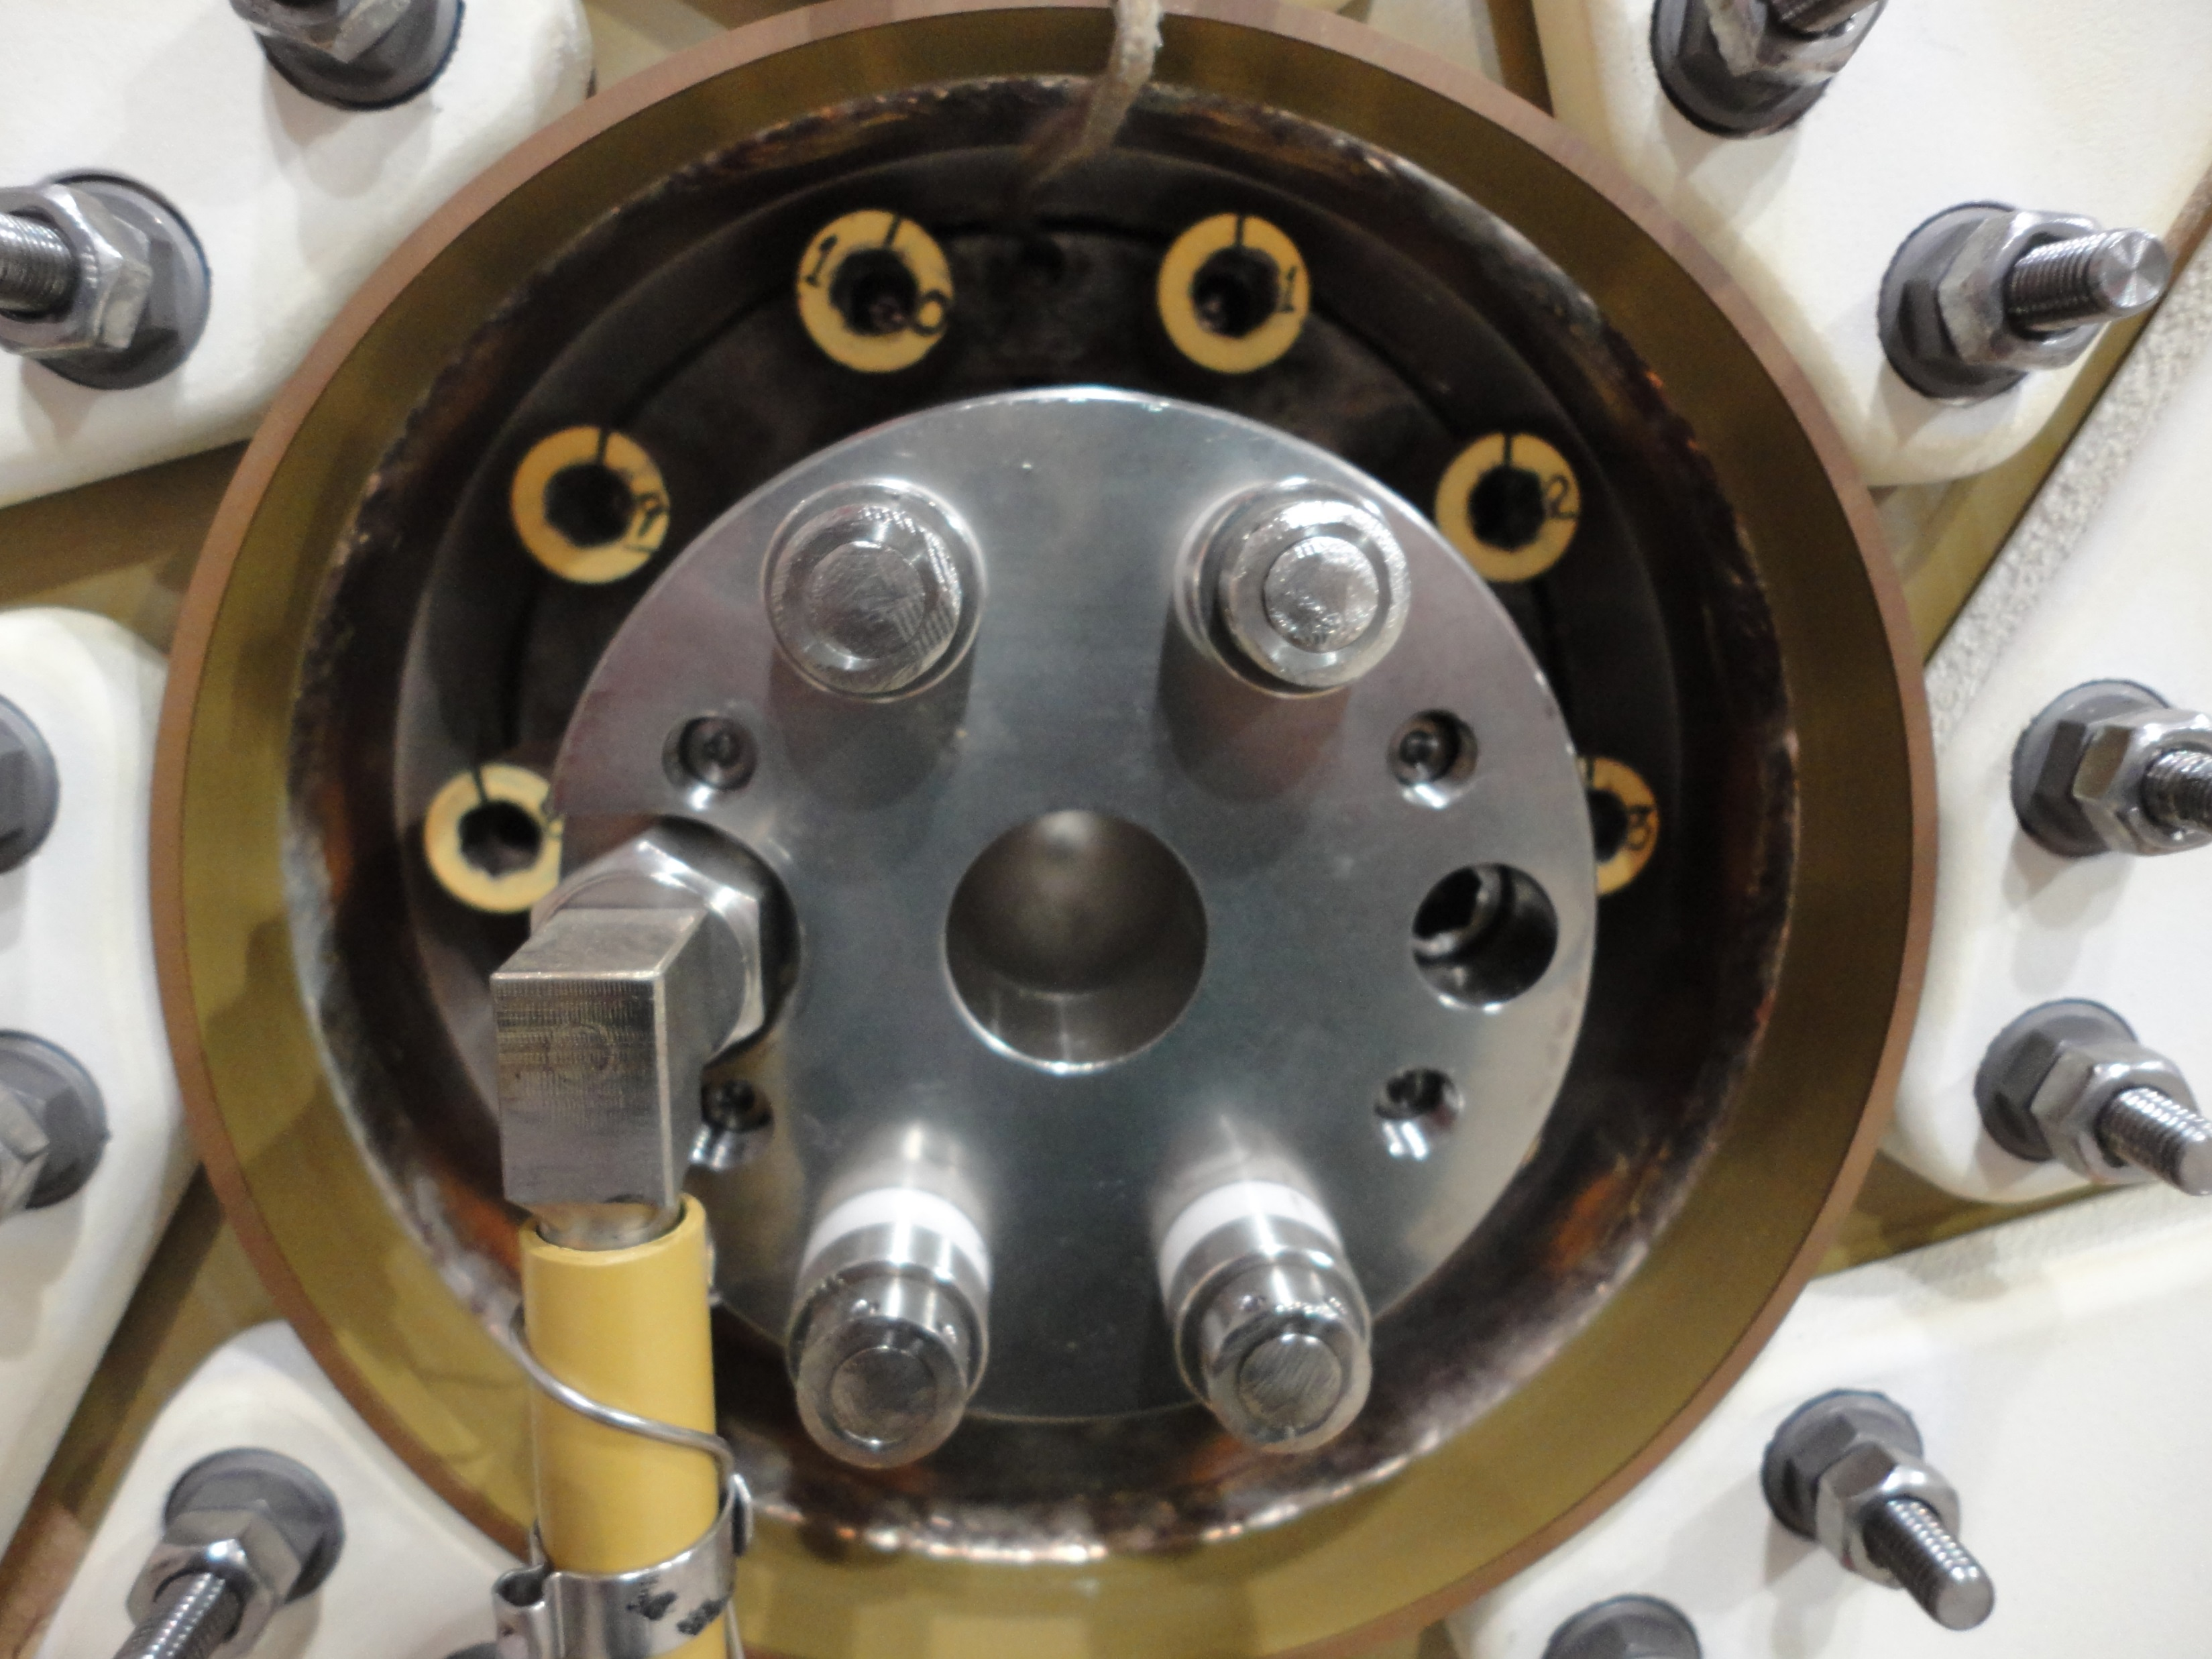
Old Lens
New Lens

