Slide 1
Muon Campus Status
Brian Drendel
Weekly Status
April 13, 2018

Slide 2
Beam to g-2 this week
Protons on target down ~4% from a week ago
Bunch lengths wider compared to March 23

Slide 3
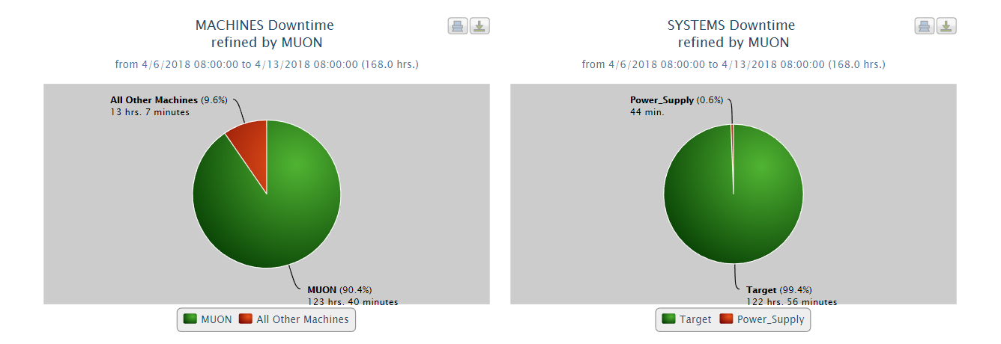
Downtime
122 hr 56 minutes of Li Lens Changeout Downtime
44 min – Li Lens external interlock trip adjustment
21 hours 26 min of half intensity running to the g-2 experiment – RR RF

Slide 4
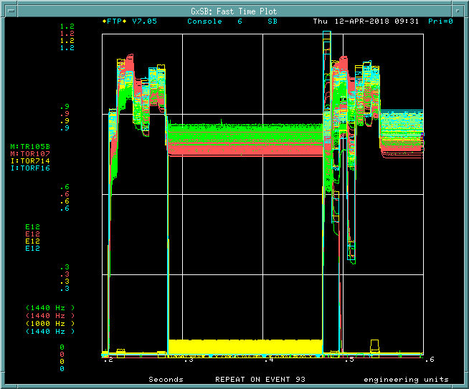
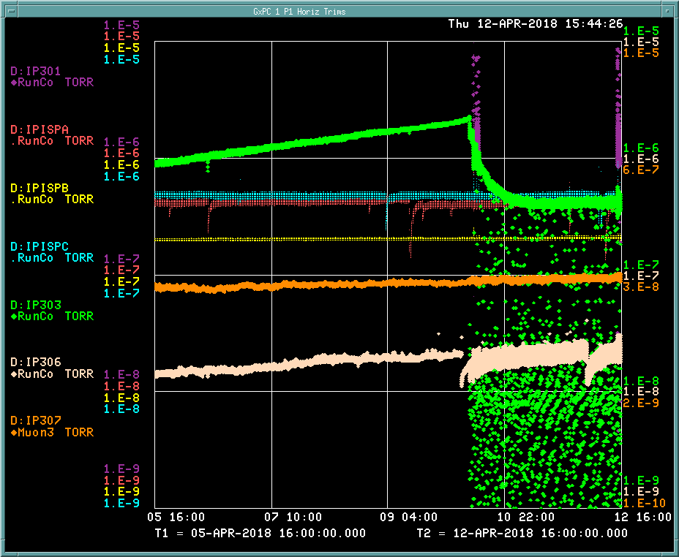
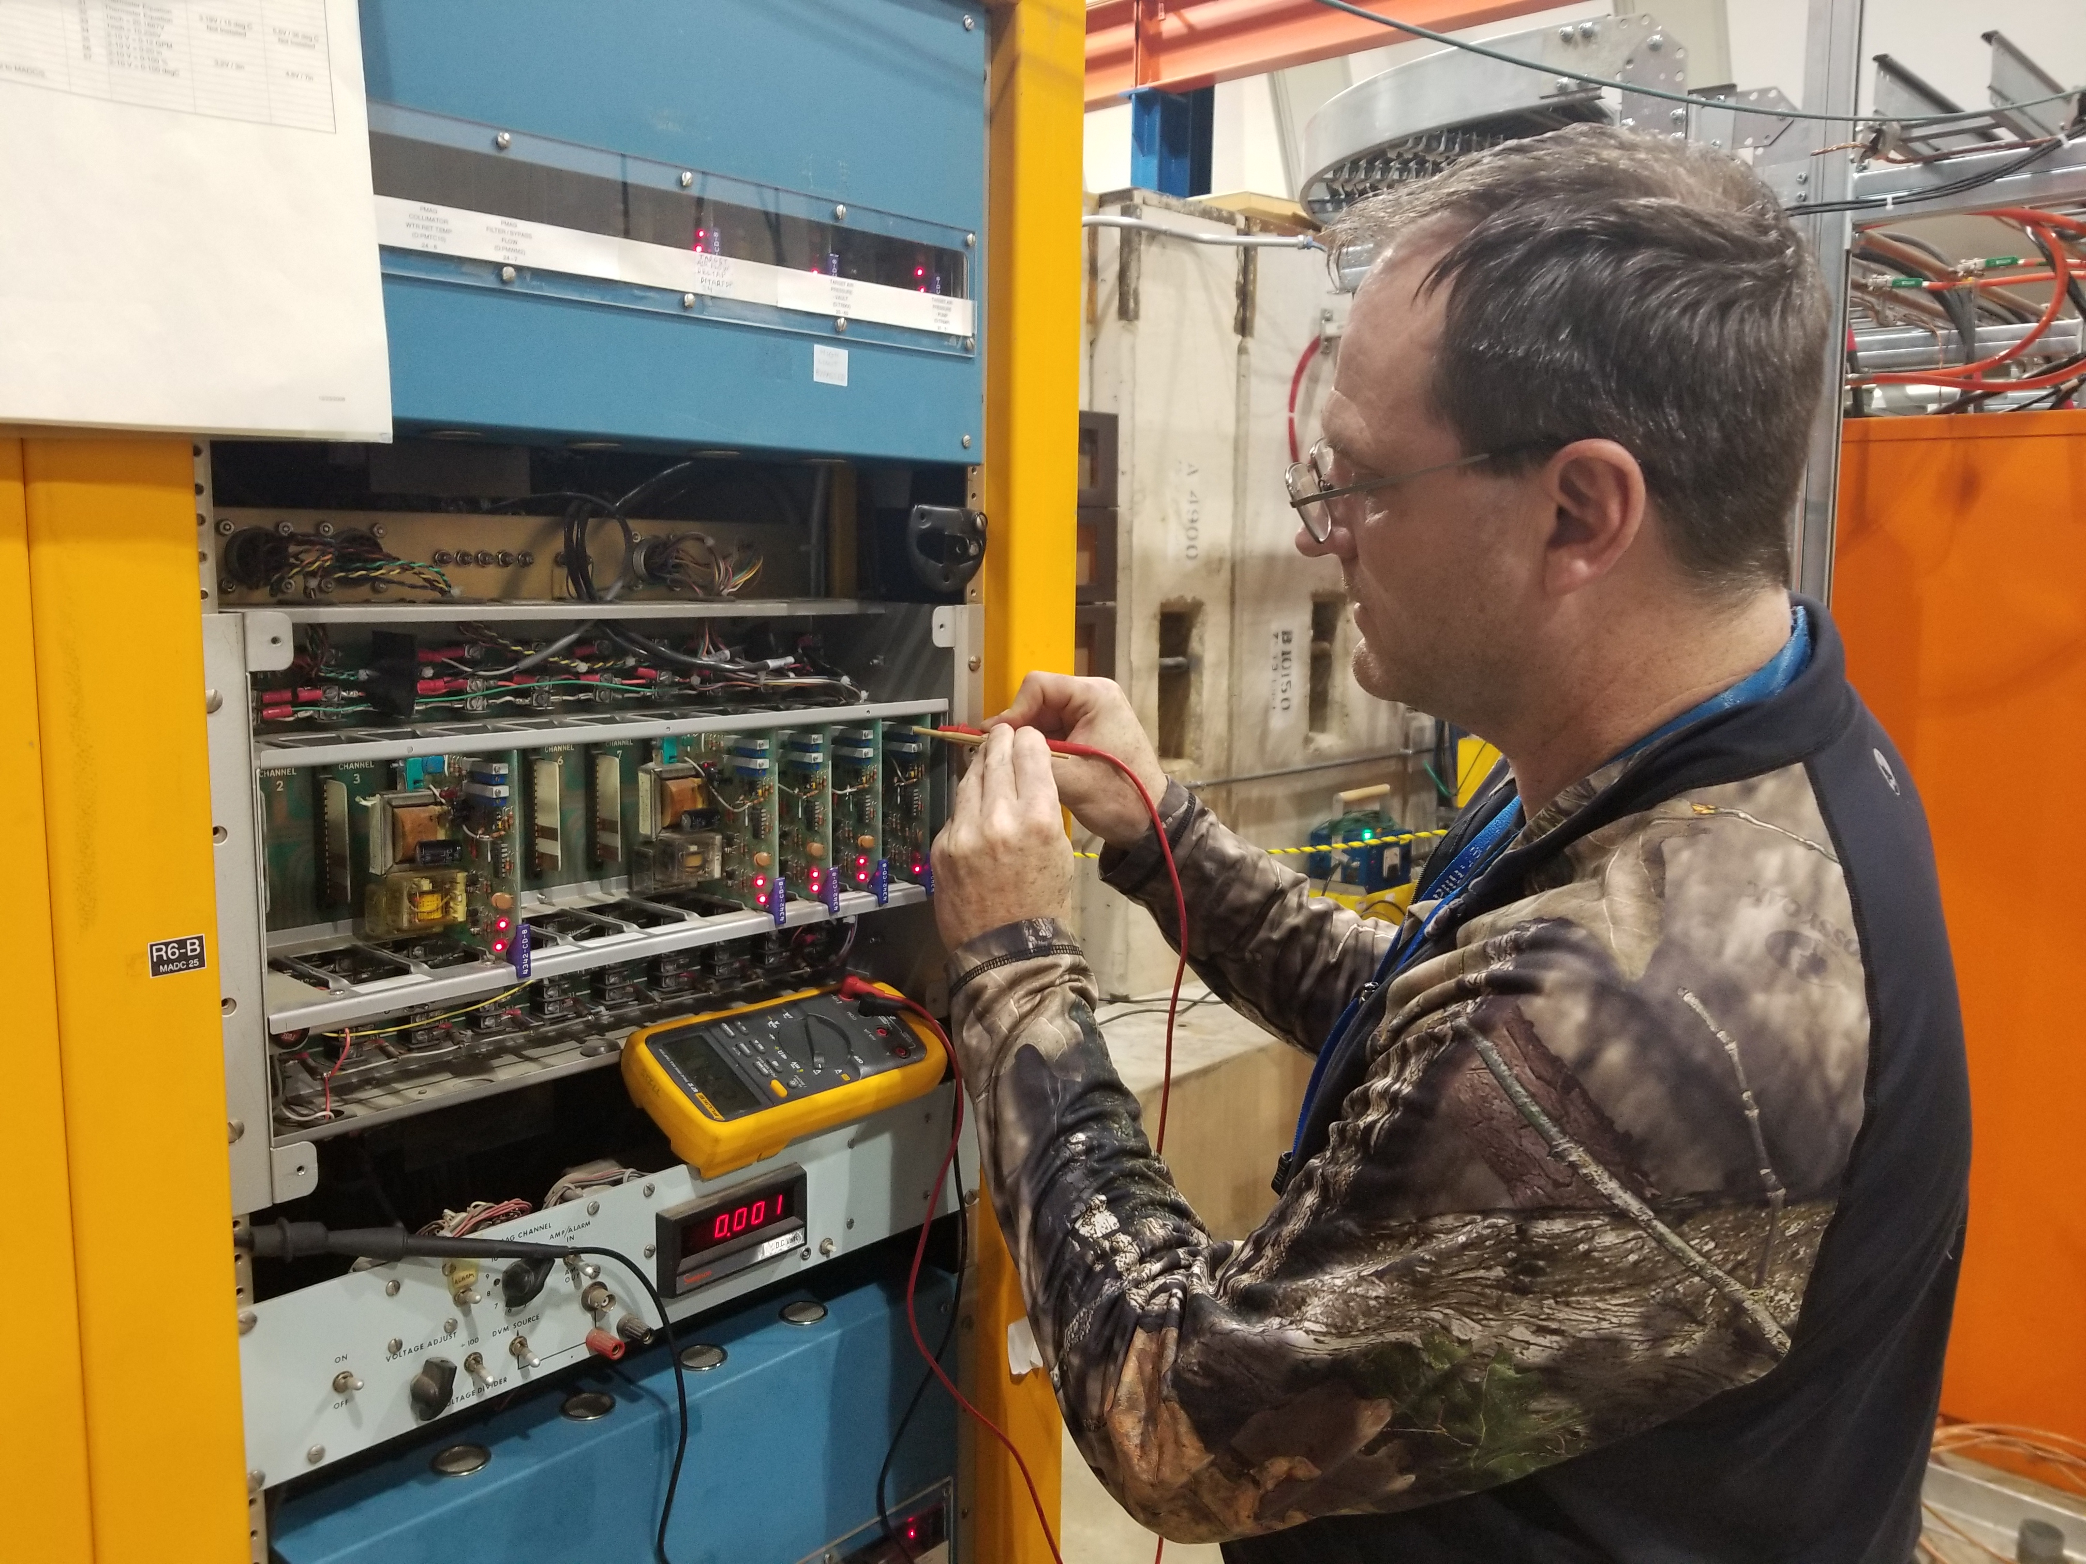
This week
Lithium Lens #4 failure
RR Feedforward
In the background
  PRAC35 code update – V003 turn-on.
  D:IP303 - Ion pump babysitter
  Li Lens external interlocks card adjustment

Slide 5
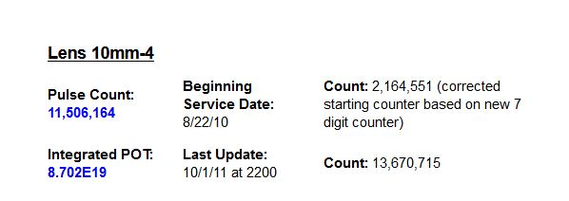
Lithium Lens 10mm-4
10mm-4 was used for both collider and g-2 operations
  Installed 8/22/10
  It did 11.5M pulses for collider and 29M for g-2 commission and 2 weeks of running at 11.4hz.
  The lens did show evidence of target sputtering (Inconel deposited on upstream face of lens) from when Target #17 Be cover failed in May of 2011.
  The lens face looks similar to photos that were taken during the target change out. in 2011.

Slide 6
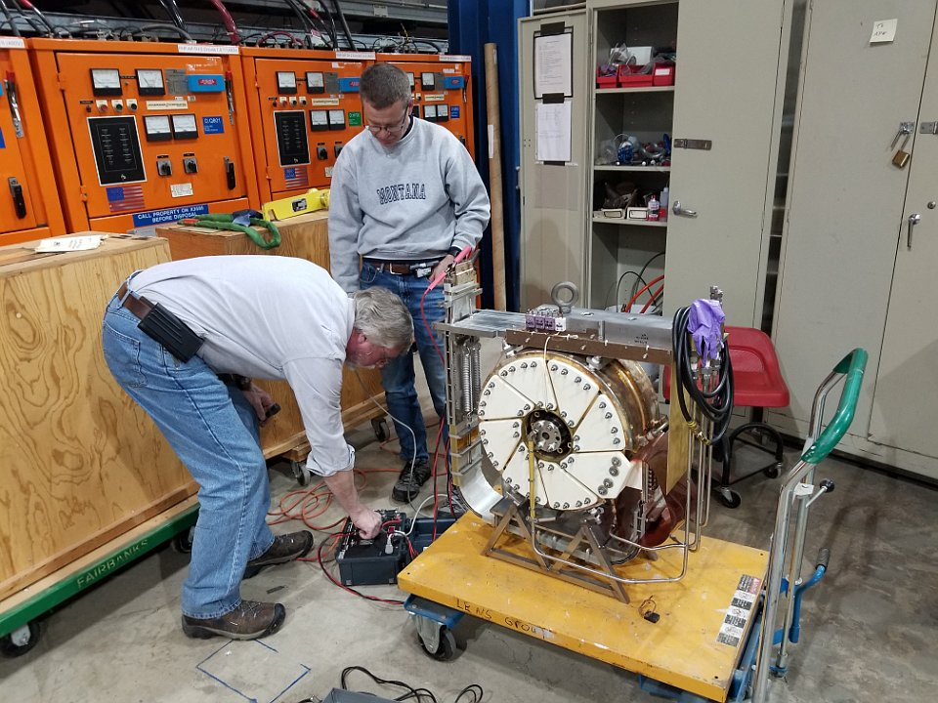
Lithium Lens Changeout
10mm-10 was the chosen replacement
  Modern diffusion bonded lens with a internally cooled transformer with ceramic coated insulators.
  The lens was conditioned in 2012 and tested to 80M pulses at an average pulse rate of 12Hz as proof of principle for g-2 operation

Slide 7
Lens Changeout
Photo Album: https://goo.gl/RS7YuS
Lens Changeout Web: https://goo.gl/9Tk2sL
Target Change Quick Facts
  First Lens change since 2010.
  Started changeout on Monday due to personnel availability.
  A coffin for the lens had to be found at TSP and transported.
  The coffin base plate that hold the lens in the coffin preventing the lens from tipping in the coffin did not fit.
  Removing the old lens was difficult because the locating pins were very rusted. Required 2 people to pry off lens from module.
  Steps were added to view the upstream target and collimator with a remote camera to ensure devices had no problems.
  The LCW was drained and scrubbed over night but a 3rd DI cartridge was installed just after pulse testing. Added 30min to scrub.

Slide 8
Work Requests
  Chipmunk Swaps:
    MC1 Hall above quad - needs scissors lift (White).
  Work on D:Q404 - 30 minutes no beam to experiment (Bernie)
  Opportunistic Access
    Delivery Ring Access to inspect vac seal on IP303 (Vrbos) - may not be as urgent now that ion pump baby sitter has seemed to stabilize vacuum.
    Check PWC014 signal connectors - Extraction enclosure (Drendel)
    Mid-transport beamline inspection (Muon Dept.) - only if going in for other reasons.

Slide 9
Upcoming Studies
  Tune-up (Morngan) – 2 to 3 hours of optimizing beam to the experiment.
  Momentum collimation studies (Morgan, Froemming) – 5 to 6 hours - need a healthy ring and DAQ.
    Study involves selecting different momentum slices of beam with the DR momentum scrapers and determine the momentum distribution of the injected muon beam into the g-2 storage ring. Also measure the dispersion in the M4/M5 line. See the above link for the complete study plan.
  M2/M3 Optics Work (Romanov) - Next round TBD.
    This is destructive to the beam, so we will try to plan around experimental downtime.
  AP0 abort SEMs (Drendel, Morgan) –
    Initial timing work will take a half shift and will not impact g-2 operations. Septa changes/moves would take a couple hours and be disruptive to g-2. This work could be done when the experiment is not taking beam.
  Ap0 chipmunk measurements (Drendel): Transparent to operatiosn
    Data is being be collected with a set of temporary chipmunks in various configurations. At this time, this work is completely transparent to operations.
  Delivery Ring Tune Measurement work (Scarpine). Requires 8 GeV operations.
  Dispersion in RR-Target (Nagaslaev, Adamson). Destructive study. 2-4 hours
    Primary 8GeV transport beam line RR-Target. We need to establish a procedure for the dispersion measurement in this line. We will have to do transfers in a slow manner, kind of 20 sec between transfers and run the waterfall display in the RR for each transfer. We will also modify the RF frequency in RR so that the beam will be slightly off momentum. This change doesn't necessarily impact the yield on the target, but may result in increased beam losses, while tuning. This study is opportunistic. Time estimate is 2-4 hours. Will impact the beam delivery to g-2, so needs to be aligned with their planning.

