Slide 1
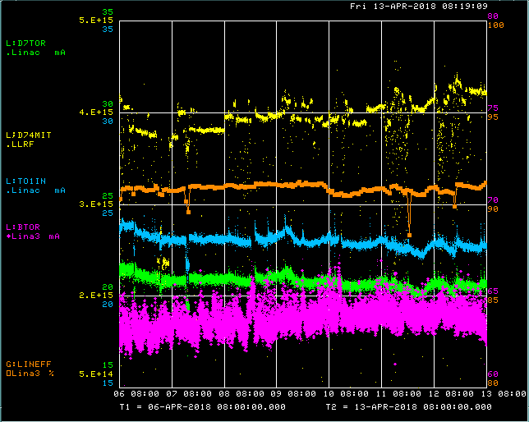
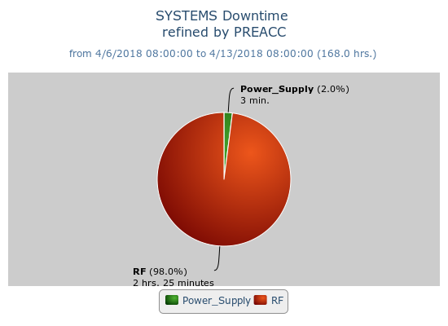
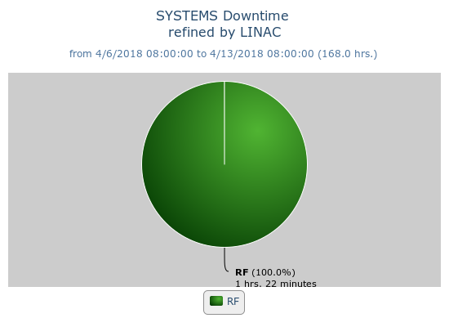
Preacc/Linac Weekly Performance
Tuesday- Moved P3 marx modulator
KRFV SRM power supply failure
Rebalanced LRF LCW levels and pressures

Slide 2
Current Conditions
Source B – 63 mA
Linac input – 23 mA
Linac output – 21 mA, ~4.6E12 p/pulse
RFQ remote reset issue if ~1 hr. opportunistic DT

