Slide 1
Machine status
Ming-Jen Yang
Friday 9:00 am Meeting,
April 13, 2018

Slide 2
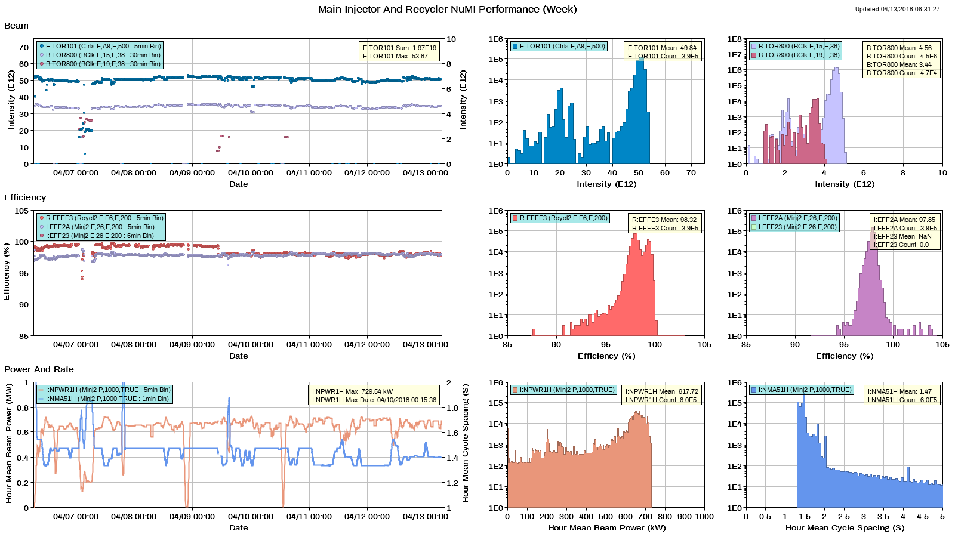
NuMI

Slide 3
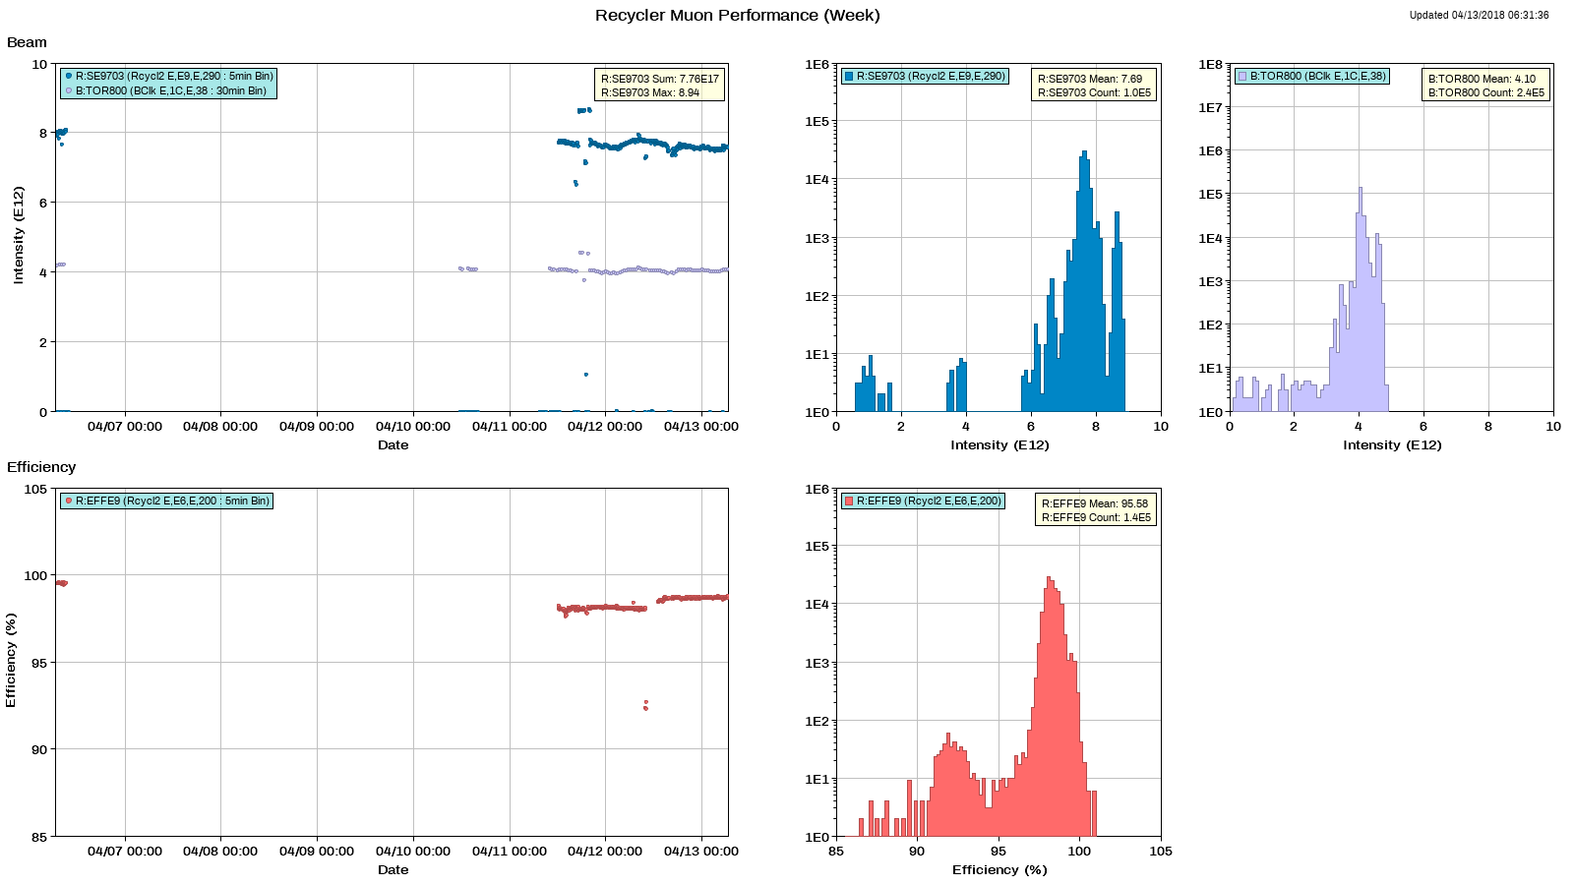
Muon

Slide 4
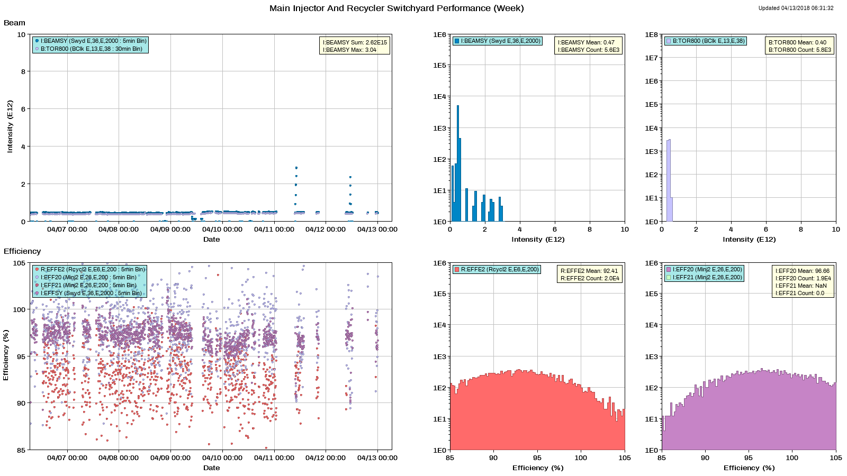
SY

Slide 5
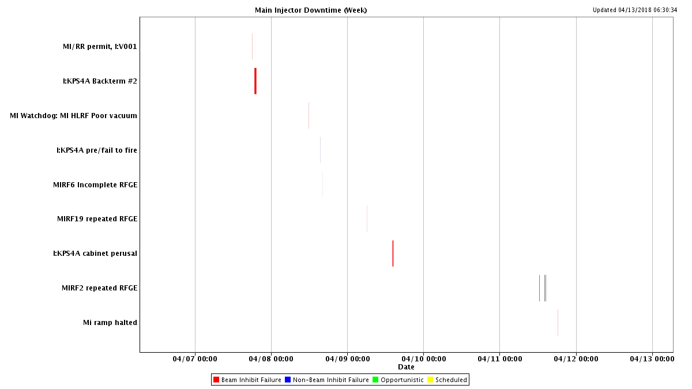
MI downtime

Slide 6
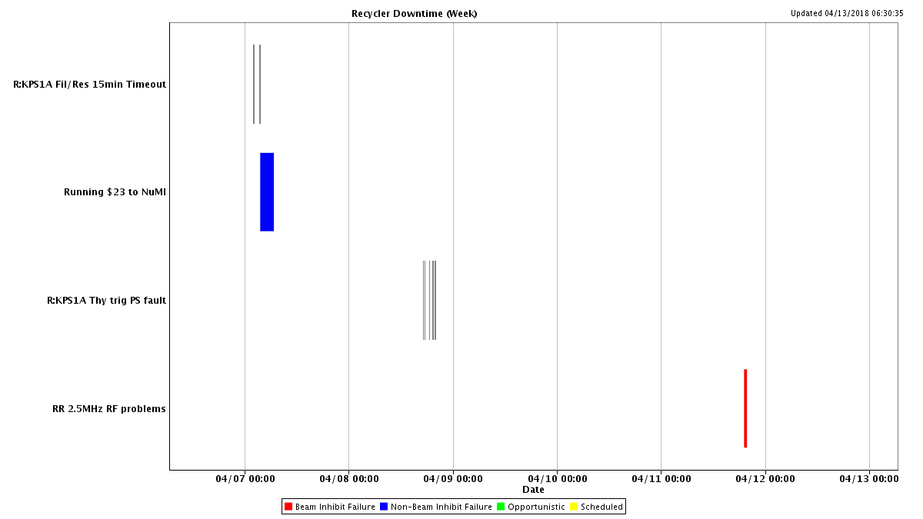
RR Downtime

Slide 7
Issues
R:KPS1A
Replaced burnt out connector on Saturday.
Changed out trigger board on Sunday.
I:KPS4A
Backterm 2 was out, for about 30 minutes.
Inspected kicker cabinet, on Monday afternoon.
Toroid re-calibration
I:TOR806, found 4.7% high.
R:TOR853, found 1.3% low.
E9 cycle 2.5 MHz RF
Add fan cooling to feed-forward board.
Looking for opportunistic downtime
4 house access to MI
To hipot upper bend bus penetration at MI60

Slide 8
Studies
Past studies
1.2 sec fast ramp.
RR dispersion function measurement.
RR E9 beam loading compensation.
Study requests
1.2 sec fast ramp.
MI TBT lattice measurement
8-GeV.
RR TBT lattice measurement

