Slide 1
Friday 9:00
2018-04-13

Slide 2
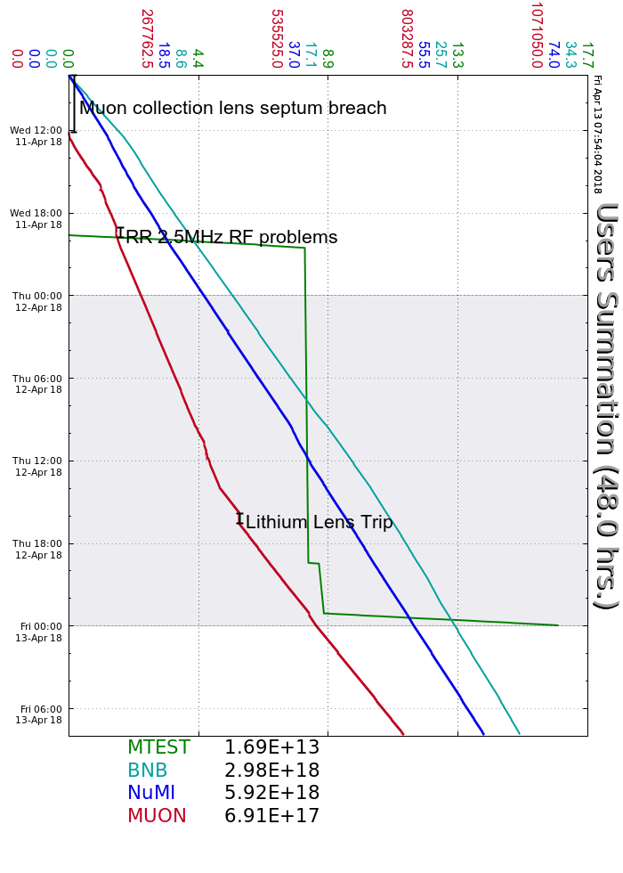
Wednesday:
SY Studies, intensity scans and BPM measurements
Muon Lithium Lens repaired
RR 2.5 MHz instabilities on second $E9
MI group decided to run just one $E9 overnight
Thursday
D:Q404 trips, experts double-swapped control cards
SY Studies continued
R:TOR853 timing adjusted
RF experts investigated RR 2.5 MHz RF issues
Traced down to feed forward hardware overheating
Added additional cooling
G2 Service Building CAMAC power supply replacement
Muon Lithium Lens trip, experts adjusted trip limits
Friday
RFQ 4616 Anode Overload trips, reset locally
Current Conditions
Beam to NuMI, BNB and Muon Campus

