Slide 1
ComPASS4 Collaboration Meeting
James Amundson
April 24 & 25, 2018

Slide 2

Welcome to Illinois
&18

Slide 3
Why we are here

Slide 4
Coordinating with the ASCR Institutes
The SciDAC-4 Coordination Committee (S4CC for short) will serve as a focal point for activities that include facilitating interactions between the Institutes and the Partnerships, and with the broader science community as well as identifying and assessing cross-cutting issues, topics and emerging needs within the SciDAC-4 community. The committee was formed in late 2017 and consists of the SciDAC-4 Institute Directors along with points of contact (POCs) from each Partnership area.
Early activities by the S4CC will focus on building collaborations between the Institutes and the Partnerships and developing a long-term strategy for maintaining effective communication between these projects. In the mid-term, S4CC will look outward to help the SciDAC-4 community to interface with facility experts and to find opportunities for broader deployment of SciDAC-4 applied math and computer science technologies.

Slide 5
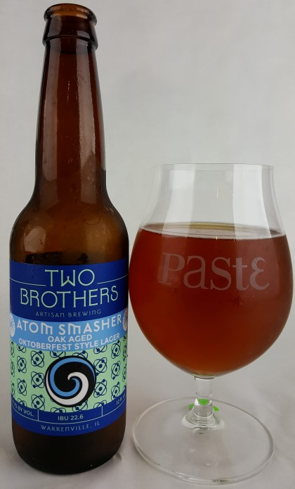

Dinner tonight
http://twobrothersbrewing.com/restaurants/tap-house/

Slide 6
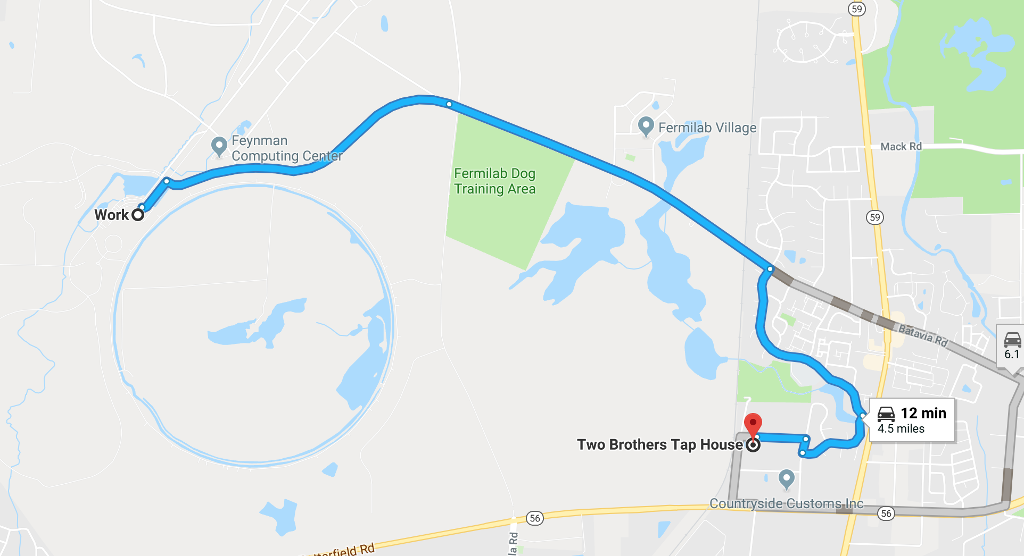
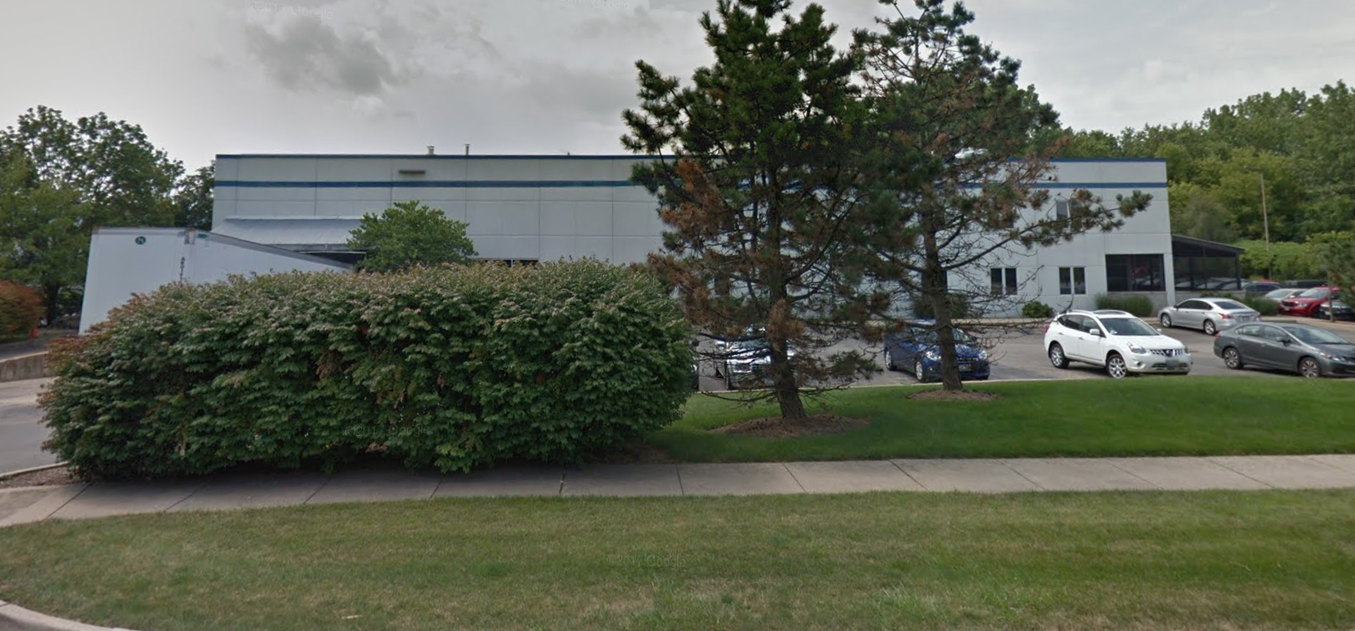
Directions
TWO BROTHERS TAP HOUSE
30W315 Calumet Ave, Warrenville, IL
P: (630) 393–2337

