Slide 1
Overview of Cavern Layout & Detector Installation Scheme
Farshid Feyzi
DUNE Installation Workshop
14 May, 2018

Slide 2
Outline
Cavern modification
Ross shaft limitations
Configuration Phases
Overall installation scheme
Configuration at 4850 level
Configuration at 4910 level

Slide 3
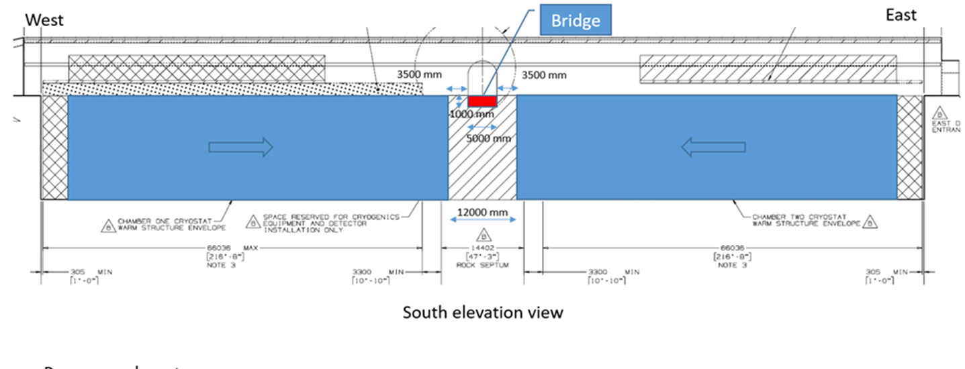
Removal of Rock Septum
Present configuration allows 3.5 slot for installation—not feasible
Remove rock septum down to 4910 level
Move east CS 4.5 m to the west, and west CS 4.5 m to the east
Build 5.00 m wide bridge between north and south drifts
Reduce cavern length by 9 m
Distance between cryostats 12m steel to steel

Slide 4
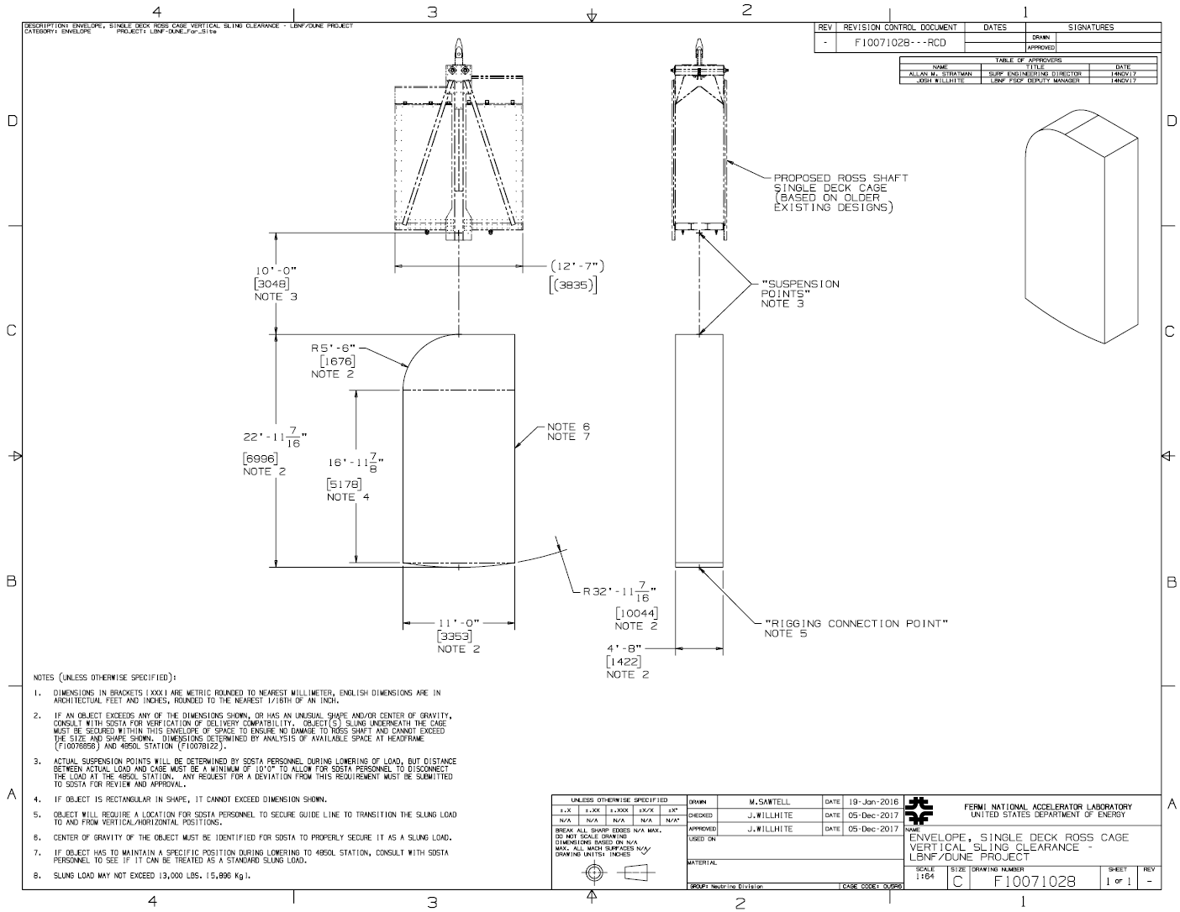
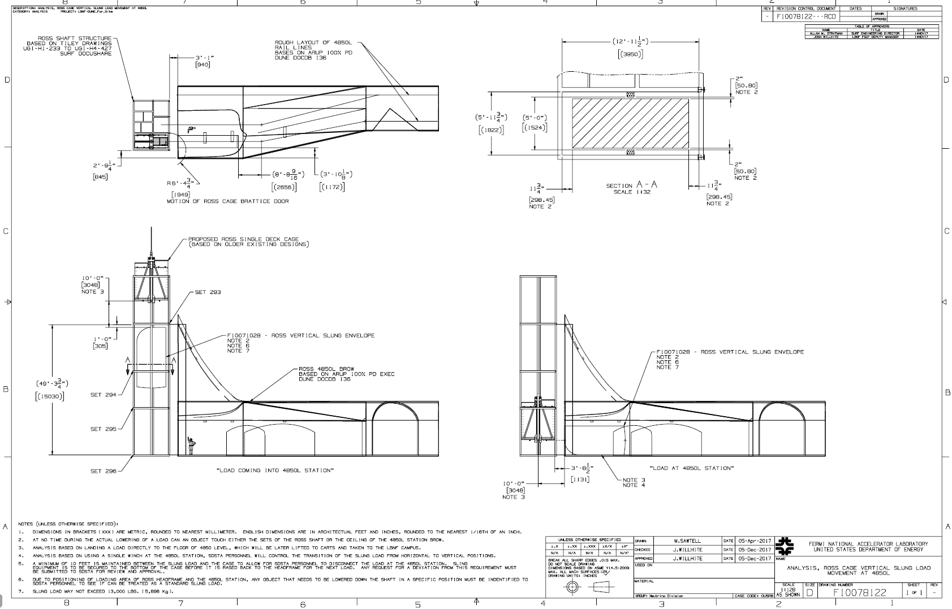
Ross Shaft Load Size Limitation
DUNE-doc-4781-v13 is controlling document

Slide 5
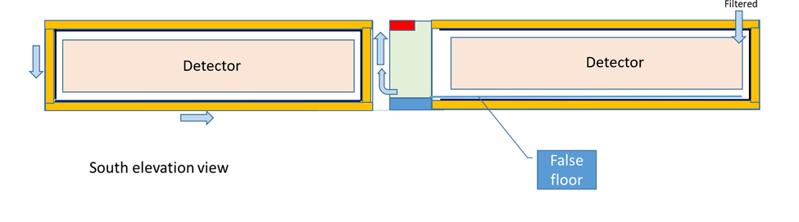
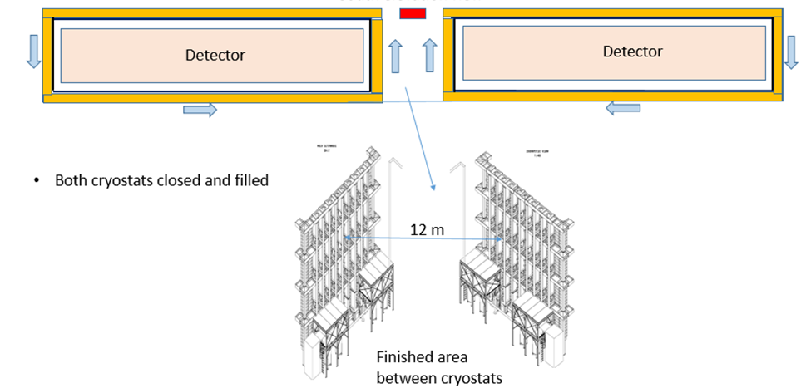
Cavern Configuration Phases
1
Overall phases for cavern configuration during cryostat construction and detector installation
West CS steel construction
East CS steel construction, west CS membrane installation
East CS membrane installation, West detector installation
West detector closure and filling, east detector installation
East detector closure and filling
Configuration phases needed to design and implement means of access, life safety, cavern and detector services, cleanrooms and other infrastructure
Lifts and stairs will be constructed from the 4850 level down to the 4910 levels
2
3
4
5

Slide 6
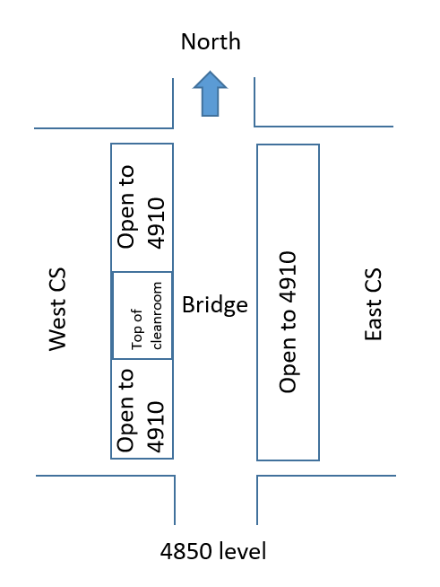
Configuration at the 4850 Level
Detector components enter the cavern through the north drift and will be staged on the bridge
Changes to rigging and transport will occur on the bridge
Side covers are removed
Either the cavern bridge crane or the monorail will be used to lower components from the 4850 level to the 4910 level
No components of the clean room will be at or above the 4850 level
Top pf CS open for rack and infrastructure installation

Slide 7
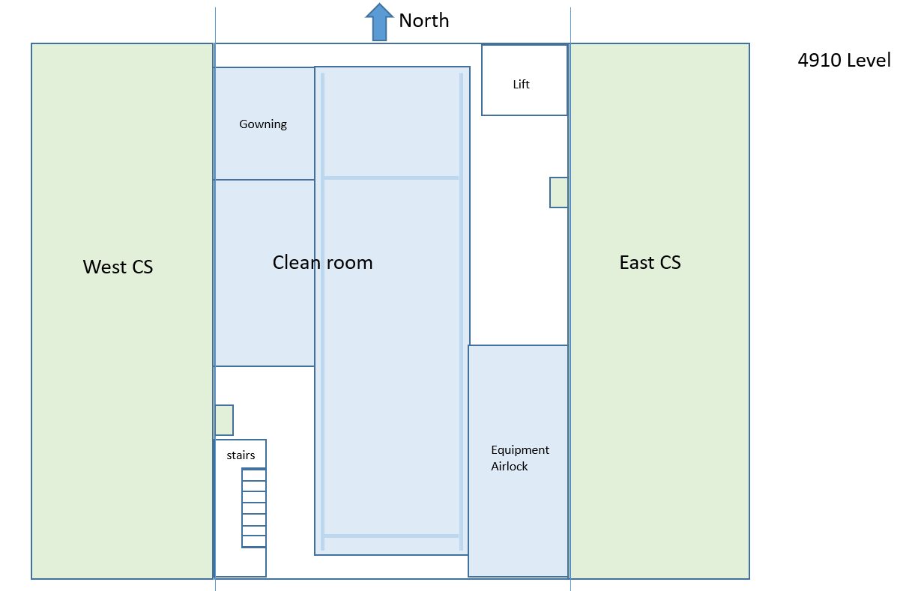
Configuration at 4910 Level
Access from the 4850 level to the 4910 level is provided by one set of stairs and one lift. (Additional egress possible through CS external structure)
A class ISO 8 (100000) cleanroom will be constructed between the 4910 level and the 4850 level
The bridge crane that is mounted under the main bridge will operate in the clean room
An equipment entry airlock will be constructed at the 4910 level adjacent to the cleanroom
A gowning room will be constructed at the 4910 level adjacent to the cleanroom.
Filtered air flow will be directed into the cryostat, from the cryostat through the opening to the clean room, then to the airlock, and out into the cavern. Local circulation and filtration in the cleanroom will be used to maintain quality.

Slide 8
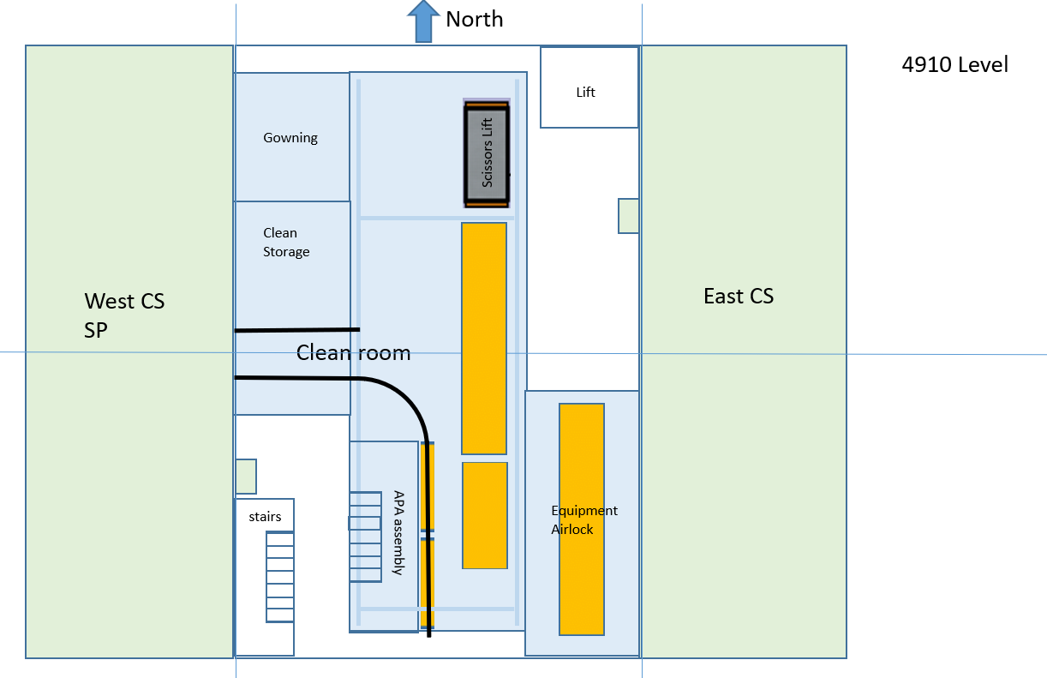
Cleanroom Configuration for East Single Phase Installation (Details in Vic’s talk)

Slide 9
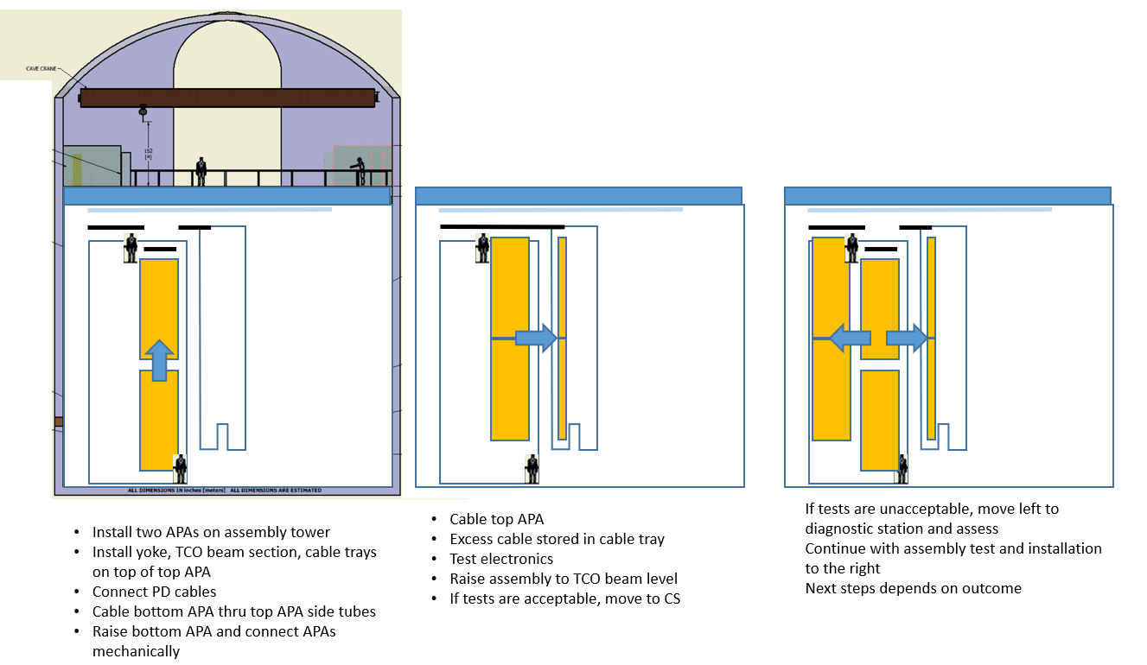
West CS Single Phase Installation

