Slide 1
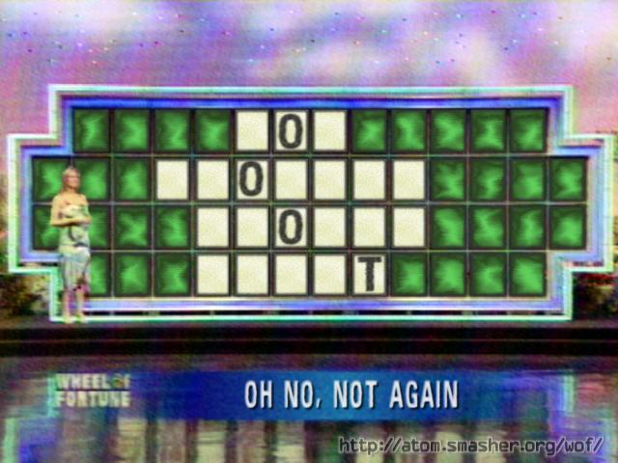
Accelerator Status Report
Weekend Update 4/16/2018

Slide 2
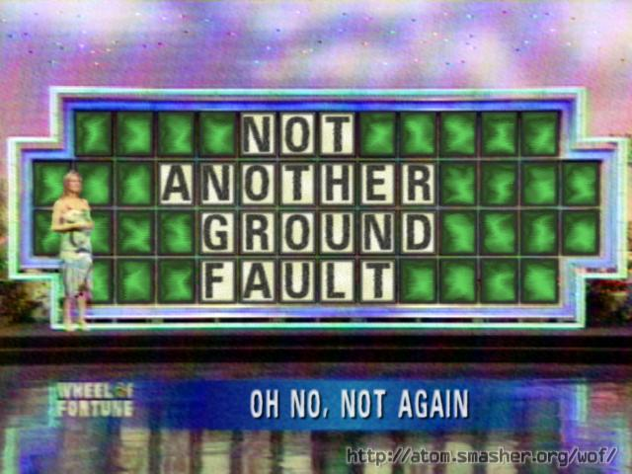
Accelerator Status Report
Weekend Update 4/16/2018

Slide 3
Friday
g-2 cryo issue
BRF12 problems
I:KPS6N shorting relay trip
Source B sparking
Saturday
A few RFQ trips
Center anode trip
Sunday
Source B issues
BRF17 roof leak
01:20 QF Bus Ground Fault
Back by 1515
Thanks to
Dave Capista
Denton Morris
Marty Murphy
Ming-Jen Yang
Steve Hays
Maddie Wolters
Jaime Clemons
and then…
Your Shift Plot
could be here!
Ask me how!
Weekend Update

Slide 4
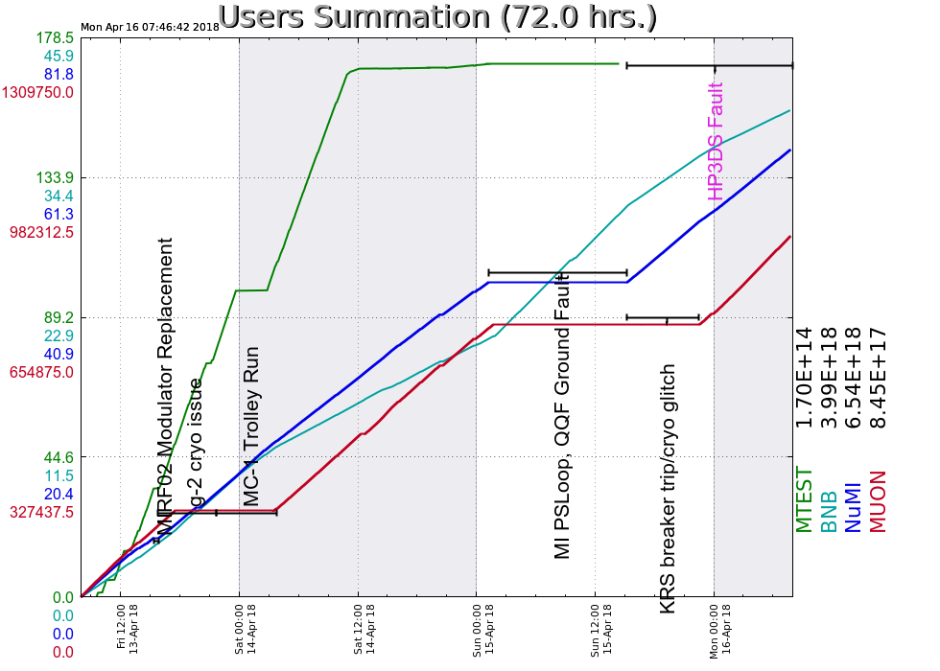
HP3DS Bus Duct arc flash trips Fdr 95
Muon compressors (A0) trip
G-2 ring dump
Prove beam to Muon by 1643
wait for magnet
Beam to g-2 ~2230
Quiet since.
Your Shift Plot
could be here!
Ask me how!
Weekend Update

Slide 5
